Slide 1
The Next Three Years first thoughts
N. Walker & M. Ross
ILC TB meeting 26.03.2013

Slide 2
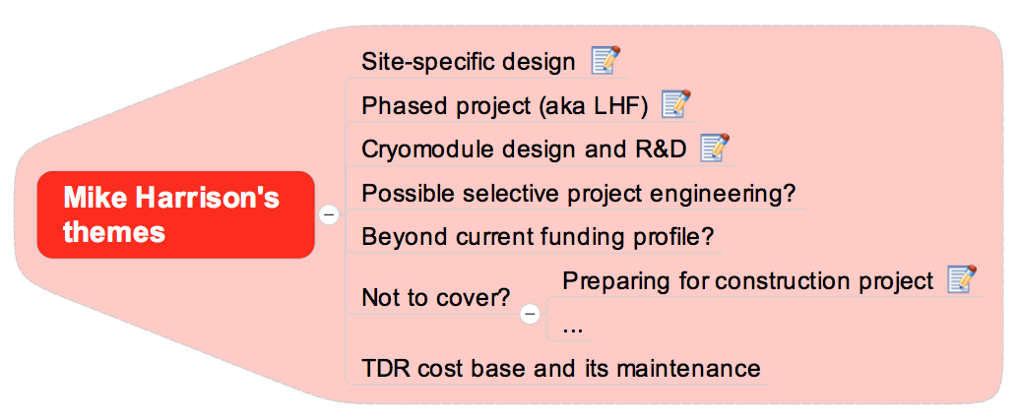
Mike’s input / questions?

Slide 3
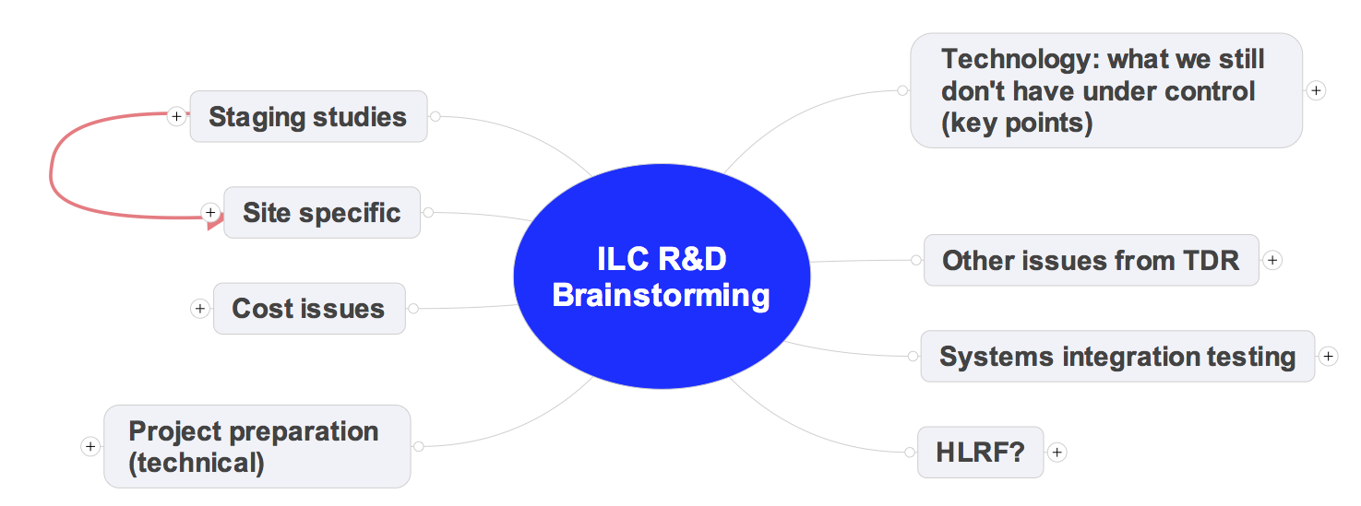
Themes
AD&I and project management
Technology R&D

Slide 4
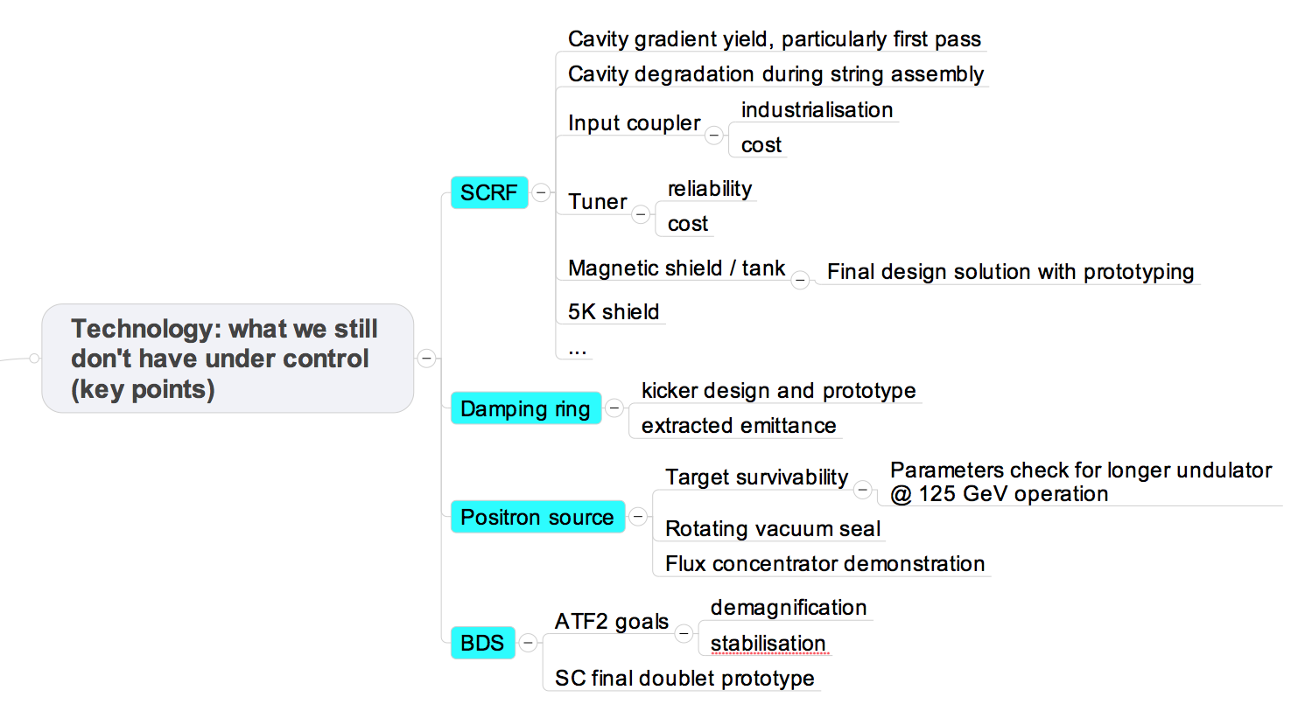

Slide 5
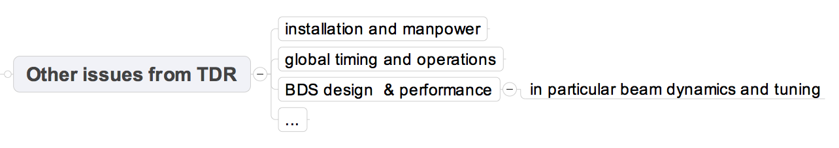
Re-read TDR and look for issues
Request input from ECFA LC2013 WGs

Slide 6
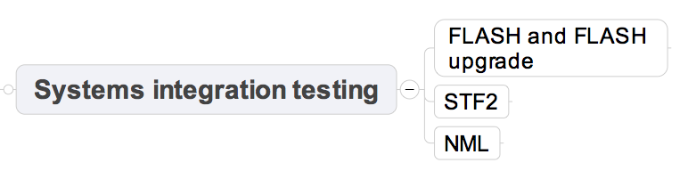
Understand individual goals and schedules
Look for “complementary programmes”
Keep concept of “9mA collaboration” and extend to STF2 and NML

Slide 7
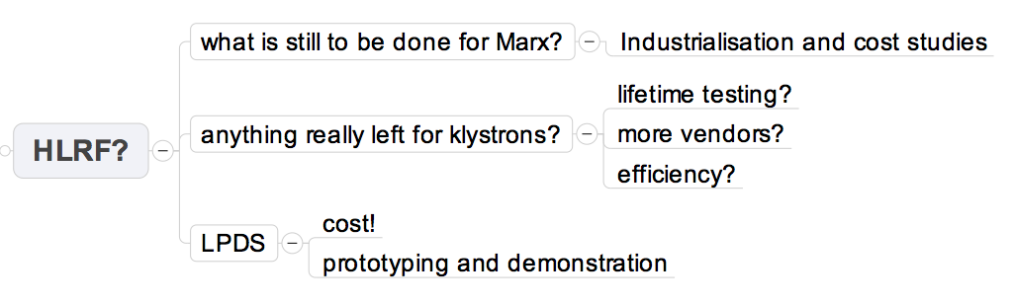
Idea to actually test remote adjustable PDS is very attractive

Slide 8
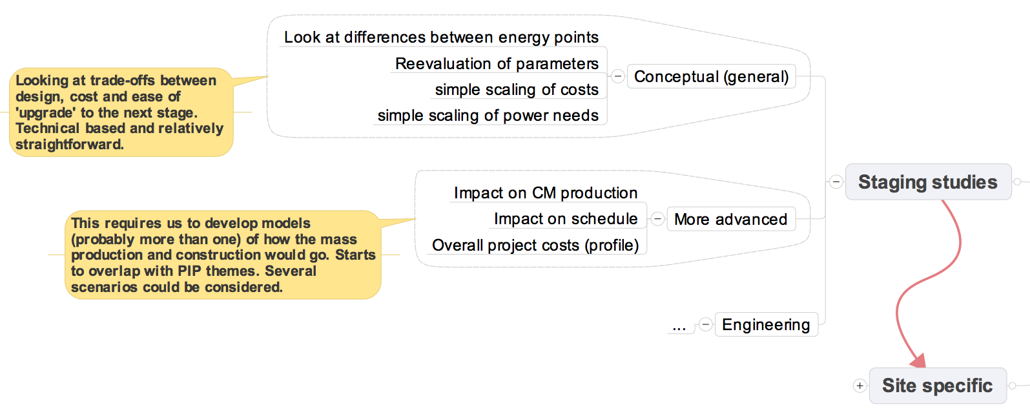
SB2009-like
TDR concept of “global value engineering” important!
cost impact / trade-off should always be considered
Change control ! (At least some form of it)

Slide 9
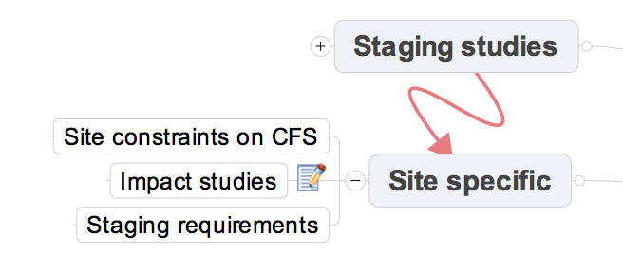
Basically reacting to 'what if' questions from site considerations. For example how can the accelerator design deal with change request driven from (for example) civil construction needs?
Note this can be considered as 'change control' and 'value engineering'.

Slide 10
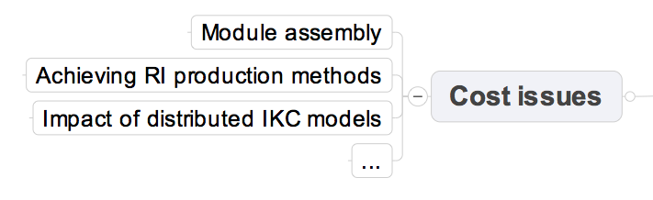
They are legion!
Propose that DESY ILC-EDMS team takes control TDR cost basis
(Additional resources to be found)

Slide 11
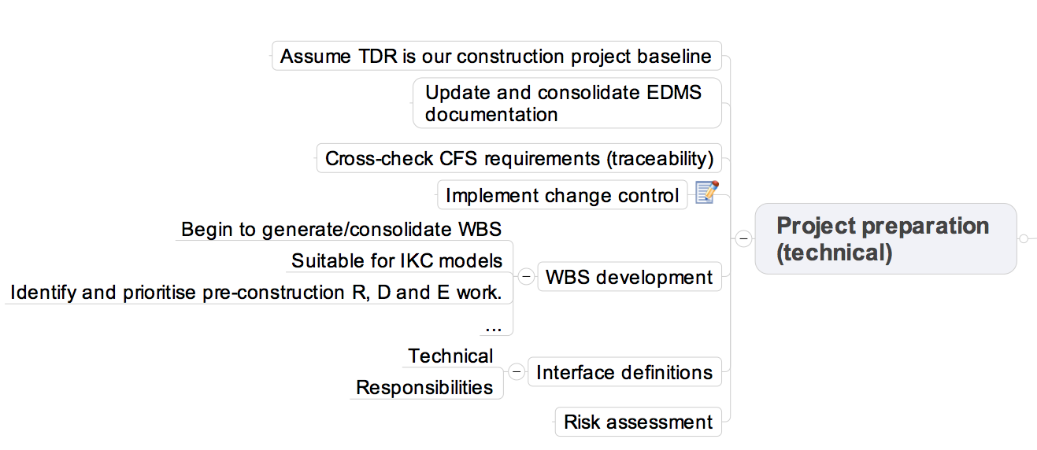

Slide 12
Reality Check
Resources!
  We have much less than during the GDE!
    currently tending to zero
  Europe has some potential
    Greater involvement from CERN?
    EU money?
    …
For technical based R&D
  GDE experience is to maximise use of existing (and funded!) programmes
    attempt to influence where possible
  Make clear priorities
    Needs discussion and consensus
For ADI-like
  Core ADI team is not available – very limited in what we can do!
    There will be many questions ‘punted’ to ‘future work’
  Project management / EDMS stuff
    Interest at DESY (obviously)

Slide 13
Next Steps
Take themes and iterate them with broader group(s)
  This board
  ECFA LC2013 WGs (part of their charge?)
Identify priorities on following time scales:
  Next 6 months (until next workshop)
  Next three years (LCB mandate)
  Construction project (think positive)
Produce a ‘plan’ report after ECFA LC2013
Go look for (new) money
  in Europe at least
Show me
the money!

