Slide 1
Relation between cross-talk and shaping time
LCTPC – 10th analysis meeting
P. Colas

Slide 2
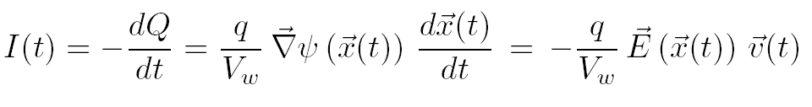
Induction in MPGDs
Ramo-Shockley theorem:
The influence is distributed according to the field lines.
Following slides taken from W. Riegler’s AIDA tutorial at Frascati.

Slide 3
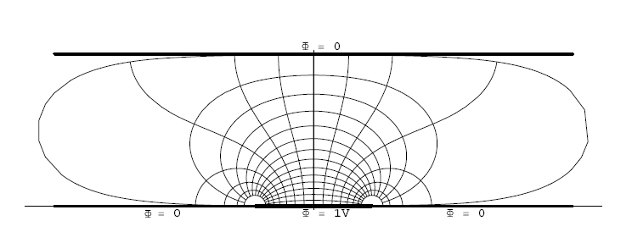
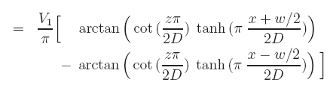





Weighting Field for a Strip in a Parallel Plate Geometry
D
w
Weighting Field:

Slide 4
Weighting Field for a Strip in a Parallel Plate Geometry
v
D
w
I(t,x) = -e₀*Ez[x,D-v*t]*v
When all charges have arrived at the electrodes the induced charge is equal to the total charge that has arrived at the electrode.
If the electronics ‘integration time’ ~ ‘peaking time’ ~ ‘shaping time’ is larger than the time it takes the electron to pass the induction gap, the readout strips that don’t receive any charge show zero signal.
If the electronics ‘integration time’ ~ ‘peaking time’ ~ ‘shaping time’ is smaller than than the time it takes the electron to pass the induction gap, the readout strips that don’t receive any charge show a signal different from zero that is strictly bipolar.

Slide 5
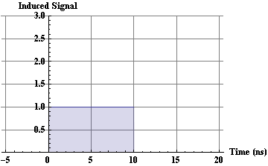
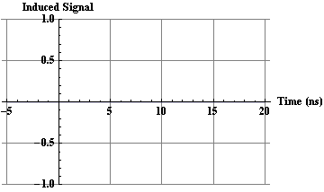
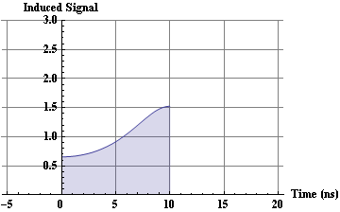
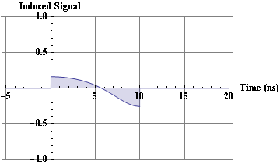
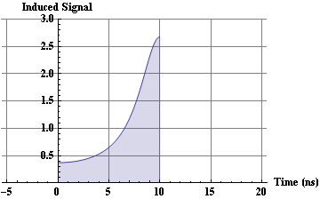
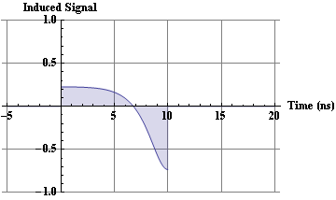
GEM Signals, Induced Currents
v
D = 1mm
Central Strip
First Neighbour
w
W >> D
W=D
W=D/2

Slide 6
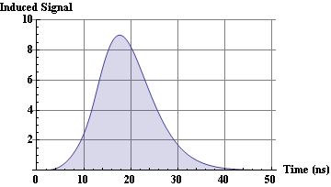
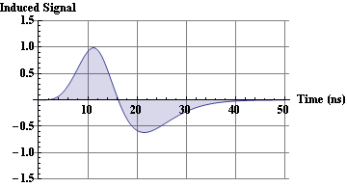
GEM Signals
v
D = 1mm
Central Strip
First Neighbour
w
W=D/2
W=D/2 (D=1mm, w=0.5mm)
Connecting an amplifier with Peaking Time = 10ns
→ 10% crosstalk !
In case the electronics peaking time is
smaller or of similar size as the time the electron takes to pass the induction gap, there is a sizable signal on the neighboring strips that do not even receive charges.
Central Strip
First Neighbor
W=D/2

Slide 7
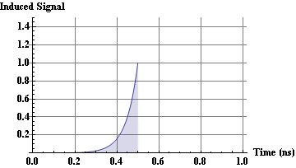
Micromega Signal
MICROMEGA
v
3mm
50um/ns
D = 0.1mm
0.1mm
200um/ns
I(t,x) = -e₀*Exp[α v t]*Ez[x,D-v*t]*v → Electrons
Electrons movementin the induction gap takes about 0.1mm/v₁=0.5ns.
Collecting all electrons from the drift gap takes a maximum of 3mm/v₁=60ns.
The MICROMEGA electron signal has a length of about 50 ns.
Typically w>>D – cluster size from electron component is dominated by diffusion and not by direct induction.
However, ion component has a length of about 100ns → Ballistic Deficit for fast electronis (e.g. 10ns peaking time).

Slide 8
CONCLUSION
In conclusion, shaping too short before discriminating or digitizing will result in a large apparent cross-talk between neighbouring pads.
This is probably what has been observed with some of the Asian GEM data (see Analysis meeting 9, Ph. Gros)

