Slide 1
Status of 250/350 GeV
MC production
Akiya Miyamoto
KEK
ILD physics/analysis meeting
8 May 2013

Slide 2
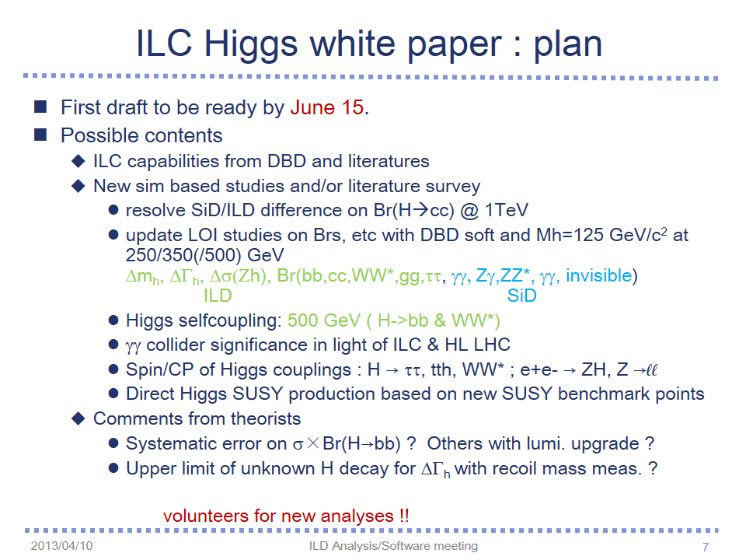
Introduction
MC production for Snowmass study ( see my talk on 10-April)

Slide 3
Status of MC samples: Mokka Sim.
Mokka simulation with ILD_o1_v05
  MC statistic plan (right table, in fb⁻¹)
    ■ cell: finished
    ☐ cell: in simulation
    no stdhep/no dat : waiting input files
File locations
  lfn:/grid/ilc/prod/ilc/mc-dbd/sim/250-TDR_ws
  ( most of 250 GeV , processed at KEK batch)
  /ilc/user/a/amiyamot/mc-dbd/sim/350-TDR_ws
  - samples produced by ILCDirac were placed
  Not registered in LCG catalog yet.
  - O(10)% failed files were re-processed at
  KEK batch servers
Ecm(GeV) | 250 | 350
Higgs | 1000 | 1000
2f-bhabhag | 20 | 10
2f-hadron | 20 | 25
2f-lepton | 100 | 200
4f | 250 | 350
tt(physsim) | - | 350
aa_2f(ee) | 2 | no stdhep
aa_2f(ll) | 25 | no stdhep
aa_2f(xx) | 50 | no stdhep
aa_2f(yy) | 250 | no stdhep
aa_minijet(4-10) | 10 | 10
aa_minijet(>10) | 250 | 350
1f(ea,ae) | 2 | no stdhep
3f(eee) | 50 | 20
3f(exx) | 250 | 100
3f(ell, eyy, lvv, vxy) | 250 | 350
5f | 0 | no stdhep
6f | 0 | no stdhep
aa_lowpt | done | done
Guineapig pairs | 1pulse | 1 pulse
(fb⁻¹)

Slide 4
Cross section of events with γ_{B}
Processes involving beamstrahlung photons ( with eB, pB )
  Luminosities of γ_{Β}e⁻, e⁺γ_{Β}, γ_{Β}γ_{Β} are not same as e⁺e⁻ luminosity
  The cross sections of γ_{Β}e⁻, e⁺γ_{Β}, γ_{Β}γ_{Β} calculated by Whizard
  partially taken into account the effect of (1), but not all.
  (3) In DBD benchmarking samples, this was not considered. As a result,
  the rates of events by γ_{Β}e⁻, e⁺γ_{Β}, γ_{Β}γ_{Β} were over estimated
  ➔ conservative results
New 250 GeV and 350 GeV samples., correct treatments
Ecm # initial state
beamstralung photons correction factor
350 GeV 0 1
350 GeV 1 0.69
350 GeV 2 0.62
250 GeV 0 1
250 GeV 1 0.68
250 GeV 2 0.62
The correction factor for 1 TeV and
500 GeV would be smaller
Updates of the web info in progress
Correct X-section will be saved in
Mokka header
Number of aa_lowpt events / signal events
0.20 @ Ecm=250 GeV 0.33 @ Ecm=350 GeV.

Slide 5
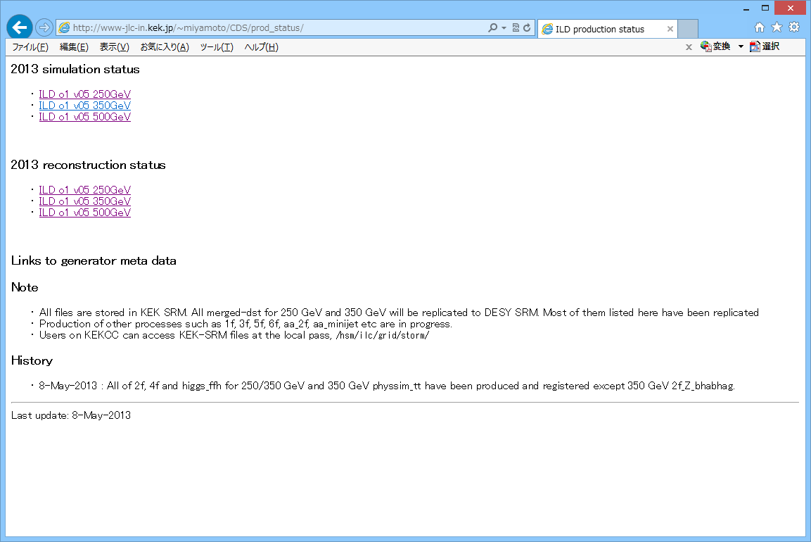
ILDConfig/v01-16-p09_350
ILDConfig/v01-16-p10_250
Production status
http://www-jlc.kek.jp/~miyamoto/CDS/prod_status

Slide 6
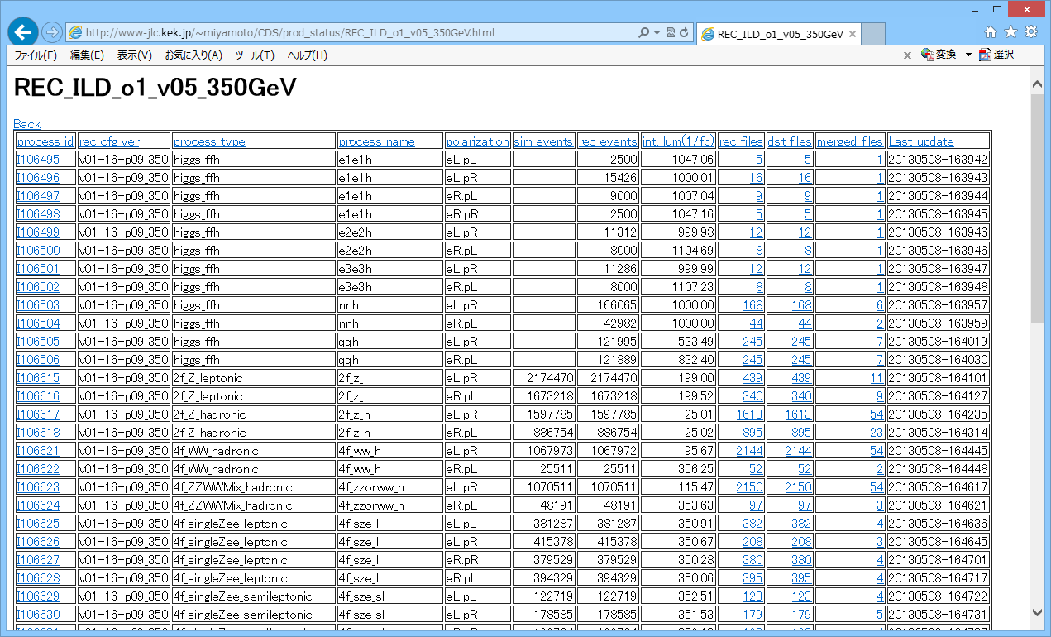
2f, 4f, higgs for 250GeV/350GeV and tt 350 GeV : completed ( except 2f_bhabhag)
merged dst files : in KEK SRM. > 2/3 replicated to DESY
File location: LCG file catalog similar to DBD 1 TeV and 500 GeV samples.

Slide 7
Summary
New DSTs for 250 GeV and 350 GeV are available.
  Looking forward to hearing analysis results in coming meetings
  Please use and let me know if you find problems.
    I heard a problem of tau polarization in Higgs to tau tau decay.
    But not investigate it I detail yet.
Production of other processes, 1f, 3f, etc, are in progress

