Slide 1


Review of ATF Shift - 100413
Mikey Davis
11 April 2013
1/13

Slide 2
Introduction
The shift focused on the IP BPMs
We tested the reference cavity signal amplitude
Checked out all the 2nd stage down mixers
We then moved on to trying to understand the resolution
We have found two “types” of second stage
I don’t think we managed to get a resolution better than about 5 μm
Mikey Davis
11 April 2013
2/13

Slide 3
A Quick Upstream Notes
I re tested the phase sensitivity of the BPMs
The phase sensitivity didn’t seem to have changed much
P2 has a phase sensitivity of 0.11 μm per °
P3 has a phase sensitivity of 0.02 μm per °
In March
P2 had a phase sensitivity of 0.08 μm per °
P3 had a phase sensitivity of 0.09 μm per °
This stability is quite positive
Mikey Davis
11 April 2013
3/13

Slide 4
Reference Cavity
10 dB of attenuation has been removed from the ref cavity input to the 1st stage (leaving 20 dB)
We tested the reference cavity signal amplitude at a number of different charge levels
The amplitude remained constant, if under the suggested 1 dB output level
Mikey Davis
11 April 2013
4/13

Slide 5
Ref Cav Levels
Remembering the suggested output level is 1 dBm
N.B. We worked with charge of 0.05 and an extra 10 dB of atten. in March
Laser Int (%) | ICT Charge (IP) | Limiter Out (p2p V) | Limiter Out (dBm)
20 | 0.21 | 400 | -4
15 | 0.21 | 400 | -4
10 | 0.23 | 400 | -4
5 | 0.33 | 400 | -4
4 | 0.29 | 400 | -4
3 | 0.25 | 400 | -4
2 | 0.2 | 400 | -4
1 | 0.16 | 400 | -4
Mikey Davis
11 April 2013
5/13

Slide 6
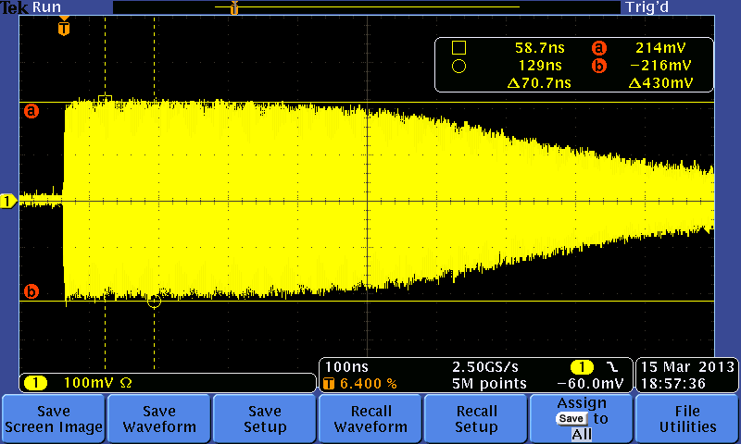
Ref Cavity
Mikey Davis
11 April 2013
6/13

Slide 7
2nd Stages
We spent some time testing all the second stages
We performed a calibration over a relatively wide range at 30dB (to get large signal to noise) for every 2nd stage
N.B. For the 1st and 2nd attempt the inputs were switched
The consts. are un charge normalised
2nd Stage | 07-3 | 07-1 | 07-2 | 06-2 | 07-4 | 06-1
1st Attempt | 0.265 | -0.779 | 0.226 | -0.842 | -0.229 | 0.750
2nd Attempt | 0.243 | 1.09
Mikey Davis
11 April 2013
7/13

Slide 8
2nd Stages
There are clearly two “types” of 2nd stage
We started off by selecting 06 – 1 and 06 – 2
Young Im should explain this
We then proceeded to try and test the resolution with this
2nd Stage | 07-3 | 07-1 | 07-2 | 06-2 | 07-4 | 06-1
1st Attempt | 0.265 | -0.779 | 0.226 | -0.842 | -0.229 | 0.750
2nd Attempt | 0.243 | 1.09
Mikey Davis
11 April 2013
8/13

Slide 9
Calibration Constants
We undertook a series of measurements to try and test the resolutions
First calibrated at atten. of 30, 20, 10 and 0 dB
Then took a jitter run at each of these settings
Found that the jitter was still considerably higher in Honda than Epics
I have checked my answers against Young Im
We get similar (at the 20pc level) calibration consts.
Mikey Davis
11 April 2013
9/13

Slide 10
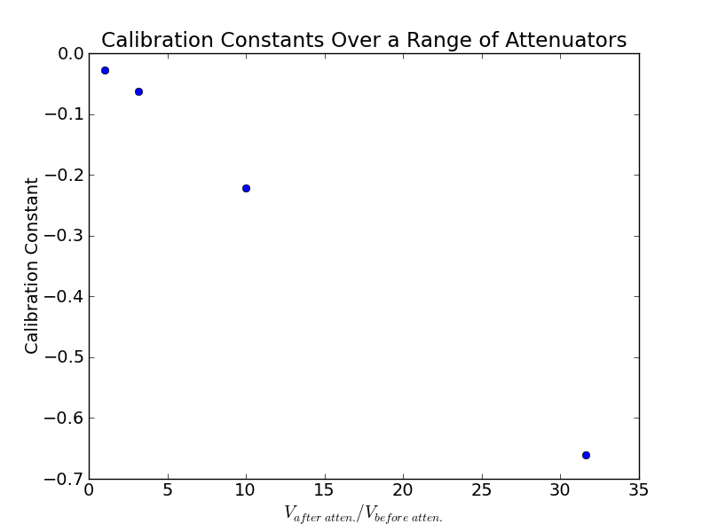
Calibration Constants
Mikey Davis
11 April 2013
10/13

Slide 11
Resolution Tests
Resolution runs were then undertaken at each attenuation settings
Atten(dB) | EPICS | 30 | 20 | 10 | 0
IPA (μm) | 0.91 | 12.4 | 6.83 | 5.30 | 5.00
IPB (μm) | - | 14.3 | 6.59 | 5.28 | 4.94
Mean Pos | -0.9 | -69 | -27 | -3 | 0.6
Res (μm) | - | 13.0 | 5.88 | 0.52 | 0.46
EPICS Pos | - | 61 | 62 | 62 | 63
Mikey Davis
11 April 2013
11/13

Slide 12
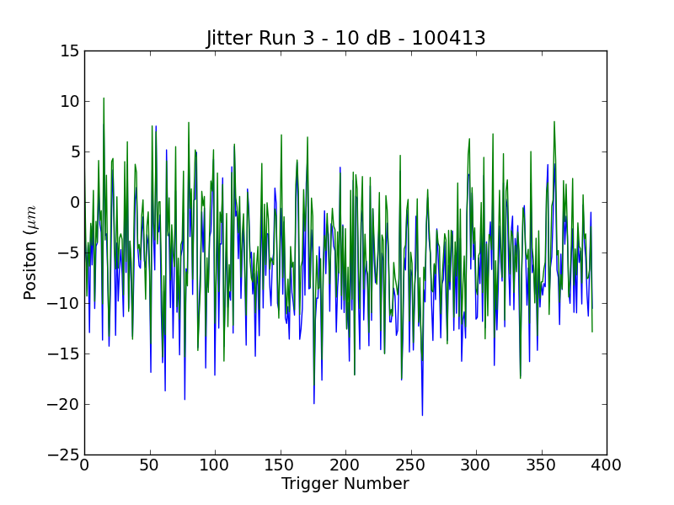
Jitter Run
Mikey Davis
11 April 2013
12/13

Slide 13
Resolution Tests
We then swapped the second stages and used two with a higher sensitivity
Atten(dB) | EPICS | 30 | 20 | 10 | 0
IPA (μm) | 0.91 | 12.4 | 6.83 | 5.30 | 5.00
IPB (μm) | - | 14.3 | 6.59 | 5.28 | 4.94
Mean Pos | -0.9 | -69 | -27 | -3 | 0.6
Res (μm) | - | 13.0 | 5.88 | 0.52 | 0.46
EPICS Pos | - | 61 | 62 | 62 | 63
Atten(dB) | 20 | 10
IPA (μm) | 5.39 | 4.72
IPB (μm) | 5.71 | 4.67
Mean Pos | 32 | 39
Res (μm) | 1.43 | 0.87
EPICS Pos | 108 | 109
Mikey Davis
11 April 2013
13/13

