Slide 1



Mass Assembly
10.9.13 – Calice Collaboration Meeting
LAPP Annecy
JGU Mainz - Phi Chau
Bruno Bauss, Volker Büscher, Julien Caudron, Reinhold Degele, Karl Heinz Geib, Sascha Krause, Yong Liu, Lucia Masetti, Uli Schäfer, Rouven Spreckels, Stefan Tapprogge, Rainer Wanke

Slide 2
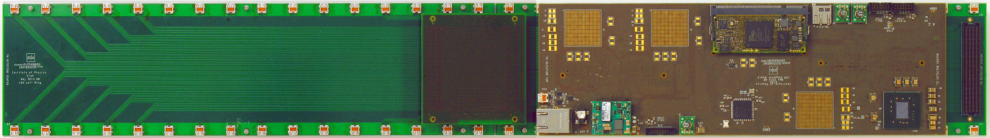
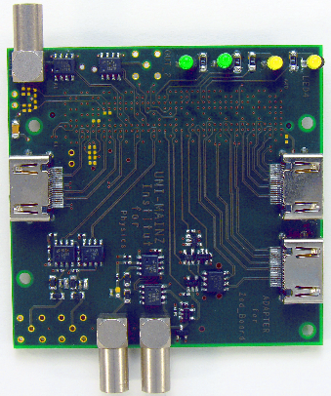

Wing LDA/CCC Status
AHCAL wing data aggregator has been built
Initial power-up tests successful
System integration started (André, Rouven,…), but further effort required
  Firmware for Kintex FPGAs
  Firmware / Software for Zynq processor (“MARS ZX3”)
VME-sized clock/control unit acting as MARS test bench
  Issues in firmware load stage observed on engineering sample
  Further effort required to debug on production silicon available now
For the time being cover all immediate needs (AHCAL LDA/CCC)
with adapter modules on “Zedboard”
  Clock/control adapters available
  Data aggregator adapter ready for production
  New batch of clock fan-out units in production
  Julien working on software integration
Notes:
Format noch korrigieren

Slide 3

Need for an automatic production
AHCAL (final design)
  About 8.000.000 tiles have to be placed on HBU boards
  With an effort of 10 s per tile → ~ 8 years are necessary for the assembling
    We need an automatic placement
    With 1 second per placement we need 1 year
Notes:
Format noch korrigieren

Slide 4
Mass production
DESY: Production of HBU boards
ITEP: Production of the tiles
Heidelberg University: Characterisation of tiles/SiPM
Wuppertal: LEDs calibrations
Mainz University: Placement of the tiles on the HBU board, functionality tests of the assembled boards
Notes:
Format noch korrigieren

Slide 5
Automatic placement
Pick-and-place machine
    Camera detects tiles/SiPMs and suction cup places them on the HBU (SiPM pins through the pin holes)
    Vision system detects tiles and the SiPM pins → quality assurance
    Problem: Reflective surface of the tiles
      Pick-and-place maschines with Vision systems
      works with light to detect the pins
Pick-and-place machine

Slide 6
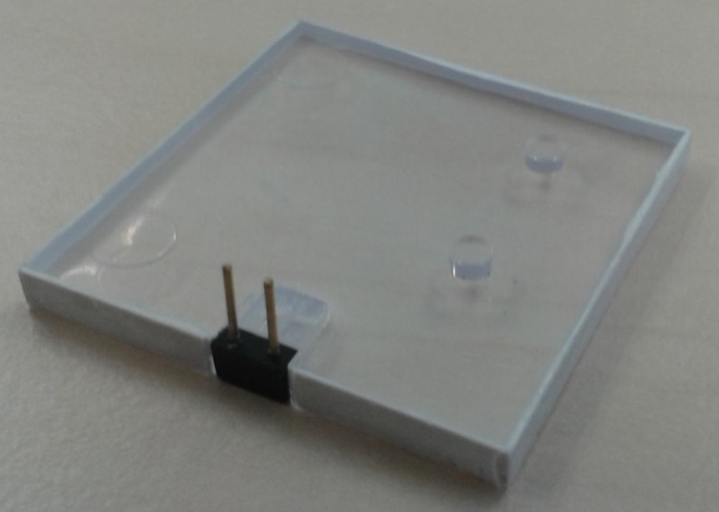
Camera tests
We have produced dummy tiles for camera tests at machine manufactors
3 companies have confirmed, that vision system can handle the tiles

Slide 7
Current design
Mounting of tile on HBU board:
  Tiles have to been pushed into the alignment pin holes
  Very small tolerances are needed to fit
  With 4 pins (2 SiPM pins, 2 allignment pins), tolerances have to be quite big
Original design:
Alignment pins
HBU
Pin (SiPM)
SiPM
Reflector foil
Absorption layer

Slide 8
Modified design: Option 1 – Not wrapped tile
Mounting of modified tile on HBU board:
  Plane tiles without alignment pins
  Requires: Fixation of the tile with gluepoint between tile and reflector foil
  Just 2 pins (from SiPM) → tolerances are less demanding
Original design:
Gluepoint
HBU
Pin (SiPM)
SiPM
Reflector foil
Absorption layer

Slide 9
Modified design: Option 2 – wrapped tile (Uni Hamburg)
Mounting of modified wrapped tile on HBU board:
  Tile is wrapped with reflector foil and flex pin connector
  Fixation of the tile with gluepoint between HBU and reflector foil
Uni Hamburg design:
Gluepoint
HBU
Pin (SiPM)
With reflector foil wrapped tile
SiPM
Absorption layer

Slide 10
Automatic placement
Screen printer
    Sets gluepoints on the surface of the HBU
    High adhesive glue is needed, because we don‘t want any time for drying-out the glue
      Silicone
      Potential issue: Does Gluepoint reduce light yield? → Tests
Pick-and-place machine
Screen printer

Slide 11
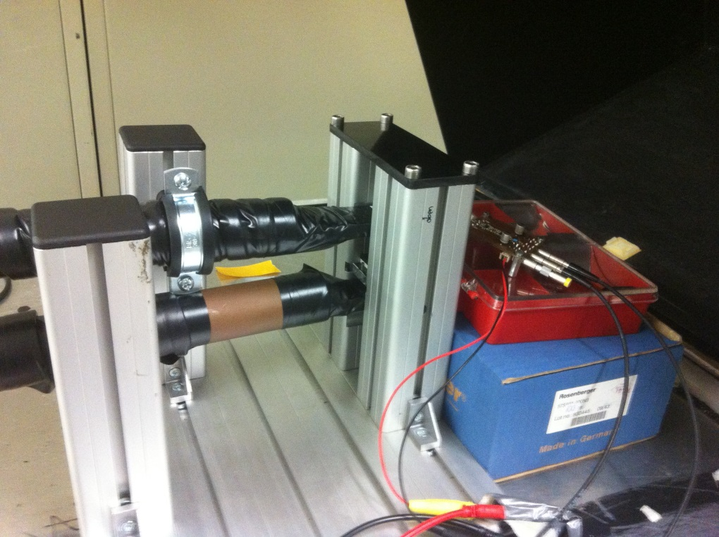
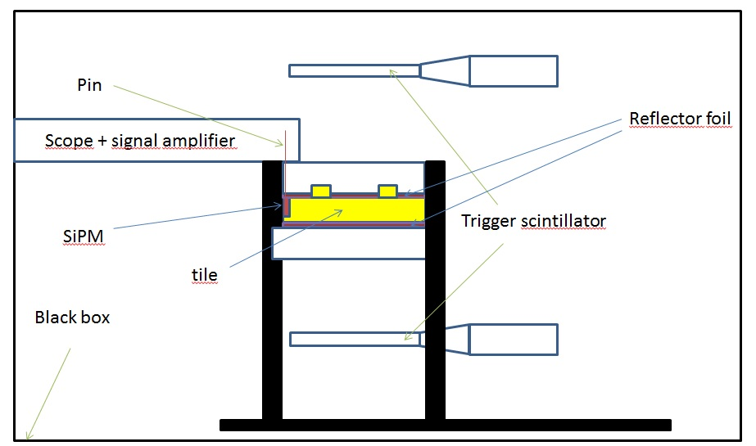
Measurement Set-up
Measurement of the influence on the optical properties with cosmics
Amplifier
Trigger scintillator

Slide 12
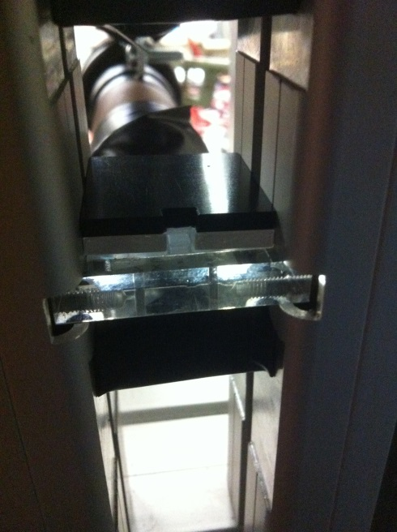
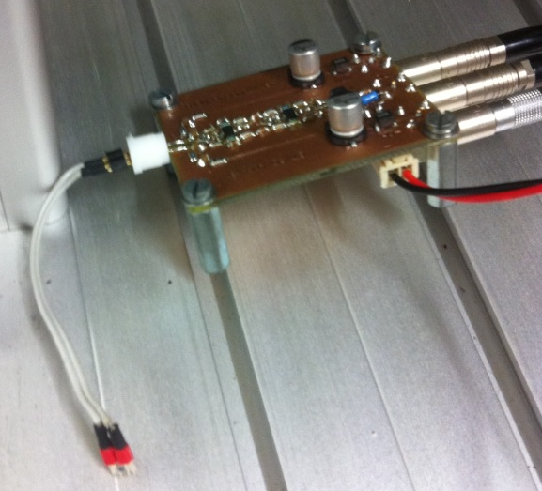
Measurement Set-up
Measurement of the influence on the optical properties with cosmics
Trigger scintillator
Amplifier
Tile between two layers of reflector foil
SiPM

Slide 13
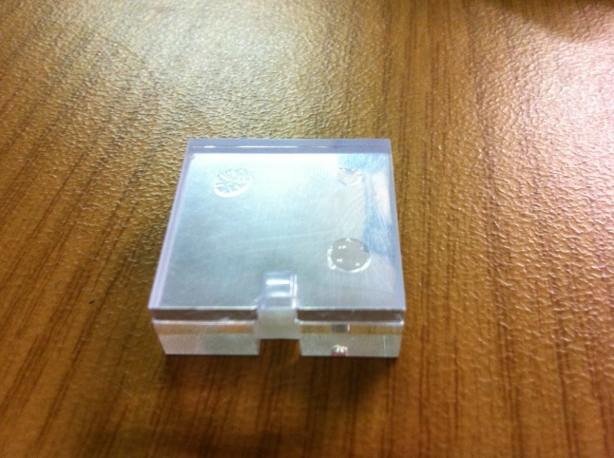
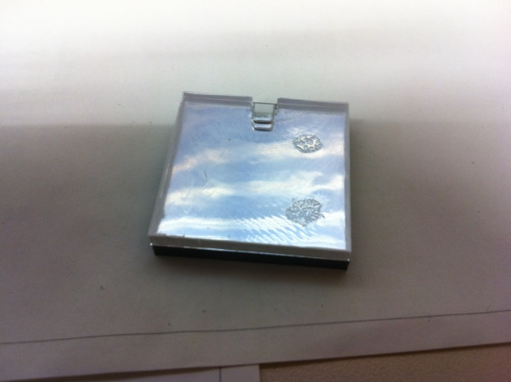
First measurement
The first measurements are finished
  2 ITEP tiles with 2 Hamamatsu MPPC S10943-8584(X) are measured with cosmics
    Unmodified without gluepoints
    Without allignment pins with gluepoints (allignment pins are removed, << 1 ml silicone is placed on tile)
Tile glued on reflector foil
Gluepoints

Slide 14
First results
Configuration | Integrated charge in arbitrary units | Normalized to measurement without glue | Numbers of measurements
Tile 1/SiPM 1 | 2,74±0,03 | 100% | 1115
Plane Tile 1/ Silicone / SiPM 1 | 3,15±0,02 | 115% | 2568
Tile 2/SiPM 2 | 4,14±0,04 | 100% | 1238
Plane Tile 2/ Silicone/ SiPM 2 | 4,39±0,04 | 106% | 1420

Slide 15
Result
Light yield of the modified design is better than light yield of current design
Later tests can determinate the configuration with the best optical properties. We want to test different settings with
  Different glue
  Glue shapes
  Quantity of glue
  Position of the glue

Slide 16
Automatic placement
Conveyor
  Transports the boards from Pick-and-place machine to soldering maschine
  Problem: Board is completely filled with tiles
    → Transportation is not possible
Pick-and-place machine
Screen printer

Slide 17
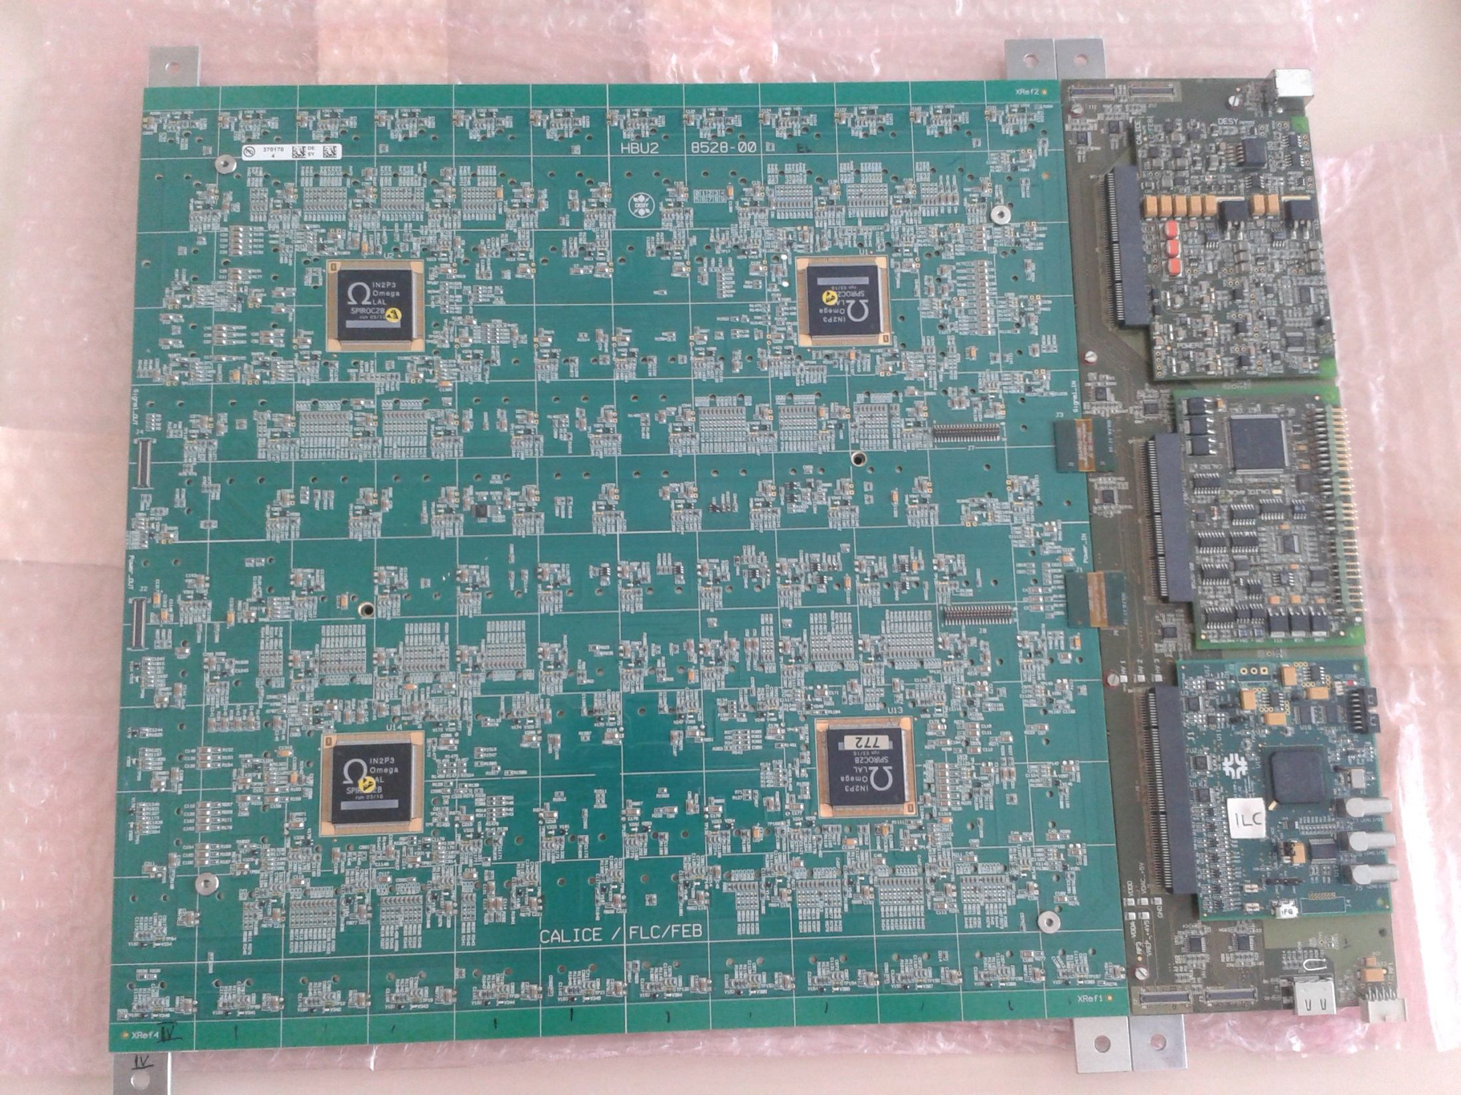
5 mm
Perforation
Solution: the existing perforated frame should stay until the whole placement process is finished
After that it can be removed

Slide 18
Automatic placement
      selective soldering would take 3-8s per soldering position (x144 soldering positions per board)
→ Wave soldering machine
    Fastest soldering technique
Pick-and-place machine
Wave soldering machine
Screen printer

Slide 19
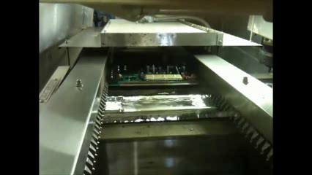
Wave soldering machine
https://www.youtube.com/watch?v=inHzaJIE7-4

Slide 20
Automatic placement
Wave soldering machine
  Problem: Board is allready assembled
  → We need a soldering mask
Pick-and-place machine
Wave soldering machine
Screen printer

Slide 21
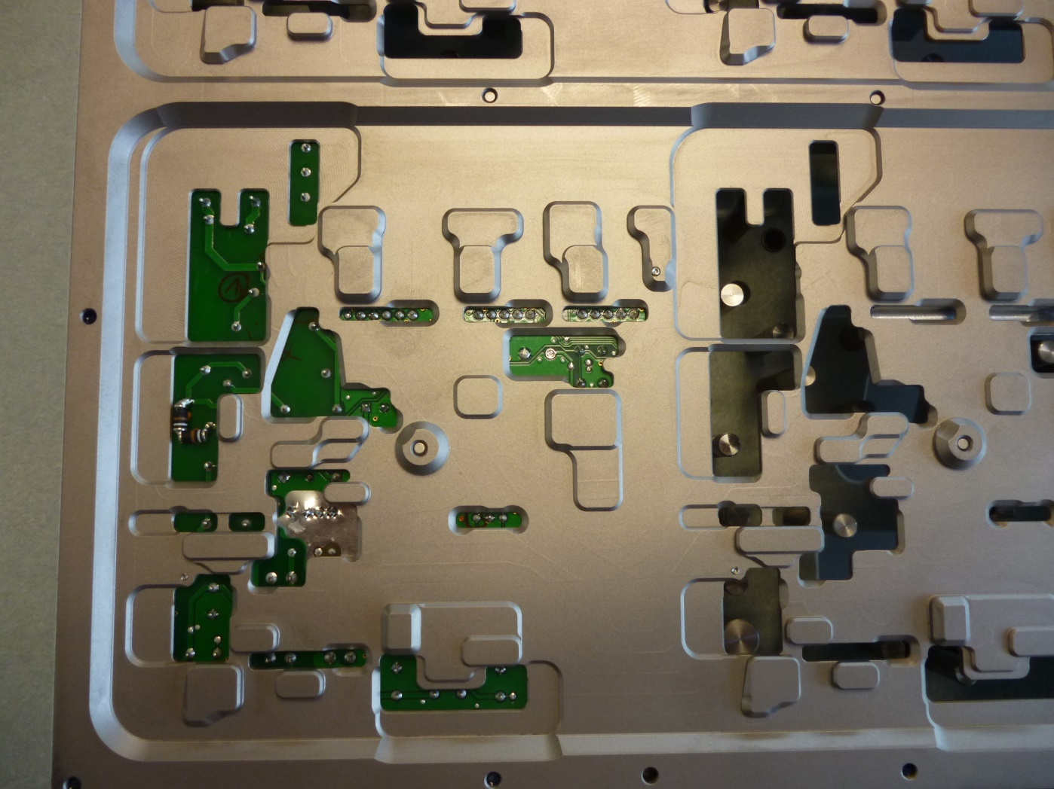
Soldering mask
Soldering positions
Protective bag for SMD components

Slide 22
Automatic placement
Wave soldering machine
    Soldering process defines (and limits) the design of the HBU board and the structure of the SiPM pins:
      the diameter of the SiPM pins and bore holes
      position of components
      SiPM pin hole position
    → Modifications of the HBU board is needed
Pick-and-place machine
Wave soldering machine
Screen printer

Slide 23
SiPM pin-, boreholediameter and shape
pin holes should be 0,3 mm larger than the pins
We also want maximally robust pins
  Pins could be pushed away from the solder → Pins with ~ 0,5 mm diameter are optimal
  The pin length should be around 1 mm outside the hole
0,3 mm
Pin
Pin hole
1 mm

Slide 24
SiPM pin-, boreholediameter and shape
Recommended Area around the SiPM holes without any SMD components: 3 mm radius
Asymmetric Area around the SiPM holes without SMD components are possible with a minimum radius of 1 mm and 3 mm on the other side
3 mm
Pin hole
1 mm
Area without SMD components

Slide 25
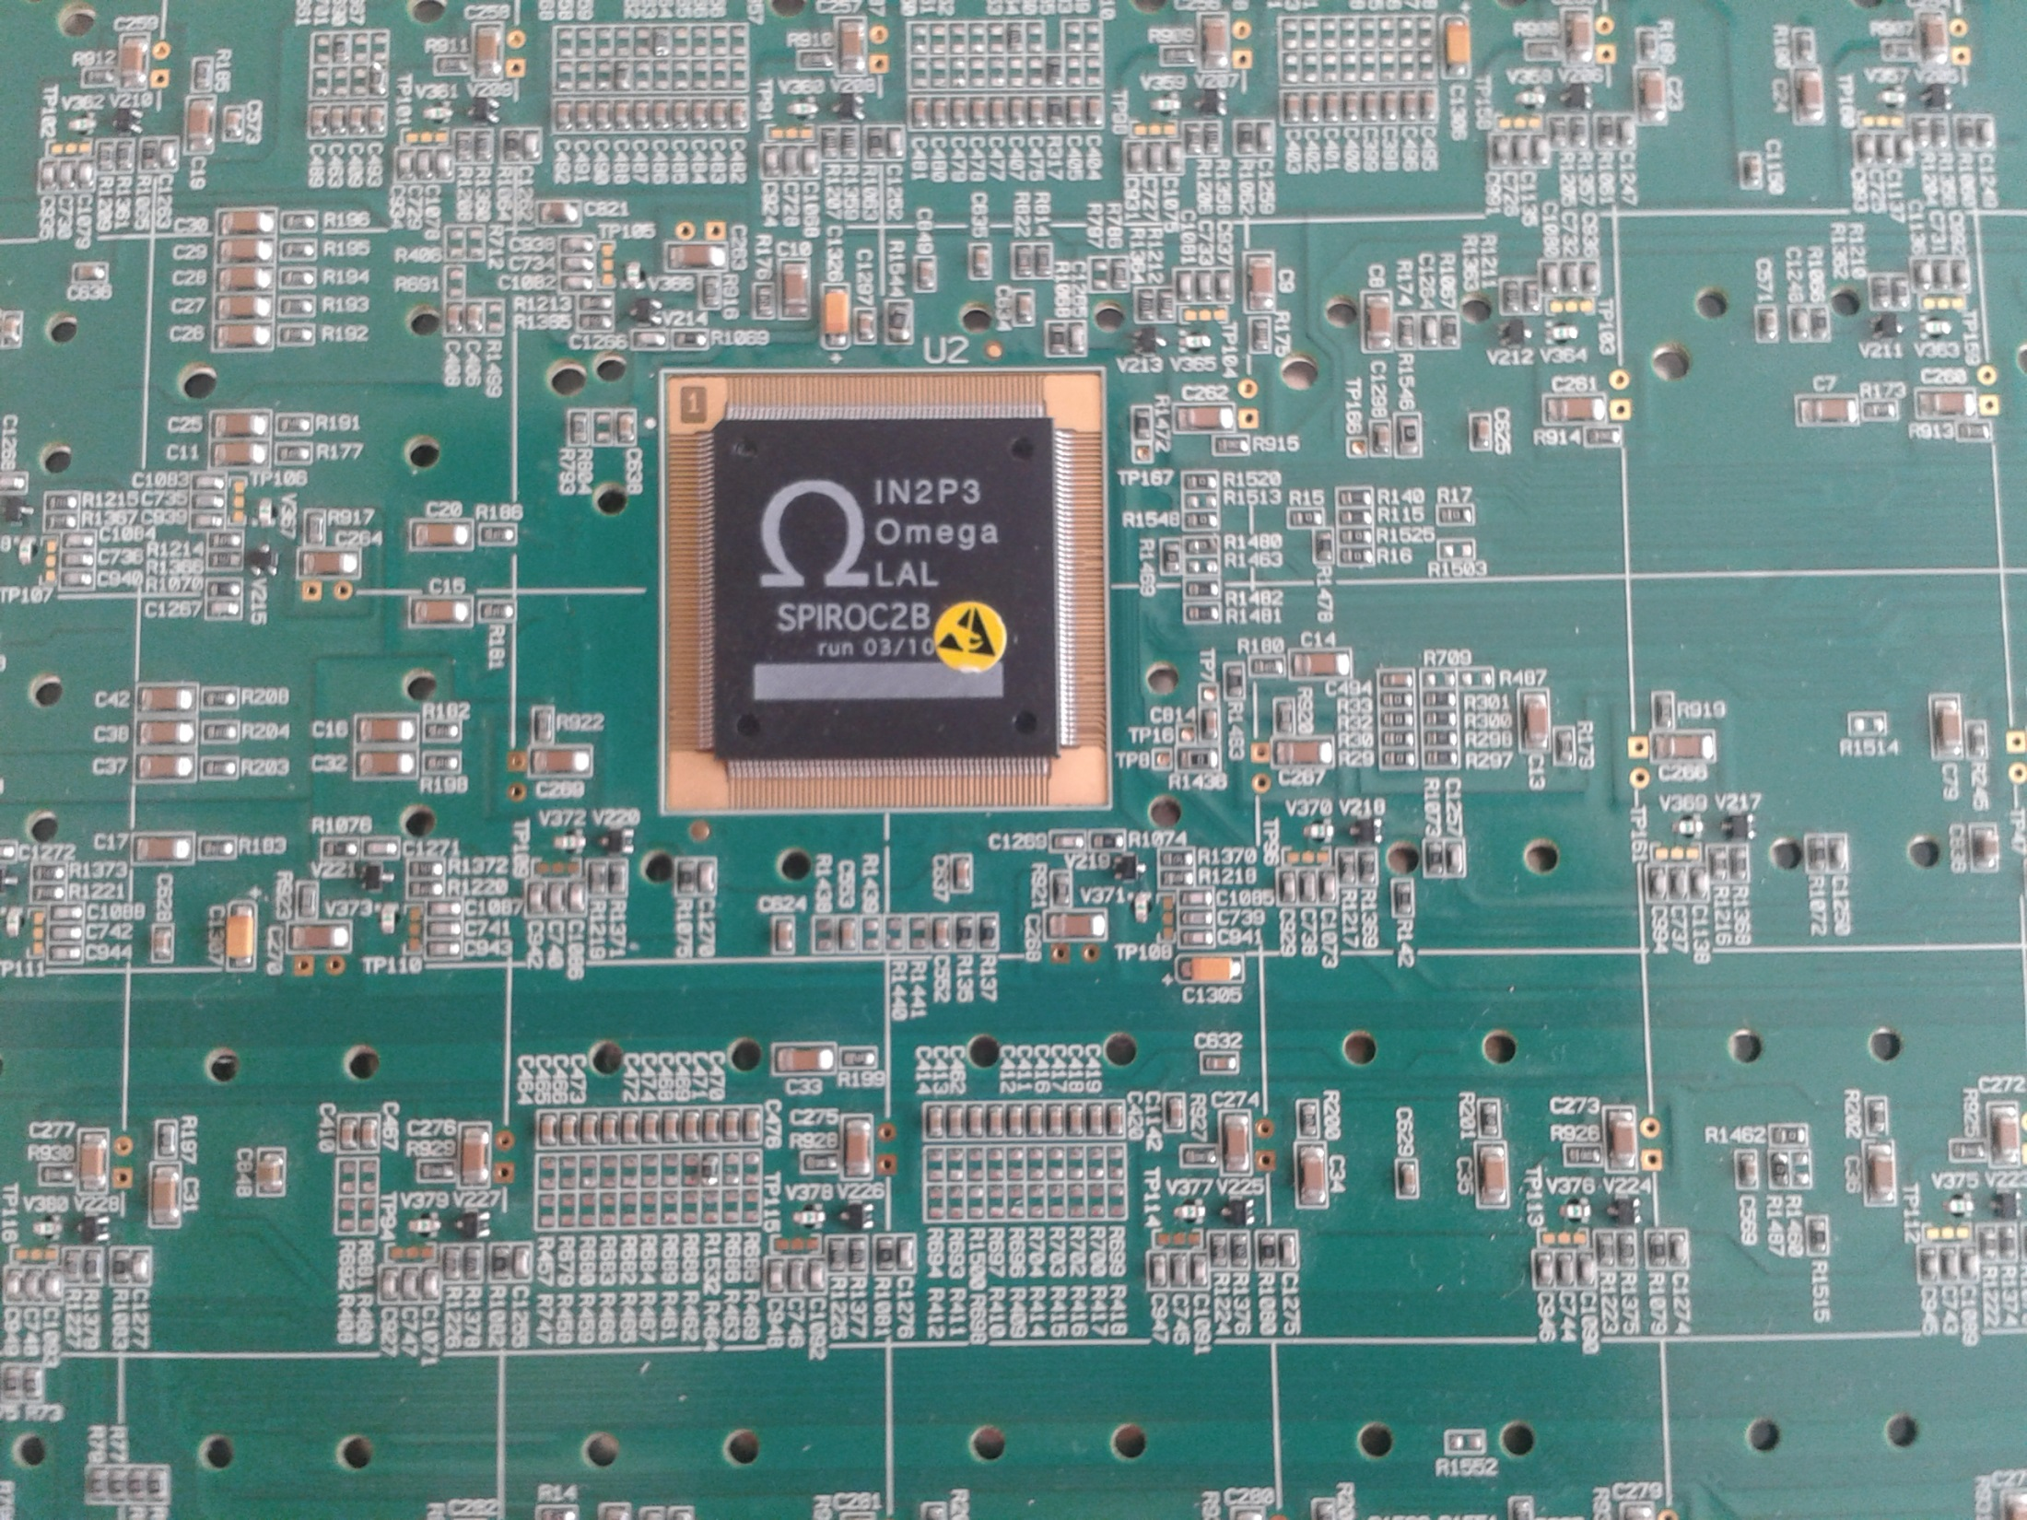
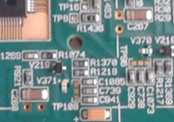
Additional advice:
Components near the SiPM connectors should be placed with the short side to the holes
The components stay fixed on one side, even if one pad is heated up
components near the pin holes can‘t be soldered out
good
bad

Slide 26
Bridge effect
In this orientation → problematic for some wave soldering machines
1
Soldering Wave
2
3
pins
Soldering bridge
pin holes
The HBU board is transported from right to left (In the coordinate system of the board → Wave moved from left to right)
The pinholes are filled with solder
With this orientation, the bridge effect can occur

Slide 27
Soldering direction
For example: at this position a rotation is not possible
Ideal conditions: Pin holes have preferred directions
Newer wave soldering machines can handle this without design changes
Soldering mask can be rotated → Effective size of the board in transportation direction is bigger (just with big soldering machines)

Slide 28
Additional tests for soldering
Temperature tests for every component (simulation of Soldering wave)
If HBU board could be change → Create a soldering mask and soldering tests

Slide 29
SMD SiPMs
With SMD SiPMs the assembling would be easier
  We won‘t need a soldering machine and the THT optimization
  More in the presentation by Yong Liu

Slide 30
Automatic placement
Functionality tests
  Fully assembled HBU test set-up (with LEDs on the Board)
  Currently setting up AHCAL DAQ for fast testing
Pick-and-place machine
Wave soldering machine
Screen printer
Functionality tests

Slide 31
Conclusion
Procedure for fast mass assembly has been defined
Mass assembly requires numerous design modifications
Initial tests sucessful
Full production line will be set up in Mainz for demonstrating mass assembly with the large prototype

Slide 32
Thank you for your attention!

Slide 33
Backup

Slide 34
Reference points
Finetuning advice: More reference points on the perforated frame (Mydata)
  Existing points can‘t be recognized after assembling
  Reference points should be on the side of the tiles and they should be on the frame

Slide 35
Tiles/SiPM
Mounting of Hamburg tile on HBU board:
  Black surface of the wrapped tile→ optical capture with cameras is easier to realize
Hamburg design:
Gluepoint
HBU
Pin (SiPM)
With reflector foil wrapped tile
SiPM
Pb or Fe absorption layer

Slide 36
Tiles/SiPM
Mounting of Hamburg tile on HBU board:
  No tests till now for wrapped surface (tests of suction cup of pick-and-place machine)
Hamburg design:
Gluepoint
HBU
Pin (SiPM)
With reflector foil wrapped tile
SiPM
Pb or Fe absorption layer

Slide 37
SiPM pin shape
  Round pins are easy, rectangular pins are more difficult to solder ( distances in the hole aren‘t constant)

