Slide 1



AHCAL Electronics.
Status of HBU, EBU and SM_HBU
Mathias Reinecke
CALICE meeting
Annecy, Sept. 10th, 2013

Slide 2
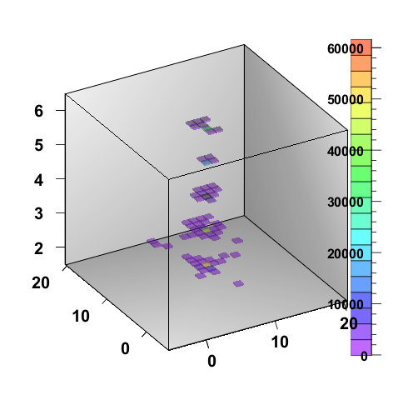
Outline
AHCAL electronics status and results
  Hardware status
  Problem: Switch-On order
  Problem: Destroyed SPIROCs
  Beam- / Noise rate and SPIROC2d/3 considerations
SM_HBU Status (AHCAL option)
EBU Status (ScECAL)
Shower in 5 AHCAL layers
(DESY testbeam)

Slide 3
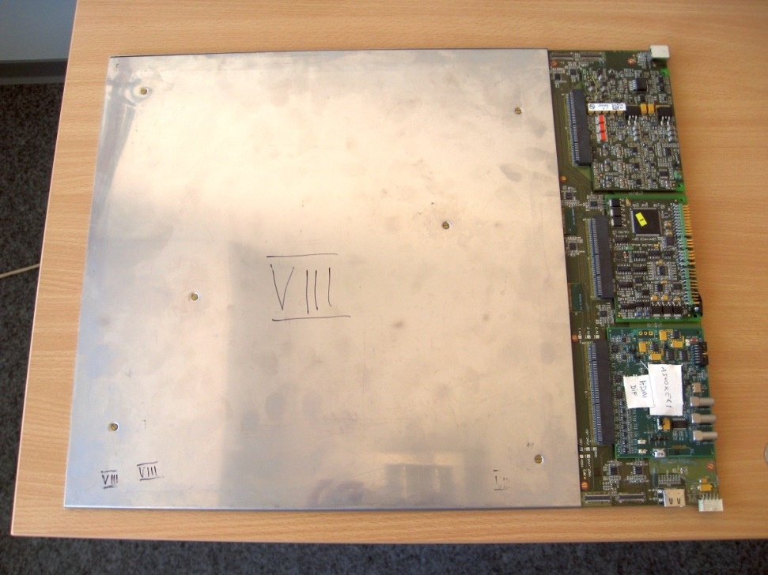
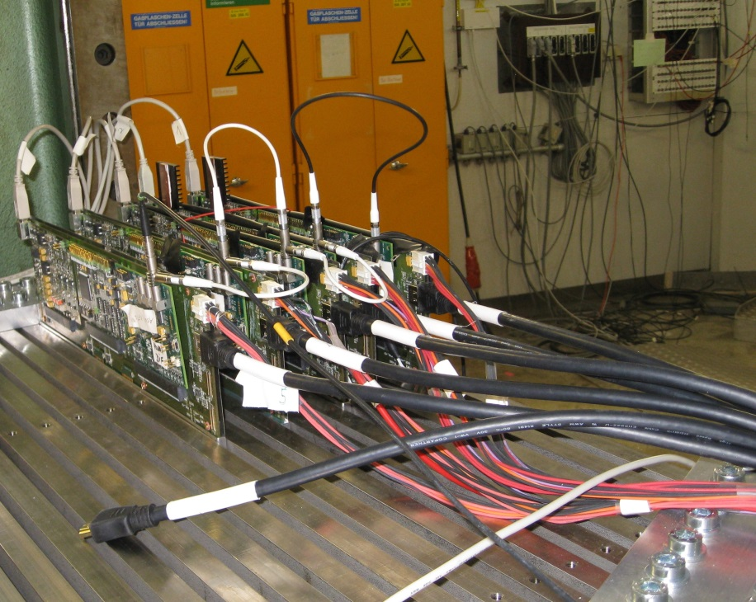
AHCAL operation in ILC-like environment
Next DAQ vers.:
No Lemo-,
USB cables
Operation for the first time in steel cassettes with final dimensions and in absorber stack.
No increased noise, no obvious shift of MIP position with respect to lab setup. => dense EUDET mechanical concept validated!

Slide 4
Hardware Status
HBU2: (two production runs): 14 boards. (tiles?)
FE-DAQ: DIF (NIU), CIB, POWER and CALIB: 20 boards.
Flexleads (2 types, a lot in use): 14 boards (each type)
EBU vertical: 4 boards
EBU horizontal: 4 boards (in production, expected beginning Oct.)
SM_HBU: 2 boards
Delivered complete sets (HBU/EBU/SM_HBU + FE-DAQ modules) to: Shinshu, Mainz, NIU. One further HBU to Wuppertal.

Slide 5
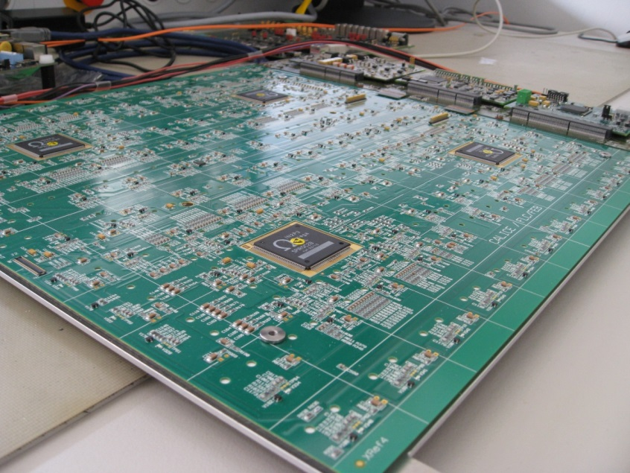
New 8 HBU2 boards
All 8 new HBU2s have been tested and work fine.
Problem: Significant spread of board dimensions within the 8 boards. Landmarks differ up to 0.4mm (0.1mm was specified).
Problems during PCB assembly and with the steel cassettes (individual cassettes needed).
From the discussion with PCB manufacturer: For the next order, there will be a pre-compensation process step for the inner pcb layers before the pressing operation. This will solve the problem as it did for the first 6 HBUs.

Slide 6
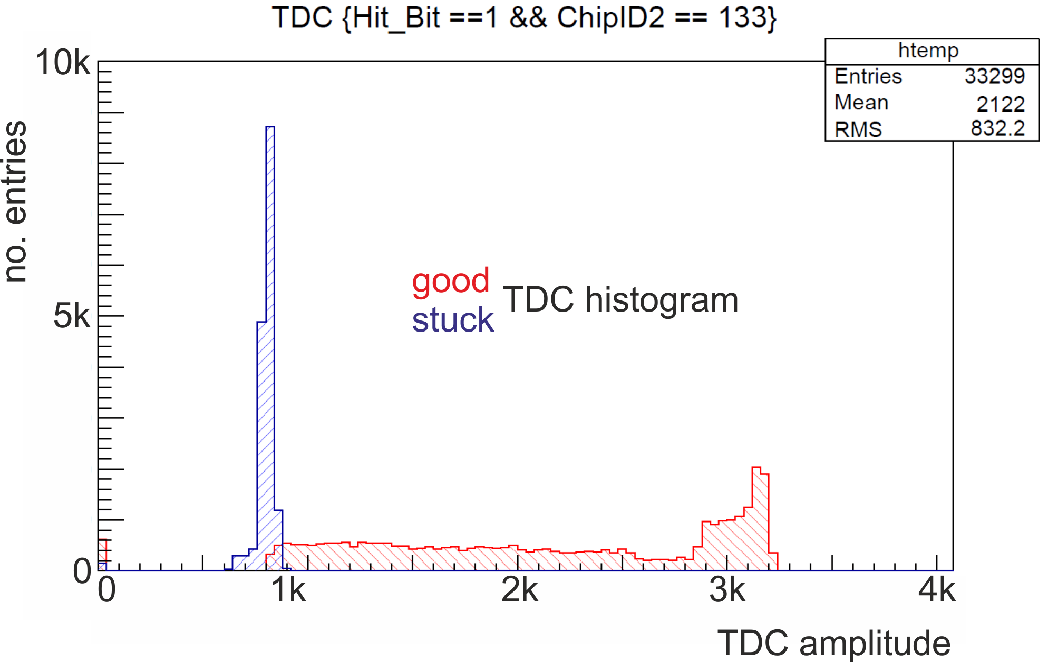
Detector Power-Up Problem
Arbitrary operating conditions in multilayer setup (very seldom in single-layer setup): Stuck TDC, spontaneous noisy channels, shifted MIP position.
SPIROC reset does not help, only re-powering helped.

Slide 7
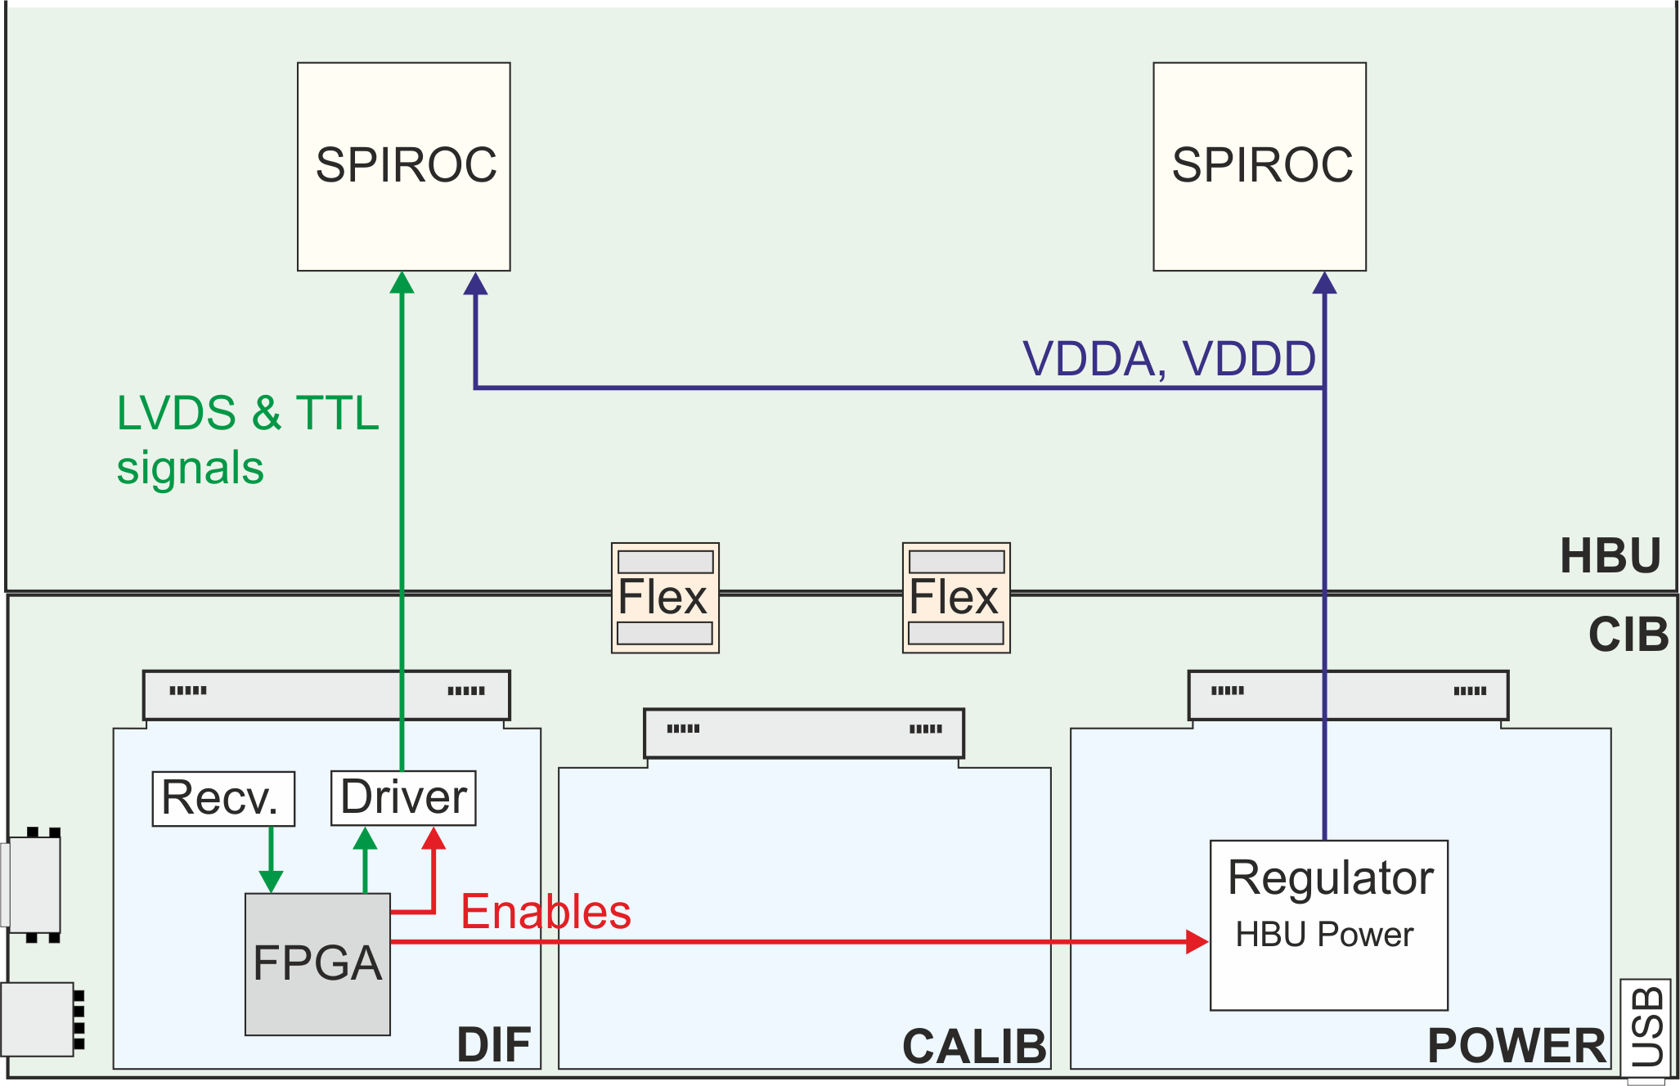
Solution for Power-Up Problem
Problem identified: After power-up and booting, the DIF FPGA sets TTL lines to SPIROCs before enabling SPIROC’s power. => SPIROCs get power through protection diodes of input channels.
New switch-on order cured the problem.

Slide 8
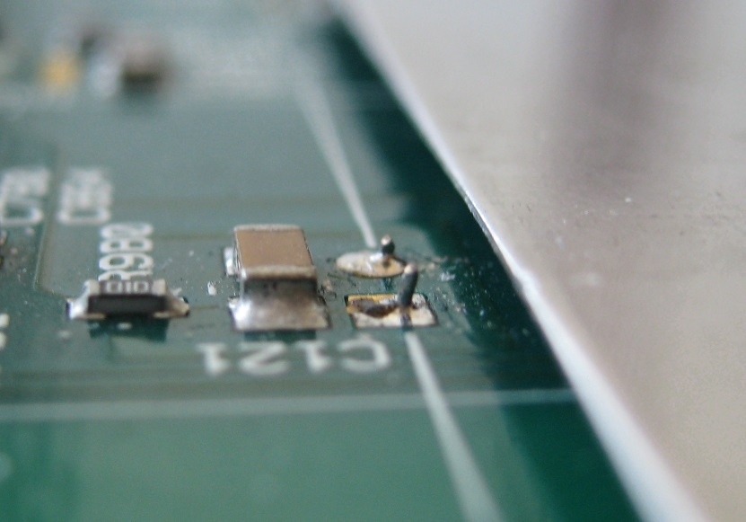
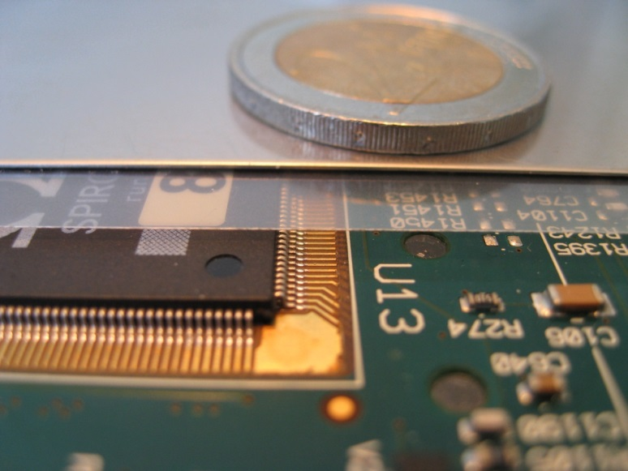
Broken SPIROCs in testbeam
During testbeam 6 out of 20 SPIROCs on three HBU2s have been damaged.
Damage is the same for all chips: oscillating input DACs.
Best explanation so far: SiPM pins have damaged the isolating foil and touched the steel cassette’s top plate. => Stronger foil ordered.
inDAC oscillation
top plate
Pins must be cut carefully

Slide 9
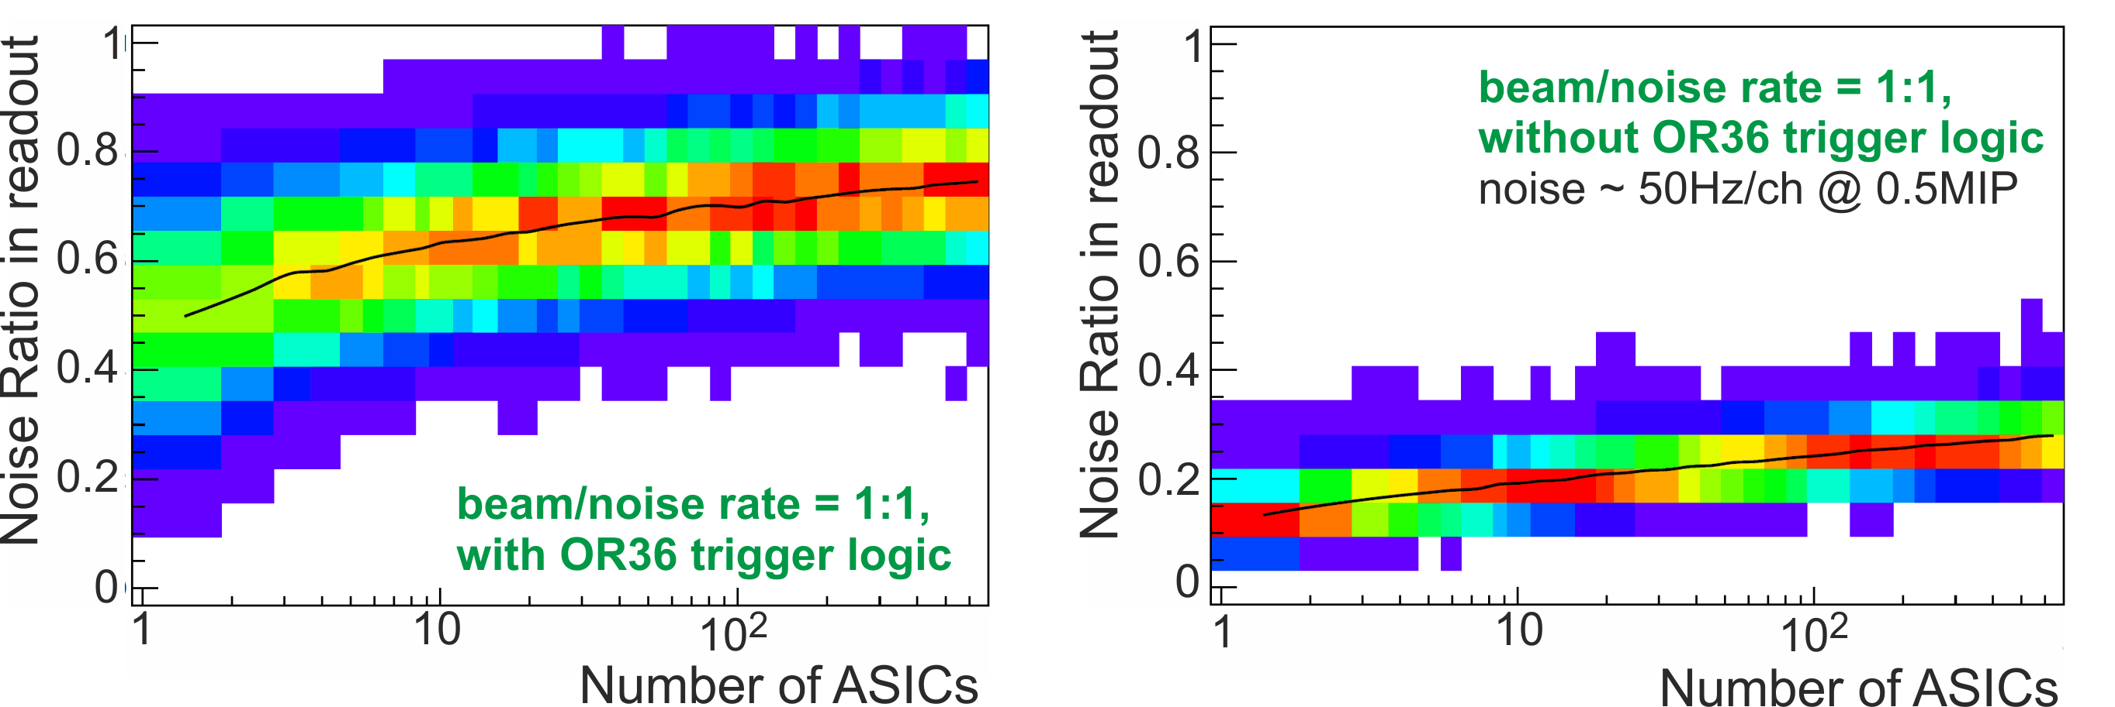
Beam rate to noise rate considerations
Can we operate 1m³ (~600 SPIROCs) with current SiPMs and ASICs?
Simulation studies of beam/noise-rate started to investigate the amount of noise events in the AHCAL detector for various operation conditions.
Exponential distributions for noise- and beam rates assumed. Different trigger architectures and memory depths under study.
First conclusion: First memory cell problem (ADC data “0”) must be solved (low occupancy in last layers). Was solved for SP2c already.
Simulations by Oskar Hartbrich

Slide 10
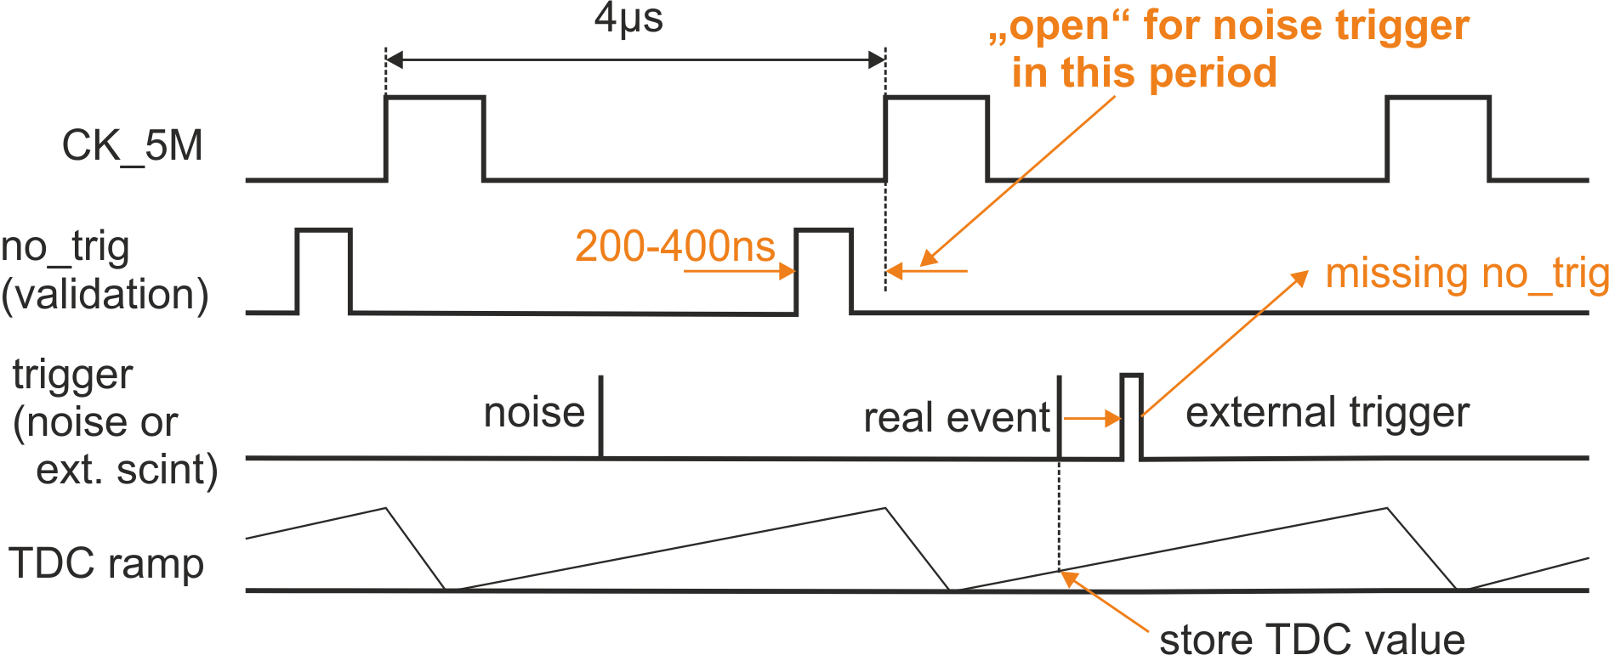
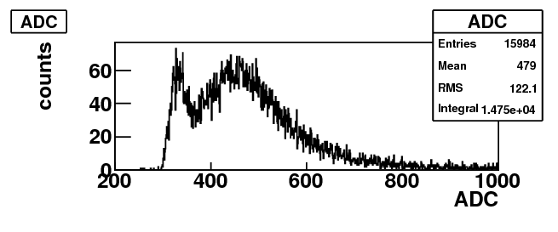
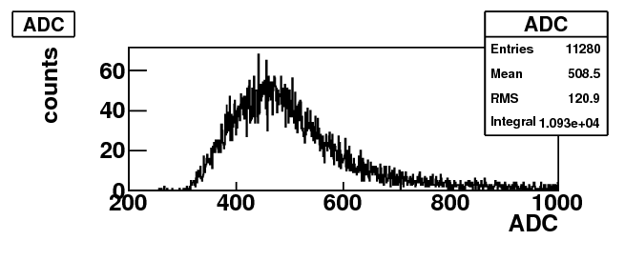
Trigger Validation (Testbeam mode)
Only stores events that are validated by an external trigger signal
Validation works fine: Histogram only shows MIP events without noise/pedestal contributions.
Problem: Validation does not work for noise hits between no_trig and rising CK_5M edge (200-400ns). Triggers in this period should be rejected (=> dead time).
Now: Factor 10 noise reduction. Improve 400ns window size.
no validation
MIP
with validation
MIP

Slide 11
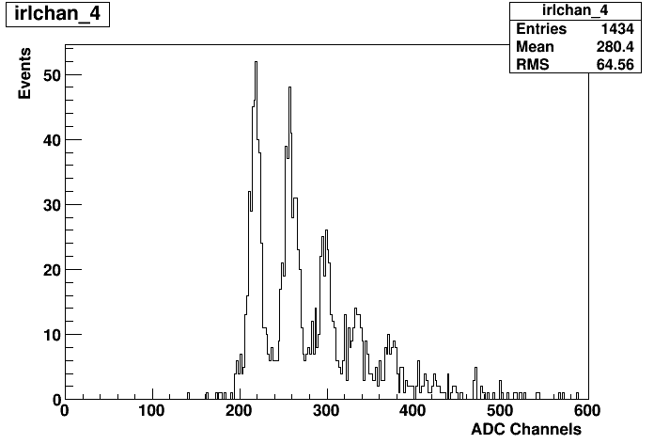
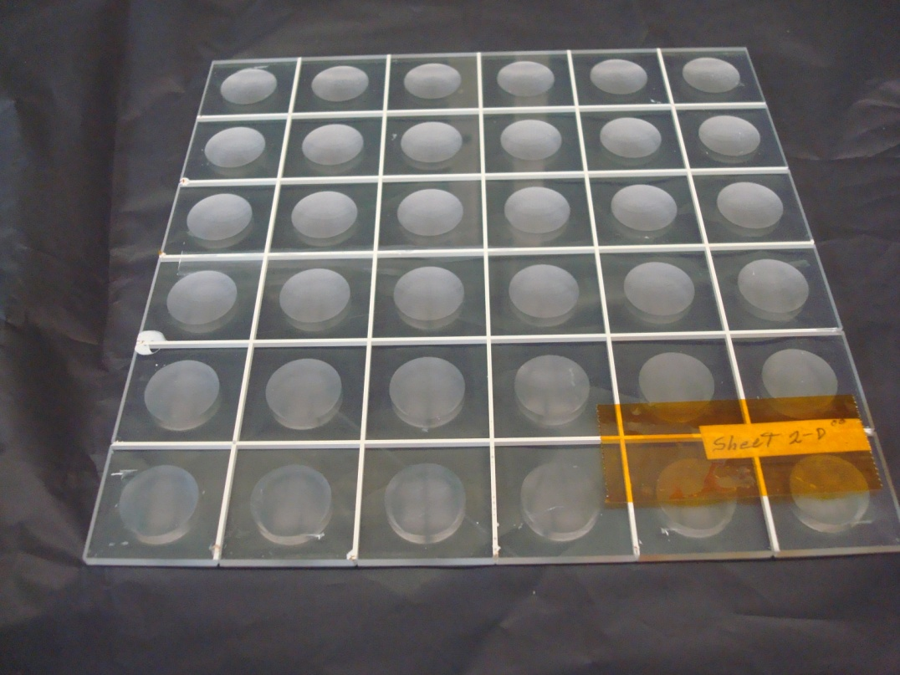
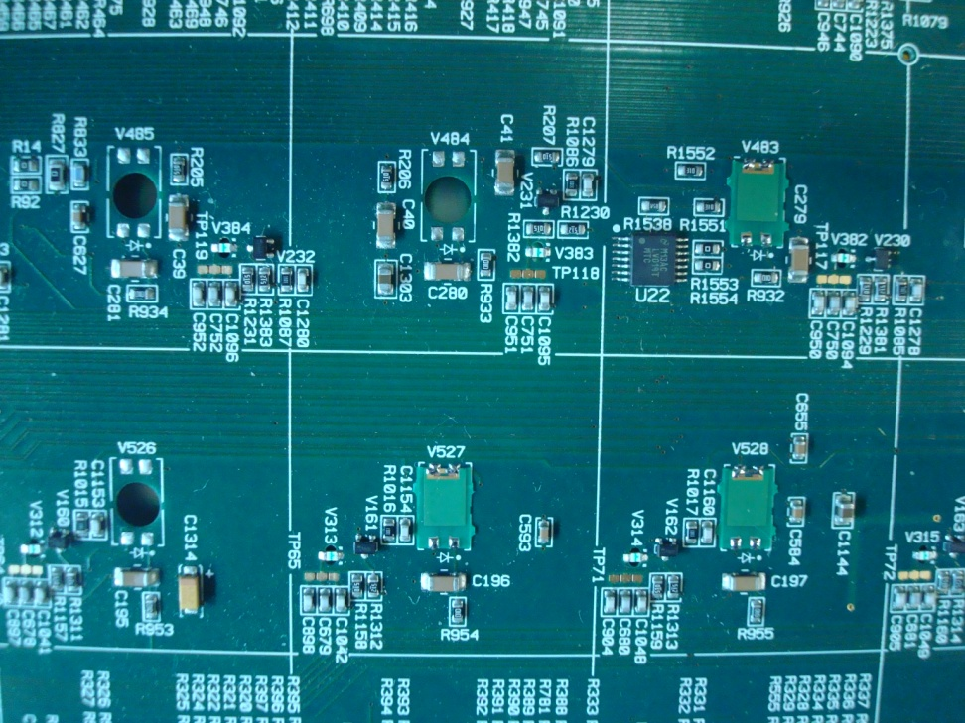
Northern Illinois University
Results by Kurt Francis
Integrated Readout Layer
First big
commissioning
steps accomplished.
Great progress…!!
- Uses HBU2 FE
- Hamamatsu MPPC mounted on small flex circuits
- Scintillator “Megatile” with 3 x 3 cm cells optically isolated with white epoxy
- Cells have a concave dimple improve the uniformity of the response and to direct light through hole in board onto MPPC
- Easier to assemble, does not need WLS optical fiber

Slide 12
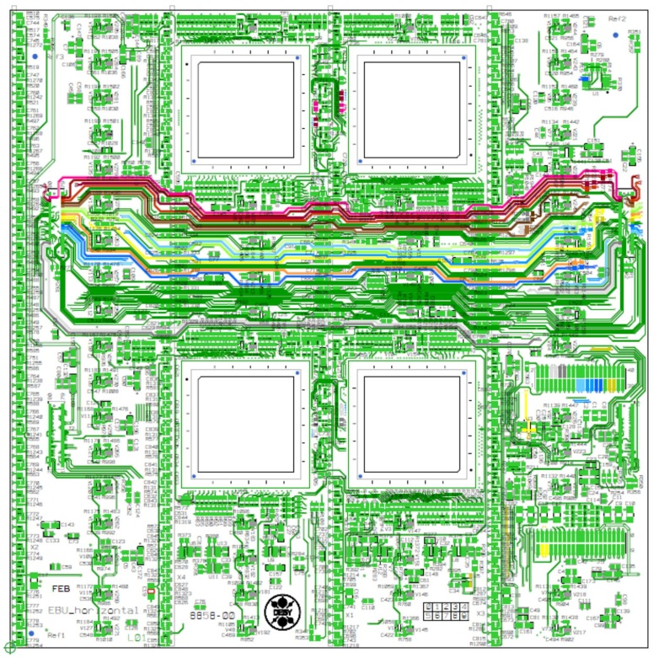
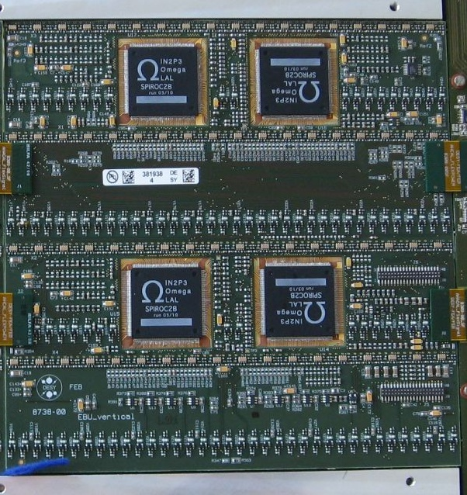
EBU status (ScECAL)
EBU-vertical (right): 4 boards realized
EBU-horizontal (left): 4 boards in production, expected beginning of October:
Final ScECAL module assembly from Shinshu at DESY in close coorporation.
EBU-horizontal requires long flexleads for EBU/EBU connection (in layout design).

Slide 13
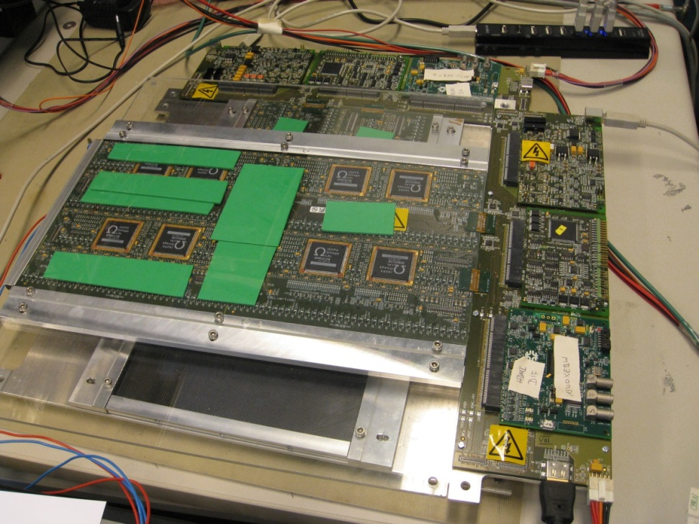
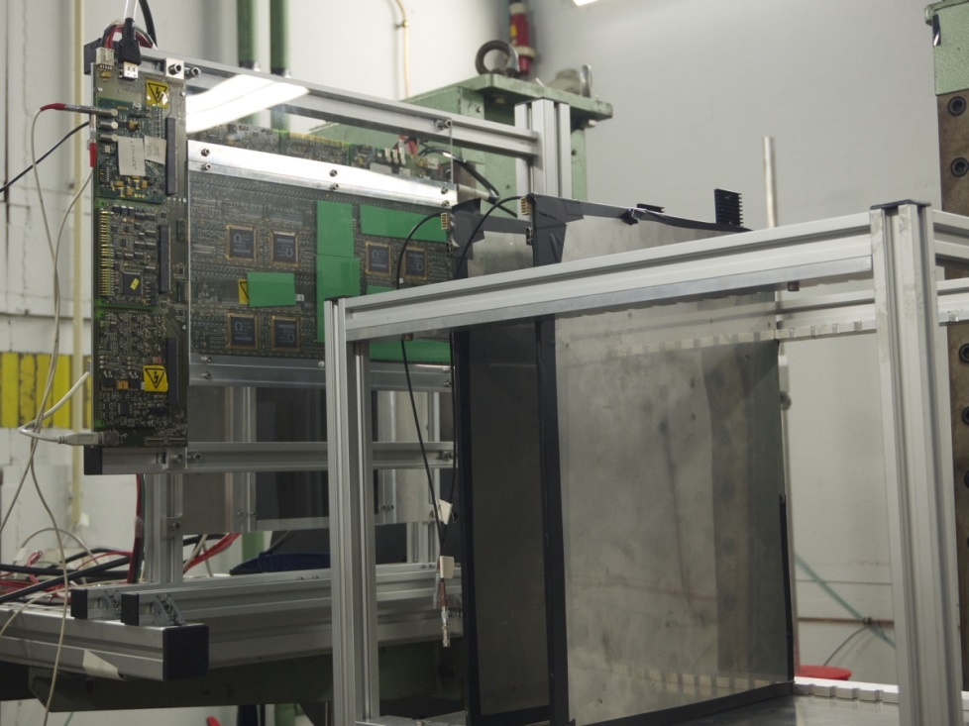
EBU status (ScECAL)
2 ScECAL layers in lab, perpendicular strip orientation
1 setup with 2 EBUs in a row, 1 setup with 1 EBU
Two ScECAL layers with two AHCAL layers together in DESY testbeam, operated synchronously and together by the AHCAL DAQ.
For results see Shinshu talk.

Slide 14
Conclusions
Multilayer operation of AHCAL (and ScECAL) has been established. Further modules in production.
2nd EBU-type in production.
SM_HBU with big progress at NIU.
Additional things to keep in mind for SPIROC2d / SPIROC3: https://ilcagenda.linearcollider.org/conferenceDisplay.py?confId=5891: talk: “Experiences with the AHCAL testbeam prototype”
Ongoing studies: Power-Pulsing with slab (6 HBU2s).

Slide 15
Backup
Backup Slides

Slide 16
Towards the next SPIROC
Topics to keep in mind …
Pedestal shift @ huge signals, pedestal different for internal/external trigger.
Memory cell dependent amplitude decay. Solved by compensation caps.
Slow-Control configuration is problematic for long slabs.
Feedback of channel-wise trigger thresholds on the global threshold.
Random zero events and zero-results for the first trigger.
Poor uniformity of the input DACs.
Holdscan is different for HG/LG.
Trigger threshold width increases with threshold height.
Amplitude-to-threshold relation depends on preamp. setting and pulse shape.
TDC: Amplitude dependent time-shifts and channel-to-channel spread.
TDC: Result depends on which ramp is used and the memory cell.
TDC: big chip-to-chip spread of ramp slopes.

Slide 17
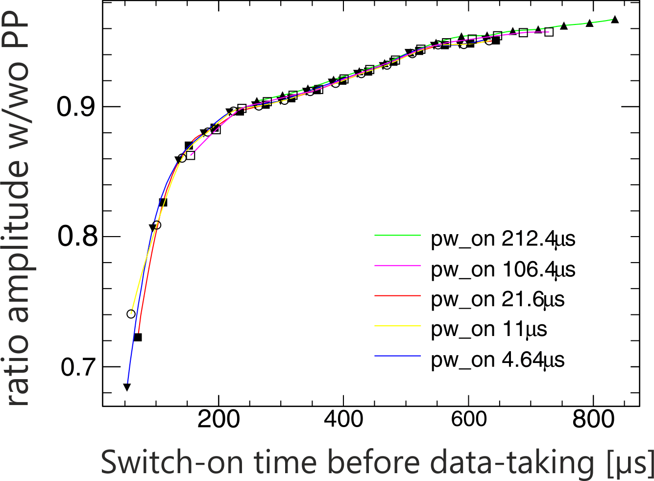
Power and Power Pulsing (PP)
Aim: Switch on as short as possible before data taking starts (initial idea: 20µs).
Results with charge injection show a decreased amplitude response with PP.
Single-Pixel Spectra measurements show a reduced amplitude with PP.
Aimed power dissipation of 20µW per channel not reached yet.

Slide 18
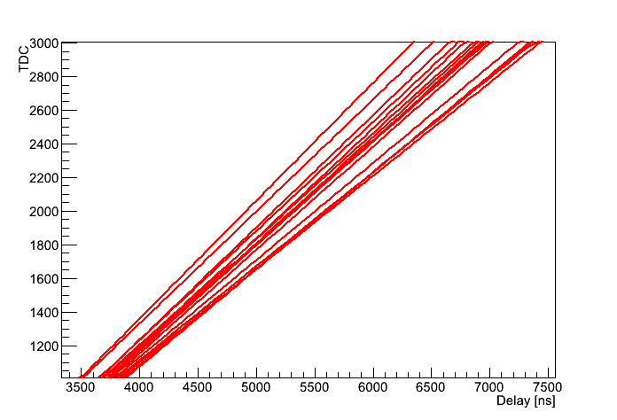
TDC Calibration – CERN Module
Calibration of all 16 SPIROC2b ASICs of the CERN Testbeam-module with charge injection.
Chip-to_chip spread of the TDC ramp slopes: Calibration necessary: TDC (time measurement!).
SPIROC2b chip-to-chip
spread of the TDC ramp
Slopes.
~1.6ns/TDC bin

Slide 19
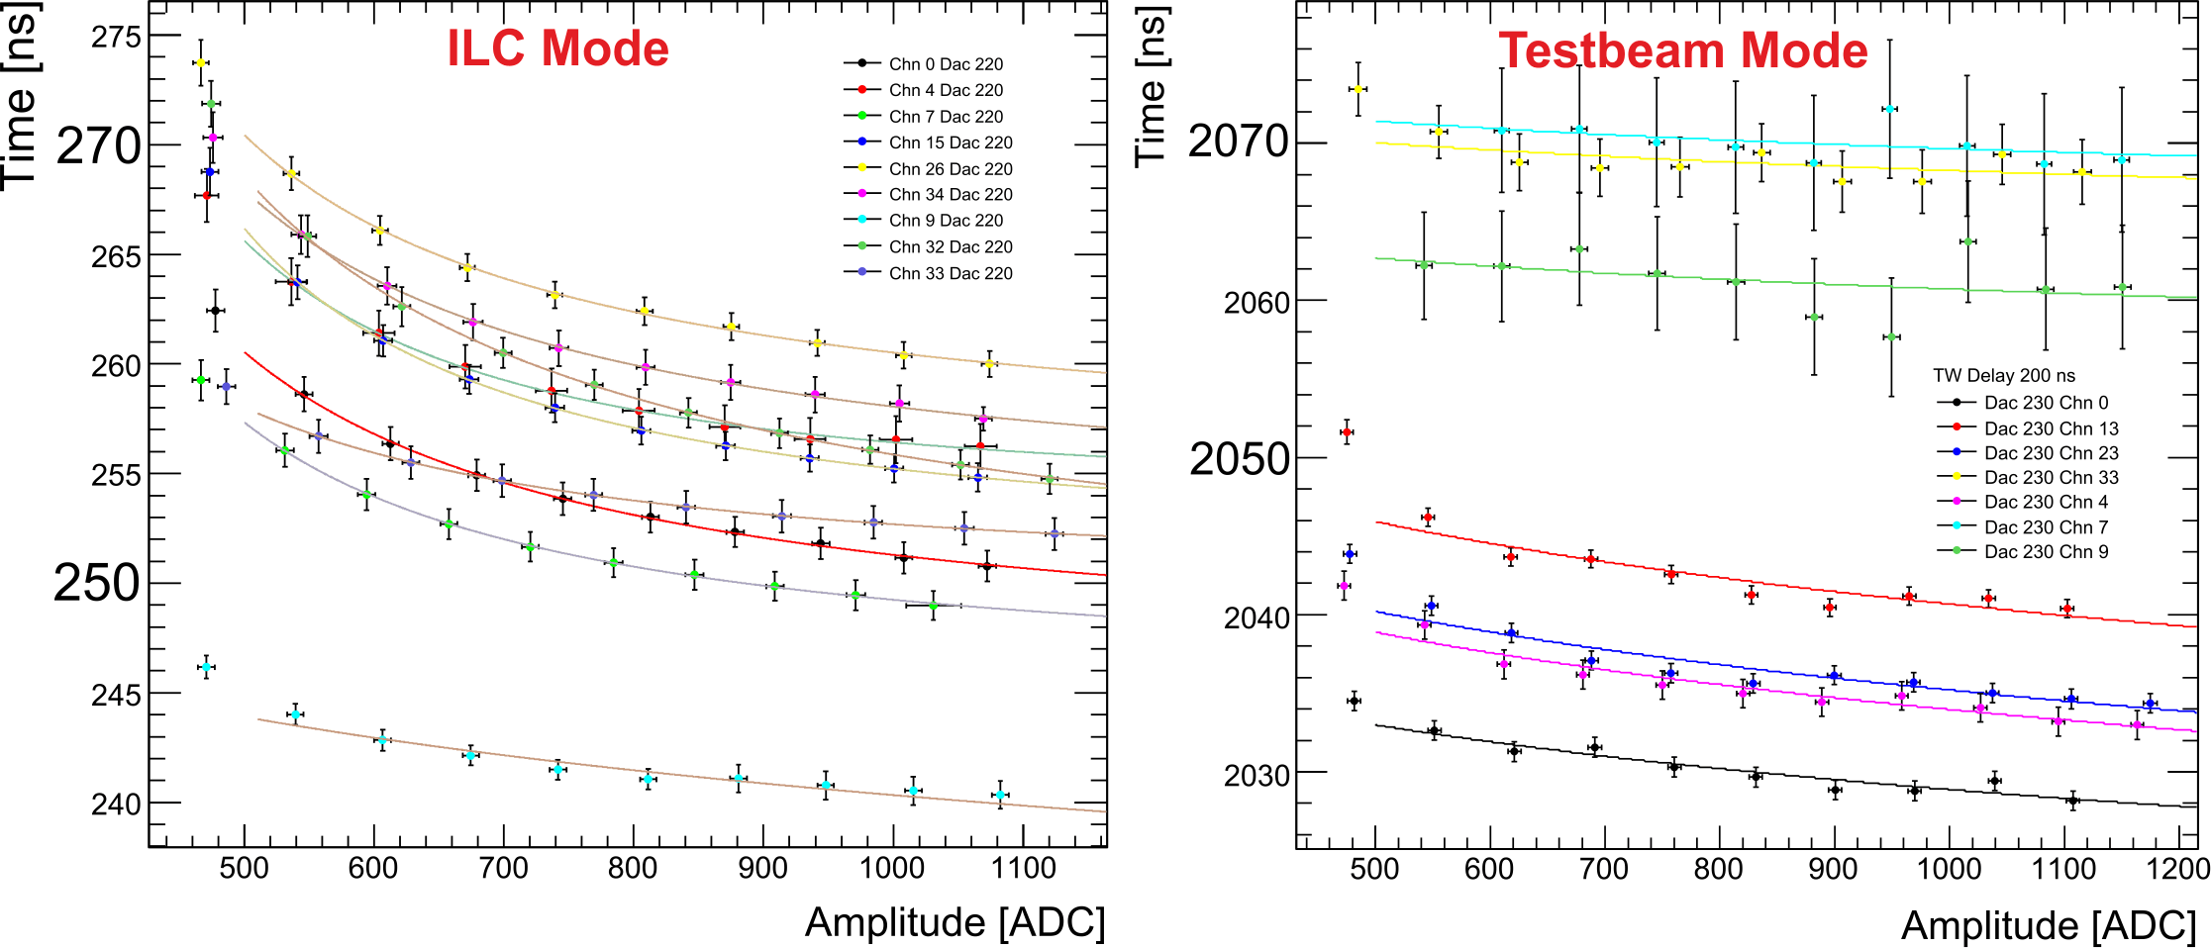
TDC: Time Walk and Channel-to-Channel Spread
Amplitude-dependent time-shifts and channel-to-channel differences.
Difficult to parameterize because of different behaviours. Channel-wise TDC calibration necessary as for ADC (MIP calibration)?

Slide 20
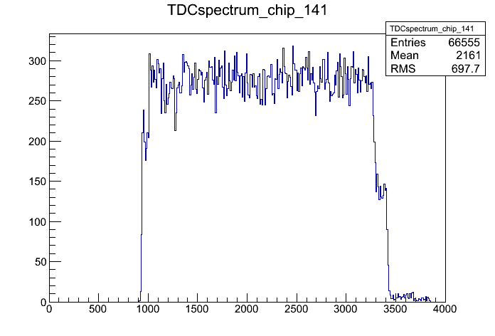
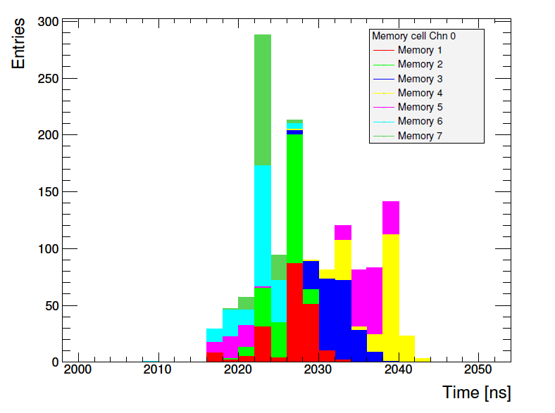
TDC: Memory Cell Dependence and „2-Ramp“ Problem
Testbeam
mode
2 ramps
Testbeam
mode
TDC result depends on memory cell
The SPIROC2b internal TDC ramps have different amplitudes and for a specific event it cannot be identified with which ramp the TDC result has been achieved (known problems).

Slide 21
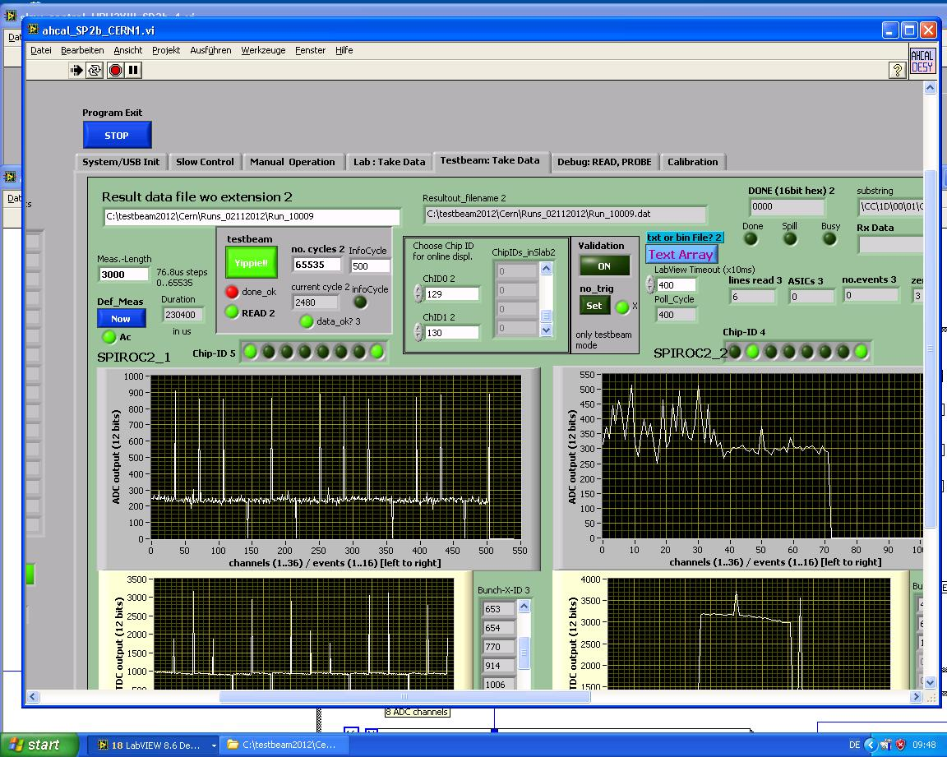
Start-Run Problem
CERN testbeam
High noise on
pedestal for
first 1-2 readout
cycles

Slide 22
Slow-Control Problem
For longer AHCAL slabs, the slow-control programming is instable. Reason: Slow-control clock, special pulse-shape needed (series R, termination R, block-C)
Conditions on the slab:
With reduced amplitude,
the slow-control works.
Although the slow-clock looks fine, the configuration does not work.
Analysis ongoing, I2C in SPIROC3.

