Slide 1

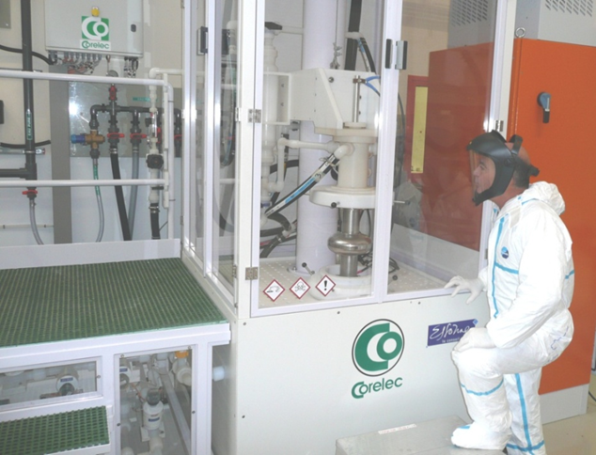



Vertical Electro-Polishing at CEA Saclay: update
April 16th 2013

Slide 2
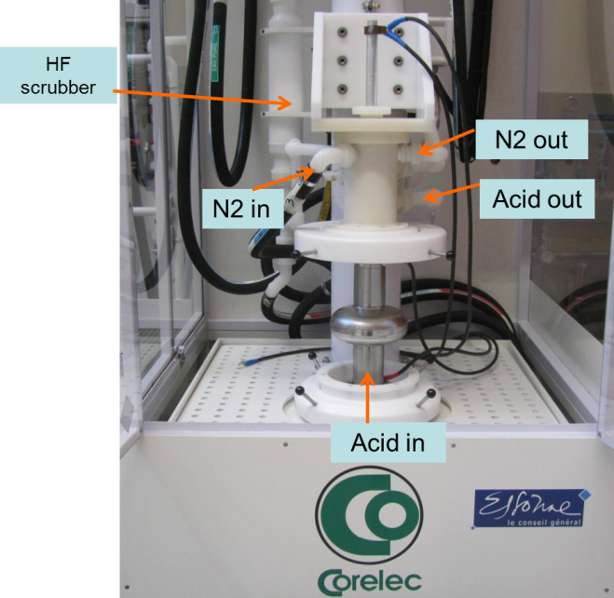
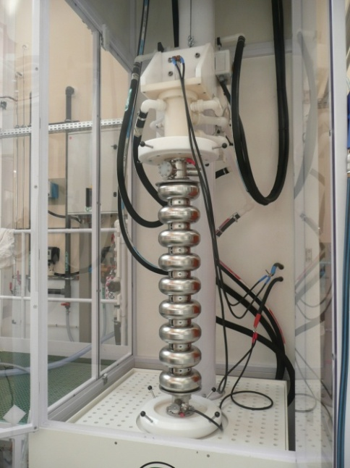

Overview
TB9RI025 cavity
Prior to VEP
Circulating acid
Constant voltage
Nitrogen blowing
VEP of 1Cell and 9Cell cavities
Focus on parameters: low voltage (~ 6V) – high acid flow (25L/min)
  Improved degassing (H₂ , O₂)
  Lower heating
Four 1-Cell cavities and 1 nine-cell cavity prepared by VEP
But delay in results: Field Emission problems (cleanroom’s water)

Slide 3

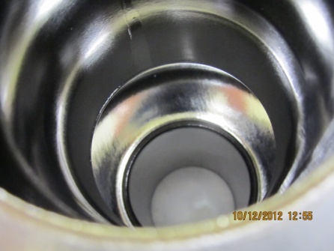
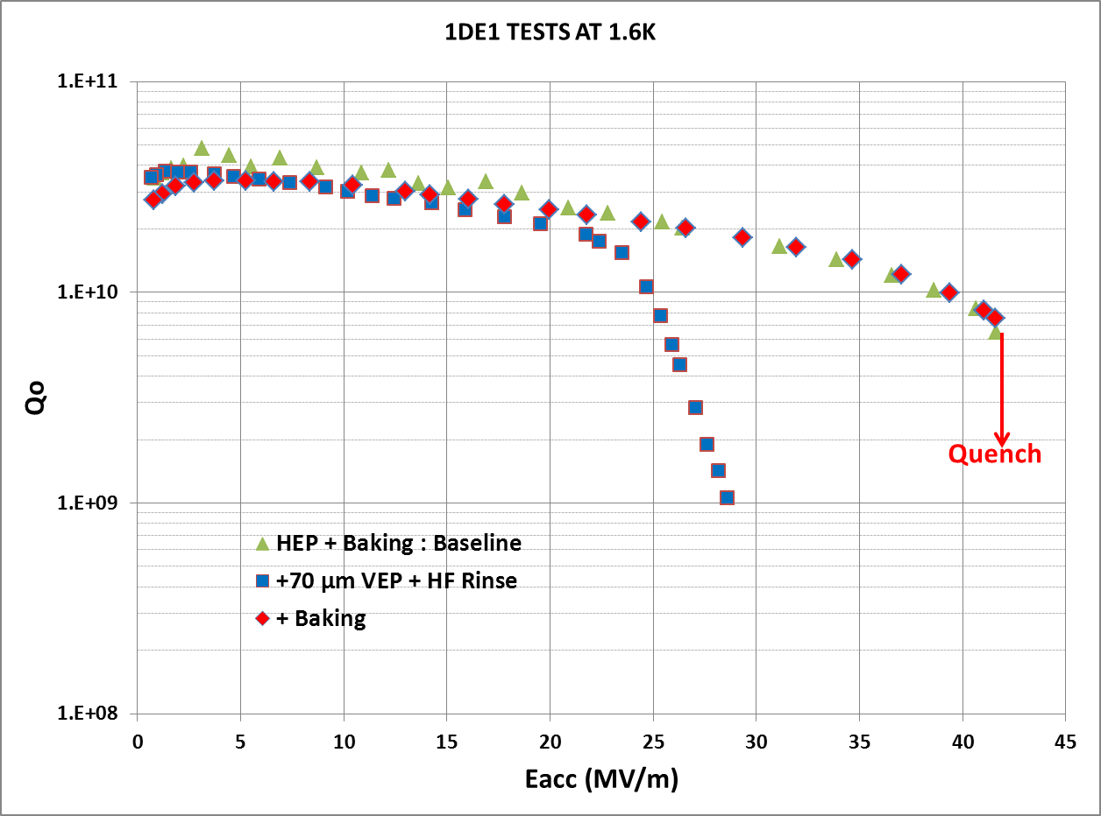
Eacc > 41 MV/m on 1Cell Cavity with Parameters:
Low Voltage – High Acid Flow
1DE1: Horizontal EP + 70 µm VEP
Parameters: 6V & >24L/min
Bright and smooth surface
Performance before/after baking similar to HEP
High gradient maintained after VEP
1DE1 after HEP + 70 µm VEP
Aspects to improve:
Low removal rate at 19°C: 0.2µm/min
asymmetry: removal rate higher in the upper part of the cell (x 3)
higher local removal
Acid flow

Slide 4
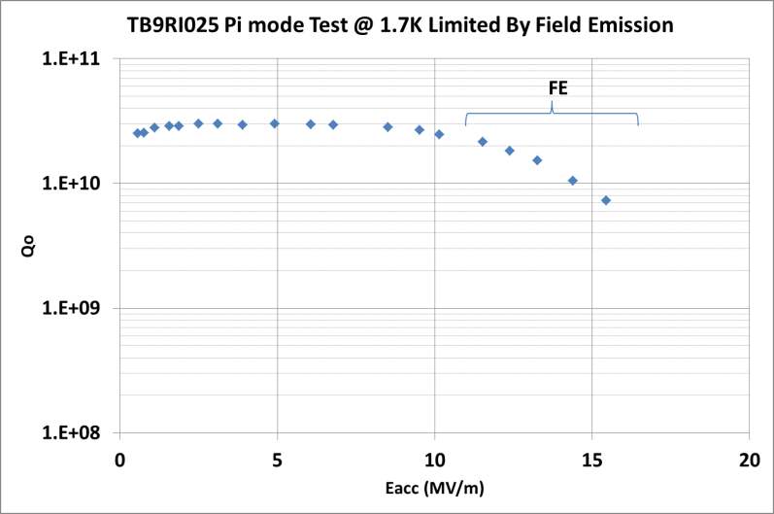
Two Cavities to be Tested in Week #16
Cavities VEP’ed at 6V & 25L/min:
1AC3 (34MV/m at previous test) + 70 µm VEP + Baking
TB9RI025: (HEP + 60 µm VEP) last test impacted by Field Emission :
→ additional HF rinsing + HPR + assembly. Under testing…

