Slide 1


Review of 120413 Shift + Weekend Tests
Mikey Davis
15 April 2013
1/Number

Slide 2
Introduction
Neven and I did some investigations before the shift and found the LO for the 2nd stage was 5dBm lower than suggested
We found that by using the damping ring 714 we could measure the output signal level and that this 5dBm made a difference of about a factor 2 in output signal level
We therefore spent the 2nd shift last week testing a number of different possible LO’s for the second stage at different power levels
Mikey Davis
15 April 2013
2/Number

Slide 3
Introduction
In summary we found that no matter what LO we used and what power level we got about 5μm jitter
EPICs measured a jitter of about 0.5μm
We found consistent good correlation between the two signal channels
We found no correlation with any other BPM
Mikey Davis
15 April 2013
3/Number

Slide 4
1st Stage LO
Over the weekend Neven and I decided it would be prudent to check the LO for the first stage
This is a more complicated setup than the 2nd stage lo and is as follows:
714 MHz Bandpass filter (± 10Hz)
4 Way Spliter
30 dBm Amp
34 dBm amp (marked 5 – 12 GHz)
30 dBm amp (marked 1 – 4 GHz)
Freq Mult
(marked
475 -> 2856 MHz,
0 dBm -> 10 dBm)
Mikey Davis
15 April 2013
4/Number

Slide 5
1st Stage LO
714 MHz Bandpass filter (± 10Hz)
4 Way Spliter
30 dBm Amp
-8.5
-10
-17
4.1
1.7
34 dBm amp (marked 5 – 12 GHz)
None
30 dBm amp (marked 1 – 4 GHz)
Freq Mult
(marked
475 -> 2856 MHz,
0 dBm -> 10 dBm)
-16
Key
Point | Power Level (dBM)
Start | -8.5
After bp filter | -10
After split | -17
After 30 dBm amp | 4.1
After freq mult | -16
After 1st amp | Peak just under -20
After 2nd amp | 1.7
Power Level at 714 MHz (dBm)
Power Level at 2856 MHz (dBm)
Power Level at 5712 MHz (dBm)
Mikey Davis
15 April 2013
5/Number

Slide 6
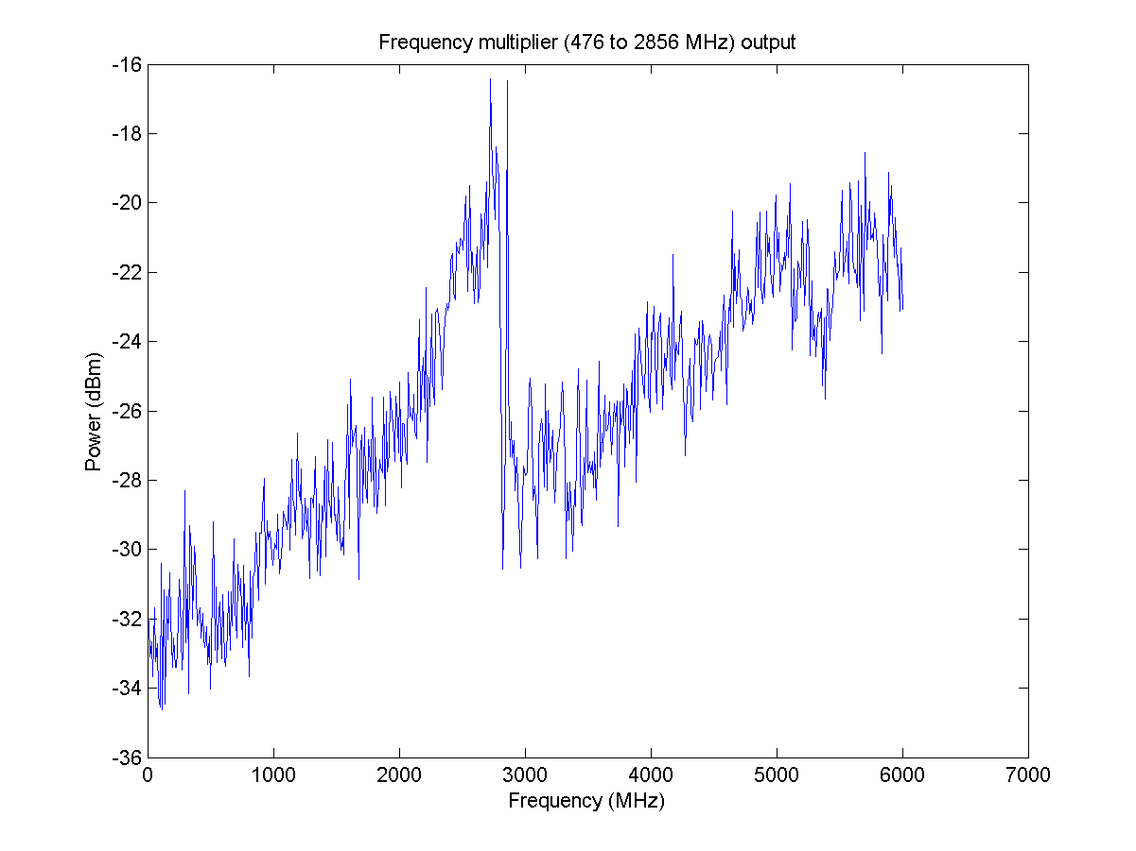
1st Stage LO Freq Spec
Mikey Davis
15 April 2013
6/Number

Slide 7
1st Stage LO Freq Spec
Mikey Davis
15 April 2013
7/Number

Slide 8
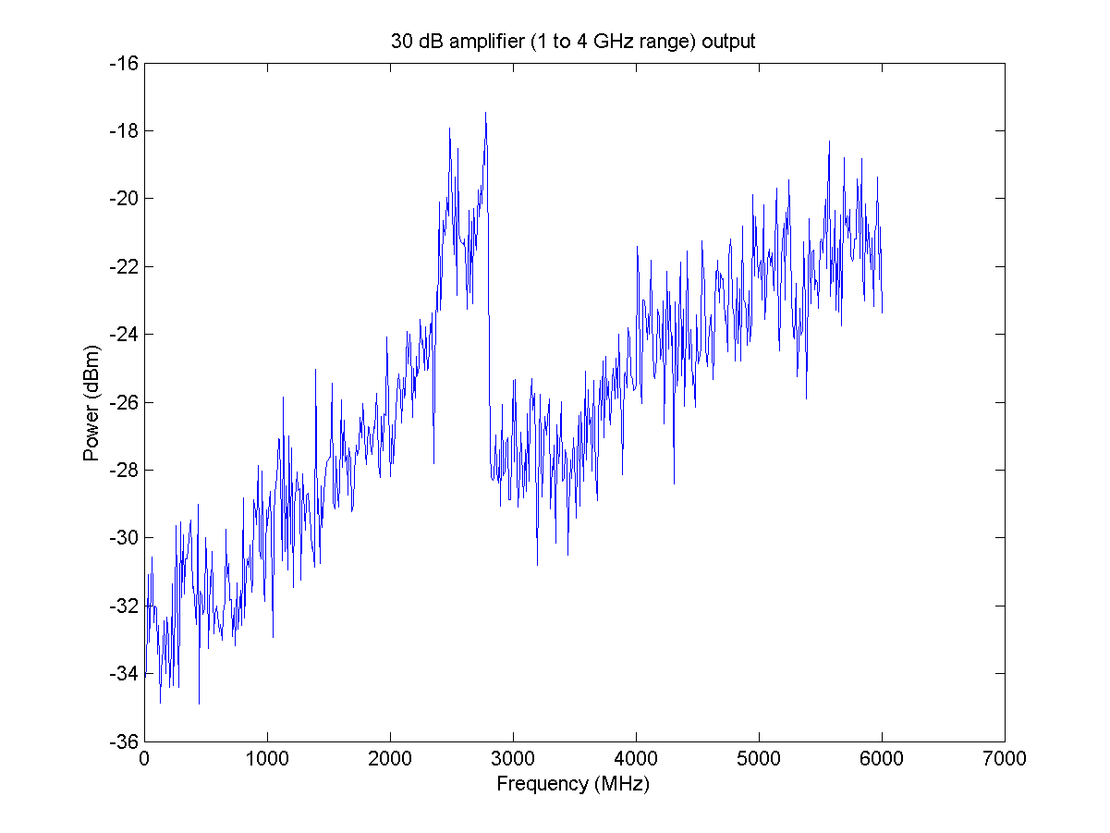
1st Stage LO Freq Spec
Mikey Davis
15 April 2013
8/Number

Slide 9
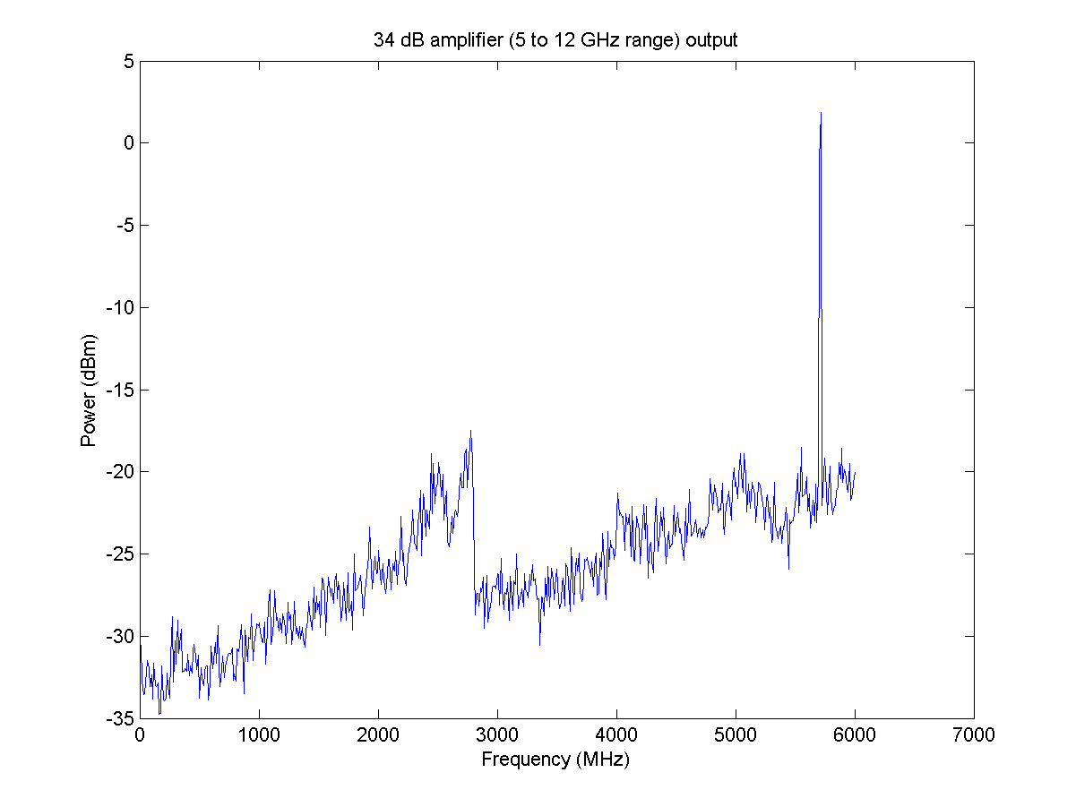
1st Stage LO Freq Spec
Mikey Davis
15 April 2013
9/Number

Slide 10
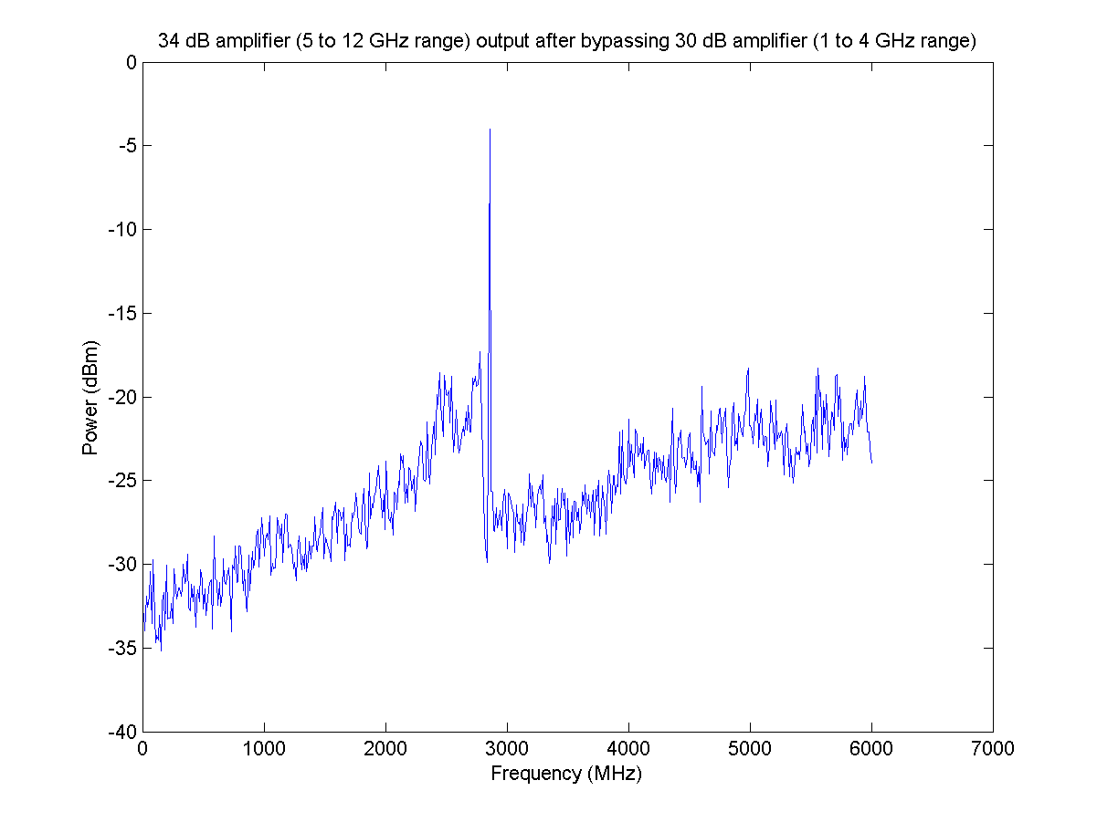
1st Stage LO Freq Spec
Mikey Davis
15 April 2013
10/Number

Slide 11
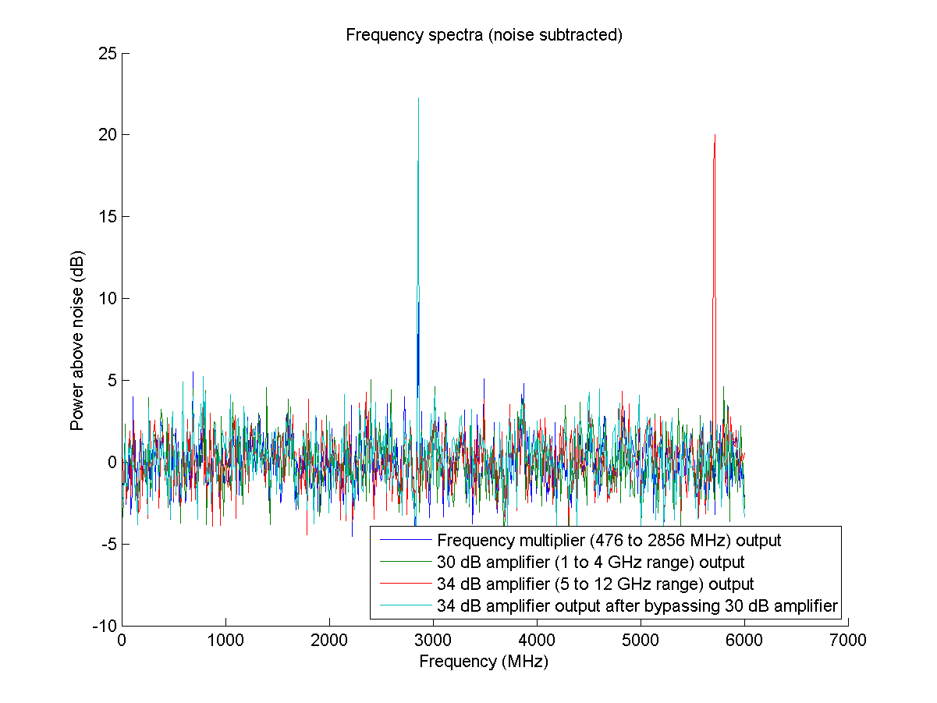
1st Stage LO Freq Spec
Mikey Davis
15 April 2013
11/Number

