Slide 1


Review of Shift 160413
Mikey Davis
17 April 2013
1/13

Slide 2
Notes on Setup
The damping ring LO was used throughout last night
This was always set to the correct level for the 2nd stage being use (either Honda or FONT)
We split IPB – the graphs are labelled IPA and IPB, this corresponds to the first and second sets of channels of IPB
Mikey Davis
17 April 2013
2/13

Slide 3
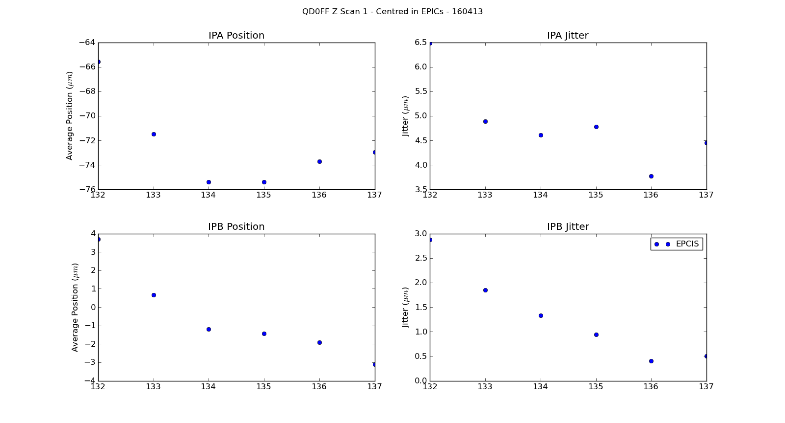
IP Waist Scan - Epics
Mikey Davis
17 April 2013
3/13

Slide 4
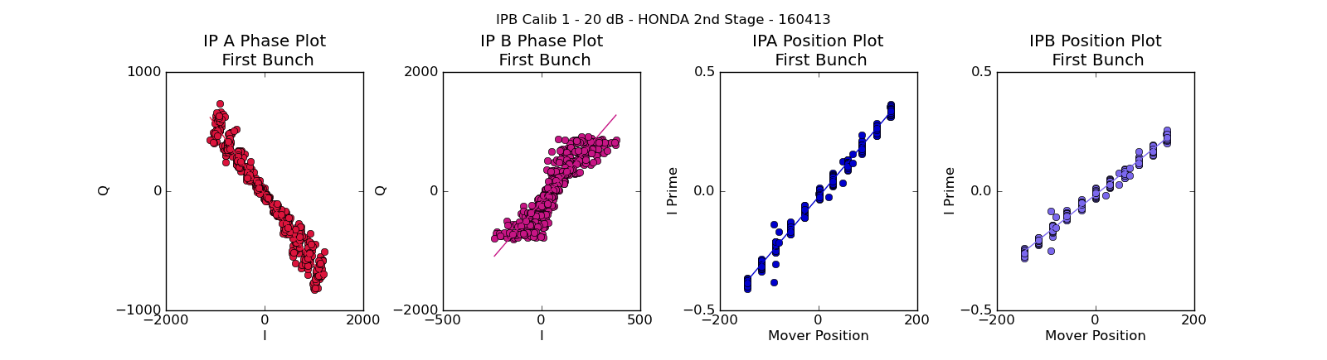
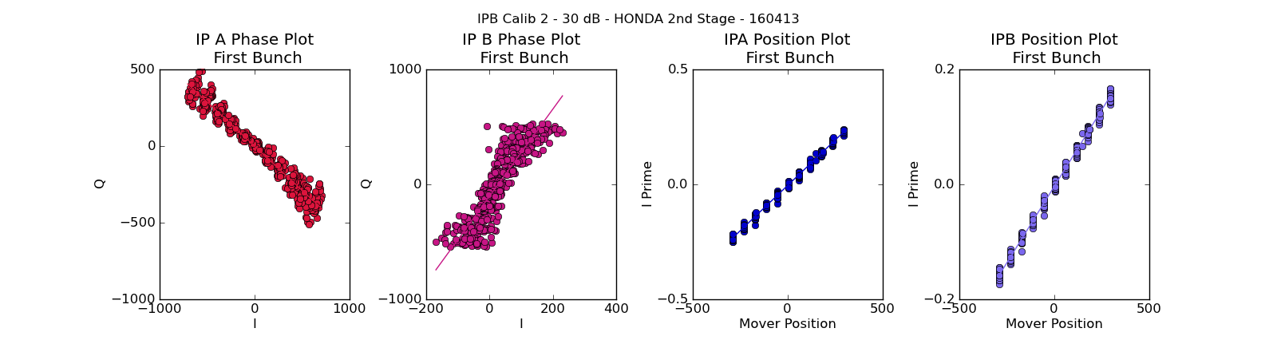
Normal Calibrations
Mikey Davis
17 April 2013
4/13

Slide 5
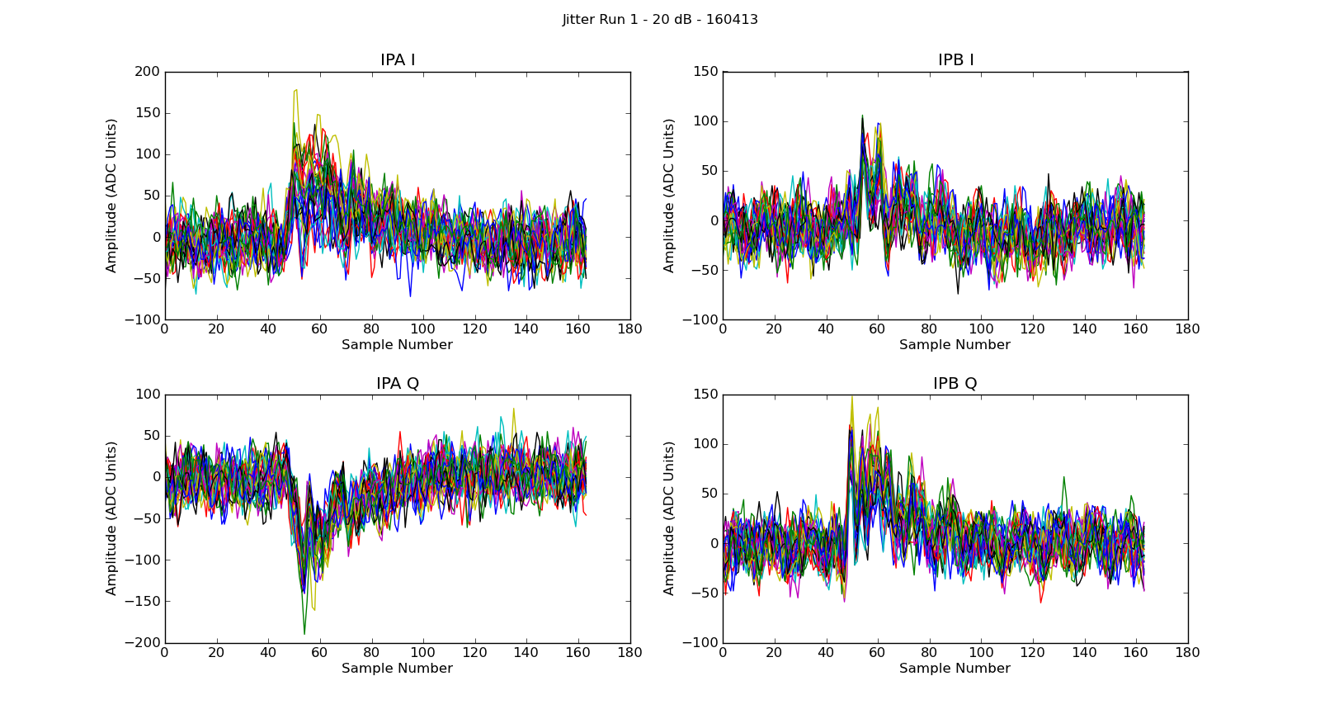
Jitter Runs
Background STD 19 Counts
Mikey Davis
17 April 2013
5/13

Slide 6
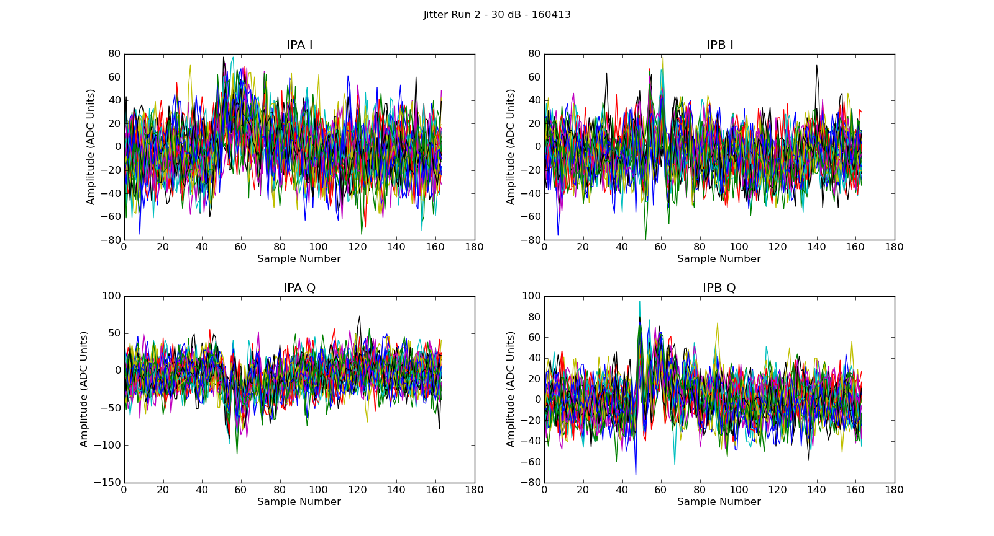
Jitter Runs
Background STD 19 Counts
Mikey Davis
17 April 2013
6/13

Slide 7
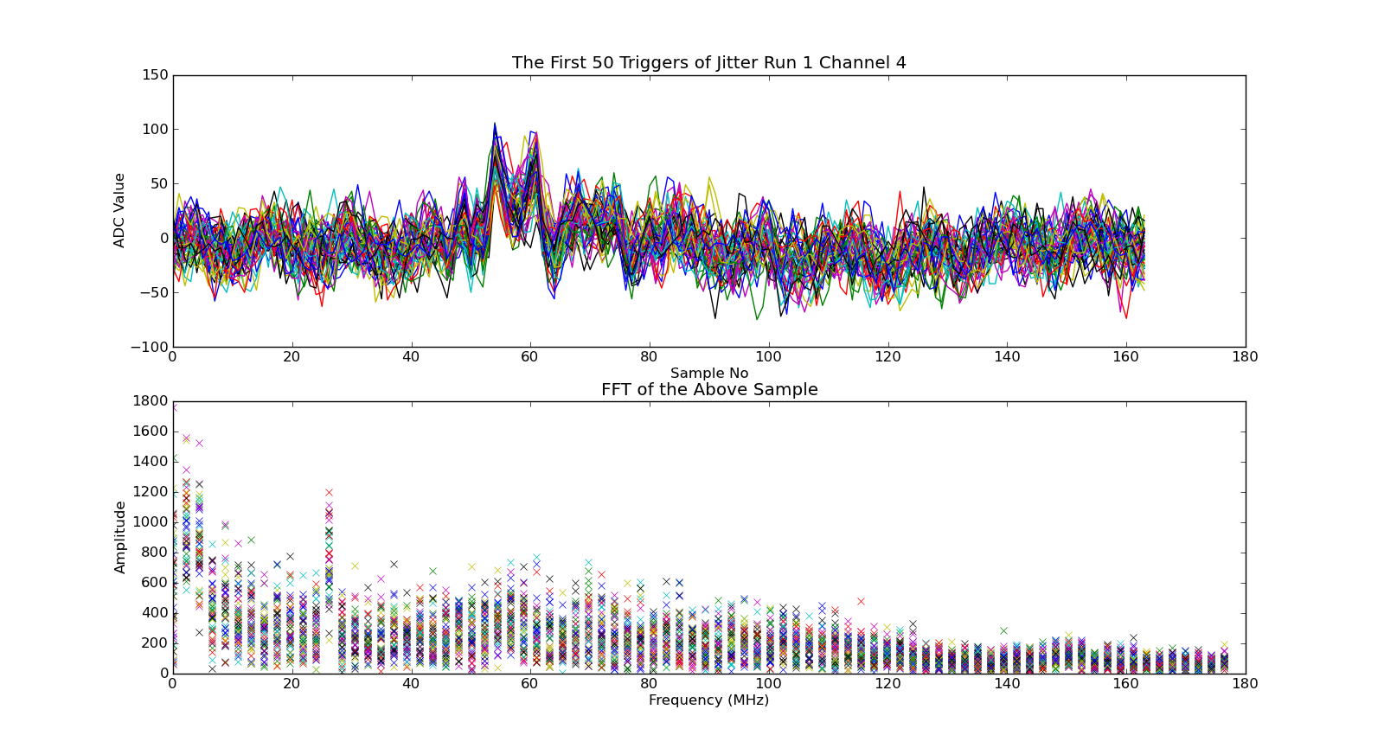
FFT of Jit Run
Mikey Davis
17 April 2013
7/13

Slide 8
Summary of the Problem
The calibration constant that turns raw I’ in FONT ADC units into microns is :
If you use this to convert the ADC noise into microns you get jitters of :
N.B. I have done this properly and combined the channels to get IPrime
Attenuation Setting | IPA Channel | IPB Channel
20 dB | 0.12 | 0.19
30 dB | 0.40 | 0.59
Attenuation Setting | IPA Channel | IPB Channel
20 dB | 2.3 | 3.0
30 dB | 8.0 | 9.7
Mikey Davis
17 April 2013
8/13

Slide 9
Summary of the Problem
This is clearly not the only problem we have
However it does contribute a lot to the jitter
I tried using the FONT BPM processor and a rigged up amplifier I found instead of the second stage
Took two calibrations using diff setups and two jitter runs, both worked better than the Honda 2nd stage
Mikey Davis
17 April 2013
9/13

Slide 10
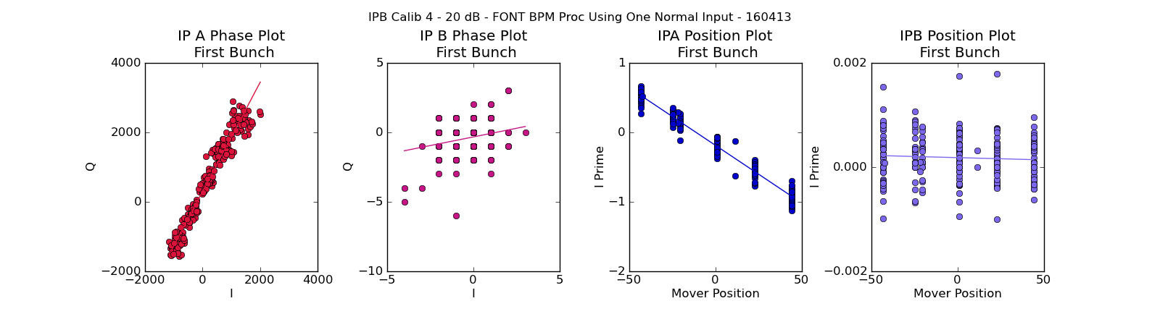
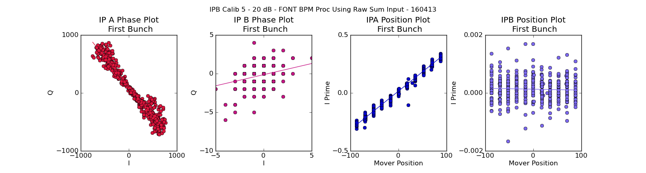
FONT BPM Proc Calibrations
Mikey Davis
17 April 2013
10/13

Slide 11
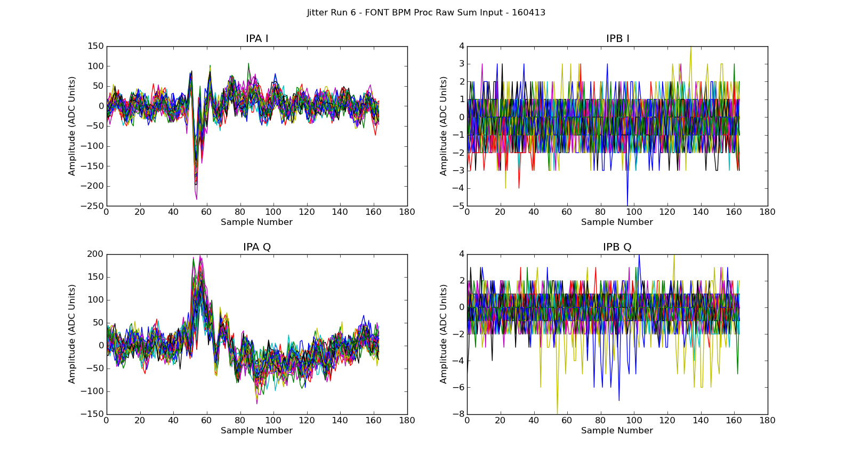
Jitter Runs
Background STD 15 Counts
Mikey Davis
17 April 2013
11/13

Slide 12
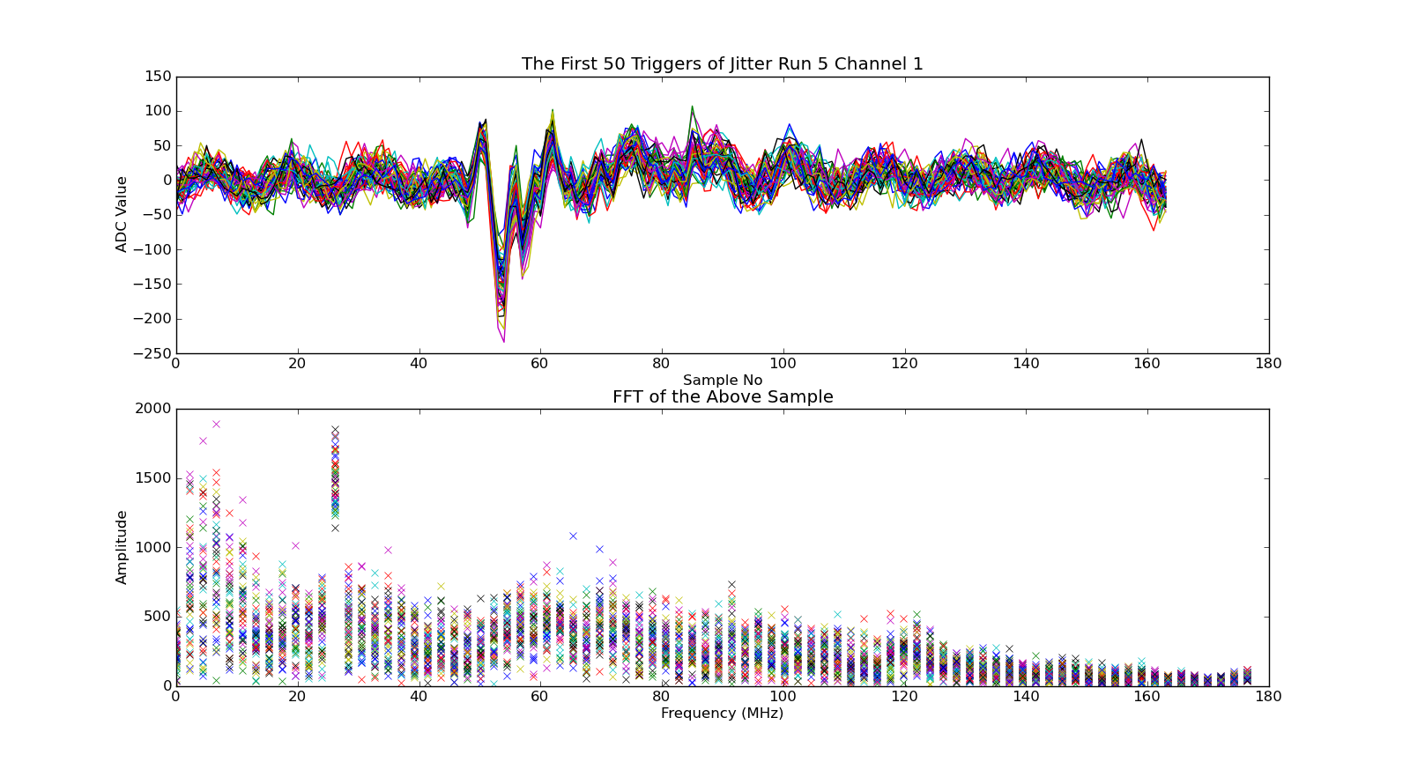
FFT of Jit Run
Mikey Davis
17 April 2013
12/13

Slide 13
Summary of the Problem
By the same method as last time this then gives us a minimum jitter or 1.5μm
The measured jitter on the last run was 3.6μm
I think this could be further improved by rejiging two processors together
  Not sure what people think
Mikey Davis
17 April 2013
13/13

