Slide 1
Snowmass pre-workshop on energy frontier lepton collider.
Marc Ross
LCC TB
April 16, 2013

Slide 2
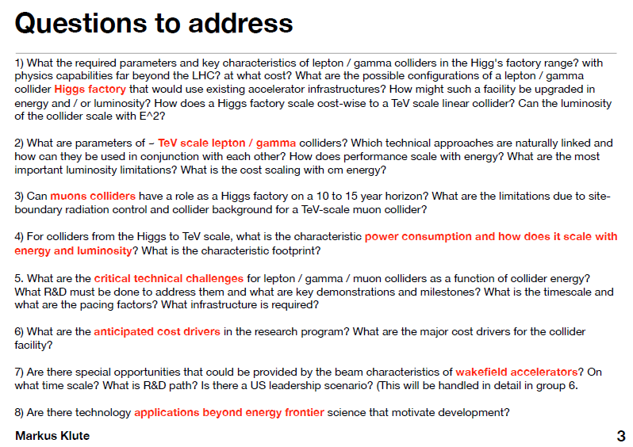

Slide 3
Snowmass pre-workshop on energy frontier lepton collider
MIT, April 10-11, 2013
https://indico.cern.ch/conferenceTimeTable.py?confId=233944#20130410.detailed
Day 1 | Presenter | Day 2 | Presenters
Physics Overview | M. Peskin | Coll. Summary | J.-P. Delahaye
ILC – Status and Questions | M. Harrison | RF Technology | R. Temkin
ILC – Design | M. Ross | Positron Source | W. Liu
CLIC | D. Schulte | Polarization | U. Wienands
Circular | J. Seeman | Rings | R. Talman
Gamma-gamma | V. Telnov | Lasers for γγ | J. Gronberg
Muon Program | M. Palmer | Muon Cooling | R. Ryne
Plasma | J.-P. Delahaye | Muon Detector | A. Mazzacane

Slide 4
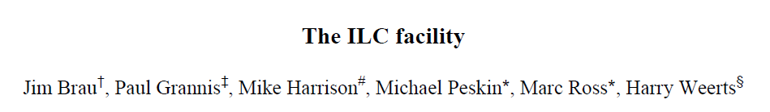
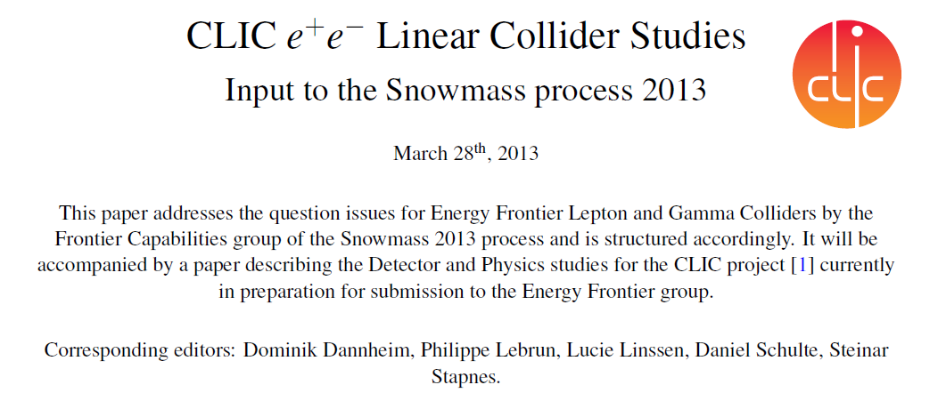
White Paper submissions: LC

Slide 5
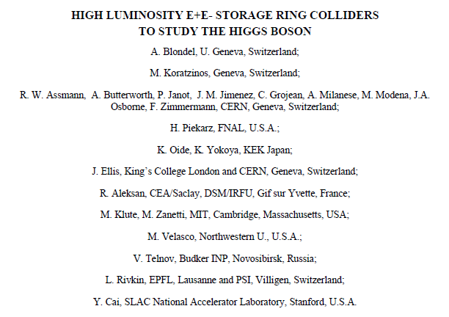
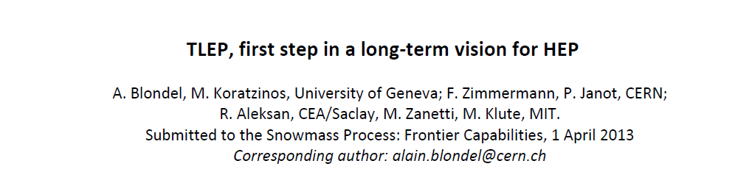
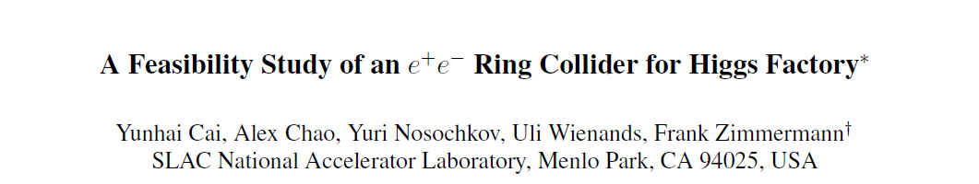
White Paper Submissions: Circular

Slide 6
White Paper Submissions:
Muon
Plasma

Slide 7
Linear and γ−γ colliders
Technical issues to be addressed by specific R&D
ILC: TDR available (2013), ready for construction
  Generation of ultra small (6nm) beam spot (70nm @ ATF/KEK)
  Target for polarized positrons
CLIC: CDR available (2012)
  If based on Two Beam Acceleration (TBA):
    Same as ILC above (3nm beam spot)
    Develop a technical design based on CDR
    Optimisation of acceleration components and systems
    Preparation of industrial procurements (series of accelerating structures and integrated Two-Beam modules )
  If based on Klystrons:
    Cost optimisation and industrialisation of NCRF Xband (NLC/JLC) technology
γ−γ colliders
  Laser power and efficiency
  Optical cavity for gamma Ray generation of several joules with MHz repetition rates
  Gamma ray generation by (tapered) FEL with high efficiency (10%)
  Primary beam as FEL driver in SAPPHIRE
  RF guns with low emittance beam generation
Summary:
Jean-Pierre

Slide 8
Technical issues to be addressed by specific R&D
Summary:
Jean-Pierre
E+/E- circular colliders
  Handling of 100 MW synchrotron radiation losses issues
  RF power generation ( high efficiency, RF couplers, Coupling impedance)
  Activation by high critical energy of synch. Rad.(1.5MeV)
  High beam current and collective instabilities (MCI)
  Beam-beam effects with large synch tune and small β_{y}
  Large energy acceptance (2-6%) for acceptable lifetime with strong beamstrahlung
  MDI with strong synchrotron radiation and background

Slide 9
Novel Acceleration Techniques
Technical issues to be addressed by specific R&D
Muon Colliders:
  High power (4MW) proton driver (Project X if at FNAL) and target
  Ionisation cooling (10⁶=10² transverse and 10⁴ longitudinal)
  Accelerating fields in low frequency RF cavities immersed in strong magnetic field
  Large field solenoids (15 to 20T)
  Low beam momentum spread (3.10⁻⁵) and stability (10⁻⁵) of collider at S resonance
  MDI and detector in high background environment
  Large background and activation due to Muon decays
Plasma based Accelerators (laser or beam driven)
  Drive to bunch acceleration with high gradient and low momentum spread
  Laser power and efficiency (laser driven)
  Laser (or drive beam) to plasma and plasma to main beam power transfer efficiency
  Emittance preservation during acceleration
  Multi-stage acceleration
  Alignment tolerances and instabilities (hose, head erosion)
  Positron acceleration
Summary:
Jean-Pierre

Slide 10
Timelines of Higgs Factory projects
Approximate dates, uncertainty increases with time
 |  | 2012 |  |  | 2015 |  |  |  |  | 2020 |  |  |  |  | 2025 |  |  |  |  | 2030 |  |  |  |  | 2035
LHC | LHC
 | HL-LHC
 | HE-LHC
Linear Colliders | ILC Higgs factory
 | CLIC klystrons
 | PWFA LC
Circular Colliders | LEP3
 | TLEP- SuperTristan –FNAL site filler IHEP – SLAC/LBNL
Gamma-Gamma Colliders | ILC based
 | CLIC based
 | SAPPHiRE
MUON COLLIDER
300 fb⁻¹
3000 fb⁻¹
RDR (CDR) R&D TDR/Preparation
Construction Operation
PROPOSED
APPROVED

Slide 11
Timelines of Higgs Factory projects
Modified by Marc
 |  | 2012 |  |  | 2015 |  |  |  |  | 2020 |  |  |  |  | 2025 |  |  |  |  | 2030 |  |  |  |  | 2035
LHC | LHC
 | HL-LHC
 | HE-LHC
Linear Colliders | ILC Higgs factory
 | CLIC klystrons |  |  |  |  |  | ? | ? | ? | ? | ? | ? | ?
 | PWFA LC
Circular Colliders | LEP3
 | TLEP- SuperTristan –FNAL site filler IHEP – SLAC/LBNL
Gamma-Gamma Colliders | ILC based |  |  |  | →
 | CLIC based |  |  |  | →
 | SAPPHiRE
MUON COLLIDER - staged
300 fb⁻¹
3000 fb⁻¹
CLIC to be built at CERN - (suggestion) →
  will not start until HL-LHC is operating
LEP3 not to be considered
FNAL site-filler also not considered
Gamma-Gamma laser R & D needs several years more than shown:
  driven by NIF success
Sapphire discouraged (Telnov)
Muon collider – multi step with R & D and physics at each stage
  reminded of SLC
RDR (CDR) R&D TDR/Preparation
Construction Operation
PROPOSED
APPROVED

Slide 12

Future objectives
Lyn Evans,
2012.10
LCWS 12
Strongly support the Japanese initiative to construct a linear collider as a staged project in Japan.
Prepare CLIC machine and detectors as an option for a future high-energy linear collider at CERN.
Further improve collaboration between CLIC and ILC machine experts
Move towards a “more normal” structure of collaboration in the detector community to prepare for the construction of two high-performance detectors.

Slide 13
Conclusion (Jean-Pierre)
Consensus of lepton collider (e+/e- or μ+/ μ-) as precision facility after LHC
  HIGGS factory logical first stage
Several alternative technologies but none of them easy & cheap
Long timeline before HIGGS factory beam available: ILC earliest by 2025
  What will have been measured by LHC at the time? What left to be measured?
Facility limited to HIGGS Physics not worth the (multiB$) investment?
  HIGGS facility only makes sense as near term approach upgradable later to higher colliding beam energies as required by Physics
  γγ colliders as add-on to linear colliders and e+/e- rings (too) limited in energy?
Circular colliders with high integrated luminosity but power consuming and not upgradable in energy with electrons /positrons
  Possible discovery facility (with Protons) expending energy frontier with (very large and expensive) circumference
ILC most mature technology and ready to build
  expensive and limited in energy upgrade
  Japanese initiative to build ILC not to be missed (if confirmed)
CLIC only presently feasible technology to extend energy range into Multi-TeV
  Power consuming
R&D on novel technologies (Two-Beam, Plasmas, Muons..) to be strongly supported to extend colliding beam energy range as (possibly) required by Physics in the future at reasonable cost and power

Slide 14
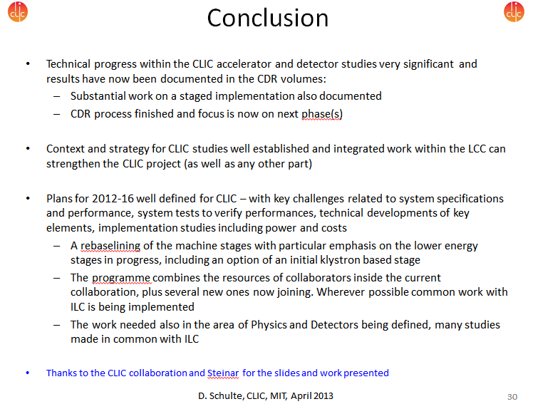
CLIC:
Summary:
Daniel Schulte

Slide 15
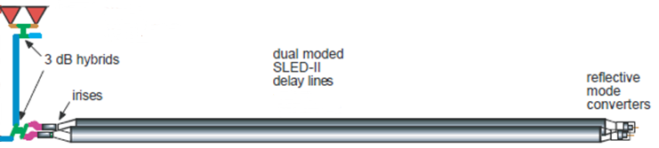
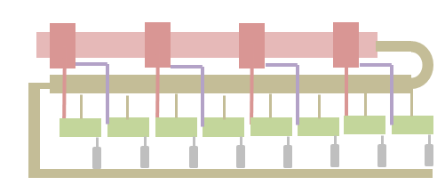
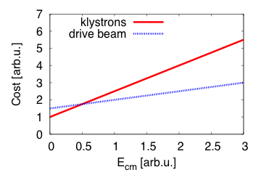
Note on Klystron-based First Stage
Preliminary RF unit design
2-pack solid state modulator
Would need about 30,000 klystrons for CLIC at 3TeV
-> much more expensive than drive beam
But could be interesting at low energies
-> is being explored for first stage
PPM klystrons
460 kV, 2 μs flat top
Summary:
Daniel Schulte
59 MW
1.95 μs
118 MW
1.95 μs
x 4.64
~17.7 m, ∅16.3 cm
TE01 transfer line (? m)
TE01 90⁰ bend
Inline RF distribution network
492 MW
244 ns
Common vacuum network
x 8 accelerating structures,
100 MV/m loaded gradient
2 m, 1.83 active
Compared to NLC, the energy gain per unit in CLIC’k case is 26% lower (need more klystrons per meter), but the unit length is ~ 3 time shorter.

Slide 16
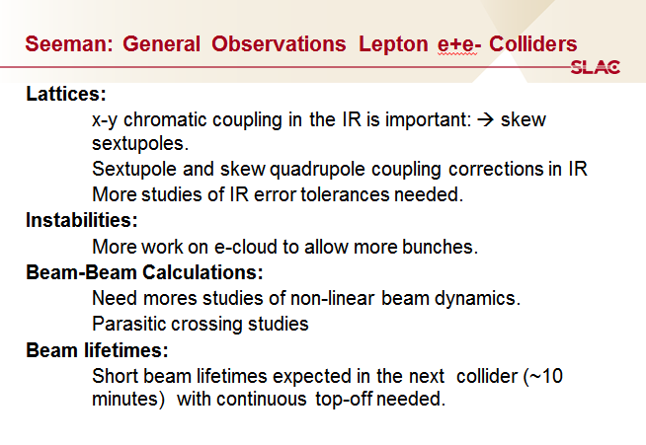
Circular

Slide 17
Seeman: Personal View
-Each region should follow their desires and strengths.
-Any new large accelerator should have a viable additional energy or physics reach.
-Every region could build all these machines, but likely:
Asia: 250 GeV ILC capable of going to 1 TeV.
Europe: 250 GeV TLEP with a VHE-LHC add-on.
Americas: Muon Collider or PWFA Collider (equal for now) with reach to several TeV.

Slide 18
Power Consumption for TLEP at 175 GeV (MW)
Summary:
John Seeman
 | TLEP
Wall-plug RF power | 218 ⁽¹⁾ [181 w/o RF feedback]
RF cryo power | 24 ⁽²⁾
Magnet system power | 6 ⁽³⁾
Cooling and ventilation | 60 ⁽⁴⁾
Experiments | 25 ⁽⁵⁾
General services | 15 ⁽⁵⁾
SPS & PS as pre-injectors (20 & 3.5 GeV) | 5 ⁽⁶⁾
e-/e+ source & pre-pre-injector | 1⁽⁷⁾
Total | 354 [318 w/o RF feedback]
(1
Need to add 80 km-long synchrotron power consumption.
Mike Koratzinos & F.Z.

Slide 19
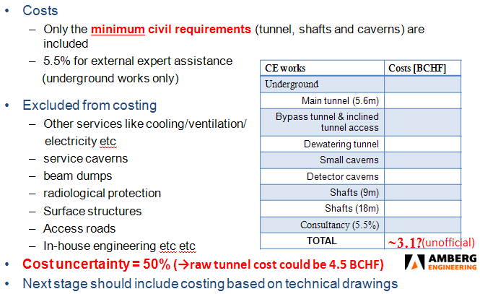
Tunnel costs: 80 km
Zimmermann
Summary:
John Seeman

Slide 20
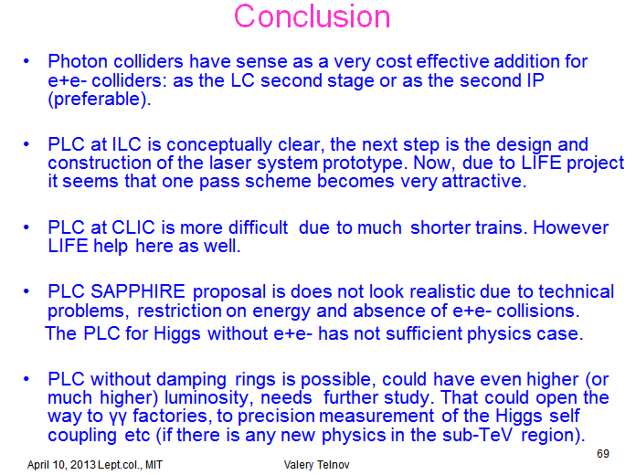
Gamma-Gamma
Summary:
Valery Telnov

Slide 21
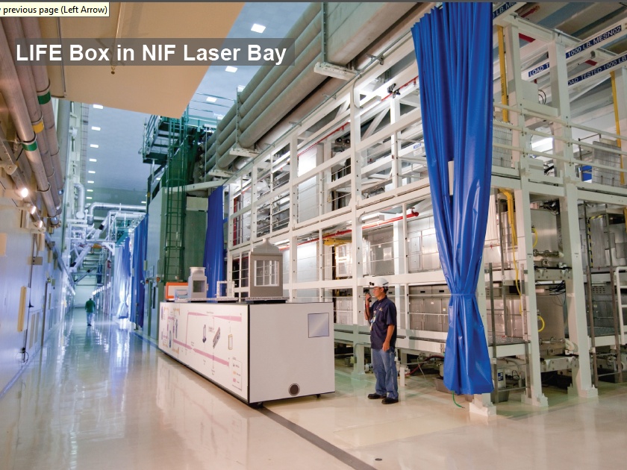

Slide 22
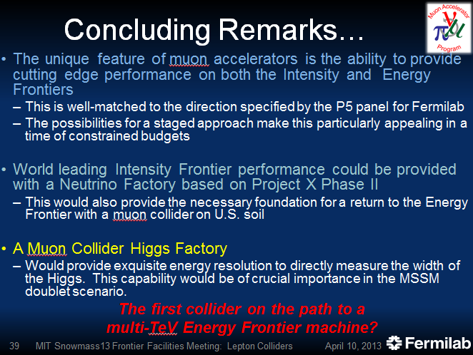
Muon Program
Summary:
Mark Palmer

Slide 23
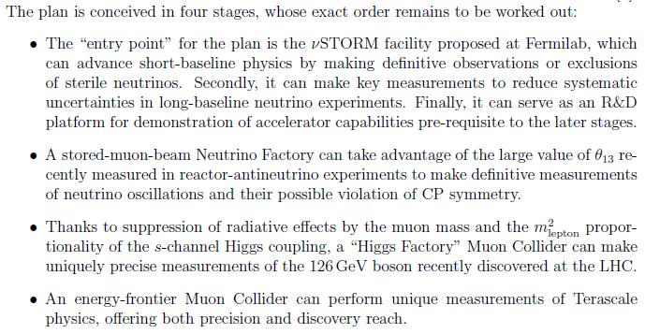
A Staged Muon-Based Neutrino and Collider Physics Program
Summary:
Mark Palmer

Slide 24
The Muon Accelerator Program Timeline
Summary:
Mark Palmer
At Fermilab, critical physics production could build on Phase II of Project X

Slide 25
Muon Program: Discussion and Comments
My Comments:
The program blurs the distinction ‘Intensity Frontier’ and ‘Energy Frontier’ ← GENERALLY HOPE THE THREE-CIRCLE FIGURE IS DEEMPHASIZED
Schedule assumes R & D success: MICE is an embarrassment – underfunded 50%
‘Staging’ forced on Fermilab ← key program element needed for other (i.e. PWFA) R&D programs
Reasonably decoupled from difficult Project X high power stages
Summary include electrical power consumption estimates ← Needs work
Civil engineering scope small ← utility work not small

Slide 26
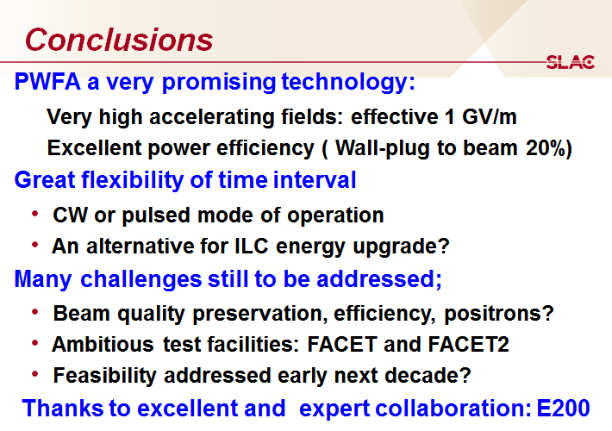
Plasma:
Summary:
Jean-Pierre

Slide 27
Report preparation
Publish outline for comment (May?)
‘Linear’ report (?)
    Linkages not discussed
Positive about ILC
    ATF2 and Positrons. Also questions about SRF learning curve.
    Upgrade strategy using plasma wake technology; 20 yrs later
Supportive of design work on TLEP w/goal of preparing for next generation LHC
    Ring is a step toward high-energy hadron collider
Very supportive of muon R & D
    Staging: R & D and physics at each step

Slide 28
Report: Comments
No Costs to be included → only cost drivers
Try to discourage use of the ‘three-circle’ diagram
    Is the Higg’s factory on the intensity frontier? Or the energy frontier?
LC energy extension plan important
    Muons or plasma. Plasma team need a program sequence.

