Slide 1
Brief Introduction of
KEK Linear Collider Project Office
Akira Yamamoto
KEK
Report provided for ILC-TB Meeting, 2013-4-12

Slide 2
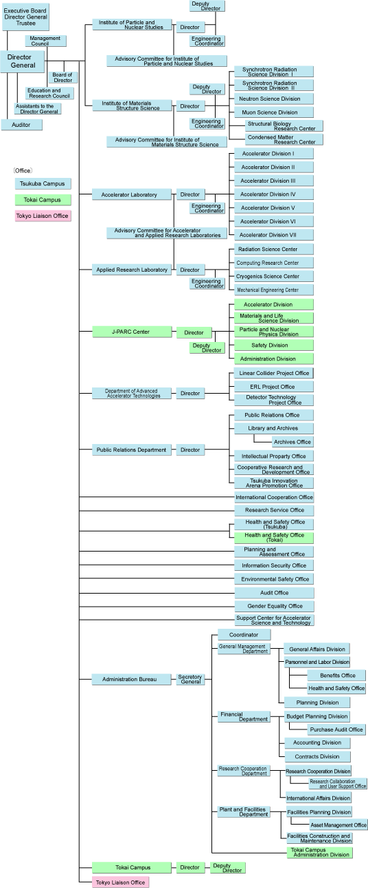
KEK Organization

Slide 3
KEK Organization
  Institute of Particle and Nuclear Study
  Institute of Materials Structure Science
  Accelerator Laboratory
    1, 2, JPARC
    3, 4 KEKB
    5 Injector Linac for KEKB and PF
    6 Acc. R&D including ILC
    7 PF-Ring and ERL
  Applied Research laboratory
    Cryogenics Science Center
  Advanced Accelerator Technologies
    Linear Collier Project Office
    ERL Project Office

Slide 4
FY2013: LC Project Office organization
2013-04-08
LC Project Office
Head / Deputy Heads A. Yamamoto / H. Hayano, K. Fujii, T. Shidara
AAT budget execution ： S. Yamaguchi (Head: Acc., #6)
Secretary: T. Shirakata
Communication： R. Takahashi, N. Kobayashi
Technical Associates:
  ATF: N. Terunuma, T. Tauchi
  STF: H. Hayano
  SCRF Cavity E. Kako
  SCRF cavity fabrication in house M. Yamanaaka
  Cryomodule and cryogenics H. Nakai
  HLRF and LLRF S. Michizono
  Beam Dynamics K. Kubo
  Physics and Detector , MDI K. Fujii,
  CFS A. Enomoto, M. Miyahara
  Accelerator Design K. Yokoya
Meetings：
Regular weekly meeting Every Monday: 9:30 ~ 11:00
KEK LC Promotion Committee Every two month

Slide 5
Function of KEK LC Office
Roles
  Program Coordination
    ILC Accelerator Design, R&D, CFS design, Geological Survey
    Support for the ILC to be hosted by Japan
Coordination for International and domestic cooperation
  Interface to global cooperation with LCC
  Coordination of domestic cooperation
  Linkage to International cooperation to/from the KEK internal coordination/activities

Slide 6
Share of Responsibilities
Dept. of AAT & LC Project Office to:
  Planning and Coordination for accelerator R&D and design study
  Planning and execution of the geological survey
Accelerator Laboratory
  Execution of the R&D and design study agreed,
Institute of Particle and Nuclear Study
  Execution of the R&D and design study agreed,

Slide 7
Cooperation Diagram
  Institute of Particle and Nuclear Study
  Institute of Materials Structure Science
  Accelerator Laboratory
    1, 2, JPARC
    3, 4 KEKB
    5 Injector Linac for KEKB and PF
    6 Acc. R&D including ILC
    7 PF-Ring and ERL
  Applied Research laboratory
    Cryogenics Science Center
  Advanced Accelerator Technologies
    Linear Collier Project Office
    ERL Project Office
Int.
Collab
ICFA
LCC
Domestic
Collab.
University
AAA
KEK
internal
Collab.
ACC
IPNS
Acc. Lab.
Director K. Oide
Dept. of Adv. Acc. Tech.
Director : Y. Okada
LC Project Office
Head: A. Yamamoto

Slide 8

ILC Technical Board
– in LCC phase
LCC Directorate
LC Project Office (KEK)
Head: Akira Yamamoto
Deputy: H. Hayano
K. Fujii
T. Shidara
ILC Collaboration
Director – Mike Harrison (BNL)
Deputy Director – Hitoshi Hayano (KEK)
Technical Board
Nobuhiro Terunuma (KEK)
Yasuchika Yamamoto (KEK)
Nick Walker (DESY)
Olivier Napoli (CEA)
Marc Ross (SLAC)
Nikolay Solyak (Fermilab)

Slide 9
KEK ILC R&D Plan beyond TDR
Cavity gradient improvement with further production of cavities, at least another 4 cavities in JFY2013, with industry
Cavity production in house, and industrial fabrication technology R&D in cooperation with industry
STF program for CM1 (8 cavity + SCQ) + CM2a (4 cavities) to realize the beam in 2014 or later,
ATF program for smaller beam size (to be 37 nm) and the nano-stability, and …

Slide 10
STF2; SCRF Accelerator R&D Plan
■ Objective
•High Gradient (32 MV/m)
＝＞Demonstration of full cryomodule
・Pulse and CW operation (for effectuve R&D
・Better efficiency power sources
・SCRF electron gun
・Training for next generation s
Proposal:
Multiple Cryomodule for system
study
In-house Cavity to be installed
in cooperation with industry
Wide range application including
Photon Science
Electron Gun
Full Cryomodule s
Undulators
Detector
CM0
BC
SC RF-Gun
CM1(既存)
CM2a+2b
CM3a +3b,
Refrigeration System
Beam Dump
Undulator

Slide 11
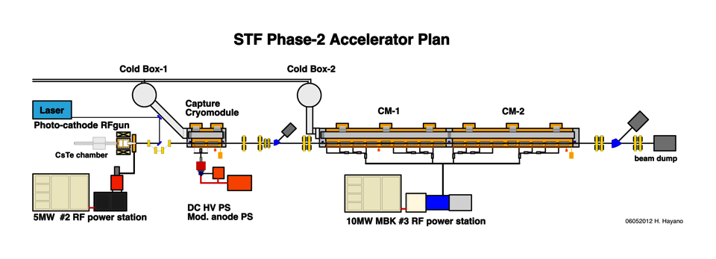
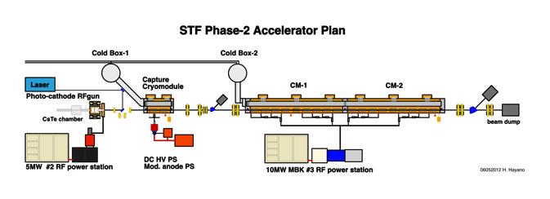
STF phase 2
H. Hayano
Cavity/CM: 2+8+(4+4)
Beam: 524MeV, 9mA, 5Hz
57m
STF phase 3 (New Possibility 1)
Cavity/CM: 2+8+(4 +4)+(4+4)+…
(max. capacity in current tunnel: 2 +32)
Beam: 1.0GeV max, 9mA, 1ms, 5 Hz
including capability of CW operation
CM1
CM2a
CM2b
CM3a + CM3b
CM4a + CM4b
STF phase 2
STF phase 3
50m
35m

Slide 12
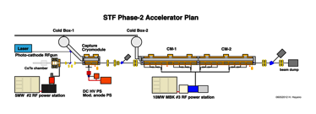
H. Hayano
SCRF Acc. R&D + User Facility: Possibility 1
STF Phase 3 + Quantum-Beam 2 : under discussion
Tunnel extension required
Beam Facility:
Inverse-Compton X-ray
Undulator SASE photon
Beam diagnostic development
1GeV SC-LINAC
Laser cavity
X-ray user
photon user
Undulator for SASE
accelerator user
Beam diagnostic beam line
Existing tunnel
Extension
STF phase 2+ phase 3
STF Quantum-Beam 2
85m
80m

Slide 13
Plan of STF R&D beyond TDR
CY2011
CY2012
CY2013
CY2014
CY2015
CY2016
ILC
GDE
ILC next-phase
TDR
TDR Review
Beyond TDR toward ILC Construction
STF
TDR complete
QB Construction
Operation
Operation
2014 or later
cool-down
cold-test
beam-test
Cryomodule (CM-1) Construction
CM-2a
Construction
CFF
Cavity mass production R&D
Functioning

Slide 14
ATF Future Plan
ATF長期計画(案)
GDE
Next KEK Roadmap
CY
2011
2012
2013
2014
2015
2016
2017
2018
ILC
others
Delay by fire and earthquake
Nano beam orbit control
Develop.(2nmBPM, Fast FB)
Nano beam orbit control (FONT extension)
Beam study
2nm stab. R&D
2nm steady op.
37nm
Steady op.
Challenging R&D of the Very high chromaticity optics
Ultra small beam ~ 20 nm
Small beam
Beam study
Gamma-gamma collider R&D
Develop. / beam study
4-mirror optical cavity (LAL/KEK)
Gamma-gamma laser system R&D
Application
High Field Physics
General R&D
Ex) for KEKB; CSR, RF gun,
Instrument develop.,
Low emittance,…
Test beamline for detector?

Slide 15
Further Possibility
A new budget is anticipated
  Facility for Center of Innovation (COI)
    A facility for Cryomodule Assembly and General Test station is anticipated to be built, in cooperation with Japanese industries.
    We will expect more industrial partnership
  We need to receive “operational funding”, including human resources.
  Further information will be available hopefully within a month.
  I will ask Hitoshi to be more practically in charge of this further activity as the deputy head of LC project office.

Slide 17
ICFA
Chair: P. Odone
FALC
Chair: Y. Okada
Program Advisory Committee
Linear Collider Board
Chair: S. Komamiya
Linear Collider Collaboration
Regional Advisors
TBA
Directorate
– Director: L. Evans
- Deputy (Physics)
H. Murayama
ILC
– Mike Harrison
- Deputy: H. Hayano
CLIC
– S. Stapnes
Physics & Detectors
– H. Yamamoto

