Slide 1


Roundup of ATF Shift 230413
Mikey Davis
24 April 2013
1/8

Slide 2
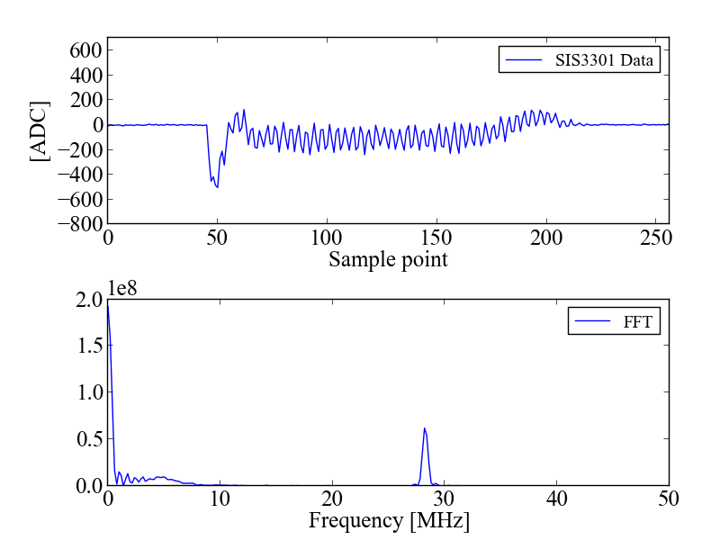
Ref Cav LO Leakage
Curtsey of Young Im
Mikey Davis
24 April 2013
2/8

Slide 3
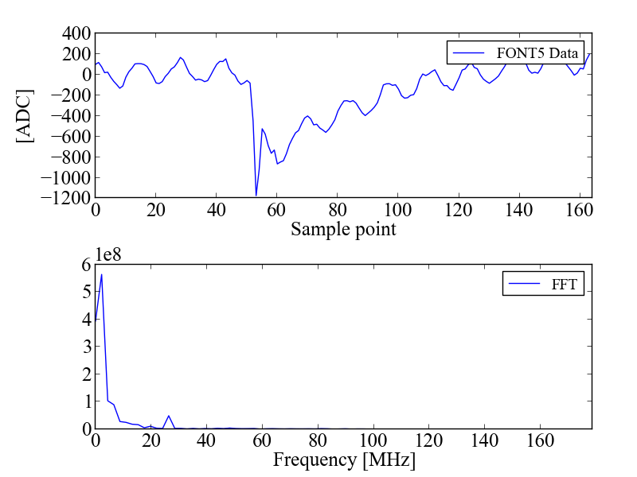
DR LO Leakage
Curtsey of Young Im
Mikey Davis
24 April 2013
3/8

Slide 4
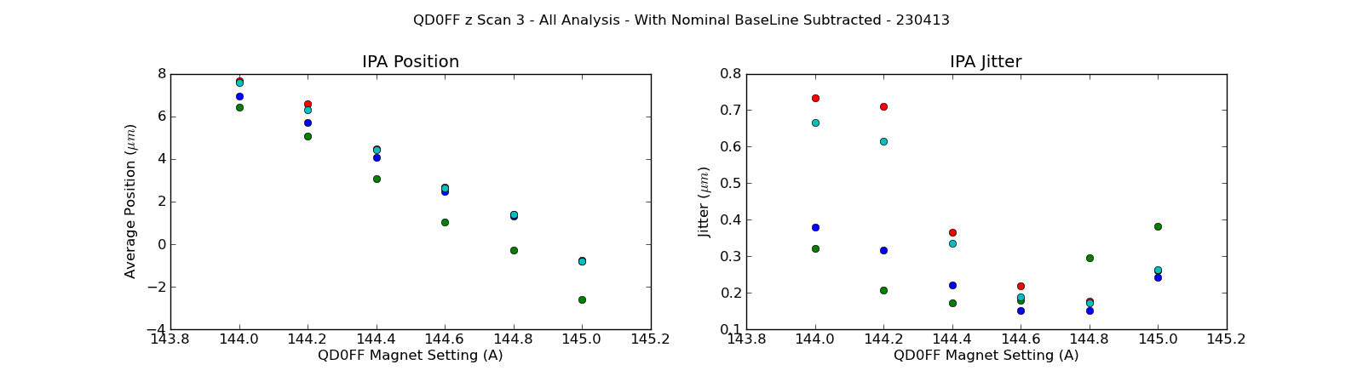
QD0FF Waist Scan 3
Mikey Davis
24 April 2013
4/8

Slide 5
Summary of Jitter Runs
FileName | Hetro Atten | Homod Atten | LO Source | Uncharge Norm Jitter | Upstream Charge Norm Jitter | Epics Charge Norm Jitter | EPICs Jitter
jitRun1_0dB_ht0dB | 0 | 0 | DR | 0.31 | 0.43 | 0.42 | 0.24
jitRun2_0dB_ht70dB | 70 | 0 | DR | 0.33 | 0.26 | 0.26 | -
jitRun3_10dB_ht0dB | 0 | 10 | DR | 0.36 | 0.35 | 0.36 | 0.21
jitRun4_10dB_ht70dB | 70 | 10 | DR | 0.33 | 0.30 | 0.30 | -
jitRun5_0dB_ht0dB_ref | 0 | 0 | Ref | 0.17 | 0.35 | 0.30 | 0.22
jitRun6_0dB_ht70dB_ref | 70 | 0 | Ref | 0.16 | 0.31 | 0.29 | -
jitRun7_10dB_ht0dB_ref | 0 | 10 | Ref | 0.43 | 0.67 | 0.62 | 0.23
jitRun8_10dB_ht70dB_ref | 70 | 10 | Ref | 0.45 | 0.61 | 0.59 | -
jitRun9_0dB_ht70dB_ref | 70 | 0 | Post-limiter amplified ref | 0.28 | 3.30 | 3.20 | -
Mikey Davis
24 April 2013
5/8

Slide 6
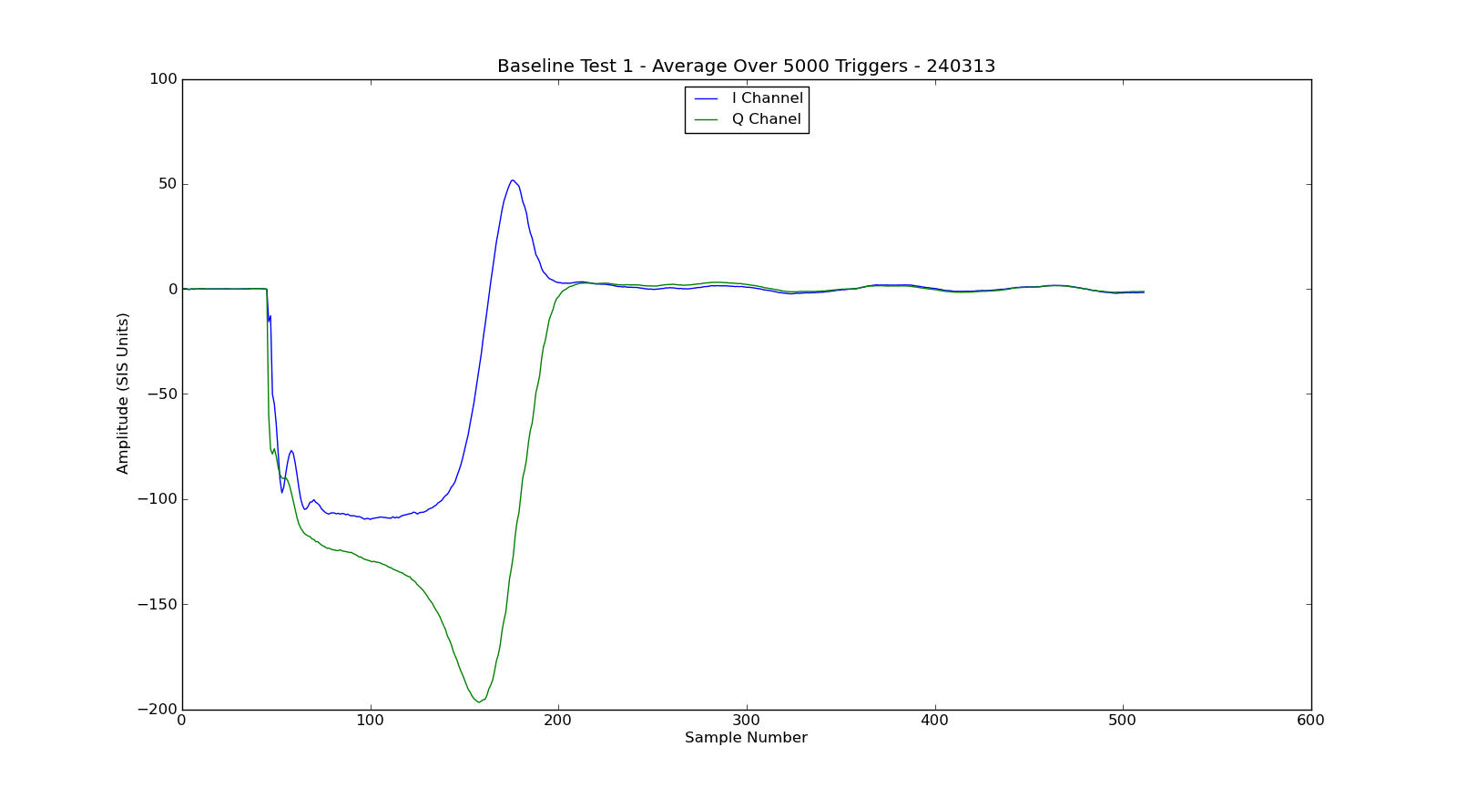
Investigation into Ref Baseline
Mikey Davis
24 April 2013
6/8

Slide 7
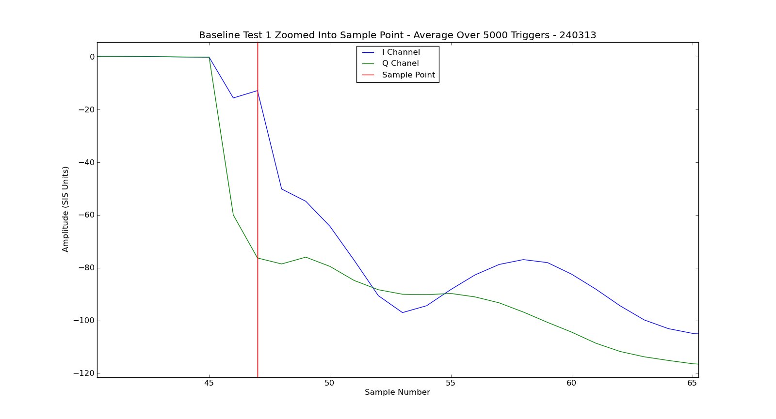
Investigation into Ref Baseline
Mikey Davis
24 April 2013
7/8

Slide 8
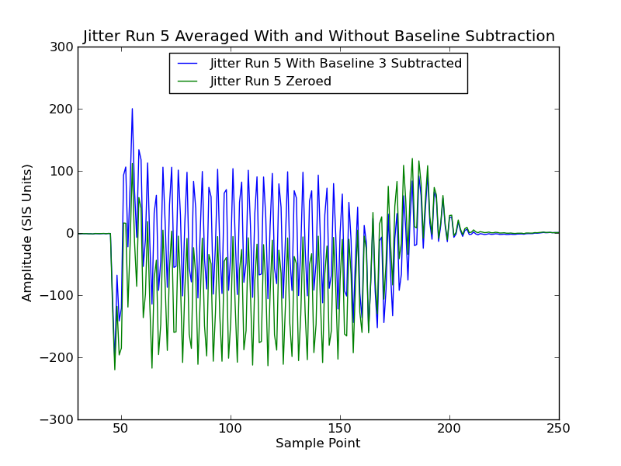
Investigation into Ref Baseline
Mikey Davis
24 April 2013
8/8

