Slide 1




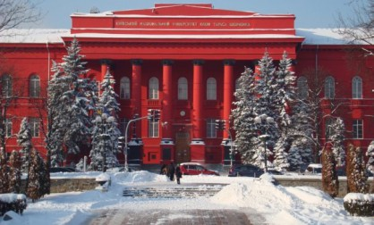

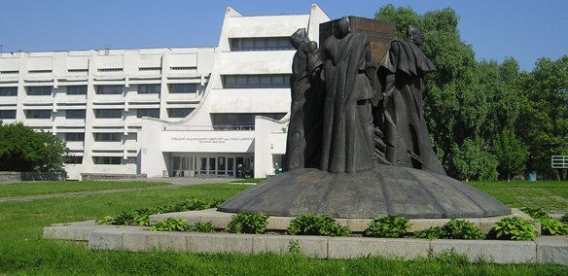
KYIV (Kiev)
Ukraine
TARAS SHEVCHENKO NATIONAL UNIVERSITY OF KYIV
Faculty of Physics
Nuclear Physics Department

Slide 2
Nuclear Physics Department
Department chair: Prof. I.Kadenko
Every year - 17-20 students in two groups:
High Energy Physics – 9-11 students
Nuclear Physics (Nuclear power plants, medical physics) – 7-9 students
Bachelor degree – 4 years; Master degree – 2 years
Simulations of Micro Pattern Gas Detectors (MPGD) – since 2012
Manpower (now):
Associate professor – Oleg Bezshyyko
Master student – Oleksiy Fedorchuk
Additionally 2-3 new students will be involved

Slide 3
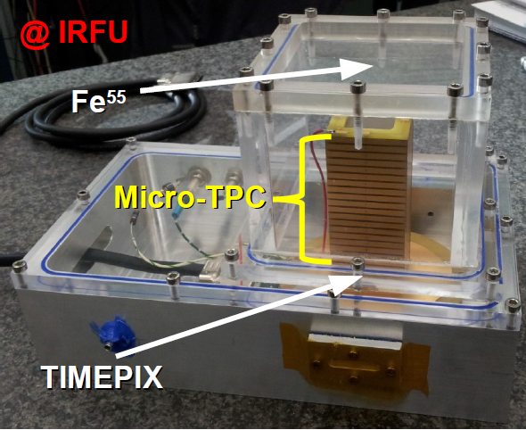
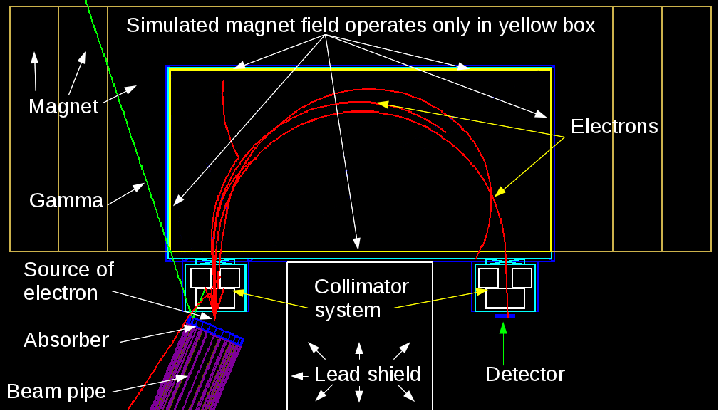
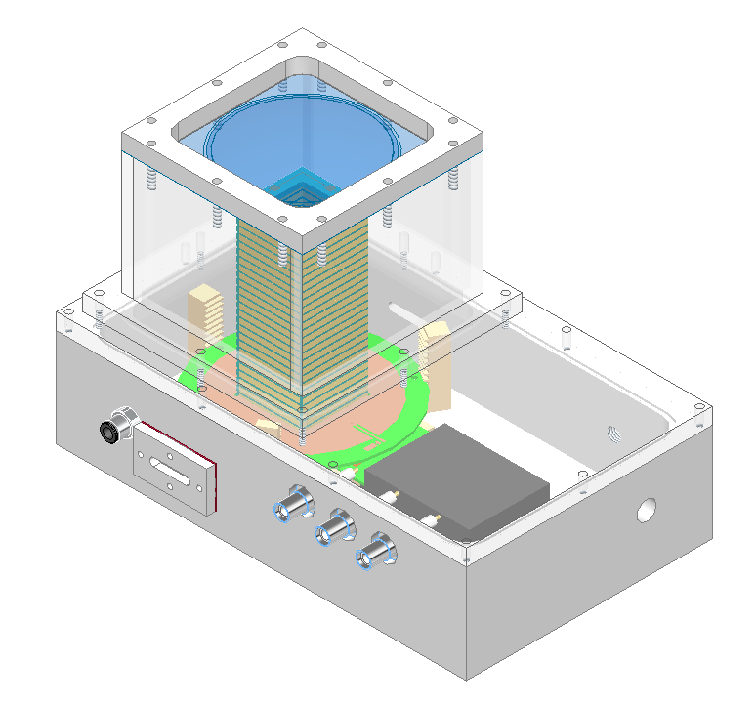
Nuclear Physics Department
Since autumn 2012 we are involved in simulations:
(many thanks to IRFU and LAL colleagues)
Micro TPC
IRFU (CEA, Saclay)
Garfield++ based simulation
Test setup for detectors (including Micromegas/InGrid)
LAL(Orsay) +IRFU (CEA, Saclay)
GEANT4 based simulation
Working with:
A. Chaus, D. Attie, P. Colas, M. Titov :

Slide 4
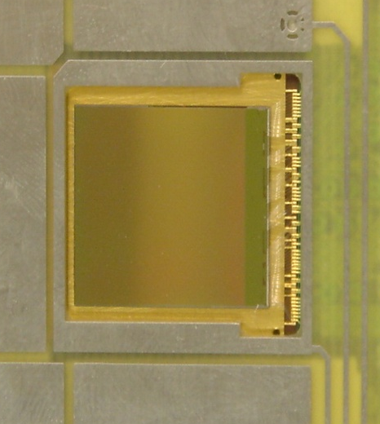
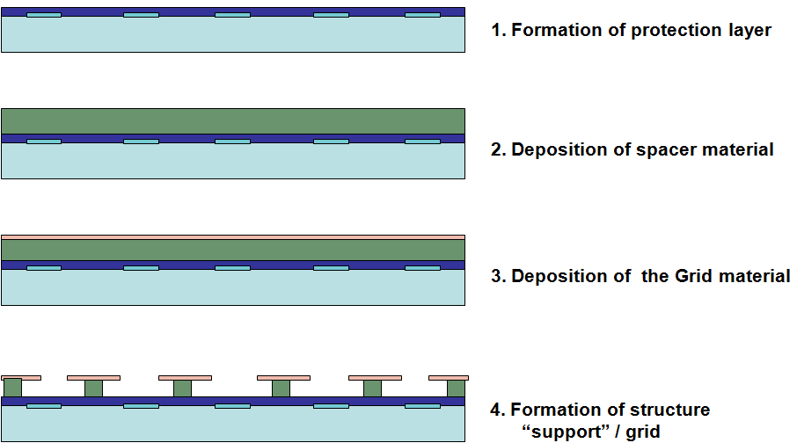
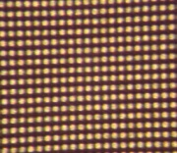
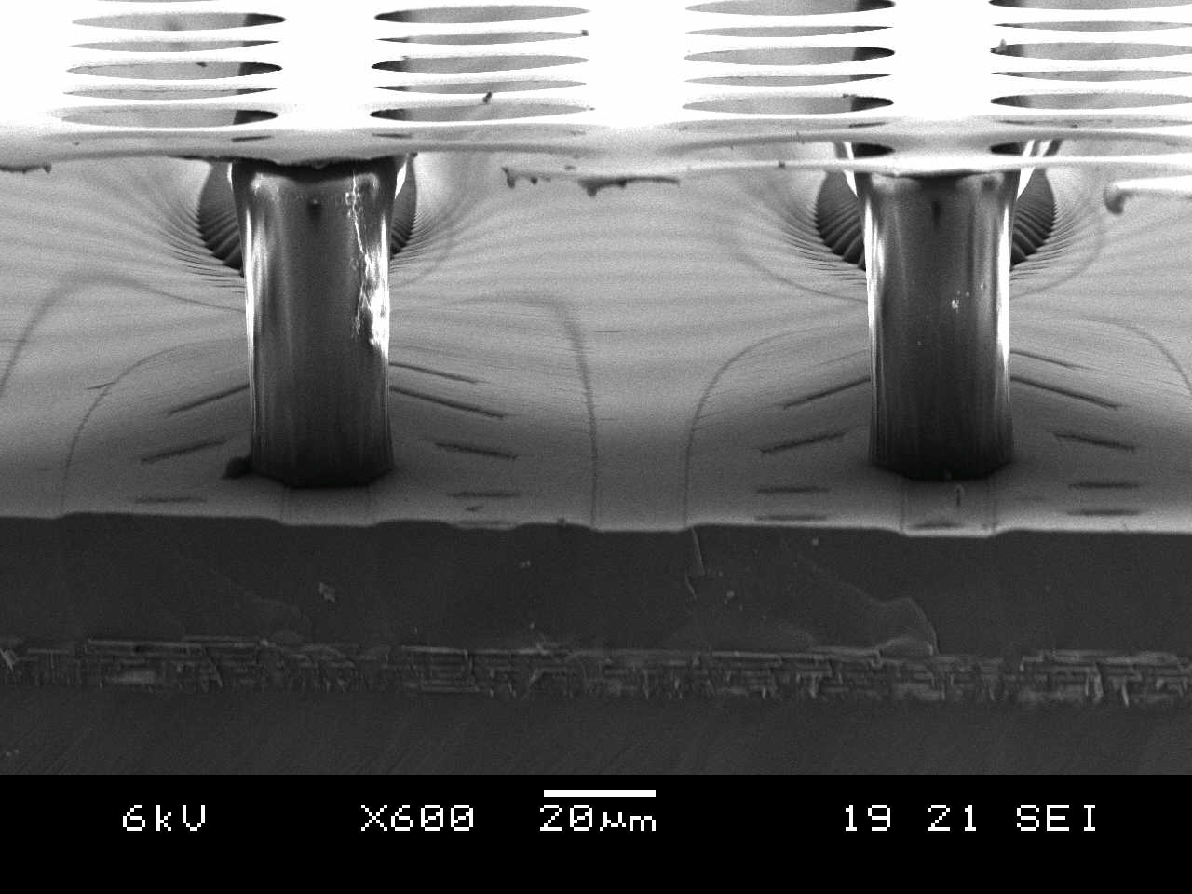
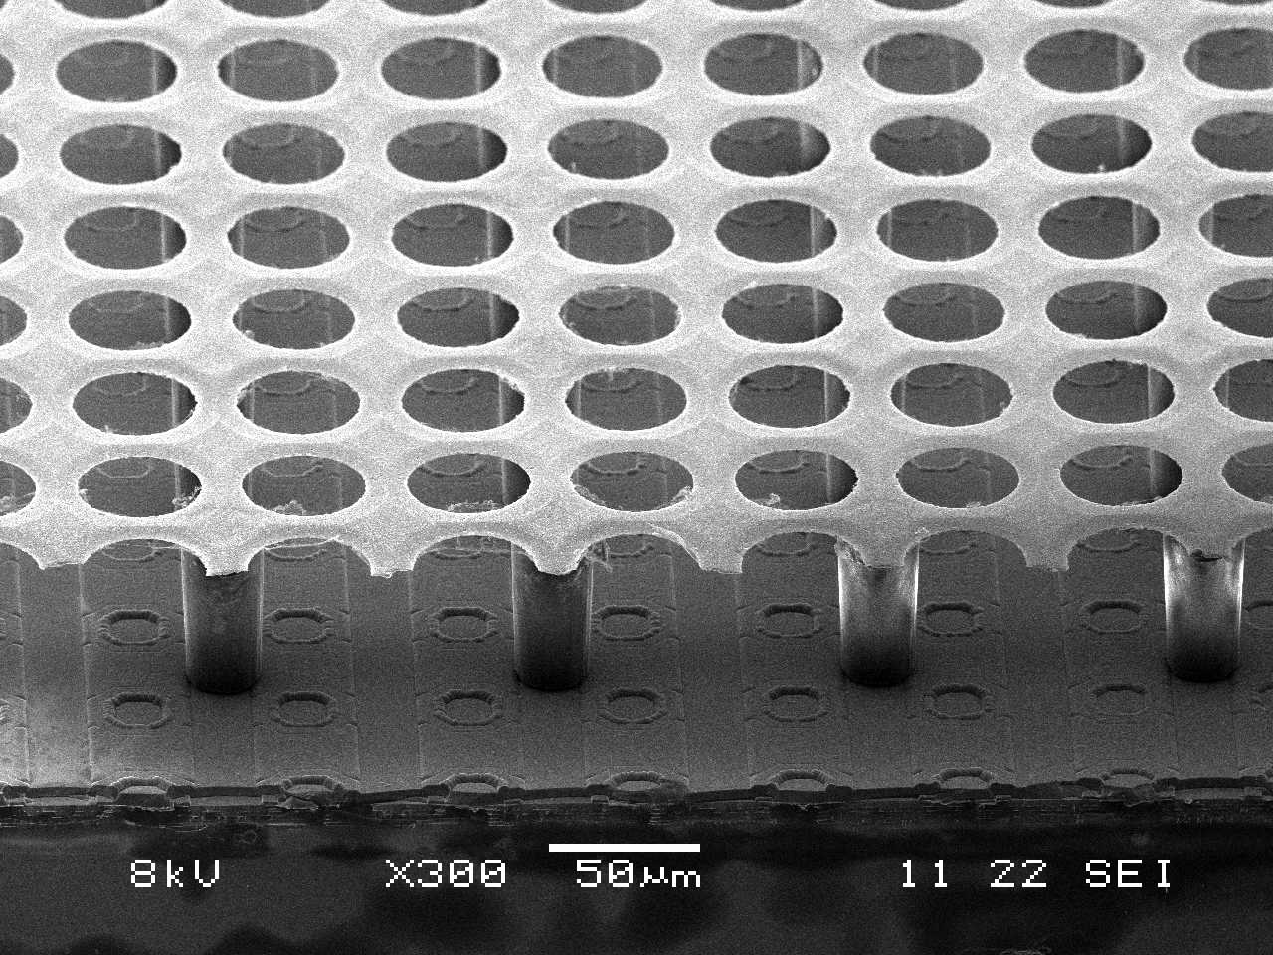
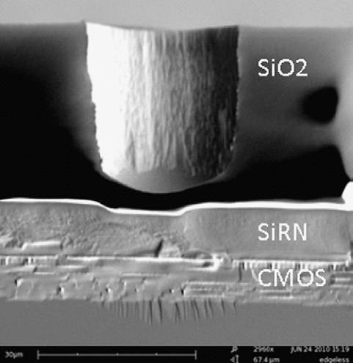
Integrated Electronics: Pixel Readout of Micro-Pattern Gas Detectors
3D Gaseous Pixel Detector → 2D (CMOS pixel chip readout) x 1D (drift time)
Through POST-PROCESSING INTEGRATE
MICROMEGAS directly on top of CMOS chip
Bump bond pads for Si-pixel
Detectors - Timepix or
Medipix2 (256 × 256 pixels
of size 55 × 55 μm2) serve
as charge collection pads.
(e.g. Si3N4)
(e.g. SU8)
Each pixel can be set to:
● TOT ≈ integrated charge
● TIME = Time between hit and shutter end
“InGrid” Concept:
50 - 80 μm
Protection Layer (few μm)
From A. Chaus, D. Attie, P. Colas, M. Titov

Slide 5
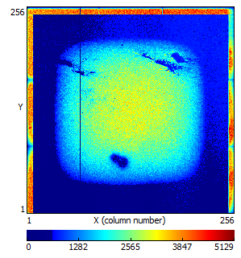
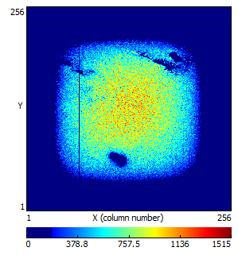
Studies of new IZM-3 InGrids in the Saclay micro-TPC
2011: Major Step Forward → InGrid Production on a wafer level
2013: 3rd IZM production run to post-process Timepix chips on a wafer level
Received 6 IZM-3 InGrids in Saclay (earlier studies with IZM-3 InGrids have been performed in Bonn, NIKHEF)
From A. Chaus, D. Attie, P. Colas, M. Titov presentation
One InGrid is tested →
in general, good behavior
Some local grid
issues
Some noise and/or
discharges
Guard ring problem
in micro-TPC
Simulation analysis is needed

Slide 6
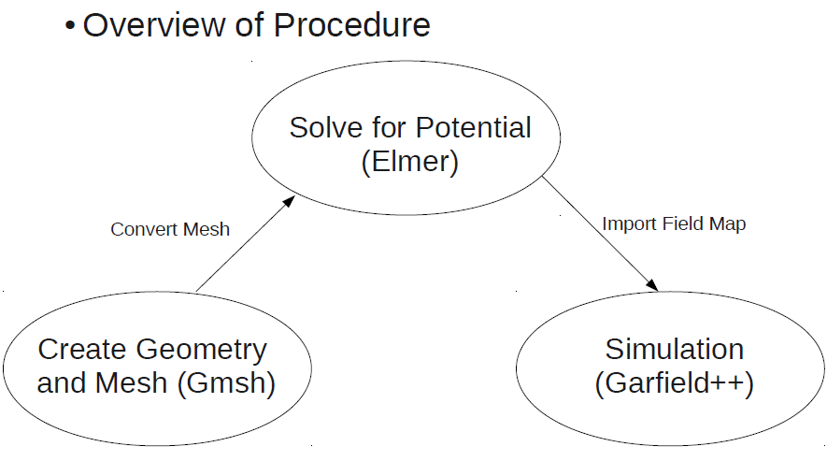
Garfield++
EM simulation software
M
COMSOL Multiphysics
http://www.comsol.com/products/multiphysics/
CST STUDIO SUITE
http://www.cst.com/Content/Products/CST_S2/Overview.aspx
ANSYS
http://www.ansys.com/
A
Elmer+Gmsh
http://www.csc.fi/english/pages/elmer/

Slide 7
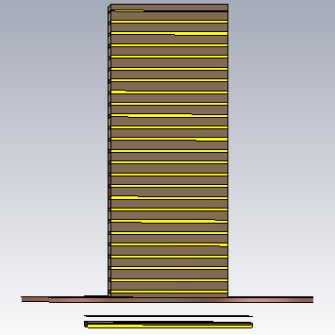
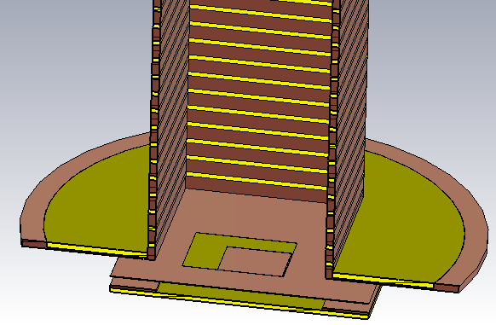
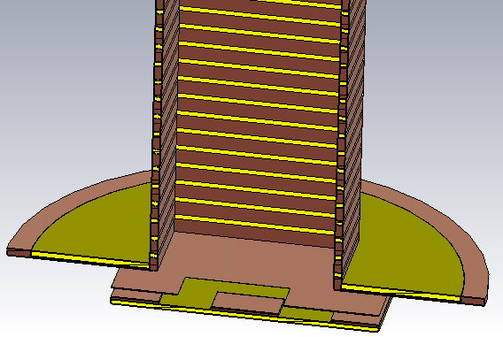
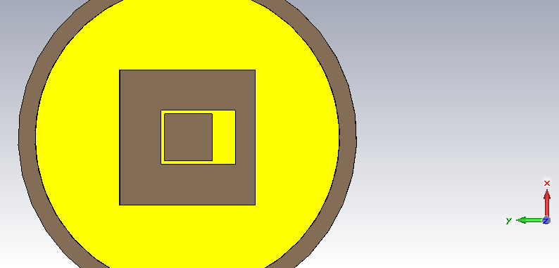
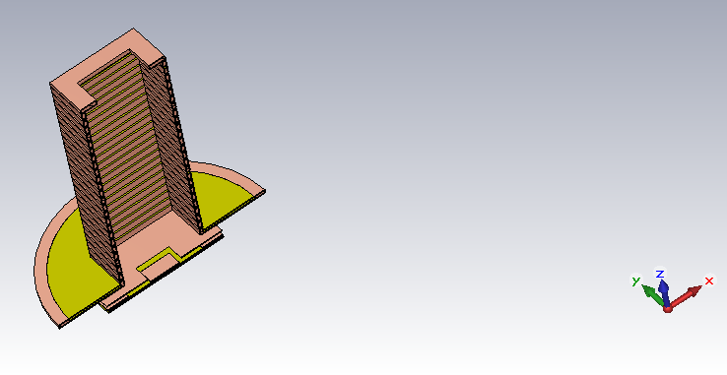
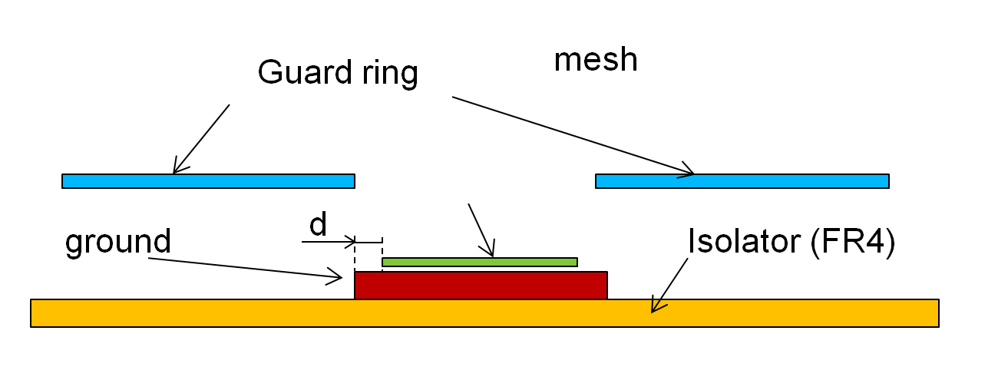
CST EM Studio
Top view
(without cage)
mesh – square,14x14 mm,
50 μm width and gap
guard ring - with window
8-8-8-14 мм (14 мм due construction restrictions)
mesh
X axis
Guard ring
0.5 mm
1 mm
ground
Isolator (FR4)

Slide 8
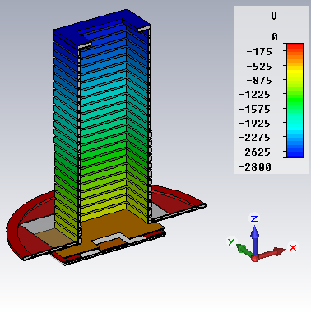
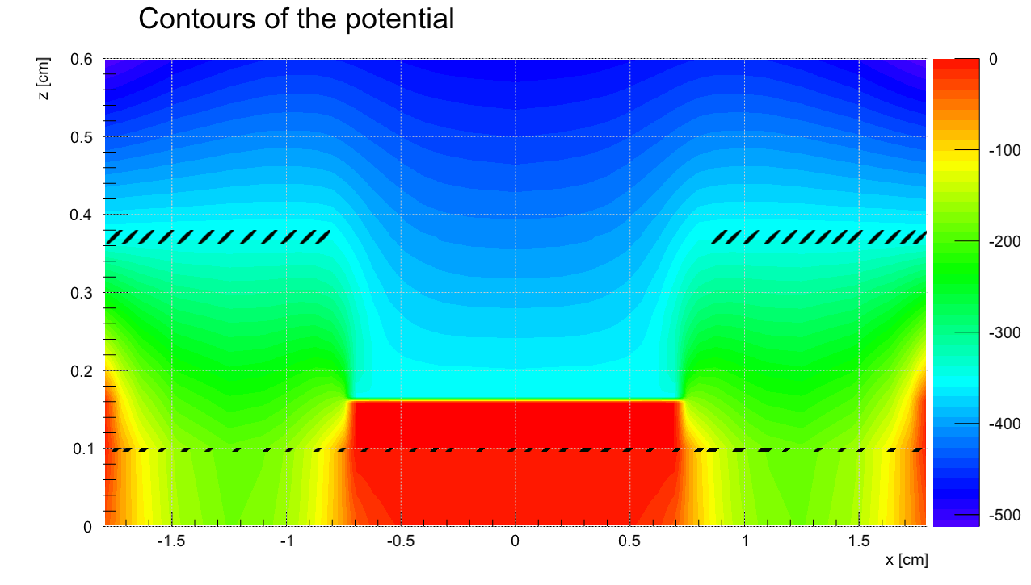
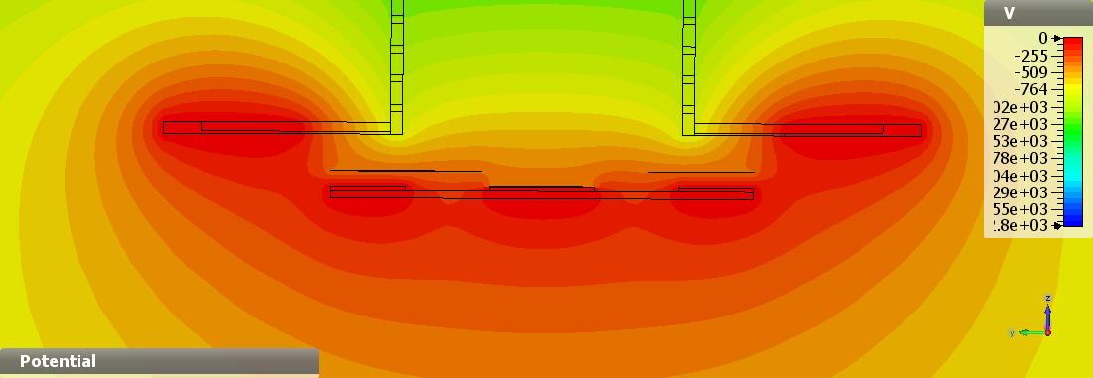
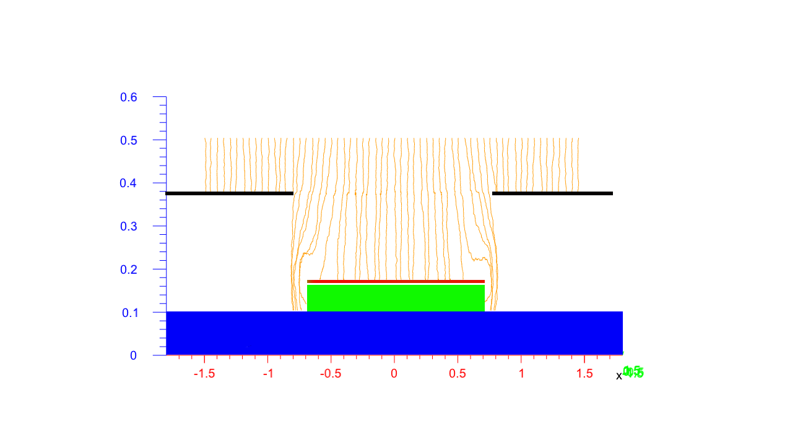
SET 1
Upper electrode – Uupe=-2800V
First strip – Ufs=-600V(-800V; -1100V)
Mesh – Um=-350V
Guard ring – Us=-350V
Conclusions: 1) Uniformity of electric field is better (in comparison with geometry without guard ring), but far not ideal; 2) Main contribution due nonuniformity near ground

Slide 9
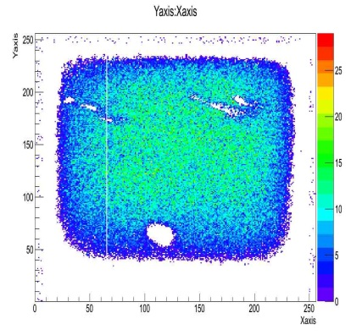
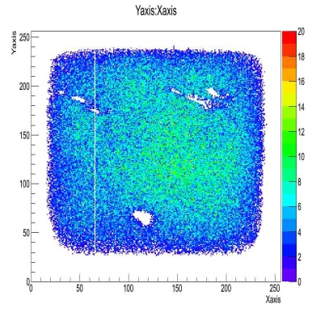
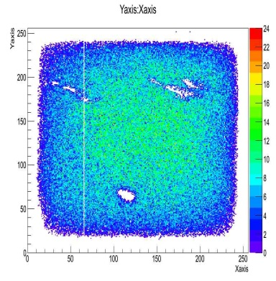
600 V
With guard ring
800 V
1100 V
Ufs=-600V
Uupe=-2600V
Um=-350V
Ufs=-800V
Uupe=-2800V
Um=-350V
Ufs=-1100V
Uupe=-3100V
Um=-350V

Slide 10
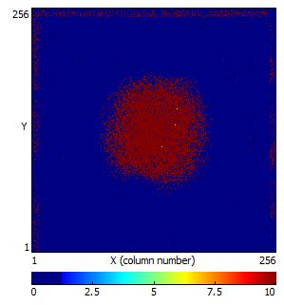
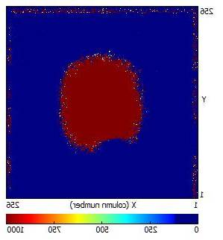
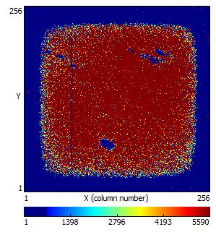
600 V
Without guard ring
800 V
1100 V
Ufs=-600V
Uupe=-2600V
Um=-350V
Ufs=-800V
Uupe=-2800V
Um=-350V
Ufs=-1100V
Uupe=-3100V
Um=-350V

Slide 11
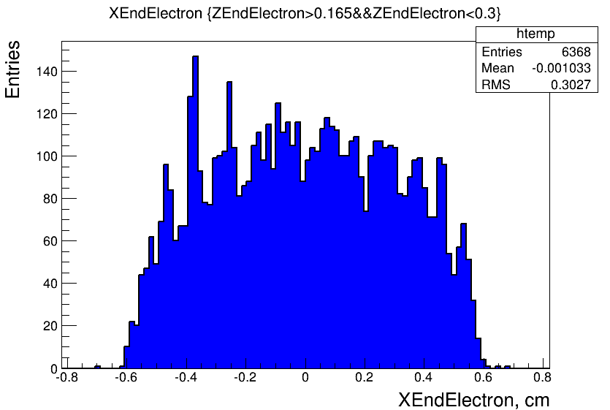
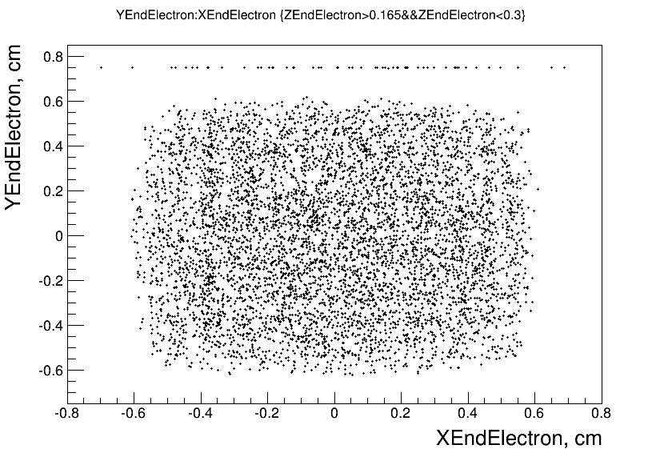
SET 1
Upper electrode – Uupe=-2800V
First strip – Ufs=-800V
Mesh – Um=-350V
Guard ring – Us=-350V

Slide 12

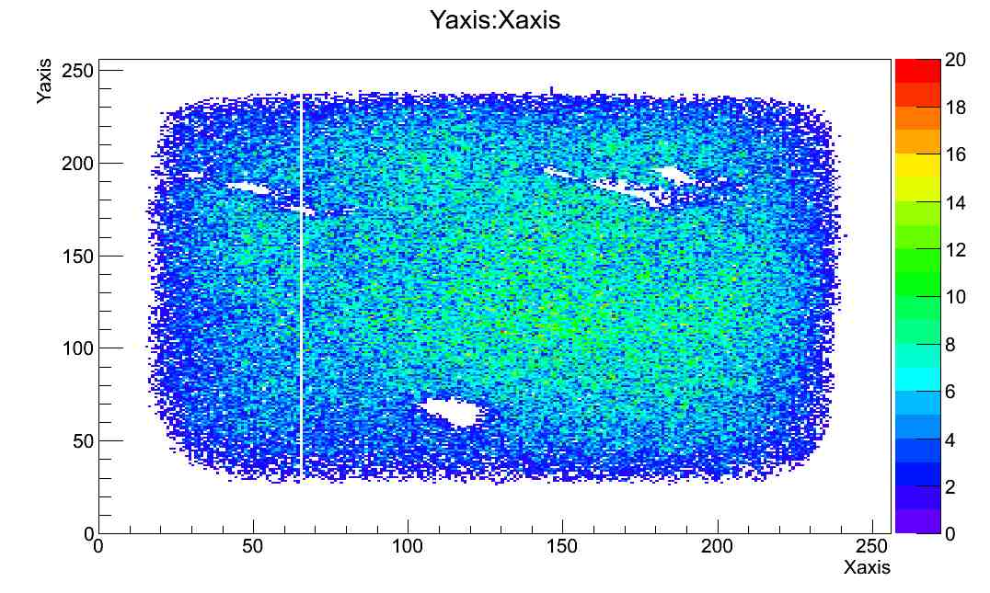

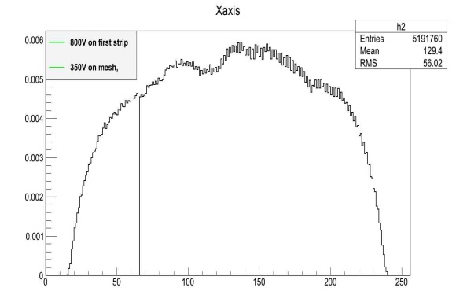
SET 1 (Comparison with experiment data)
Upper electrode – Uupe=-2800V
Mesh – Um=-350V
Guard ring – Us=-350V
First strip – Ufs=-600V
First strip – Ufs=-800V
First strip – Ufs=-800V
First strip – Ufs=-1100V

Slide 13
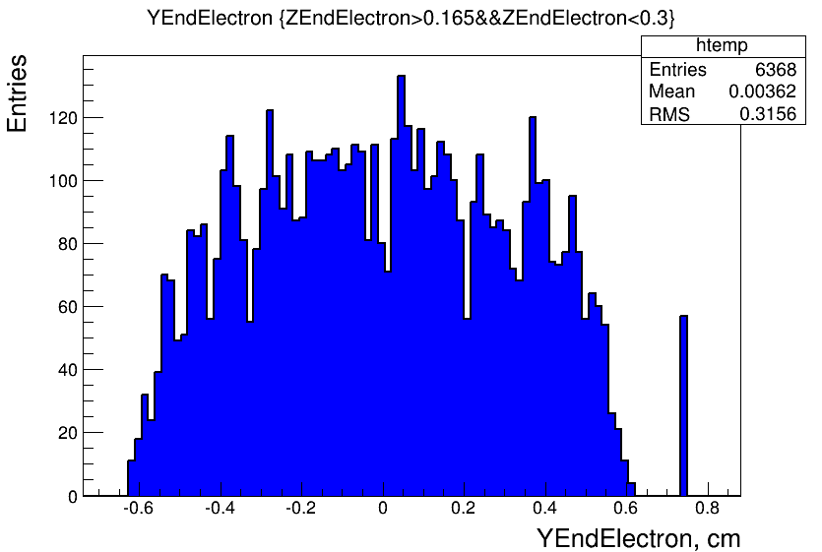

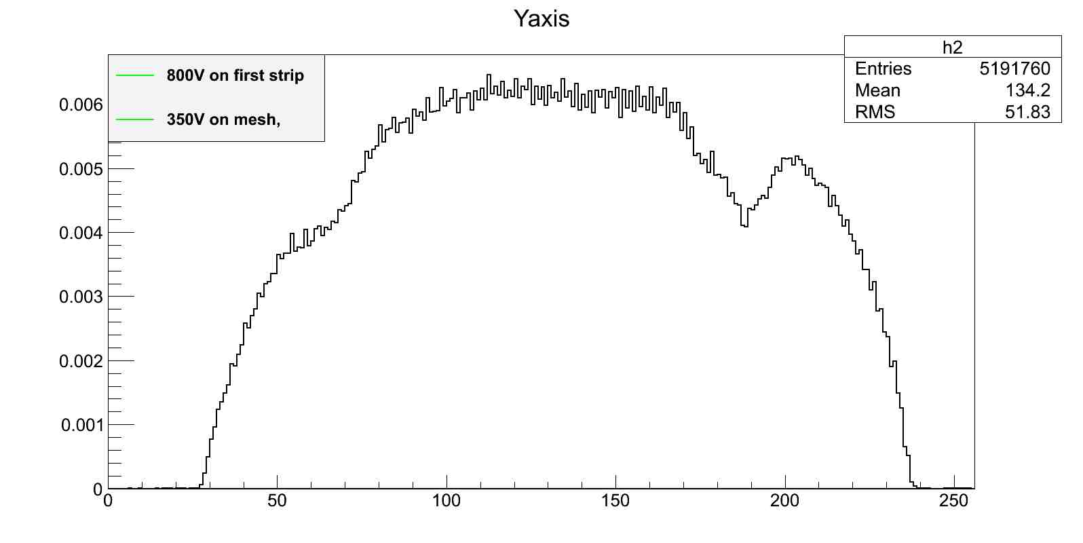
SET 1 (Comparison with experiment data)
First strip – Ufs=-800V
Upper electrode – Uupe=-2800V
Mesh – Um=-350V
Guard ring – Us=-350V
First strip – Ufs=-800V

Slide 14
SET 1
Upper electrode – Uupe=-2800V
First strip – Ufs=-600V(-800V; -1100V)
Mesh – Um=-350V
Guard ring – Us=-350V
Influence of Ufs change (-600V;-800V; -1100V) is minor (adjusting of Us is better)

Slide 15
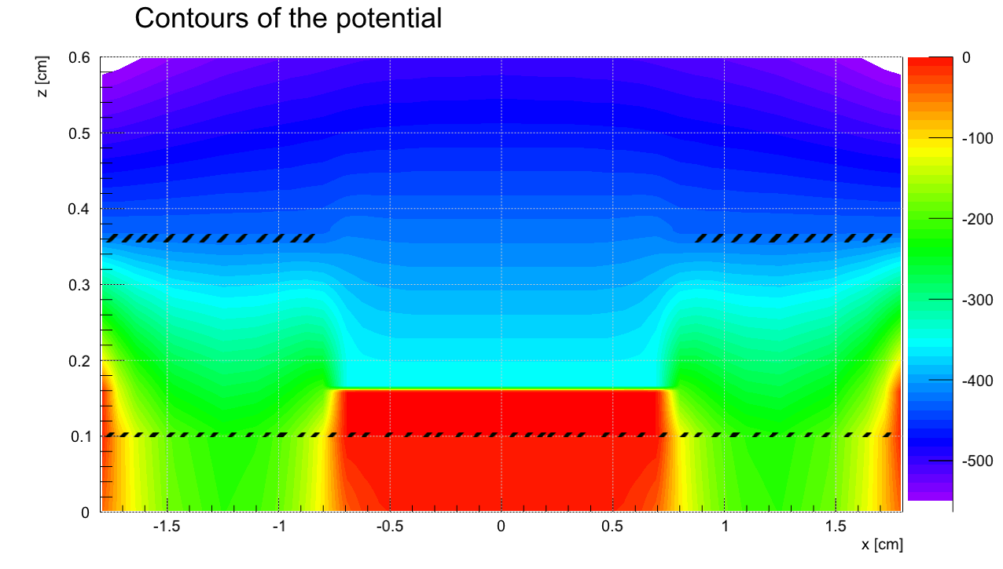
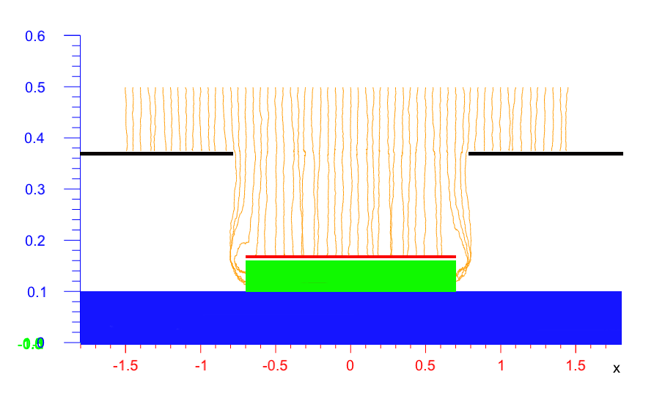
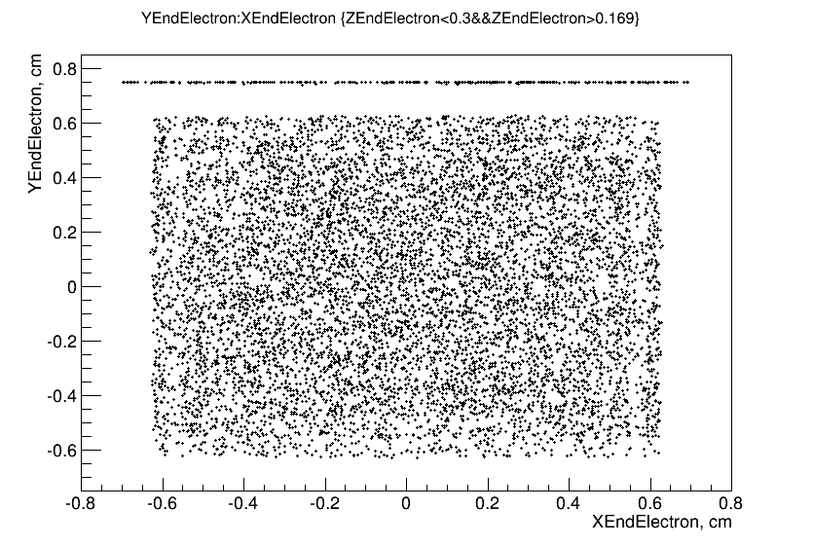
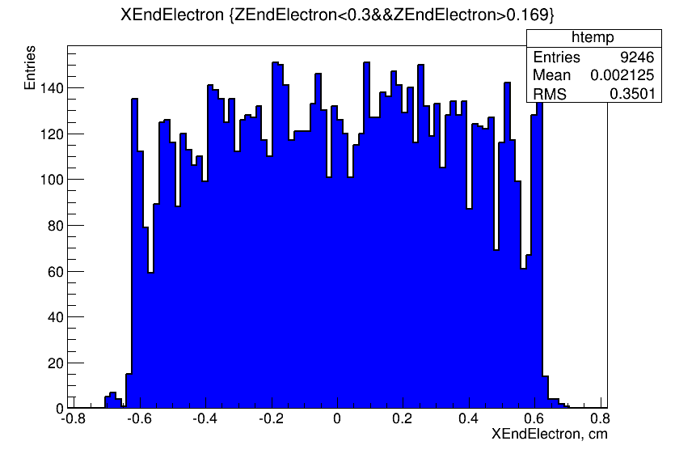
SET 2
(optimal Us for better field uniformity)
Upper electrode – Uupe=-2800V
First strip – Ufs=-800V
Mesh – Um=-350V
Guard ring – Us=-430V
Conclusion:
better field uniformity in the center but weak influence near the mesh edges

Slide 16
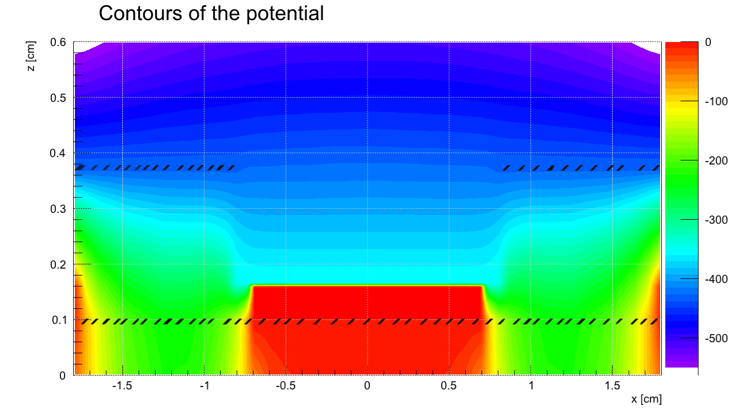
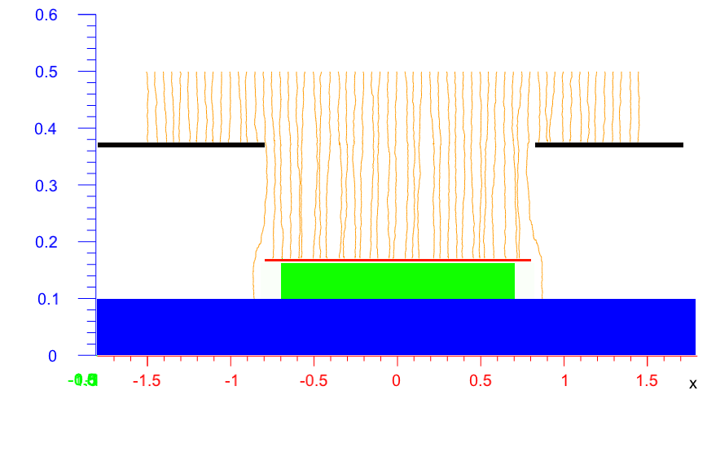
SET 3
(addition of mesh “wings” (edges 1 mm) -
attempt to obtain uniform field near mesh edges)
Upper electrode – Uupe=-2800V
First strip – Ufs=-800V
Mesh – Um=-350V
Guard ring – Us=-430V
Conclusion:
Very good result but question about constructive restrictions
1 mm
X axis

Slide 17
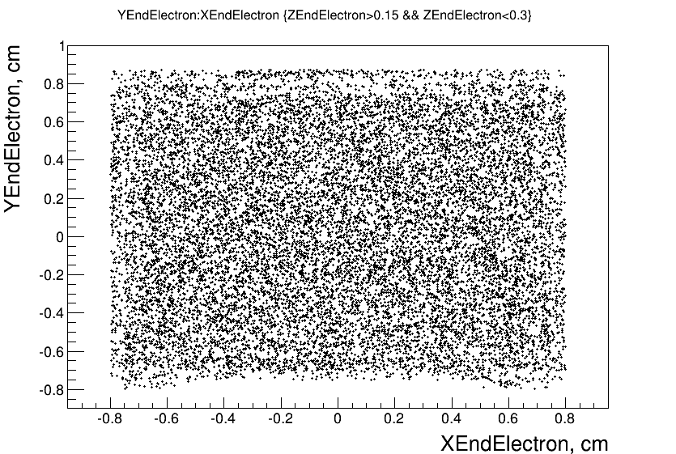
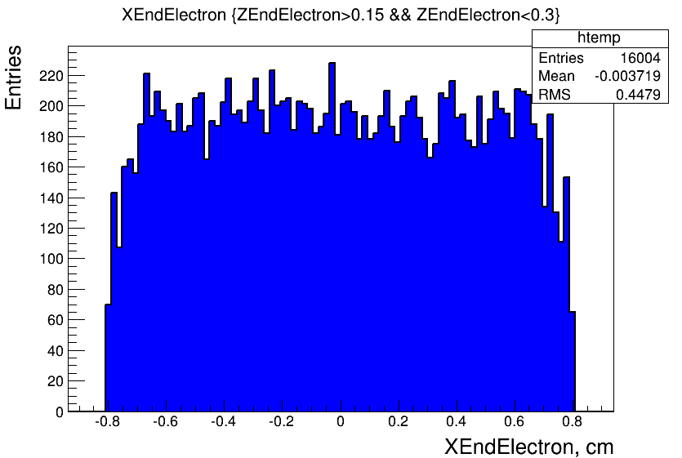
SET 3
(addition of mesh “wings” (edges 1 mm) -
attempt to obtain uniform field near mesh edges)
Upper electrode – Uupe=-2800V
First strip – Ufs=-800V
Mesh – Um=-350V
Guard ring – Us=-430V
Conclusion:
Very good result but question about constructive restrictions
1 mm

Slide 18
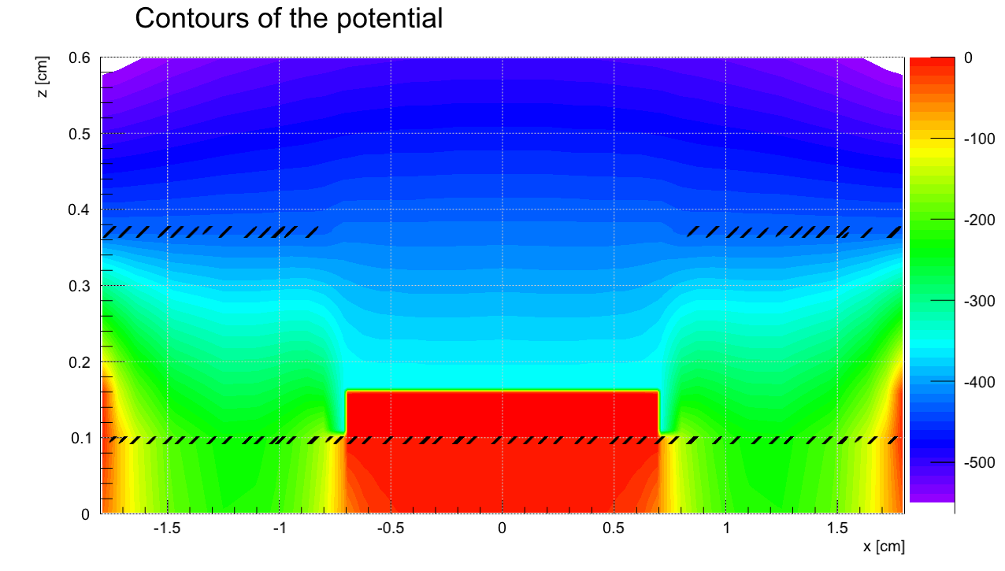
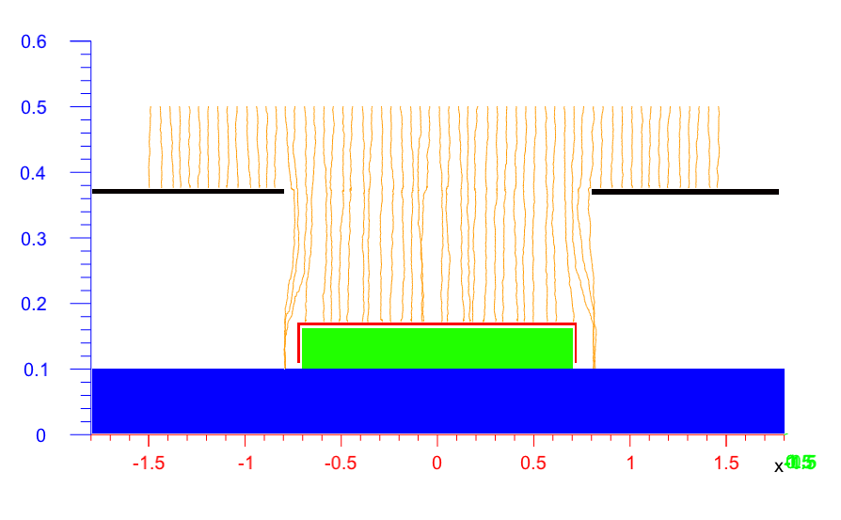
SET 4
(addition of side screening electrode -
attempt to obtain uniform field near mesh edges)
Upper electrode – Uupe=-2800V
First strip – Ufs=-800V
Mesh – Um=-350V
Guard ring – Us=-430V
Side screening electrode Uss=Um
Conclusion:
Not bad result but question about constructive restrictions
side screening electrode
X axis

Slide 19
Conclusions
Simulations (first steps) for micro TPC based on Micromegas/Ingrid were performed
Calculated values are compared with experimental data
Good qualitative agreement was observed between experimental and calculated values, but some studies and analysis are needed for full quantitative coincidence of values
Our next steps (summer - autumn):
additional using ANSYS ( EM results verification);
from one computer → parallel programming (clusters and others)

Slide 20


Slide 21
Back-up slides
Guard ring
mesh
ground
d
Isolator (FR4)

Slide 22



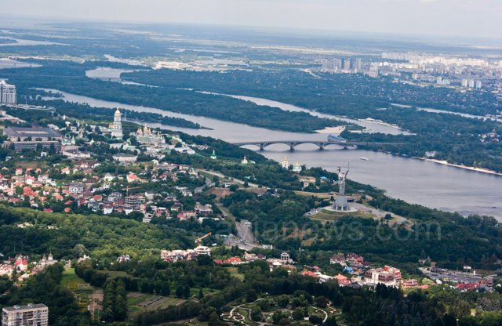


KYIV (Kiev)
Ukraine

Slide 23
Elmer+Gmsh
field is 6 kV/cm
field is 10 kV/cm

Slide 24
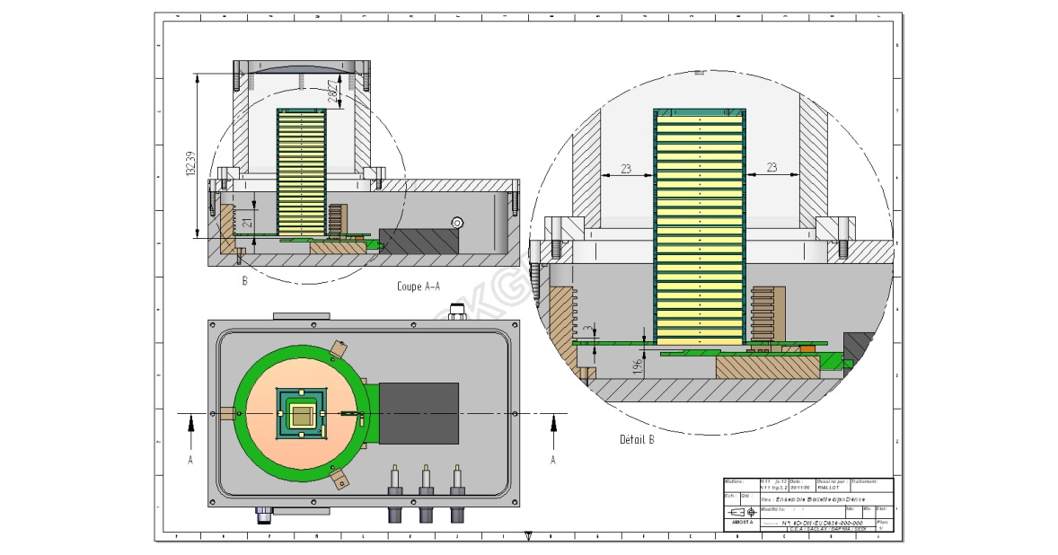
Micro TPC

Slide 25
SET 1
Upper electrode – Uupe=-2800V
First strip – Ufs=-600V
Mesh – Um=-350V
Guard ring – Us=-350V
Conclusions: 1) Uniformity of electric field is better (in comparison with geometry without guard ring), but far not ideal;
2) Main contribution due nonuniformity near ground
Garfield++ calculation with test electrons (on Z=5 mm level)

Slide 26
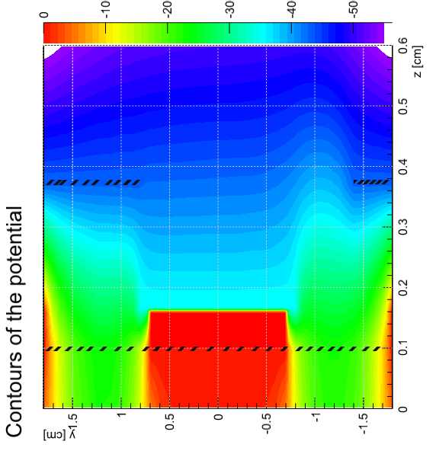
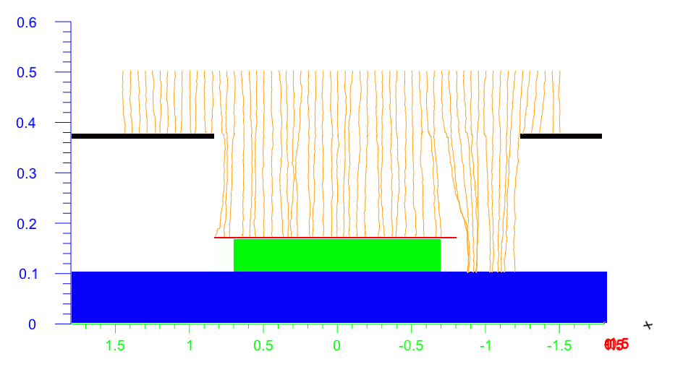
SET 3
(addition of mesh “wings” (edges 1 mm) -
attempt to obtain uniform field near mesh edges)
Upper electrode – Uupe=-2800V
First strip – Ufs=-800V
Mesh – Um=-350V
Guard ring – Us=-430V
1 mm
Y axis
Y axis

