Slide 1
Submission of Timepix3
Xavier Llopart, Tuomas Poikela, Massimiliano De Gaspari
CERN, PH-ESE
LC-TPC meeting May 2013

Slide 2
Main features
Acquisition Mode | VCO Superpixel | Readout Mode
ToA & ToT | ON | Zero-suppressed and data-driven or Zero-suppressed and frame-based | ToA:14bit ToT: 10bit Fast ToA: 4bit @ 640 MHz (1.56ns)
 | OFF |  | ToA:14bit ToT: 10bit Hit Counter: 4bit
Only ToA | ON | Zero-suppressed and data-driven or Zero-suppressed and frame-based | ToA:14bit Fast ToA: 4bit @ 640 MHz (1.56ns)
 | OFF |  | ToA:14bit Hit Counter: 4bit
Event Count & Integral ToT | ON | Zero-suppressed and frame-based | Integral ToT: 14bit Hit counter: 10bit
 | OFF |  | Integral ToT: 14bit Hit counter: 10bit Hit Counter: 4bit
Matrix layout: 256x256 pixels (Pixel size 55x55 µm)
Data-driven and 0-suppressed Readout
“controlled” power pulsing in:
Analog power pulsing
Digital: Selective clock gating
Technology choice: IBM 130nm CMOS DM 4-1

Slide 3
Floorplan
Highly configurable design
256x256 matrix of 55x55um pixels
Full chip size: 14.1x16.21mm (active periphery 1.26 mm high)
Analog/digital ratio: 730/2300um² per pixel
Data-driven or sequential readout through 8 SLVS pairs, at a maximum of 5.12Gbps
Available connection from the back side of the chip using Through-Silicon-Vias (TSV)
Design effort shared between CERN, Bonn University and Nikhef

Slide 4
Power consumption, power pulsing
Front-end power consumption, per pixel:
ON period or continuous mode operation:
3uA preamplifier
2uA discriminator stage 1
2uA discriminator stage 2
600nA pixel calibration DAC
Total=7.6uA=11.4uW/pixel=377mW/cm²=747mW/chip
Feedback current I_{krum} negligible.
Power pulsing, OFF period, adjustable values (to be tested):
80nA preamplifier
80nA discriminator stage 1
80nA discriminator stage 2
600nA pixel calibration DAC
Total=840nA=1.26uW/pixel=42mW/cm²=83mW/chip
Pixel digital power consumption:
Idle ~0.5uW
If pixel hit (while discriminator ON) ~50uW

Slide 5
Readout modes
Data-driven readout mode.
Sequential readout mode.

Slide 6
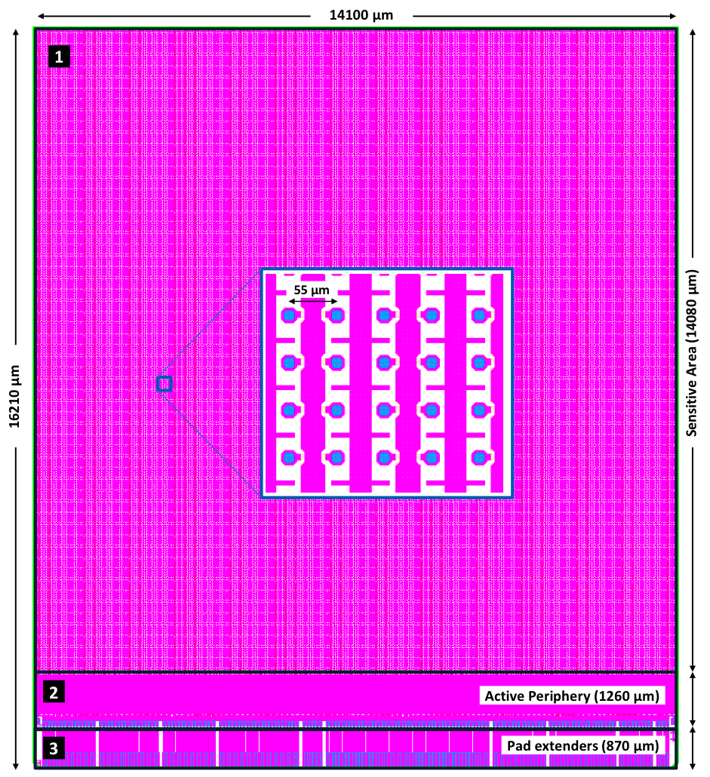
Timeline
24th of May 2013: design submitted to IBM for fabrication
First 2 wafers expected at CERN in 6-8 weeks
Readout developments:
Spider/Speedway (Nikhef/CERN)
USB3 (UTEF/Prague)
1st version of the Timepix3 operation manual released soon
Verilog model of the chip also soon available

