Slide 1
Laser calibration systems
STAR, ALICE, NIKA, ILC?
A.Lebedev, BNL
LCTPC meeting, May 31, 2013

Slide 2
Why we need laser?
Simulation of charged particles with infinite momentum in gas.
Drift velocity measurement.
Misalignment and global ExB effect correction.
Space charge buildup corrections.

Slide 3
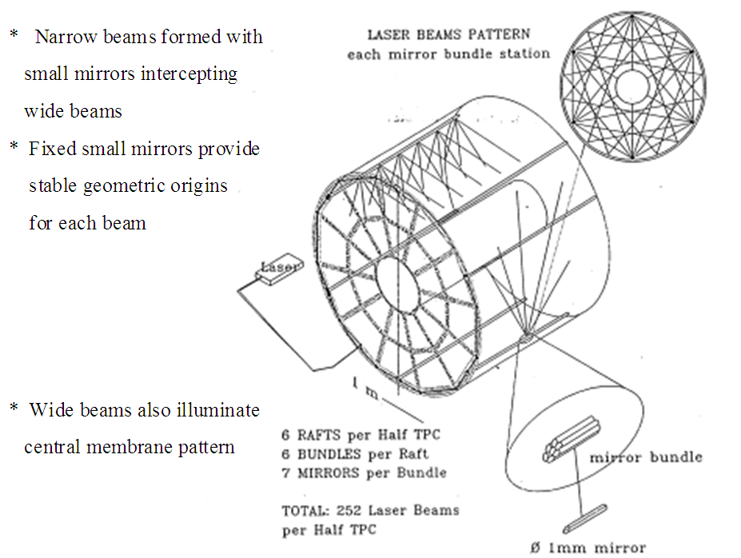
STAR TPC laser system conception

Slide 4
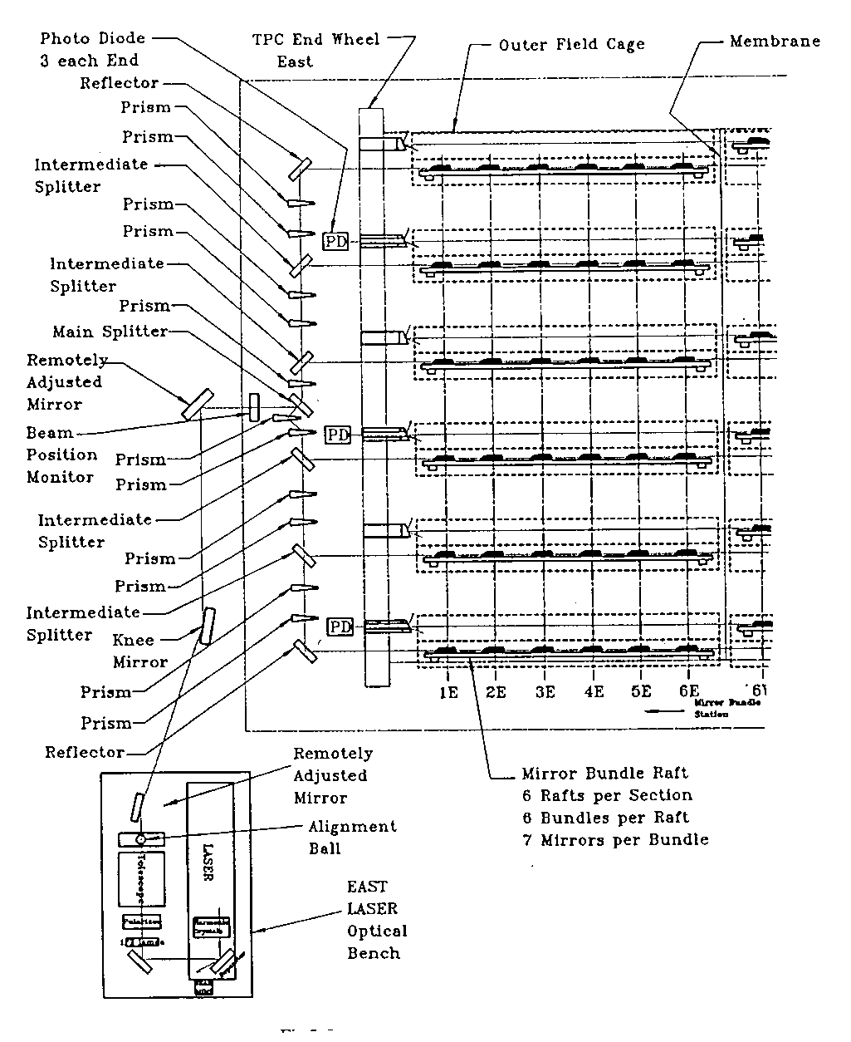
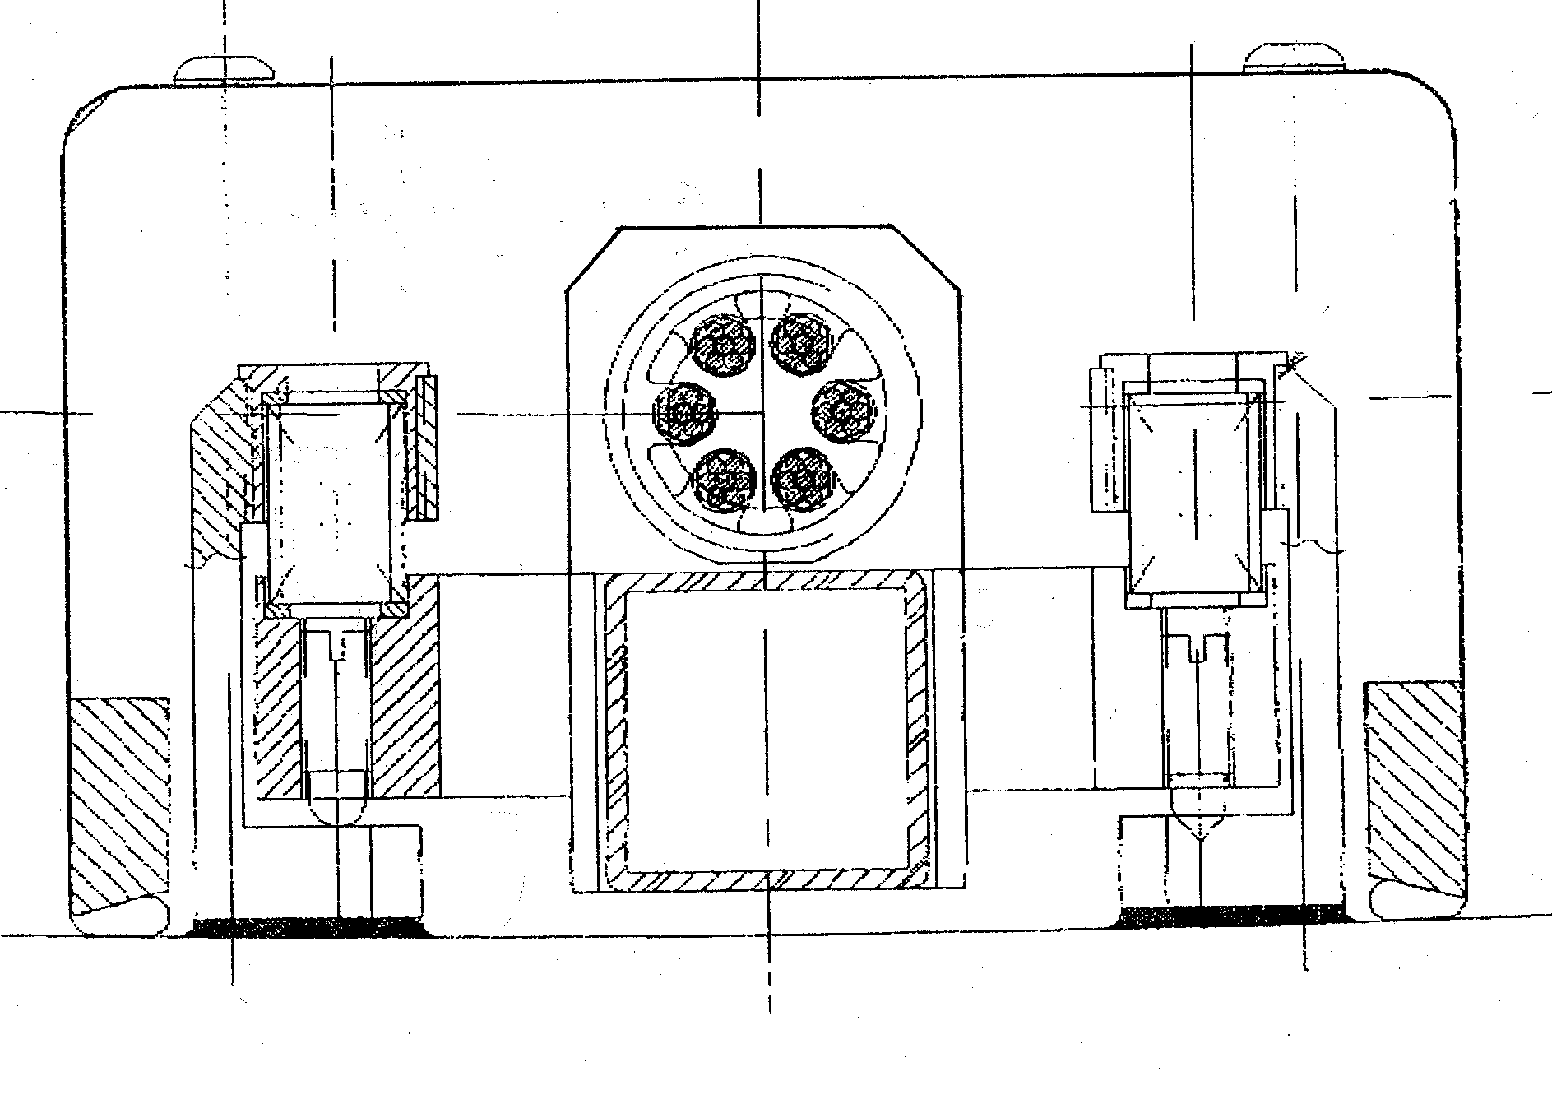
. Optical scheme for one half TPC.
-Mirror bundles glued to pyrex tube,
serving as a light optical bench.
-
Outer field cage
Front view of laser raft

Slide 5
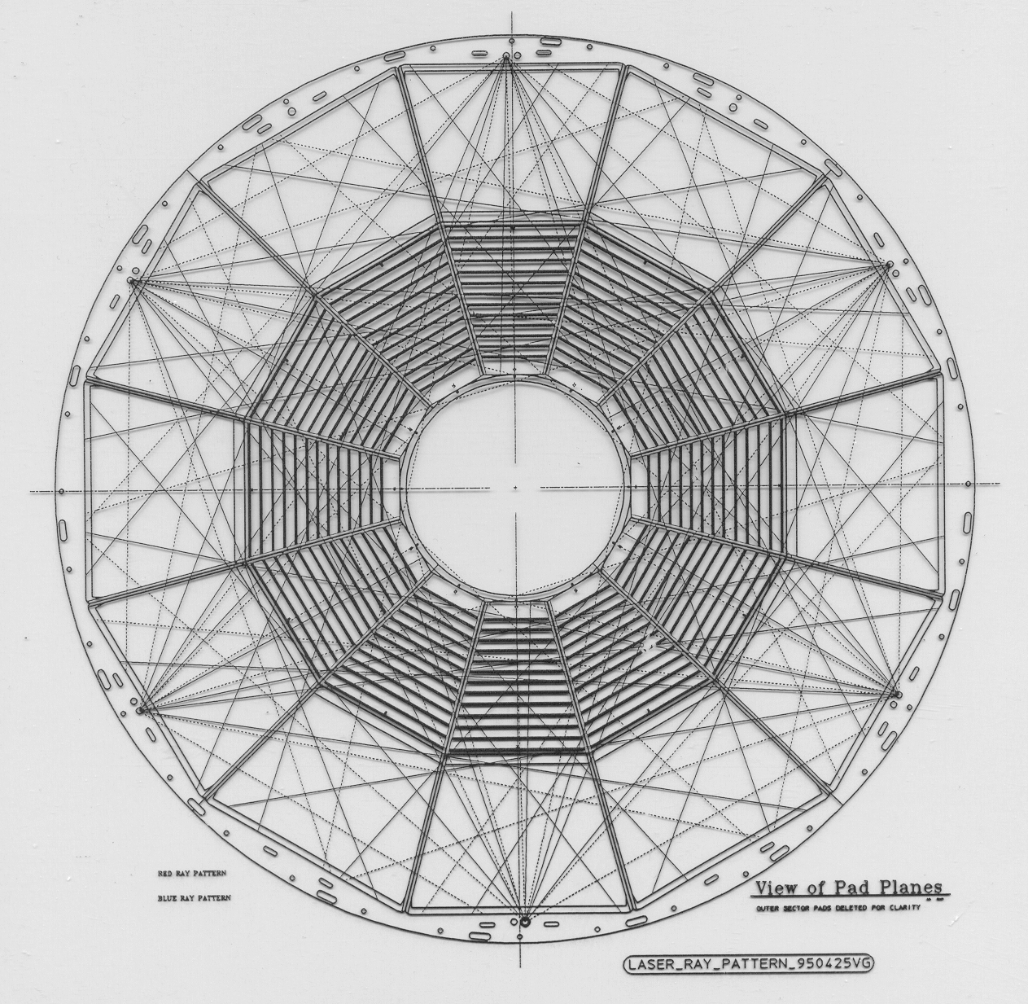
Laser tracks in TPC (ideal)
Two sets of angles in mirror bundles-
wide and narrow.

Slide 6
This is a picture with ~ 400 laser beams in STAR TPC.
Wide laser beam ~ 30mm diameter used to illuminate 1mm mirrors.

Slide 7
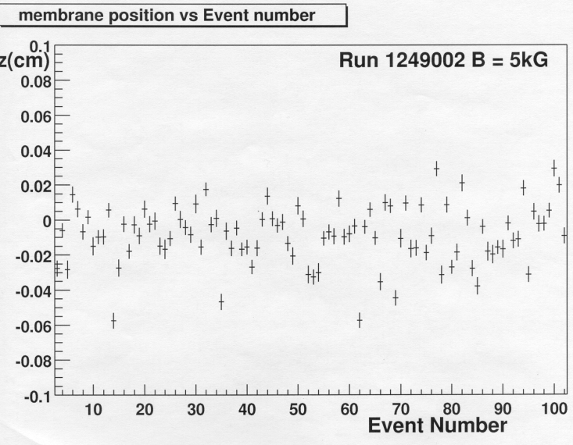
Main results
High accuracy in drift velocity measurements – reached ~ 0.02%.
This accuracy in Z ~200-300 um allows to use TPC tracks to align and calibrate space position of silicon drift chambers. Usually silicon detectors used to calibrate TPC.
ExB effect correction.
SHORTCOMINGS
-we tried to produce laser beams crossed in the TPC space; very difficult and created problems in track reconstruction,
-lasers not used for sector’s alignment,
-wide lasers are useless in any analysis

Slide 8
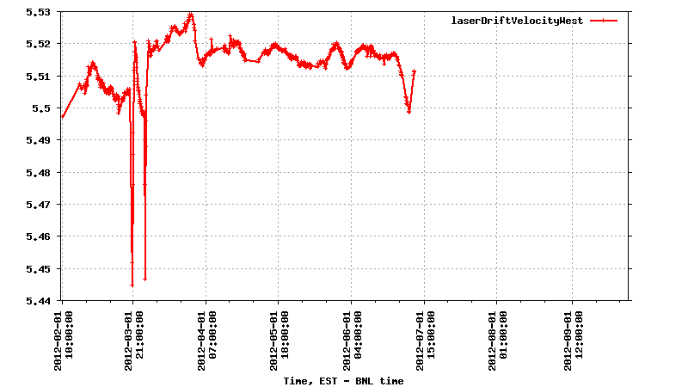
Drift velocity measurements, run 2012
Gas system failures due to thunderstorms

Slide 9
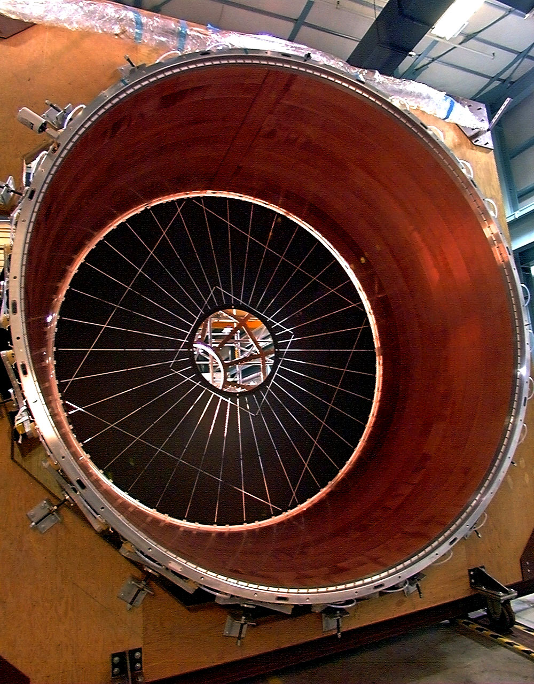
Central membrane with Al stripes pattern
Membrane made from conductive capton
Al coated mylar strips were glued radially.
Membrane illuminated by diffuse UV-
by- product after passing laser raft.
Good contrast with photoefficiency-
Al/capton ~100.
Strips covers all sectors, we started to use
them for sectors alignment.
Work is in progress, accuracy could be
~ 50-100um.

Slide 10
ALICE TPC laser system
In ALICE TPC laser system a STAR design widely was used,
BNL and MEPhI(Moscow) participated in optics and mechanical parts production –bundles mirrors holders,
Assembly, start-up and operation- NBI.
Main steps in laser construction-see
http://www.nbi.dk/~borge/tpclaser
Nuclear Instruments and Methods in Physics Research Section A, Volume 622, Issue 1, p. 316-367.

Slide 11
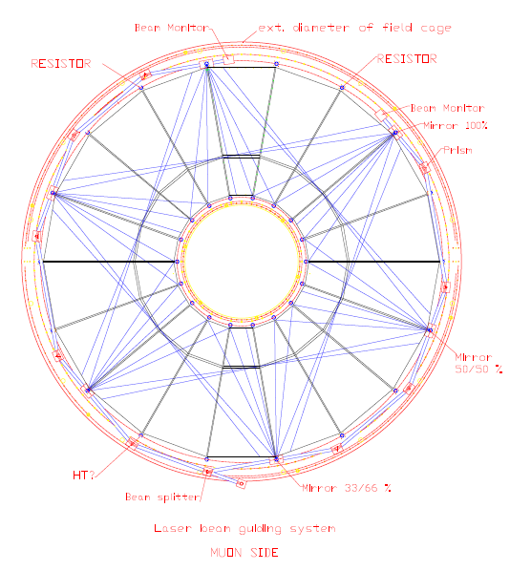
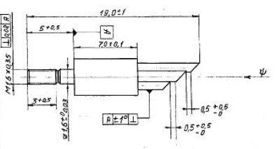
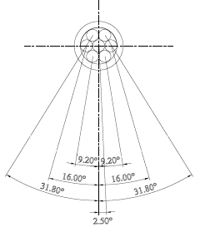
ALICE TPC design pattern
Laser beams pattern in TPC.
Mirror bundle with narrow angle set

Slide 12
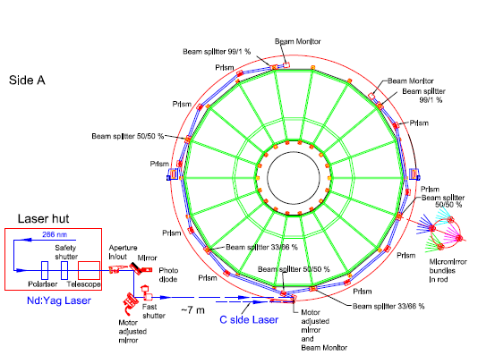
Расположение оптики в ALICE TPC

Slide 13
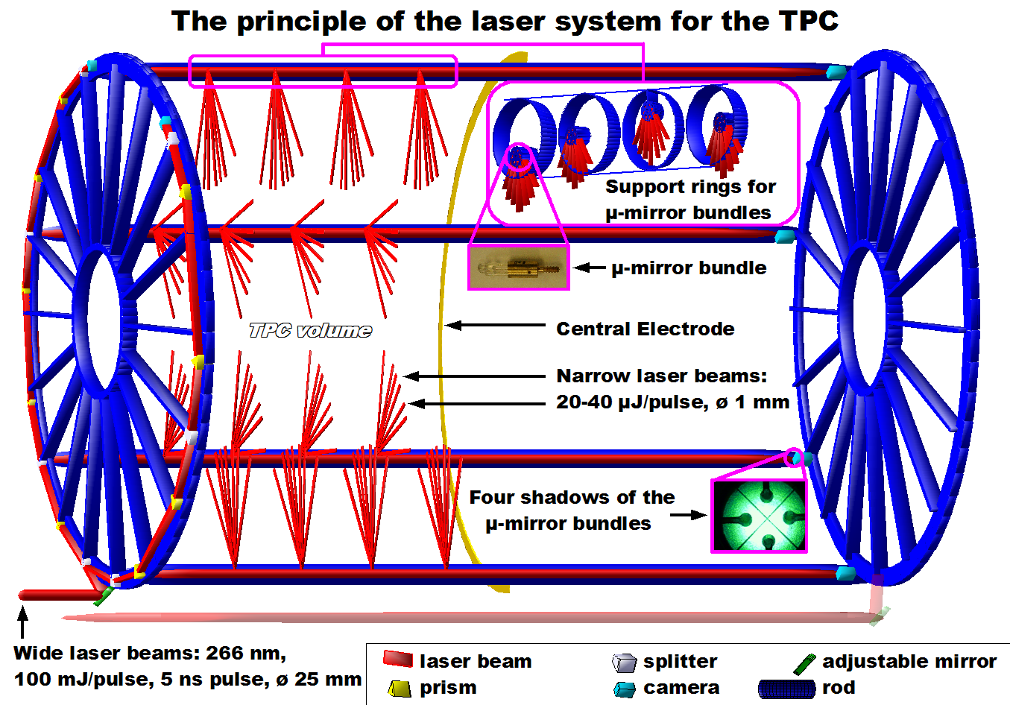
Position of bundles in ALICE TPC.
Bundles are shifted in Z to avoid crossings in TPC volume.
Design was accommodated to field cage structure.

Slide 14
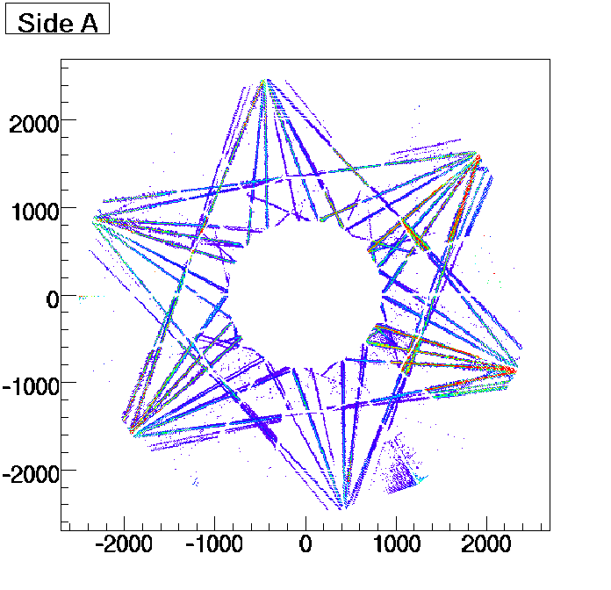
Lasers used to measure drift
velocity with accuracy ~150um
for drift distance ~ 250cm.
Side view of laser event in ALICE TPC

Slide 15
Lasers for LC TPC
The same approach with mirror bundle.
Less beams for drift velocity measurement.
Simple wide laser beam fanout on TPC wheel at Outer Field Cage- NIKA TPC (DUBNA).
Separate laser system with thin Poisson beams
to align GEM(MICROMEGAS).

Slide 16
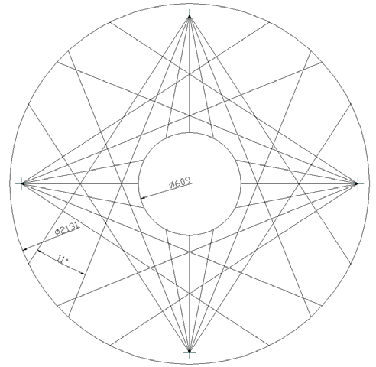
NIKA TPC proposed laser beams
TPC electronics
Wide laser beam splitters

Slide 17
Conclusions
Lasers are useful tool.
Detailed design is needed to accommodate previous experience to LC TPC.
Extensive R&D is necessary to implement Poisson beams into LC TPC.
A new method utilizing diffraction of UV laser beams on annular diaphragms provides very narrow laser beams with full diameter 100-400 μm, divergence ~0.05mrad and effective length up to 10 meters
(A. Lebedev, IEEE2007)

