Slide 1
Large Field Test Facility
Ties Behnke, DESY

Slide 2
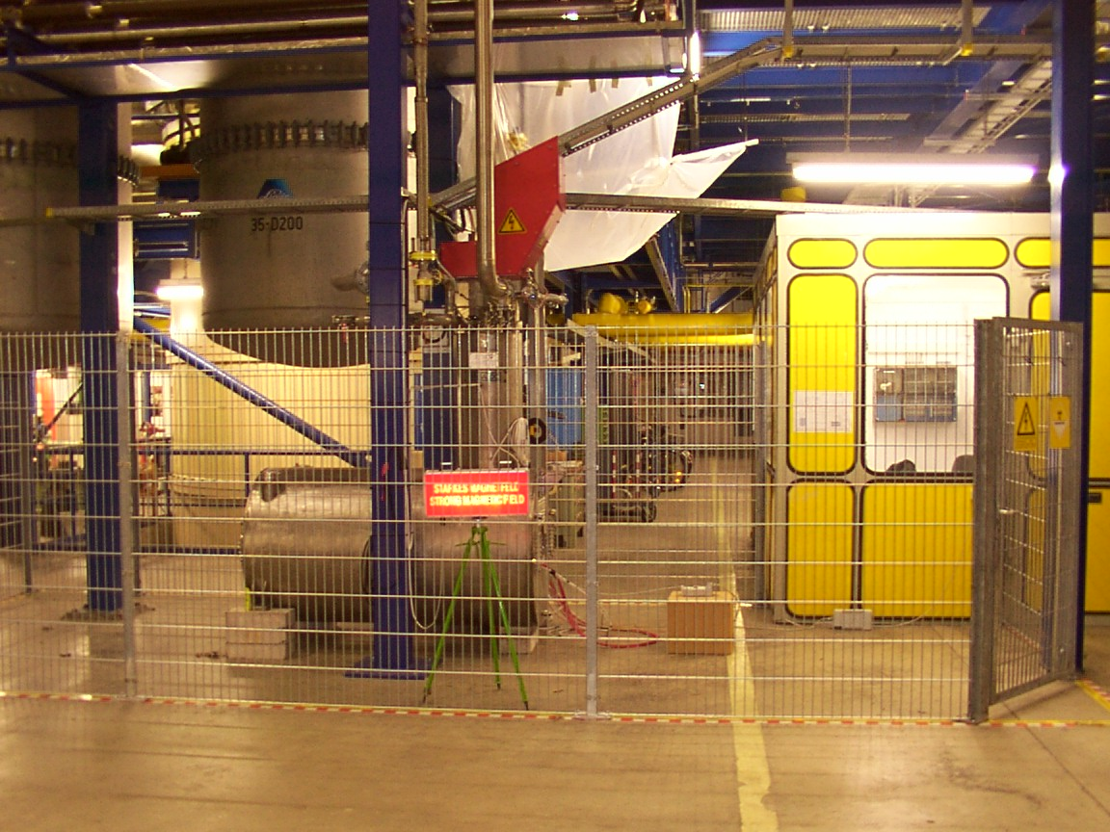
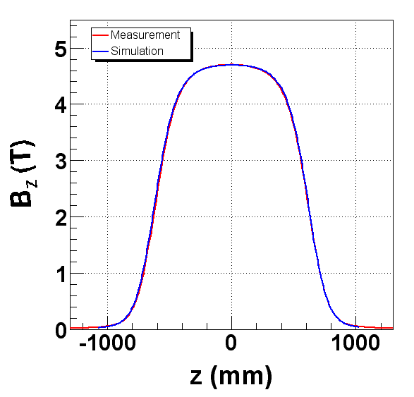
KOMAG at DESY
Superconducting magnet
Field 4T (5T on the limit)
Active area about 20 cm Dia
about 30 cm long
Picture of the old setup at DESY:
Operating 2002-20008
Dismantled 2009 to make place for XFEL

Slide 3
High fields
Clear need for a high fields test facility for detector development
Performance in a strong field
  Resolutions etc
  Operation aspects
  Fundamental (detector) physics studies at high fields
“System” aspects
  Power pulsing
  Power supply
  Forces on the mechanical structures
  etc
There is a clear need for a facility available to the community which
provides a high magnetic field (around 4 T).

Slide 4
Situation at DESY
High demand on the cryogenics groups and infrastructure during XFEL construction
There is little hope to get significant resources from the DESY cryo group before
2015
The infrastructure is operating at its limit and it is not trivial (but also not excluded)
to gain access to the central cryo system

Slide 5
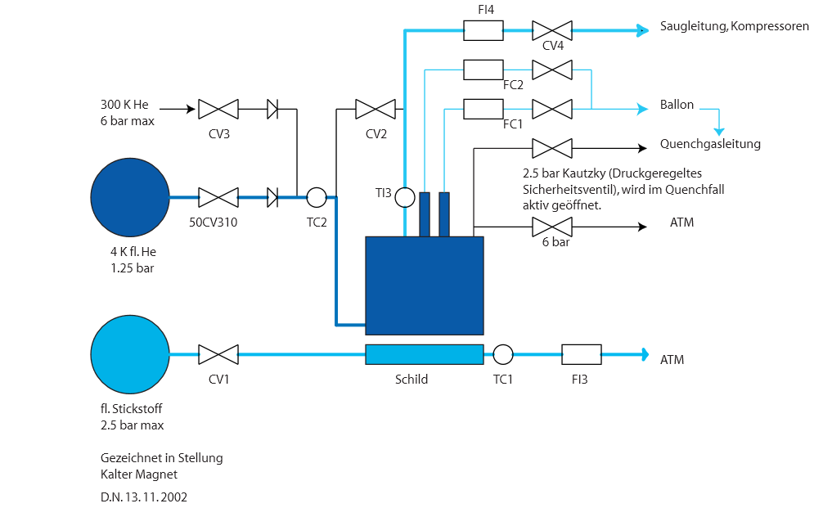
Connection of PCMAG

Slide 6
Is there an alternative
Consumption during operation:
3g/s liquid He and 1.6g/s liquid N2 (0.12g/slHe for the current leads)
During cooling : 10g/s liquid He and 6g/s liquid N2
(the larger the flow, the faster you can ramp).
For a controlled cool down some warm Helium is needed for mixing.
Question: can we provide at least the steady state operation for example
through cryo-coolers?

Slide 7
Strategy
Understand whether we can operate KOMAG with a stand alone system
If yes,
  Need to find the money (maybe part of AIDA2 proposal?)
  Need to find the expertise (can we collaborate on this again with KEK?)
  The following is my personal point of view, and has not been approved
  within DESY
  DESY will provide the infrastructure needed to operate the magnet inclunding
  floor space, electrical connection, power supply, etc.
  DESY will try to support the conversion, but our means are limited
Remark: There have been repeated and strong statements by the DESY particle physics
review committee to support the restart of the magnet.

