Slide 1
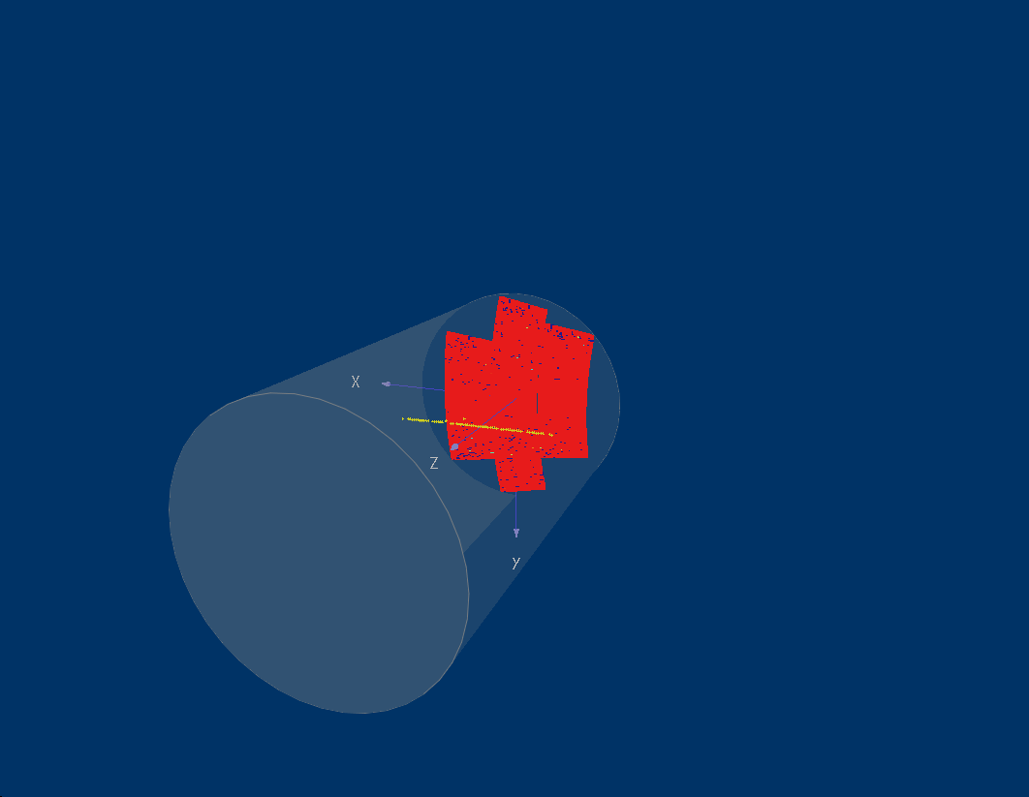
Recent Micromegas TPC R&D results
LCTPC Collaboration meeting
DESY, May 31, 2013
David Attié, Paul Colas, Wenxin Wang, CEA/Irfu
+ contributions from Carleton, KEK, Kolkata

Slide 2
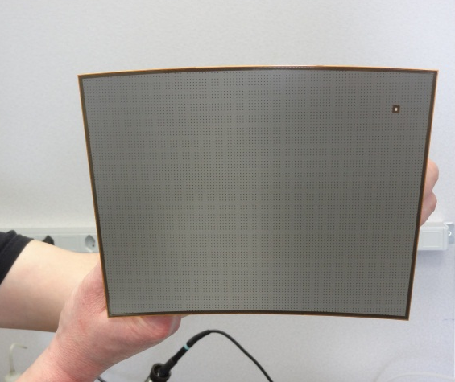
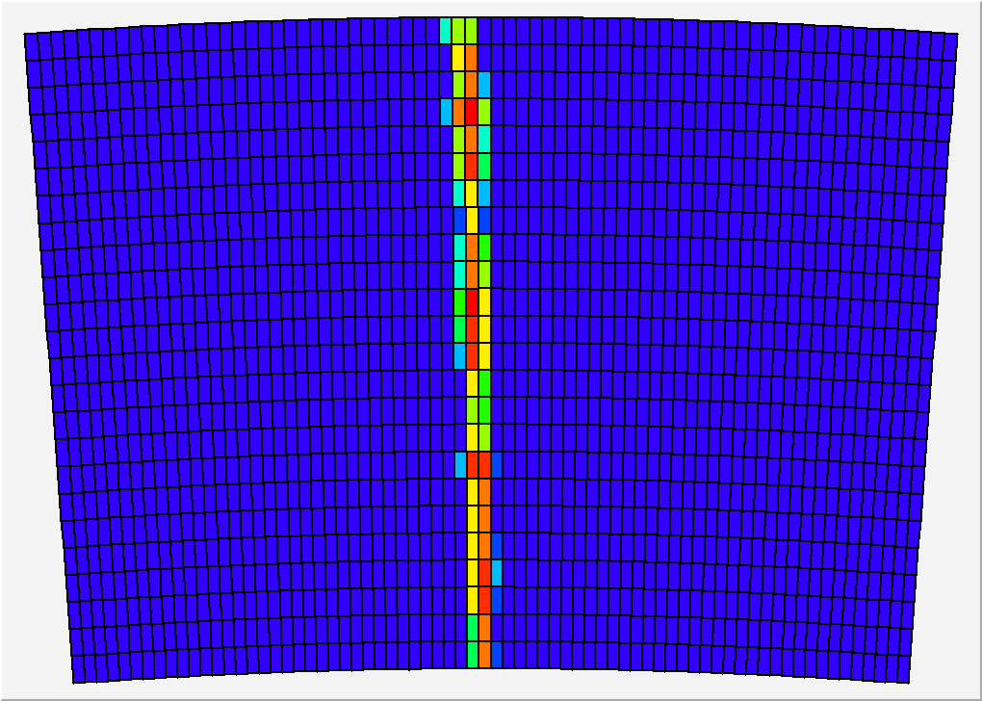
Micromegas module
Module size: 23 cm × 17 cm
24 rows × 72 columns
Readout: 1726 Pads
Pad size: ~3 mm × 7 mm

Slide 3
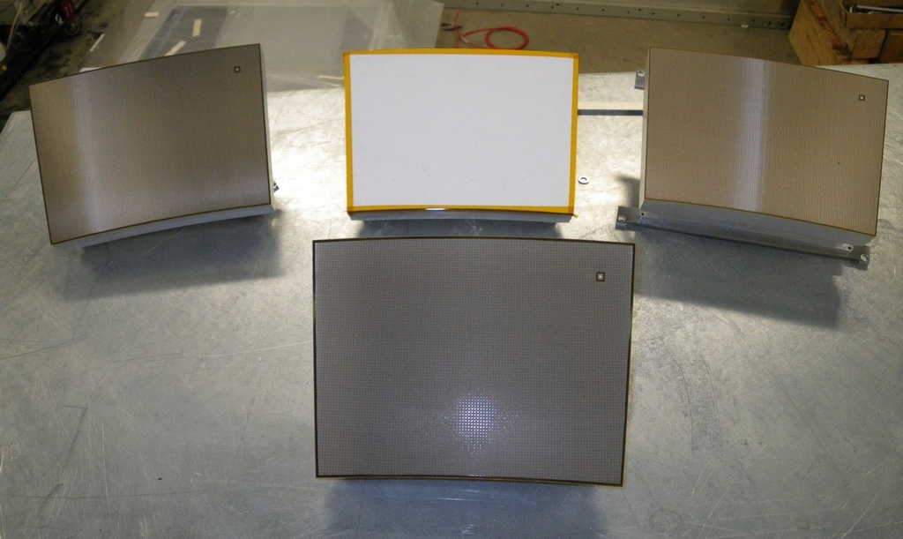
Micromegas modules
Resistive Kapton
~3 MΩ/□
Resistive Kapton
~5 MΩ/□
Standard
Resistive ink
~3 MΩ/□

Slide 4
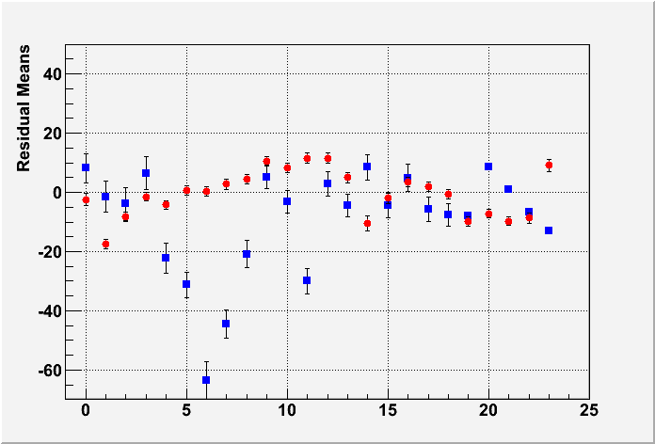
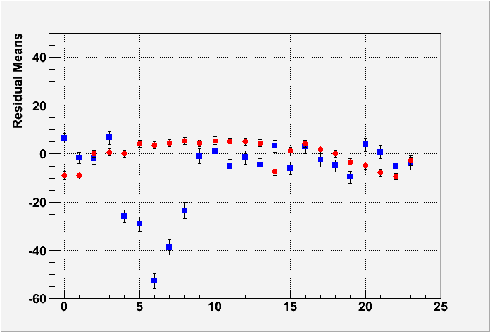
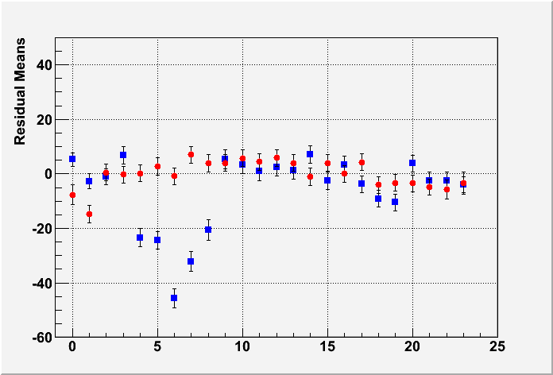
Uniformity
Mean Residual vs Row Number
Z-independent distortions
Distortions up to 50 microns for resistive ink (blue points)
Rms 7 microns for CLK film
(red points)
Z=5cm
Z=35cm
Z=50cm
Row Number

Slide 5
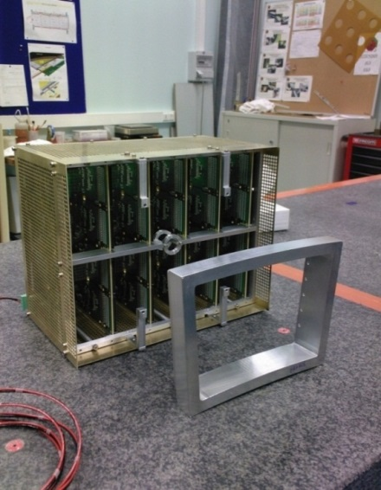
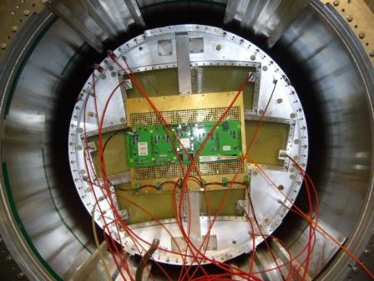
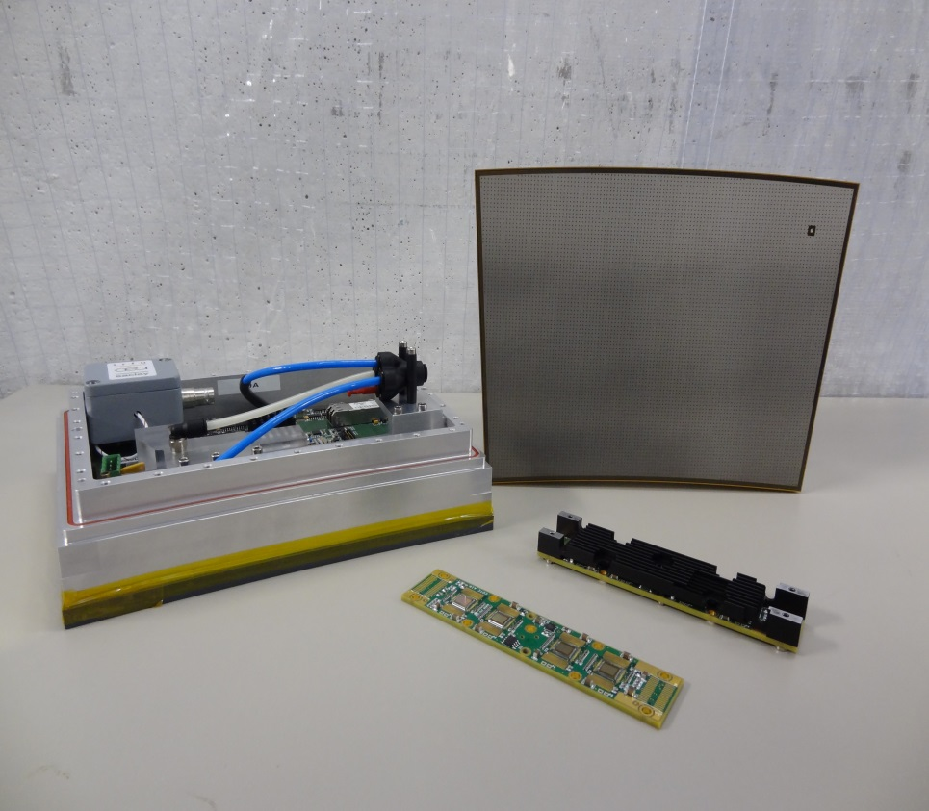
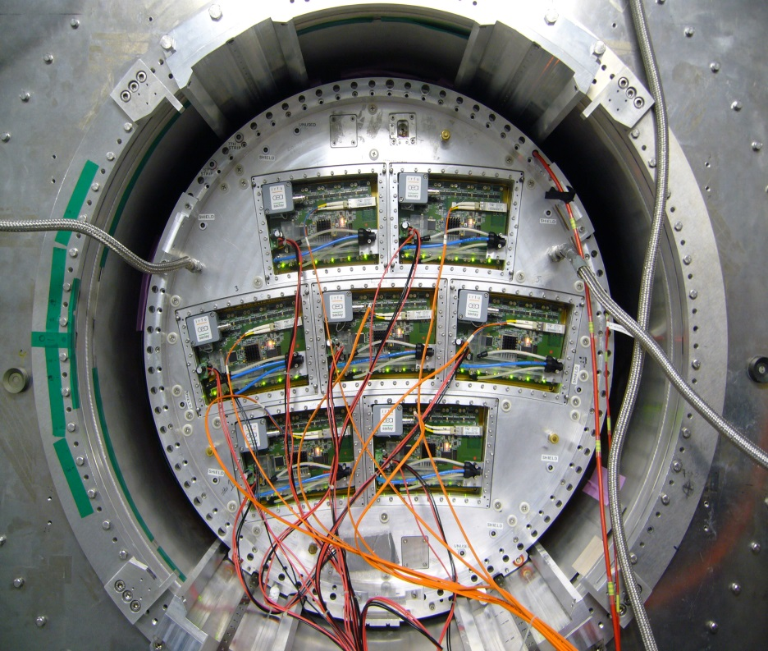
Beam test
2008~2011:
Test with one module
T2K electronics
(32cm × 25cm × 14cm )
2012~2013:
Test with
multi-modules
Integrated electronics ( 23cm × 17cm × 5cm )
Resistive Micromegas Detector
FEM
Fully integrated Module
FEC

Slide 6
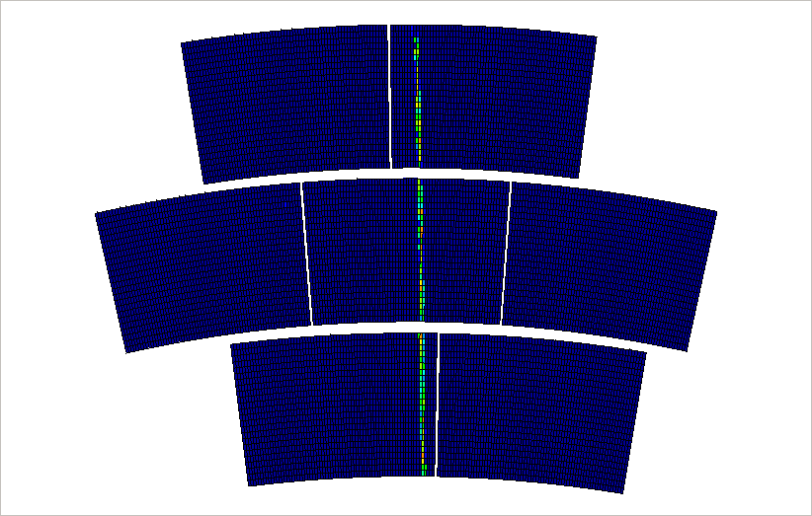
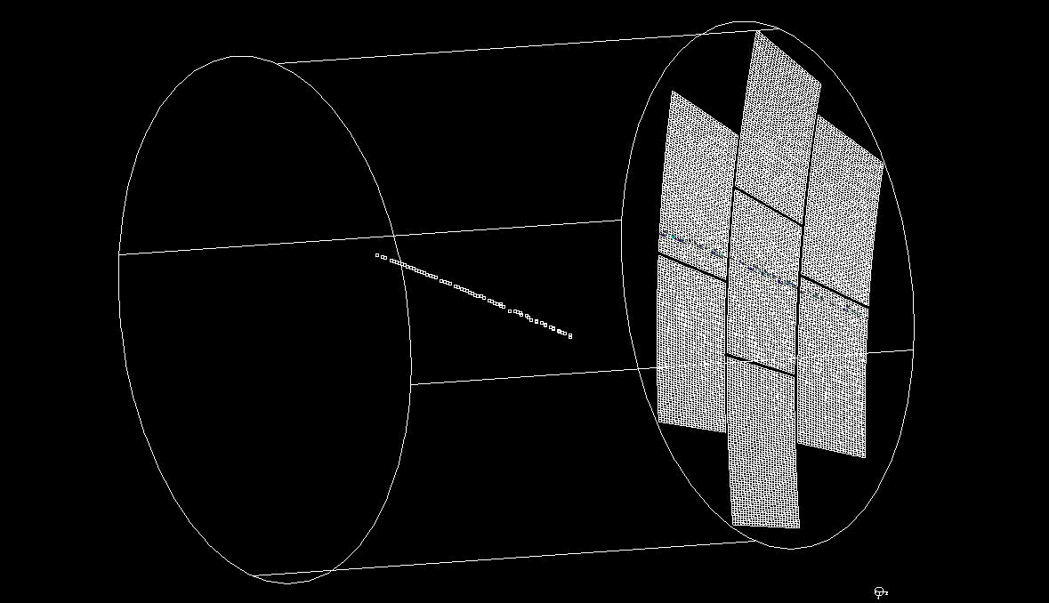
Event display
Online monitor
2D or 3D display software available
Offline monitor

Slide 7
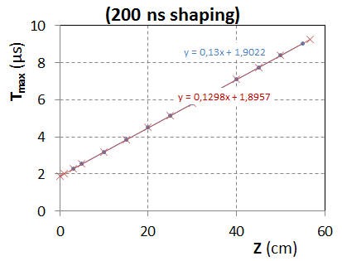
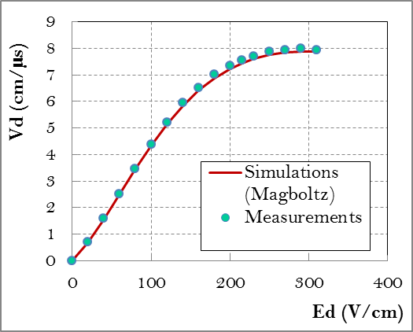
Drift Velocity
Test in 2009 (B=0T):
T2K gas: Ar:CF4:iso=95:3:2
T=19ºC - P = 1035hPa
H2O:35ppm
At E=230 V/cm :
V_{drift} = 7.698 +- 0.040 cm/µs (Magboltz : 7.583+-0.025(gas comp.))
The difference is 1.5+-0.6 %

Slide 8
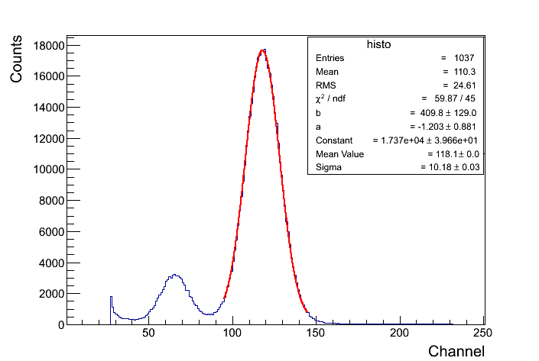
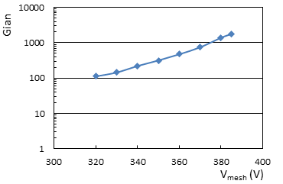
Gain measurements with a small detector (bulk; T2K gas) and a calibrated chain
Note that there is no resisitve foil and that the mesh signal is used
(at Saclay with Purba and Sudeb Bhattacharya, Supratik Mukhopadhyay and Najana Majumber)

Slide 9
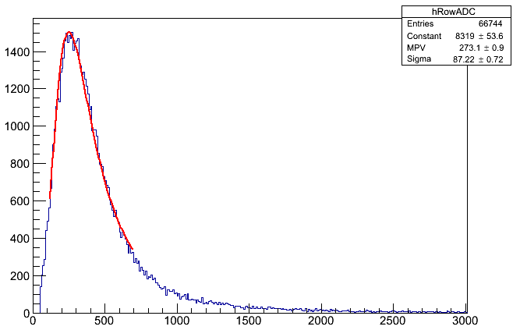
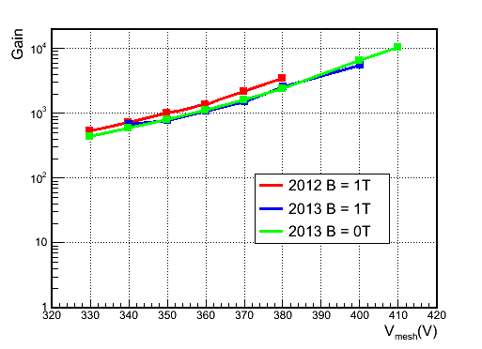
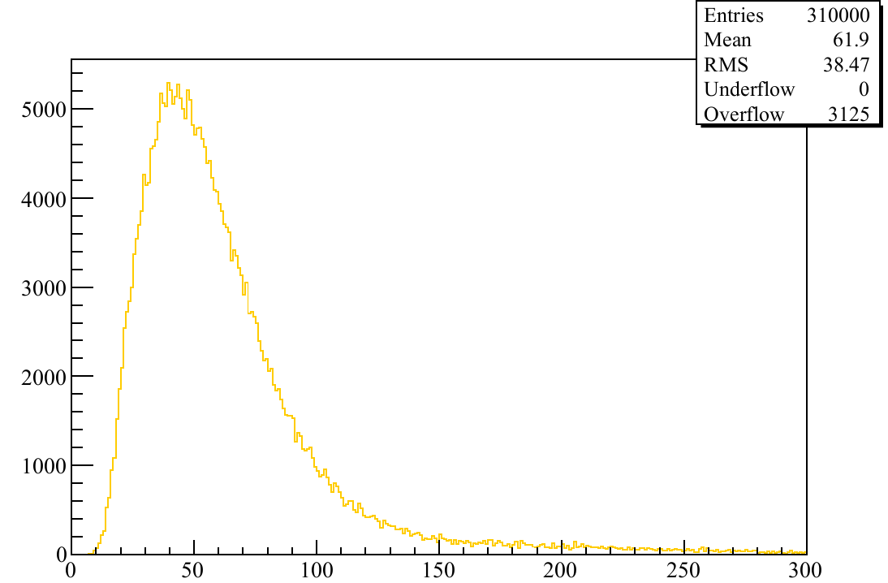
Gain Study (with beam test data)
Data
ADC
ADC
Heed
For 6.84 mm pitch and 5 GeV e-
Expectations for Ntot: 61.9
(from HEED simulation)
Number of electrons

Slide 10
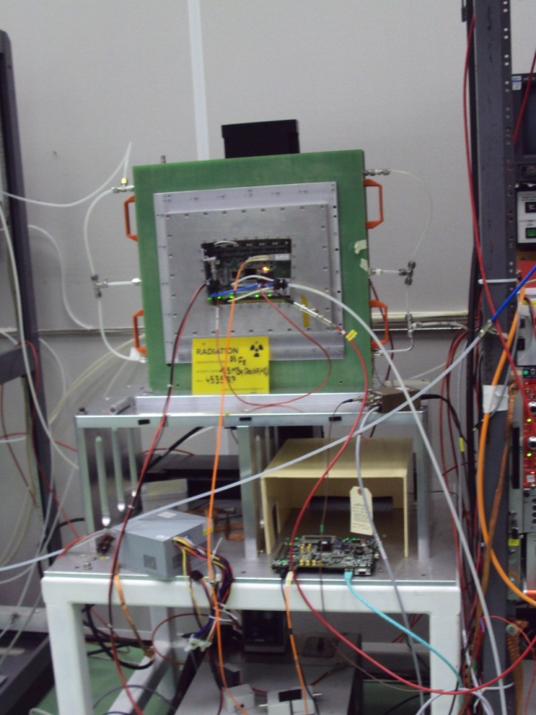
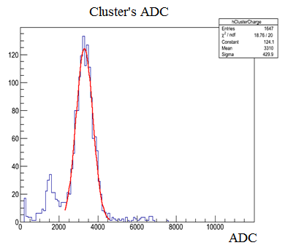
Test bench
Energy Resolution :~13% rms
Gain ~2600
(using collimated source, Vmesh=380V)
The ⁵⁵Fe source is put in an aluminum collimation tube and fixed on a set of two mechanical arms (X-Y).

Slide 11
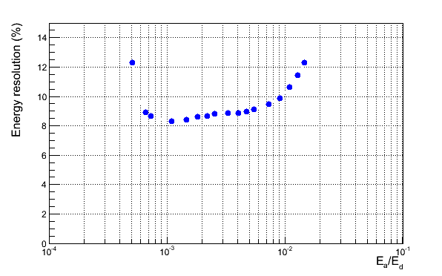
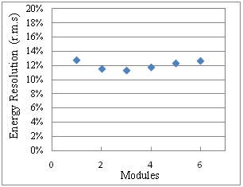
Test bench – Energy resolution
Energy Resolution :11~13% rms at 380V
(Gain ~2600)
(using collimated source)

Slide 12
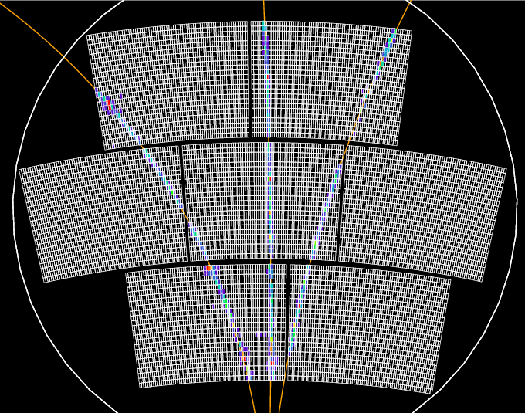
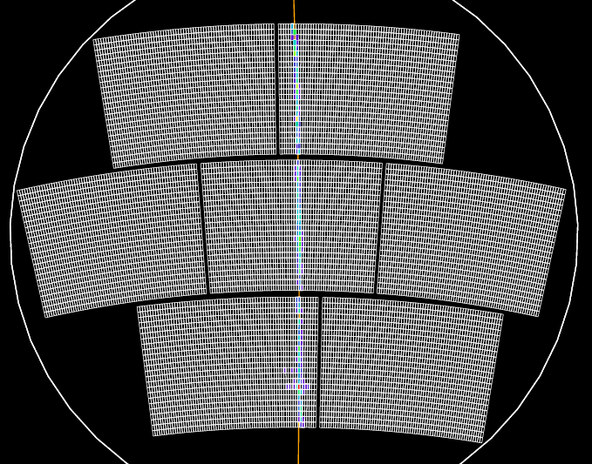
Spatial resolution
Event selection
Select events with exactly 1 track

Slide 13
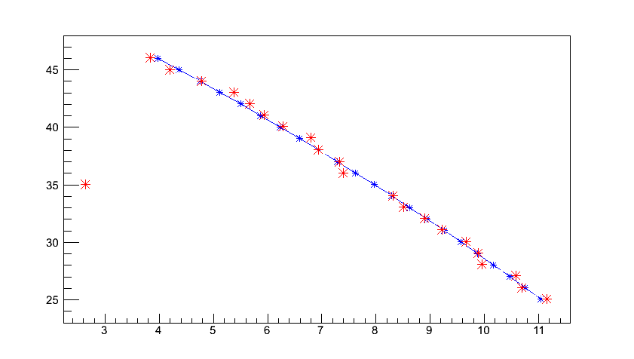
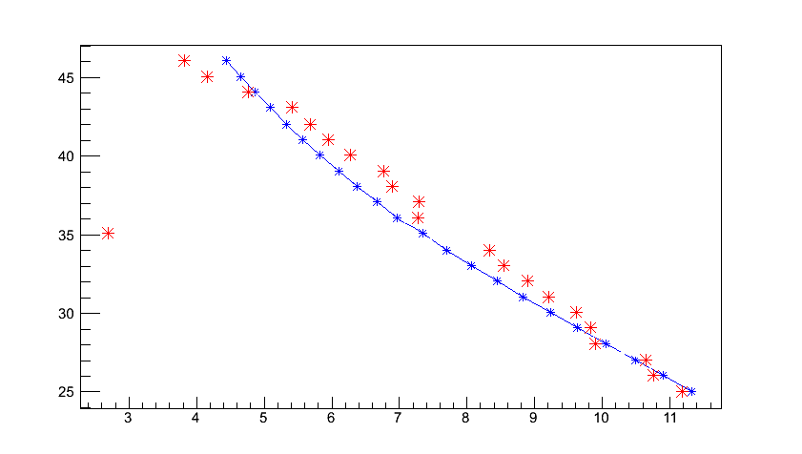
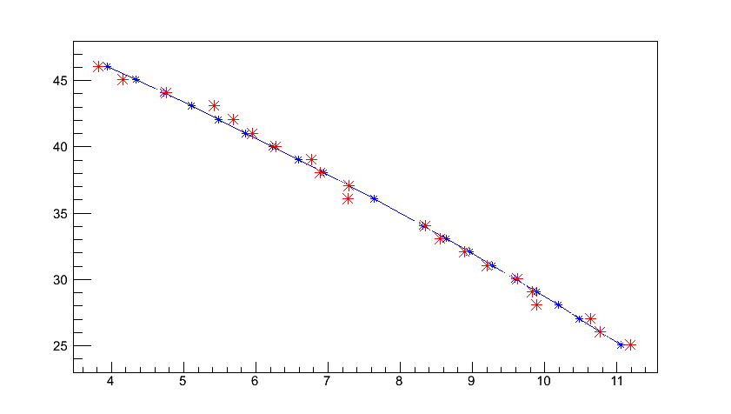
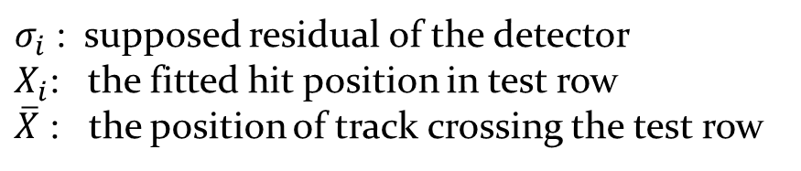
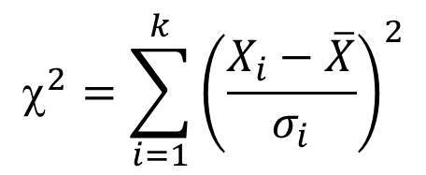
Spatial resolution
Hits selection
(c) Fit track after selection hits (row 35)
Row number
(b) Fit track without using hit in row 35
Row number
(a) Fit track with all rows
X (mm)
X (mm)
$$^{2}=\sum_{i=1}^{k}{{\left(\frac{X_{i}−\overline{X}}{σ_{i}}\right)}^{2}}$$
$σ_{i}$ : supposed residual of the detector
$X_{i}$: the fitted hit position in test row
$\overline{X}$ : the position of track crossing the test row

Slide 14
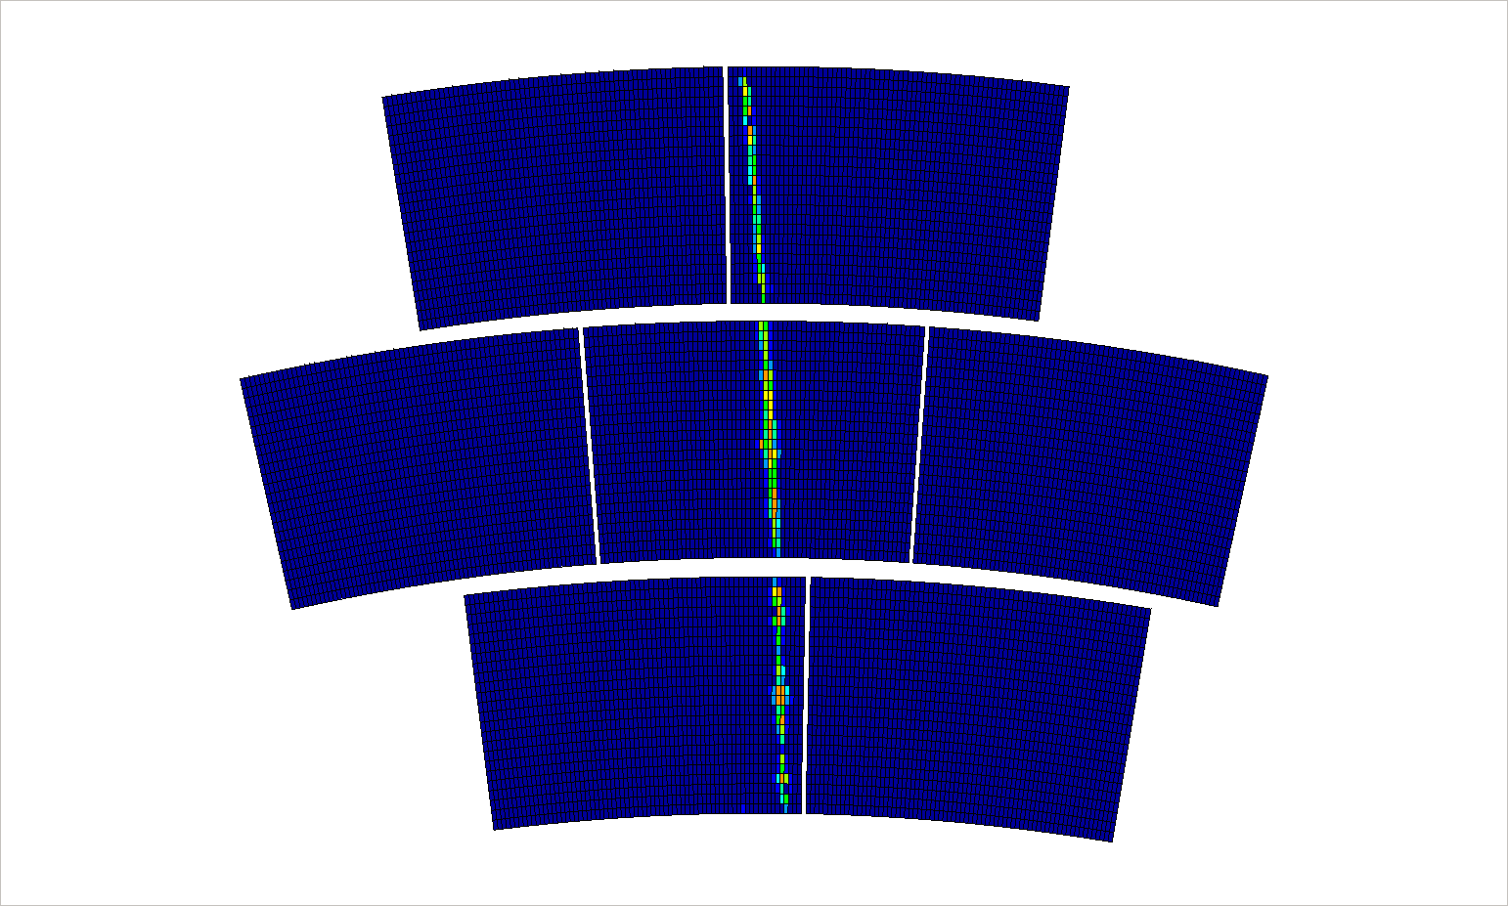
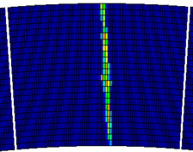

Slide 15
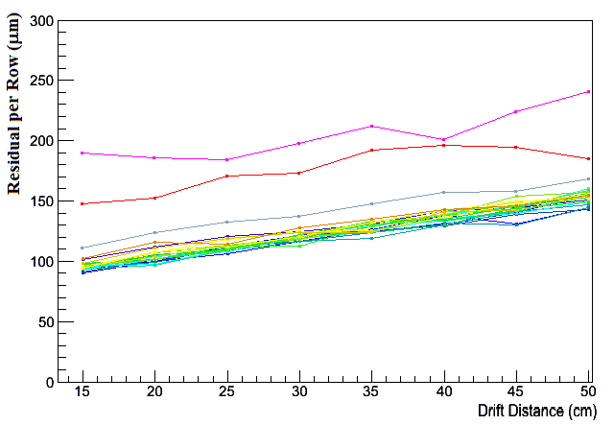
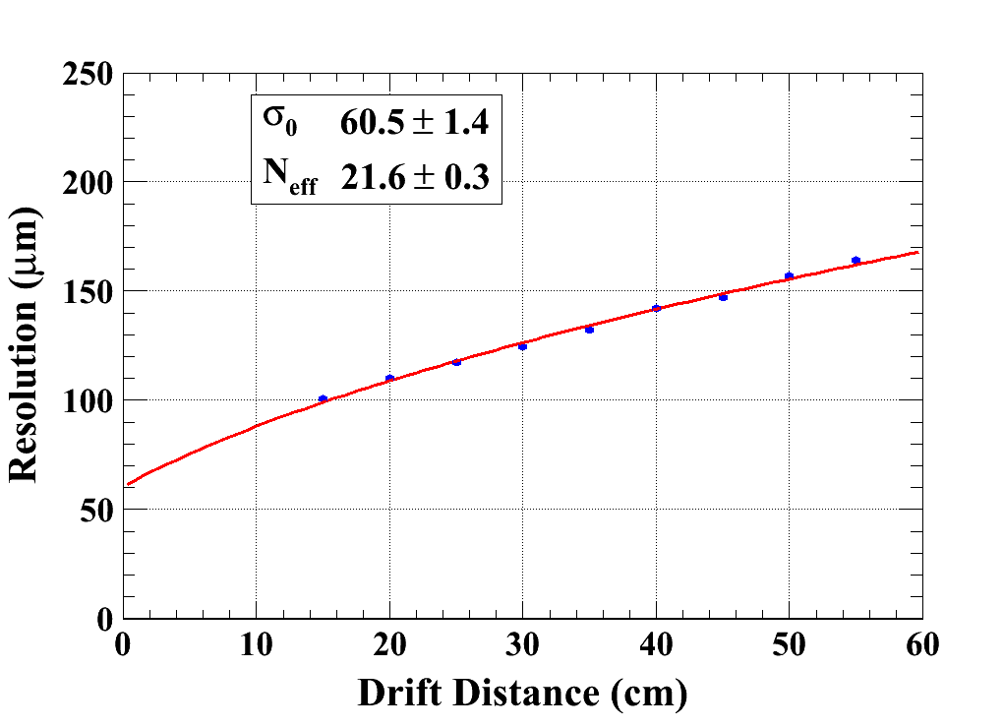
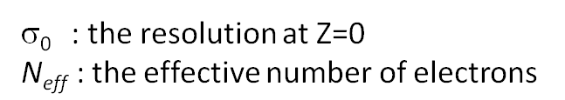
Spatial resolution
B=1 T C_{d} = 94.2 µm/√cm (Magboltz)

Slide 16
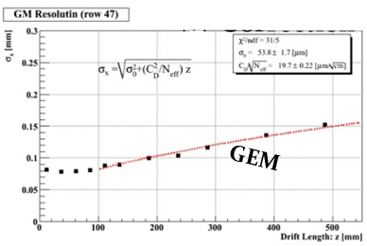
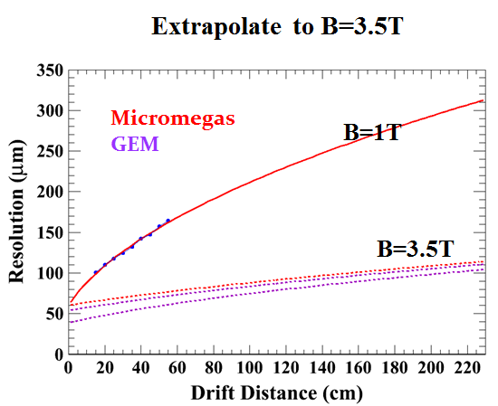
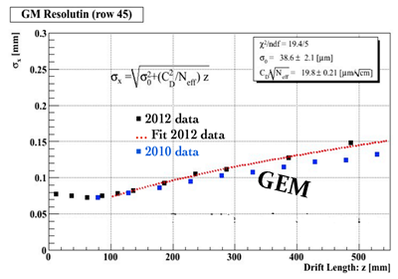
Compare with GEM
( Spatial resolution )

Slide 17
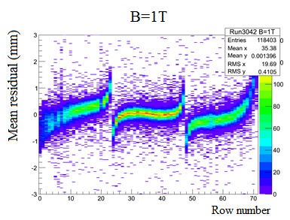
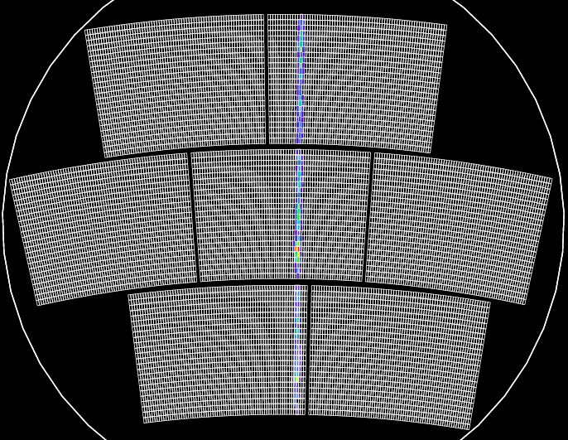
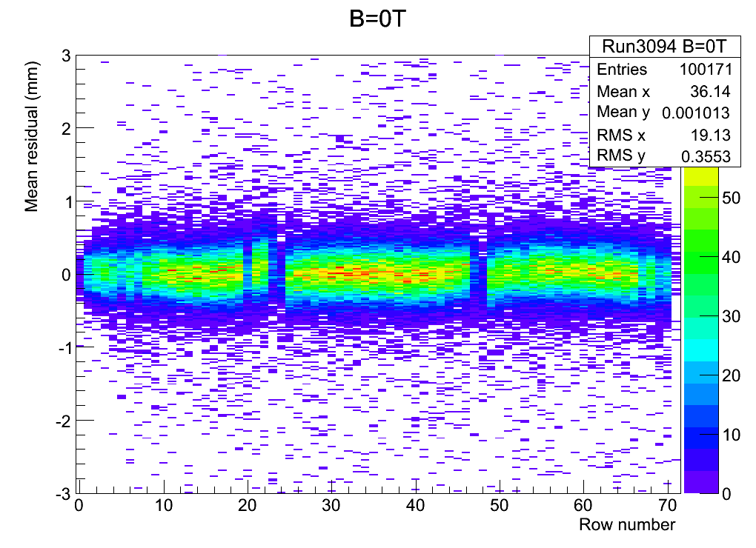
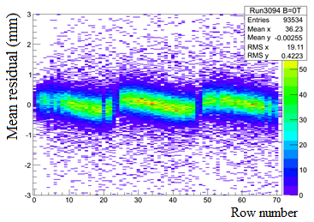
Field distortions
B=1T
After alignment
B=0T
B=0T

Slide 18
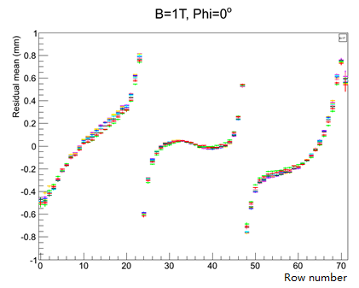
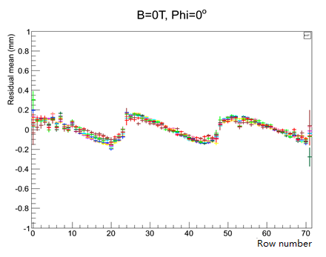
Field distortions
B=1T
Distortions at different drift distances
in B=0T or B=1T
B=0T

Slide 19
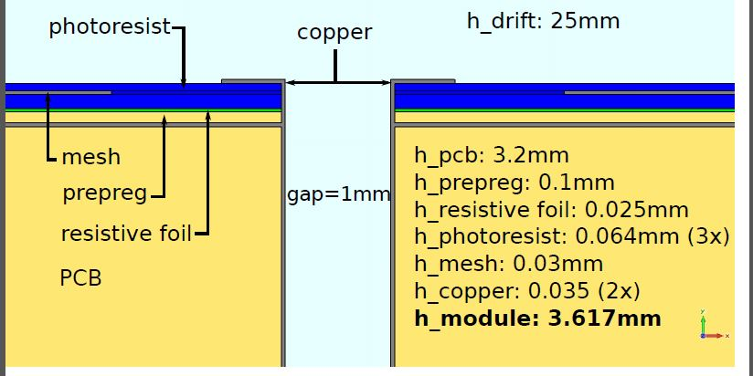
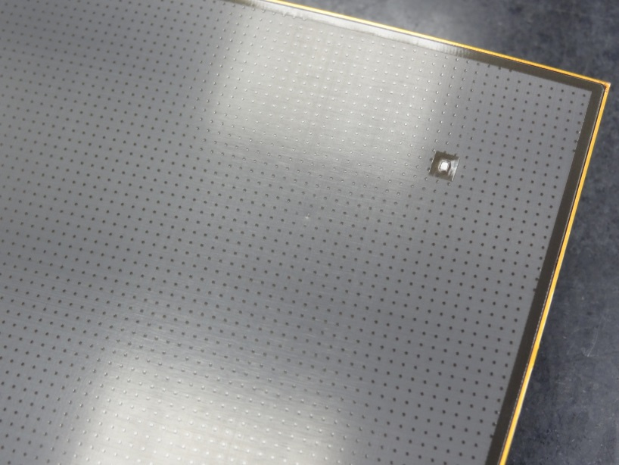
Mitigating distortions?
Leave the corner insulated and floating.
Burry the grounding of the resistive kapton.
(Not so easy)

Slide 20
Conclusion
A lot of experience has been gained in building and operating Micromegas TPC panels.
The characteristics of the Micromegas modules, such as the uniformity, energy resolution, stability have been studied in detail.
7 modules have been successfully tested with full integration of the electronics at the same time. 9 modules have been manufactured and characterized in a quasi-industrial process.
Thanks to the resistive technology, the measured resolution is about 60 microns at zero drift distance with 3 mm wide pads. This meets ILC needs.
Distortions are observed. Their detailed study will allow to correct them and improve the design to minimize them.

