Slide 1
Ion backflow measurements
P. Colas

Slide 2
Ion backflow measurements with Micromegas: 2002. 50micron gap, P10 gas
Published in NIM 2004, with model: IBF ~ Edrift/Eamp
Complete set of measurements with InGrids (Max Chefdeville, thesis). Confirms in detail the model

Slide 3
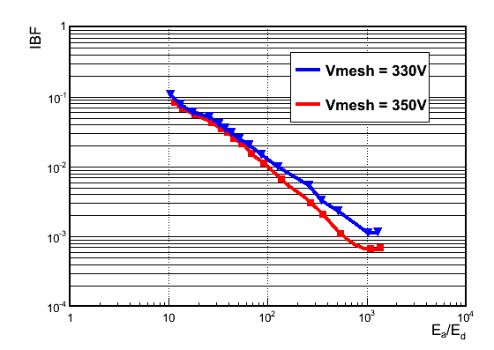
New measurements in Feb 2013
With T2K gas and 128 µ gap bulk (D. Attié, Purba and Sudeb Bhattacharya, S. Mukhopadhyay, N. Majumbar, W. Wang)
Confirms the 1/field ratio suppression

