Slide 1
Electronics for ILD TPC
LCTPC Collaboration meeting
DESY, June 1, 2013
P. Colas

Slide 2
Requirements (assumptions)
To be ready in 10-12 years (not much before, not later)
Very packed (7 to 21 mm² per channel)
Very thin (total 0.25 X° with the detector and cooling)
Low consumption (power-pulsable)
Low noise O(500 e-)

Slide 3
GdSP
GdSP (Paul Aspell et al.) would meet this need:
New Common Front End with VFAT3
Filter as in SALTRO and ALTRO
Various power regions for optimal pulsing
Optimized integrated ADC saving space and power
Technology to be revised. For the time being 130 nm (IBM), but will probably change. 128 channels per chip.

Slide 4
Present status
Presently, VFAT3/GdSP under development for CMS LS2 upgrade. Latest meeting May 22, 2013.
CFE : Fabrice Guilloux (AIDA) -> submission in September 2013?
ADC : Marek Idzik (too late to be included in a submit in 2014)
RAMs : student Jérôme Masson
DSP: Tina Sirea Naranjia. Need digital micro-electronics specialists for this part.

Slide 5
Road map evolution
Initially VFAT3 (for CMS) and GdSP (for LC TPC) were felt to go in the same project. Common Front End somewhat advanced.
Then ALICE joined (TPC and di-muon arm)
Recent evolution : ALICE does not choose VFAT3/GdSP (meeting May 22, 2013). They entrust a Brasilian Nuclear Physics lab to do both electronics (in 130 nm TSMC).
This task will probably escape CERN.

Slide 6
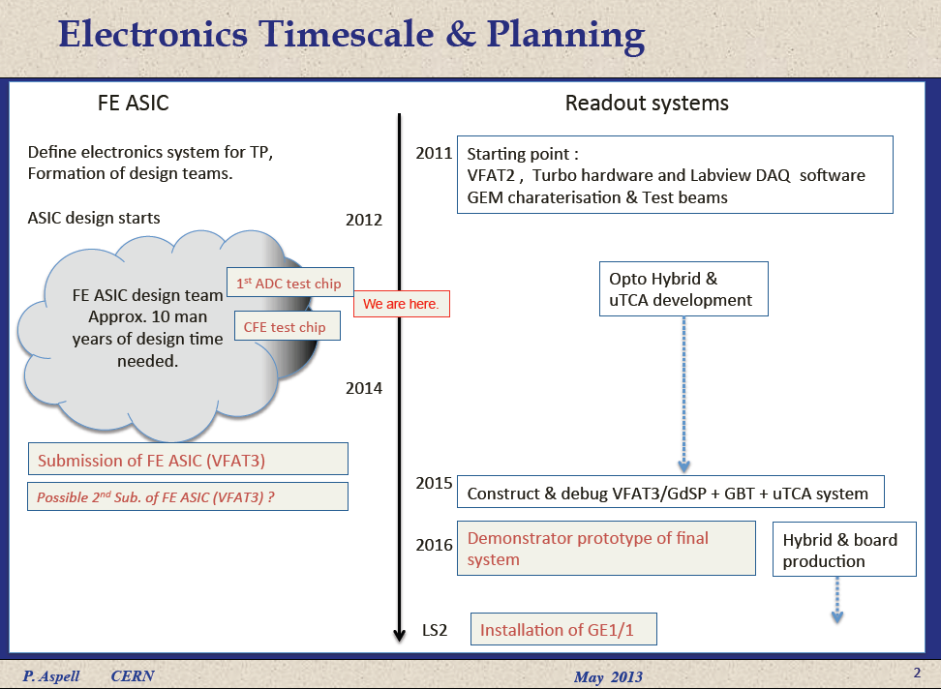

Slide 7
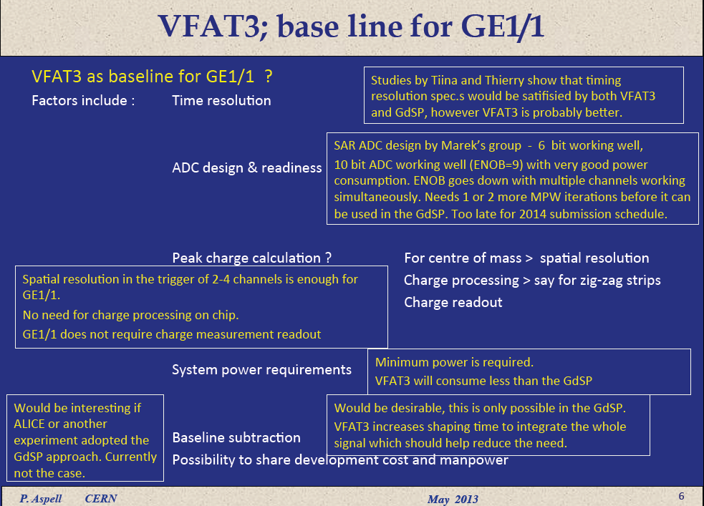

Slide 8
