Slide 1


Further Data Analysis April 2013 ATF Trip
Mikey Davis
03 May 2013
1/6

Slide 2
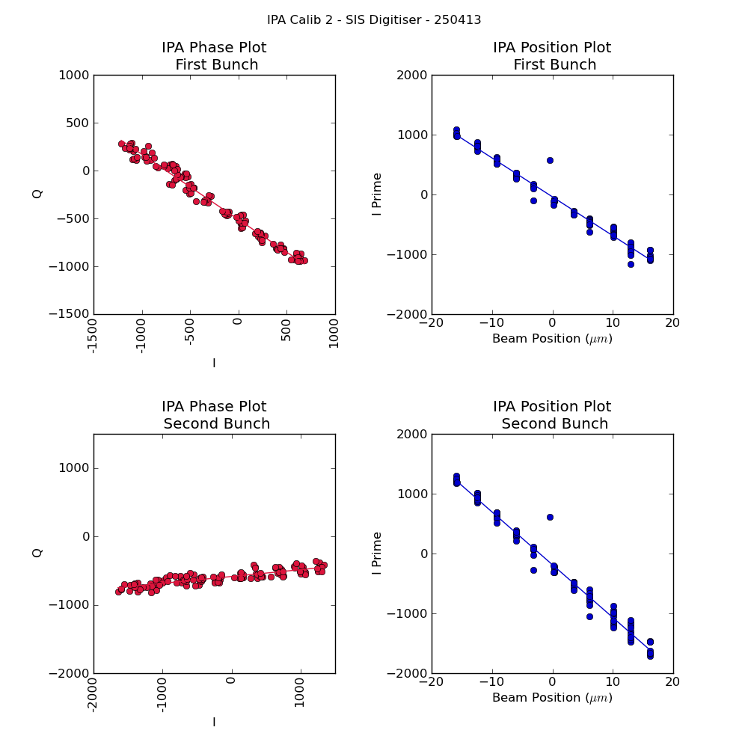
IPA Calib 2 Sis Dig
Mikey Davis
03 May 2013
2/6

Slide 3
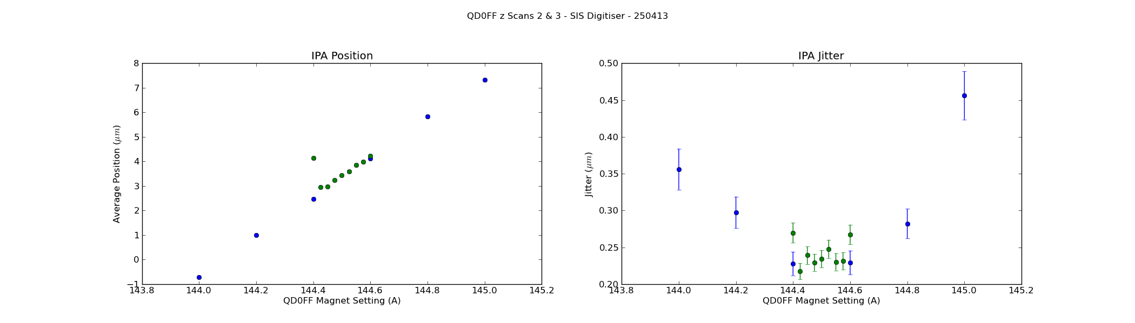
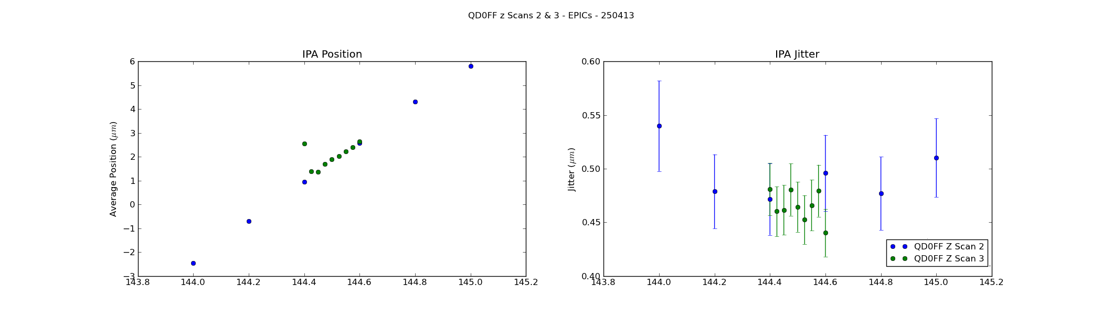
IPA QD0FF z Scans
Mikey Davis
03 May 2013
3/6

Slide 4
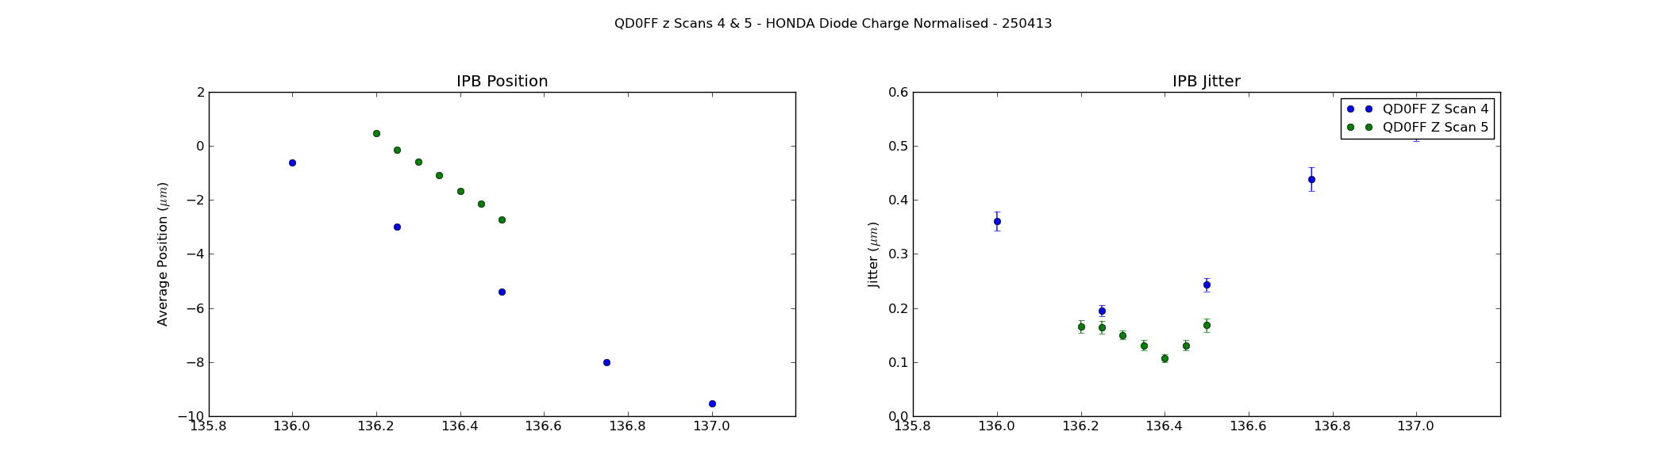
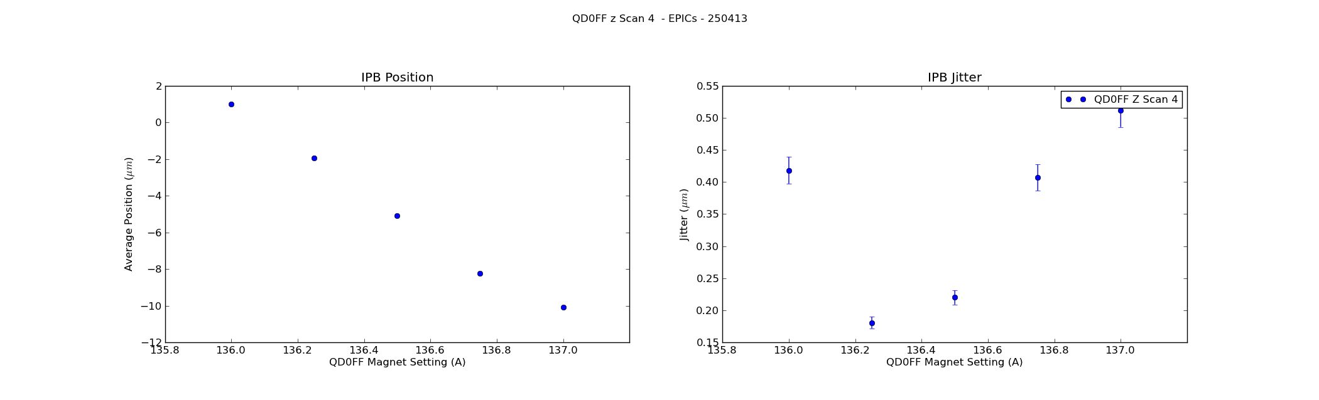
IPB QD0FF z Scans
Mikey Davis
03 May 2013
4/6

Slide 5
B 2 B Correlation
Run | P1(%) | P2(%) | P3(%)
fbRun1 | 86 | 93 | 97
fbRun2 | 84 | 93 | 94
fbRun3 | 87 | 94 | 98
fbRun4 | Only have feedback on data
Run | IPB(%)
Ipfb1 | 28
Ipfb2 | 57
Ipfb3 | 40
ipfb4 | 64
Mikey Davis
03 May 2013
5/6

Slide 6
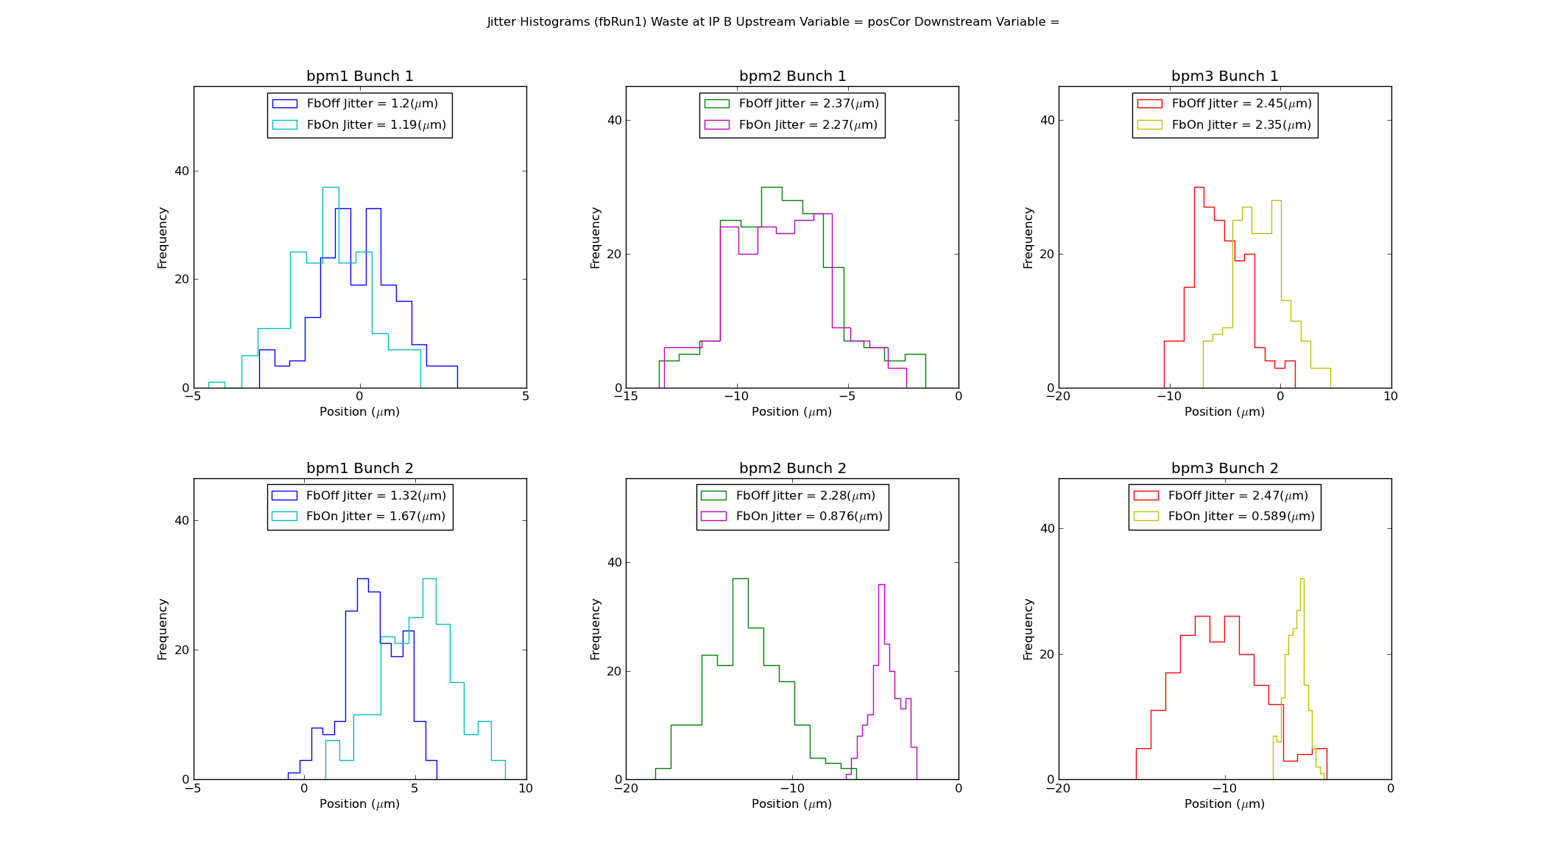
fbRun 1 - Upstream
Mikey Davis
03 May 2013
6/6

