Slide 1
Baseline runs
N. Blaskovic

Slide 2
Introduction
‘Baseline runs’ were taken where only the LO was supplied to the homodyne second stage electronics, with no IP BPM signal:
LO
I
terminated
FONT5 or SIS
Q

Slide 3
Reference cavity LO
Noise jitter (in ADC counts):
using FONT5 board with different 2nd stages
using SIS digitiser (which 2nd stage?)

Slide 4
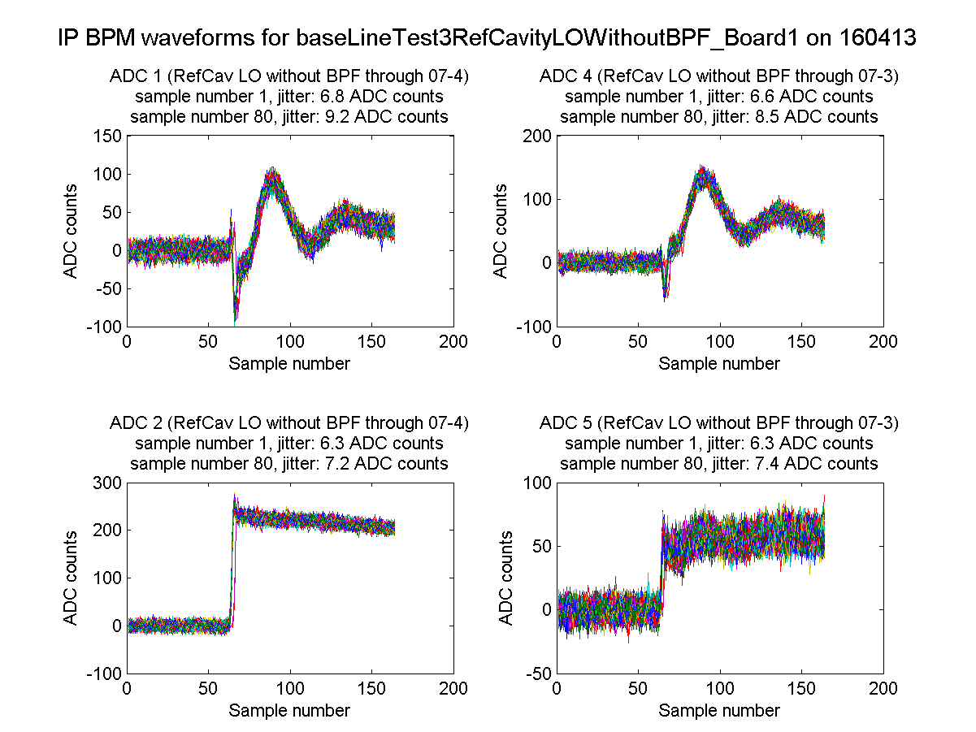
Reference cavity LO, FONT5 board
2nd stage 07-3
N. Blaskovic

Slide 5
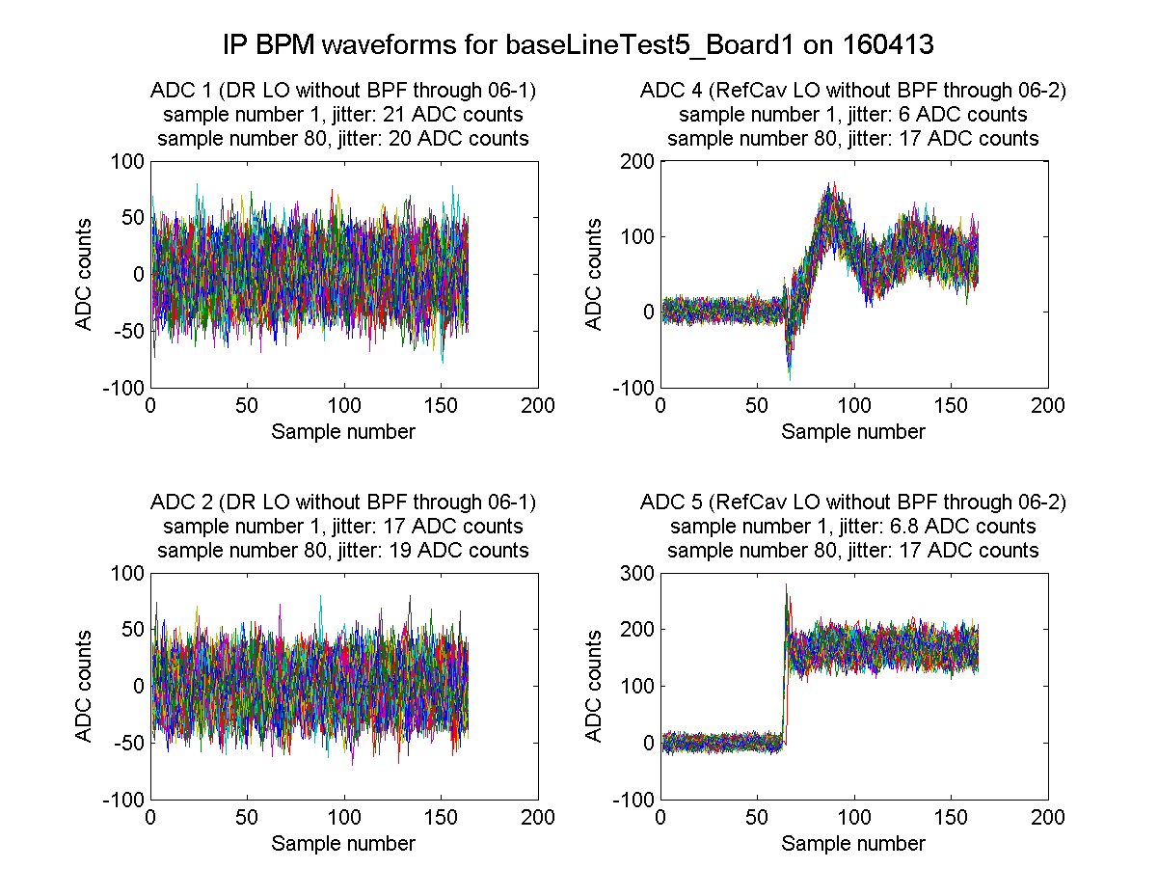
Reference cavity LO, FONT5 board
2nd stage 07-3
2nd stage 06-2
N. Blaskovic

Slide 6
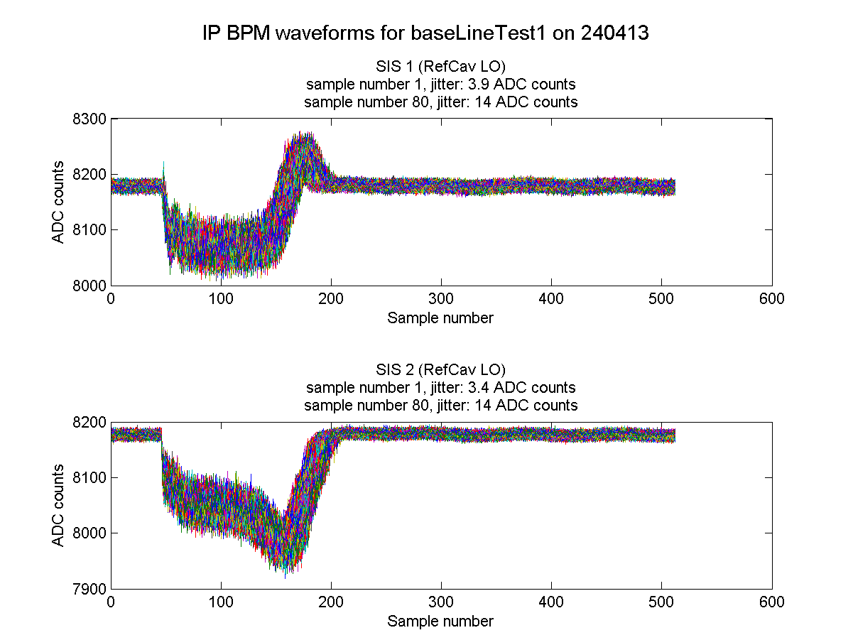
Reference cavity LO, SIS digitiser
N. Blaskovic

Slide 7
Other sources of LO
Noise jitters (in ADCs) for other LOs:
Damping ring LO
Signal generator 714 MHz LO
Record of which 2nd stage modules used not found.

Slide 8
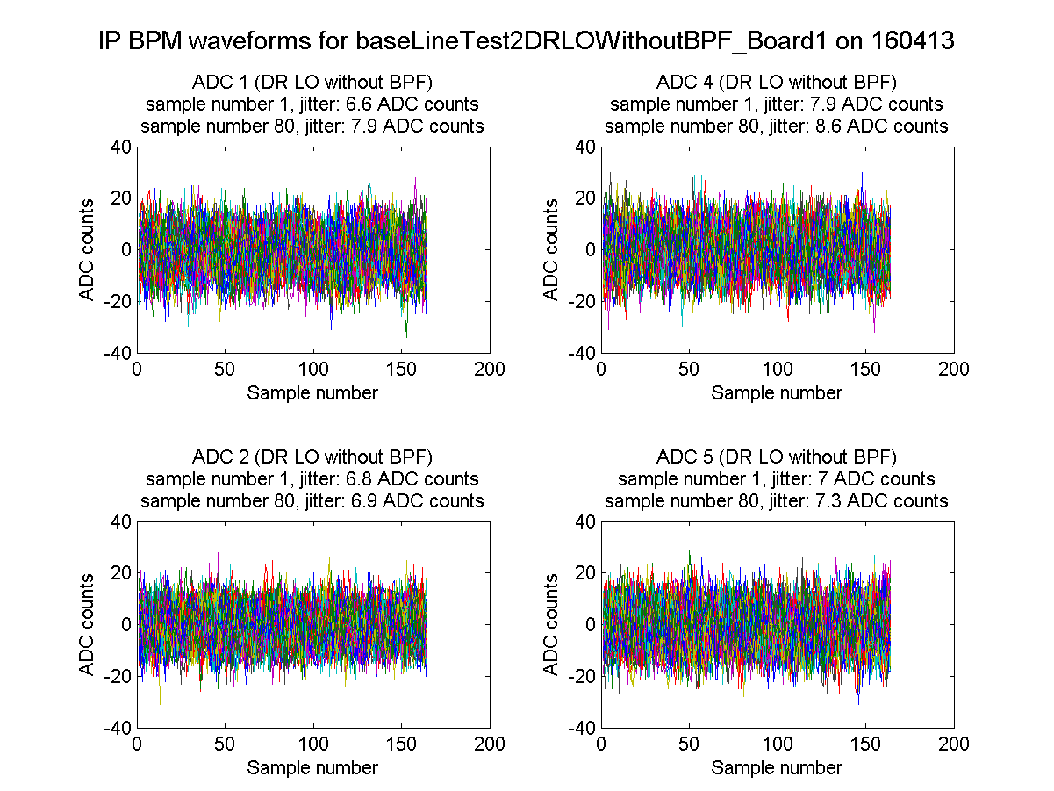
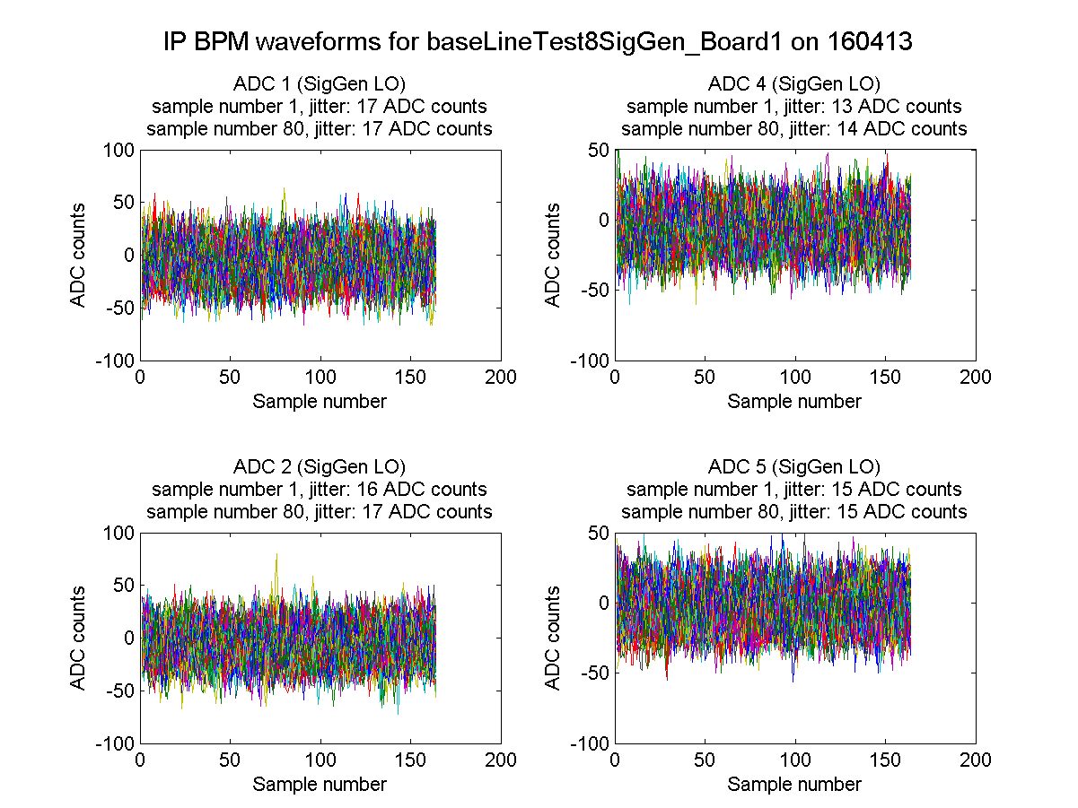
Damping ring LO,
FONT5 board
Signal generator LO,
FONT5 board
N. Blaskovic

Slide 9
Summary
 | Noise jitter (ADC counts)
Using FONT5 board | 6~17
Using SIS digitiser | 4~14
Noise jitter is affected by homodyne 2nd stage module. Noise jitter may also be affected by choice of LO and/or digitiser.

Slide 10
Appendix
Digitiser | Noise jitter (ADC counts) | Scale factor (um/ADC)
FONT5 | 6~17 | 0.005
SIS | 4~14 | 0.01
Scale factor given by Mikey obtained from a calibration with beam at a homodyne variable attenuator setting of 0 dB.

Slide 11
Appendix
Over the following slides, waveforms for baseline runs taken
using FONT5 digitiser on 16 Apr 2013
using SIS digitiser on 24 Apr 2013

Slide 12
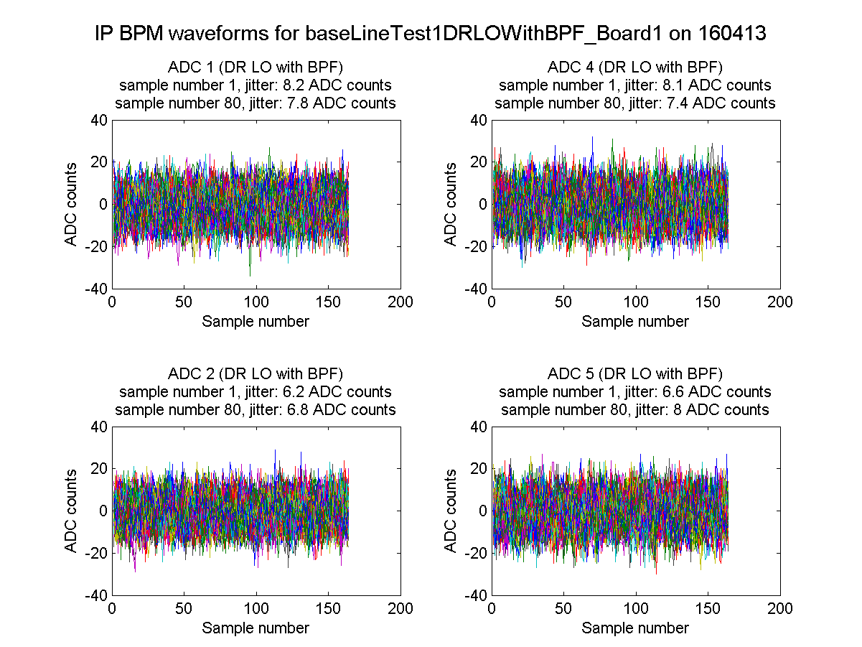
N. Blaskovic

Slide 13
N. Blaskovic

Slide 14
N. Blaskovic

Slide 15
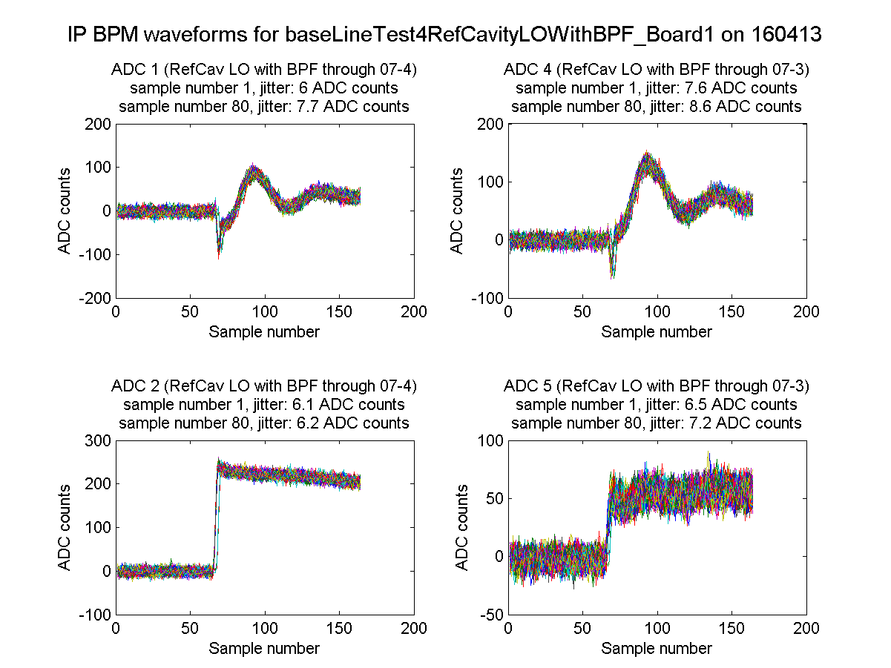
N. Blaskovic

Slide 16
N. Blaskovic

Slide 17
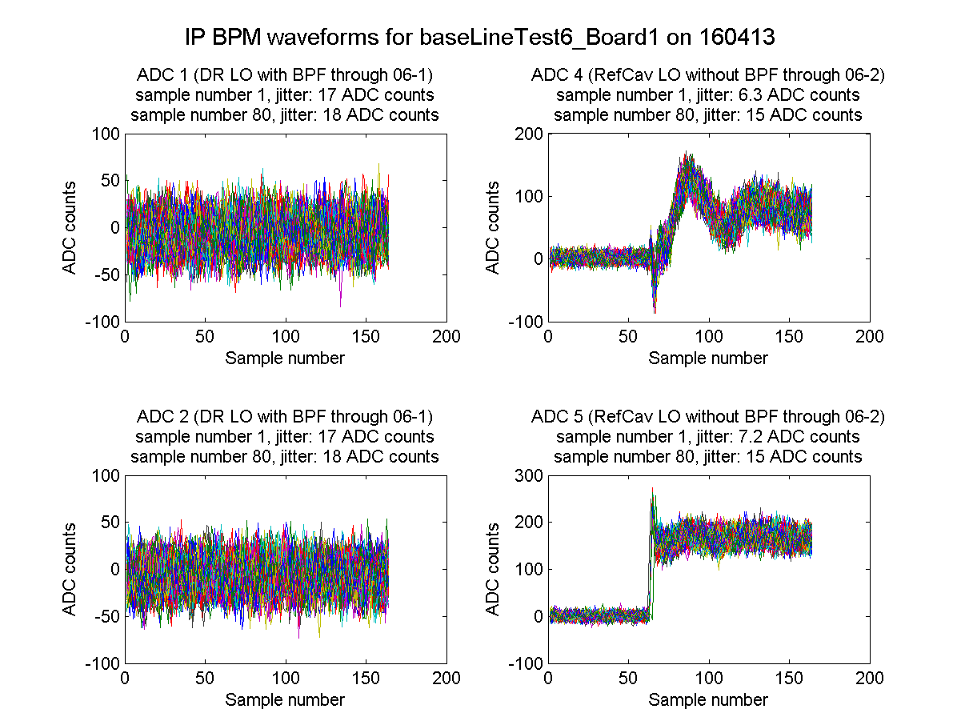
N. Blaskovic

Slide 18
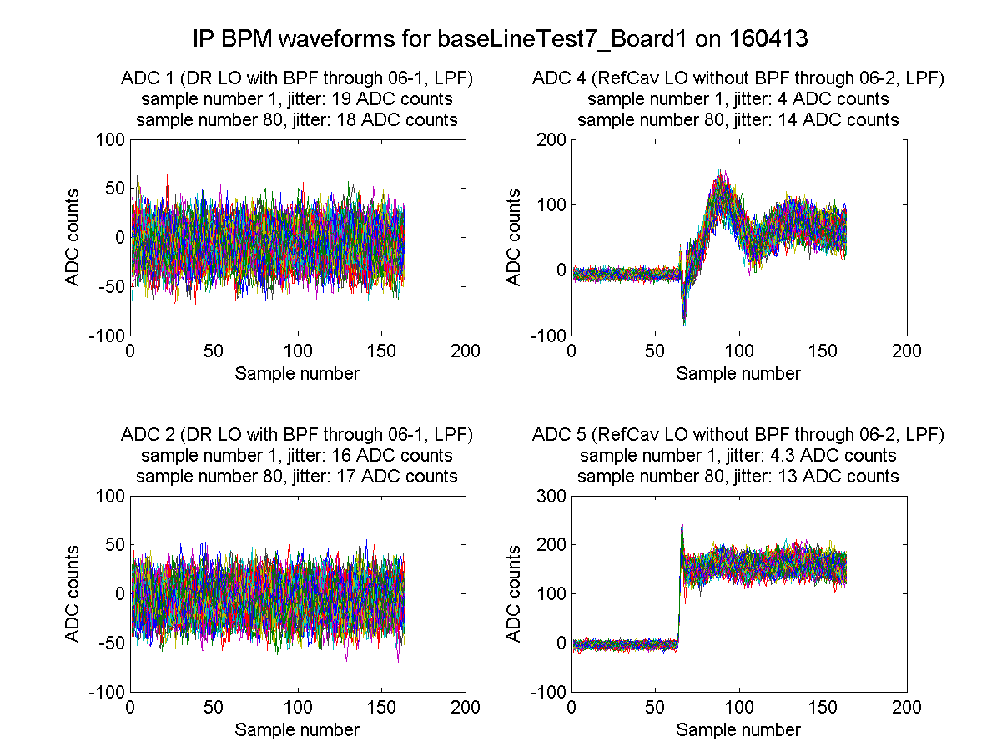
N. Blaskovic

Slide 19
N. Blaskovic

Slide 20
N. Blaskovic

