Slide 1
Fourier transforms of baseline runs
N. Blaskovic

Slide 2
Introduction
‘Baseline runs’ were taken where only the LO was supplied to the homodyne second stage electronics, with no IP BPM signal.
The FONT5 board was used to digitise baseline runs using (in turn) damping ring, signal generator and reference cavity LO.
The SIS digitiser was used with the reference cavity only.

Slide 3
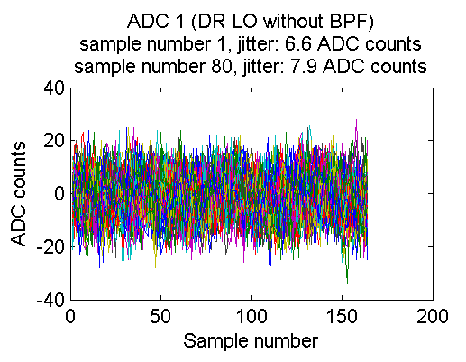
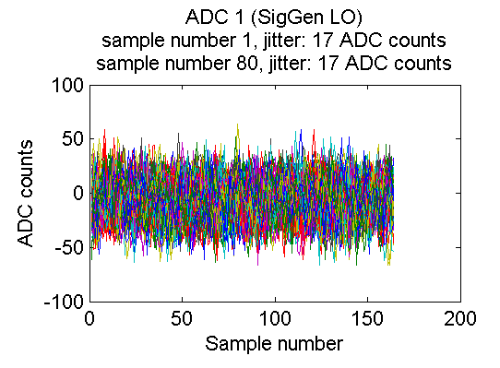
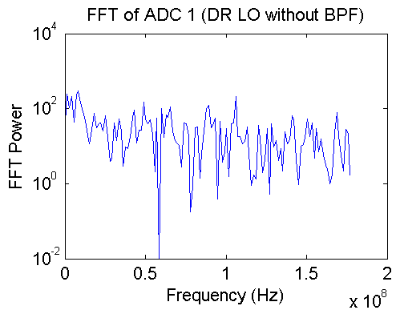
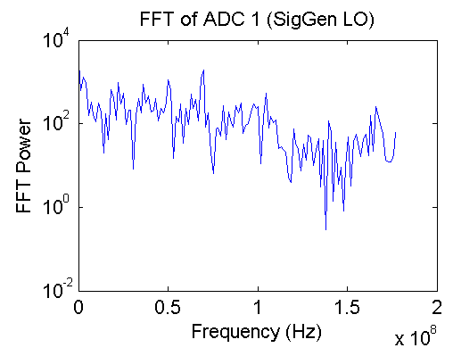
Damping ring LO,
FONT5 board
Signal generator LO,
FONT5 board
N. Blaskovic

Slide 4
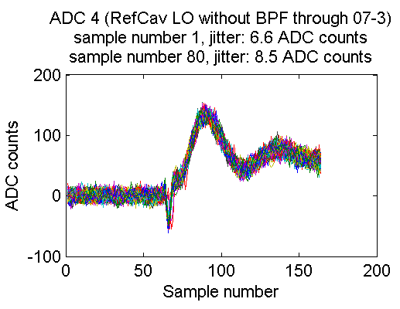
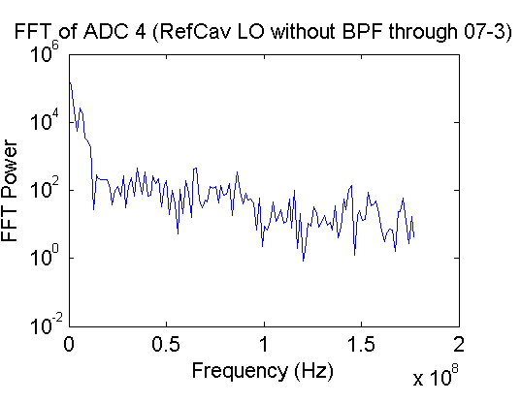
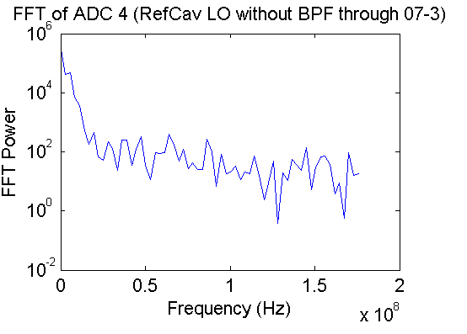
Reference cavity LO,
2nd stage 07-3,
FONT5 board
Samples 1 to 164
Samples 70 to 164
N. Blaskovic

Slide 5
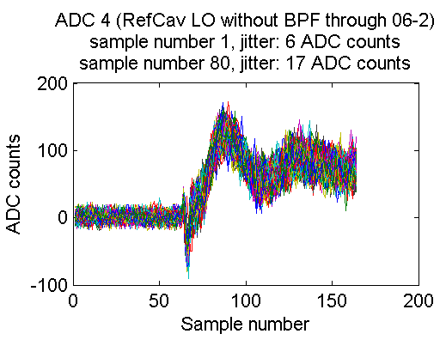
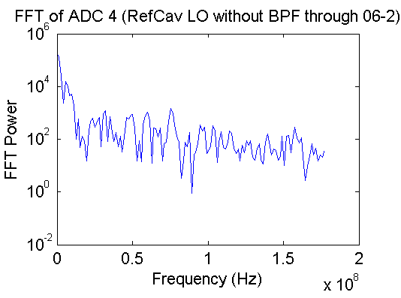
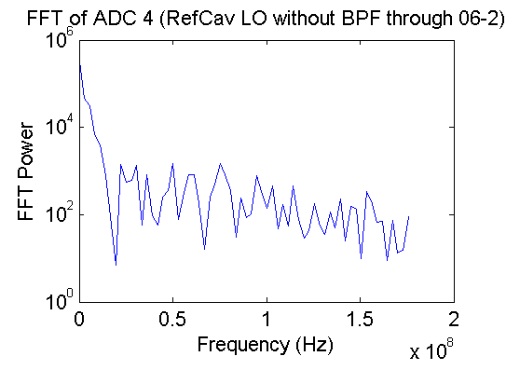
Reference cavity LO,
2nd stage 06-2,
FONT5 board
Samples 1 to 164
Samples 70 to 164
N. Blaskovic

Slide 6
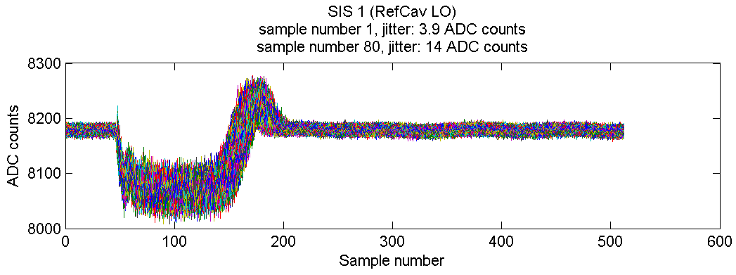
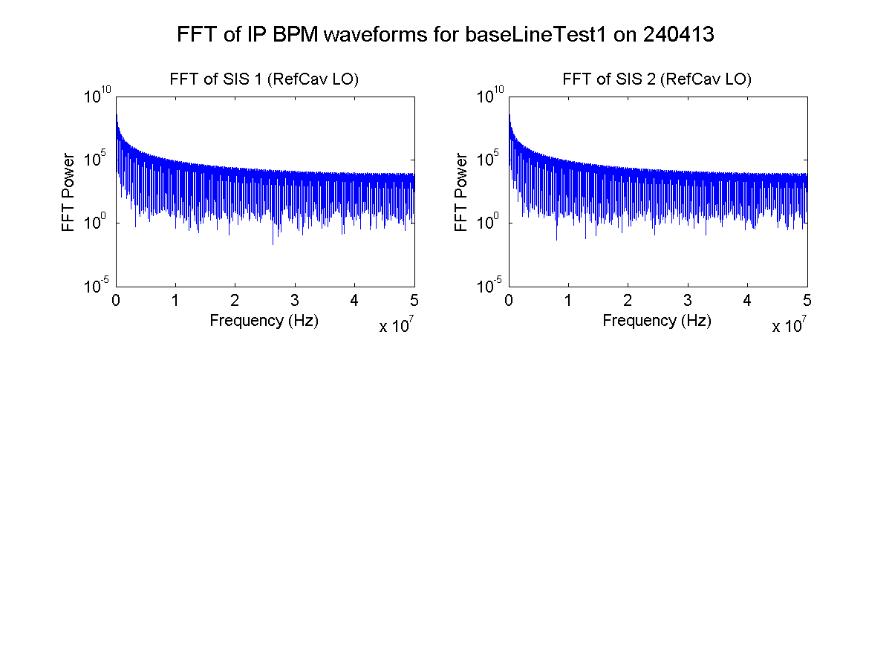
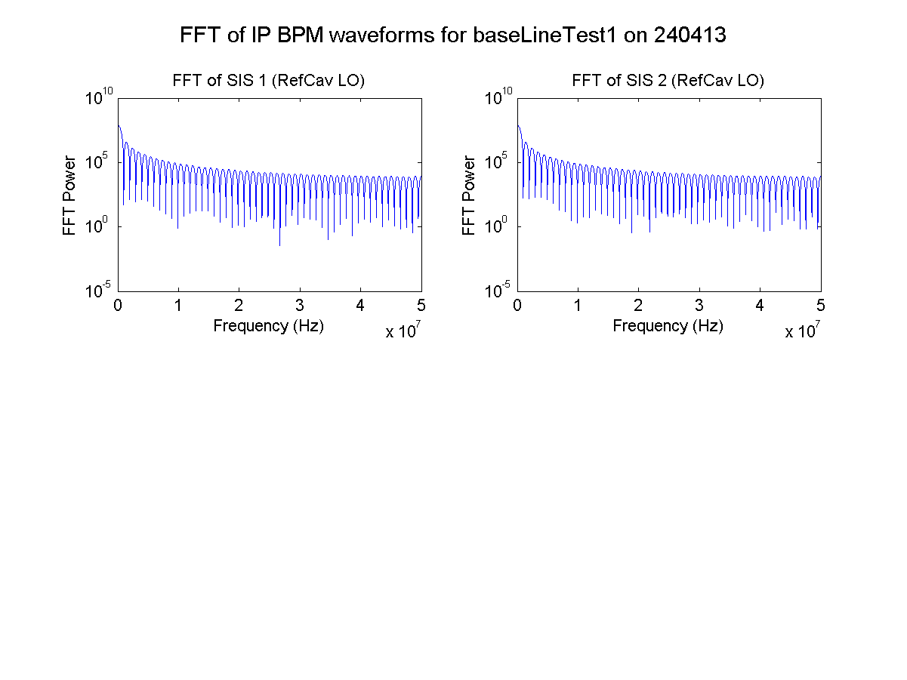
Ref cavity LO,
SIS digitiser
Samples 1 to 512
Samples 50 to 150
N. Blaskovic

