Slide 1
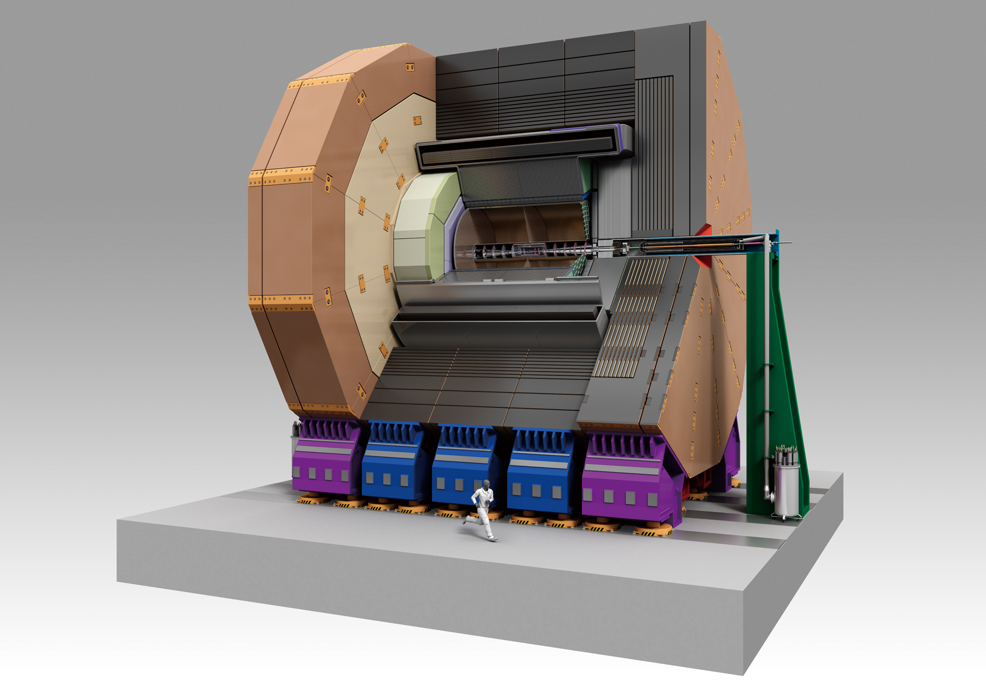







ILD Status
Taikan Suehara
Tohoku University

Slide 2
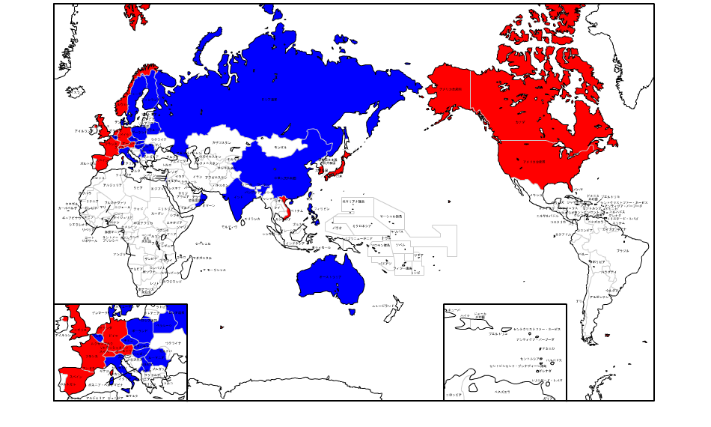
ILD worldwide
Latest ILD workshop in Japan (2012)
ILD LoI Signatories (2008)

Slide 3
ILD Timelines/Workshops
2007 Unification of GLD & LDC
  2008.1 ILDWS DESY
  2008.9 ILDWS Cambridge
  2009.2 ILDWS Seoul
2009.3 Letter of Intent
  2010.1 ILDWS Paris
  2011.5 ILDWS Orsay
  2012.4 ILDWS Kyushu
2012.12 DBD Report
Intensive physics
studies for LoI
Detector R&D
Intensive physics
studies for DBD

Slide 4
ILD Organization

Slide 5

ILD detector
Components:
Vertex
Silicon tracking
(SIT/SET/ETD/FTD)
Gas TPC
ECAL/HCAL/FCAL
SC Coil (3.5 Tesla)
Muon in Iron Yoke

Slide 6
ILD Tracking System
Technology | Silicon Pixel | Silicon Strip | Gas TPC
Detector | VTX / FTD (inner) | SIT/SET/ETD/ FTD (outer) | TPC
Point resolution | ◎ | ○ | △
Time resolution | △ | ◎ (2 ns by topology)
Occupancy | ◎ | △ | △
Number of points | △ | △ | ◎

Slide 7
1. Vertex Detector
Target: 5 μm IP resolution for high-p tracks
within high background environment
3 x 2 layers: r = 16 & 18, 35 & 37, 58 & 60 mm
(option: equally spaced 5 layers at 15-60 mm)
Length: 125 mm (first 2 layers) & 250 mm (others)
cosθ up to 0.9-0.97 is covered
Technology | CMOS | FPCCD | DEPFET
Pixel size | 17 / 34 um | 5 / 10 um | 20 / ? um
Readout time | 50 / 100 us | Slow (intra-train) | 50 / 100 us
Resolution | 2.8 / 4 um | 1.4 / 2.9 um | Similar to CMOS
Temperature | 30 C | -40 C | 30 C
Heat | 10 W | 35 W | 10 W
Cooling | Air or N2 | CO2 (two phase) | Air or N2
Radiation | Proved | Will be checked
Technology | Matured | Advanced | Used in Belle2

Slide 8
2. Silicon Tracking
Detectors
SIT – 2 layers of strips between VTX & TPC
SET, ETD – 1 layer strip after TPC (barrel, endcap)
FTD – 7 discs
  Inner 2 discs: pixel (similar to the vertex detector)
  Outer 5 discs: strip (similar to SIT/SET/ETD)
Functions / merits
Precise space points to connect VTX/TPC/ECAL
Time stamping
Calibration of TPC
Close collaboration with
SiLC / SiD / LHC groups

Slide 9
3. Time Projection Chamber
Target: δ(1/p_{T}) ~ 10⁻⁴ /GeV/c (TPC only)
TPC characteristics:
Continuous tracks
strong for off-axis tracks
Low material in barrel region
TPC issues
Field distortion by ions
  Primary ion effect is not critical
  ion-gate to avoid secondary ion
Gas amplification
  Micromegas
  GEM
Readout
  Pad (1 x 6 mm)
  Pixel
track at test beam

Slide 10
Tracking Software / Performance
Current design of the tracking
Silicon tracking
(pattern rec. + Kalman)
using VTX + SIT + FTD
-> SiTracks
Clupatra for TPC tracking
Refitting SiTracks
and TPC tracks
impact parameter resolution
tracking efficiency on ttbar events
track momentum resolution

Slide 11
ILD Calorimeter System
Highly granular calorimetry
is essential to Particle Flow.
Good coverage in forward
region is also important.
ECAL, HCAL, FCAL(LumiCal, LHCAL, BeamCal)

Slide 12
1. Electromagnetic Calorimeter
Granularity of ECAL
is critical for PFA
-> 5 mm “pixel” for ILD
Two options
Silicon tiles
Scintillator strips
Beam test at larger tiles
gives σ ~ 15 % / √E
with good linearity in both
 | SiECAL | ScECAL
Absorber | Tungsten | Tungsten
Sensor | Si tile | Plastic sci. strip
Granularity | 5 x 5 mm² | 5 x 45 mm²
Cost | High | Low (~ half of Si)
Perf. at Z pole qq | ◎ | ◎
Perf. at high E qq | ◎ | ○ (software ?)
Hybrid option is
being investigated

Slide 13
2. Hadron Calorimeter

Slide 14
Perticle Flow Performance

Slide 15
Other Components

Slide 16
Jet Clustering / Flavor Tagging

Slide 17
DBD Physics Analyses
E/L | Process | Measure | Stat. error | Comments
√s = 1 TeV L = 0.5 ab⁻¹ for each P = (-80,+20) / (+80,-20) | ννh->ννbb | ΔσBR /σBR for each P | 0.54 / 2.1 %
 | ννh->ννcc |  | 5.7 / 36.8 %
 | ννh->ννgg |  | 3.9 / 25.7 %
 | ννh->ννWW*(4j) |  | 3.6 / 23.7 %
 | ννh->ννμμ |  | 41% / -
 | ee->WW | ΔP/P for e-/e+ | 0.19 / 1.13 %
 | tth | Δg_{tth}/g_{tth} | 4.3 % | 6 + 8 jets
500 GeV | tt hadronic | A_{FB} | 3.0 / 3.2 % | Consistent to LoI
500 GeV | Zhh + ννhh | Δλ/λ | 44 % | 2ab-1
1 TeV | ννhh | Δλ/λ | 18 % | 2ab-1, Preliminary
500 GeV | tt semileptonic | A_{FB} λ_{t} | 1.7 / 1.3 % 3.3 / 3.7 %

Slide 18
1 TeV Analysis: ννh -> ννqq
H.Ono
Conditions:
DBD, m_{H} = 125 GeV
γγ->hadron overlayed
k_{T} jet clustering 2j
forced 2-jet, R = 1.1
LCFIPlus re-JC & flavor tag
Cuts on:
E_{BCAL} < 50 GeV
Thrust < 0.95
100 < E_{vis} < 400 GeV
P_{T} > 50 GeV
N_{chargedPFO} > 15
|cosθ_{h}| < 0.95
110 < M_{jj} < 150 GeV
No BG
R=0.8
R=1.1
R=1.4
sig only
Including b-likeness cut
Eff. ~ 35%
Pur. ~ 33%

Slide 19
1 TeV Analysis: ννh -> ννqq
H.Ono
Template fit with b-, c-, bc- likeness; Toy-MC with 5000 data sets
DATA
h->others
SM bkg.
h->bb
h->cc
h->gg
cf. 500 GeV
LoI, m_{H}=120
1 TeV DBD
m_{H} = 125

Slide 20
1 TeV Analysis: ννh -> ννWW*
H.Ono
Conditions: Almost the same as qq
4-jet clustering instead of 2j
Cuts on:
E_{BCAL} ,Thrust, E_{vis}, P_{T}, N_{cPFO} > 25
|cosθ_{j}| < 0.9
Y₂₃ and Y₃₄ (JC threshold)
Anti-btag (sum b-like < 0.8)
60 < M_{W1} < 95 GeV
15 < M_{W2} < 60 GeV
110 < M_{h} < 140 GeV
Just
counting
S & N
after cuts

Slide 21
1 TeV Analysis: ννh -> ννμμ
C.Calancha
preselection cuts
N = only 45 with 1 TeV, 500 fb⁻¹ P(-0.8, 0.2)
optimized cuts for S/√S+B
124 – 126 GeV window: S=14.95, B=21.96, ~2.3σ
S/√S+B = 0.444 ± 0.015, ΔσBr/σBr = 44 ± 3 %

Slide 22
1 TeV Analysis: WW
A.Rosca
Target: luminosity-weighted
polarization measurement
Procedure:
Use only semileptonic WW
(for charge/mass reconstruction)
Preselection by N_{PFO}, P_{T}, E_{vis}, m_{vis}
Isolated lepton selection
kT jet clustering: R=1.3, 2-jet
2C kinematic fit
Tau veto & Mass & cosθ_{W} cut
Polarization calculation:
Brondel scheme: use σ for
(++),(+-),(-+),(--) = (1:1:1:1) data
Angular fit: use cosθ_{W} distribution
to be compared with templates
(++),(+-),(-+),(--) = (1:4:4:1) or
(+-),(-+) only
1ab⁻¹ result

Slide 23
1 TeV Analysis: tth
T.Price et al.
Direct measurement of top-Yukawa coupling
N_{tth} (6qlν) = 629, n_{tth} (8q) = 653 at 500 fb⁻¹ each pol.
6qln
8q
Procedure:
Use 8q / 6qlν final states
Isolated lepton search
based on E_{lep}/E_{jet}
4-momentum cons. for p_{ν}
k_{T} JC w/R=1.2 for γγ->hadron
χ²-based jet-pair selection
with b-tag value by LCFIPlus
Variables for cuts or TMVA:
N_{isolep}, E_{vis}, N_{PFO}, thrust
Jet Clustering y_{ij}
b-tag (3rd and 4th largest)
Helicity of Higgs decay
g_{tth} can be determined by 4.3%
with TMVA BDT results

Slide 24
500 GeV: tt hadronic
To repeat the LoI analysis with improved geometry and software
Procedure:
Signal only (no process bkg.)
gg -> hadron is overlayed
6-jet clustering by LCFIPlus
(Durham based)
2 b-tag by LCFIPlus -> 2 tops
χ² based jet-pair selection
χ² cut, mass cut
Jet charge determination
(LCFIPlus)
Calculate A_{FB}
jet charge distribution - consistent with LoI
almost the same result
as LoI is obtained

Slide 25
Zhh and ννhh at 500 and 1000 GeV
500 GeV result
J.Tian
category | S | B | S/√B
bbbbbb | 13.6 | 30.7 | 2.2
qqbbbb | 18.8 | 90.6 | 1.9
ννbbbb | 8.5 | 7.9 | 2.5
eebbbb | 3.7 | 4.3 | 1.5
μμbbbb | 4.5 | 6.0 | 1.5
500 GeV – Zhh dominant
(6f – heavy tt background)
1 TeV – ννhh dominant
Combined: σ = 0.22 ± 0.06 fb, 5.0 σ excess
Δλ_{hhh} / λ_{hhh} = 44% (incl. event weighting)
Condition:
m_{H} = 120 GeV, 2 ab⁻¹
no γγ -> hadrons
Zhh: 5 categories of Z
bb, qq, νν, ee, μμ
Durham JC, LCFIPlus
Using TMVA MLPs
for bkg. separation
1 TeV result
S = 35.7, B = 33.7, 7.2 σ excess
Δλ_{hhh} / λ_{hhh} = 18% (incl. event weighting)
better sensitivity on λ_{hhh} mainly
comes from larger dependence of σ on λ_{hhh}

Slide 26
tt semileptonic at 500 GeV
Semiletonic is more suitable for A_{FB} because of easier charge determination
cosθ_{top}
lepton angle
AFB (hadronic)
2.9%
3.2%
usable for determining
top form factors

Slide 27
Reprocessing 250/350/500 GeV
For staged construction of ILC, 250 GeV performance with latest software is critical.
250/350/500 GeV DBD sample is almost ready.
Higgs recoil & Br. analysis will be redone
for snowmass input
Plenty of other physics programs still ongoing
  tt threshold analysis at 350 GeV for top-Yukawa
  h -> ττ analysis (3.5% obtained with LoI sample)
  (those two are also for snowmass)
  Zhh with h->bbWW*
  Exotic Higgs search (CP-odd Higgs, charged Higgs)
  more coming...

Slide 28
ILD Cost

Slide 29
Summary

