Slide 1
Initial Data Analysis From CTF3 Trip 8th-10th May
G. Christian, D. Bett, J. Roberts, D. Gamba

Slide 2
Last meeting
Set up FONT5 board in rack by phase monitors.
Frank Tecker provided us with a trigger locked to the beam and with variable delay.
Collected data using the old firmware
Pulse not stable in sampling window due to reliance on ring clock.
System stable otherwise and able to run DAQ from control room via remote desktop.
Issues uploading new firmware to FONT5 board.

Slide 3
Progress
We managed to upload the new firmware to the board (corrupted file?)
Doug made changes to the DAQ to work with the new firmware.
Successfully took data with various beam conditions.
Started data analysis.

Slide 4
Data Collected
Trigger = 0.8 Hz, 50 pulses ~ 1 minute data taking.
Data Runs:
350 pulses with nominal phase and original setup.
Leading and trailing edge of the pulse (noise).
LO Phase Scans – coarse scan and fine scan.
Beam with no phase switches.
Beam with shorter pulse lengths.

Slide 5
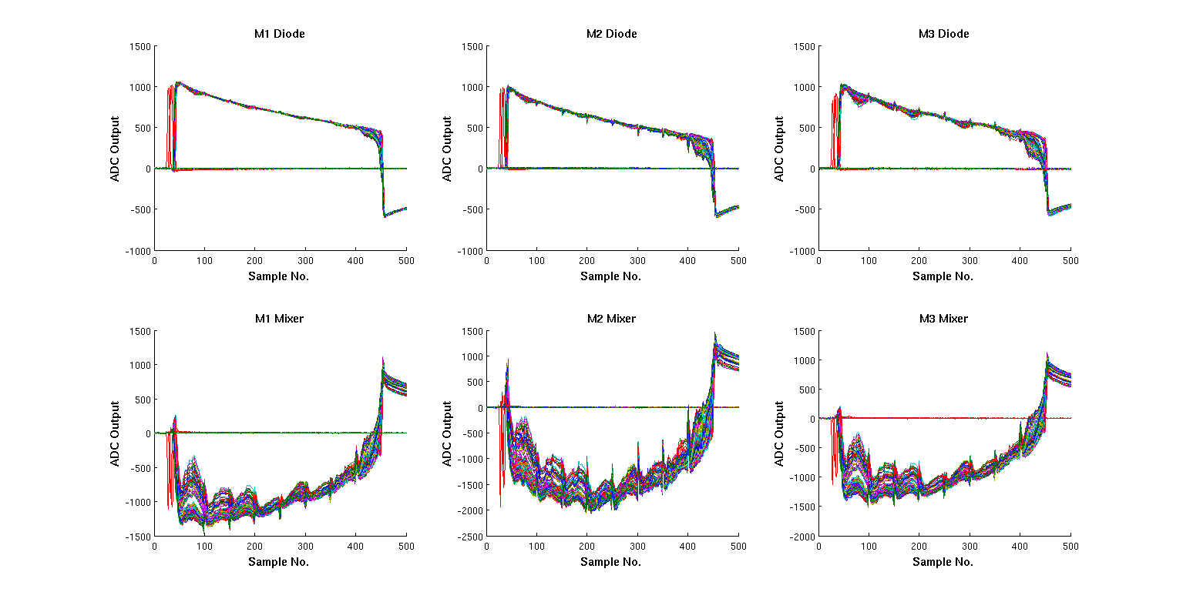
350 Pulse Run with 12GHz Beam and Original Setup
Jitter on diode at end of pulse
Empty triggers/short pulses
(Klystron trips etc.)

Slide 6
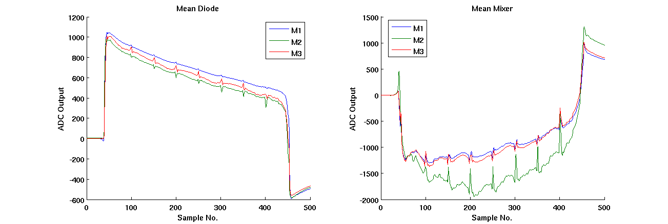
Channel Means (excl. bad triggers)
ADC Droop
180º Phase Switches

Slide 7
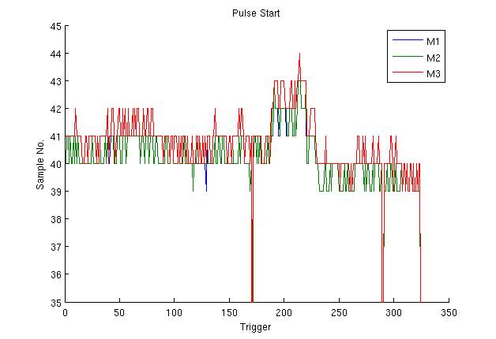
Stability of Pulse in Sampling Window
Pulse start in sampling window stable to within a couple of samples.
Some drift in the last third of the run (beam effect?)
Probably about what’s expected without a synchronous clock.

Slide 8
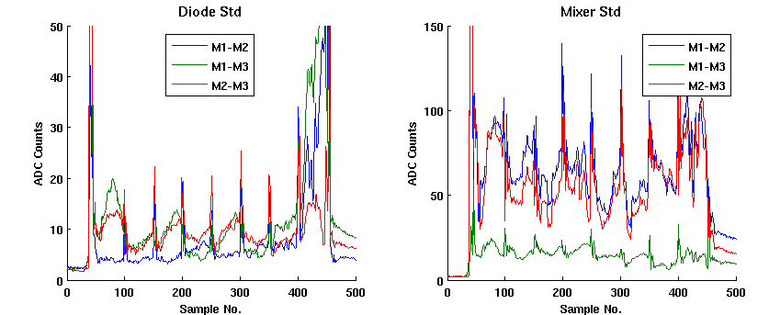
Standard Deviations of Differences
Standard deviation of the difference between the response of two monitors for each possible combination.

Slide 9
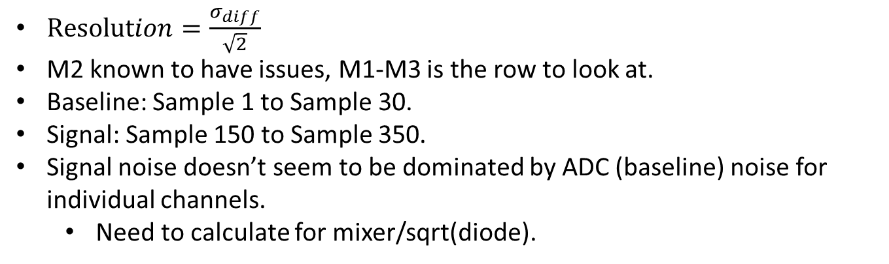
Resolutions
 | Diode Baseline | Diode Signal | Mixer Baseline | Mixer Signal
M1 – M2 | 1.68 | 3.89 | 1.59 | 40.78
M1 – M3 | 1.35 | 5.35 | 1.25 | 11.16
M2 – M3 | 1.70 | 6.42 | 1.58 | 33.09
$Resolution=\frac{σ_{diff}}{\sqrt{2}}$
M2 known to have issues, M1-M3 is the row to look at.
Baseline: Sample 1 to Sample 30.
Signal: Sample 150 to Sample 350.
Signal noise doesn’t seem to be dominated by ADC (baseline) noise for individual channels.
Need to calculate for mixer/sqrt(diode).

Slide 10
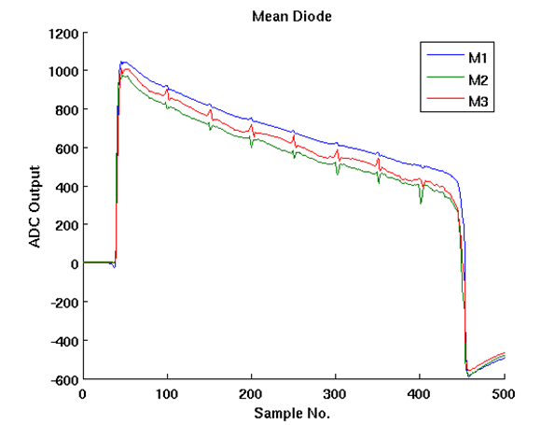

ADC Droop
Long 1 µs pulse at CTF3 – see droop in ADC response.
Complicates calibrations (shown later).
Can characterise using an exponential fit:
$$\text{Diode}=a \text{exp}(−t/T)$$
$$a=A^{2}$$
$$t=\text{Samples} \text{from} \text{peak}\text{.}$$
$$\text{T}\text{ = }\text{Decay} \text{constant}$$

Slide 11
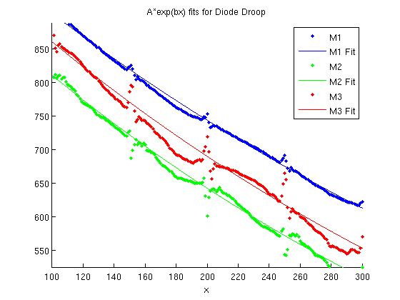
ADC Droop - Fit
Monitor | a | T | Fit R²
M1 (ADC1) | 1004 | 517 | 0.997
M2 (ADC4) | 925 | 431 | 0.995
M3 (ADC7) | 971 | 454 | 0.981

Slide 12
Coarse LO Scan
We have access to a manual phase shifter for the LO used by the monitor mixers.
Nominal phase shifter setting was 87º of 1 GHz.
Collected 50 pulses for shifter settings 72º to 102º in steps of 3º.
This corresponds to ±180º at 12 GHz (monitors).

Slide 13
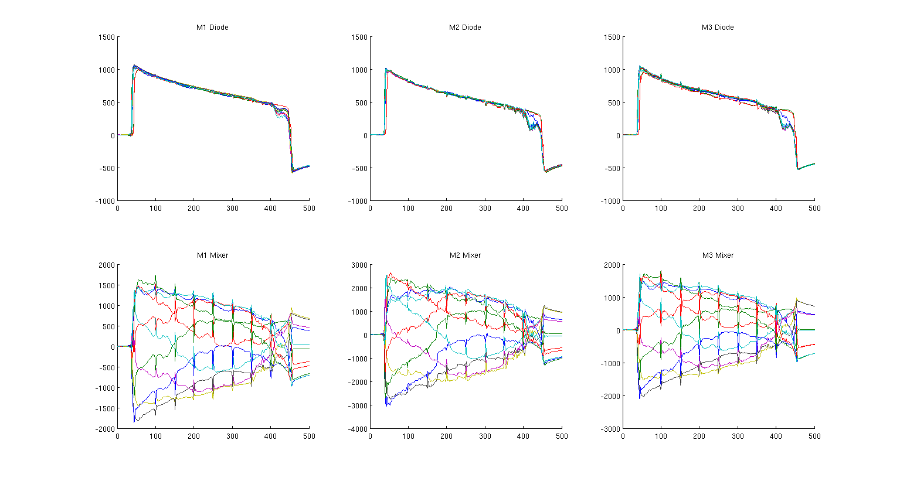
Mean for All Phase Settings

Slide 14
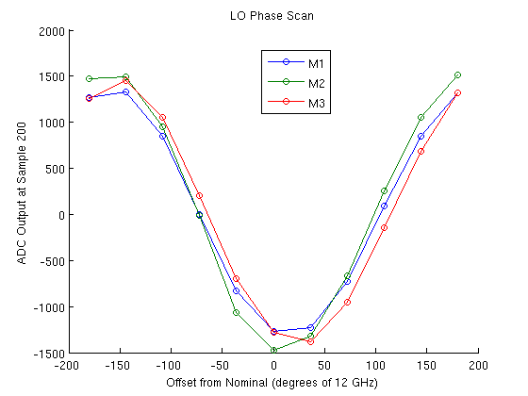
ADC Output vs. Phase Setting
Nicely shows a sine curve through ±180º as expected.
We assumed the nominal setting was the optimal setting... It’s the opposite!

Slide 15
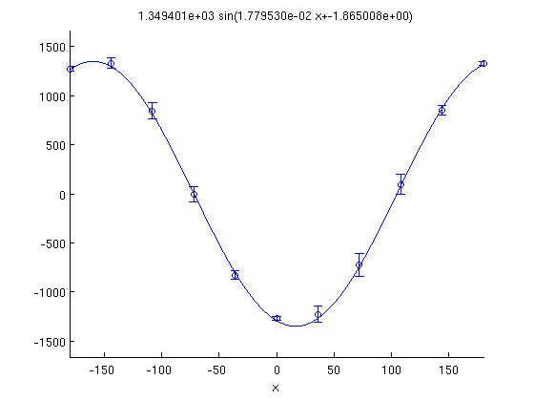
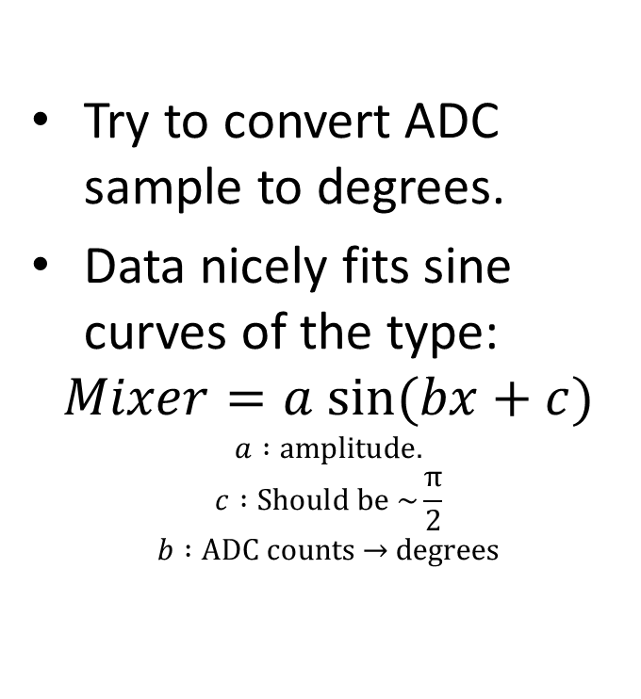
Calibration Attempt – Sine Fit
Try to convert ADC sample to degrees.
Data nicely fits sine curves of the type:
$$Mixer=a sin⁡(bx+c)$$
$$a :\text{amplitude}\text{.}$$
$$c :\text{Should} \text{be}\text{ \sim }\frac{\text{π}}{\text{2}}$$
$$b :\text{ADC} \text{counts}\text{ → }\text{degrees}$$

Slide 16
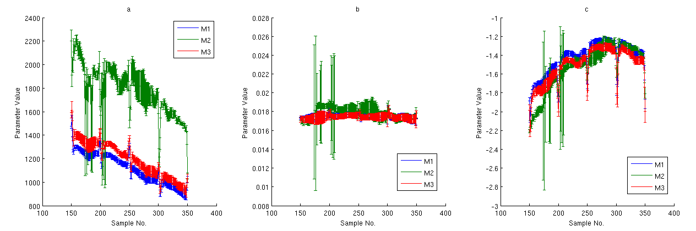
Fit “Constants”
Because of the ADC droop the fit parameters aren’t constant with sample number.
b is fairly constant, with values:
Monitor | b
M1 | 0.0176 ± 0.0003
M2 | 0.0179 ± 0.0005
M3 | 0.0175 ± 0.0003

Slide 17
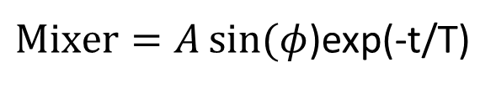

How to remove droop and calculate phase?
$\text{Diode}\text{=}{\text{A}}^{\text{2}}$exp(-t/T)
$\text{Mixer}=A\sin{(φ}$)exp(-t/T)
Phase normally asin(Mixer/sqrt(Diode)), but this leaves a factor exp(-t/2T).
Either correct for droop using the fits shown before.
Or assume A is constant, absorb it in to the calibration constant and use asin(Mixer/Diode).
I’m working on this.

Slide 18
Calibration Attempt – Linear Fit
Can try a crude calibration using the points nearest the zero crossings.
Compare resolution to sine fit.
Constants still vary due to ADC droop.

Slide 19
Summary
We were able to collect data with the new firmware and the system was stable.
Jitter on pulse arrival time of a few samples could be improved by using a clock synchronised to the beam.
The resolution does not seem to be dominated by ADC noise at a first glance but errors need to be propagated to the phase calculation.
ADC droop is significant for the long pulse at CTF3 and needs to be removed either in hardware or software.
Work on calibration (without droop) ongoing.
Much more data to look at.

