Slide 1
TPC Power pulsing
Madhu and Paul

Slide 2
Introduction
It is almost necessary to power-pulse the electronics, to lower the consumption and thus cooling needs.
There are several aspects of this, that can be partially addressed with small setups
  Electromechanical aspects: large current draws in a strong magnetic field puts strengths on conductors
  Functional effects: how the operation of the electronics is affected by pulsing?
  EMI effects: what will be the radiated noise?

Slide 3
The two options
One very simple option is to pulse the front end of the present AFTER electronics from the mezzanine card and check the outcome on event quality, consumption, vibrations… This can be done for the next data taking early 2014.
Another option is to pulse the mesh electronics of a simple detector with an iron 55 source (at Kolkata), equipped with an electronics designed for local power storage in large capacitors (Montreal electronics)

Slide 4
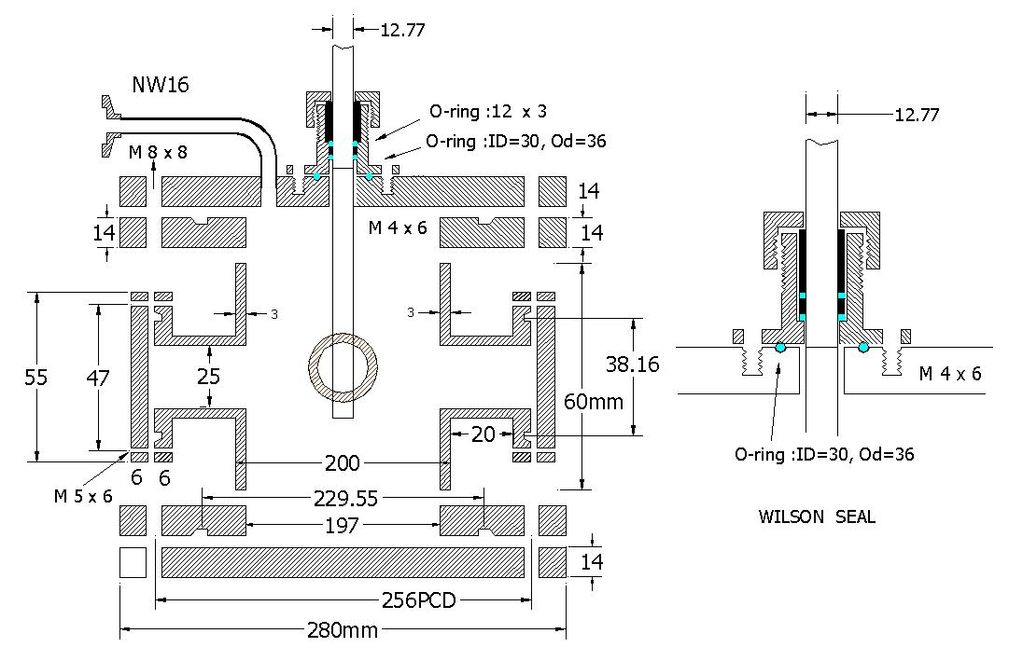

Slide 5
