Slide 1
Cooling test with the 7 Micromegas modules
D. Attié, P. Colas, M. Riallot

Slide 2
Integrated electronics
About 30 Watts dissipated (mainly ADC and regulators)
Al radiators that could be equipped with thin pipes
Necessary to make it possible to remove a module

Slide 3
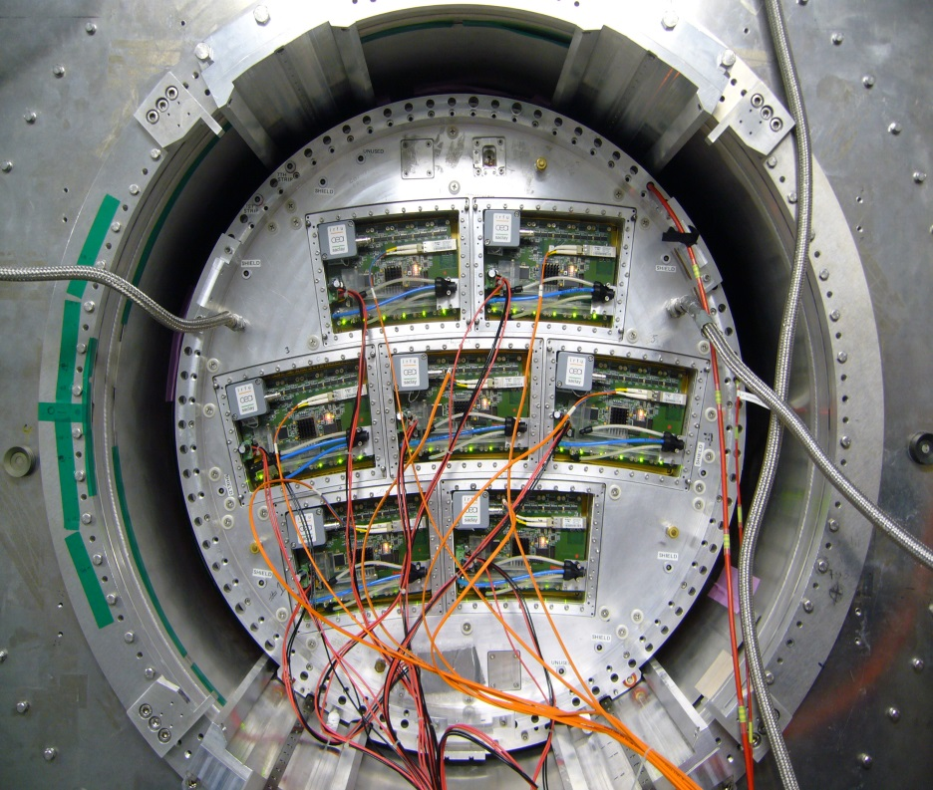
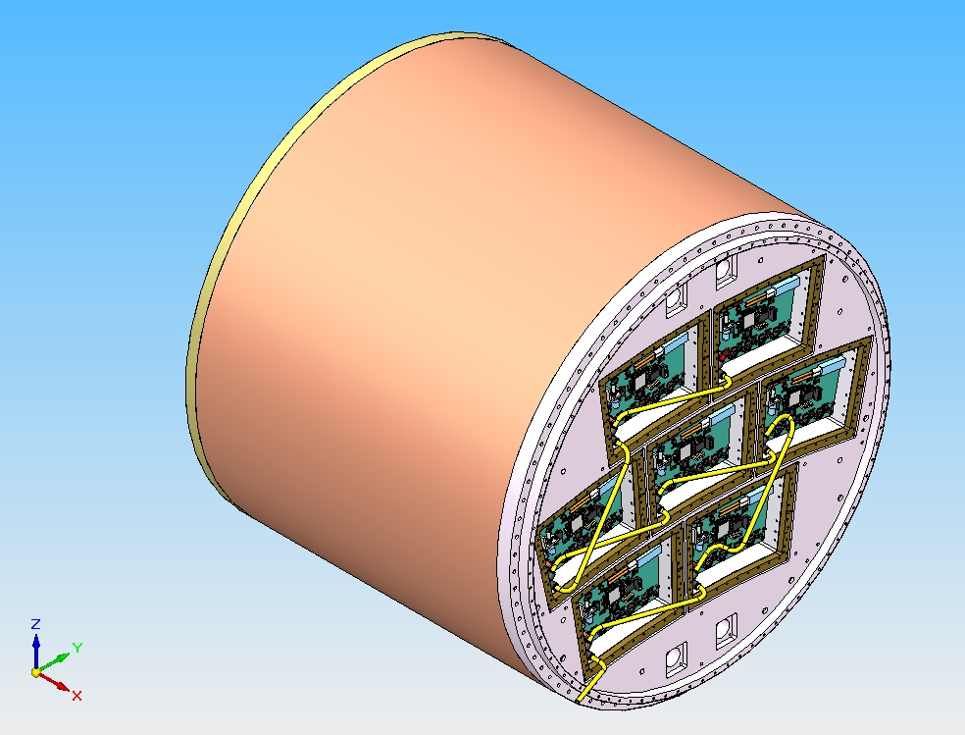

Slide 4
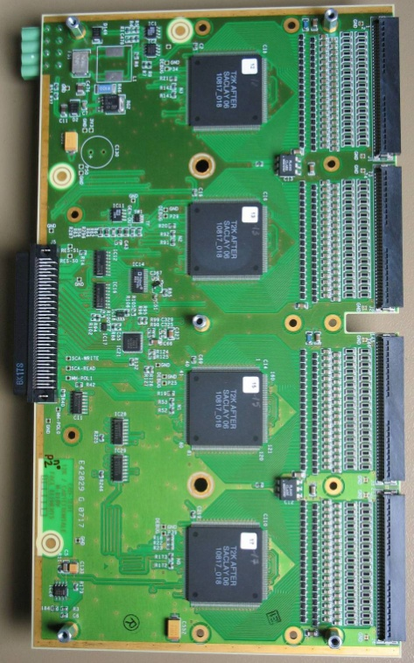
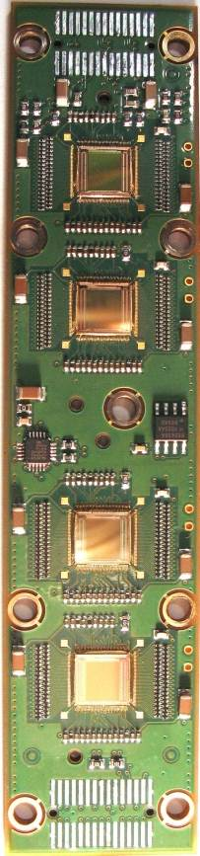
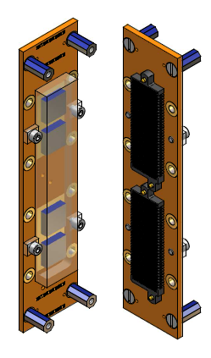
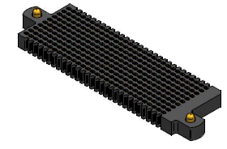
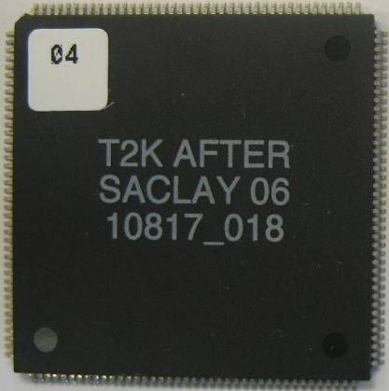
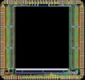
Integrated electronics for 7-module project
Remove packaging and protection diodes
Wire –bond AFTER chips
Use 2 × 300 pins connector
FEC
25 cm
4,5 cm
12,5 cm
14 cm
3,5 cm
2,8 cm
3,5 cm
0,78 cm
Chip
0,74 cm
after 2 weeks of operation: no ASIC lost:
The resistive foil protects against sparks

Slide 5
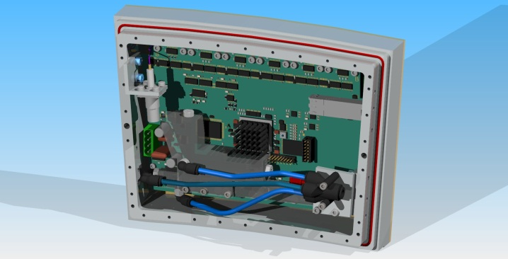
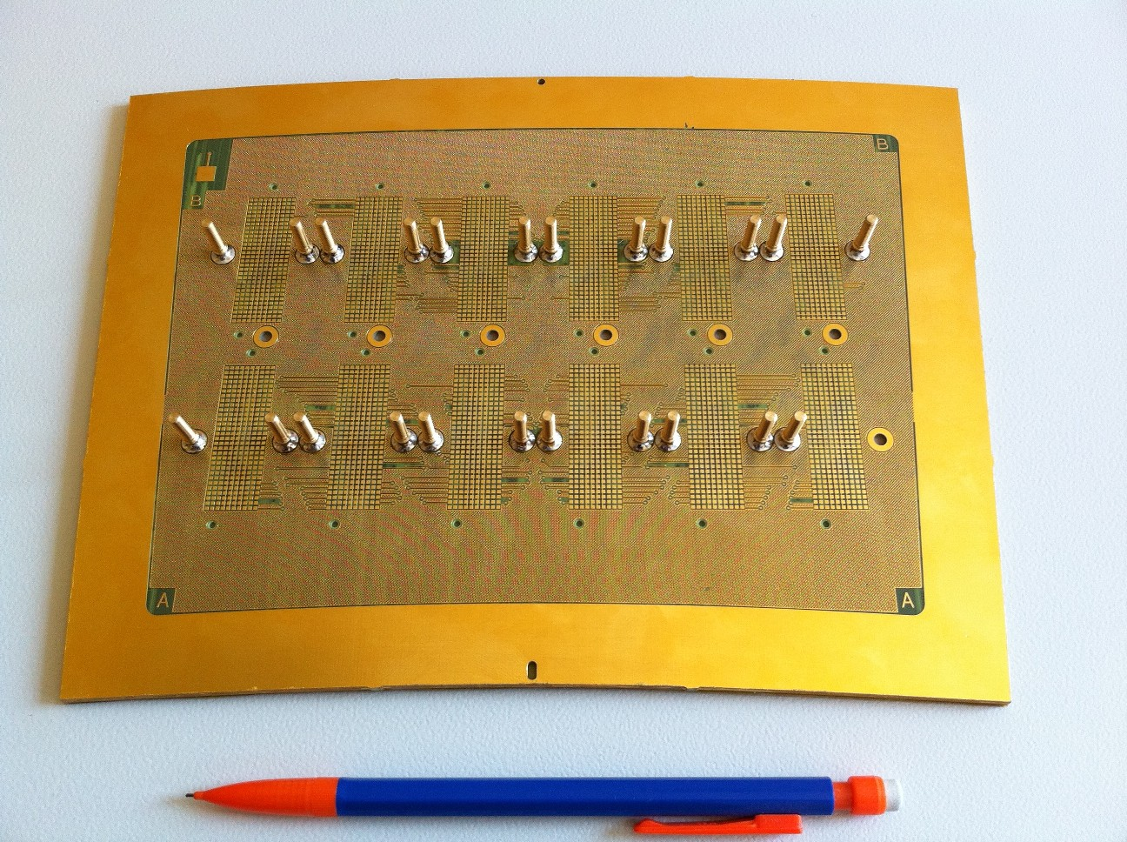
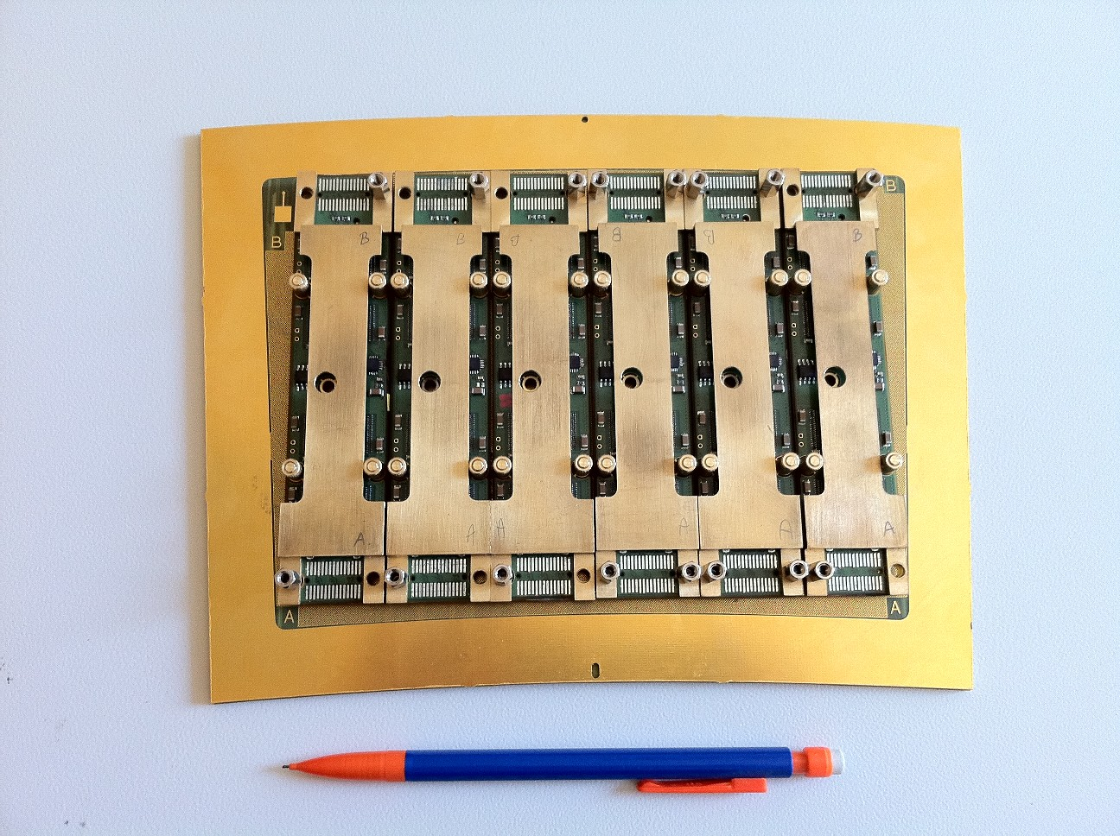
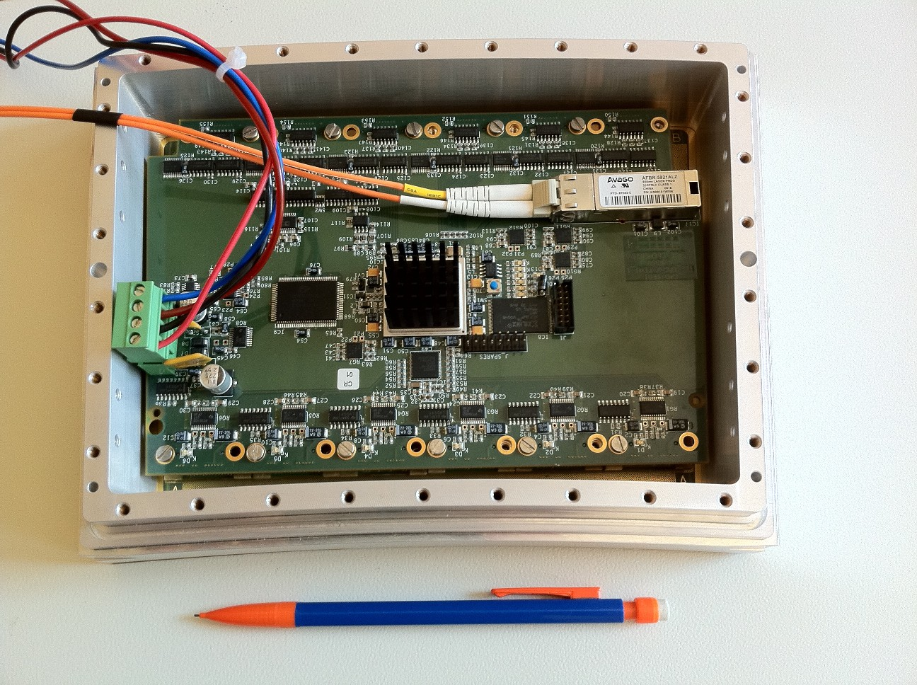
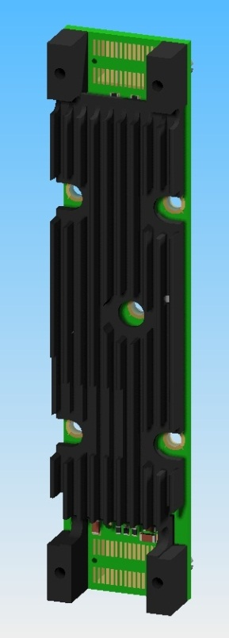
The goal of < 25% X0 is attained
radiator
Goals:
-test of full integration
-test of quasi industrial production, with characterization and qality procedures

Slide 6
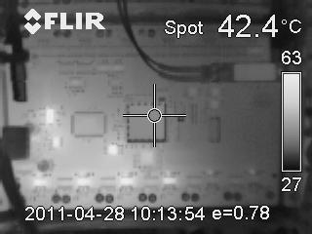
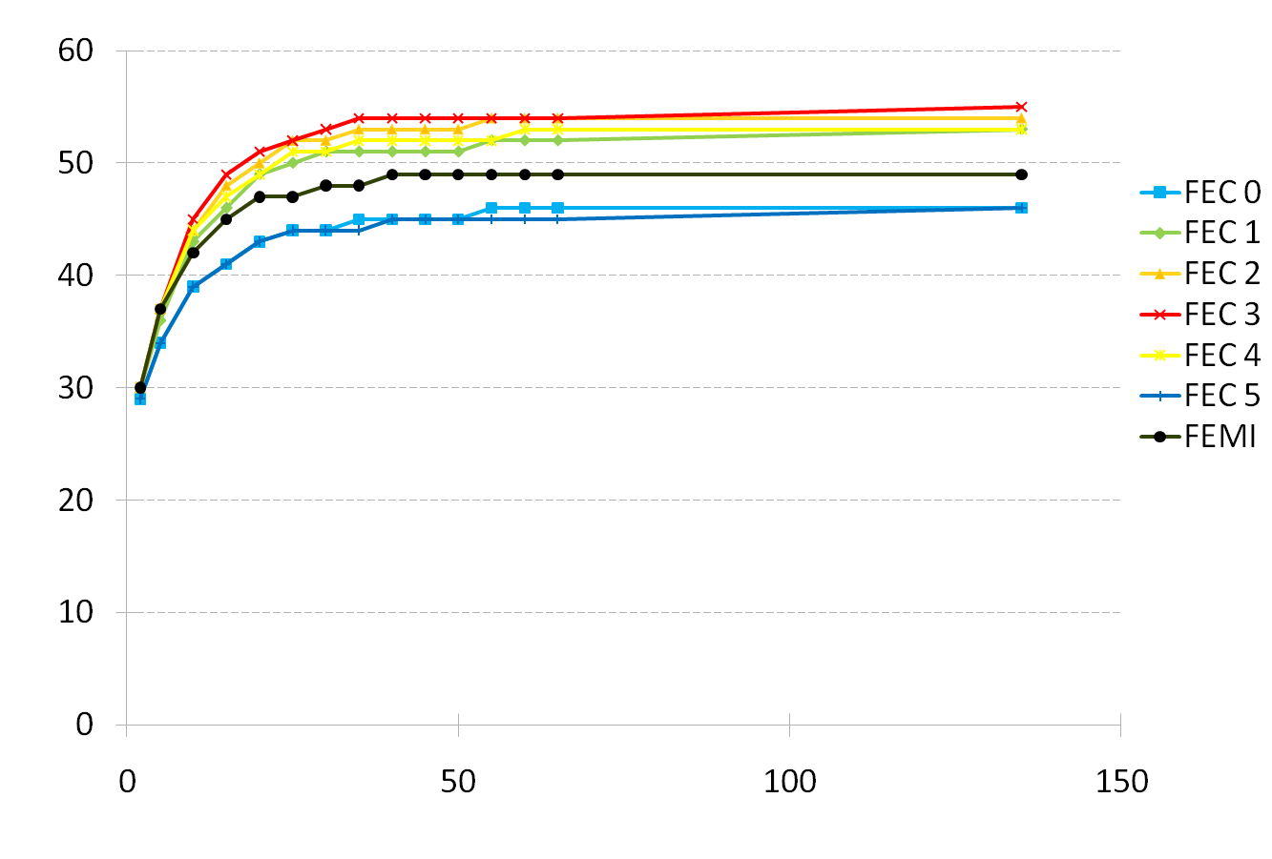
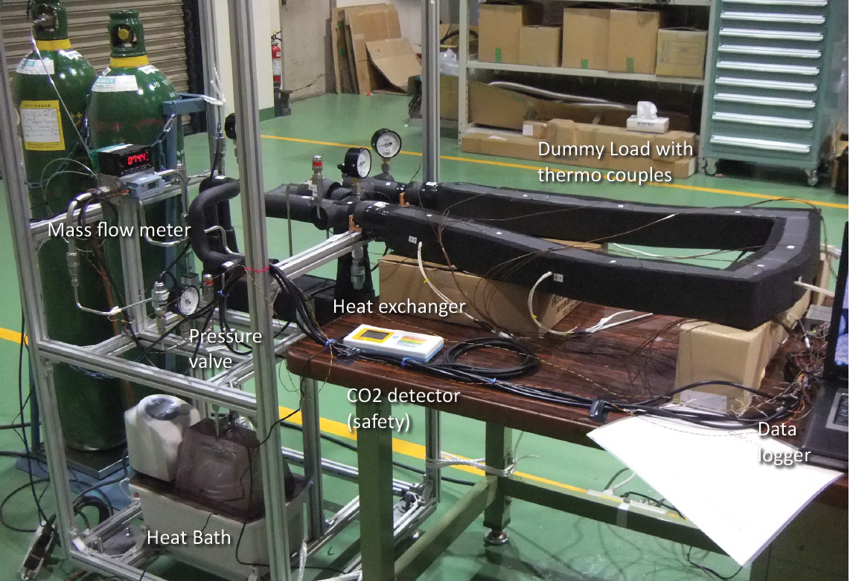
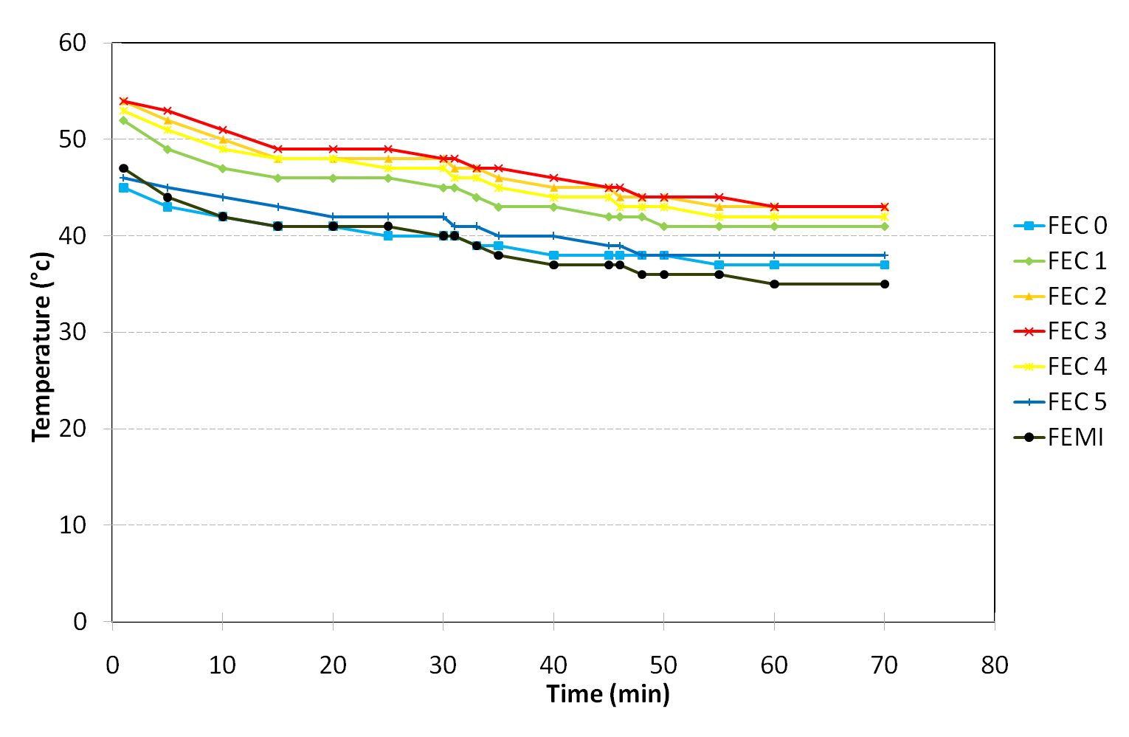
Thermal studies. IR camera shows hot spots (regulators, ADC). T-probes on every component.
2-phase CO2 cooling under study (KEK, Nikhef)
Onset of the electronics
Nitrogen cooling

Slide 7
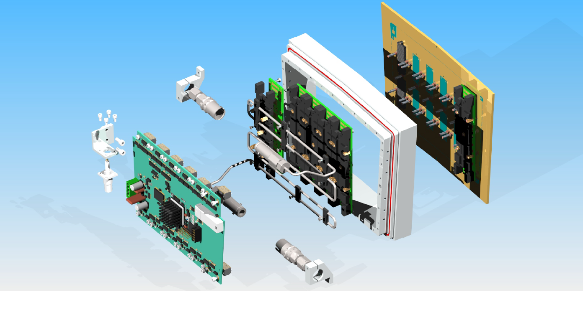

Slide 8
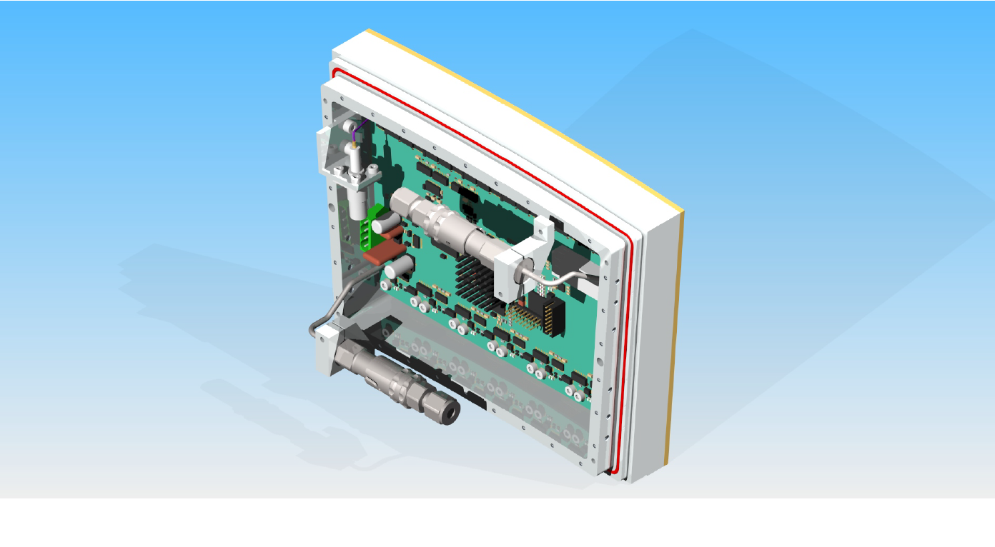

Slide 9
