Slide 1
Update on Data Analysis from May CTF3 Trip
Jack Roberts

Slide 2
Overview
Summary of meeting with Piotr and Alexandra yesterday.
Calibration without ADC droop.
Phase resolution.
Sample averaging.
Alignment of mixer and diode channels.
ADC droop lab tests.

Slide 3
Meeting with Piotr and Alexandra
We had a meeting yesterday to discuss some of the results shown here and in the meeting a couple of weeks ago.
ADC Droop – Alexandra offered the possibility of providing equipment to correct the droop externally.
Cross-talk between diode and mixer – is caused by the power of the LO signal being ~1000 times greater than the diode. The diode channel has ~50 dB rejection but a small component of the LO still leaks through.
If all three phase monitors (in their final positions) will be connected to the same board, we need to be able to handle the 380ns delay between the signals due to the beam T.O.F.
Piotr is keen to sort out all issues with communicating to the board via the control system and to have a clear plan in place for what is needed to view and analyse the effects of the feedforward system.
And…

Slide 4
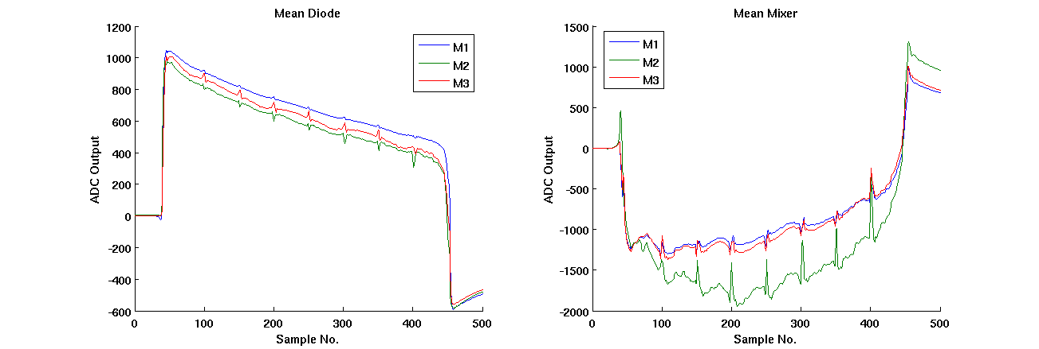
Phase Switches
The spikes in the phase switches are a real effect present in the beam, not an artefact of the monitors.
The presence of the spikes in the diode channel is not due to cross-talk – there is a real effect on the beam charge.
The difference in the appearance of spikes between monitors needs to be verified with other data and the CERN digitisers.

Slide 5
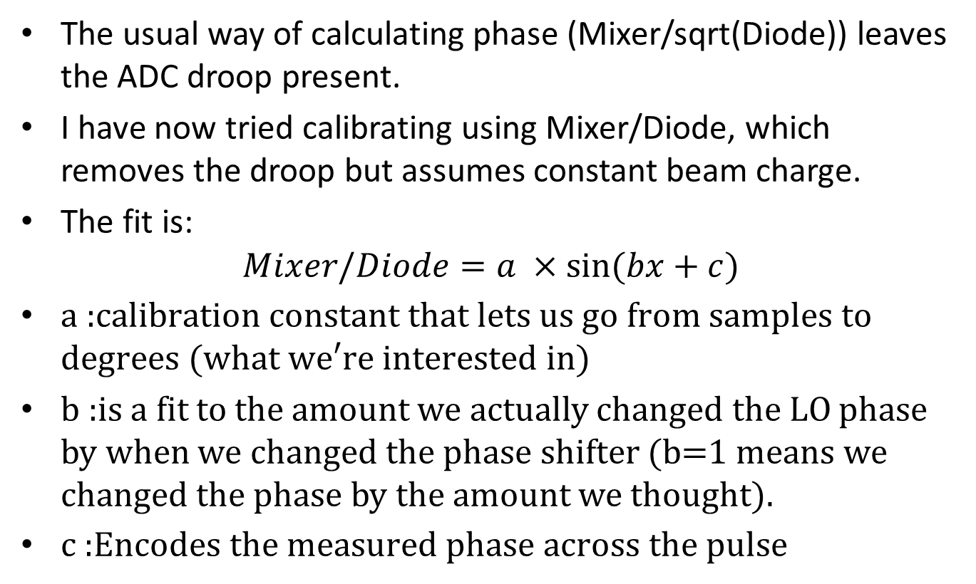
Mixer/Diode Calibration
The usual way of calculating phase (Mixer/sqrt(Diode)) leaves the ADC droop present.
I have now tried calibrating using Mixer/Diode, which removes the droop but assumes constant beam charge.
The fit is:
$$Mixer/Diode=a ×sin⁡(bx+c)$$
$\text{a}\text{ :}\text{calibration} \text{constant} \text{that} \text{lets} \text{us} \text{go} \text{from} \text{samples} \text{to} \text{degrees}\text{ (}\text{what} \text{we}\text{′}\text{re} \text{interested} \text{in}\text{)}$
$\text{b}\text{ :}\text{is} \text{a} \text{fit}$to the amount we actually changed the LO phase by when we changed the phase shifter (b=1 means we changed the phase by the amount we thought).
$\text{c}\text{ :}\text{Encodes} \text{the} \text{measured} \text{phase} \text{across} \text{the} \text{pulse}$

Slide 6
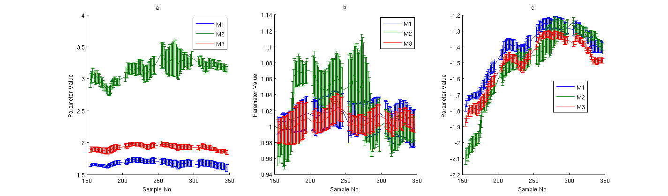
Fit Parameters
Phase switches have been removed.
Mixer/Diode does a pretty good job of removing ADC droop (a is ~constant across the pulse).
b is about 1 as expected.
Monitor | a
M1 | 1.666
M2 | 3.107
M3 | 1.922

Slide 7
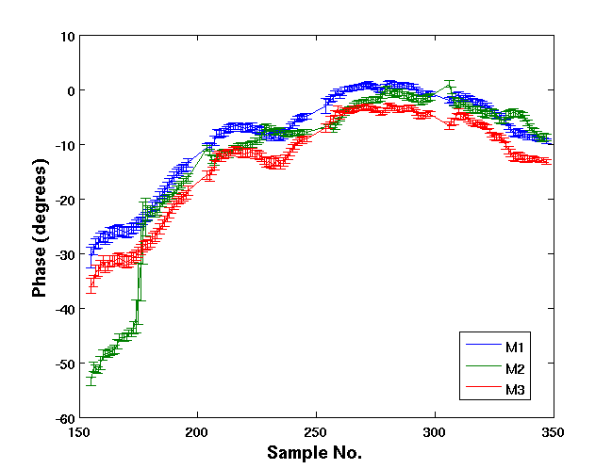
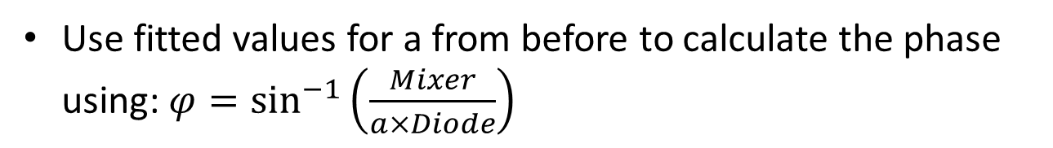
Reconstructed Phase
Use fitted values for a from before to calculate the phase using:$φ=\sin^{−1}\left(\frac{Mixer}{a×Diode}\right)$

Slide 8
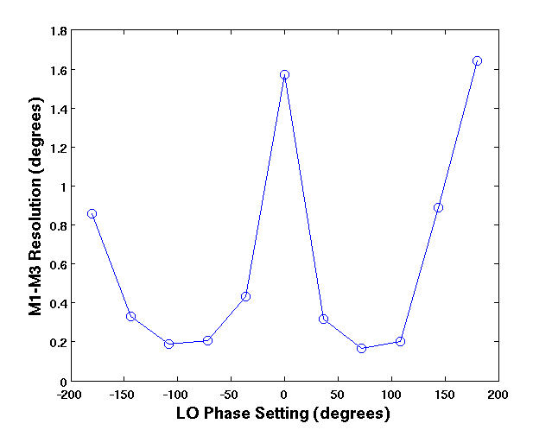
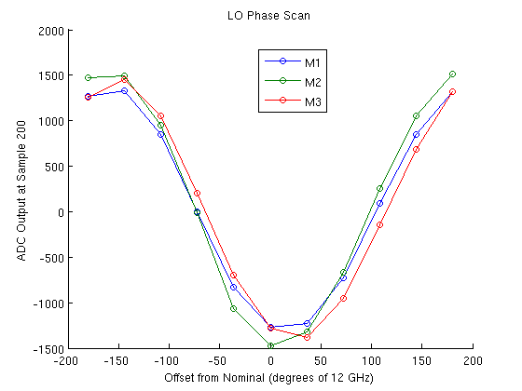

Phase Resolution (M1-M3 only)
Resolution vs. LO Phase
ADC Output vs. LO Phase
$Resolution=\frac{σ_{diff}}{\sqrt{2}}$
Best resolution near zero crossings in LO scan.

Slide 9
Phase Resolution (M1-M3 only)
Resolution ~0.2º , which matches what has been seen previously with the CERN digitisers.
Phase Setting | Resolution
-180º | 0.86º
-144º | 0.33º
-108º | 0.19º
-72º | 0.20º
-36º | 0.43º
0º | 1.57º
+36º | 0.32º
+72º | 0.17º
+108º | 0.20º
+144º | 0.89º
+180º | 1.64º
Resolution vs. LO Phase

Slide 10
Sample Averaging
See if the resolution can be reduced by either binning the data or using a rolling average.
Averaged over 1 to 16 samples.
Shouldn’t make a big difference if we’re not limited by ADC noise.

Slide 11
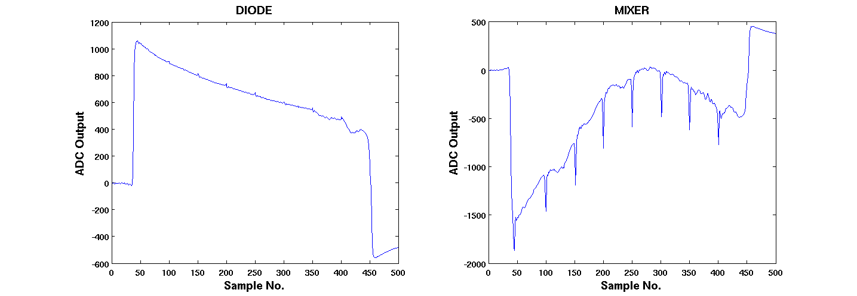
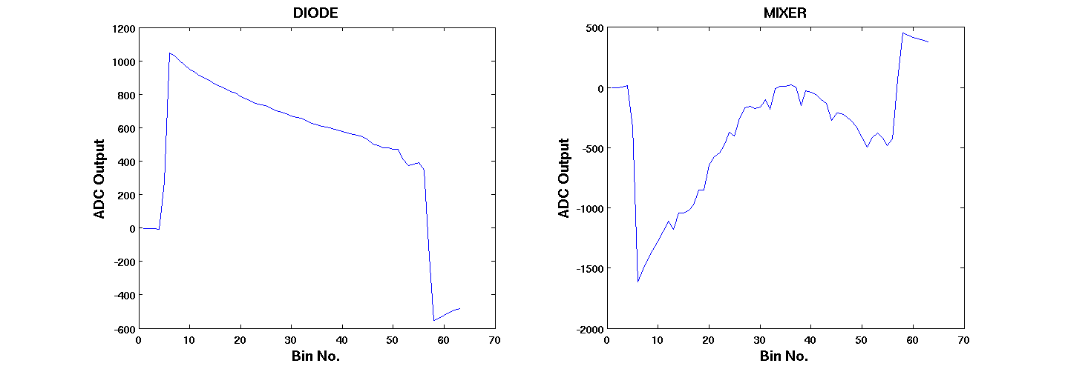
Binned Average
No Binning
8 Samples Per Bin

Slide 12
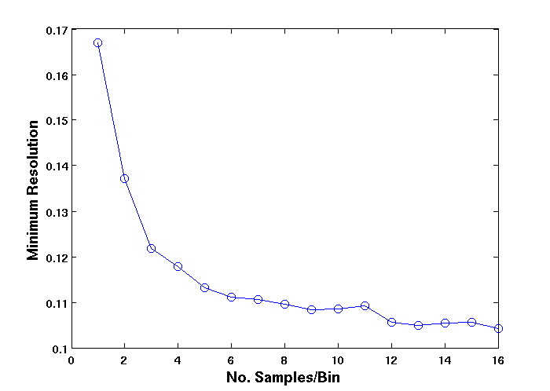
Resolution vs. No. Samples Per Bin
Samp./Bin | Res. | Samp./Bin | Res.
1 | 0.167º | 9 | 0.108º
2 | 0.137º | 10 | 0.109º
3 | 0.122º | 11 | 0.109º
4 | 0.118º | 12 | 0.106º
5 | 0.113º | 13 | 0.105º
6 | 0.111º | 14 | 0.105º
7 | 0.111º | 15 | 0.106º
8 | 0.110º | 16 | 0.104º
Binned averaging can improve the resolution from around 0.17º to 0.11º in this case.

Slide 13
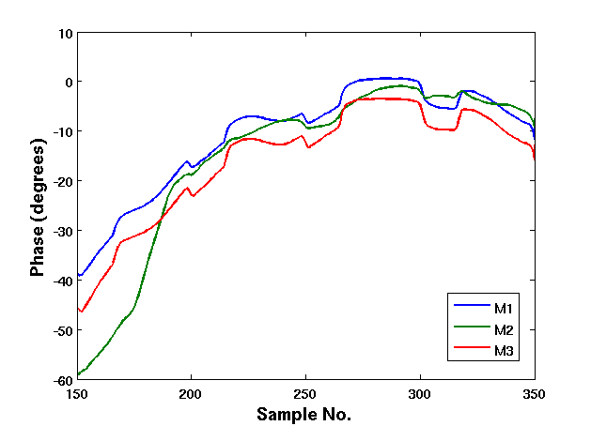
Rolling Average
Average over 16 Samples
Phase switches not removed.

Slide 14
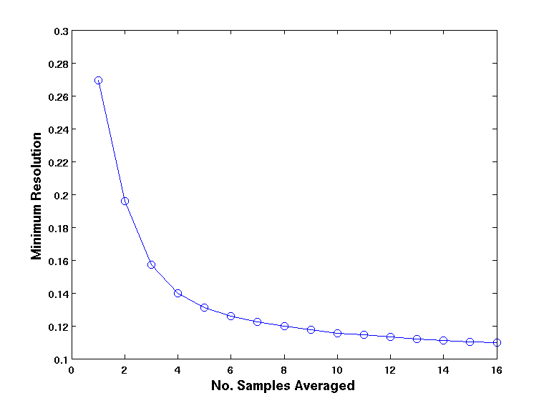
Resolution vs. Samples Averaged
Samp./Bin | Res. | Samp./Bin | Res.
1 | 0.269º | 9 | 0.118º
2 | 0.196º | 10 | 0.116º
3 | 0.157º | 11 | 0.114º
4 | 0.140º | 12 | 0.113º
5 | 0.131º | 13 | 0.112º
6 | 0.126º | 14 | 0.111º
7 | 0.122º | 15 | 0.110º
8 | 0.120º | 16 | 0.110º
Best resolution of 0.11º matches binned approach.
Resolution without averaging worse due to phase switches.

Slide 15
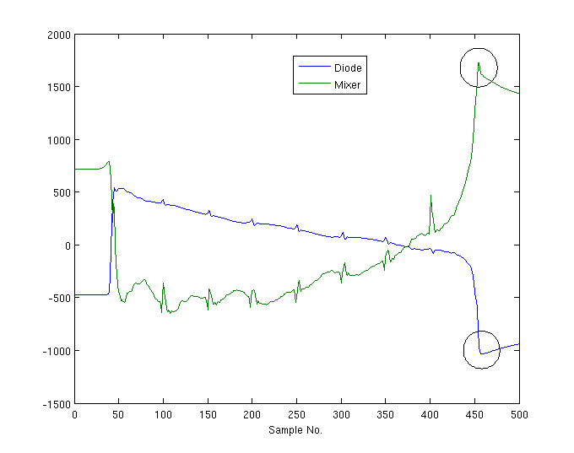
Mixer and Diode Alignment
See if Mixer and Diode signals arrive at the same point in the sampling window.
Compare position of pulse end and phase switches:
Phase Switches (two spikes)
Pulse End

Slide 16
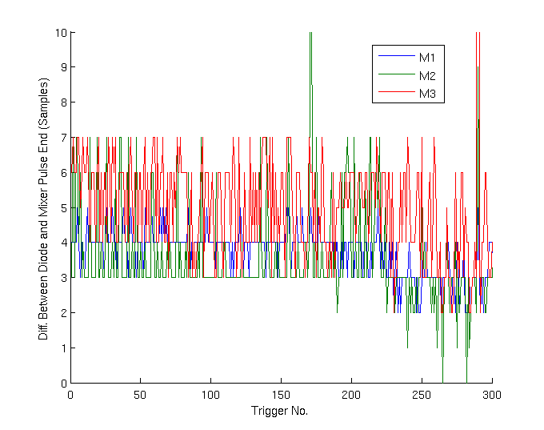
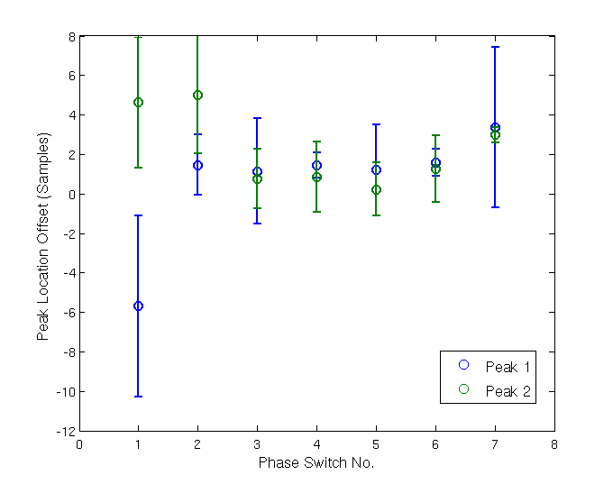
Some evidence to suggest that diode response is a few samples later than the mixer but it might just be an artefact of how I’m identifying the features.
Even if it is a real effect the resolutions I’ve shown are already pretty good.
Might also be interesting to check alignment between monitors.

Slide 17
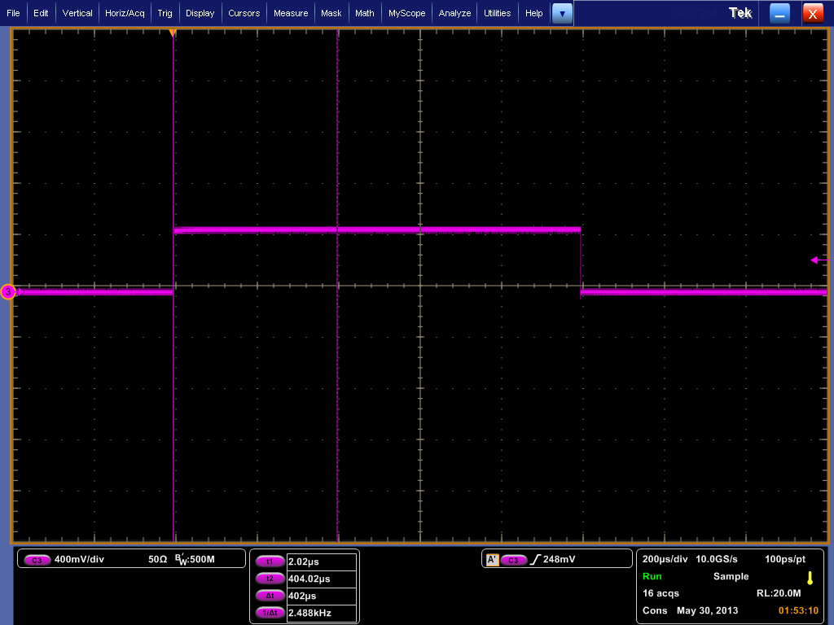
ADC Droop Tests
Glenn, Neven and Doug made measurements of the ADC droop in the lab using a 10µs DC input pulse (below).
I’ve tried to fit exponential curves to the measurements.

Slide 18
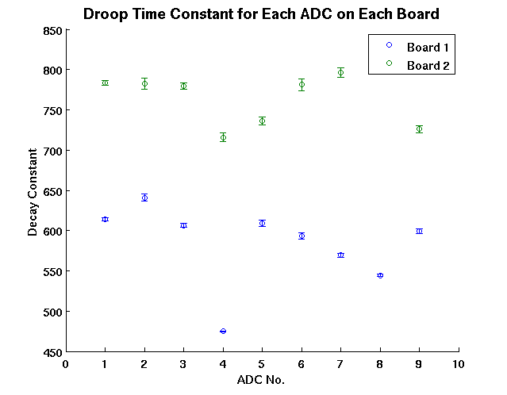
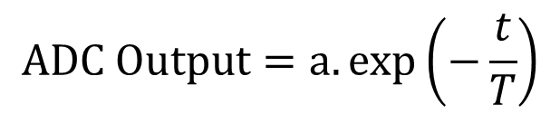
Exponential Fit
$$ADC Output=a.exp\left(−\frac{t}{T}\right)$$
Decay constant T (in ADC counts) is plotted below.
All fits give R² values > 0.99, however…

Slide 19
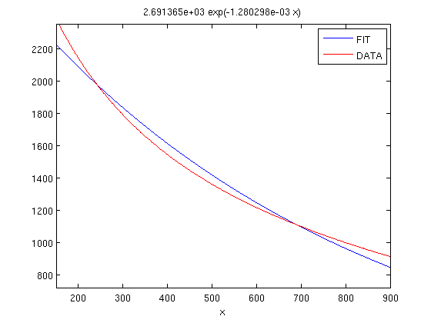
I don’t think the data is described very well by a simple exponential fit.
The fitted decay constants are very sensitive to the sampling window chosen, and change if a vertical offset is included (aexp(-t/T)+c).
You can get a perfect fit using two exponential terms, but I haven’t pursued this further.
It’s not clear whether you could actually remove the droop this way as the signals from the beam are obviously nowhere near as clean.

Slide 20
Summary
Phase switch spikes are a real effect (don’t need to remove them from correction).
We need to make sure we have all the necessary tools in place to start analysis when the beam is back.
Calibrating using Mixer/Diode gives good results.
Measured resolution of ~0.2º is in agreement with previous measurements using the CERN digitisers.
ADC droop is not purely a simple exponential decay.

