Slide 1


Roundup of FONT Shifts June Run Week 1 2013
Mikey Davis
7 June 2013
1/12

Slide 2
Introduction
Today we concentrated on beam correction
Achieved correction in the IP region using:
Upstream feedback
Upstream -> downstream feedforward
IP feedback
Convincing sets of results for all three
Multiple runs over multiple QD0FF and gain settings
Got some very good upstream feedback results
Mikey Davis
7 June 2013
2/12

Slide 3
Upstream Feedback
Many runs taken
Different gains
Different QD0FF strengths (jitters)
Repeated correction in both IPA and IPB
Very good agreement upstream with model\
Bunch to bunch correlations of between
80 – 85% for P2
90 – 95% for P3
Ext kicker timing scan didn’t improve this
Mikey Davis
7 June 2013
3/12

Slide 4
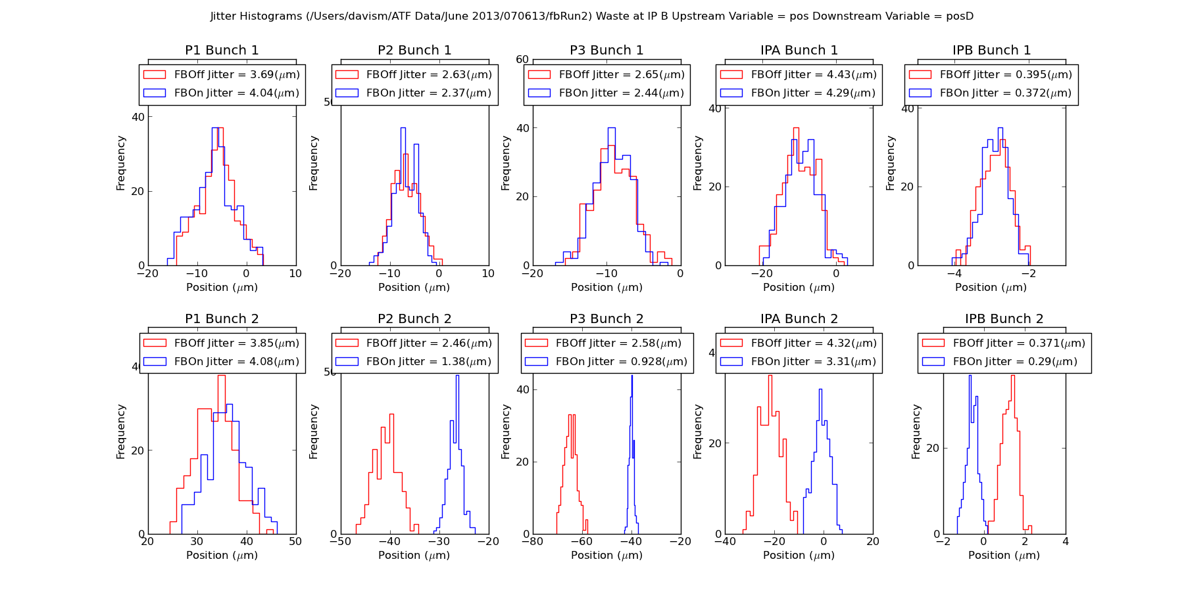
Upstream Feedback
Mikey Davis
7 June 2013
4/12

Slide 5
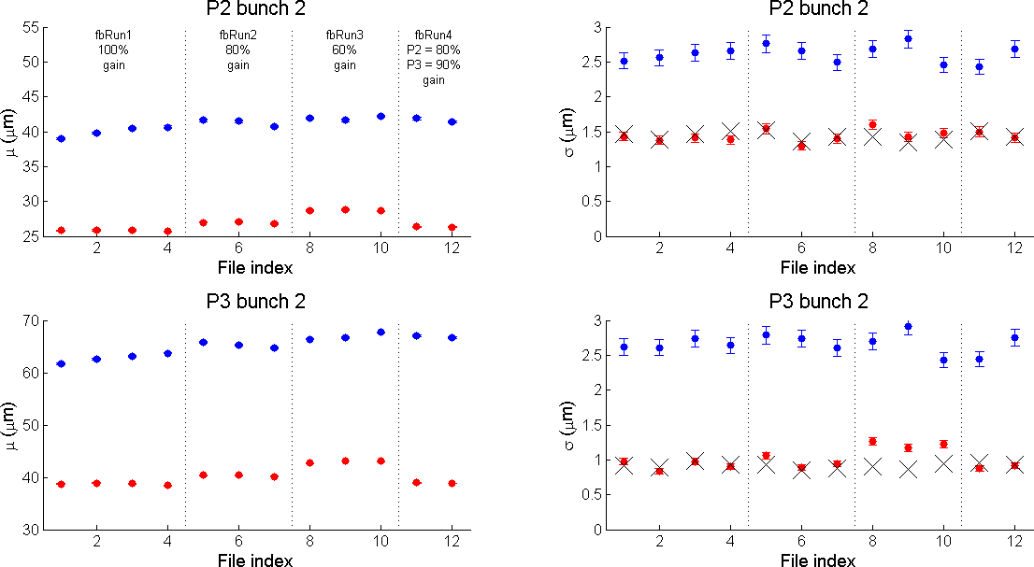
Upstream Feedback
Mikey Davis
7 June 2013
5/12

Slide 6
Upstream -> Downstream Feed Forward
Got more stable gain calculations than last time
I used charge norm position which worked better
Upstream fb to downstream second bunch
Not much higher bunch to bunch correlations
Around 70 %
Need to look more at this as not sure it’s always this
Mikey Davis
7 June 2013
6/12

Slide 7
Upstream Downstream Feed Forward
Mikey Davis
7 June 2013
7/12

Slide 8
IP Feedback
Managed to get many runs with an improvement on the jitter
Scanned QD0FF strength to change the amount of jitter
Maybe see an improvement at IPA
Not convinced
Bunch to bunch correlations of about 95% when not limited by resolution
Mikey Davis
7 June 2013
8/12

Slide 9
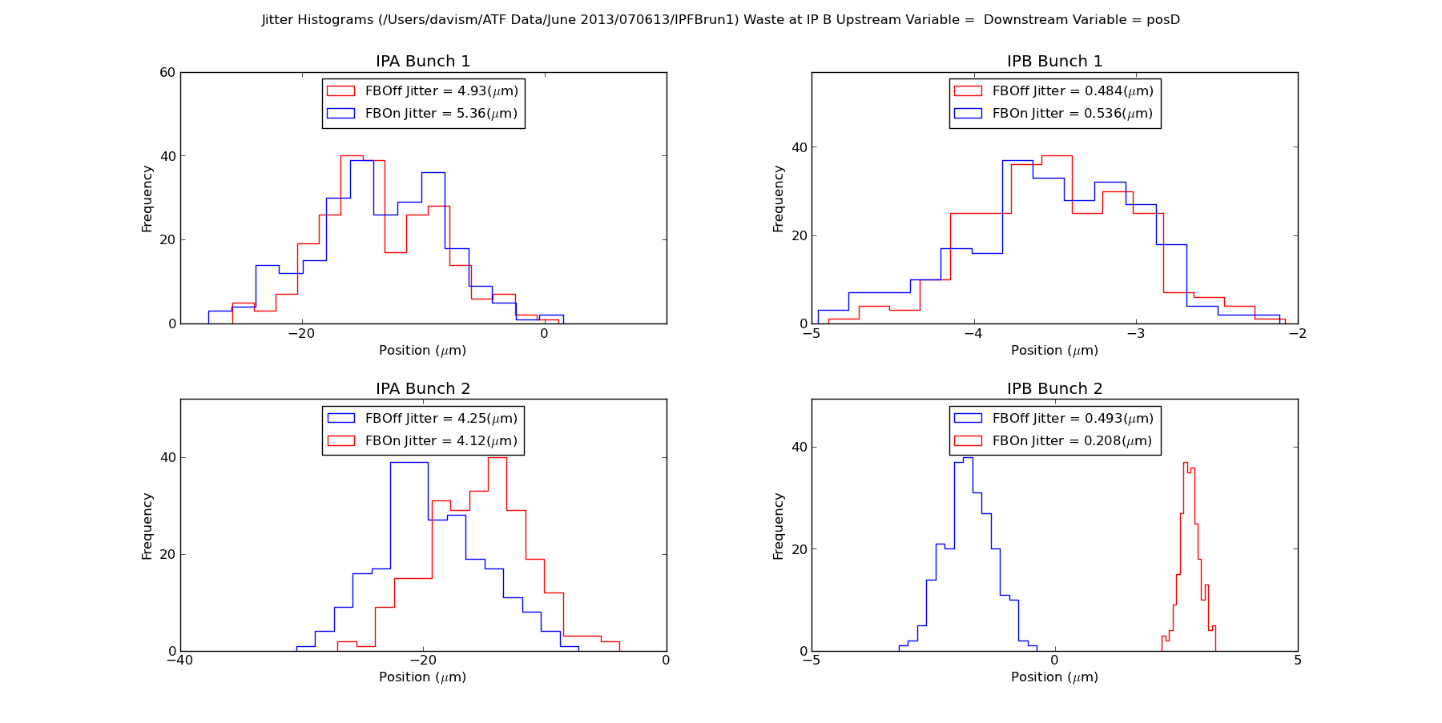
IP Feedback
Mikey Davis
7 June 2013
9/12

Slide 10
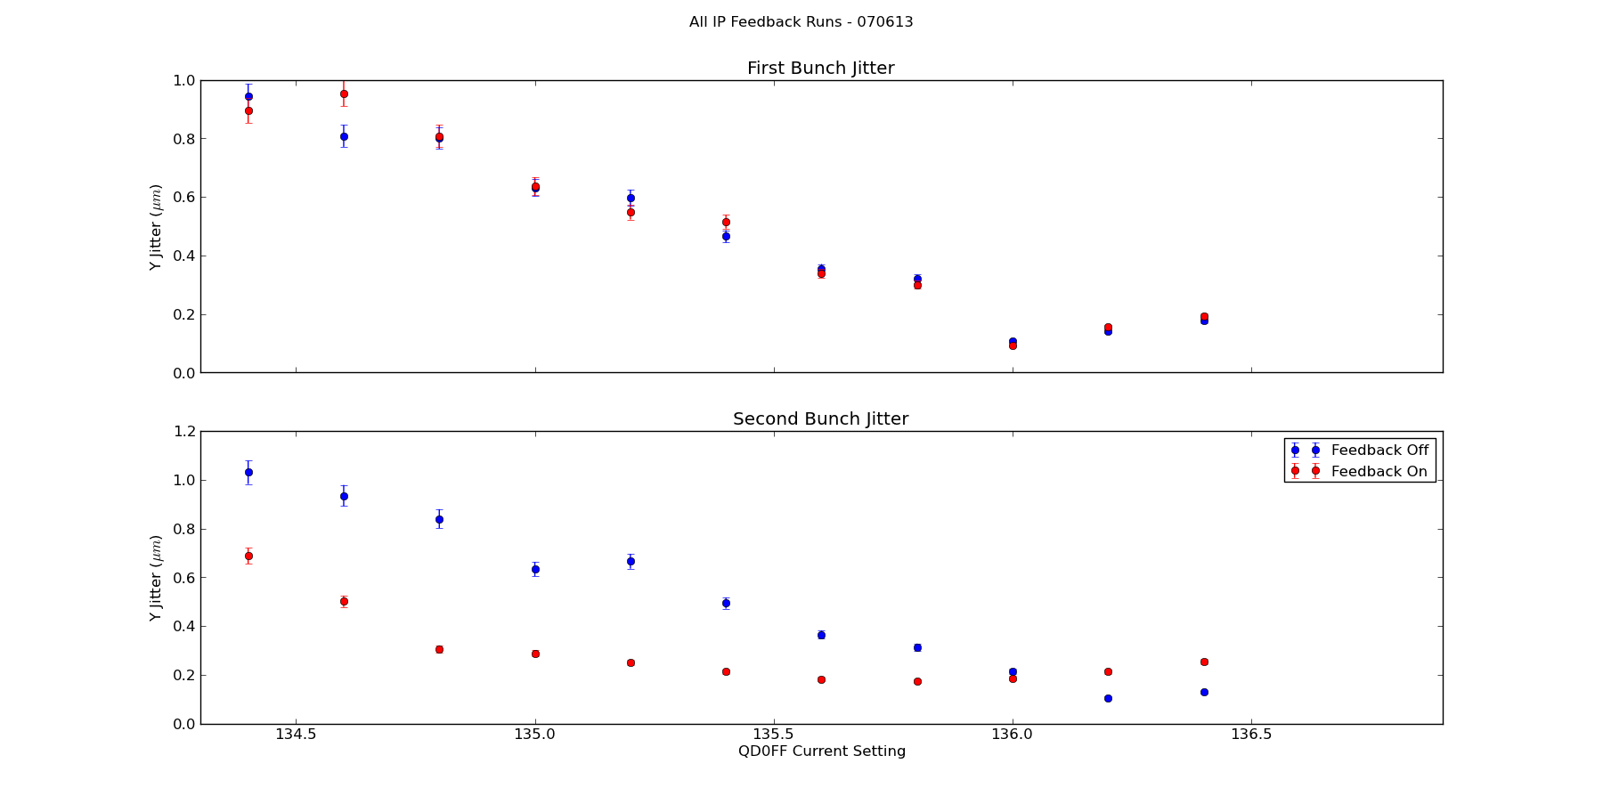
IP Feedback
Mikey Davis
7 June 2013
10/12

