Slide 1


Roundup of FONT Shifts
2nd Week – June Run 2013
Mikey Davis
14 June 2013
1/11

Slide 2
Introduction
We’ve had two 1 ½ shifts this week
First shift focused on beam conditions
  Understanding the X beam conditions
  Properly aligning both bunches upstream and at the IP
Second shift focused on beam corrections
  Worked on optimising upstream system to correct at IP
  Showed the upstream system zeroing second bunch
  Repeated above for IP system
  Measured the latency of the IP system
  Introduced filters to the IP system
Mikey Davis
14 June 2013
2/11

Slide 3
Resolutions + Correlations
Resolution (FB) | P1 | P2 | P3
Without Lo Correction | 2.18 | 1.01 | 1.00
With Correction on P1 | 0.56 | 0.58 | 0.53
B2B Corr (%) | P1 | P2 | P3
Without Lo Correction | 0.87 | 0.74 | 0.94
Jitter | P1 | P2 | P3
Fb | 3.89 | 2.52 | 2.26
Sb | 3.71 | 2.54 | 2.33
Mikey Davis
14 June 2013
3/11

Slide 4
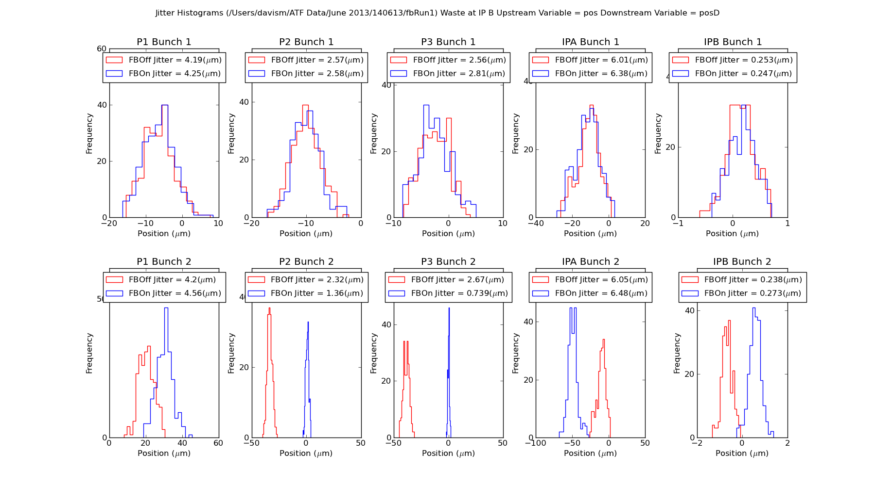
Upstream FB Run
Mikey Davis
14 June 2013
4/11

Slide 5
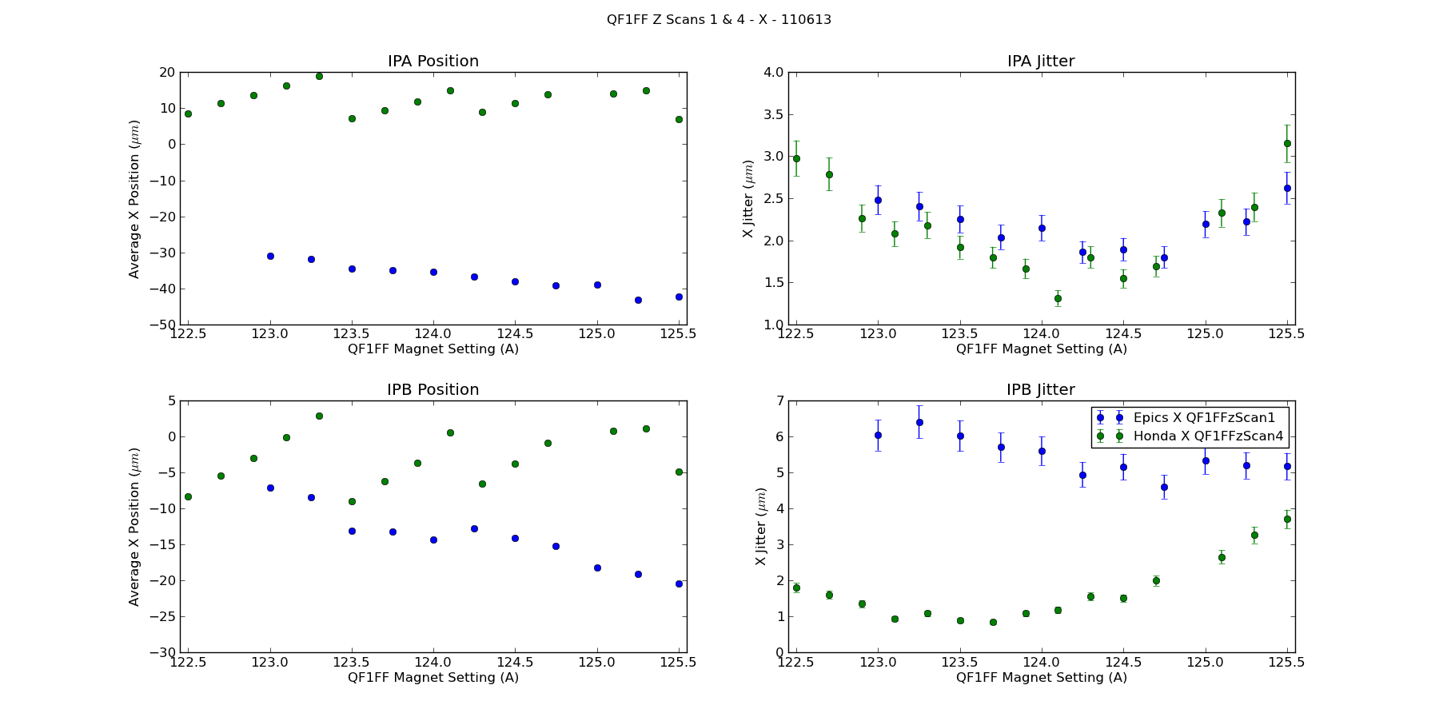
QF1FF z Scan
Mikey Davis
14 June 2013
5/11

Slide 6
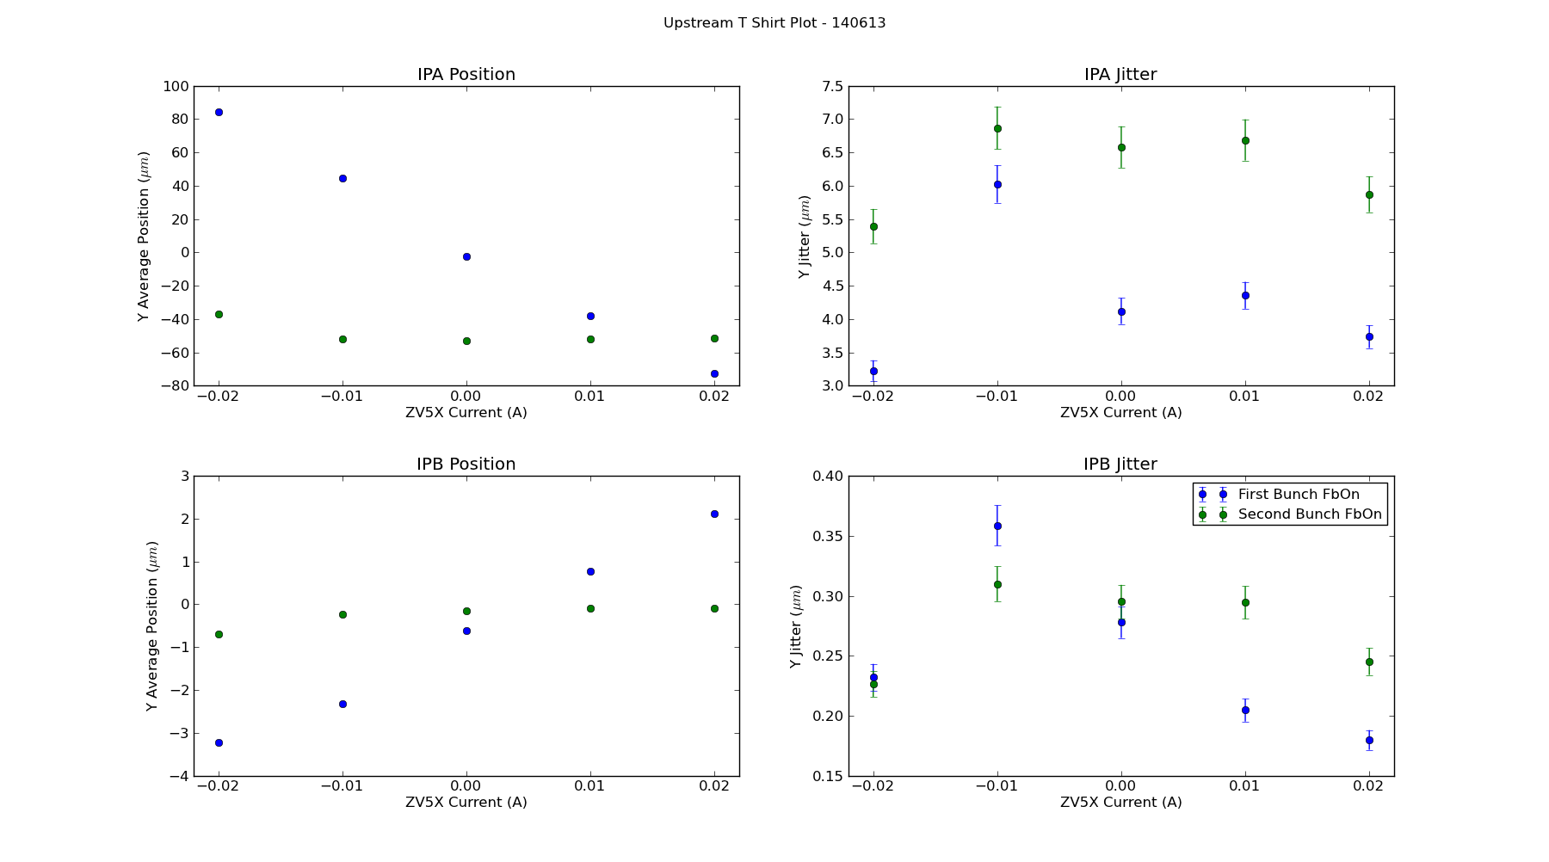
Upstream T Shirt Plot
Mikey Davis
14 June 2013
6/11

Slide 7
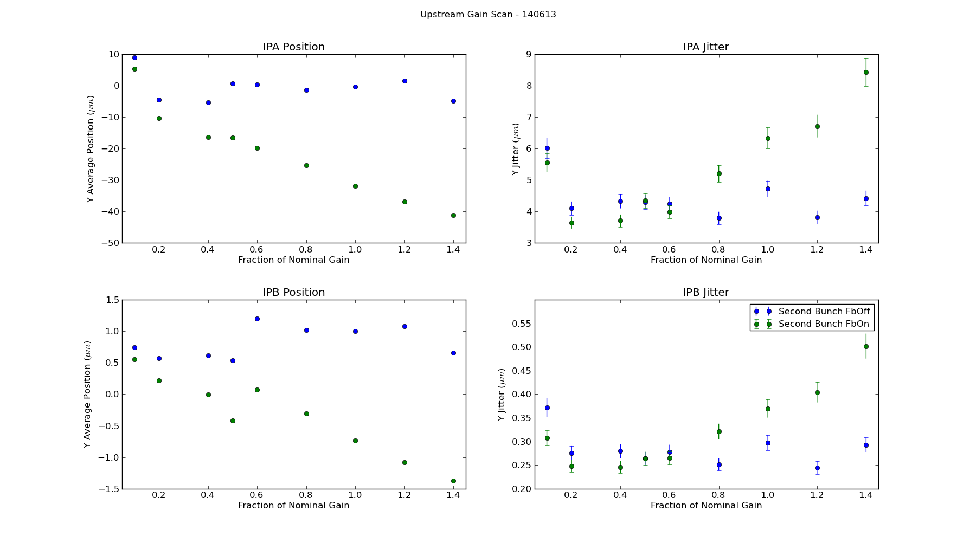
Upstream Gain Scan
Mikey Davis
14 June 2013
7/11

Slide 8
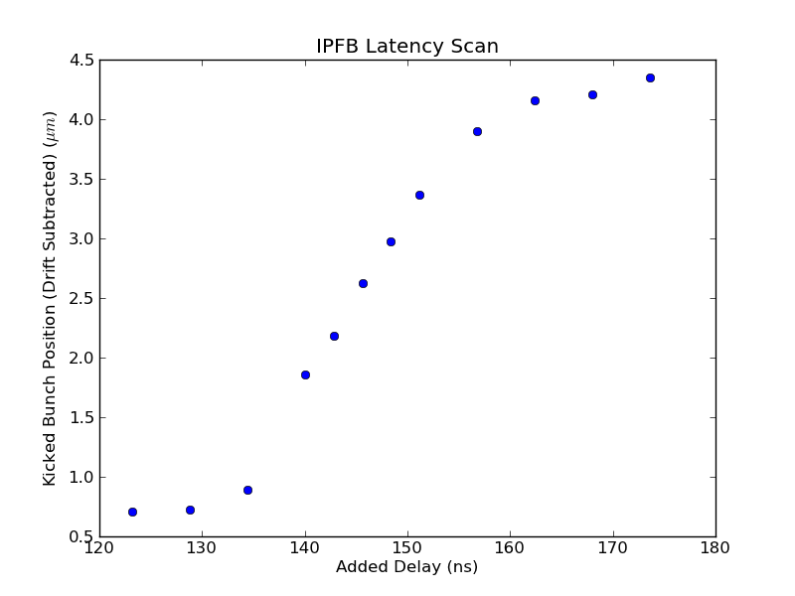
IP FB Latency Scan
Mikey Davis
14 June 2013
8/11

Slide 9
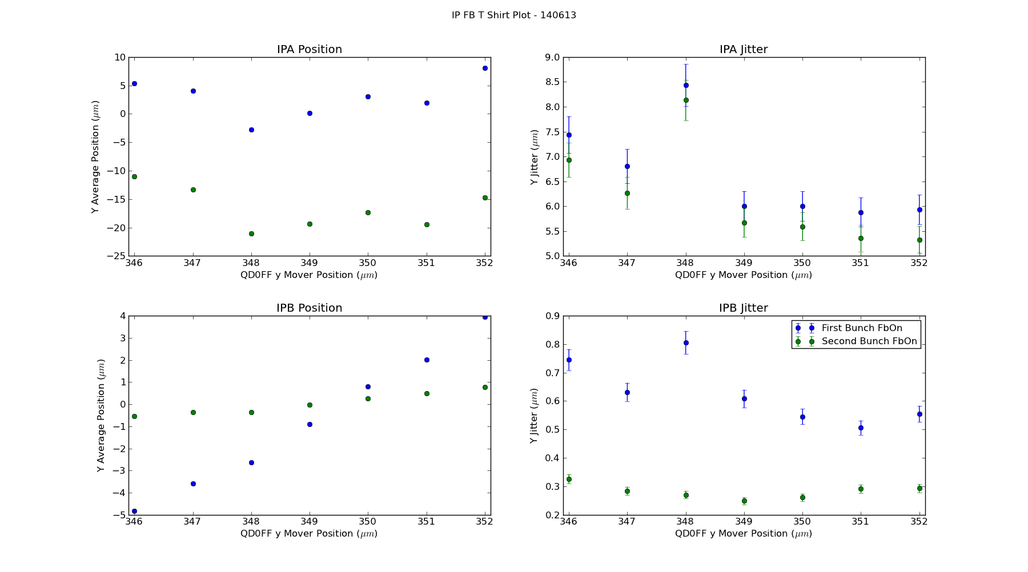
IPFB T Shirt Plot
Mikey Davis
14 June 2013
9/11

Slide 10
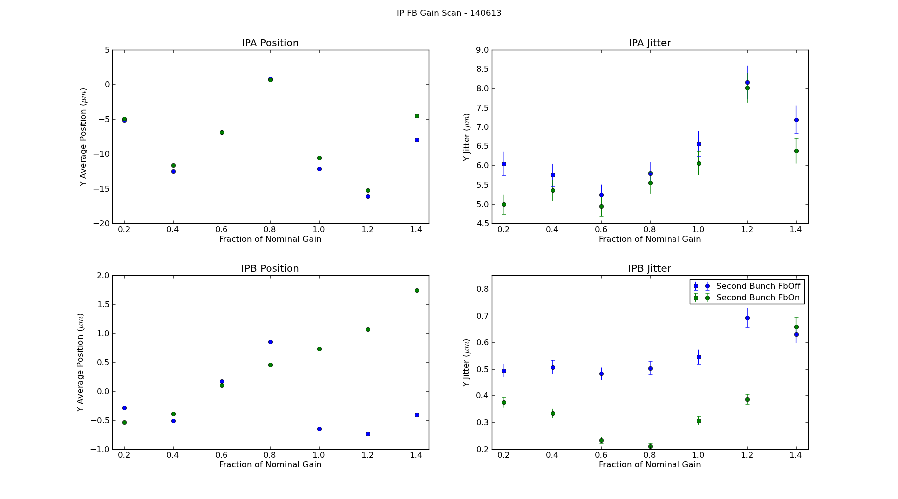
IP FB Gain Scan
Mikey Davis
14 June 2013
10/11

Slide 11
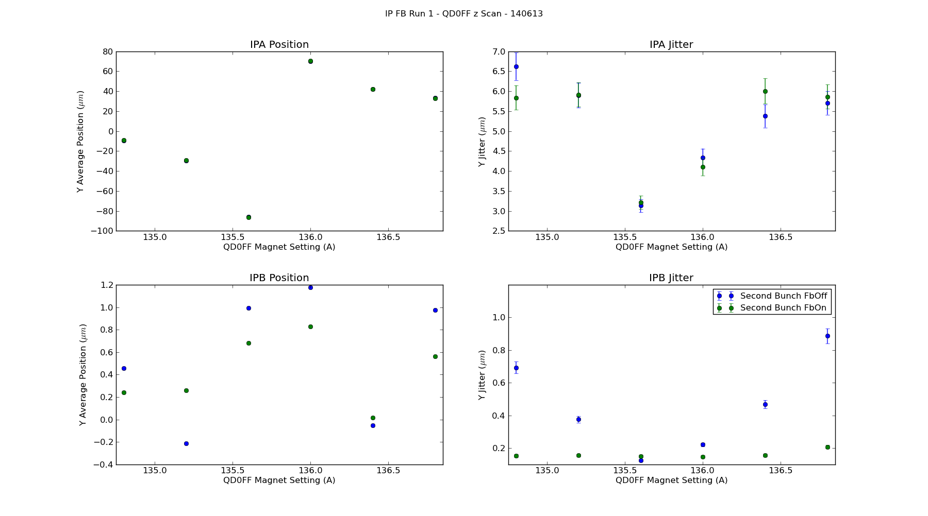
IP FB QD0FF Current Scan
Mikey Davis
14 June 2013
11/11

