Slide 1
Nouvelles de l’ILC
Paul Colas

Slide 2
ECFA-DESY fin mai
12 juin: remise du TDR (passage du GDE au LCC)
Linear Collider Collaboration Status
L. Evans

Slide 3
Organization
ICFA
Program Advisory Committee
Linear Collider Board
FALC
Regional Directors
Brian Foster
Harry Weerts
Directorate
Lyn Evans
Deputy (Physics)
Hitoshi Murayama
ILC
Mike Harrison
CLIC
Steinar Stapnes
Physics & Detectors Hitoshi Yamamoto

Slide 4
Objectives
Support long-term R&D on CLIC, the only credible way we have today to access multi-TeV leptons, as a possible future option after LHC.
- Support the construction of a staged linear collider in Japan. Prepare a site-specific design of the machine and its detectors.
-Exploit the synergy between ILC and CLIC. Prepare a plan for the sharing of the work.

Slide 5
Visit to Japan, 25-27 March
Takeo Kawamura, former chief Cabinet Secretary and former MEXT Minister, chairman of Federation of Diet Members
S&T Minister Ichita Yamaoto.
MEXT Minister Hakubun Shimomura
Chairman of AAA and former President Mitsubushi Heavy Industries Takahashi Nikiosha
Chairman of Japan Chamber of Commerce and former CEO of Toshiba Tadashi Okamura

Slide 6
Japan visit continued
Japan Productivity Center Masayoshi Matsukawa.
Federation of Diet Members (150-strong)
Prime Minister Abe
Yasushi Furukawa, Governor of Saga Province
Japan Association of Corporate Executives Kiyohiko Ita.

Slide 7
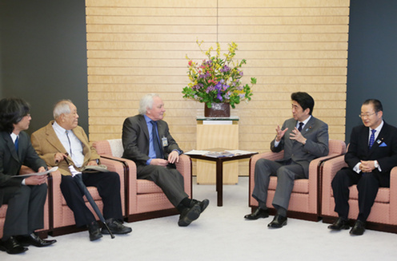

Slide 8
Japanese visit to Washington 30th April 2013
High-level visit of MEXT and S&T Ministers
Symposium with Diet members and industrialists.
Three delegations at CERN from Iwate and Saga province.

Slide 9
Feuille de route japonaise

Slide 10
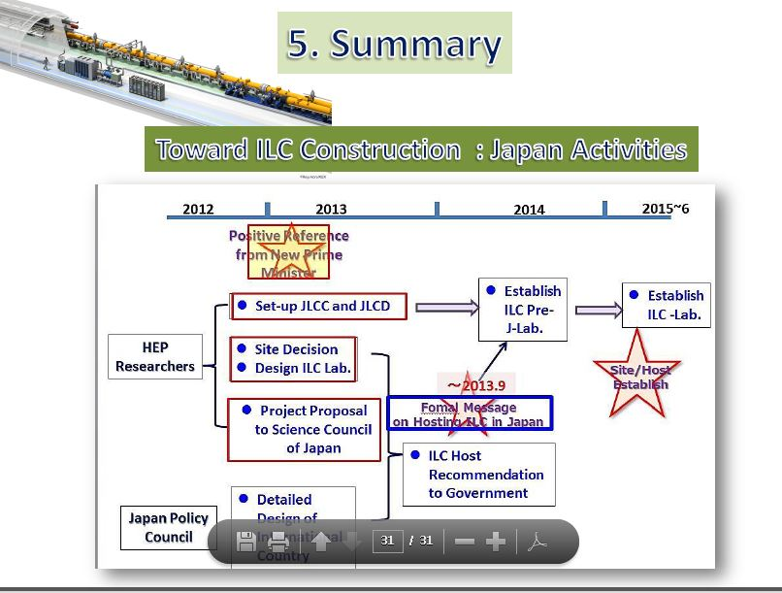

Slide 11
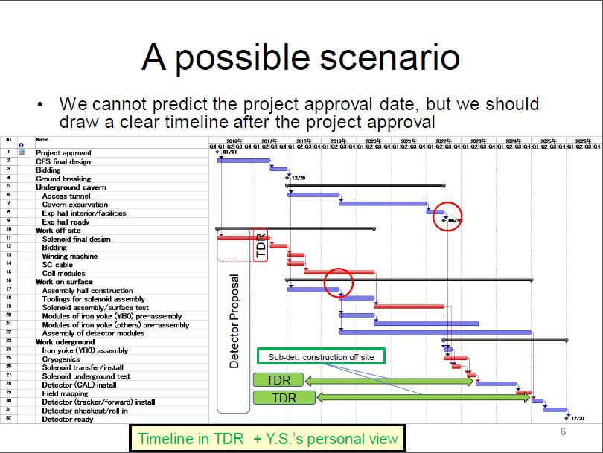

Slide 12
Collaboration ILD

