Slide 1


Roundup of Weeks FONT Shifts 3rd Week – June ATF Run
Mikey Davis
21 June 2013
1/11

Slide 2
Introduction
Spent this week trying to roundup lose ends
Also tried to get some better results
Discovered a problem in out upstream system
Was concerned about P2 correlation
Swapped the processor, reset RCPS
Correlation up to 95% (same as P3)
Third shift bunch to bunch correlation were very good, got some interesting results
Concentrated on feedforward
Got our best IP feedback results yet
Mikey Davis
21 March 2013
2/11

Slide 3
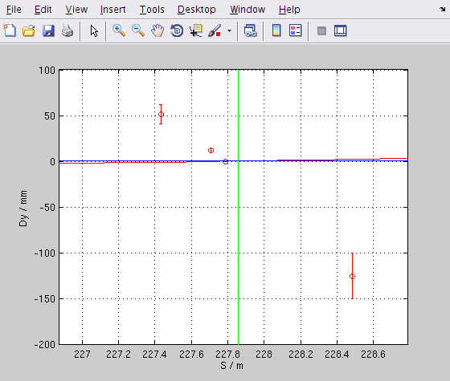
Dispersion at the IP – Y
Mikey Davis
21 March 2013
3/11

Slide 4
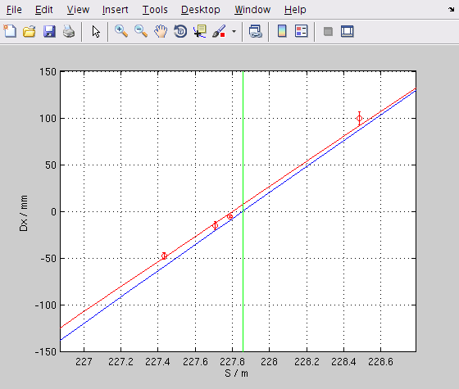
Dispersion at the IP – X
Mikey Davis
21 March 2013
4/11

Slide 5
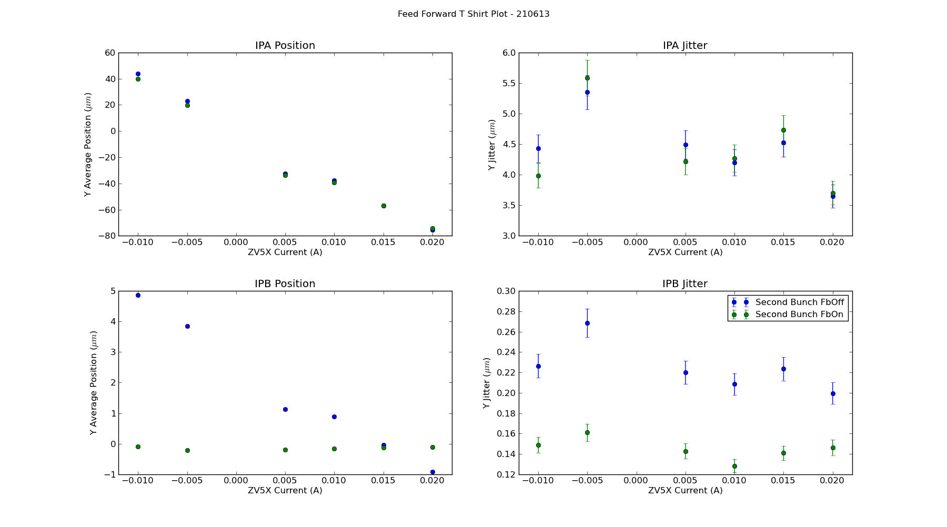
Feed Forward T Shirt Plot
Mikey Davis
21 March 2013
5/11

Slide 6
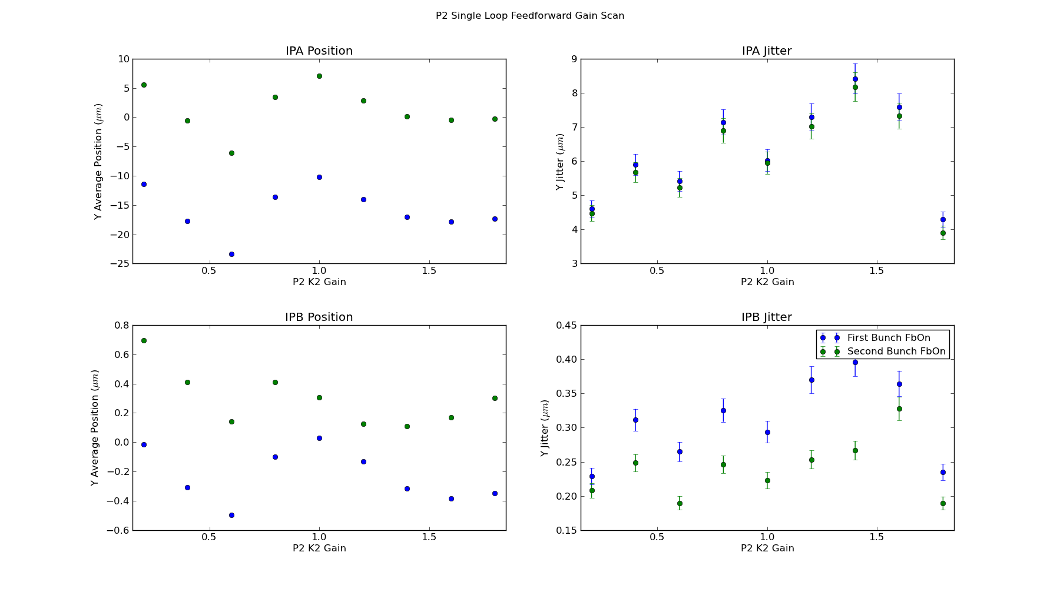
Feed Forward Single Loop P2 Gain Scan
Mikey Davis
21 March 2013
6/11

Slide 7
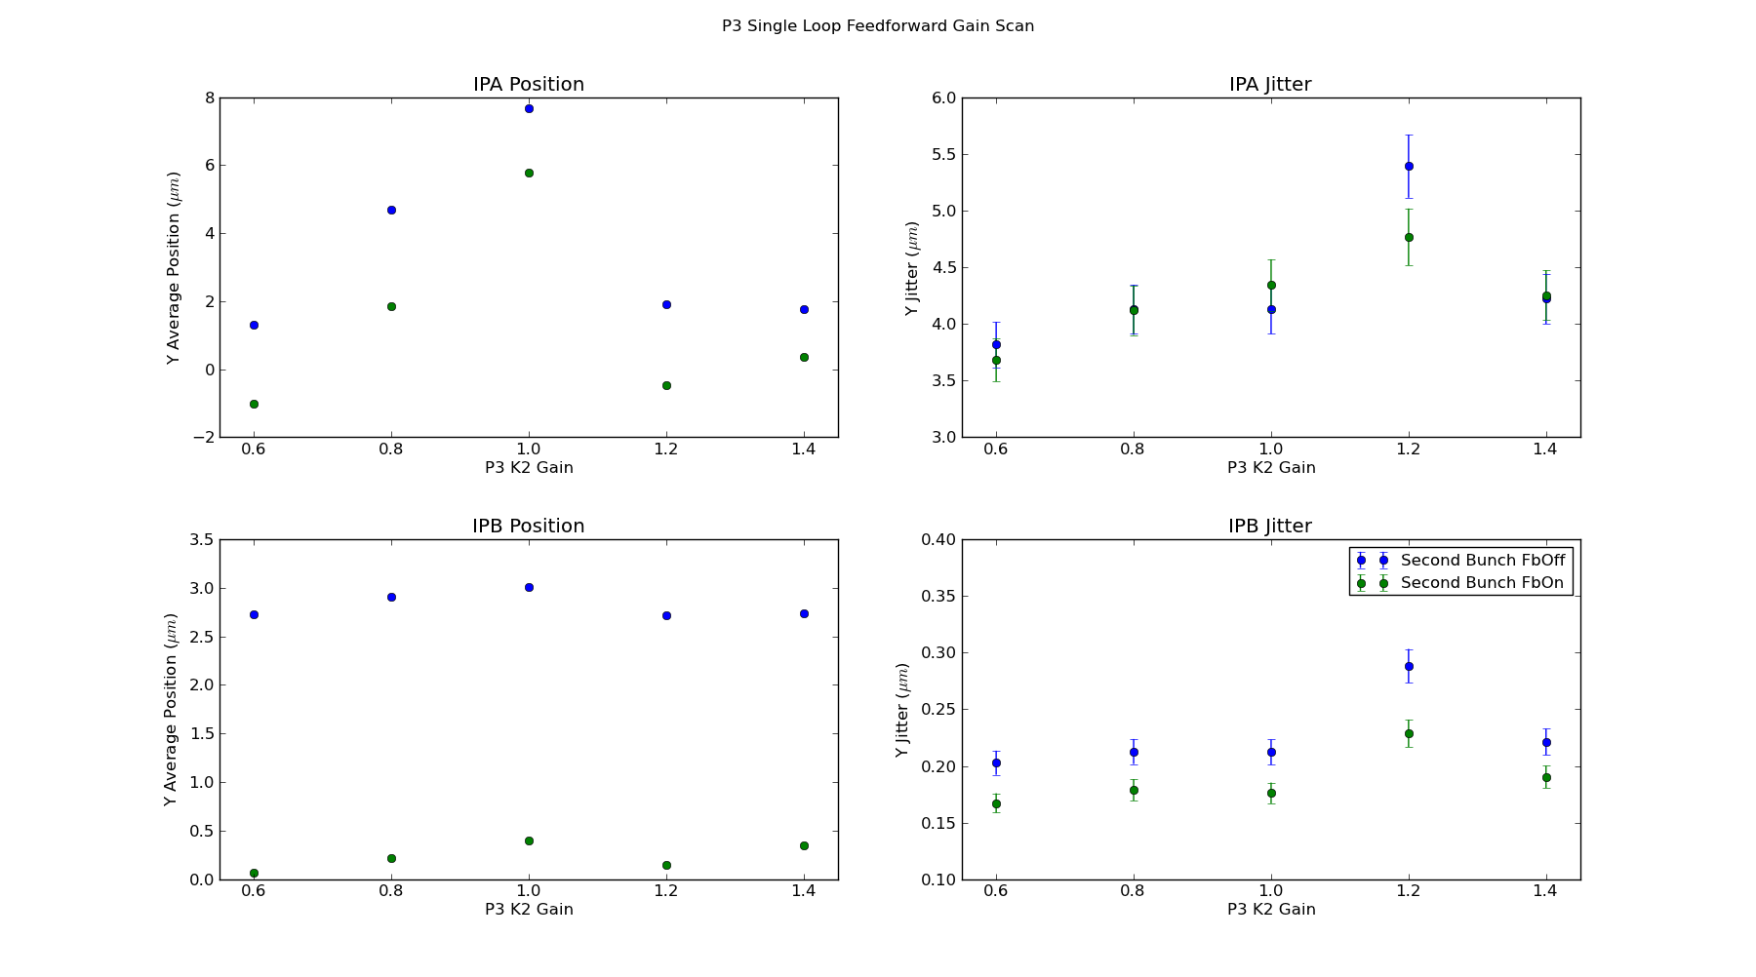
Feed Forward Single Loop P3 Gain Scan
Mikey Davis
21 March 2013
7/11

Slide 8
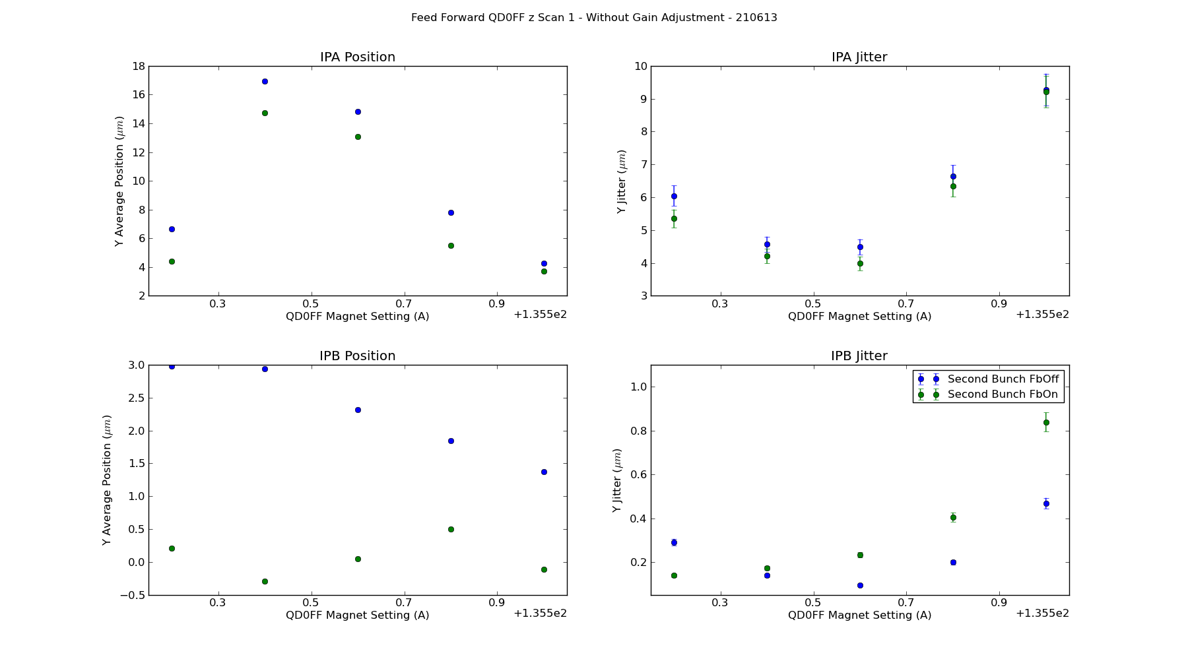
QD0FF z Scan with Feed Forward
Mikey Davis
21 March 2013
8/11

Slide 9
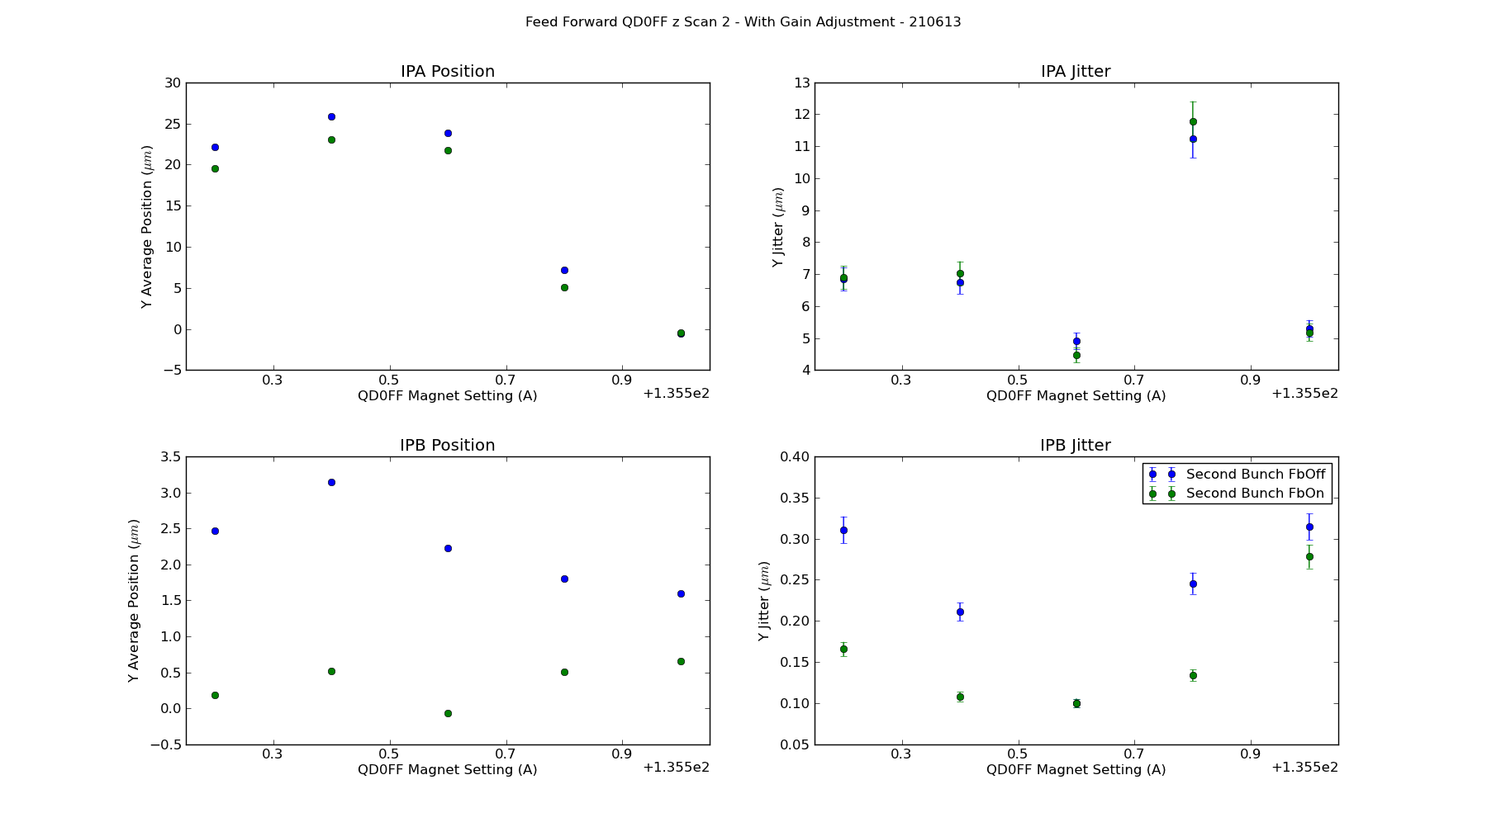
QD0FF z Scan with Feed Forward
Mikey Davis
21 March 2013
9/11

Slide 10
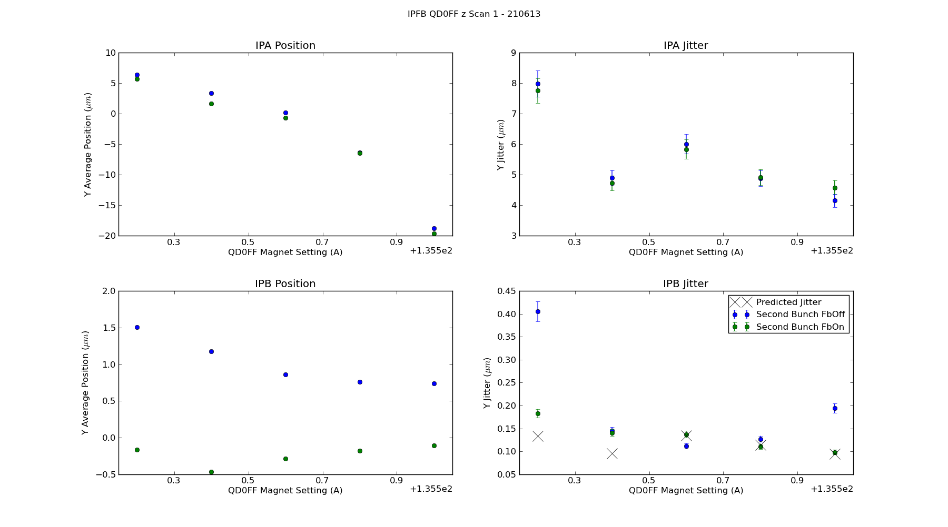
IP Feedback QD0FF z Scan
Mikey Davis
21 March 2013
10/11

Slide 11
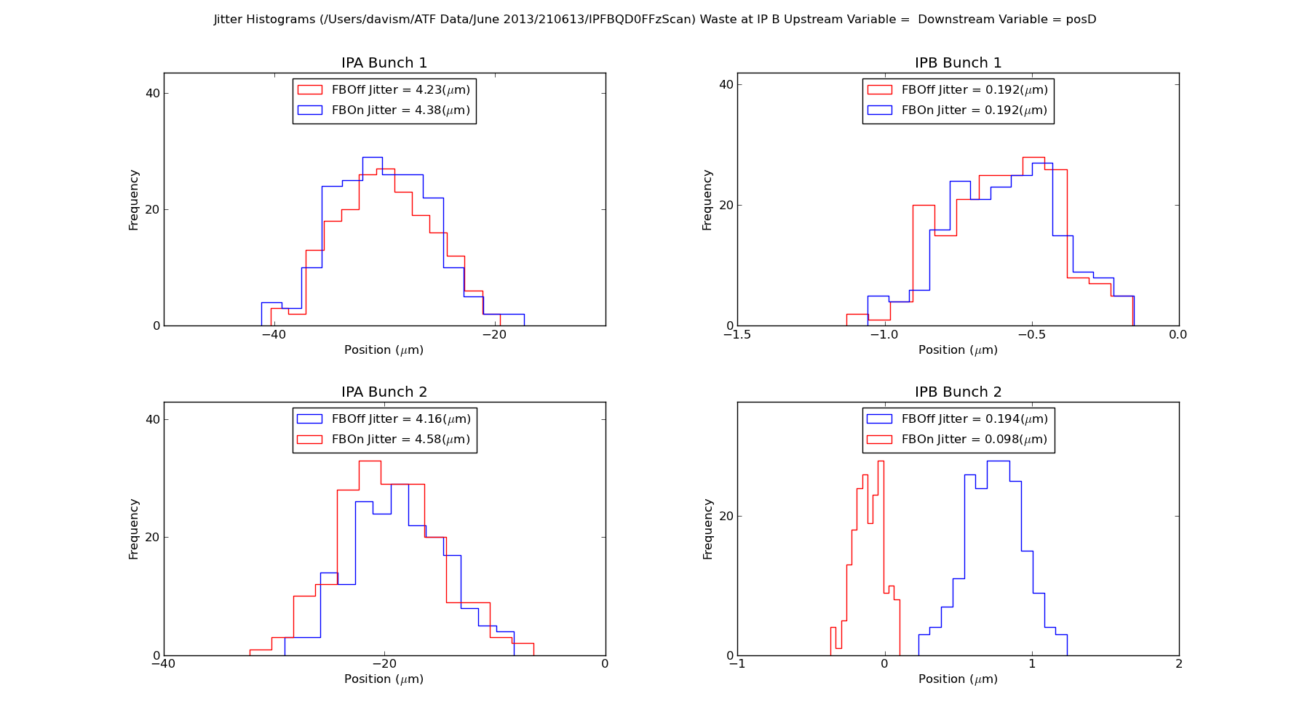
Best IP Feedback Run
Mikey Davis
21 March 2013
11/11

