Slide 1
Change Control & EDMS (TDD)
Ideas for the next step in AD&I
Understanding what we want (and can) do while
Evolving towards a real construction project

Slide 2
Change Control: Philosophy
Expect the “design” to evolve
Premise: we will start construction in 2015/16
  This is essentially tomorrow!
Changes will be driven by
  Site specific constraints ← our primary focus?
  Cost and/or performance technology choices
    e.g. cryomodule and cavity package discussions
  R&D results (e.g. positron source)
Change should be driven by facts, resulting in a better design “value”

Slide 3
Change Control: Philosophy
During a design phase, CC is all about keeping all the baseline documentation current and correct
During CC, we use the documentation to
  Help us assess the impact of the proposed change
  Evaluate the pros and cons (including cost)
  Make sure no effect of the change is overlooked
  Communicate with stakeholders (as and when necessary)
This is basically what change control is about

Slide 4
Change Control: Philosophy
During TDR we had two levels of CC
  TLCC – big top-level modifications which required consensus of broad spectrum of stakeholders
  BTR – PM-driven ‘technical’ decisions –much smaller ‘team’.
Both rather ad hoc – teams were small enough to get people in a room to hammer out decisions.
Note AD&I activity really pre-dates most of the TDD in EDMS
  this was mostly generated/collected after the major design decisions.

Slide 5
EDMS & Change Control
TDR Status
  ~200 documents representing design as presented in TDR
    reports
    spread sheets
    drawings
    cad models
    other (e.g. lattice files)
    Cost data ← important!
Situation is much better than for RDR
  Only had written RDR
  Supporting documentation was strewn across the world’s computers
    or stored in individual’s heads!
We now finally have something (TDD) we can formally apply CC to – but how?

Slide 6
Two approaches
Ad hoc
  Group of people discuss a modification.
  Canvas input from the other experts or stakeholders
  Decides to make the change.
  Report is written up explaining the rationales of the decisions as well as the (incremental) design modifications accepted.
More formal – similar to above except
  A formal process is established (see next slide)
  A change request is issued
  As part of the deliberations, the scope of impact on the baseline (EDMS) documentation is also assessed, and a plan established to update the documentation.
  Acceptance of change triggers the documentation update
    and possibly also additional second-level change requests

Slide 7
Two approaches
Ad hoc
  Group of people discuss a modification.
  Canvas input from the other experts or stakeholders
  Decides to make the change.
  Report is written up explaining the rationales of the decisions as well as the (incremental) design modifications accepted.
More formal – similar to above except
  A formal process is established (see next slide)
  A change request is issued
  As part of the deliberations, the scope of impact on the baseline (EDMS) documentation is also assessed, and a plan established to update the documentation.
  Acceptance of change triggers the documentation update
    and possibly also additional second-level change requests
This is how we worked so far
This is how we must eventually work (real project)

Slide 8
Two approaches
Ad hoc
  Group of people discuss a modification.
  Canvas input from the other experts or stakeholders
  Decides to make the change.
  Report is written up explaining the rationales of the decisions as well as the (incremental) design modifications accepted.
More formal – similar to above except
  A formal process is established (see next slide)
  A change request is issued
  As part of the deliberations, the scope of impact on the baseline (EDMS) documentation is also assessed, and a plan established to update the documentation.
  Acceptance of change triggers the documentation update
    and possibly also additional second-level change requests
How to evolve?

Slide 9
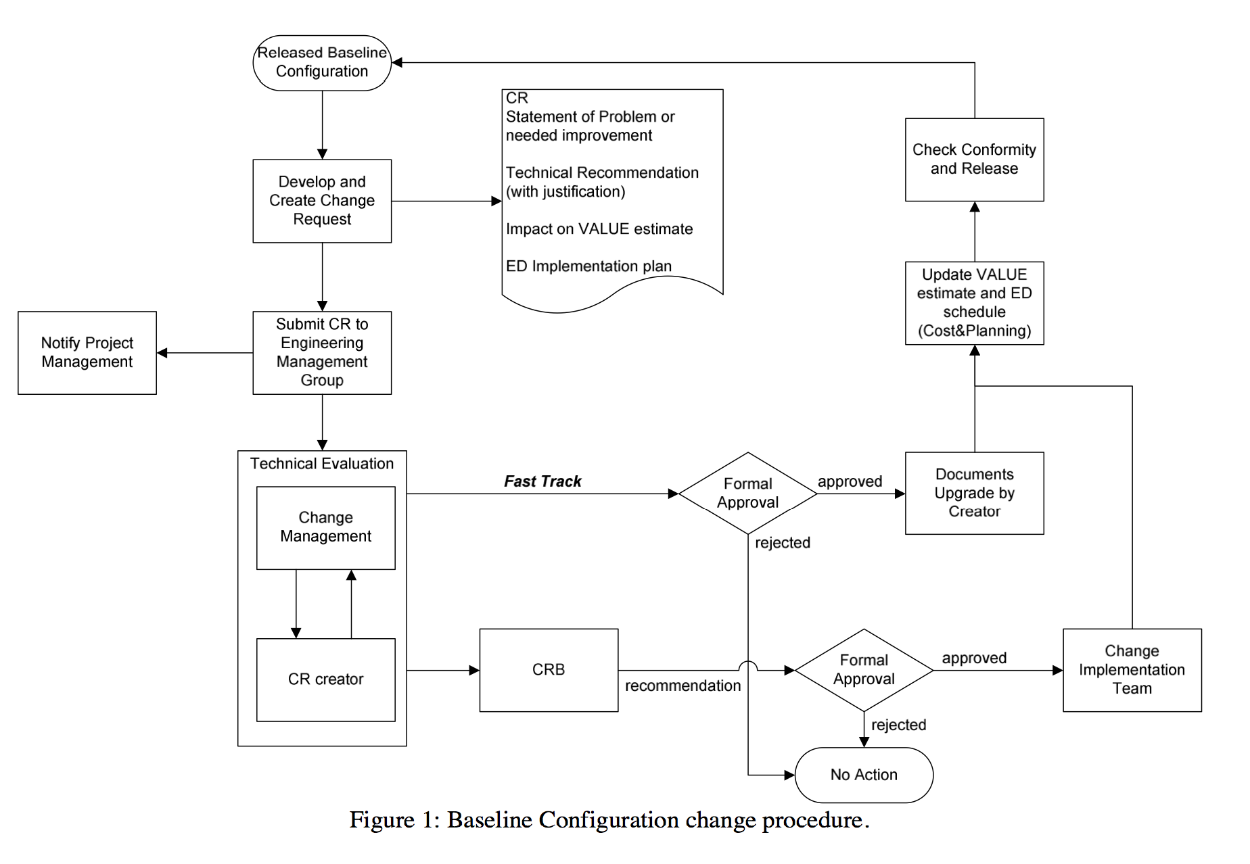
Formal Change Control Process
Already published in ILC Project Management Plan (2007) Appendix B
EDMS ID D*808115
Notes:
Basic concepts are valid for any approach including ad hoc:
proposal
evaluation
acceptance / rejection.

Slide 10
A concrete (interim) proposal
Change Review Board (CRB)
  This technical board (standing members)
  Plus (as and when needed)
    Broader stakeholders (e.g. physics and detectors)
    Additional technical experts (e.g. CFS)
Use biannual workshops as “CR reviews”
  Accumulate ‘change requests’ between workshops
  Preparatory work (running up to workshops)
  Final review and decisions at workshops
  Plan to update documentation (if not done already)
Notes:
Similar to TD Phase BTRs which worked quite well.

Slide 11
The role of EDMS
A WBS is critical for maintaining the baseline documentation
  we already have one but we should review it
CC can be formally implemented in EDMS
  Keeping clear responsibilities
Our goal is to maintain the TDD in EDMS (WBS) to represent the “current baseline design”
  this includes the COST data
  Formal update 2x per year

Slide 12
Resources
DESY can provide the central PO services for this
  As we did during the TDR
  Assuming we need an additional 2-3 FTE here
  Provide the integration services
However, AD&I team is needed for real work
  individuals responsible for key accelerator and technical sub-systems
    somebody actually has to do the design update work!

Slide 13
Next steps
Attempt to make a comprehensive list of design elements we expect to change
  or at least get reviewed.
  based on our current knowledge and
  questions left open in the TDR
Japanese site will be the biggest driver
Understand scope of design work
  Resources: require and type
  TDD documentation associated with it.
DESY can start to think about this, but eventually we need additional (international) input
  especially from Japan!

