Slide 1
Initial Tests of the FONT5 Digitiser Board at CTF3
Jack Roberts

Slide 2
Overview
CLIC and CTF3.
Phase Feedforward motivation and design.
FONT5 Board
Calibration and Resolution measurements.

Slide 3
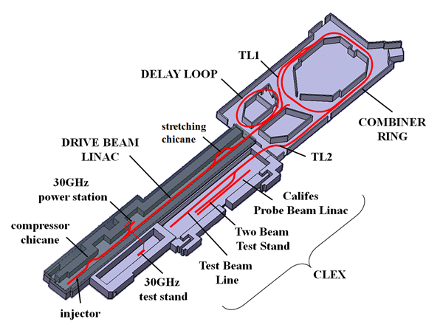
Motivation for Phase Feedforward at CLIC
CTF3
CLIC – Proposed linear collider using a novel two beam acceleration concept
RF power to accelerate main beam provided by a second “drive” beam.
Phase of drive beam and main beam bunches must be synchronised to 0.1º
Feedforward system required to maintain this synchronisation.
Proof of concept being installed at CTF3, the CLIC Test Facility.

Slide 4
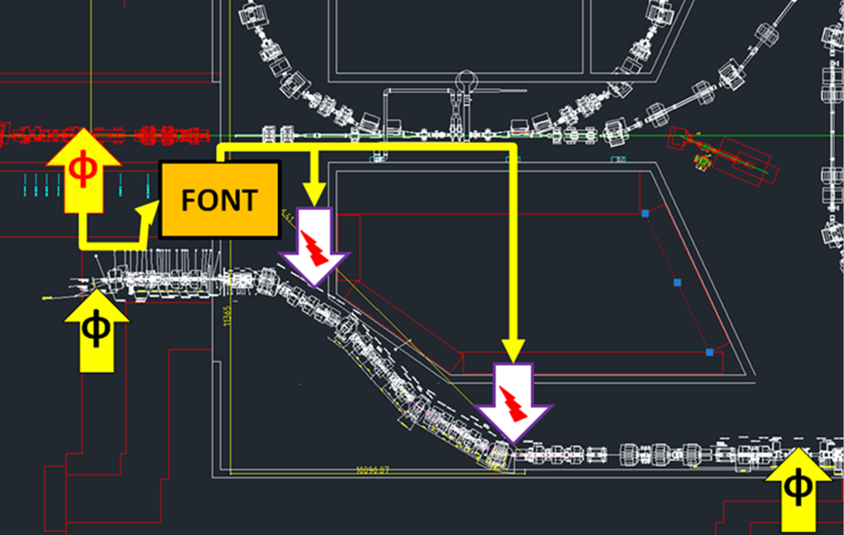
Phase Feedforward at CTF3
Measure the phase using three phase monitors.
Vary the path length through a chicane using two kickers.
Calculate the required kicker voltage with a digital processor (FONT).

Slide 5
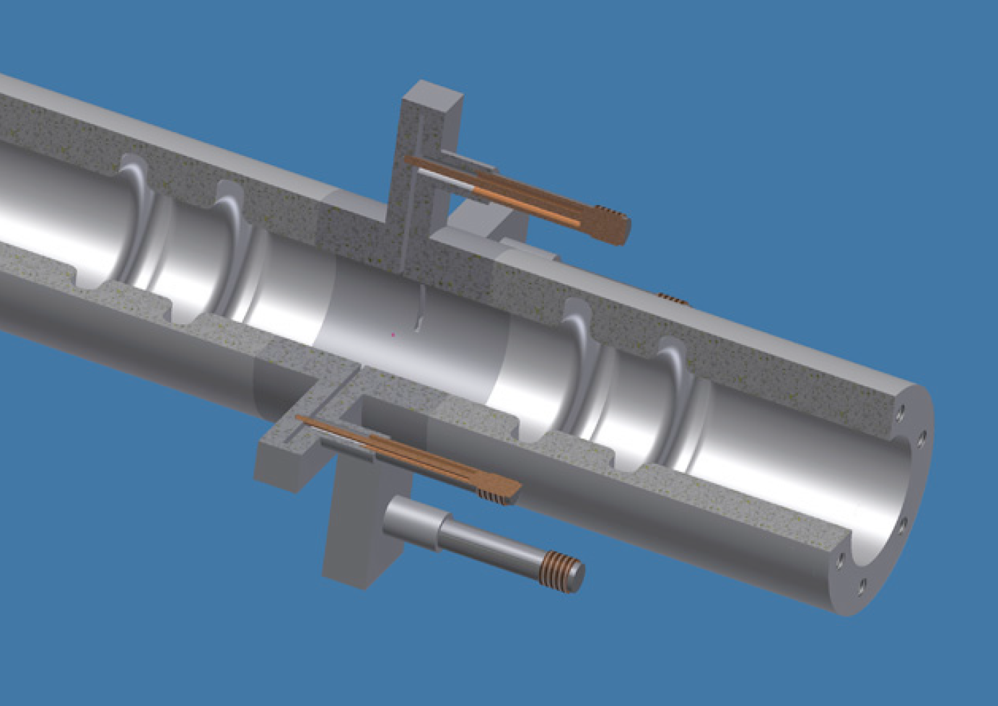
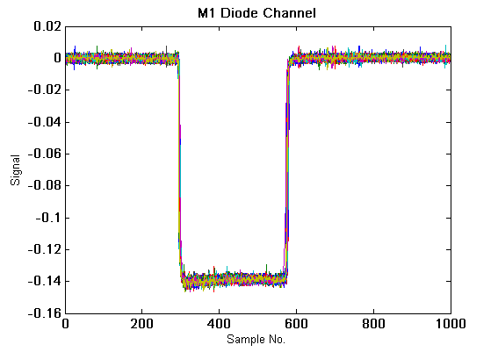
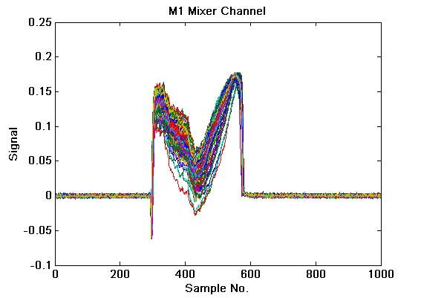
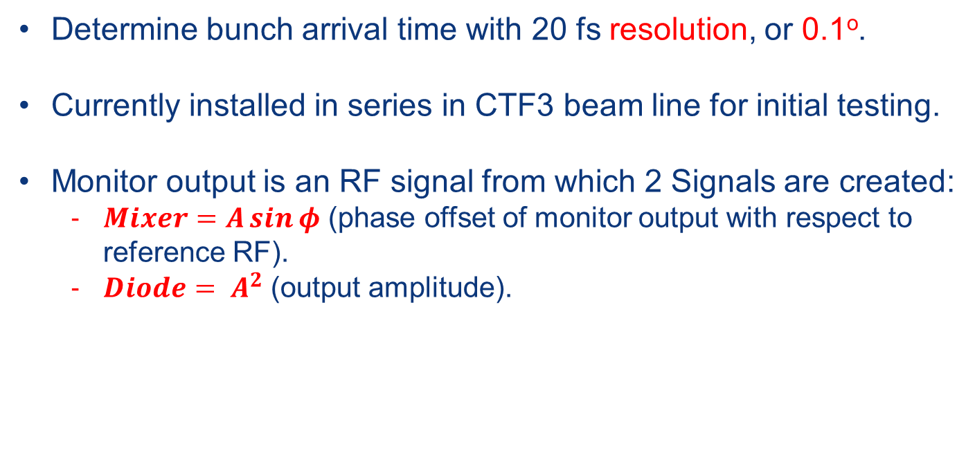
Phase Monitors
Determine bunch arrival time with 20 fs resolution, or 0.1º.
Currently installed in series in CTF3 beam line for initial testing.
Monitor output is an RF signal from which 2 Signals are created:
$Mixer=A\sin{φ}$ (phase offset of monitor output with respect to reference RF).
$Diode= A^{2}$ (output amplitude).

Slide 6
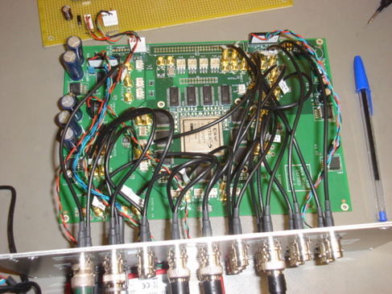
FONT5 Board
Custom low latency digital processor used to calculate the phase and output the necessary correction.
FONT5 BOARD
ADC = Analogue to Digital Converter , DAC = Digital to Analogue Converter
FPGA = Field Programmable Gate Array.
Monitor
ADC
Diode
Mixer
ADC
FPGA
DAC
Kicker
Monitor
ADC
DAC
Kicker
Diode
Mixer
ADC
DAQ
Monitor
ADC
Diode
LabVIEW data acquisition system (DAQ)
Mixer
ADC
357 MHz from signal generator
Clock
Trigger
0.8 Hz from beam gun

Slide 7
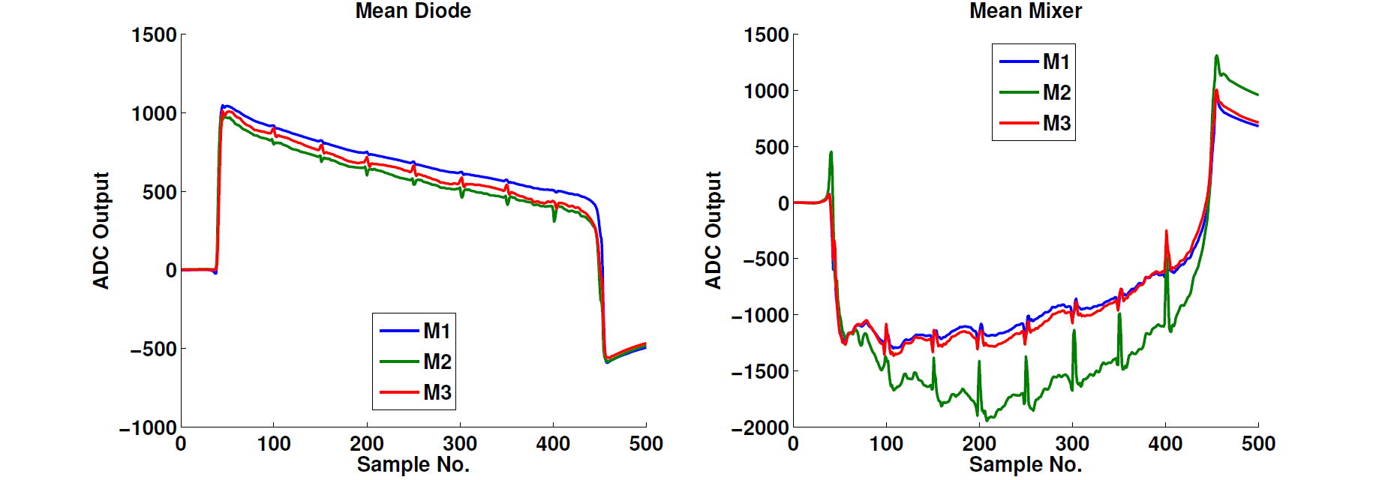
Phase Monitor Signals on the FONT5 Board
Two features:
Phase spikes: Artefact of the beam setup, will not be present when the feedforward system is used.
ADC droop: Complicates phase calculation. Needs to be removed via adjustments to the FONT ADCs and digital filtering.

Slide 8
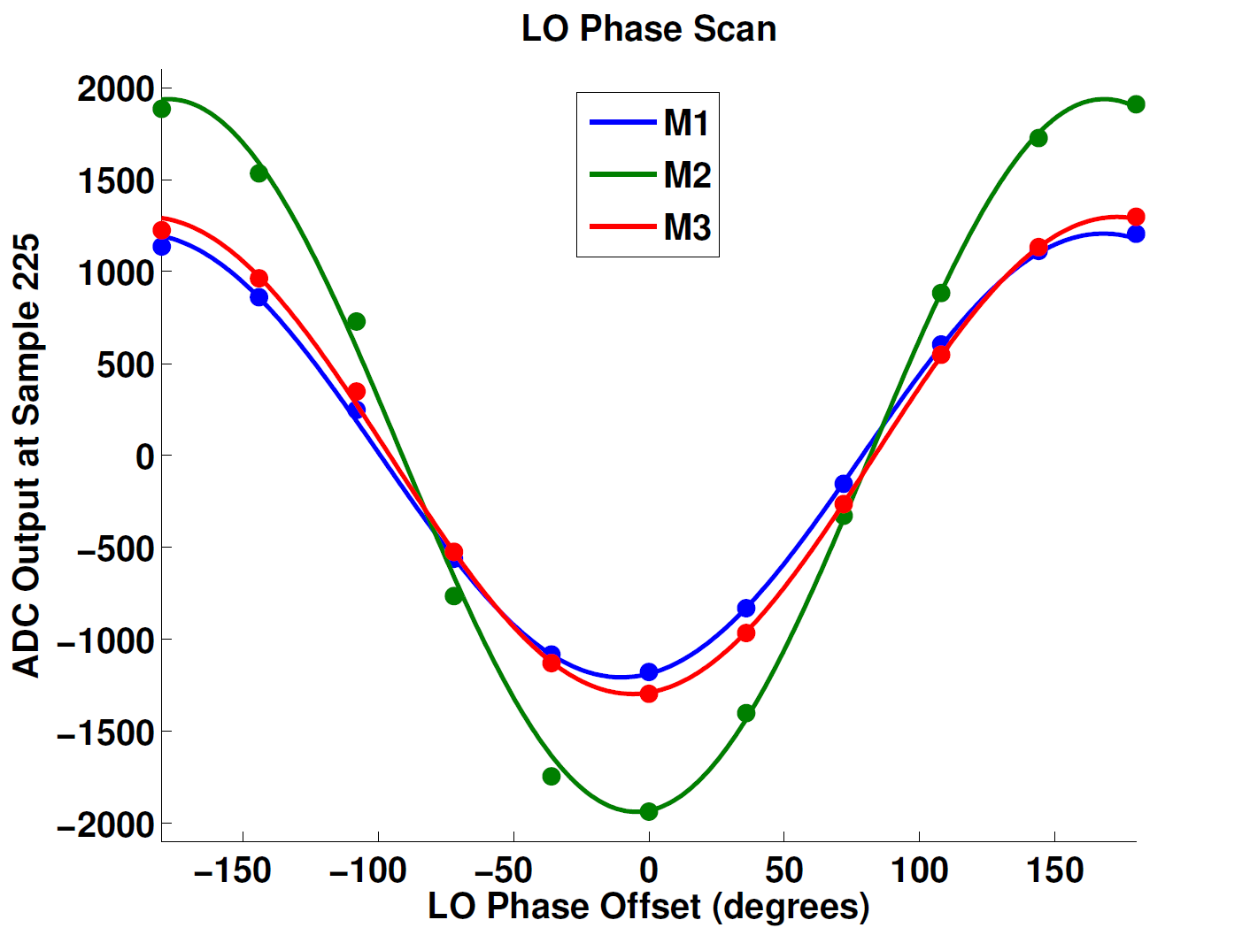
LO Scan
Change the reference (LO) phase used by the mixer channel.
Map out the response of the mixer channel to different beam phase offsets.
Sine behaviour as expected.
Need to fit to the amplitude to reconstruct the beam phase…

Slide 9
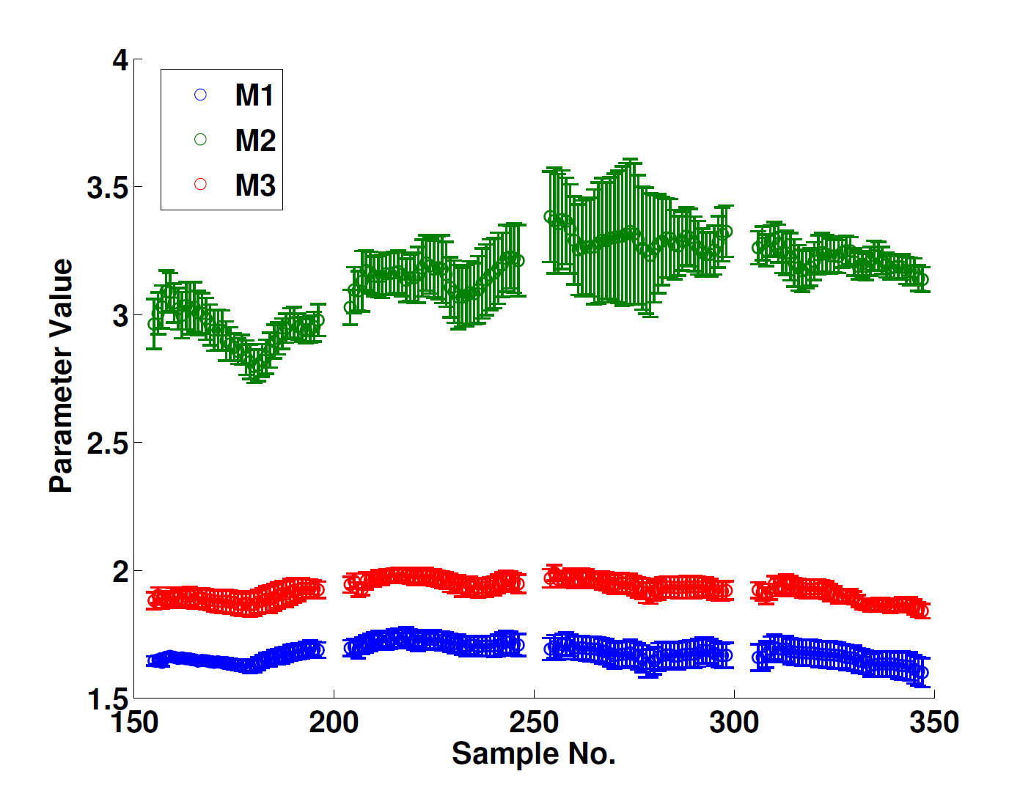
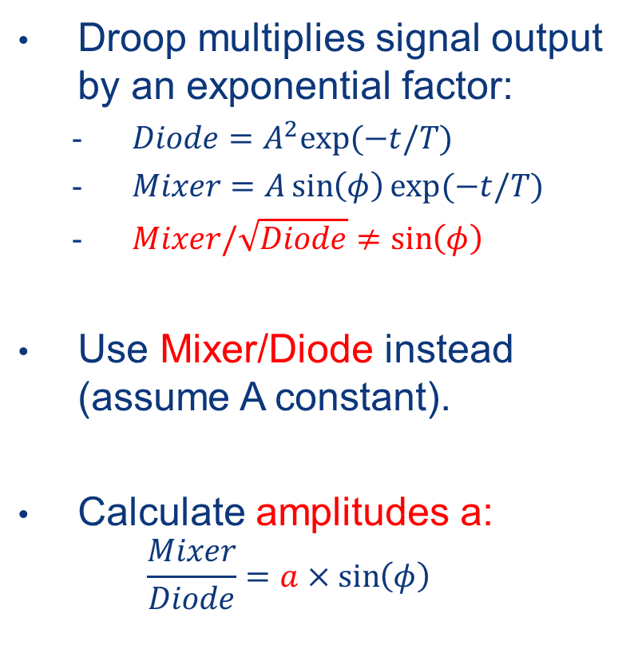
Calibration
Droop multiplies signal output by an exponential factor:
$Diode=A^{2}exp⁡(−t/T)$
$Mixer=A\sin\left(φ\right)\exp{(−t/T)}$
$Mixer/\sqrt{Diode}≠\sin\left(φ\right)$
Use Mixer/Diode instead (assume A constant).
Calculate amplitudes a:
$$\frac{Mixer}{Diode}=a×\sin\left(φ\right)$$
Monitor | a
M1 | 1.666 ± 0.001
M2 (damaged) | 3.107 ± 0.003
M3 | 1.922 ± 0.001

Slide 10
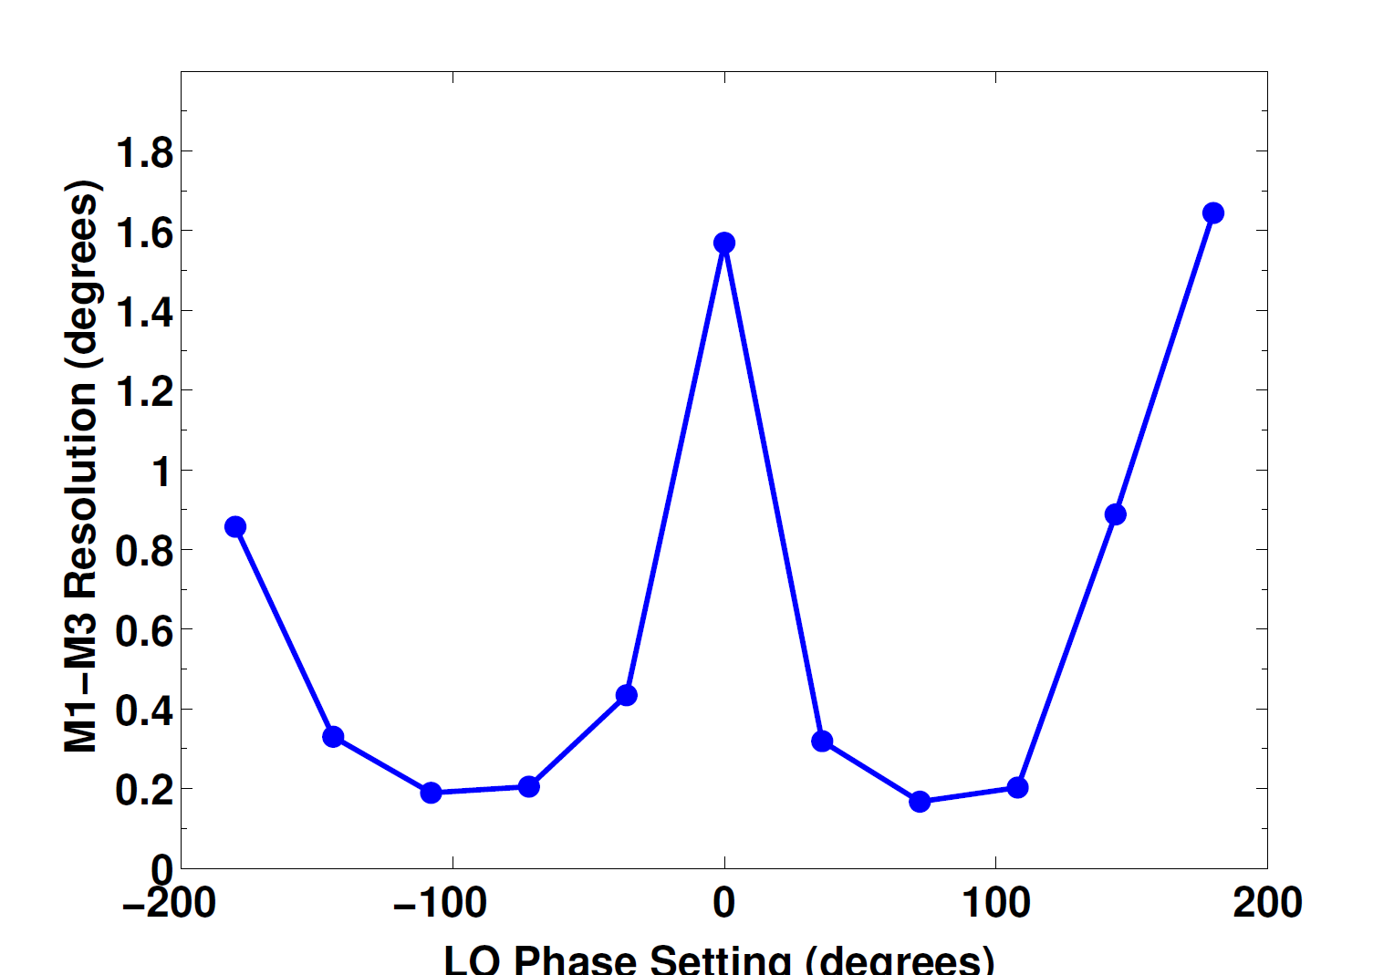
Resolution
Best resolution near zero crossings of LO scan.
Linear part of sine wave (proportional change in output with phase).
Resolution ~0.2º including all forms of noise.
Noise from the FONT5 board is not the limiting factor.

Slide 11
Summary
A phase feedforward system is required at CLIC to maintain synchronisation between main beam and drive beam to 0.1º.
Initial tests of the central processor of the system, the FONT5 board, have been performed at CTF3.
Obtained phase resolution of 0.2º in agreement with previous results using other equipment.
ADC noise on the FONT5 board is not the dominant contribution to the resolution.
ADC droop will have to be removed via changes to the FONT5 board.

Slide 12
Backup

Slide 13
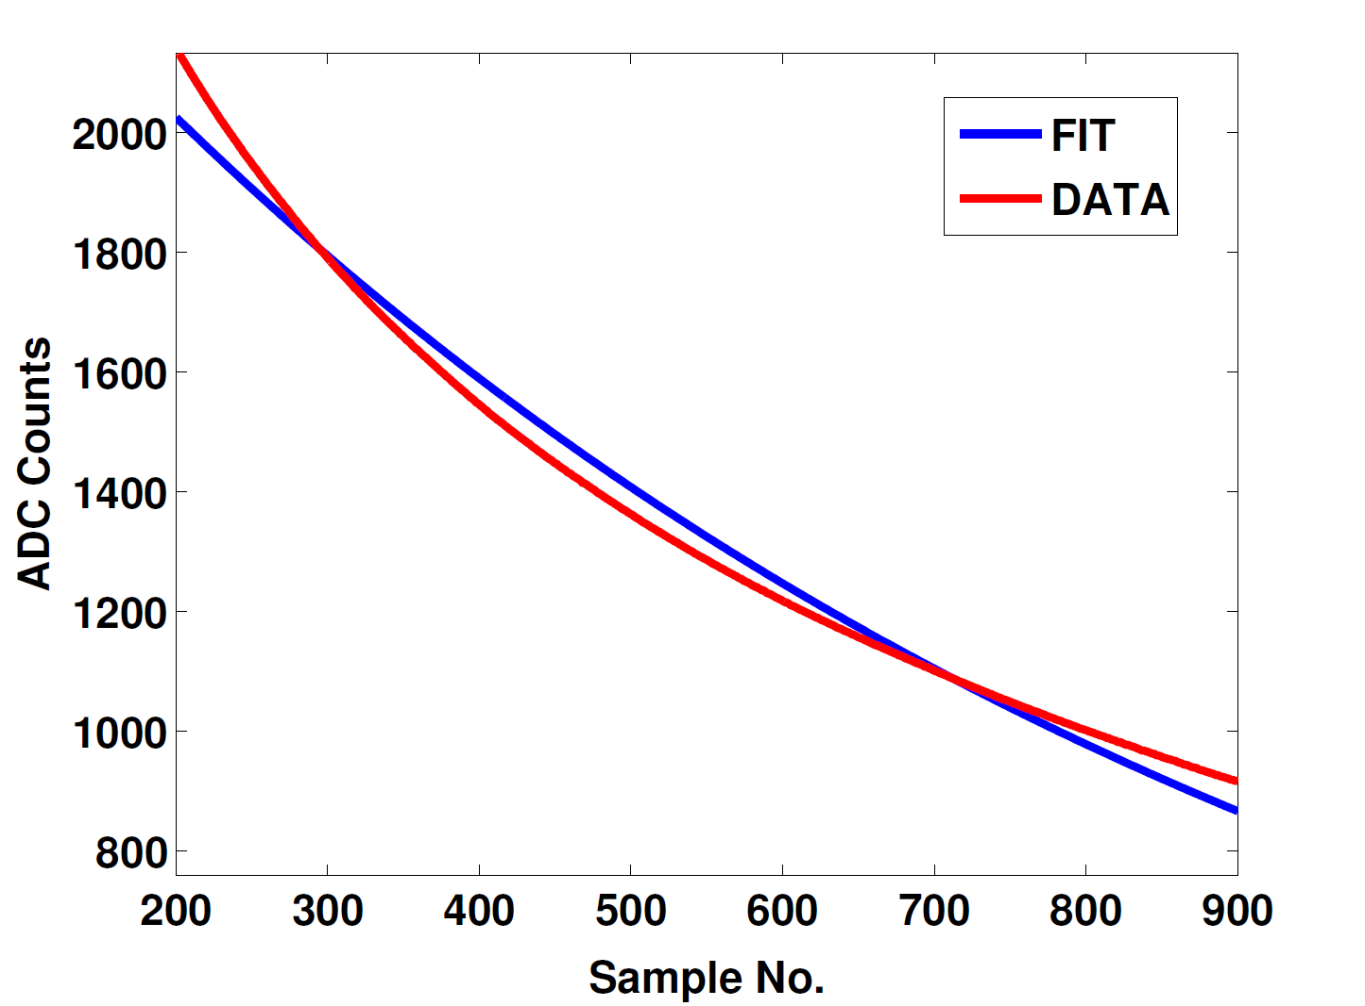
ADC Droop
ADC droop is caused by AC coupling on input transformers.
DC component of signals not transmitted.
Lab tests show droop is not well described by a simple exponential decay.
New transformers and digital filtering will be used to eradicate droop.

Slide 14
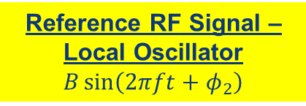
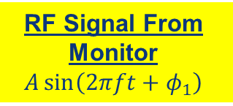
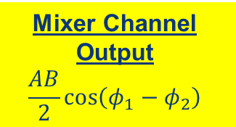
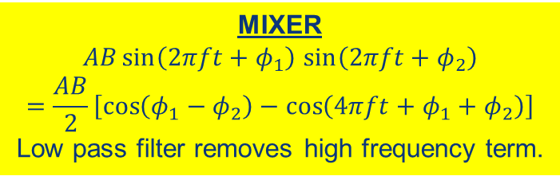
RF Mixer
Reference RF Signal – Local Oscillator
$$B\sin\left(2πft+φ_{2}\right)$$
RF Signal From Monitor
$$A\sin\left(2πft+φ_{1}\right)$$
Mixer Channel Output
$$\frac{AB}{2}\cos\left(φ_{1}−φ_{2}\right)$$
MIXER
$AB\sin\left(2πft+φ_{1}\right)$ $\sin\left(2πft+φ_{2}\right)$
$$=\frac{AB}{2}\left[\cos\left(φ_{1}−φ_{2}\right)−\cos\left(4πft+φ_{1}+φ_{2}\right)\right]$$
Low pass filter removes high frequency term.

Slide 15
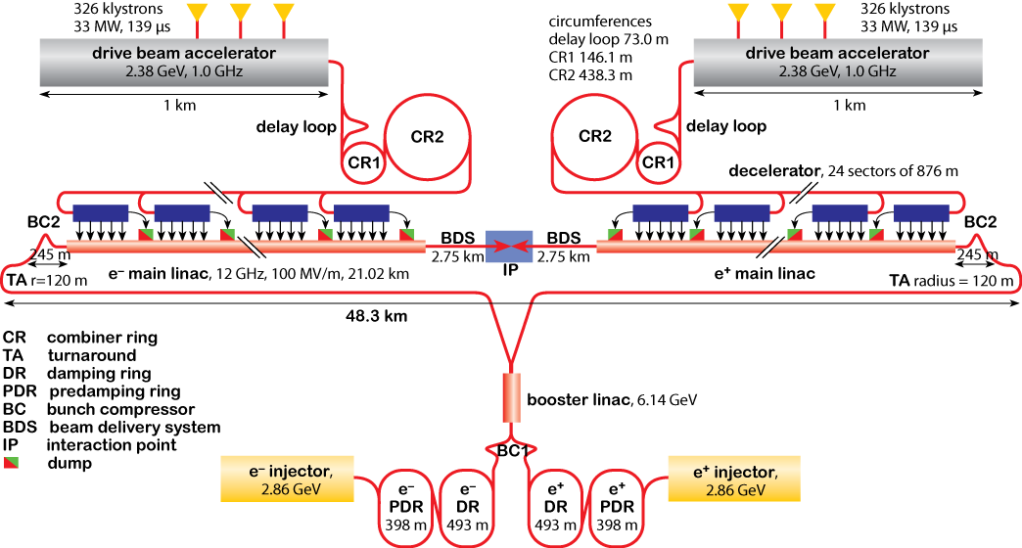
CLIC Accelerator Complex

Slide 16
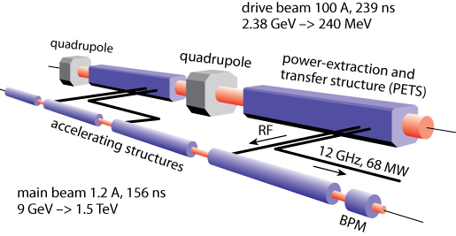
Two Beam Acceleration Concept
RF power to accelerate the main beam is extracted from the drive beam.
Drive beam: Low energy (2 GeV), high current (100 A).
Main beam: High energy (1.5 TeV), low current (1 A).
Total of 48 (24 per beam) power extraction and transfer structures (PETS) for 3 TeV CLIC.

Slide 17
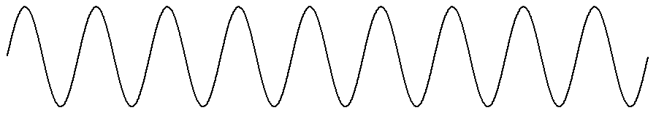
Delay Loop
Delay Loop
Drive Beam
RF
Deflector
Depending on phase bunches are either deflected or pass through the delay loop.
Deflected bunches recombine with drive beam to create high current pulses.

Slide 18
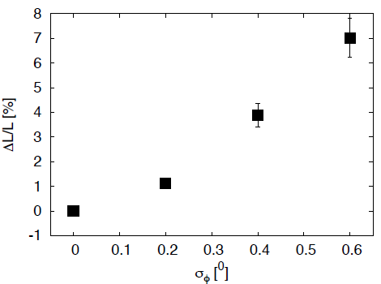
Luminosity Loss due to Drive Beam Phase Offset
0.3º phase offset of drive beam with respect to power extraction results in ~2% luminosity loss.
Energy offset degrades performance of final focus system for the interaction point.

Slide 19
CLIC Phase Feedforward Scheme
Kicker
Kicker
Kicker
Kicker
FONT
Drive
Beam
Phase
Monitor
48 of these systems required for 3 TeV CLIC, one at each turnaround before each PETS.

