Slide 1


Further ATF Analysis
Mikey Davis
04 July 2013
1/21

Slide 2
Introduction
I’ve continued with the analysis of the ATF data
Focused on the things I was asked about last week
  Checked the specifics of the calibrations
  Upstream – Downstream charge correlations
  Sample point averaging
Mikey Davis
04 July 2013
2/21

Slide 3
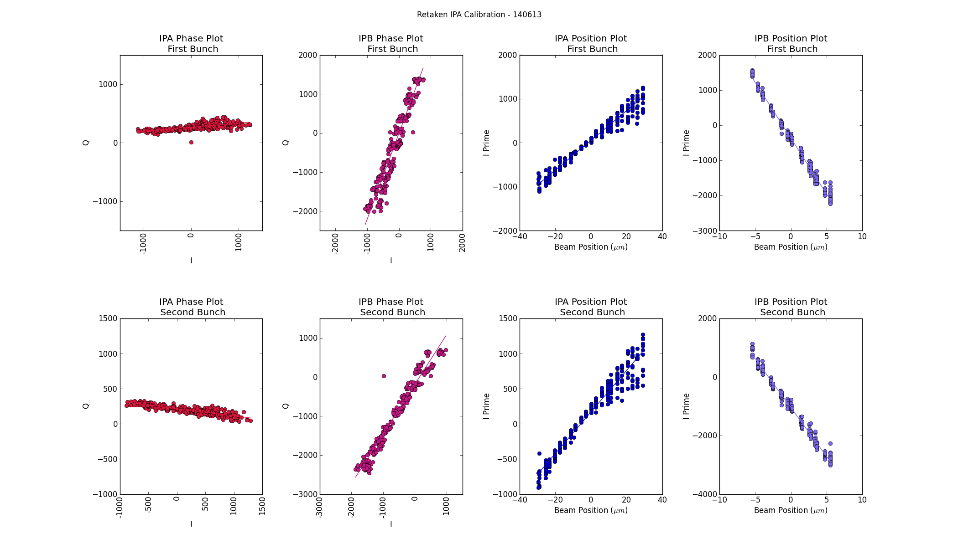
140613 Calibration
Mikey Davis
04 July 2013
3/21

Slide 4
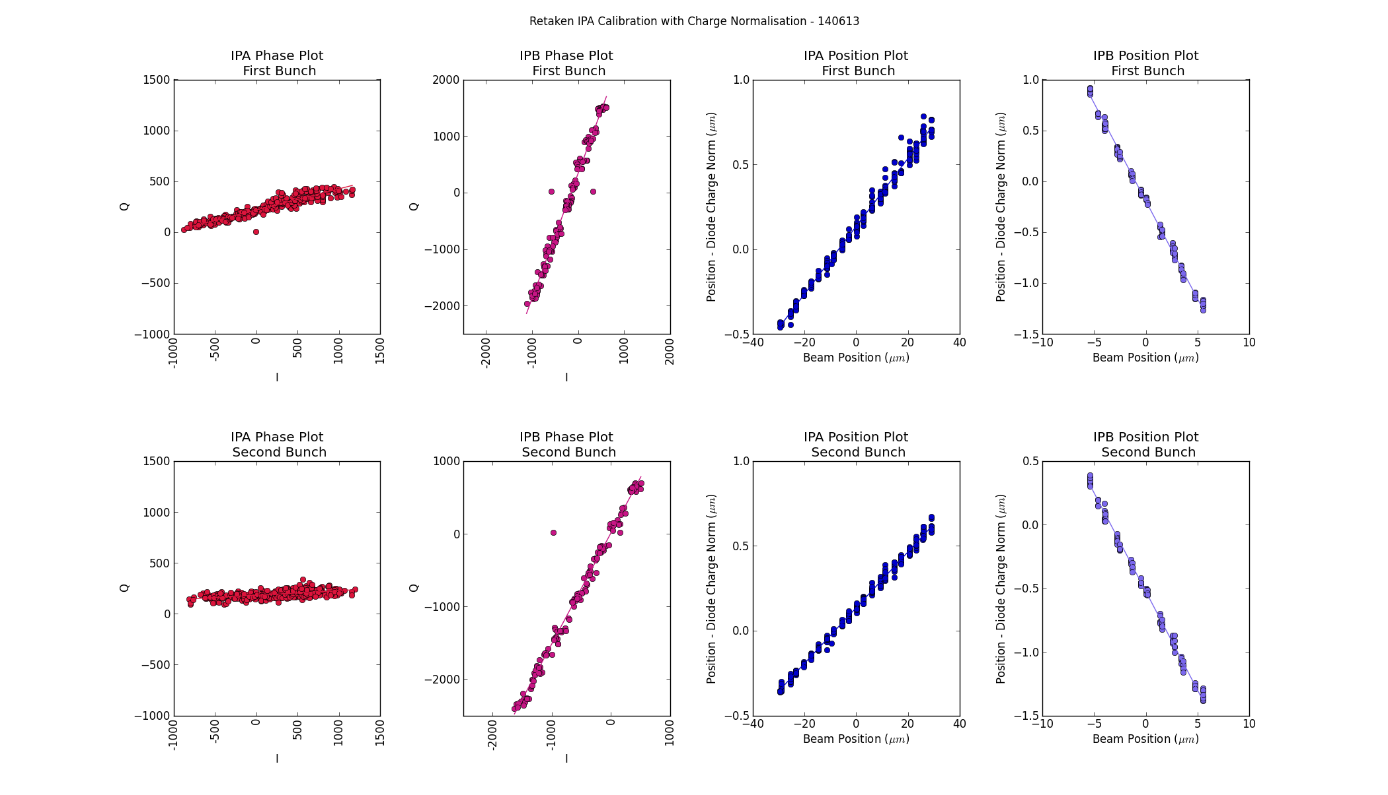
140613 Calibration
Mikey Davis
04 July 2013
4/21

Slide 5
140613 Calibration Constants
Theta | IPB First Distribution | IPB Second Distribution
First Bunch | 1.33 | 1.34
Second Bunch | 1.16 | 1.17
K (diode norm) | IPB First Distribution | IPB Second Distribution
First Bunch | -5.47 | -5.50
Second Bunch | -6.71 | -6.98
Mikey Davis
04 July 2013
5/21

Slide 6
Magnitude of Quadrature Component
I’ve had a look at the size of the quadrature component in the signals
  I’ = I cos(θ) + Q sin(θ)
  Q’ = I sin(θ) – Q cos(θ)
  (with maybe an incorrect magnitude convention)
I’ve then used the calibration constant that would convert from I’ into position to convert Q’ into “position”
Mikey Davis
04 July 2013
6/21

Slide 7
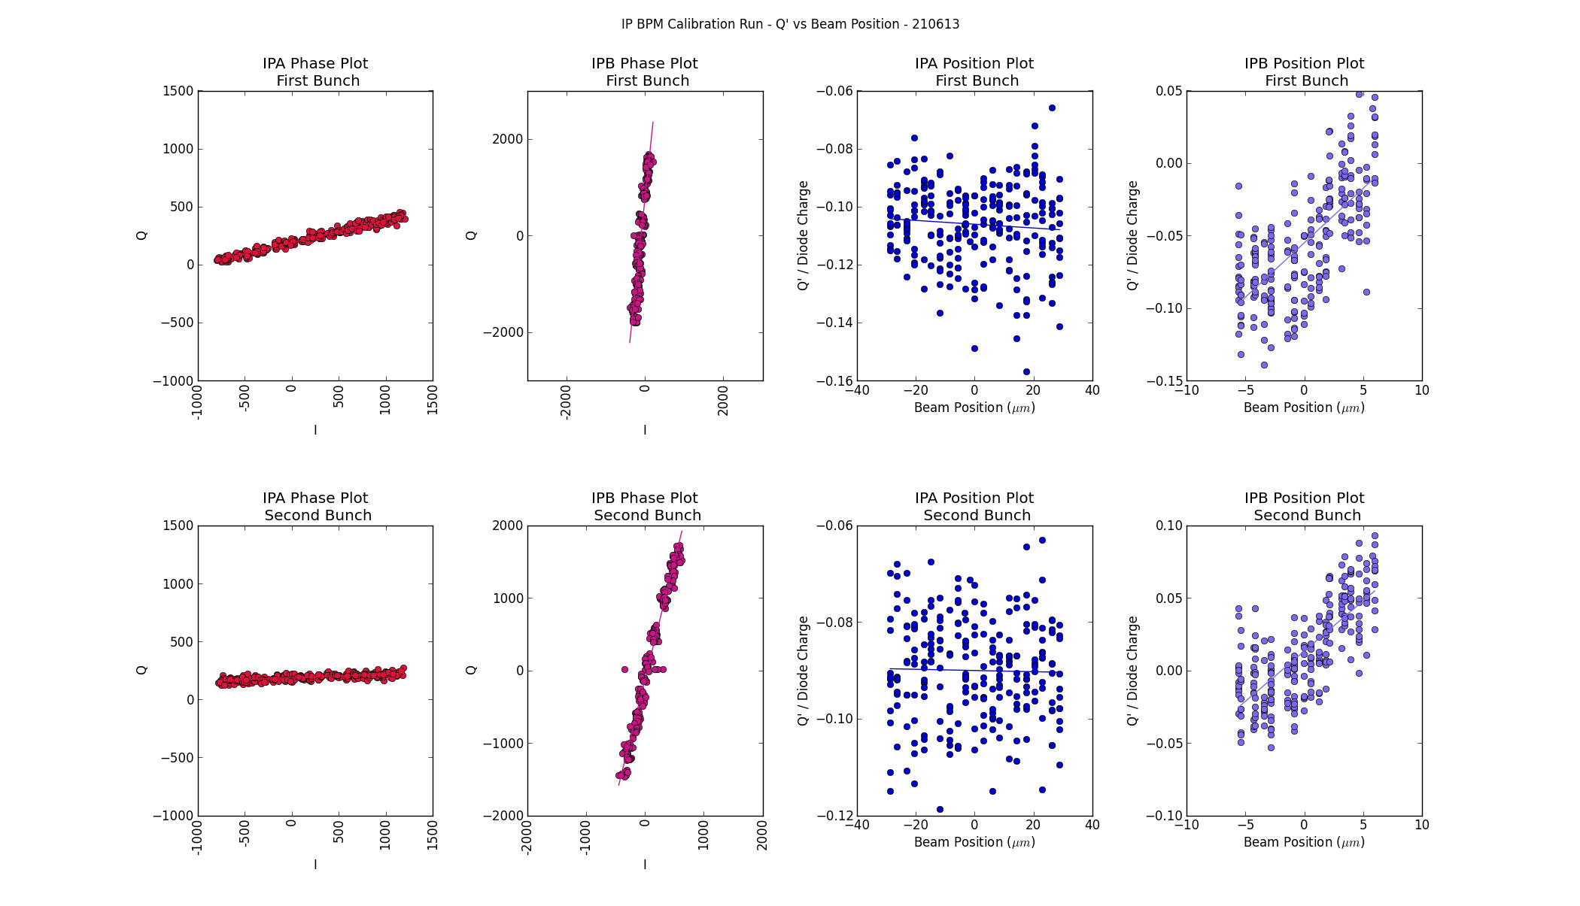
Q’ vs Mover Position
Mikey Davis
04 July 2013
7/21

Slide 8
Quadrature Position
Jitter Run 1 – 21 06 13 (on waist 500 triggers)
Ave Pos (μm) | P2 | IPA | IPB
First Bunch | -6.48 | -18.6 | 0.74
Second Bunch | -49.7 | -0.40 | -0.35
Q’ / Diode Pos | P2 | IPA | IPB
First Bunch | - | -6.33 | 0.16
Second Bunch | - | -7.82 | -0.18
Q’ Pos | P2 | IPA | IPB
First Bunch | - | -5.61 | 0.18
Second Bunch | - | -7.04 | -0.19
Mikey Davis
04 July 2013
8/21

Slide 9
Quadrature Position
Jitter Run 2 – 21 06 13 (off waist 500 triggers)
Ave Pos (μm) | P2 | IPA | IPB
First Bunch | 5.17 | -29.1 | -0.079
Second Bunch | -48.5 | -9.75 | 0.28
Q’ / Diode Pos | P2 | IPA | IPB
First Bunch | - | -5.62 | 0.44
Second Bunch | - | -7.00 | -0.04
Q’ Pos | P2 | IPA | IPB
First Bunch | - | -5.55 | 0.52
Second Bunch | - | -6.93 | -0.04
Mikey Davis
04 July 2013
9/21

Slide 10
Quadrature Jitter
Jitter Run 1 – 21 06 13 (on waist 500 triggers)
Jitter (μm) | P2 | IPA | IPB
First Bunch | 2.5 | 4.9 | 0.12
Second Bunch | 2.4 | 4.9 | 0.14
Q’ / Diode Jitter | P2 | IPA | IPB
First Bunch | - | 0.59 | 0.16
Second Bunch | - | 0.61 | 0.14
Q’ Jitter | P2 | IPA | IPB
First Bunch | - | 0.86 | 0.15
Second Bunch | - | 0.79 | 0.14
Mikey Davis
04 July 2013
10/21

Slide 11
Quadrature Jitter
Jitter Run 2 – 21 06 13 (off waist 500 triggers)
Jitter (μm) | P2 | IPA | IPB
First Bunch | 2.4 | 4.2 | 0.31
Second Bunch | 2.3 | 4.0 | 0.30
Q’ / Diode Jitter | P2 | IPA | IPB
First Bunch | - | 0.70 | 0.15
Second Bunch | - | 0.57 | 0.13
Q’ Jitter | P2 | IPA | IPB
First Bunch | - | 0.70 | 0.13
Second Bunch | - | 0.59 | 0.12
Mikey Davis
04 July 2013
11/21

Slide 12
Upstream Downstream Charge Correlation
Had a look at the upstream to downstream charge correlations
I decided the best way to do this was brute force
Threw it at the batch farm and told it to analyse every data set we took during the June trip
Throw out anything with feedback on
Throw out any Lo Phase Scan results
Mikey Davis
04 July 2013
12/21

Slide 13
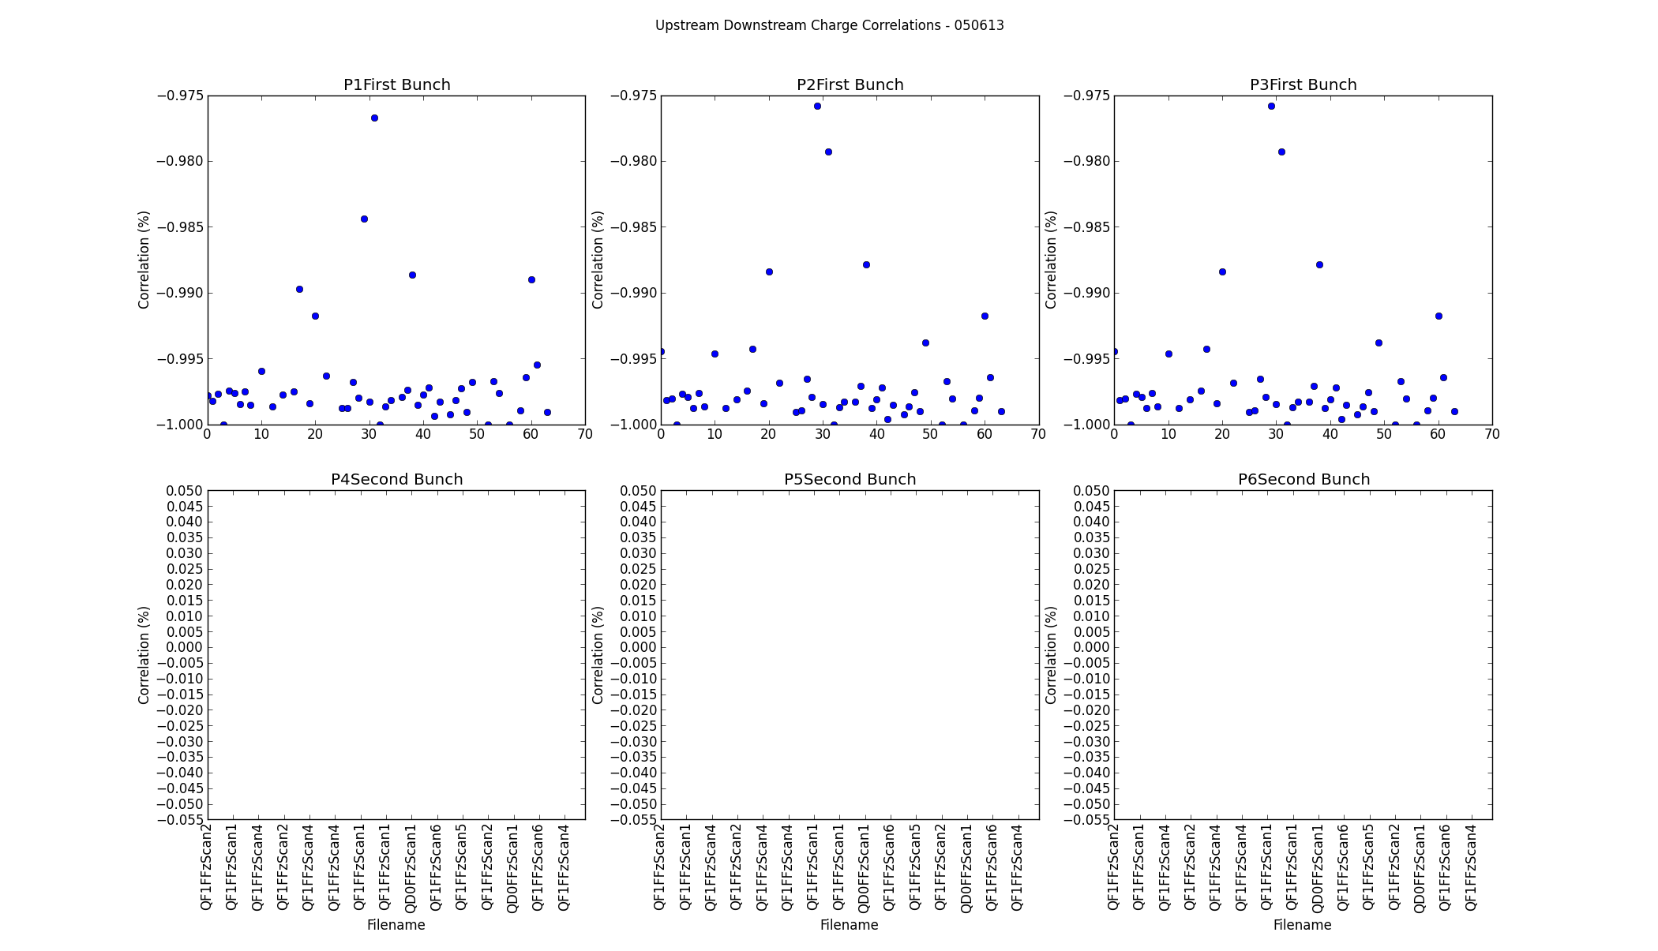
050613
Mikey Davis
04 July 2013
13/21

Slide 14
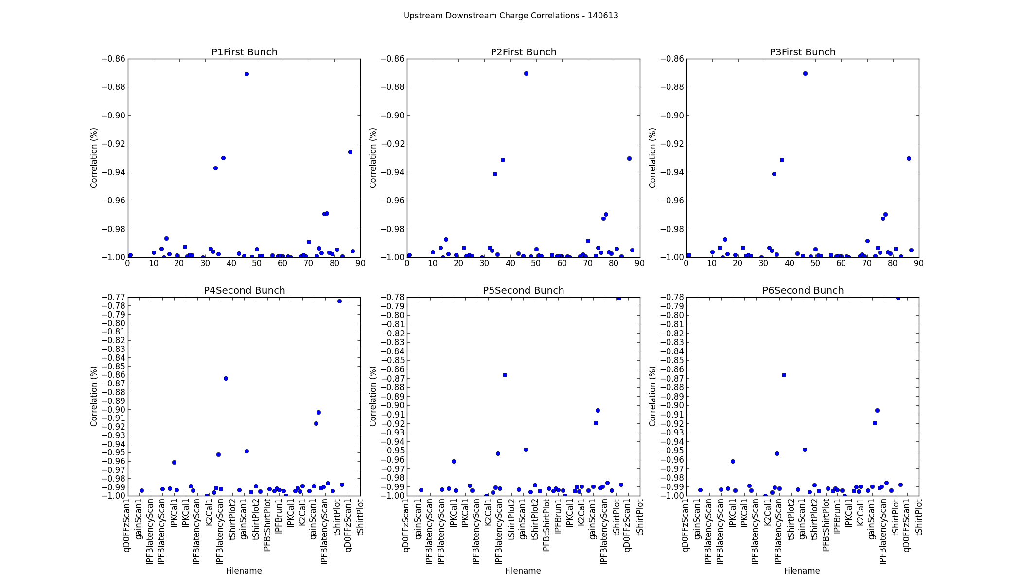
140613
Mikey Davis
04 July 2013
14/21

Slide 15
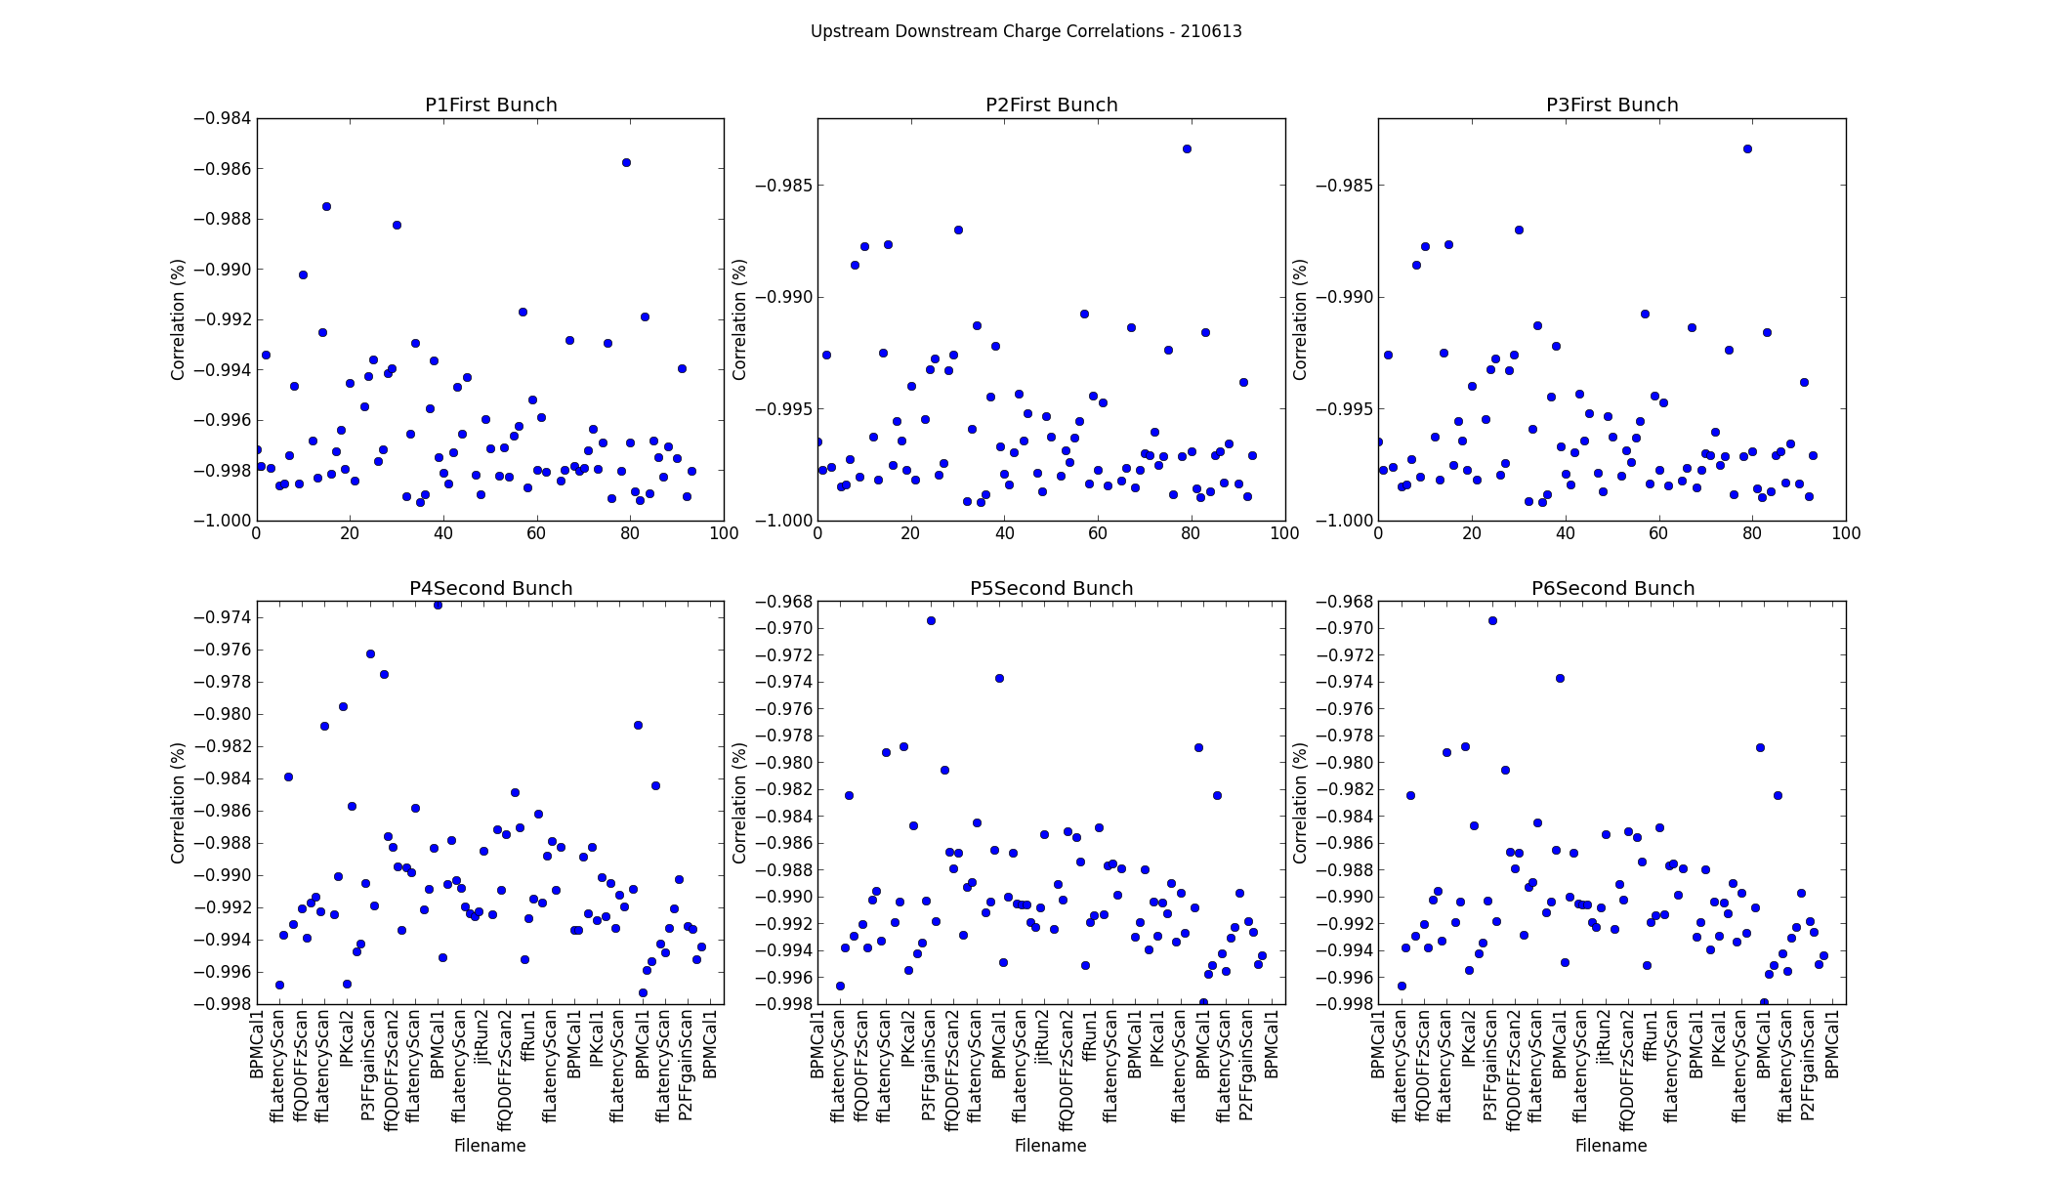
210613
Mikey Davis
04 July 2013
15/21

Slide 16
Sample Point Stuff
I’ve taken a further look at some of the sample point stuff
Check what different sample points look like over a greater range
  They give answers that are largely as expected
  Don’t suggest anything new
Looked at some data files with sample point averaging
  Lowest jitter we get is about 75 nm
  I haven’t looked at this in much depth yet
Mikey Davis
04 July 2013
16/21

Slide 17
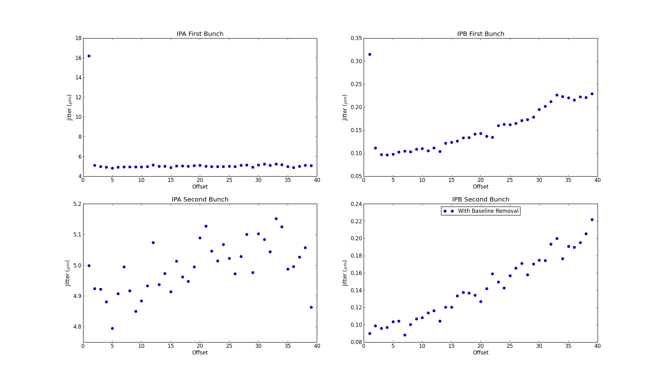
Different Sample Points
Mikey Davis
04 July 2013
17/21

Slide 18
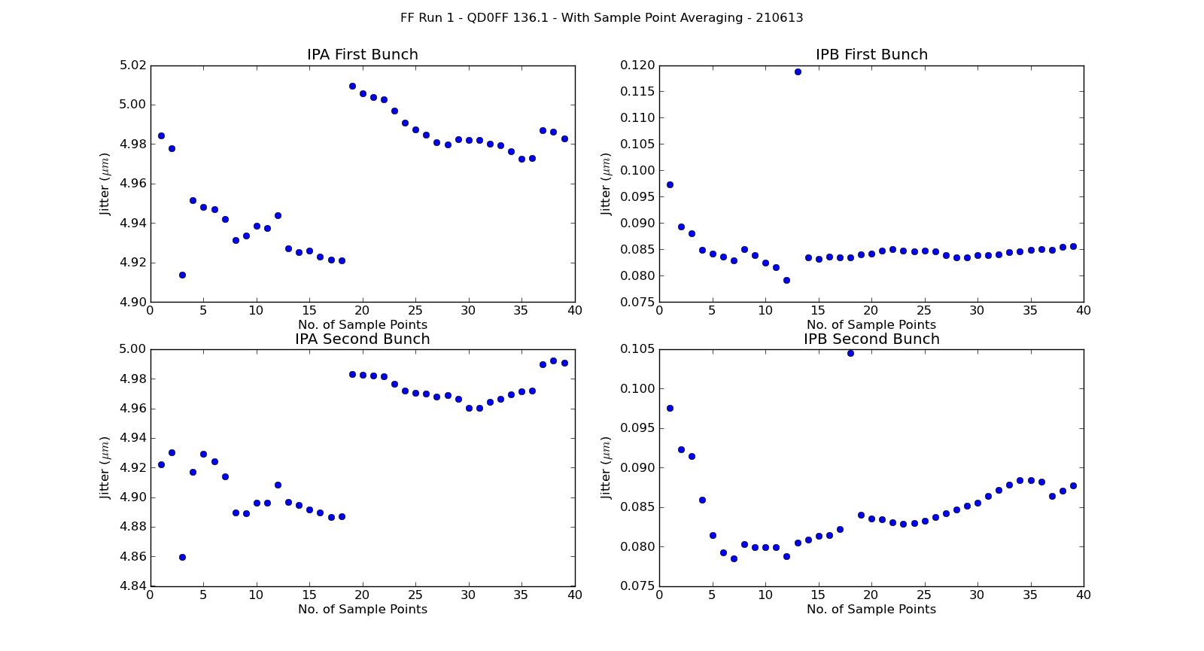
Sample Averaging
Mikey Davis
04 July 2013
18/21

Slide 19
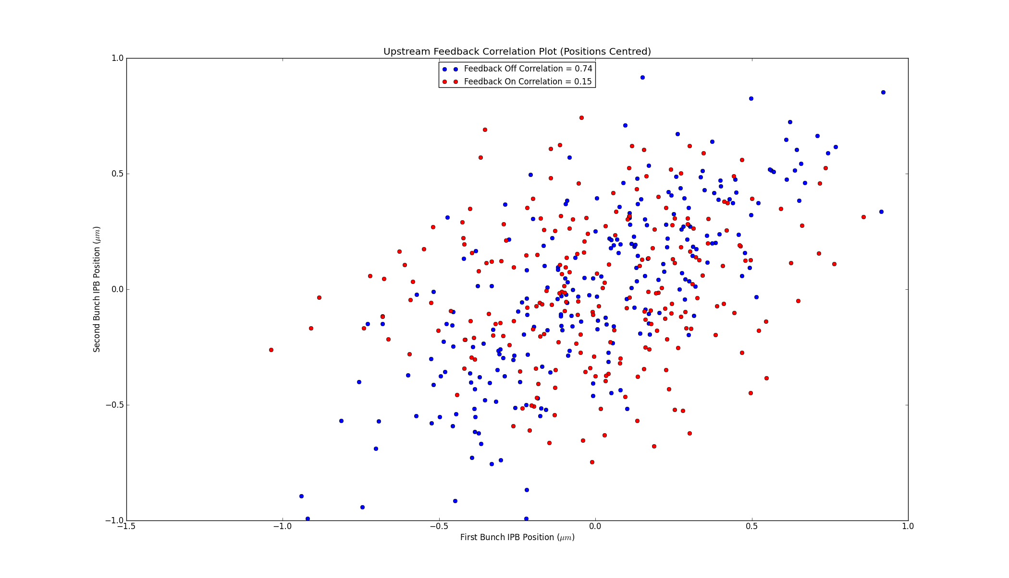
Upstream Feedback Corr Plot
Mikey Davis
04 July 2013
19/21

Slide 20
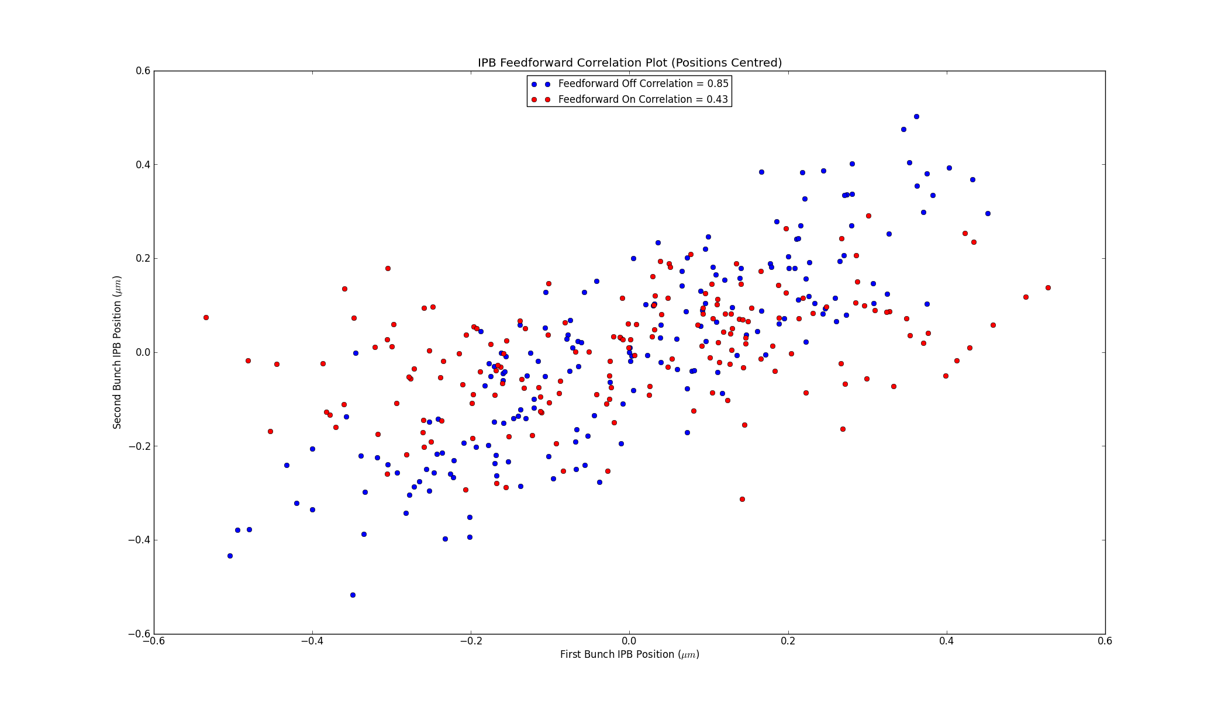
Feedforward Correlation Plot
Mikey Davis
04 July 2013
20/21

Slide 21
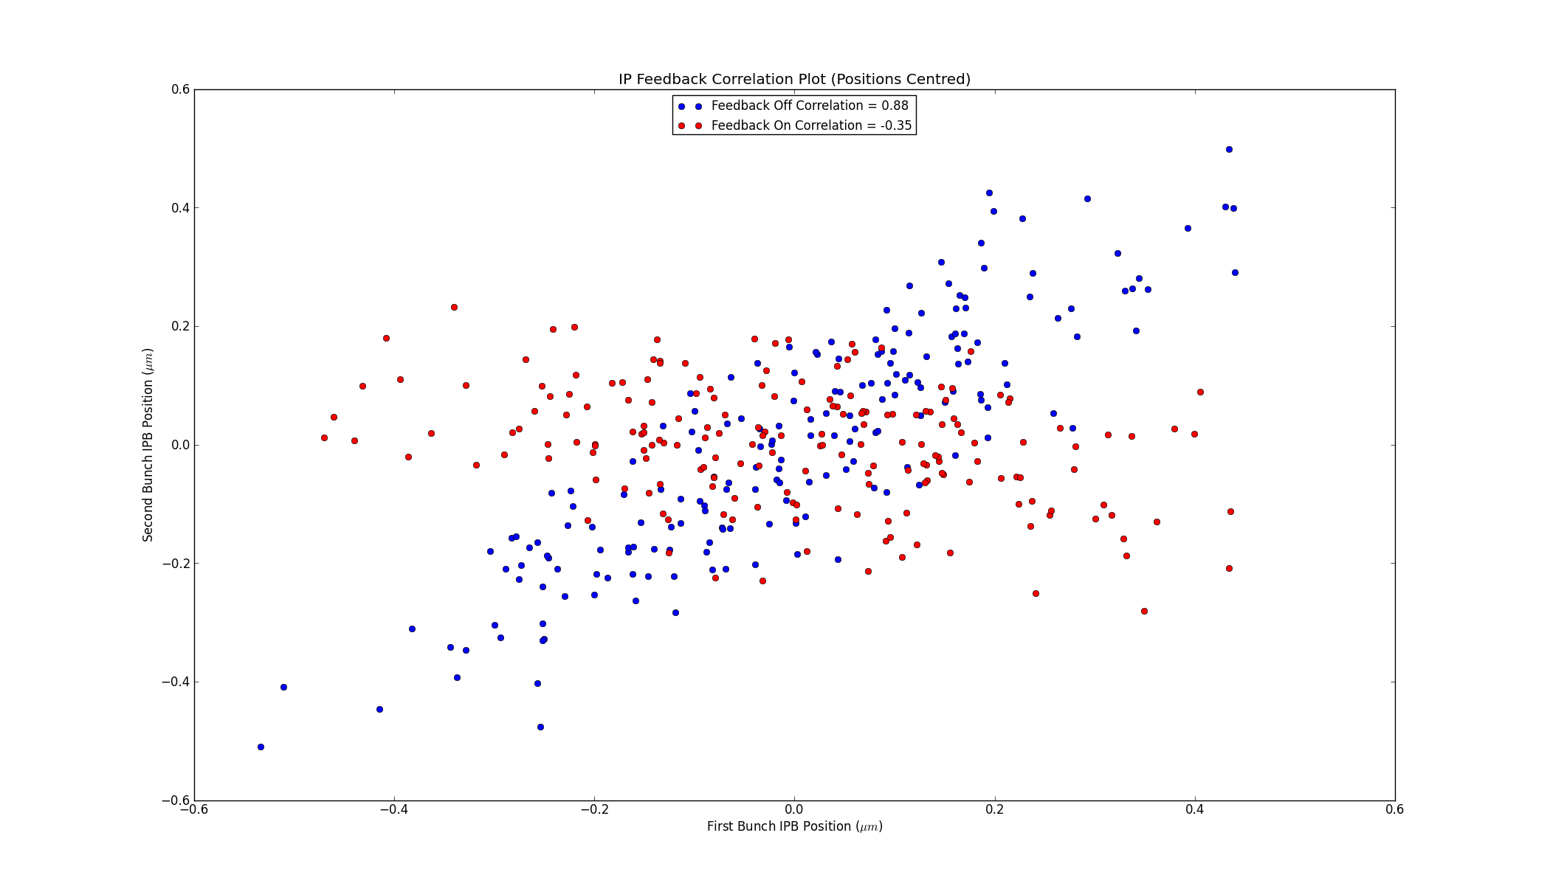
IP Feedback Correlation Plot
Mikey Davis
04 July 2013
21/21

