Slide 1
ATF June 2013 - Miscellany
D. R. Bett

Slide 2
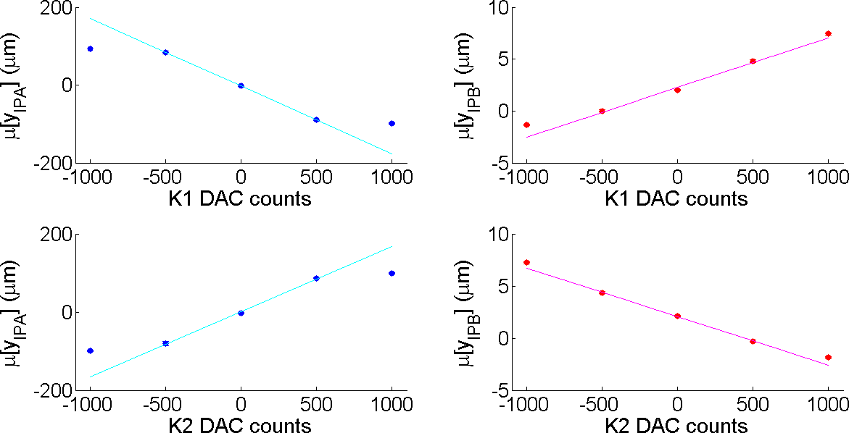
Effect of K1 and K2 at the IP
from 14-06-13
c.f. Blaskovic presentation from FONT Meeting 22nd February 2013

Slide 3
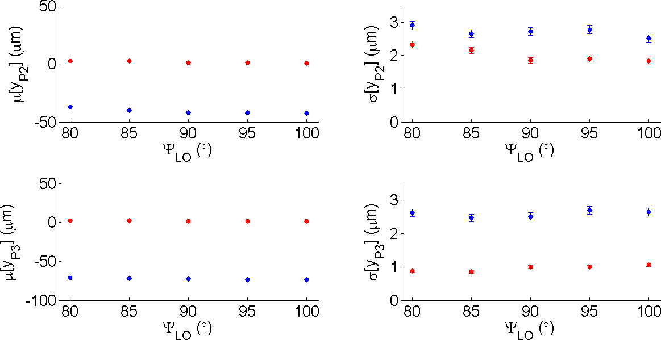
Effect of LO phase on feedback
from 19-06-13

Slide 4
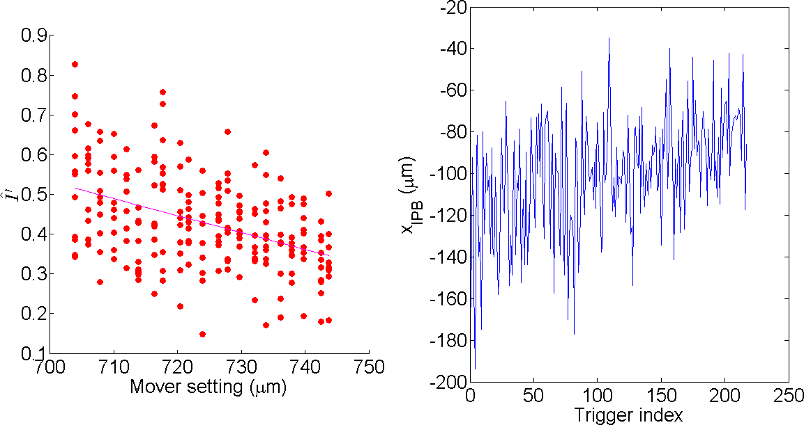


IPB(x) calibration – bunch 1
$$I^{′}=I∙\text{cos}\text{(}\text{θ}\text{)}+Q∙\text{sin}(θ)$$
$$\hat{I^{′}}=\left(I/I_{\text{ref}}\right)∙\text{cos}\text{(}\text{θ}\text{)}+\left(Q/Q_{\text{ref}}\right)∙\text{sin}(θ)$$
from 20-06-13
N.B. assumes one-to-one relation between quad mover setting and beam position

Slide 5
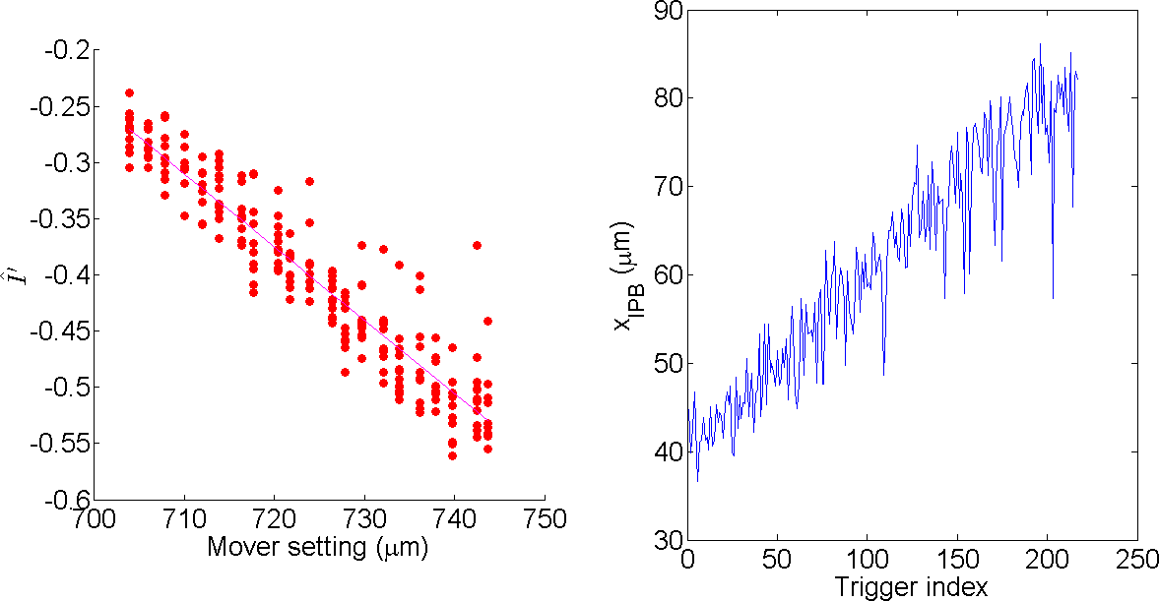
IPB(x) calibration – bunch 2
from 20-06-13
N.B. assumes one-to-one relation between quad mover setting and beam position

