Slide 1


Overview of progress at FONT
Neven Blaskovic
TMD technologies CASE student John Adams Institute Oxford University

Slide 2
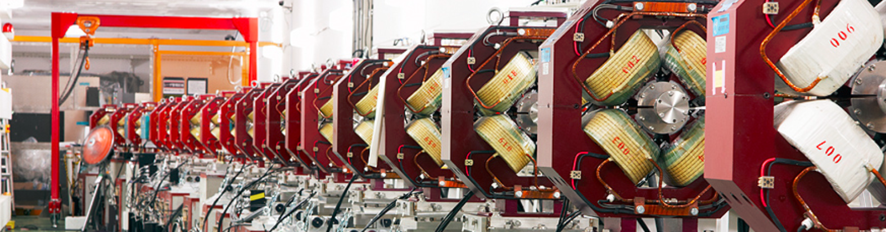
Contents
Introduction to our work at ATF
Update on our most recent results
Academic work that I have undertaken
Outlook for upcoming tasks
Neven Blaskovic 2

Slide 3
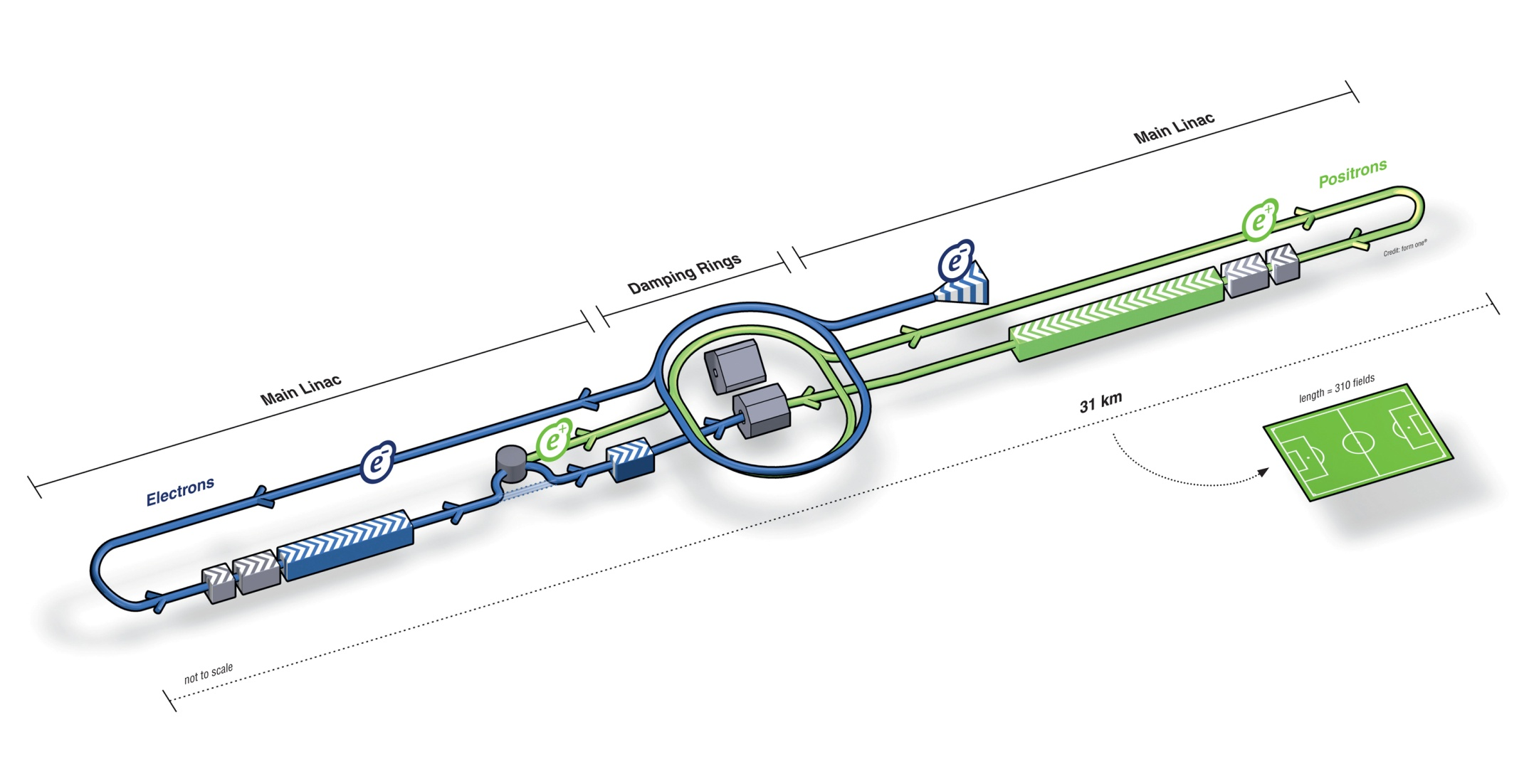
Introduction
International Linear Collider (ILC)
The next large particle accelerator will most likely be a linear electron-positron collider
A proposed design is the International Linear Collider (ILC):
Neven Blaskovic 3

Slide 4
Introduction
Feedback on Nanosecond Timescales (FONT)
Linear colliders are single-pass machines
Successful collision of bunches is critical
A fast feedback system is required, e.g. FONT:
Neven Blaskovic 4

Slide 5
Introduction
Accelerator Test Facility (ATF), Japan
We test the FONT feedback system at ATF, the Accelerator Test Facility for the future ILC:
Extraction line
Damping ring
Linear accelerator
90 m
Neven Blaskovic 5

Slide 6
Introduction
Feedback at the Accelerator Test Facility
ATF provides pairs of bunches travelling in the extraction line with ~150 ns bunch separation
We measure the position of the first bunch in order to correct the path of the second bunch
Extraction line
Neven Blaskovic 6

Slide 7
Introduction
Feedback at the Accelerator Test Facility
IPB
IPA
IPK
P3
P2
K2
P1
K1
Key
P1
P2
P3
Stripline BPMs
IPA
IPB
Cavity BPMs
Processor
Processor
Amplifier
Processor
Processor
Amplifier
Processor
Amplifier
Processor
Down mixer
Board
Digital board
Amplifier
Kicker amplifier
Board
Board
K1
K2
IPK
Stripline kickers
Neven Blaskovic 7

Slide 8
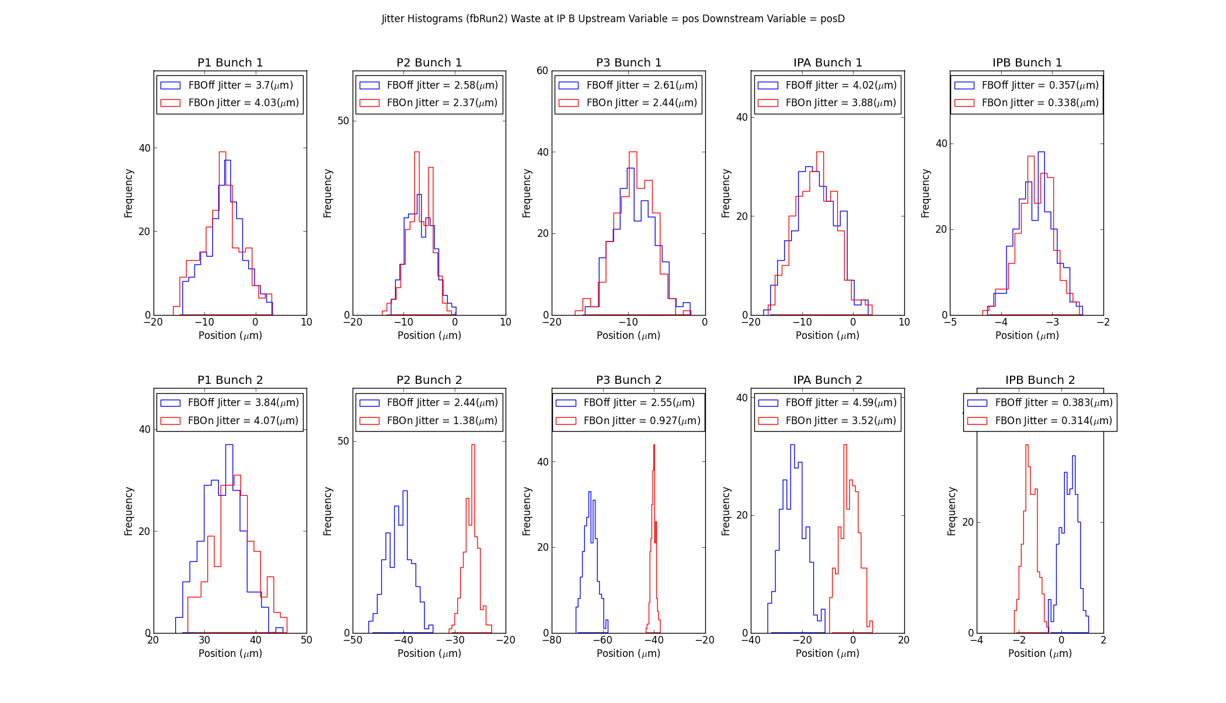
FONT Group Results at ATF
Upstream Feedback
IPB
IPA
IPK
P3
P2
K2
P1
K1
Processor
Processor
Amplifier
Processor
Processor
Amplifier
Processor
Amplifier
Board
Board
Neven Blaskovic 8

Slide 9
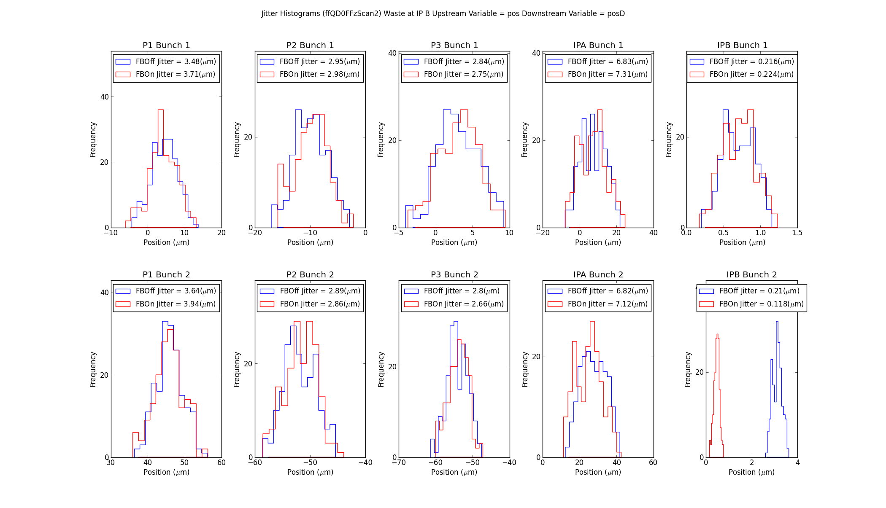
FONT Group Results at ATF
Feedforward
IPB
IPA
IPK
P3
P2
K2
P1
K1
Processor
Processor
Amplifier
Processor
Processor
Amplifier
Processor
Amplifier
Board
Board
Neven Blaskovic 9

Slide 10
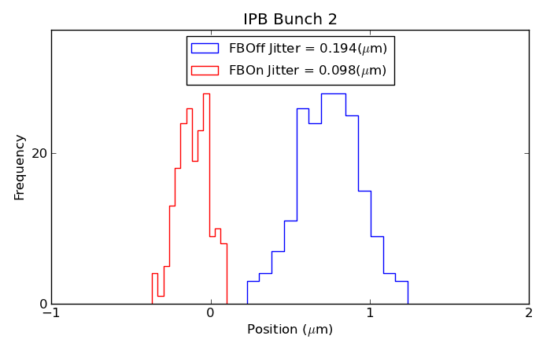
FONT Group Results at ATF
Downstream Feedback
IPB
IPA
IPK
P3
P2
K2
P1
K1
Processor
Processor
Amplifier
Processor
Processor
Amplifier
Processor
Amplifier
Board
Board
Neven Blaskovic 10

Slide 11
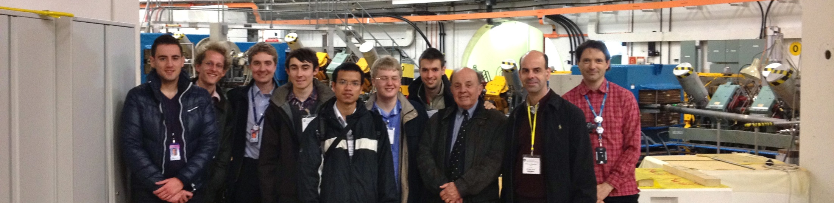
Academic work undertaken
JAI Accelerator Physics course
Attended the JAI course which equipped us with accelerator physics knowledge (2011–12)
Team of 6 students worked on a design project to upgrade the ISIS Neutron Source at RAL, working on lattice, magnet and RF design
Neven Blaskovic 11

Slide 12
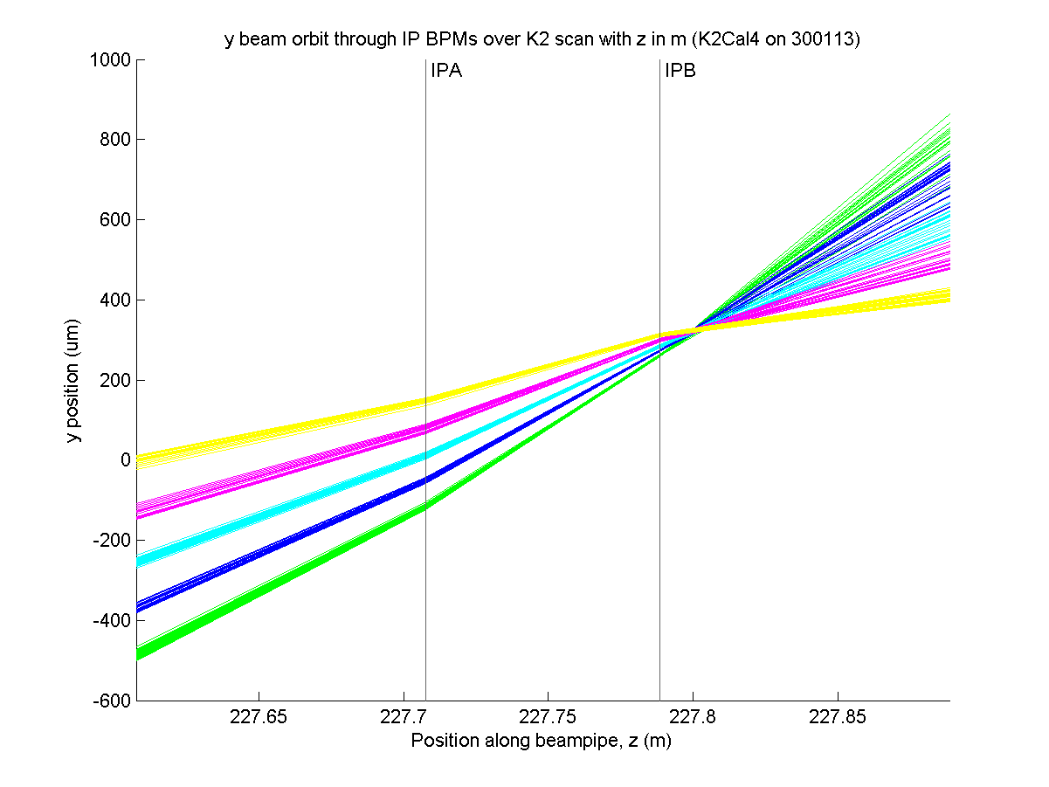
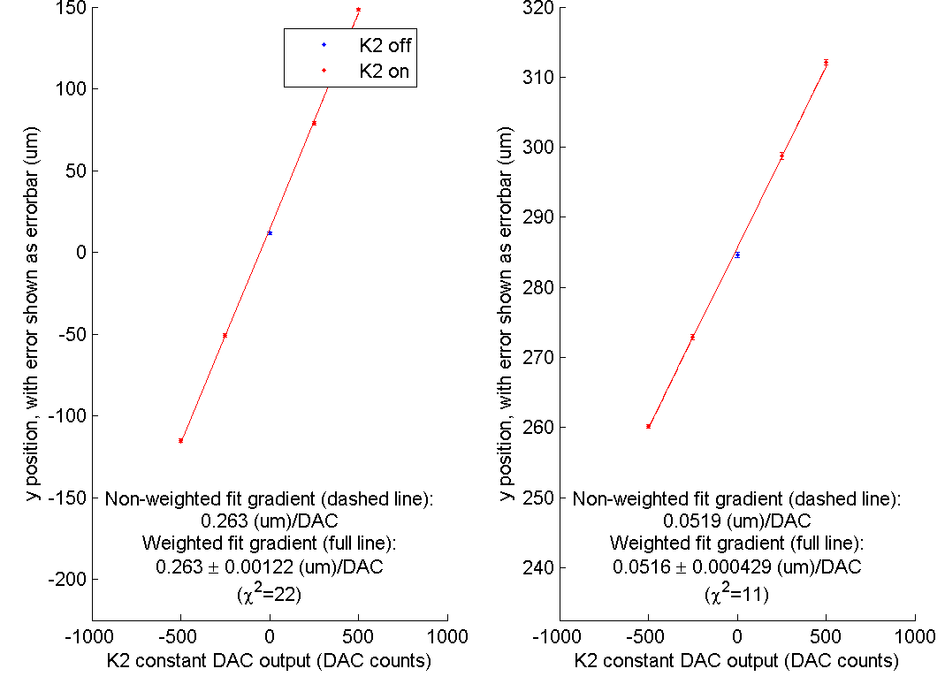
Academic work undertaken
FONT Work at ATF
Worked on setup, data taking and analysis over 9 FONT trips to ATF
Vertical beam path through IPA & IPB over an upstream K2 kicker scan
Position at IPA vs. K2 kicker setting
Position at IPB vs. K2 kicker setting
Neven Blaskovic 12

Slide 13
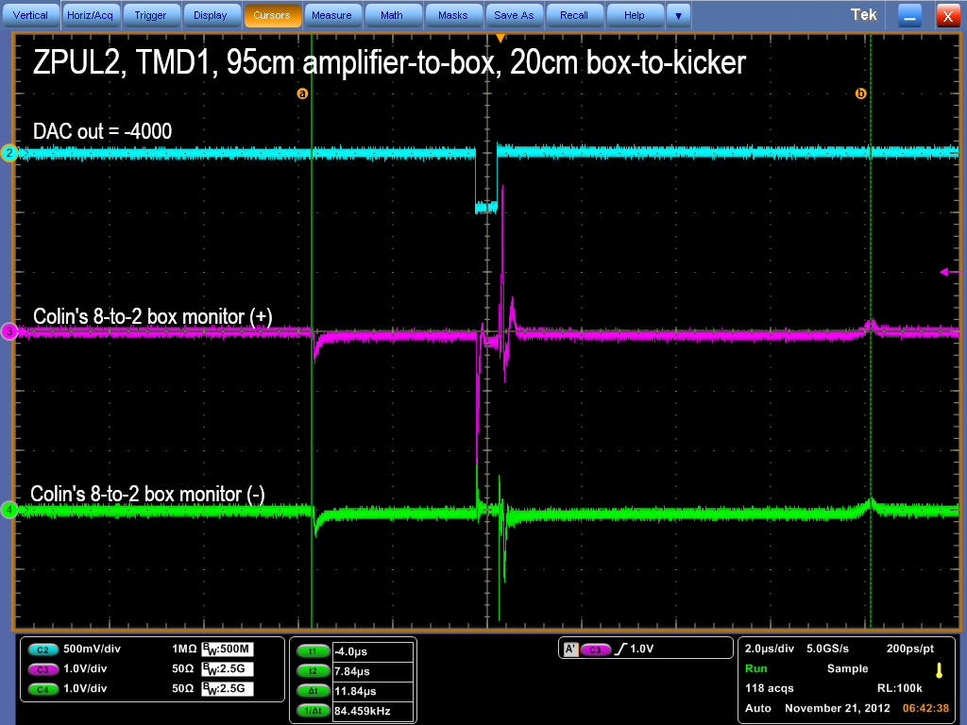
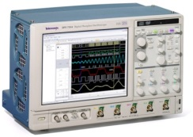
Academic work undertaken
FONT Bench Tests at Oxford
Performed bench tests in Oxford, looking at kicker amplifier and digital board performance
FONT5 board
ZPUL
Atten
TMD amplifier
Gen
Fast clock
DAC 1
6dB
Analogue in
FONT4
Dig in 1
Trigger in
~450 ns
FONT4
Dig in 2
Aux out A
Out (+)
Out (–)
BPM
(used as kicker)
Colin’s box
In (+)
In (–)
Monitor (+)
~12 us
Monitor (–)
In (‘top’)
Out (+)
In (‘bottom’)
Out (–)
Neven Blaskovic 13

Slide 14
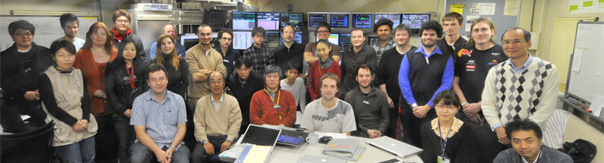
Academic work undertaken
ATF Small Beam Size Goal
Received training and participated in ATF tuning tasks to reduce final focus beam size
Stable vertical beam size below 70 nm achieved (December 2012, May 2013)
Neven Blaskovic 14

Slide 15
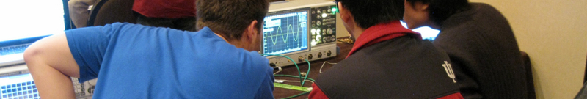
Academic work undertaken
US Particle Accelerator School
The Microwave Measurements and Beam Instrumentation Laboratory (June 2013) dealt with TDRs and spectrum & network analysers
Hands-on: from testing cable impedances to diagnosing performance of a stripline BPM & characterising modes excited in an RF cavity
Neven Blaskovic 15

Slide 16
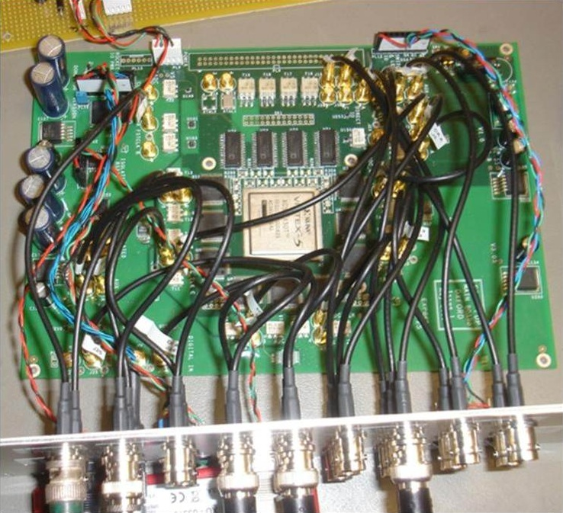
Outlook
Plans for the upcoming months
Learn and develop the group’s FPGA firmware
Analyse results from past FONT at ATF data
Take on the role of senior PhD student
Pursue further feedback tests at ATF
Neven Blaskovic 16

Slide 17
Acknowledgements, for their support, to:
the FONT team P.N. Burrows, G.B. Christian, C. Perry, Y.I. Kim, R. Apsimon, D.R. Bett, M.R. Davis, J. Roberts
TMD technologies
Neven Blaskovic 17

