Slide 1
Fourier transforms of baseline runs
N. Blaskovic

Slide 2
Introduction
Baseline runs taken with LO input to homodyne 2nd stage but no IPBPM input
Particular baseline run presented here was taken in single bunch mode on 16th April
Slide 3 contains waveforms (I on ADCs 1 and 4; Q on ADCs 2 and 5)
Slide 4 contains FFT of individual triggers, and in bold, the average over all FFTs
N. Blaskovic

Slide 3
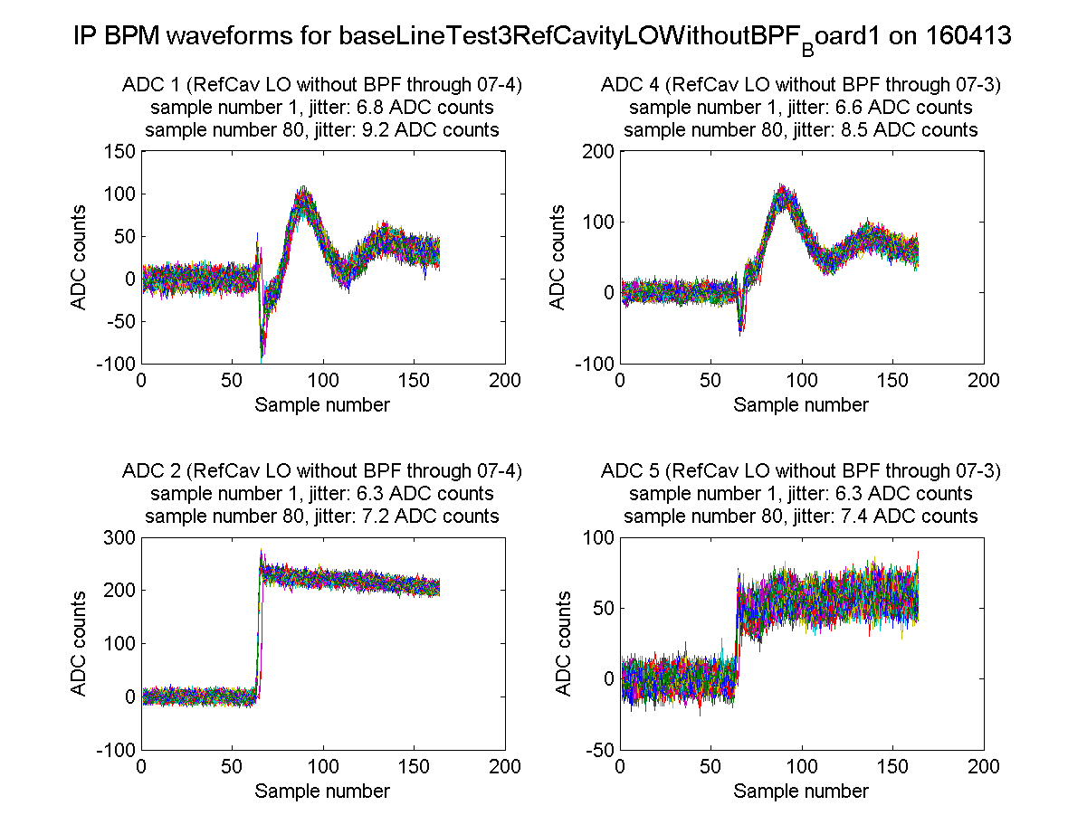
ZPUL3 power supply
It was found that the wires carrying the 24 V supply to ZPUL3 made an intermittent connection to the ZPUL.
Re-soldering the wires to the ZPUL led to a stable connection.
N. Blaskovic

Slide 4
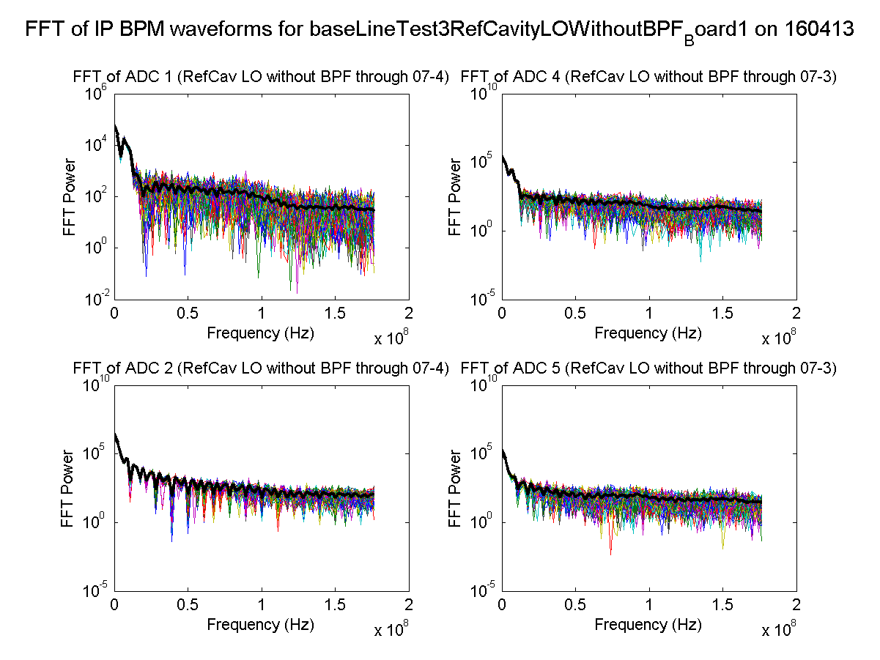
ZPUL3 power supply
It was found that the wires carrying the 24 V supply to ZPUL3 made an intermittent connection to the ZPUL.
Re-soldering the wires to the ZPUL led to a stable connection.
N. Blaskovic

