Slide 1
Feedforward runs
N. Blaskovic

Slide 2
Introduction
A first analysis of June 2013 data, looking particularly at feedforward runs on 7th June
IPB calibration used: IPBcalib4_0dB_twoBunchMode
Feedforward runs 1–4 analysed
N. Blaskovic

Slide 3
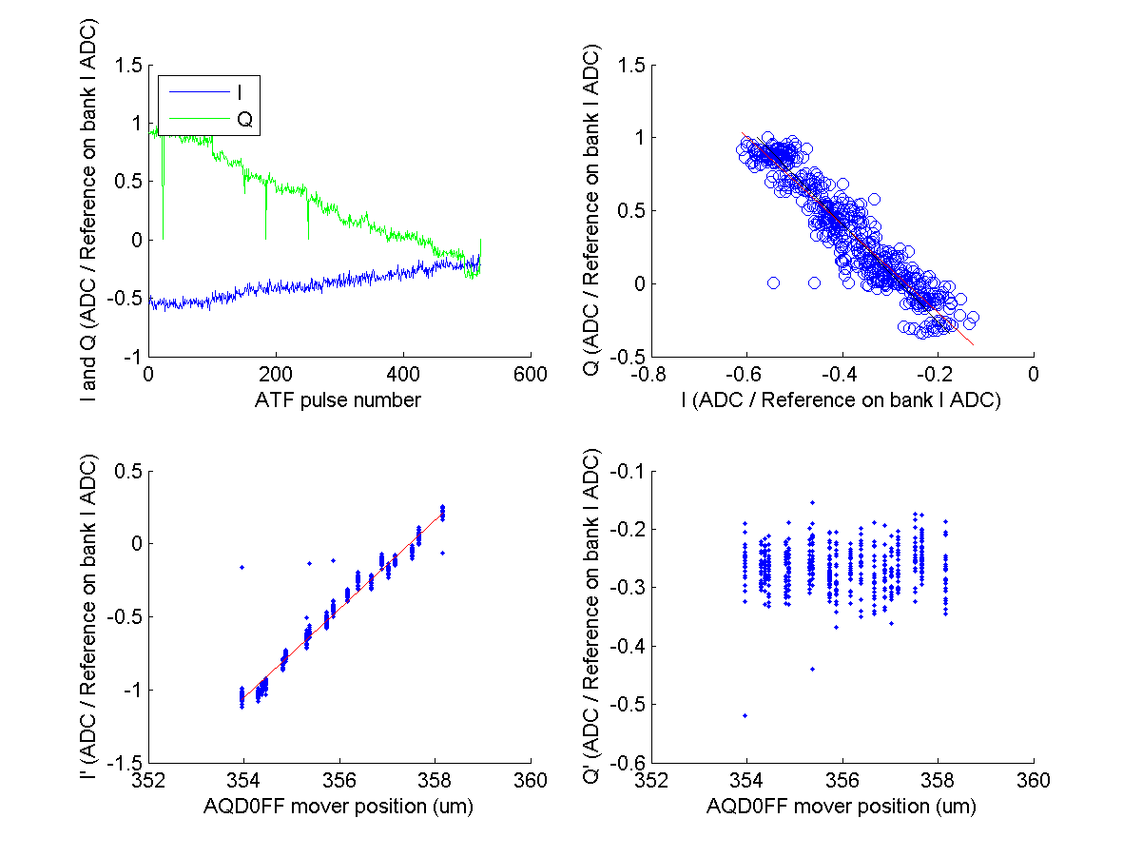
Bunch 1 IPB Calibration
(I sample 29, Q sample 34, Reference on bank I sample 20)
N. Blaskovic

Slide 4
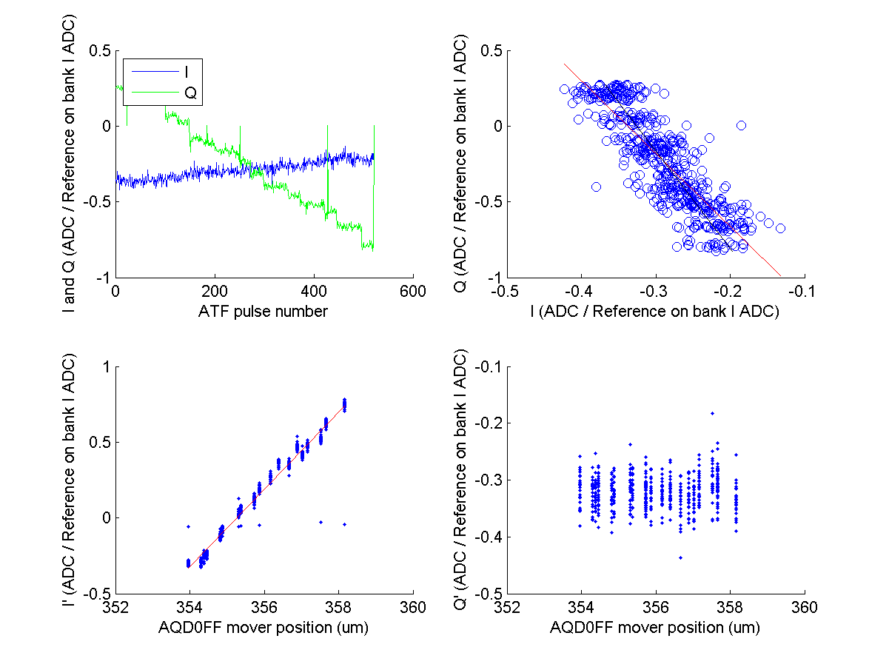
Bunch 2 IPB Calibration
(I sample 127, Q sample 132, Reference on bank I sample 118)
Bunch 2 IPA calibration was erroneously placed here originally;
this has been corrected on 19th July after the meeting
N. Blaskovic

Slide 5
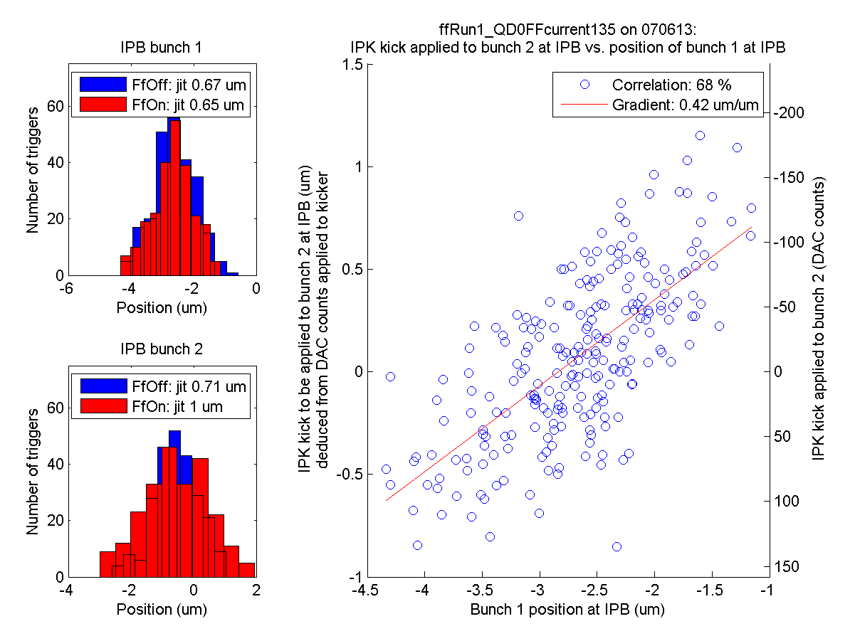
ZPUL3 power supply
ffRun1
Wrong gain sign!
It was found that the wires carrying the 24 V supply to ZPUL3 made an intermittent connection to the ZPUL.
Re-soldering the wires to the ZPUL led to a stable connection.
N. Blaskovic
a

Slide 6
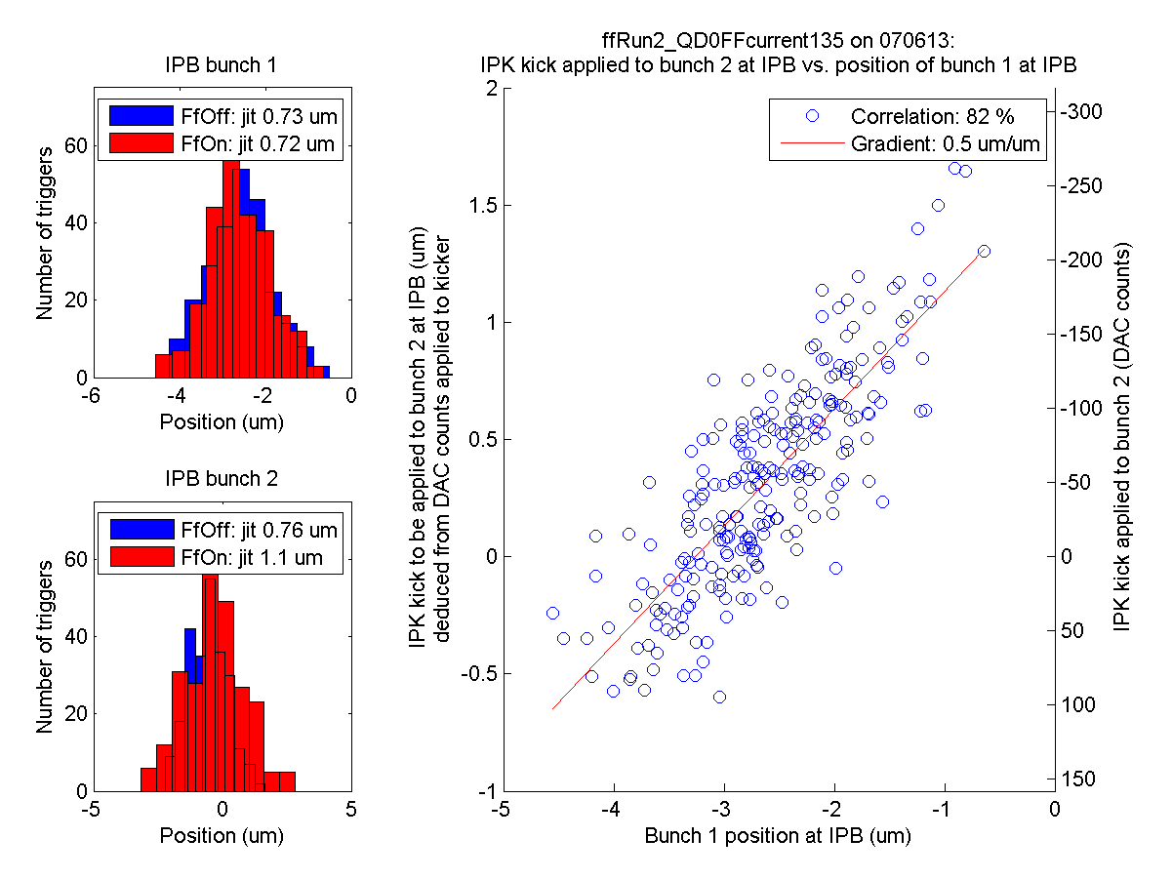
ZPUL3 power supply
ffRun2
Wrong gain sign!
It was found that the wires carrying the 24 V supply to ZPUL3 made an intermittent connection to the ZPUL.
Re-soldering the wires to the ZPUL led to a stable connection.
N. Blaskovic
a

Slide 7
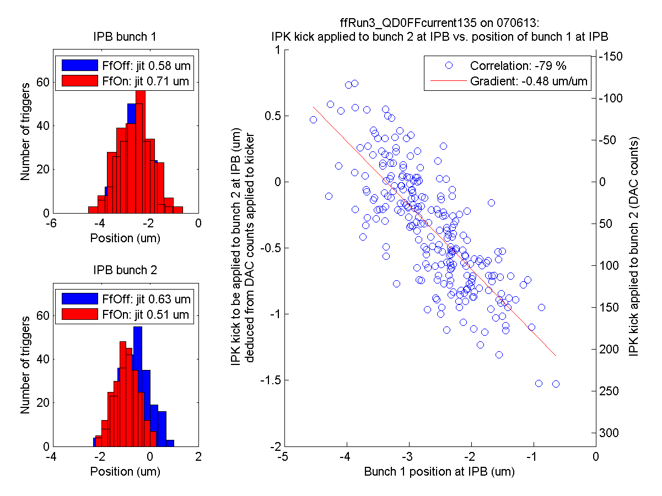
ZPUL3 power supply
ffRun3
Insufficient gain?
It was found that the wires carrying the 24 V supply to ZPUL3 made an intermittent connection to the ZPUL.
Re-soldering the wires to the ZPUL led to a stable connection.
N. Blaskovic
a

Slide 8
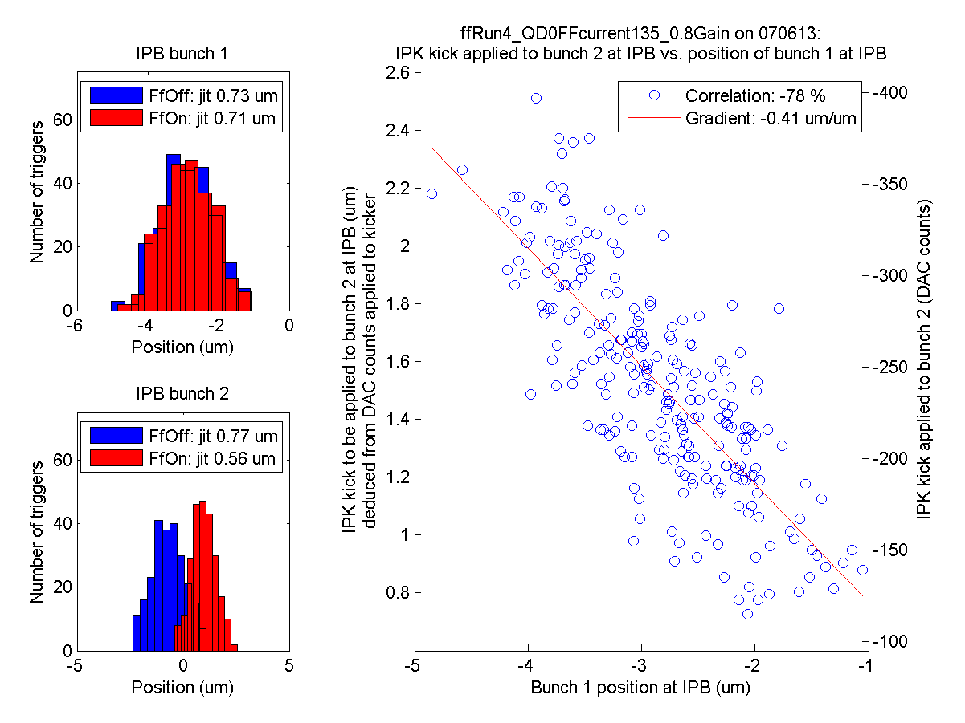
ZPUL3 power supply
ffRun4
Insufficient gain?
It was found that the wires carrying the 24 V supply to ZPUL3 made an intermittent connection to the ZPUL.
Re-soldering the wires to the ZPUL led to a stable connection.
N. Blaskovic
a

Slide 9
Appendix
theta vs. sample number for the calibration run IPBcalib4_0dB_twoBunchMode

Slide 10
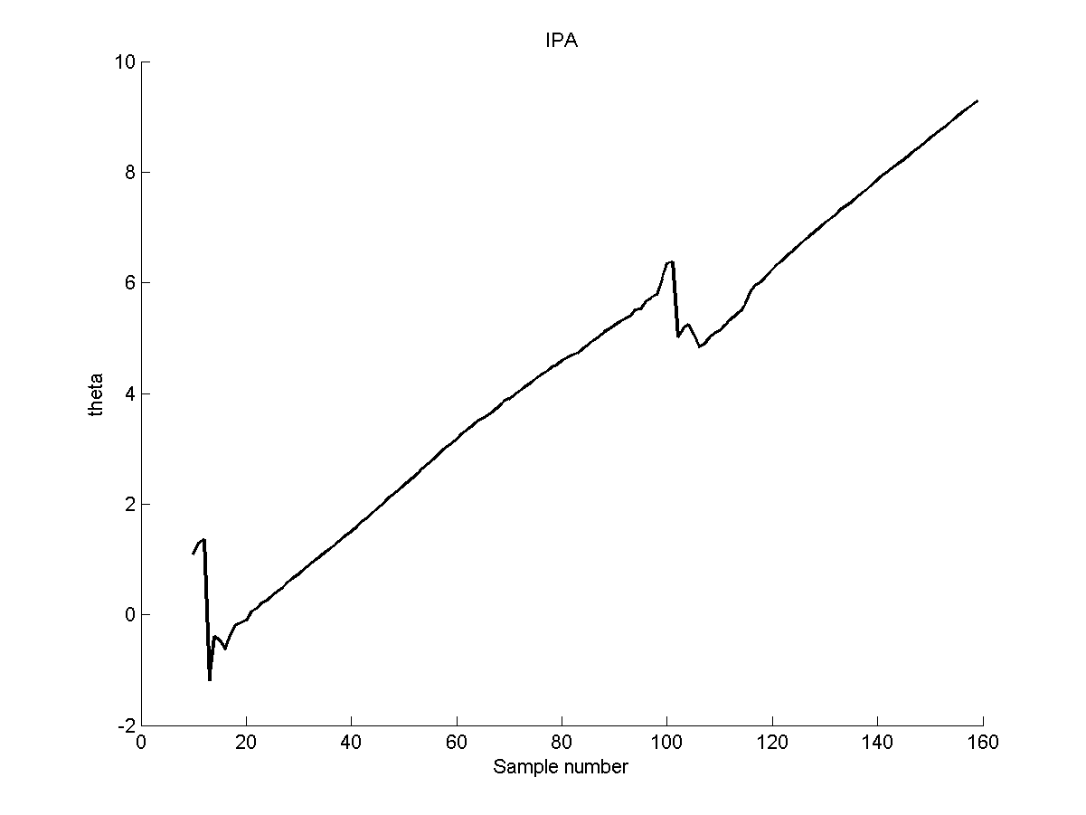
ZPUL3 power supply
It was found that the wires carrying the 24 V supply to ZPUL3 made an intermittent connection to the ZPUL.
Re-soldering the wires to the ZPUL led to a stable connection.
N. Blaskovic

Slide 11
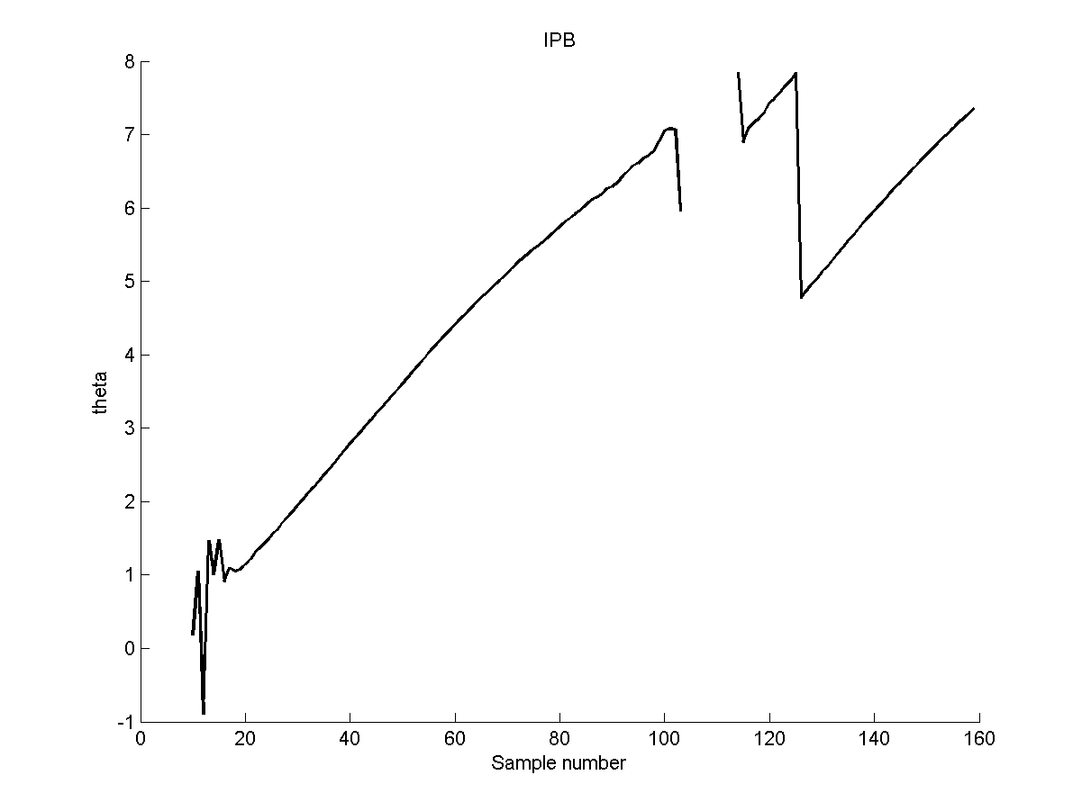
ZPUL3 power supply
It was found that the wires carrying the 24 V supply to ZPUL3 made an intermittent connection to the ZPUL.
Re-soldering the wires to the ZPUL led to a stable connection.
N. Blaskovic

Slide 12
Appendix
IPK kick vs. IPB bunch 1 position plot explanation

Slide 13
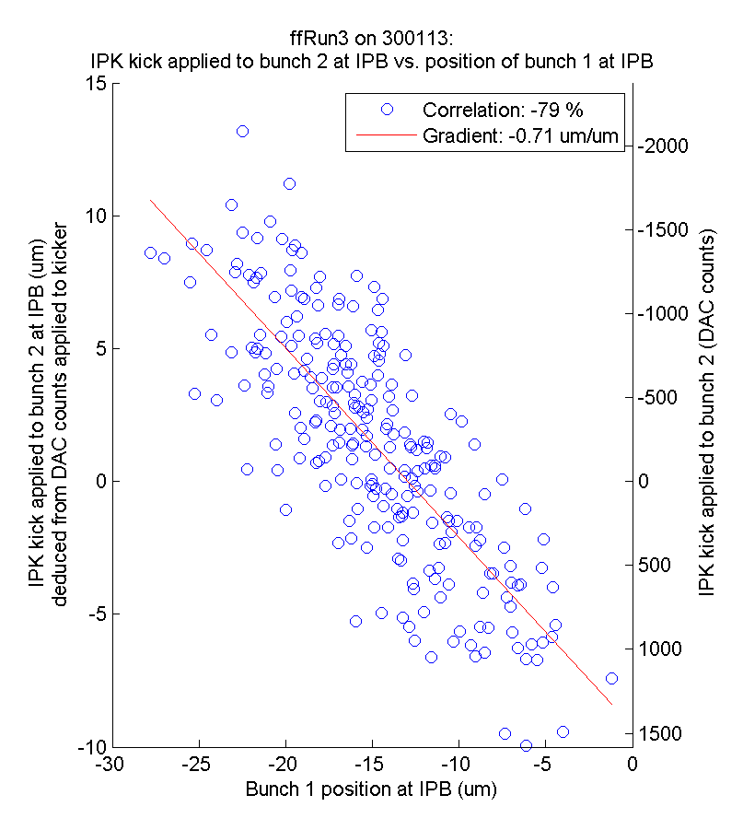
Example
Bunch 1 upstream-downstream position correlation
Ratio of calculated kick to kick that should have been applied
Whether DAC outputs are within the kicker amplifier’s linear range
Negative gradient: ‘correcting towards 0’
N. Blaskovic

