Slide 1
Feedforward runs
N. Blaskovic

Slide 2
Introduction
Further analysis of June 2013 data, looking at feedforward runs on 21st June as part of:
  Waist scan (QD0FF current scan)
  P2-IPK ‘single loop’ gain scan
Simulating the DAC outputs over a feedforward run for an arbitrary pair of gains P2-IPK and P3-IPK
N. Blaskovic

Slide 3
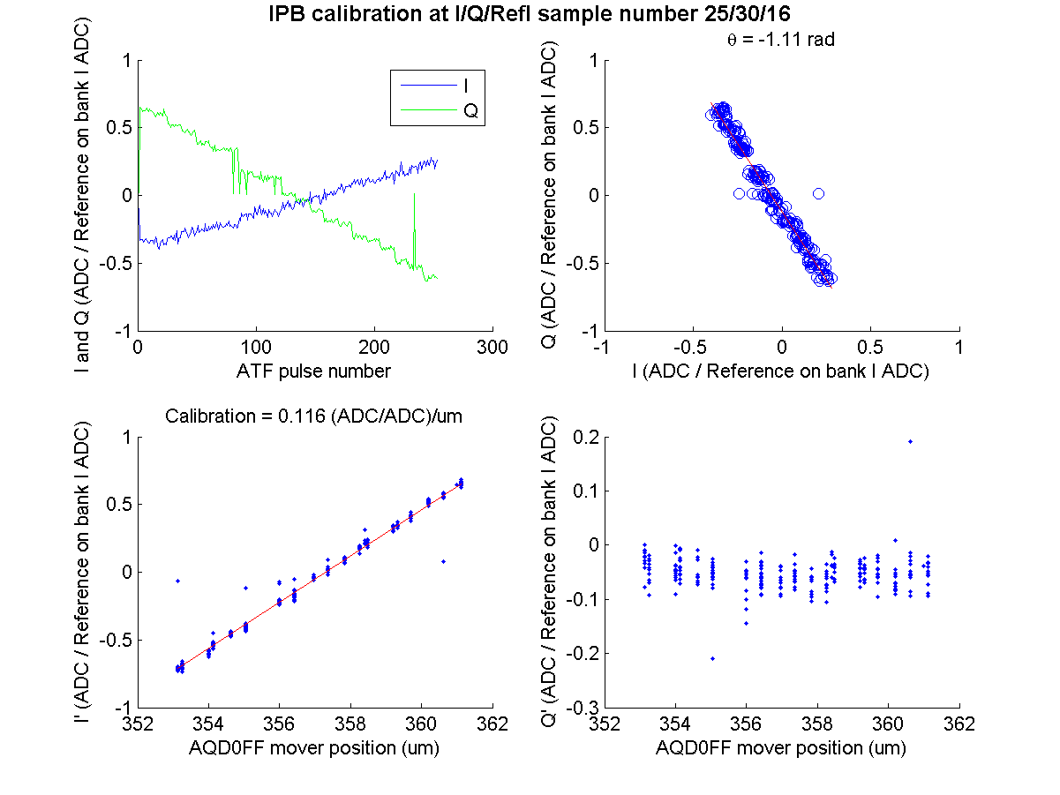
ZPUL3 power supply
It was found that the wires carrying the 24 V supply to ZPUL3 made an intermittent connection to the ZPUL.
Re-soldering the wires to the ZPUL led to a stable connection.
calibration file: IPBcalib1_y_0dB_twoBunchMode_noFilters on 210613
N. Blaskovic

Slide 4
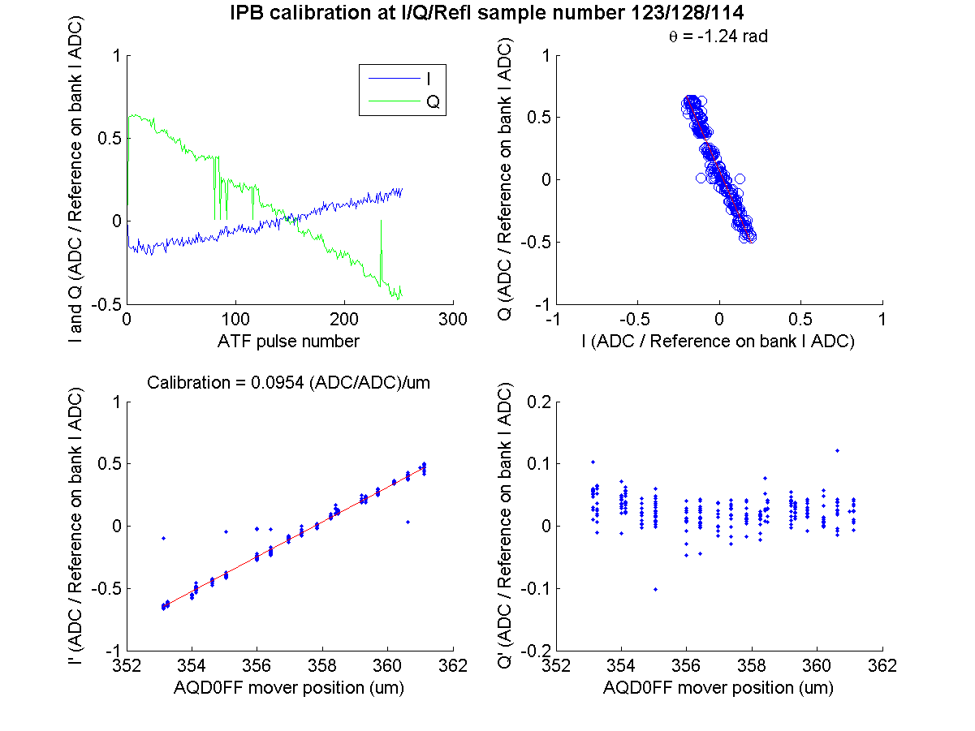
ZPUL3 power supply
It was found that the wires carrying the 24 V supply to ZPUL3 made an intermittent connection to the ZPUL.
Re-soldering the wires to the ZPUL led to a stable connection.
calibration file: IPBcalib1_y_0dB_twoBunchMode_noFilters on 210613
N. Blaskovic

Slide 5
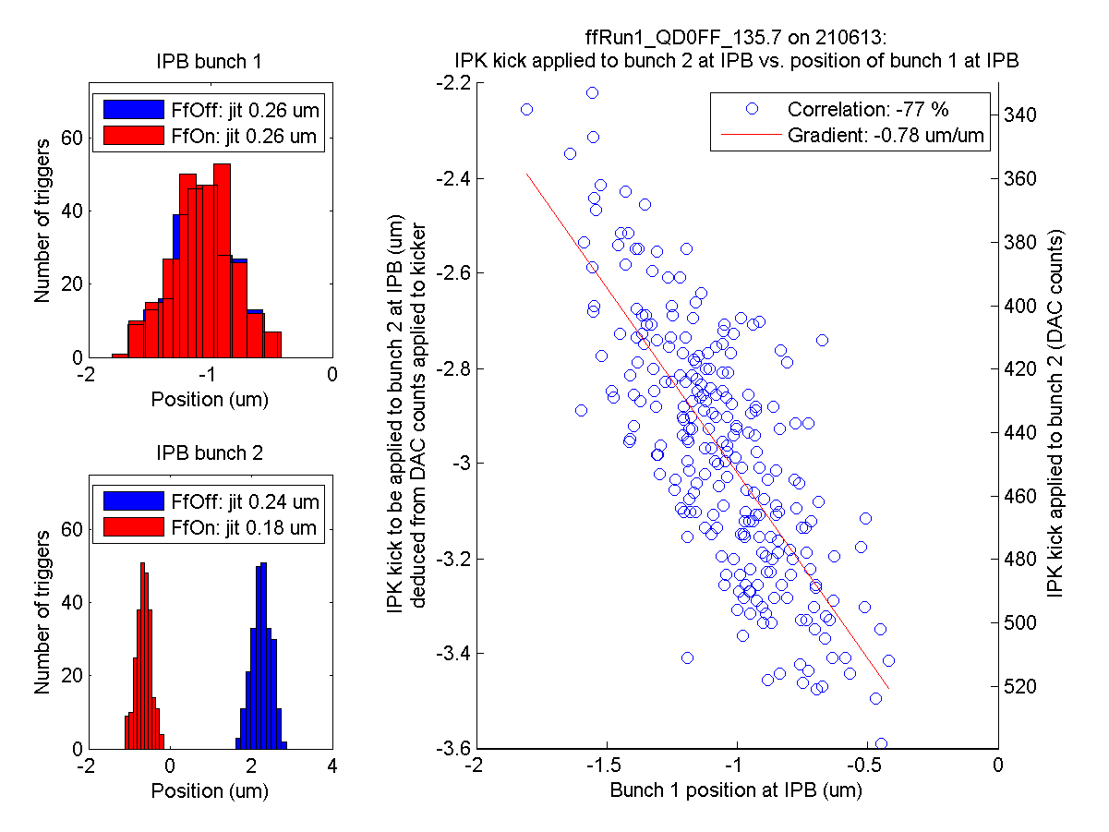
ZPUL3 power supply
First run
It was found that the wires carrying the 24 V supply to ZPUL3 made an intermittent connection to the ZPUL.
Re-soldering the wires to the ZPUL led to a stable connection.
N. Blaskovic

Slide 6
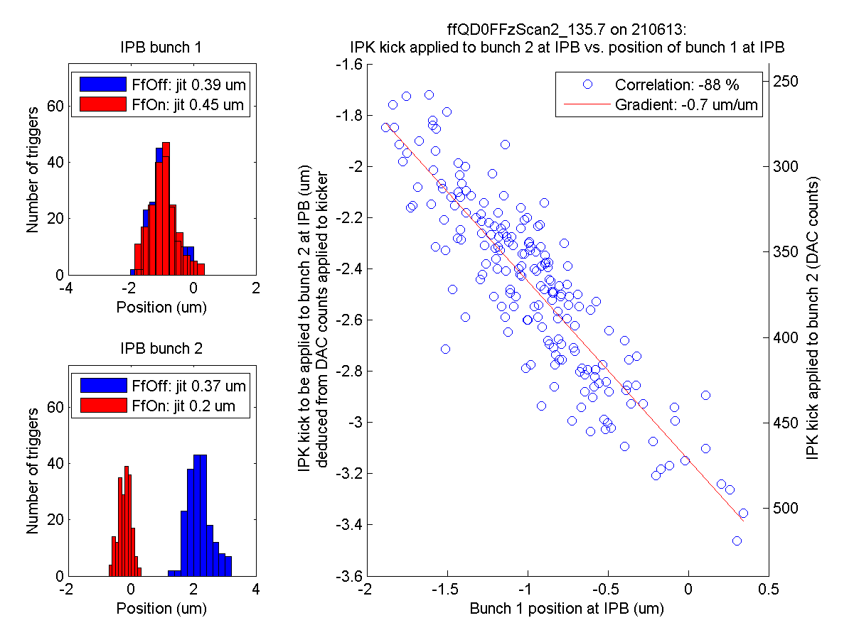
ZPUL3 power supply
Waist scan
It was found that the wires carrying the 24 V supply to ZPUL3 made an intermittent connection to the ZPUL.
Re-soldering the wires to the ZPUL led to a stable connection.
N. Blaskovic

Slide 7
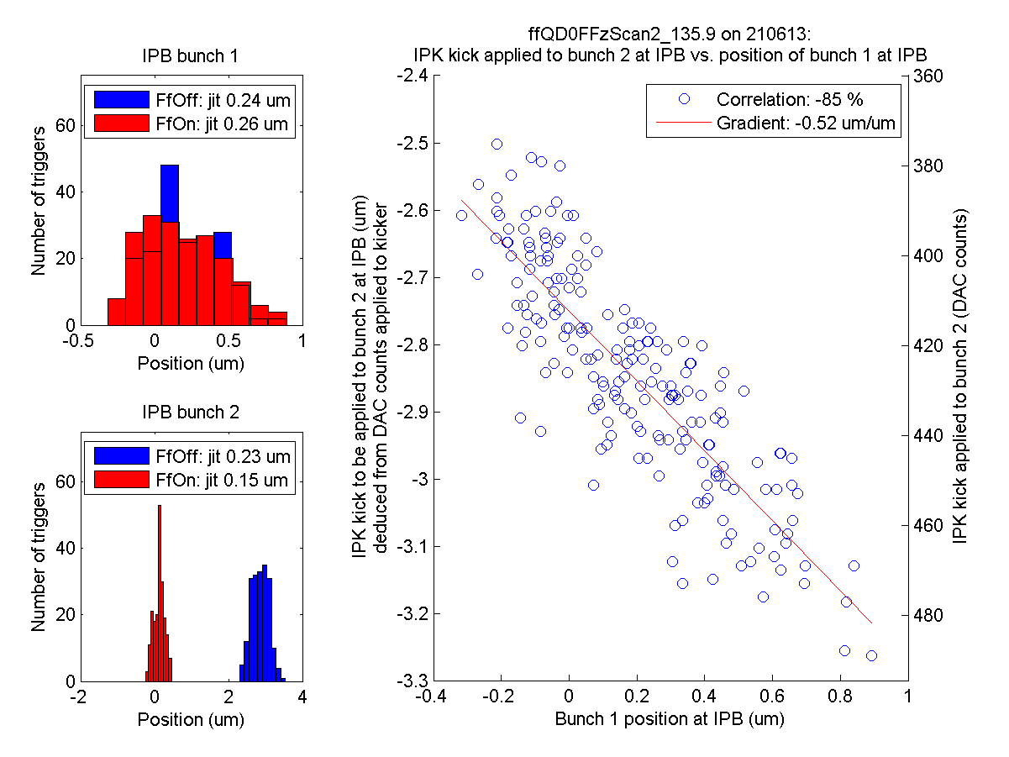
ZPUL3 power supply
Waist scan
It was found that the wires carrying the 24 V supply to ZPUL3 made an intermittent connection to the ZPUL.
Re-soldering the wires to the ZPUL led to a stable connection.
N. Blaskovic

Slide 8
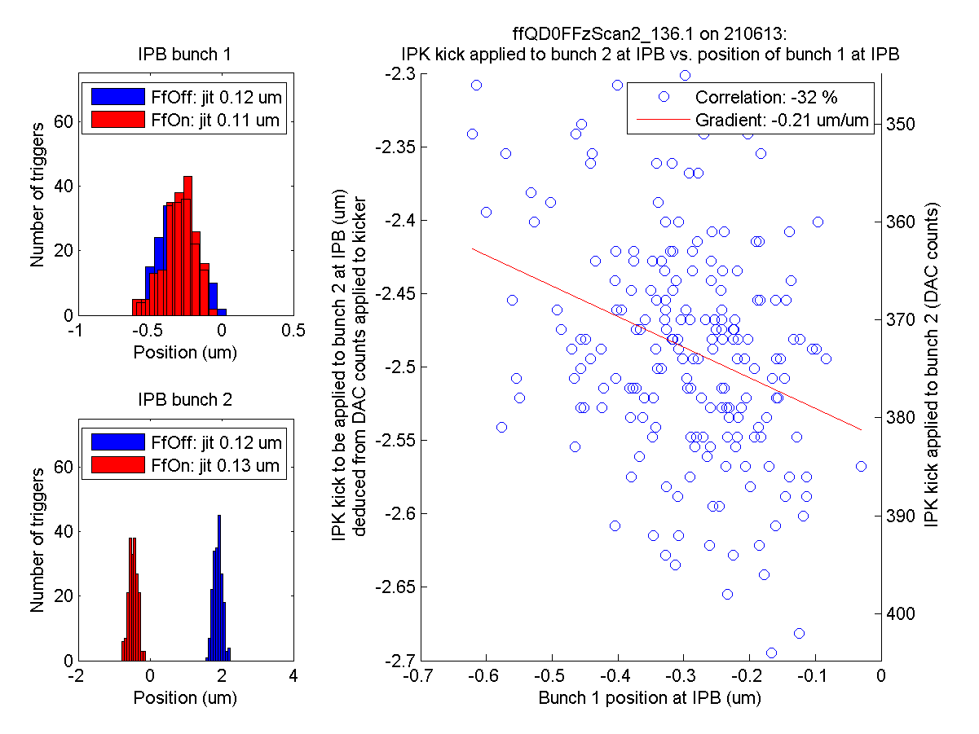
ZPUL3 power supply
Waist scan
low upstream-downstream correlation when waist at IP BPM
It was found that the wires carrying the 24 V supply to ZPUL3 made an intermittent connection to the ZPUL.
Re-soldering the wires to the ZPUL led to a stable connection.
N. Blaskovic

Slide 9
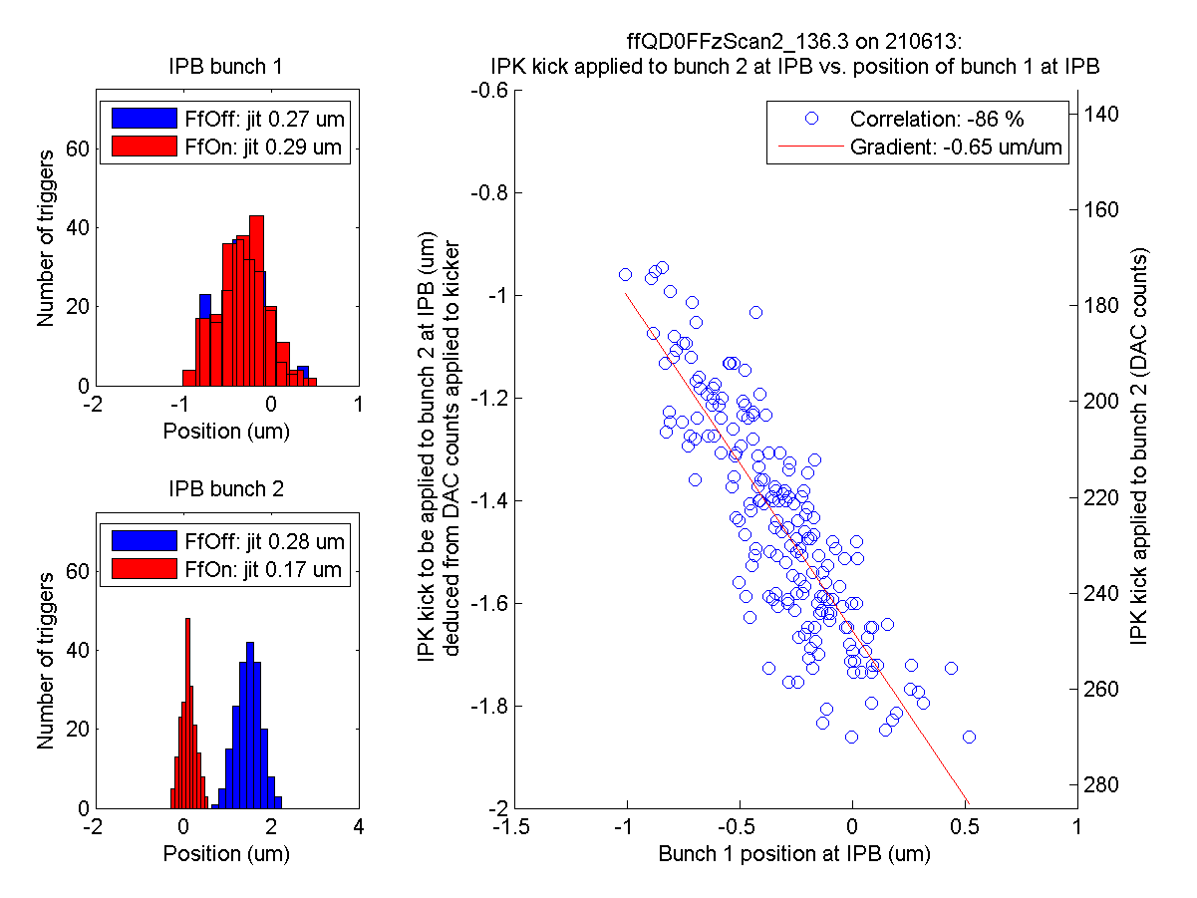
ZPUL3 power supply
Waist scan
It was found that the wires carrying the 24 V supply to ZPUL3 made an intermittent connection to the ZPUL.
Re-soldering the wires to the ZPUL led to a stable connection.
N. Blaskovic

Slide 10
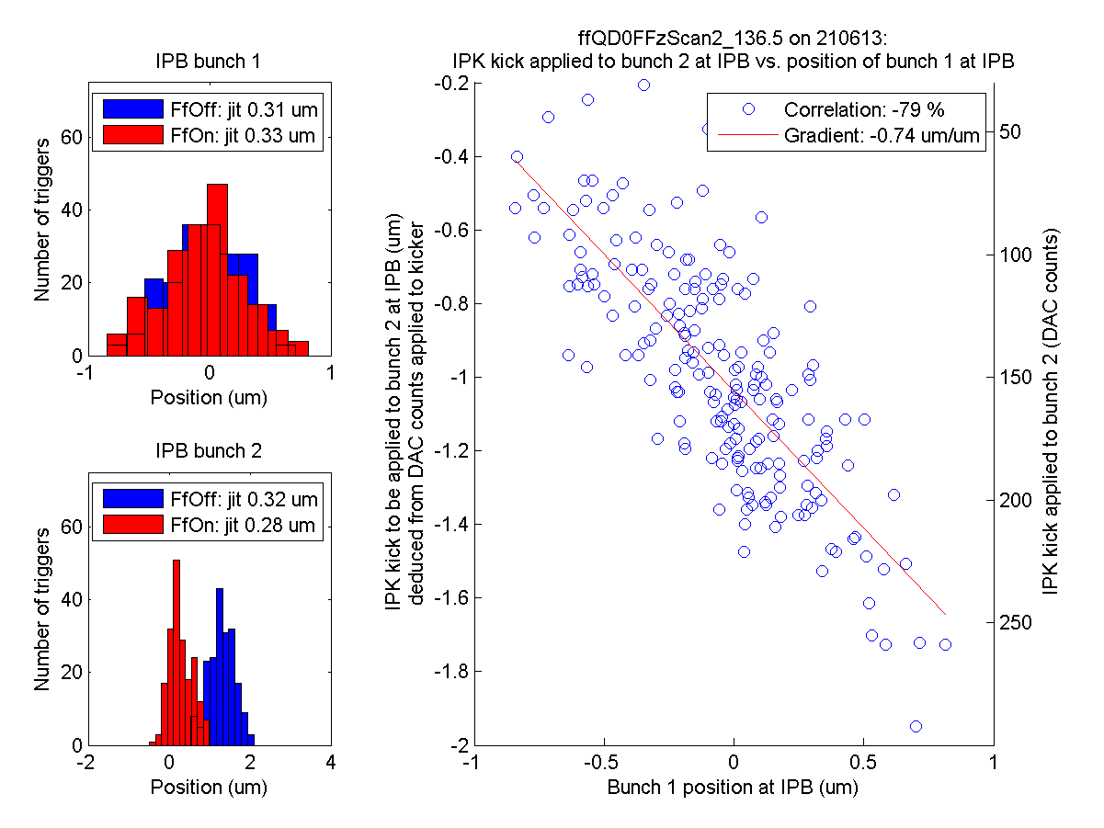
ZPUL3 power supply
Waist scan
It was found that the wires carrying the 24 V supply to ZPUL3 made an intermittent connection to the ZPUL.
Re-soldering the wires to the ZPUL led to a stable connection.
N. Blaskovic

Slide 11
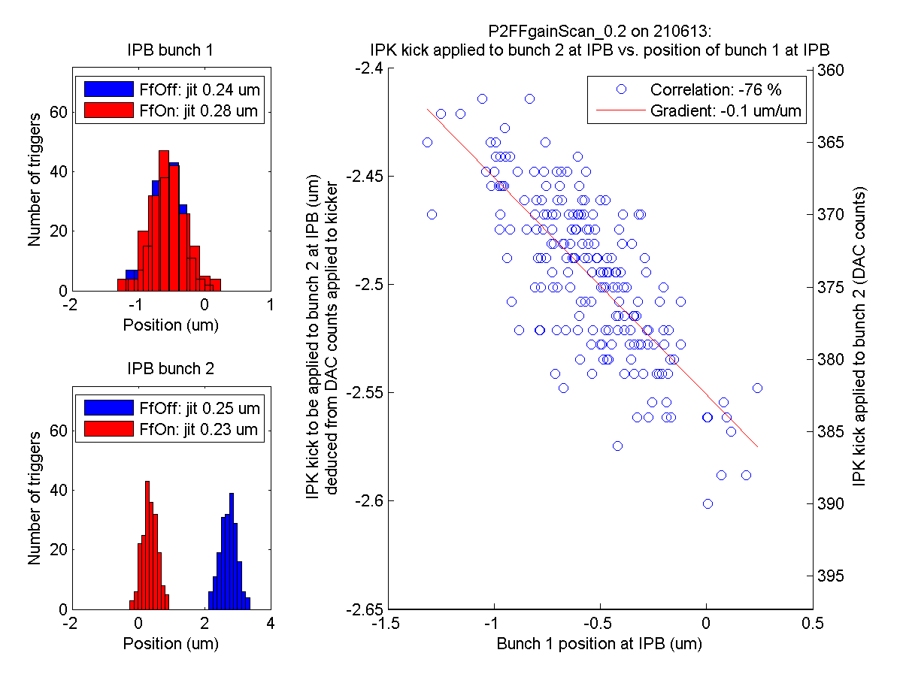
ZPUL3 power supply
P2-IPK gain scan
It was found that the wires carrying the 24 V supply to ZPUL3 made an intermittent connection to the ZPUL.
Re-soldering the wires to the ZPUL led to a stable connection.
N. Blaskovic

Slide 12
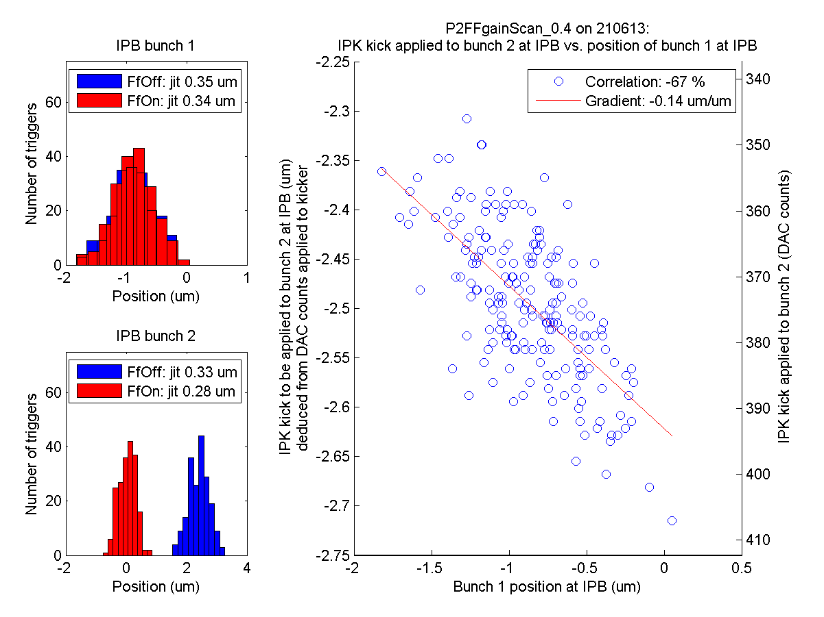
ZPUL3 power supply
P2-IPK gain scan
It was found that the wires carrying the 24 V supply to ZPUL3 made an intermittent connection to the ZPUL.
Re-soldering the wires to the ZPUL led to a stable connection.
N. Blaskovic

Slide 13
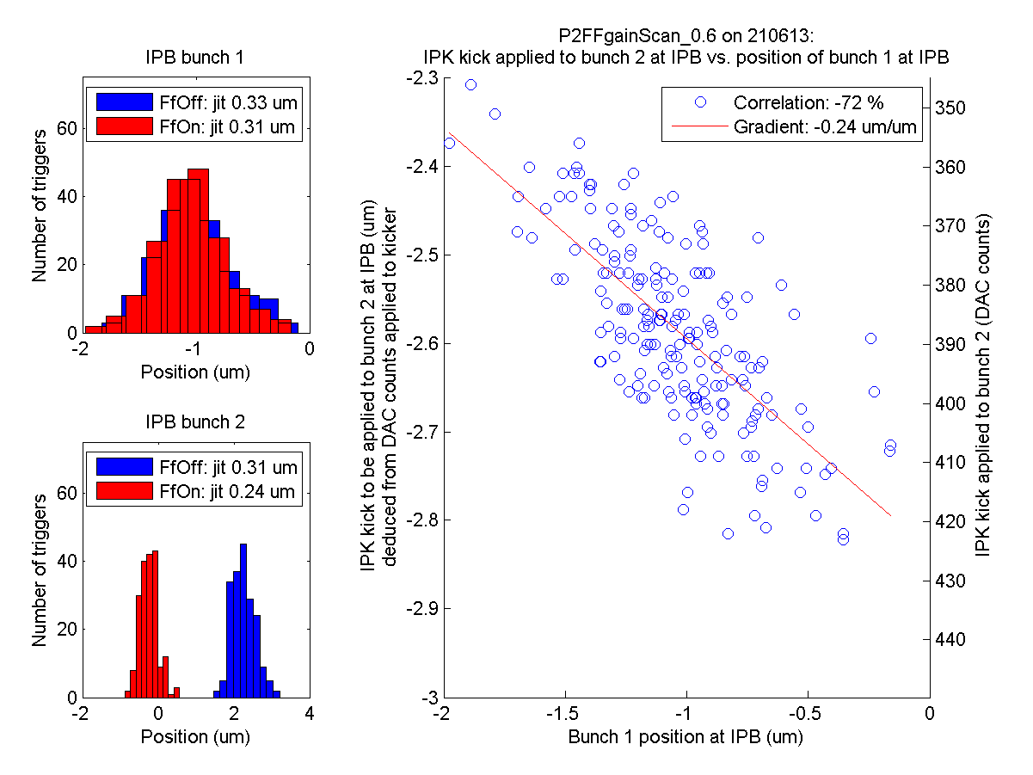
ZPUL3 power supply
P2-IPK gain scan
It was found that the wires carrying the 24 V supply to ZPUL3 made an intermittent connection to the ZPUL.
Re-soldering the wires to the ZPUL led to a stable connection.
N. Blaskovic

Slide 14
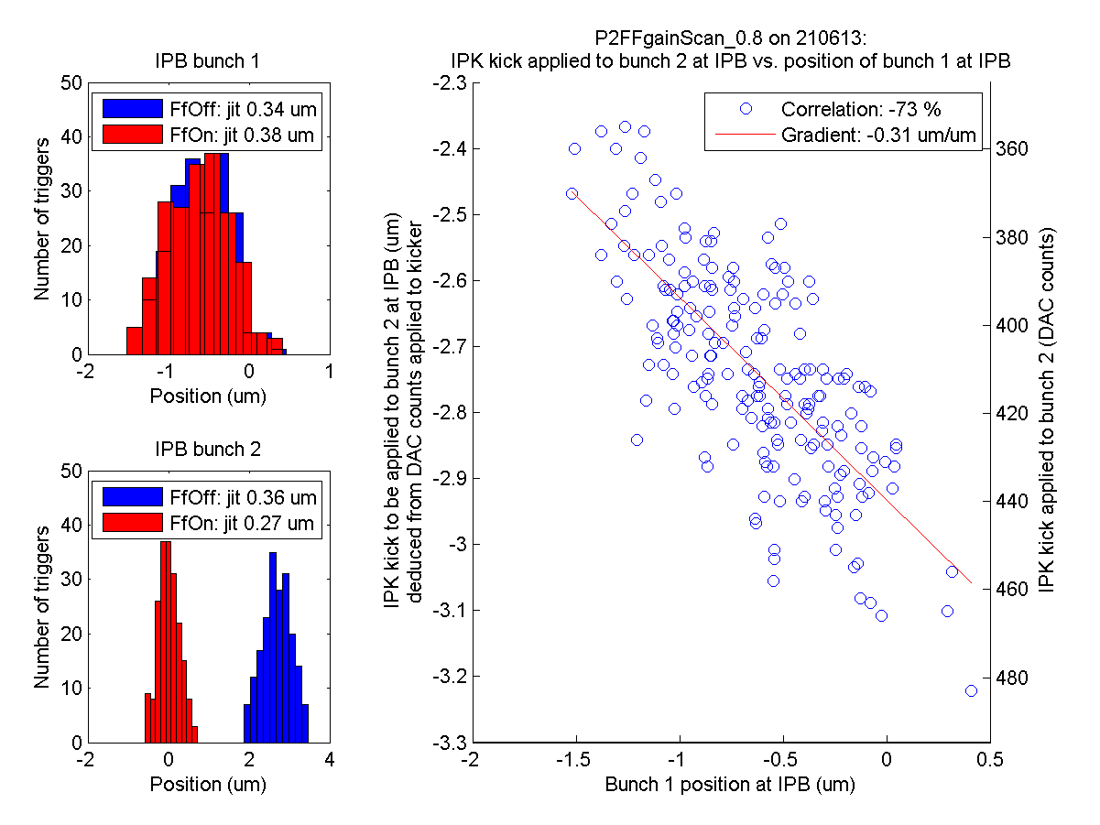
ZPUL3 power supply
P2-IPK gain scan
It was found that the wires carrying the 24 V supply to ZPUL3 made an intermittent connection to the ZPUL.
Re-soldering the wires to the ZPUL led to a stable connection.
N. Blaskovic

Slide 15
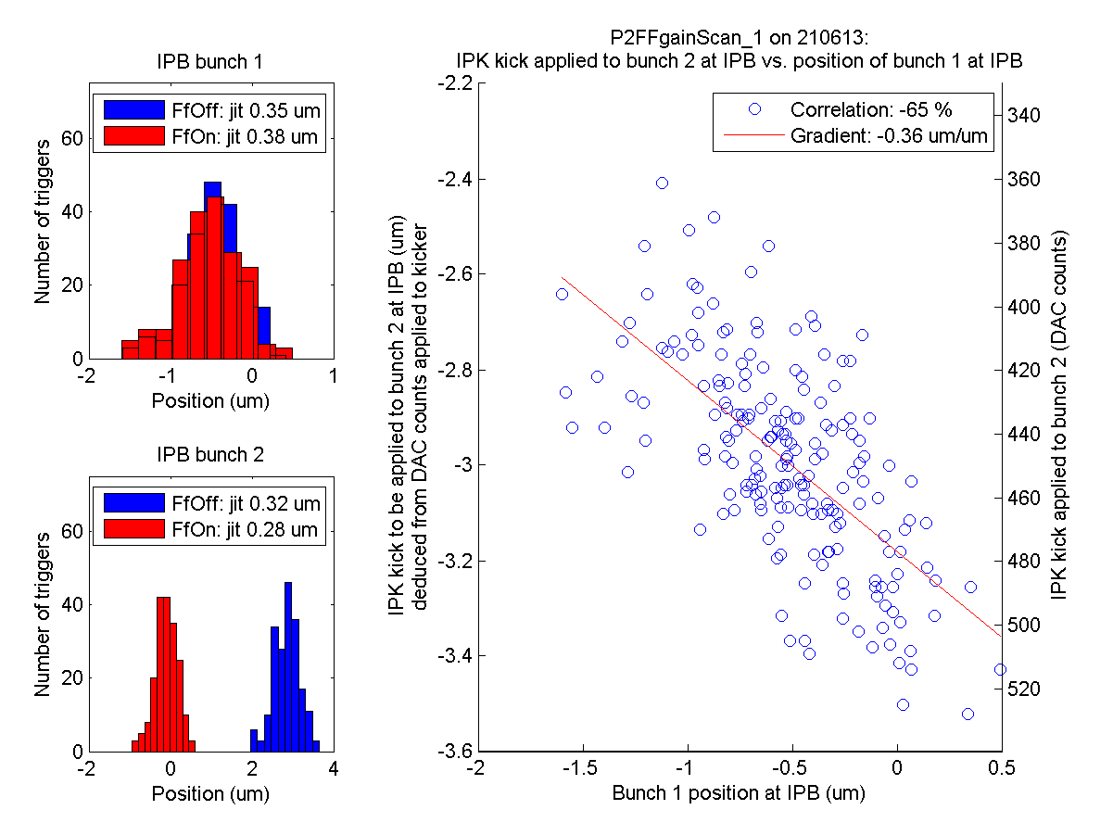
ZPUL3 power supply
P2-IPK gain scan
It was found that the wires carrying the 24 V supply to ZPUL3 made an intermittent connection to the ZPUL.
Re-soldering the wires to the ZPUL led to a stable connection.
N. Blaskovic

Slide 16
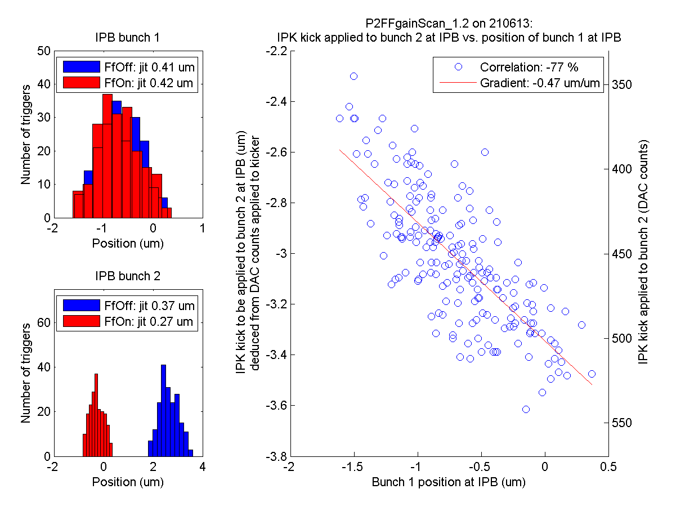
ZPUL3 power supply
P2-IPK gain scan
It was found that the wires carrying the 24 V supply to ZPUL3 made an intermittent connection to the ZPUL.
Re-soldering the wires to the ZPUL led to a stable connection.
N. Blaskovic

Slide 17
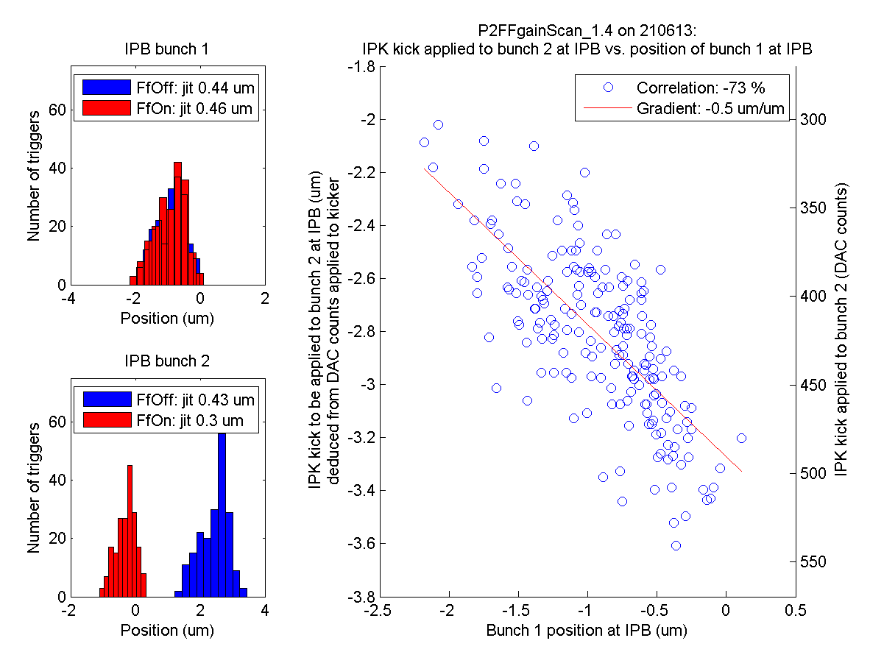
ZPUL3 power supply
P2-IPK gain scan
It was found that the wires carrying the 24 V supply to ZPUL3 made an intermittent connection to the ZPUL.
Re-soldering the wires to the ZPUL led to a stable connection.
N. Blaskovic

Slide 18
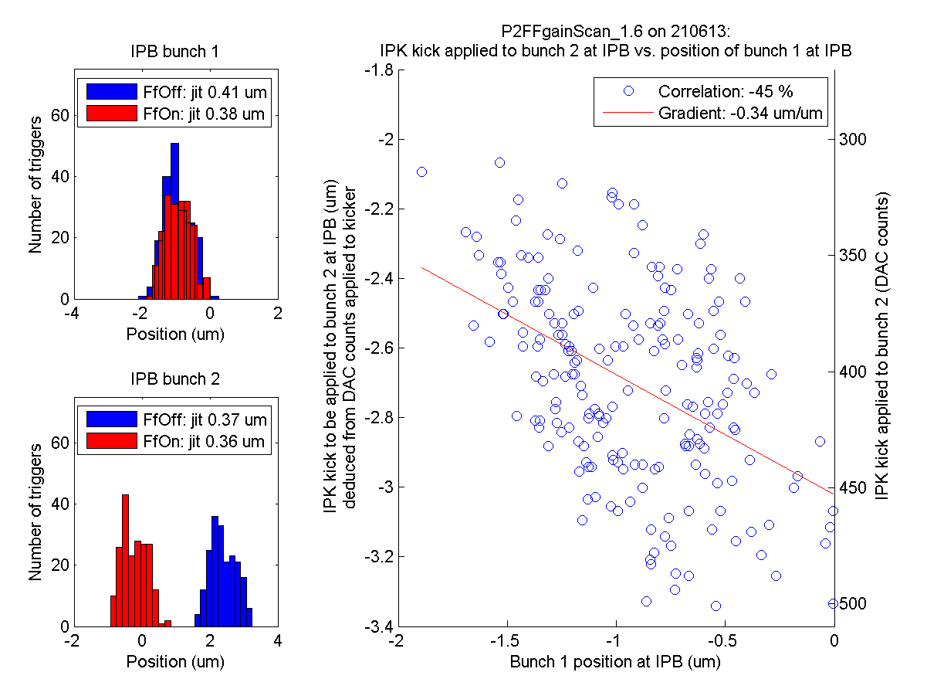
ZPUL3 power supply
P2-IPK gain scan
It was found that the wires carrying the 24 V supply to ZPUL3 made an intermittent connection to the ZPUL.
Re-soldering the wires to the ZPUL led to a stable connection.
N. Blaskovic

Slide 19
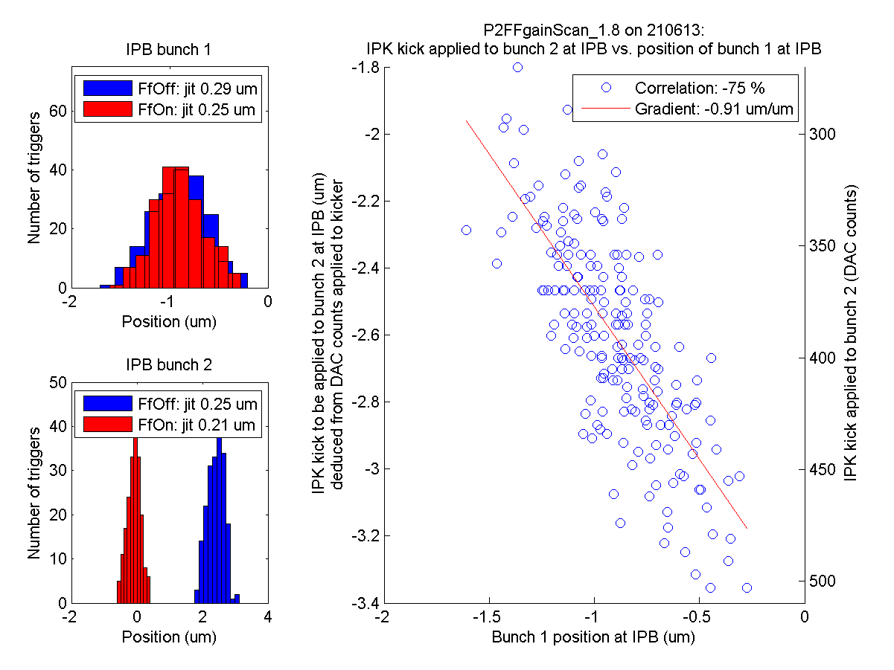
ZPUL3 power supply
P2-IPK gain scan
Gradient still > -1 even when P2-IPK gain is at 1.8 times nominal
It was found that the wires carrying the 24 V supply to ZPUL3 made an intermittent connection to the ZPUL.
Re-soldering the wires to the ZPUL led to a stable connection.
N. Blaskovic

Slide 20
Simulating DAC outputs
The DAC outputs that would have been obtained in a feedforward run for a different pair of P2 and P3 gains can be simulated
The resulting plot of simulated kick (in um) to bunch 2 at IPB against bunch 1 position at IPB can be produced
For example, ffRun3 on 7th June in reality had the following performance:
N. Blaskovic

Slide 21
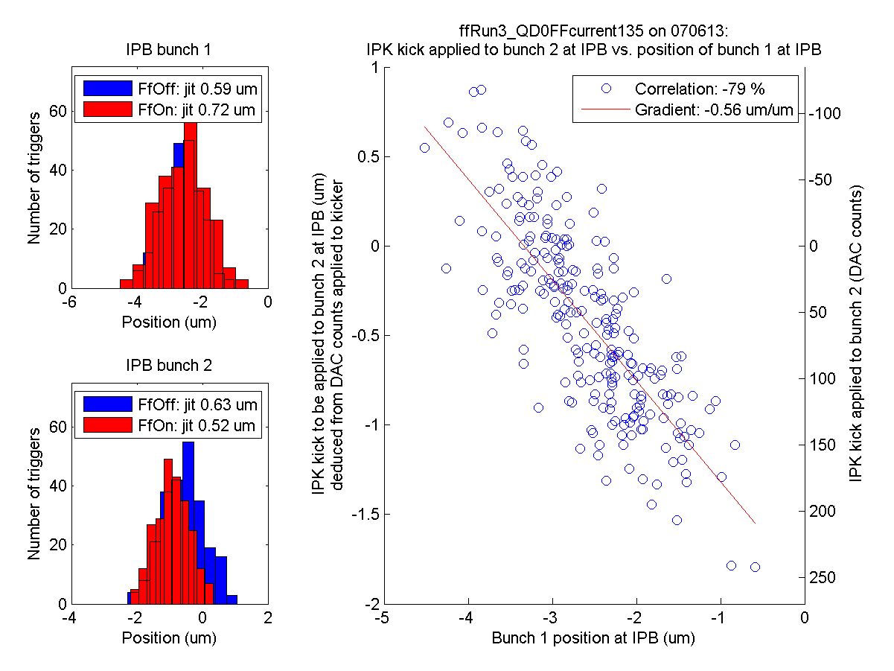
ZPUL3 power supply
It was found that the wires carrying the 24 V supply to ZPUL3 made an intermittent connection to the ZPUL.
Re-soldering the wires to the ZPUL led to a stable connection.
N. Blaskovic

Slide 22
Simulating DAC outputs
Taking the same run and replacing the DACs by those that would have been obtained using gains of -21185 and 9611 gives the plot on the next slide
Note that these new gains were obtained by fitting the bunch 1 feedforward on data of precisely this run
N. Blaskovic

Slide 23
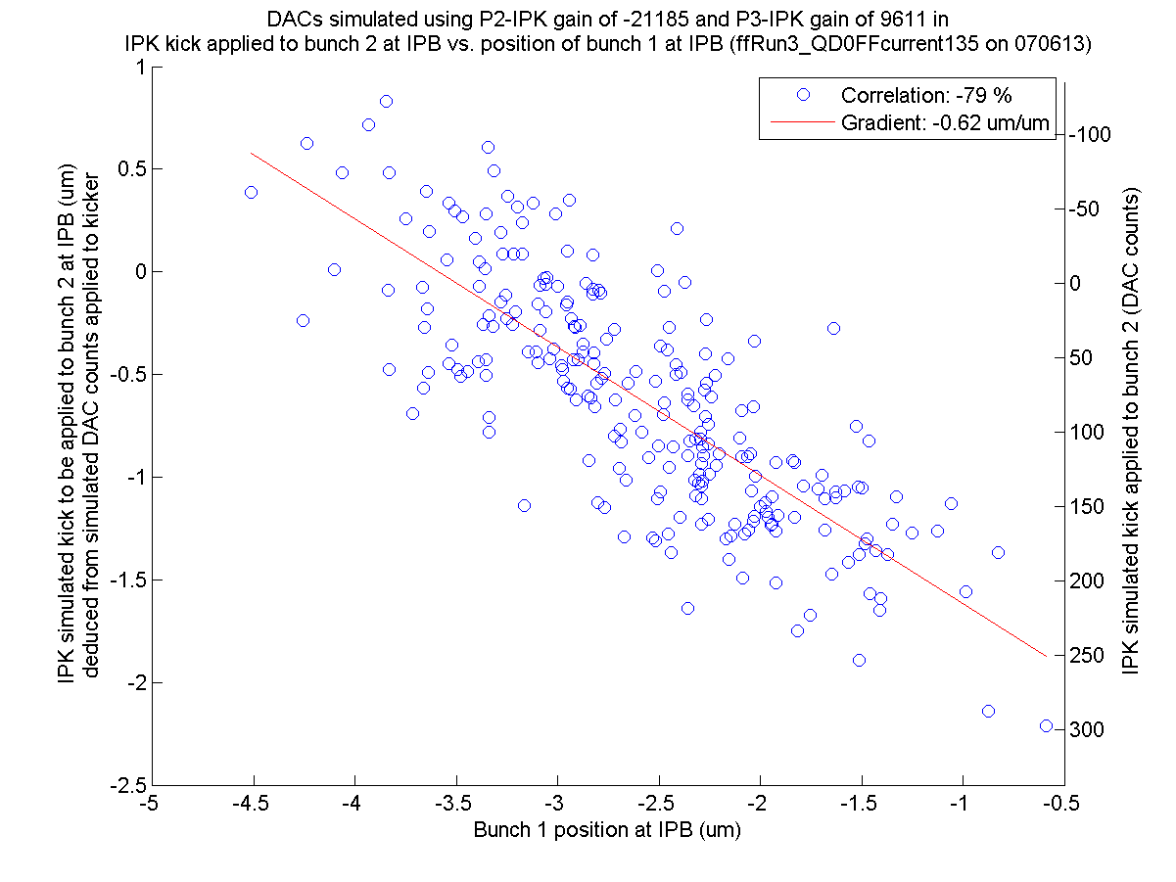
ZPUL3 power supply
It was found that the wires carrying the 24 V supply to ZPUL3 made an intermittent connection to the ZPUL.
Re-soldering the wires to the ZPUL led to a stable connection.
N. Blaskovic

Slide 24
Simulating DAC outputs
A large range of pairs of P2 and P3 gains can be simulated
The gradient and correlation of the bunch 2 kick-to-bunch 1 position plots can be presented as a function of the gains used
N. Blaskovic

Slide 25
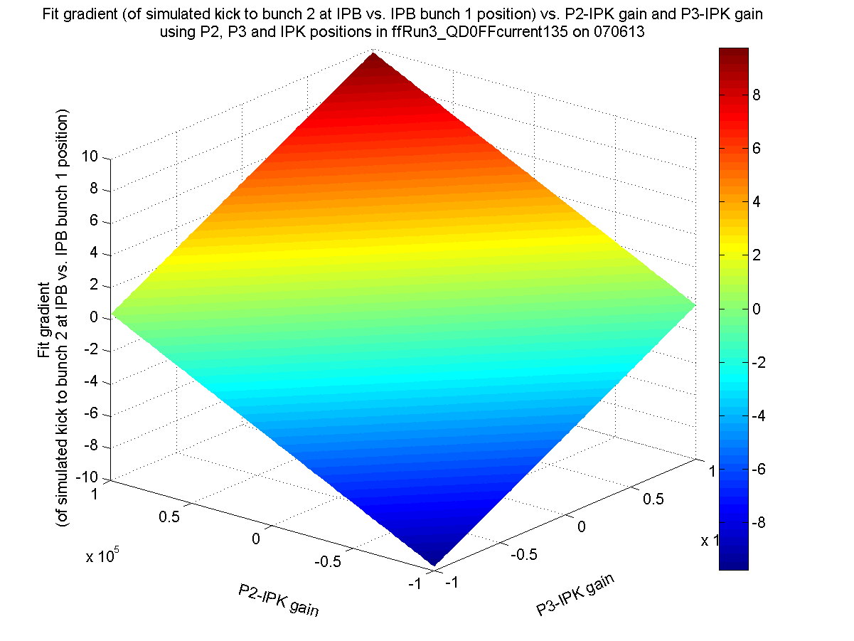
ZPUL3 power supply
It was found that the wires carrying the 24 V supply to ZPUL3 made an intermittent connection to the ZPUL.
Re-soldering the wires to the ZPUL led to a stable connection.
Fit gradient = -1 um/um
N. Blaskovic

Slide 26
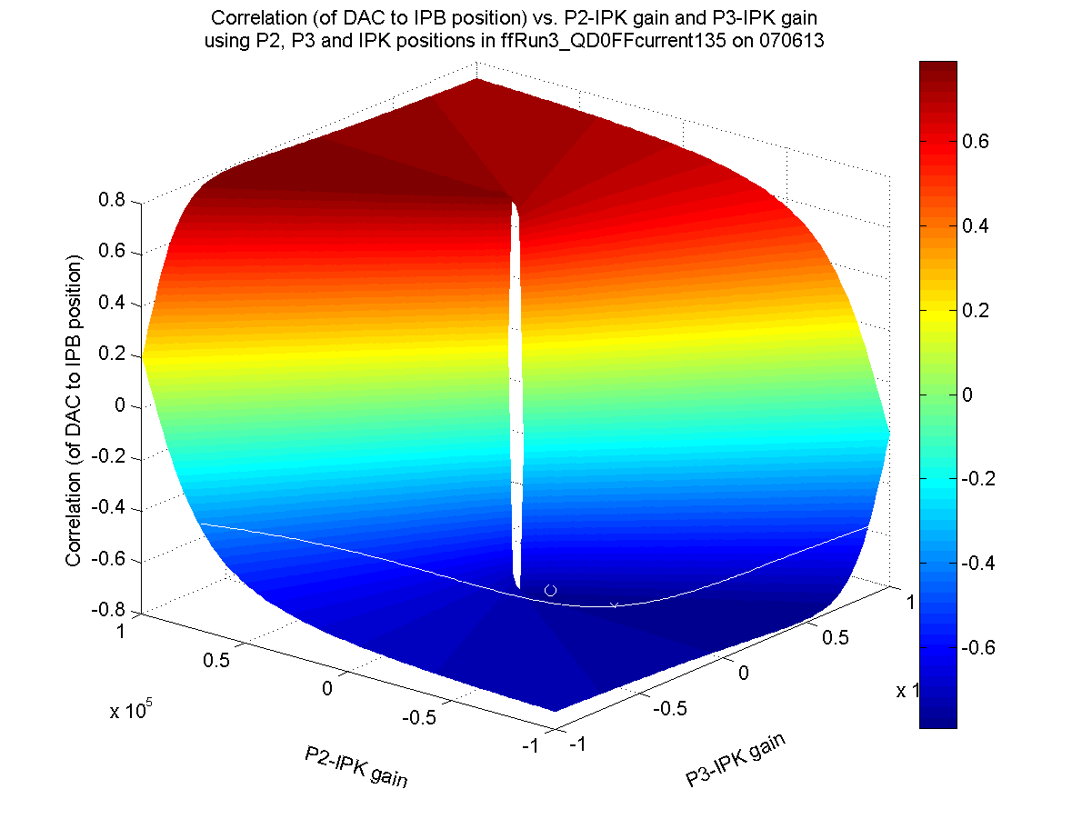
ZPUL3 power supply
It was found that the wires carrying the 24 V supply to ZPUL3 made an intermittent connection to the ZPUL.
Re-soldering the wires to the ZPUL led to a stable connection.
Fit gradient = -1 um/um
Gains used for the run
Optimum?
N. Blaskovic

Slide 27
Simulating DAC outputs
This approach can give pair of gains which
  Give a kick to bunch 2 equal but opposite to the position of bunch 1 at IPB (‘gradient = -1’)
  Maximise the magnitude of the correlation of the kick applied to bunch 2 to the position of bunch 1 at IPB
However, the inability to get a gradient of -1 even when fitting to the run itself may be an indication of a computational error or other limitation
N. Blaskovic

Slide 28
Appendix
theta vs. sample number
for the 210613 calibration run IPBcalib1_y_0dB_twoBunchMode_noFilters

Slide 29
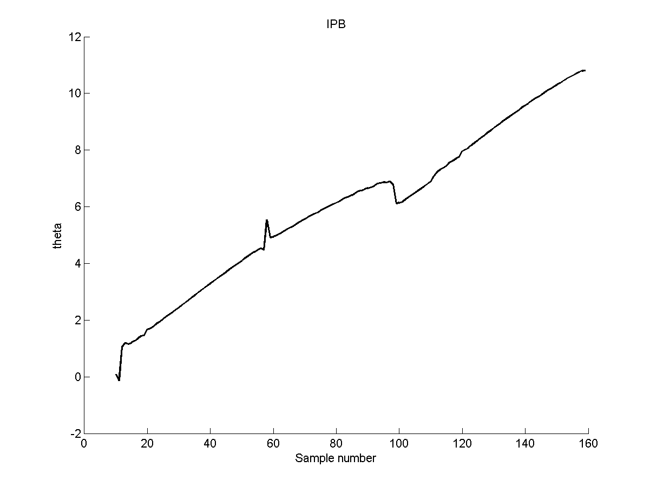
ZPUL3 power supply
It was found that the wires carrying the 24 V supply to ZPUL3 made an intermittent connection to the ZPUL.
Re-soldering the wires to the ZPUL led to a stable connection.
calibration file: IPBcalib1_y_0dB_twoBunchMode_noFilters on 210613
N. Blaskovic

Slide 30
Appendix
IPK kick vs. IPB bunch 1 position
plot explanation

Slide 31
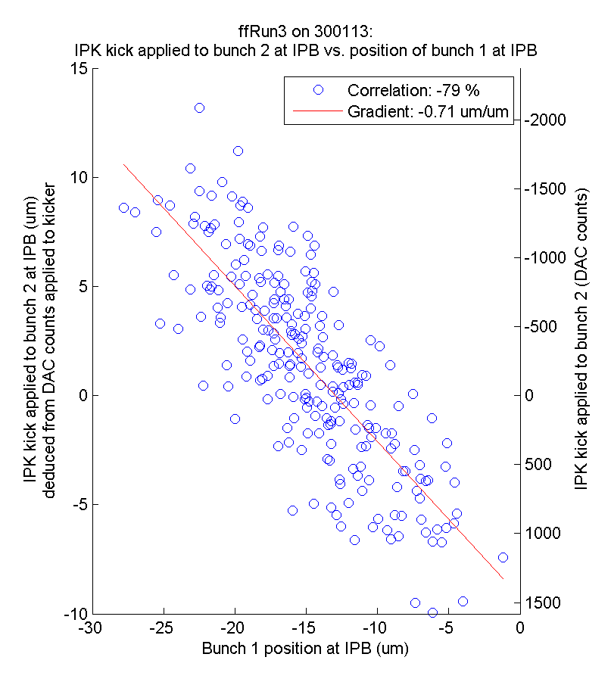
Example
Bunch 1
upstream-downstream position correlation
Ratio of calculated kick to kick that should have been applied
Whether DAC outputs are within the kicker amplifier’s linear range
Negative gradient: ‘correcting towards 0’
N. Blaskovic

