Slide 1


Feedforward Gain Calculation
Mikey Davis
23 May 2013
1/**number**

Slide 2
Introduction
Will go through the steps I took to get the FF gain
Nothing really new but feels like we’ve all forgotten
Will talk about the fitting a bit too
Mikey Davis
23 May 2013
2/**number**

Slide 3
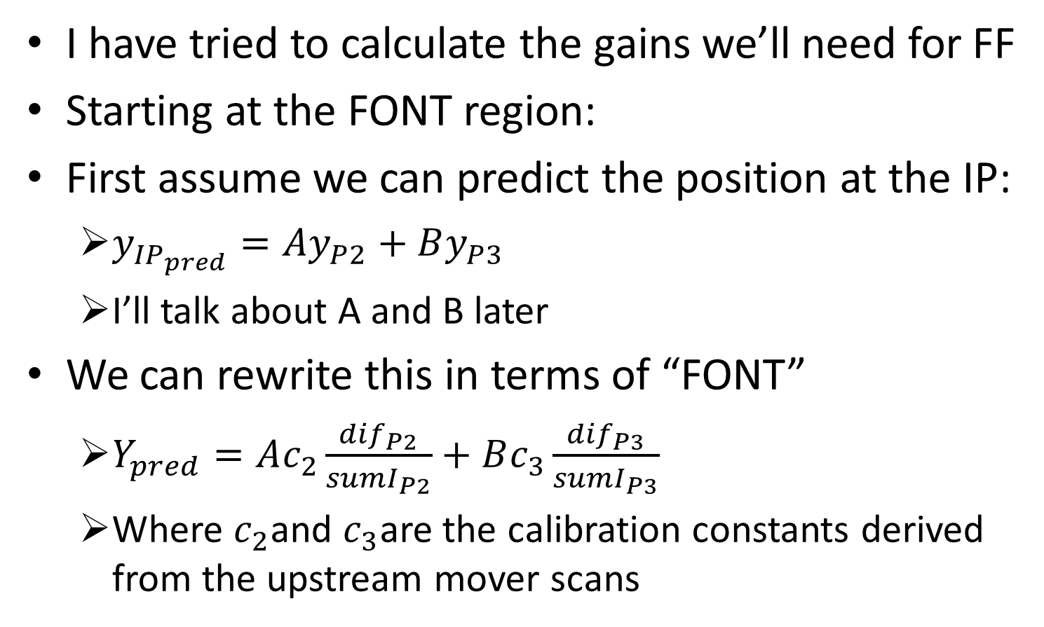
Feedforward Gain Calculation
I have tried to calculate the gains we’ll need for FF
Starting at the FONT region:
First assume we can predict the position at the IP:
$y_{{IP}_{pred}}=Ay_{P2}+By_{P3}$
I’ll talk about A and B later
We can rewrite this in terms of “FONT”
$Y_{pred}=Ac_{2}\frac{{dif}_{P2}}{{sumI}_{P2}}+Bc_{3}\frac{{dif}_{P3}}{{sumI}_{P3}}$
Where $c_{2}$and $c_{3}$are the calibration constants derived from the upstream mover scans
Mikey Davis
28 September 2012
3/7

Slide 4
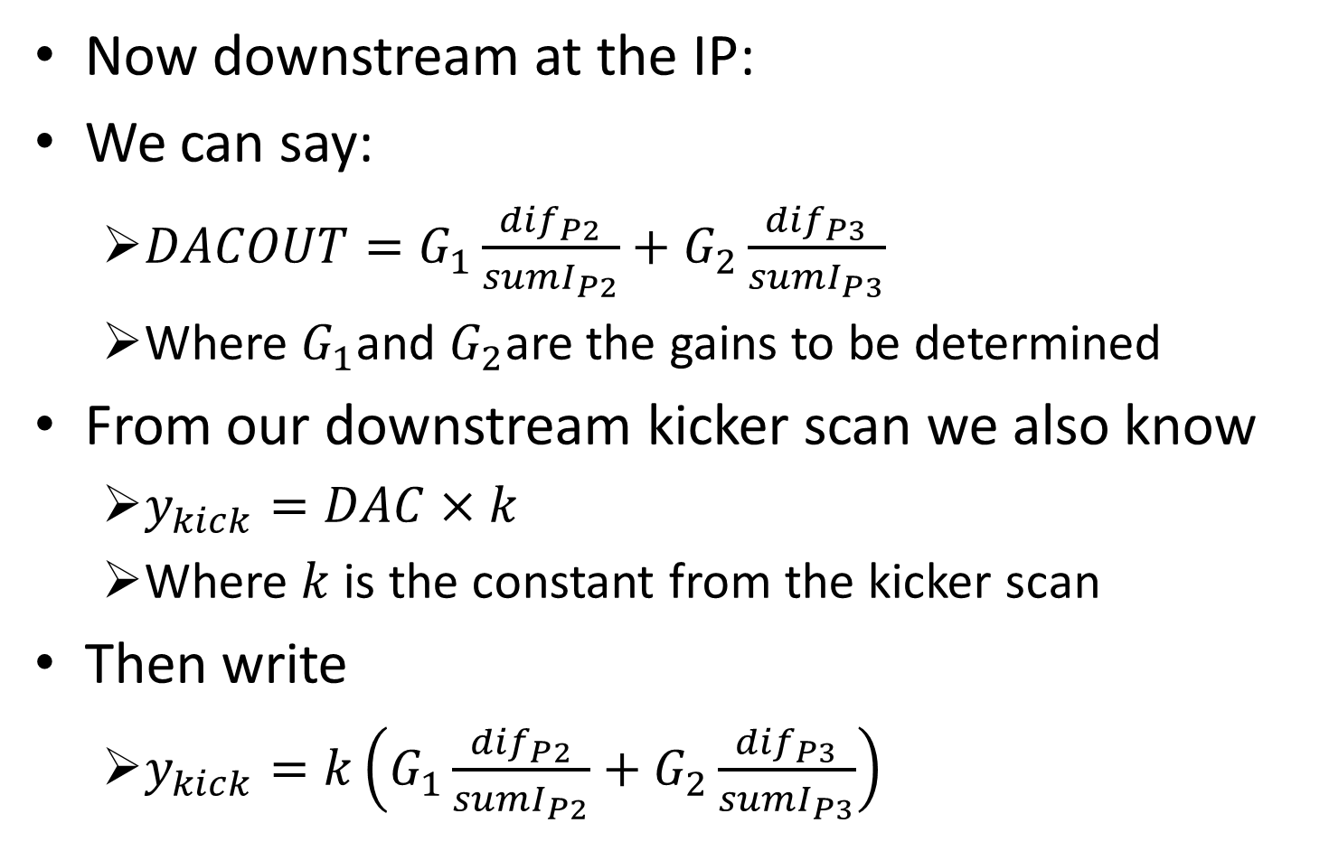
Feedforward Gain Calculation
Now downstream at the IP:
We can say:
$DACOUT=G_{1}\frac{{dif}_{P2}}{{sumI}_{P2}}+G_{2}\frac{{dif}_{P3}}{{sumI}_{P3}}$
Where $G_{1}$and $G_{2}$are the gains to be determined
From our downstream kicker scan we also know
$y_{kick}=DAC×k$
Where $k$ is the constant from the kicker scan
Then write
$y_{kick}=k\left(G_{1}\frac{{dif}_{P2}}{{sumI}_{P2}}+G_{2}\frac{{dif}_{P3}}{{sumI}_{P3}}\right)$
Mikey Davis
28 September 2012
4/7

Slide 5
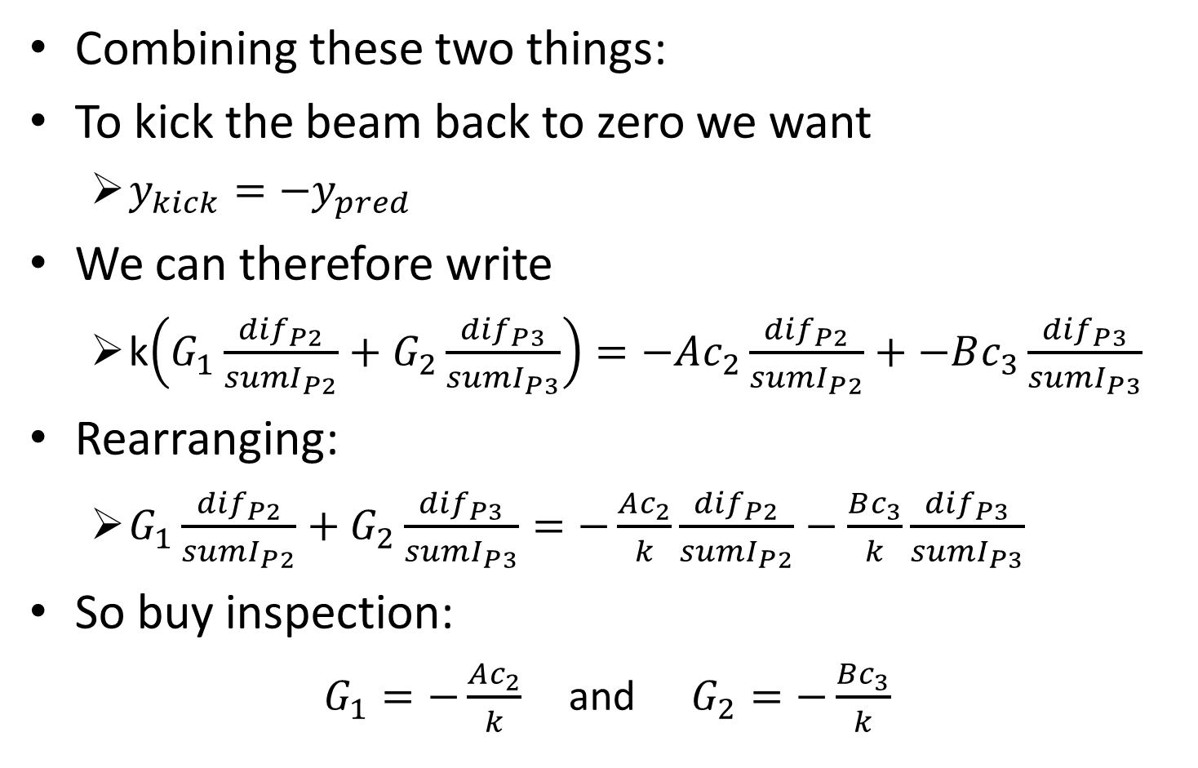
Feedforward Gain Calculation
Combining these two things:
To kick the beam back to zero we want
$y_{kick}=−y_{pred}$
We can therefore write
k$\left(G_{1}\frac{{dif}_{P2}}{{sumI}_{P2}}+G_{2}\frac{{dif}_{P3}}{{sumI}_{P3}}\right)=−Ac_{2}\frac{{dif}_{P2}}{{sumI}_{P2}}+−Bc_{3}\frac{{dif}_{P3}}{{sumI}_{P3}}$
Rearranging:
$G_{1}\frac{{dif}_{P2}}{{sumI}_{P2}}+G_{2}\frac{{dif}_{P3}}{{sumI}_{P3}}=−\frac{Ac_{2}}{k}\frac{{dif}_{P2}}{{sumI}_{P2}}−\frac{Bc_{3}}{k}\frac{{dif}_{P3}}{{sumI}_{P3}}$
So buy inspection:
$G_{1}=−\frac{Ac_{2}}{k}$ and $G_{2}=−\frac{Bc_{3}}{k}$
Mikey Davis
28 September 2012
5/7

Slide 6
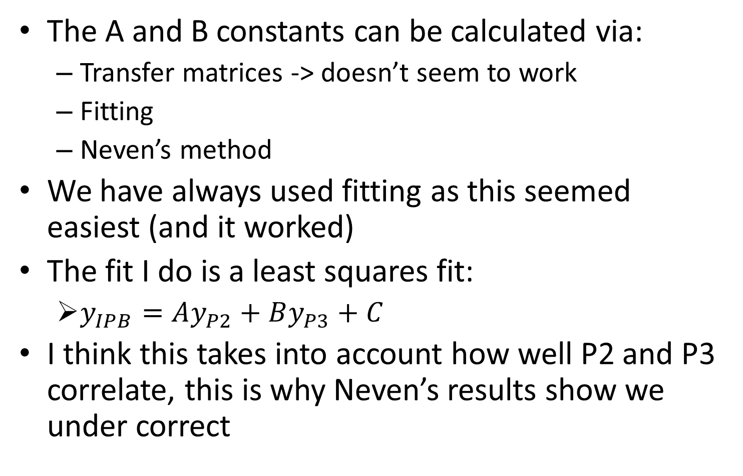
Feedforward Gain Calculation
The A and B constants can be calculated via:
Transfer matrices -> doesn’t seem to work
Fitting
Neven’s method
We have always used fitting as this seemed easiest (and it worked)
The fit I do is a least squares fit:
$y_{IPB}=Ay_{P2}+By_{P3}+C$
I think this takes into account how well P2 and P3 correlate, this is why Neven’s results show we under correct
Mikey Davis
28 September 2012
5/7

