Slide 1
Measurement of σ_{ZH} using Z→qq mode
- preliminary result -
Akiya Miyamoto
KEK
ILD Analysis/Software meeting
4 September 2013

Slide 2
Motivation
σ_{ZH} measurement by Z→e⁺e⁻/μ⁺μ⁻ recoil mass technique.
at 250 GeV/ 250 fb⁻¹ : 2.6%
  Precession is limited by event statistics.
  σ_{ZH} is very important observable for the absolute Higgs coupling measurement.
Possible way to improve would be
  High Luminosity ILC : with 1150 fb⁻¹ → 1.2% (Snowmass ILC Higgs WG)
  Another possibility : Z→ qqbar
    Philosophy:
      Find jet pair ( or a jet ) with mass M_{Z} inclusively.
      Measure Higgs from a recoil mass of jet pair.
      ➔ Measured yield will not depend on Higgs decay mode.

Slide 3
Inclusive jet pair study
Event selection strategy
  k_t jet clustering with R=1.2
  Select good jet by kt2 (Pt_{jet}² )
  Observed correlation in jet mass and jet energy was corrected.
    improved S/N of recoil mass distribution
250 GeV: Jets in Higgs events are fat, though jet from Z or W are not
the study is done 350 GeV, where jets are more sharp.

Slide 4
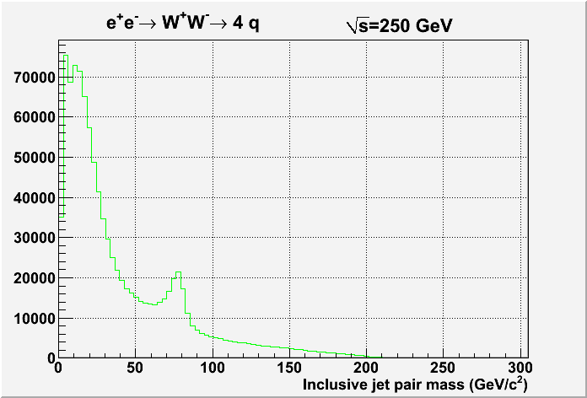
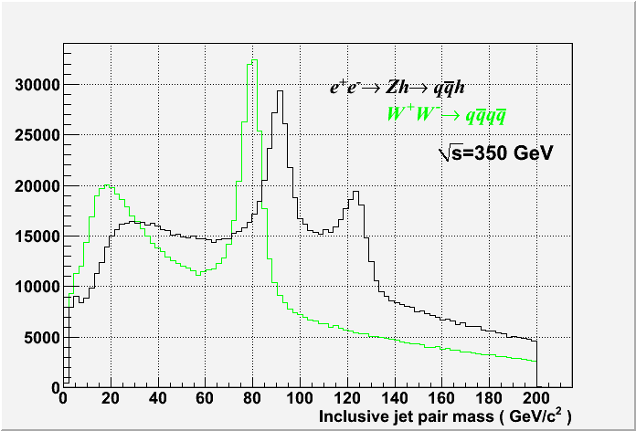
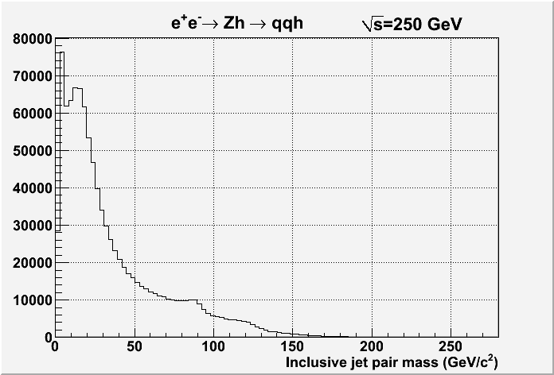
Inclusive Jet pair mass distribution
- Kt jet clustering, R=1.2
- Mass of any two jet commbination
- Compare Zh and 4q with
arbitrary normalization

Slide 5
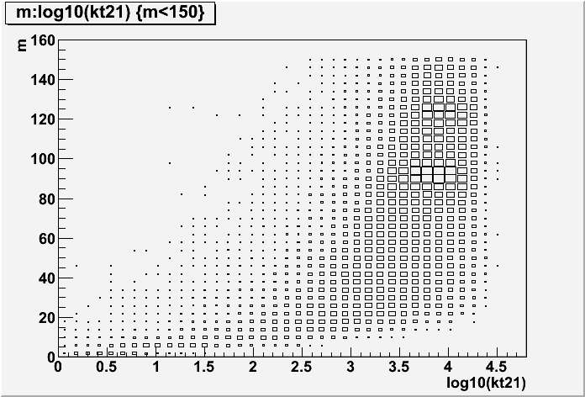
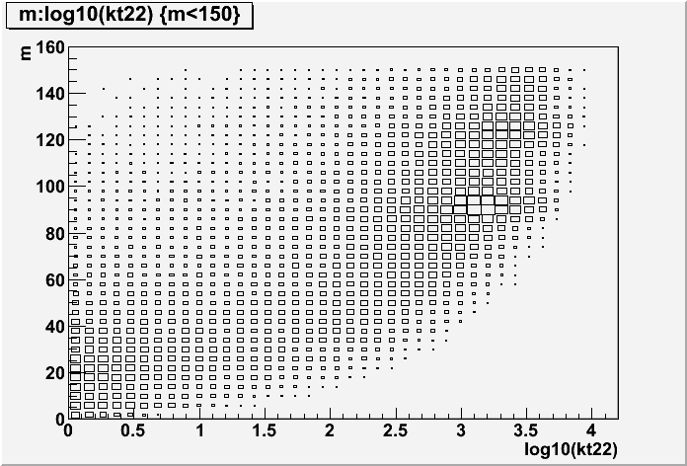
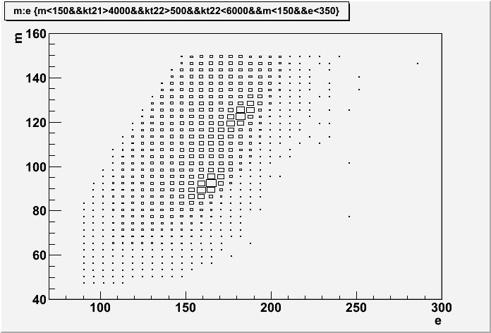
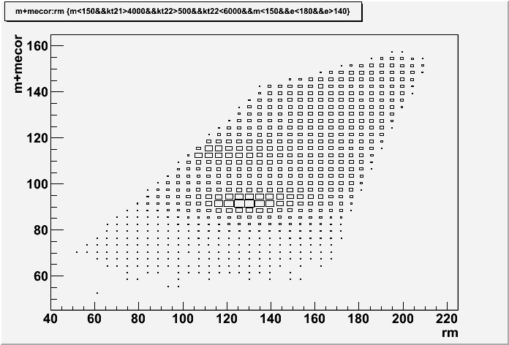
Various distribution for qqh events
Jet pair mass
Jet pair mass
kt2 jet1
kt2 jet2
Jet pair E and M correlation
Jet pair mass_corr
kt2(jet1)>4000
kt2(jet2): 500~6000
Recoil mass

Slide 6
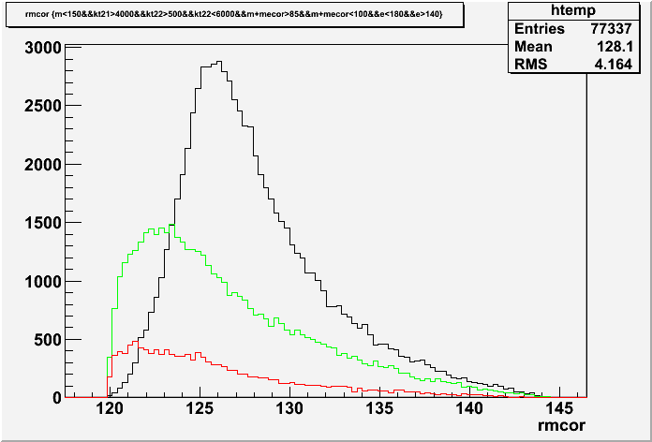
Event selection
Selection condition
  kt2(jet1)>4000 && kt2(jet2) >500 && kt2(jet2)<6000
  Jet pair energy : 140 ~ 180 GeV
  Jet pair mass w. E corr : 85 ~ 100 GeV/c²
  Eg max < 80 GeV
350 GeV
eL.pR
qqh
4q(ww)
4q(zz)
Recoil mass

Slide 7
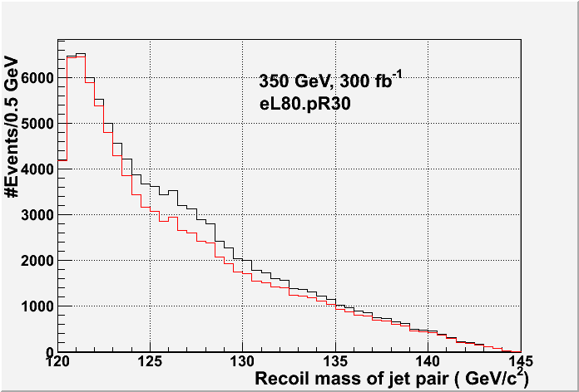
Including all background
Selection statistics
 | eR80.pR30 (300fb-1) | eL80.pR30 (300fb-1)
qqh | 7581 | 11263
2f_h | 13049 | 33326
4f_h | 15726 | 109011
4f_sl | 10767 | 65971
4f_l | 597 | 1755
Higgs | 1313 | 1975
aa/ae/ea | 3971 | 7320
tt | 4124 | 8441
all-bkg | 49546 | 227800
S/sqrt(S+B) | 31.72 | 23.04
sqrt(S+B)/S | 0.03153 | 0.04341
S/N | 0.153 | 0.049
Recoil mass 123~133 GeV were counted.
150 fb-1 each to
-80/+30 & +80/-30%
Δσ/σ ∼ 3.6%

Slide 8
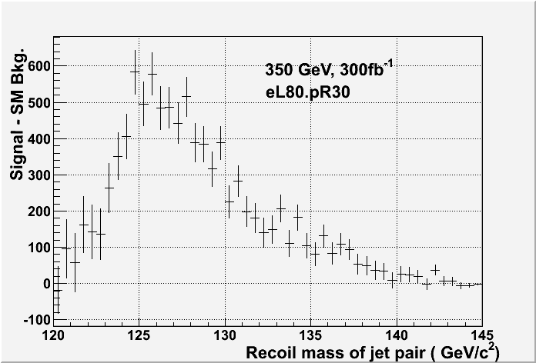
Typical distribution

Slide 9
350 GeV Summary
Preliminary results of the recoil mass study of jet pair at 350 GeV,
combining eL80/eR30 150fb⁻¹ and eR80/eL30 150fb⁻¹,
Δσ/σ ∼ 3.6%
Assuming 2.6% from e+e-/ mu+mu- recoil mass measurement at 350 GeV, Δσ/σ(ΖΗ) ∼ 2.1% could be obtained with 300 fb⁻¹(300 days) by
combining leptonic and hadronic mode.
Combining Δσ/σ(ΖΗ) ∼ 2.6% (leptonic only ) at 250 fb⁻¹@250 GeV, Δσ/σ(ΖΗ) ∼ 1.6% by running 250 GeV and 350 GeV with TDR nominal design. (without HL ILC)

Slide 10
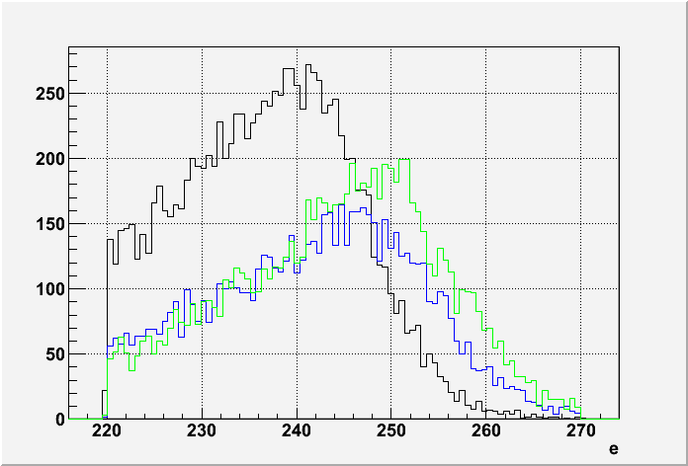
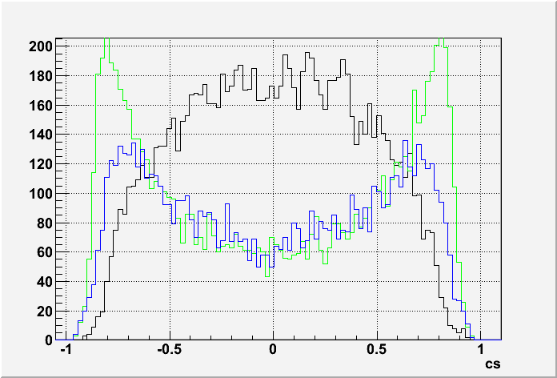
Study at 500 GeV
At 500 GeV, σ_{qqH} ( eL80.pR30 ) ~ 70fb. ➔ ~ 35k events w. 500fb⁻¹
Jet is narrower at 500 GeV. Instead of reconstruct 2 jet with smaller R,
use R=1.2 and reconstruct Z as a single jet.
WW→4q
qqh
qqh
WW→4q
ZZ→4q
ZZ→4q
Cosθ(jet)
Jet Energy

Slide 11
Event selection at 500 GeV
Pre-selection
  Jet Pt > 50 GeV
  Jet mass : 70 ~ 150 GeV/c²
  Jet energy : 210 ~ 300 GeV
  pre-selected qqh sample was used to define energy corrected jet mass,
  similar to 350 GeV analysis.
Final selection
  Corrected jet mass : 87 ~ 105 GeV/c²
  |cosqjet| < 0.7
  Number of particles in jet > 20
  Maximum Eγ < 100 GeV ( to suppress qqγ events )

Slide 12
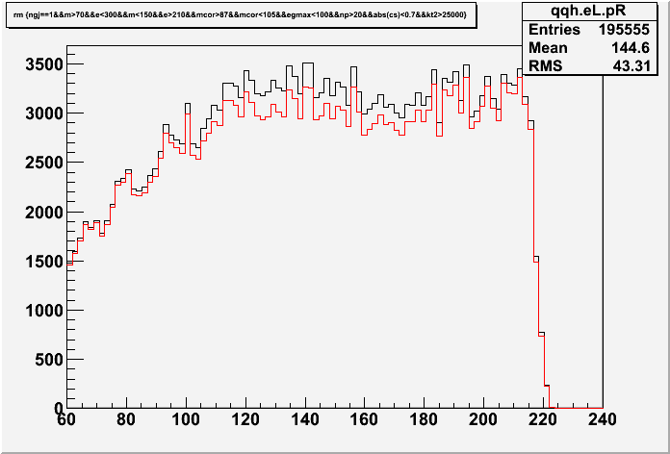
Final selection recoil mass & statistics
Event statistics for 500 fb-1,
eL80.pR30 at 500 GeV
Red: all background
Black: qqh + background
 | Process | Nevents | Fraction(%)
S | qqh | 11113
B | ffh | 338 | 0.19
 | 2f | 47377 | 27.01
 | 4f | 121086 | 69.02
 | 6f | 6357 | 3.62
 | aa_2f | 91 | 0.05
 | ae/ea | 186 | 0.11
Recoil mass
Hard to see recoil mass peak,
but excess due to qqh could be seen
S/N=0.0633
sqrt(S+N)/S=0.0389

Slide 13
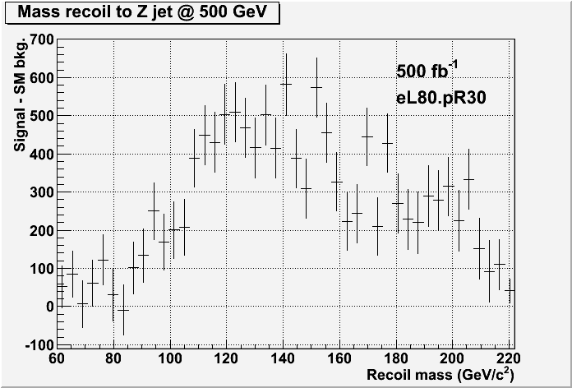
Recoil mass distribution
Recoil mass distribution
after subtracting background

Slide 14
Summary
A possibility to measure σ_{ZH} using using Z→qq mode was investigated.
At 350 GeV, Higgs peak in jet recoil mass can be seen.
Combining eL80/eR30 150fb⁻¹ and eR80/eL30 150fb⁻¹,
Δσ/σ ∼ 3.6% is expected.
At 500 GeV, hard to see Higgs peak in jet recoil mass distribution.
But from event excess in qqh like events, Δσ/σ ∼ 3.9% is expected
for 500 fb⁻¹, eL80.pR30 beam polarization.
Further improvement may be possible by more sophisticated analysis.
A possibility to use Z→qq at 250 GeV should be investigated.

