Slide 1
Beam test Analysis Micromegas TPC by Wenxin Wang
CEA-Saclay

Slide 2
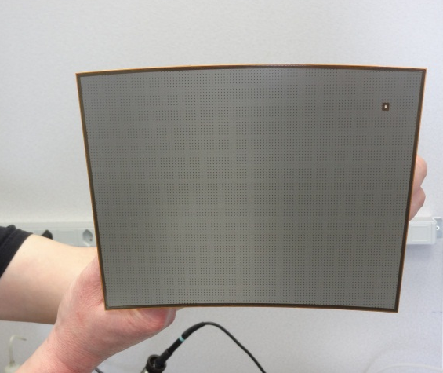
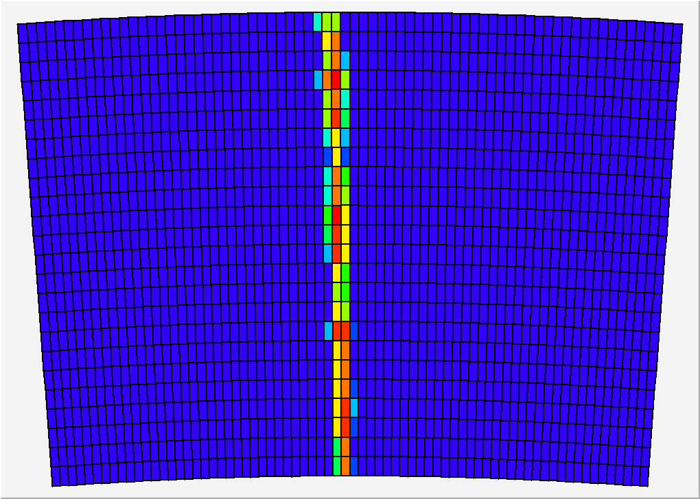
Micromegas module
Module size: 22 cm × 17 cm
24 rows × 72 columns
Readout: 1726 Pads
Pad size: ~3 mm × 7 mm

Slide 3
2008~2011:
Test with one module at the center of LP-TPC
2012~2013:
Test with multi-modules at the endplate of LP-TPC

Slide 4
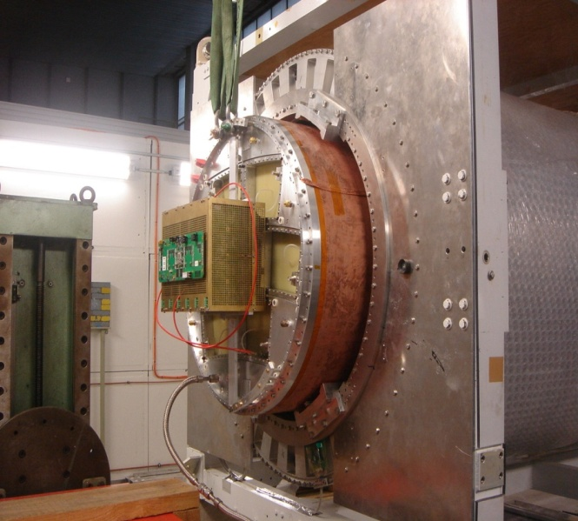
Tests with one single module
(2008~2011)
At the center of LP-TPC

Slide 5
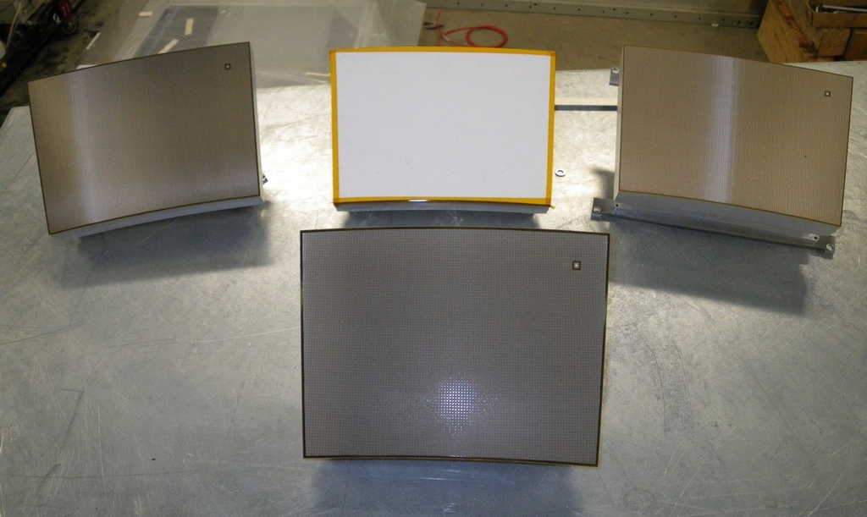
Micromegas modules
Module 4 &
Module 5
Module 3
Module 1
Resistive Kapton
~3 MΩ/□
Resistive Kapton
~5 MΩ/□
Standard
(no resistive layer)
Module 2
Resistive ink
~3 MΩ/□

Slide 6
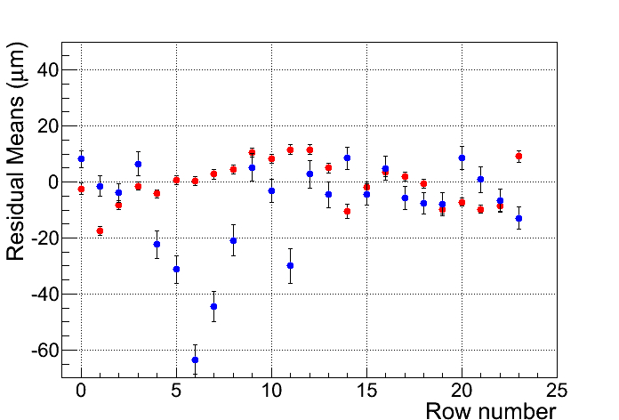
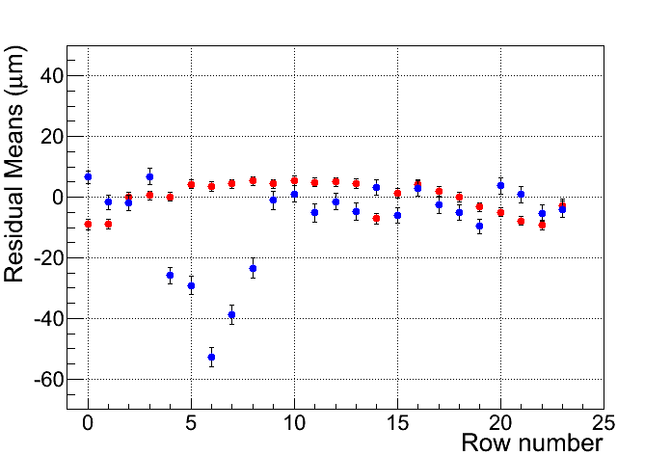
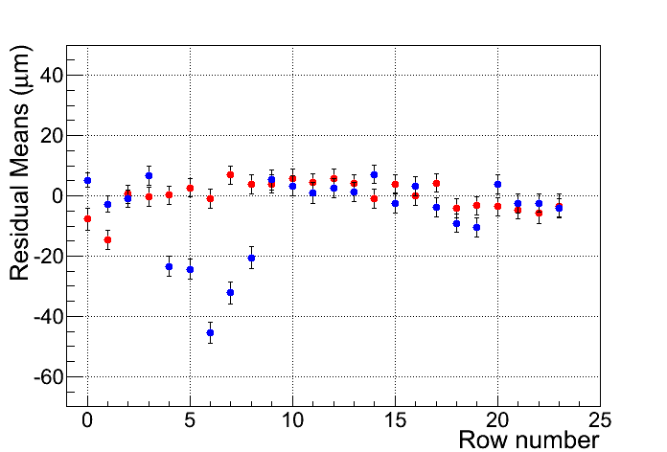
Uniformity
Resistive CLK Module
Resistive ink Module
Z=5cm
Mean Residual vs Row Number
Z-independent distortions
Distortions up to 50 microns for resistive ink (blue points)
Rms 7 microns for CLK film
(red points)
Z=35cm
Z=50cm
Row number

Slide 7
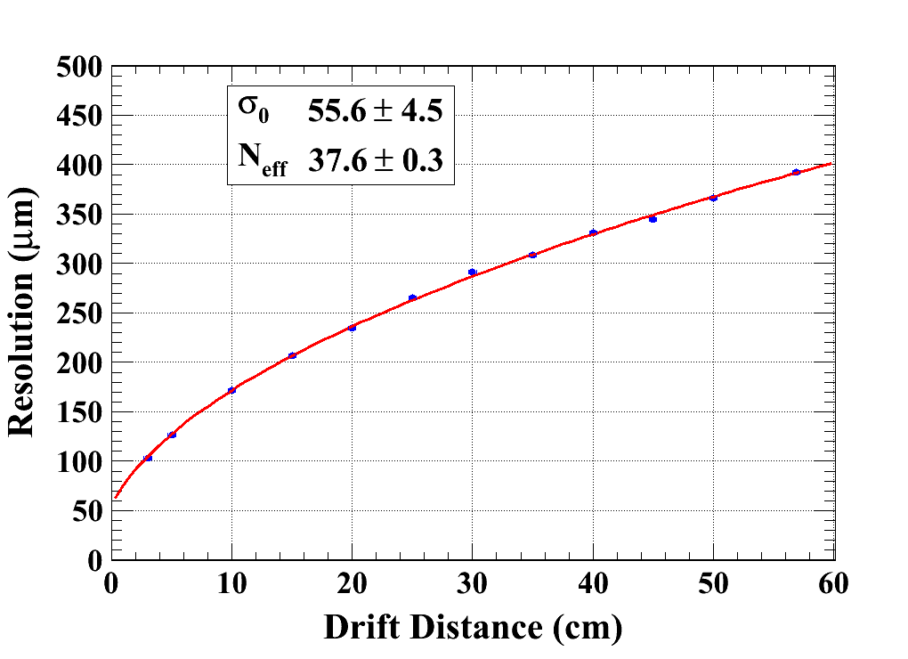

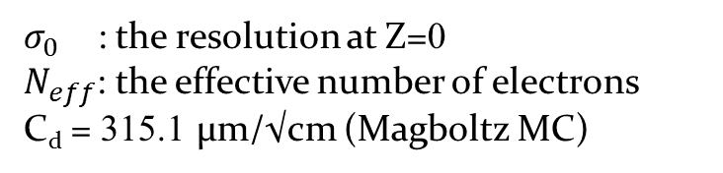
Spatial resolution
(B = 0T)
$σ_{0}$ : the resolution at Z=0
$N_{eff}$: the effective number of electrons
C_{d} = 315.1 µm/√cm (Magboltz MC)
Module 4
Module 5

Slide 8
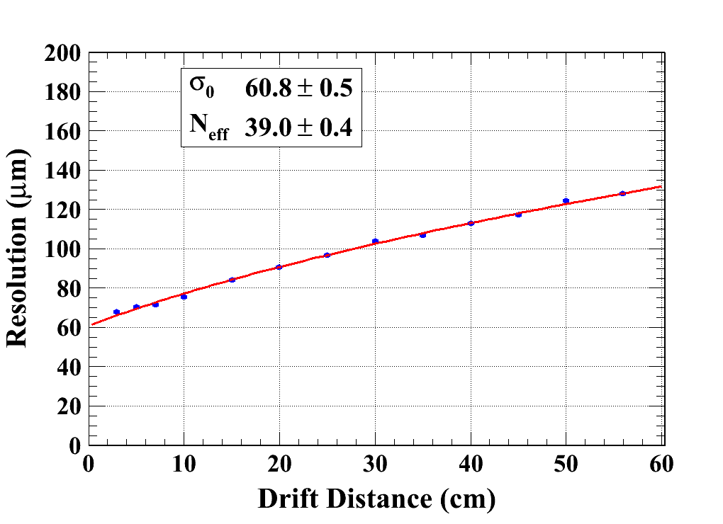
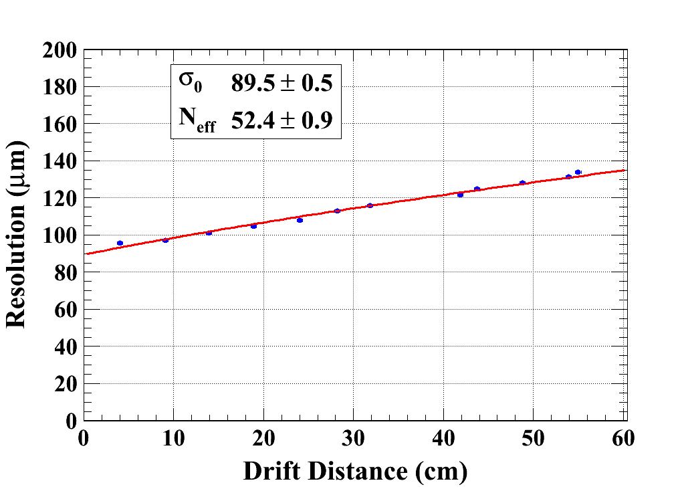
Spatial resolution
(B = 1T)
C_{d} = 94.2 µm/√cm (Magboltz MC)
Module_CLK
Module_INK

Slide 9
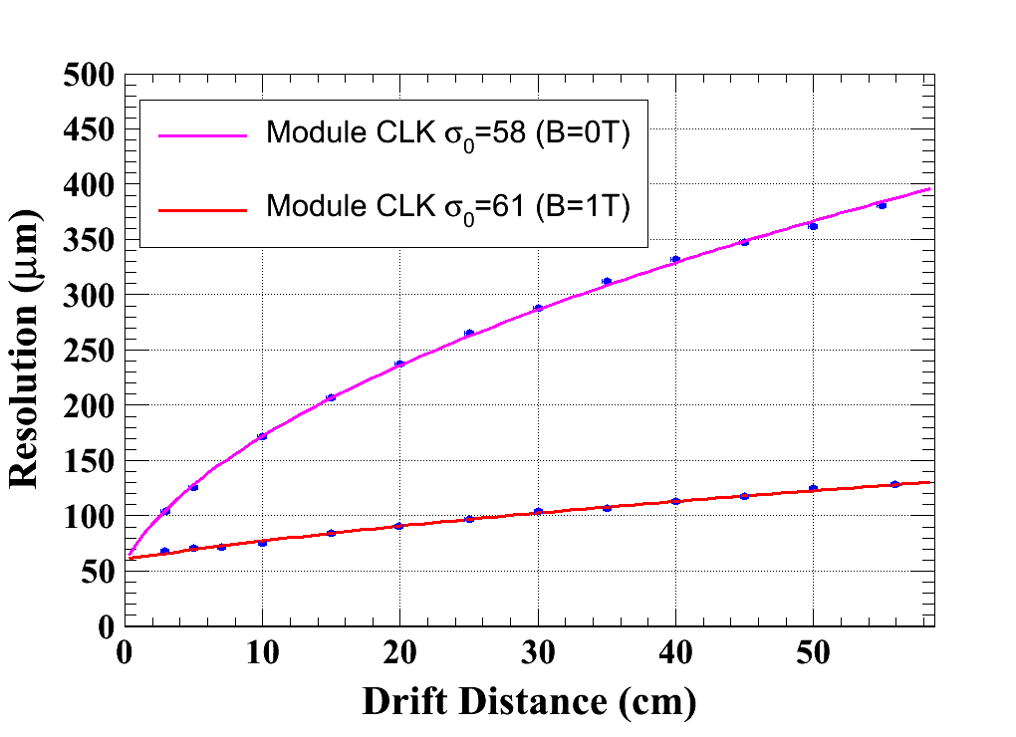
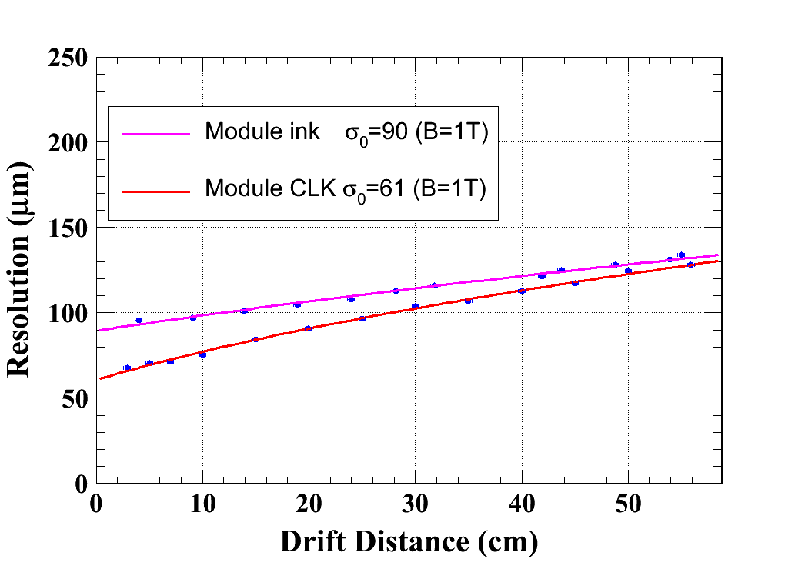
Spatial resolution

Slide 10
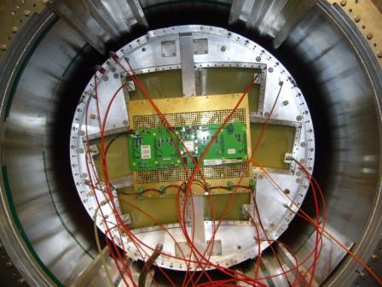
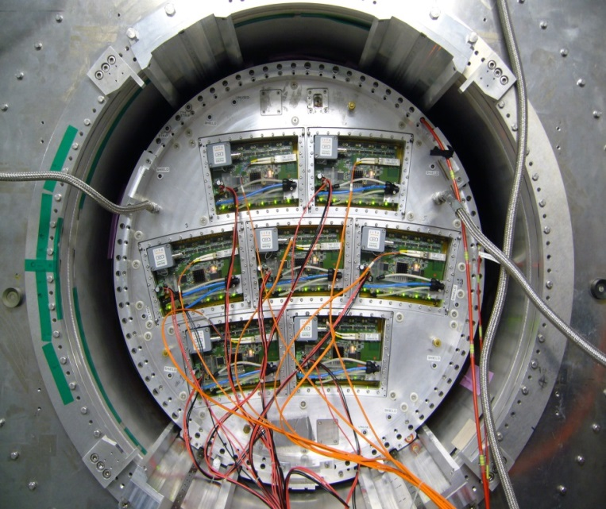
Tests with multi-modules
(2012~2013)
Fully cover the endplate of LP-TPC
Using a quasi-industrial production chain

Slide 11
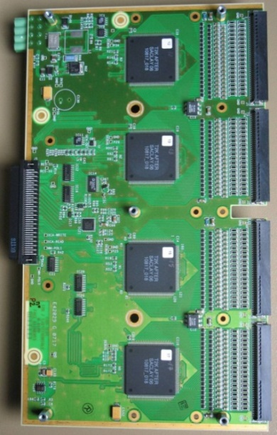
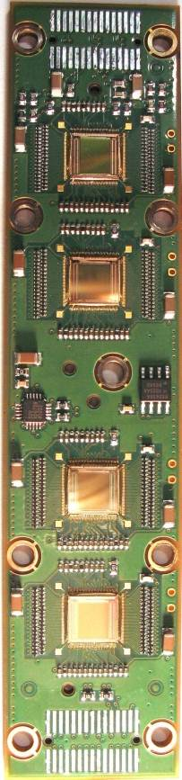
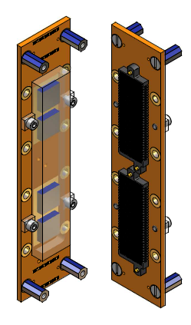
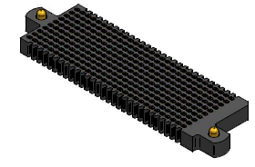
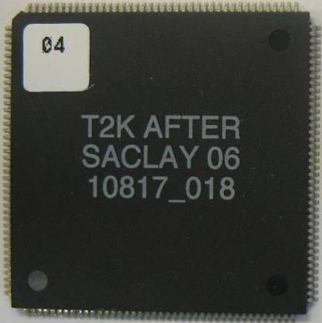
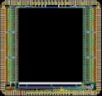
Integrated electronics
Remove packaging and protection diodes
Wire-bond AFTER chips
Use two 300-point connectors
Front-End Card
(FEC)
25 cm
4.5 cm
12.5 cm
14 cm
3.5 cm
2.8 cm
3.5 cm
0.78 cm
AFTER Chip
0.74 cm
The resistive foil protects against sparks

Slide 12
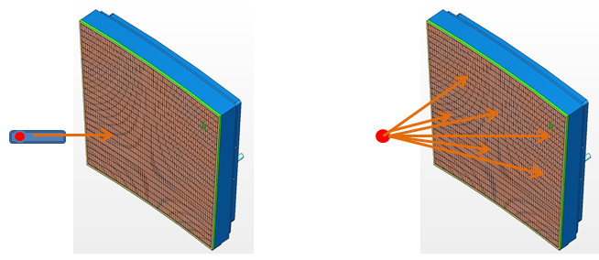
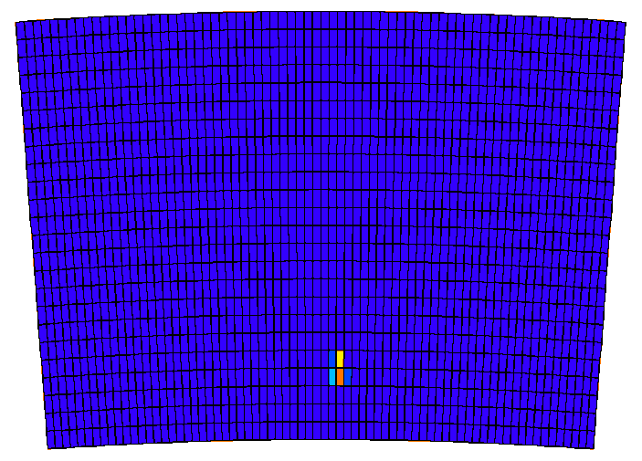
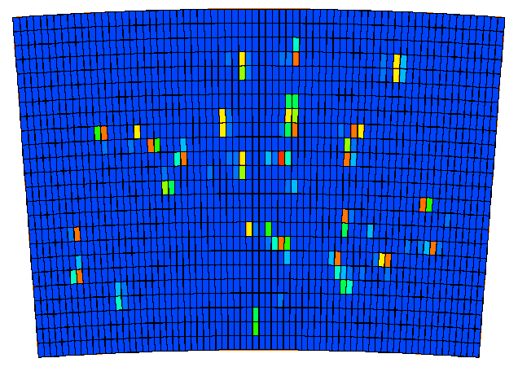
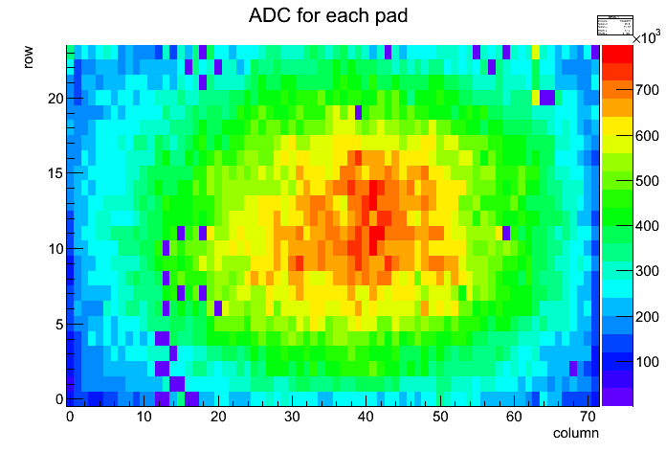
Test bench
Test without collimator
to check the map of missing pads
Test with collimator

Slide 13
Modules comparison
At V_{mesh} = 380 V, Energy resolution ~12% r.m.s

Slide 14
Modules comparison
At V_{mesh} = 380 V, average gain ~ 2630, gain spread ~15%

Slide 15
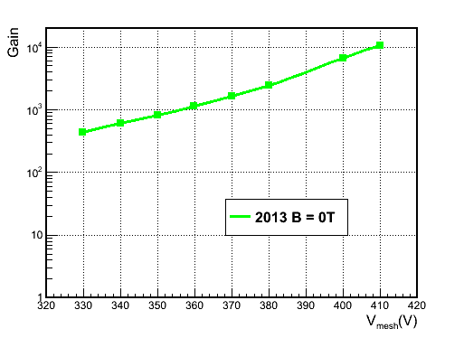
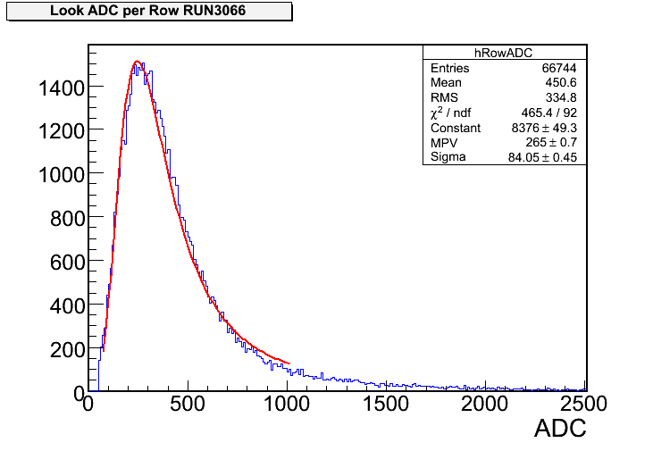
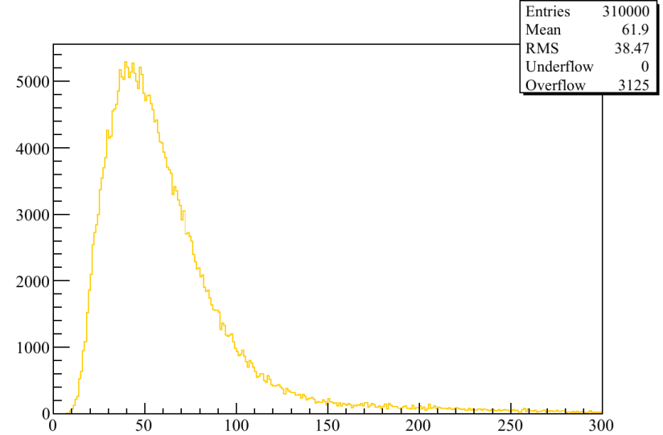
Gain Study using beam events
Charge per row
For 6.84 mm pitch & 5 GeV e-
N_{electron} (MPV) expected = 45
(from HEED simulation)
2500 at V_{mesh}=380V
( 2700 at V_{mesh}=380V
From test bench)

Slide 16
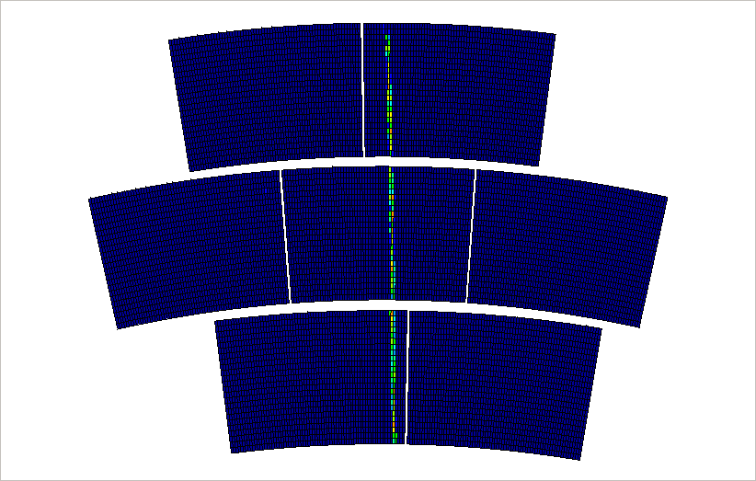
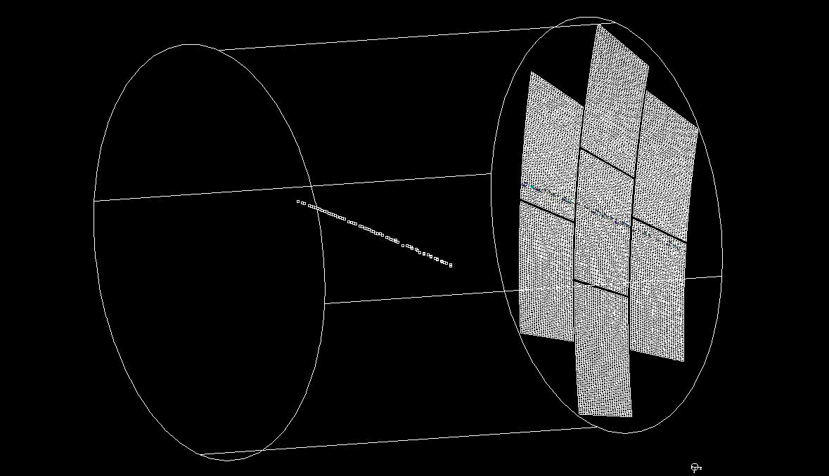
Beam events display
Online monitor
2D or 3D display from ILC software
Offline monitor

Slide 17
Analysis Framework: MarlinTPC
MarlinTPC
Marlin based simulation, digitization, reconstruction and analysis code for the TPC.
KalDet &KalTest: (installed in Marlin)
A ROOT-based Kalman Filter Package.
Used to reconstruct tracks.

Slide 18
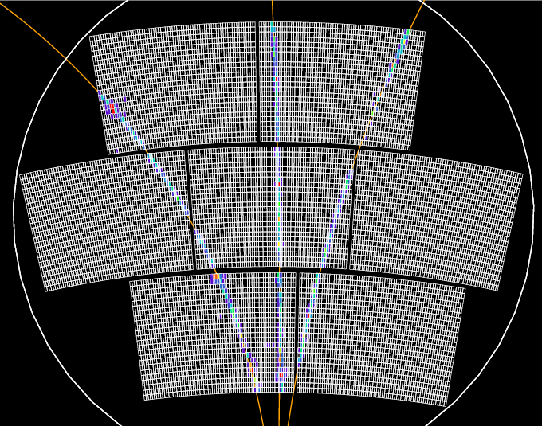
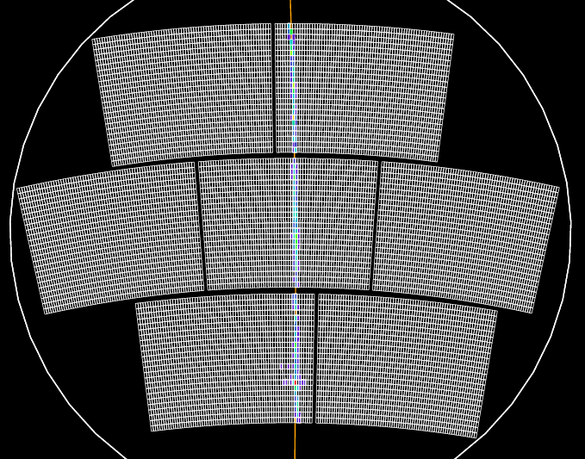
Spatial resolution
Event selection
→ only single track event

Slide 19
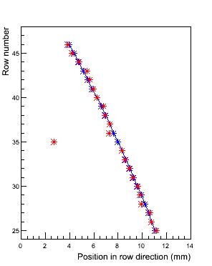
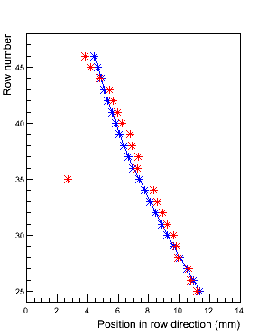
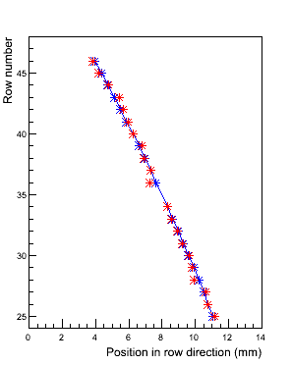
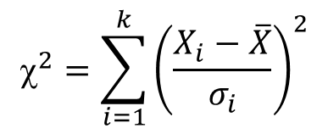
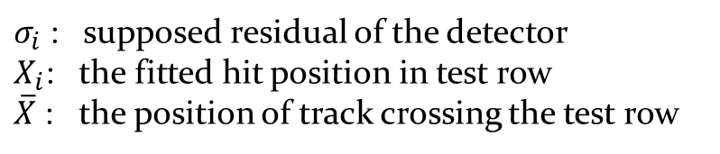
Spatial resolution
Hit selection
Fit track with all rows
$σ_{i}$ : supposed residual of the detector
$X_{i}$: the fitted hit position in test row
$\overline{X}$ : the position of track crossing the test row

Slide 20
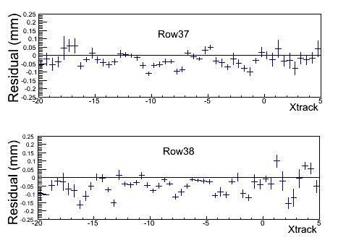
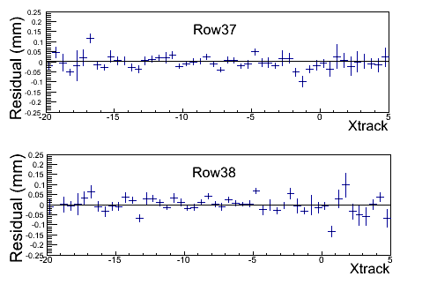
Spatial resolution
Pad size
(mm)
(mm)
(mm)
(mm)
Profile histogram of the residual with the track in one row before bias correction
Profile histogram of the residual with the track in one row after bias correction

Slide 21
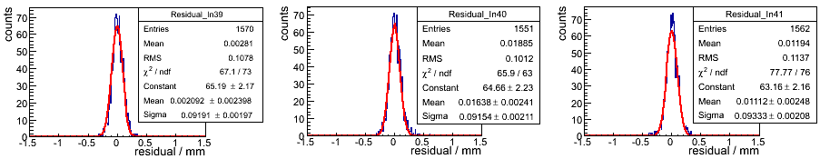
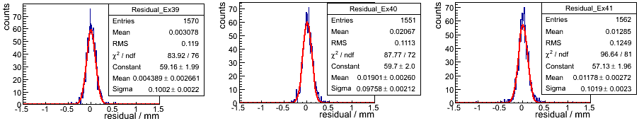
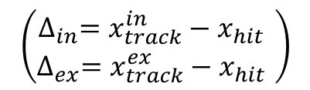

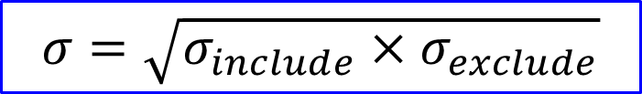

Spatial resolution
Distribution of the residuals (z = 15 cm)
$$∆_{in}$$
$$∆_{ex}$$
$$σ=\sqrt{σ_{include}×σ_{exclude}}$$
$$\left(\begin{aligned}∆_{in}=x_{track}^{in}−x_{hit} \\ ∆_{ex}=x_{track}^{ex}−x_{hit} \end{aligned}\right)$$

Slide 22
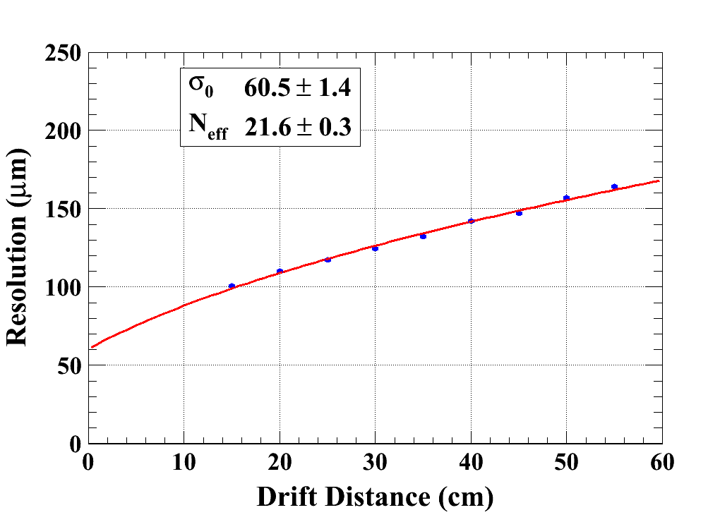
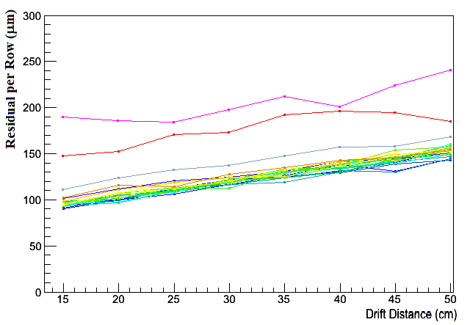
Spatial resolution
B=1 T C_{d} = 94.2 µm/√cm (Magboltz MC)
24 rows of a module

Slide 23
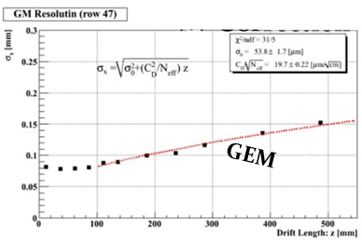
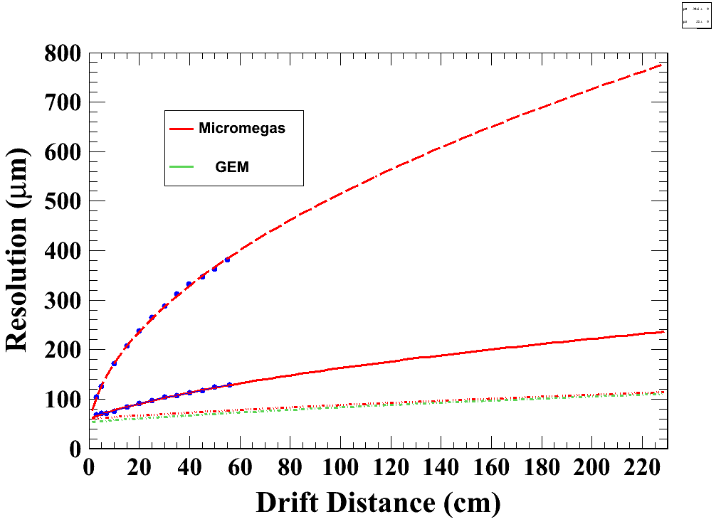
Extrapolation of the spatial resolution
Extrapolate to 2.3m & B=3.5T
B=1T
--- Micromegas with
3 mm width pads
--- GEM with 1 mm
width pads
B=0T
B=1T
B=3.5T

Slide 24
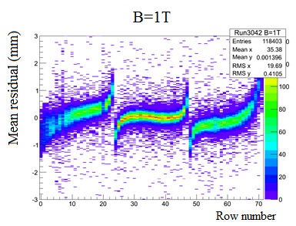
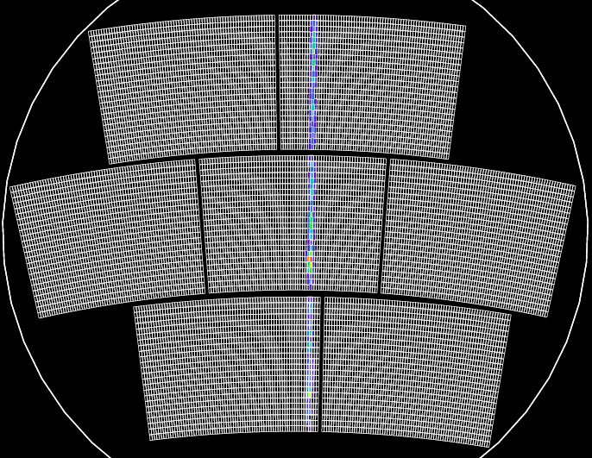
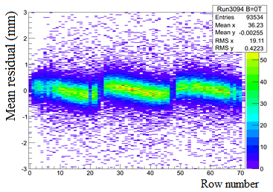

Distortions
B=1T
After alignment B=0T
B=0T

Slide 25


Field distortions
Distortions in B=0T or B=1T
at different drift distances z (15cm~50cm)
B=0T
B=1T

Slide 26


Gain
A measured ⁵⁵Fe spectrum
(at V_{mesh} = 350 V and V_{drift} = 400 V)
Gain as a function of V_{mesh}
(E_{drift} = 0.2 kV/cm at atmospheric pressure)

Slide 27

Electron transparency

Slide 28
Conclusion
A lot of experience has been gained in building and operating Micromegas TPC panels.
The characteristics of the Micromegas modules, such as the uniformity, energy resolution, stability have been studied in detail.
7 modules have been successfully tested with full integration of the electronics at the same time.
Thanks to the resistive technology, the measured resolution is about 60 microns at zero drift distance with 3 mm wide pads. This meets ILC needs.
Distortions are observed. Their detailed study will allow to correct them and improve the design to minimize them.

