Slide 1
llh recoil analysis
at 500 GeV
Taikan Suehara
(Tohoku University)

Slide 2
Motivation
Absolute Zh cross section
(2.6% with Zh -> llh in 250 GeV)
limits global fit of Higgs couplings
Some ideas to improve σ_{Zh}
  including qqh
    Talk in previous meeting by Akiya
  including 500 GeV
    This talk

Slide 3
llh at 500 GeV
Cross section (μμh) eL(0.8) pR(0.3)
  250 GeV: 10 fb
  500 GeV: 3.3 fb
  Combining two may improve the resolution
Recoil mass
  Smeared in 500 GeV
Background
  Large t-channel diagram in 500 GeV
Analysis
  Almost the same as 250 GeV

Slide 4
Cuts
Almost same as LoI
Lepton ID
Z mass (81.2 to 101.2 GeV)
di-lepton pT > 20 GeV
recoil mass (115-250 μμ, 100-250 ee)
acoplanarity (π +- 0.1 rad vetoed)
pT balance
|di-lepton pT – pT of the most energetic neutral particle| > 10 GeV

Slide 5
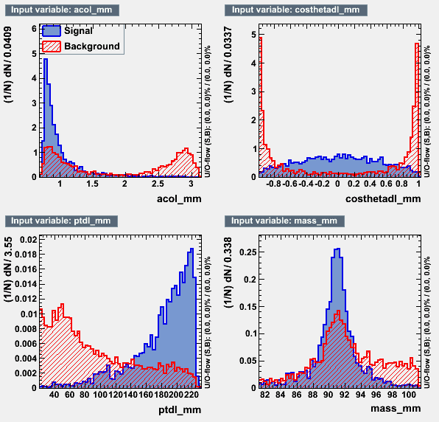
Likelihood
Same as LoI
di-lepton pT
cosθ of di-lepton
acolinearity
Z mass
TMVA used
BDT & likelihood gives similar results
Likelihood adopted

Slide 6
mumu channel: cut table
cut | eeh | mmh | ooh | 2f | 4f | 6f | o
m>=2 | 128 | 1691 | 3490 | 1.03e+6 | 966334 | 56719 | 361231
z mass | 7.2 | 1499 | 141 | 225706 | 111908 | 4203 | 2765
ptdl>20 | 6.2 | 1492 | 124 | 64342 | 95766 | 3861 | 1573
recoil | 1.6 | 1211 | 11 | 15198 | 30594 | 232 | 68
acop | 1.3 | 1208 | 11 | 14598 | 28447 | 227 | 56
ptbal | 1.2 | 1206 | 10 | 4544 | 27618 | 217 | 35
like>0.8 | 0 | 997 | 6.5 | 1632 | 3345 | 63 | 1.3

Slide 7
Recoil fit
BG fit (Gaus * 2nd pol for mm, linear for ee)
Fit will all paremeters free
  GPET with 5 parameters
  Gaus (left side)
  Gaus + expo (right side)
  background distribution from fit function
    to avoid large fluctuation due to the small stat
Toy-MC – 10000 times
  Poisson from data (sig), func (bg)
  Fit with fixing shape parameters
  (mean and amplitude free)

Slide 8
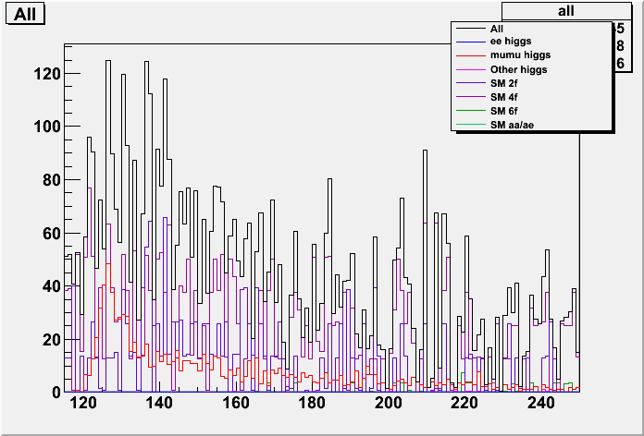
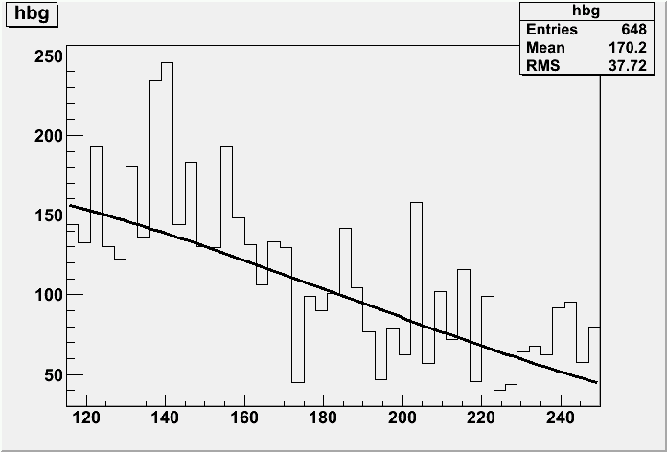
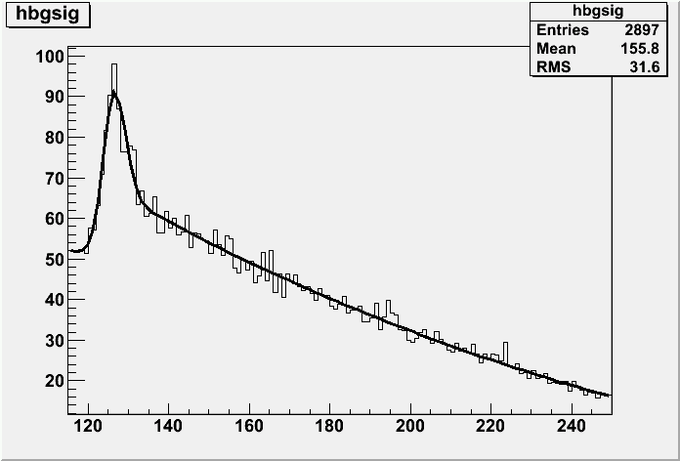
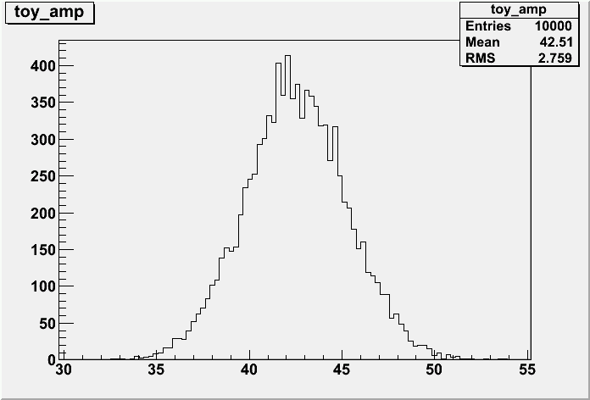
mumu: recoil fit
6.49%

Slide 9
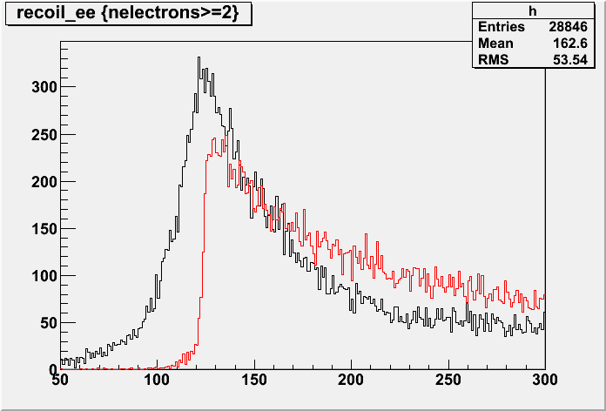
ee: brems recovery
all neutral particle at cosθ > 0.99 are added

Slide 10
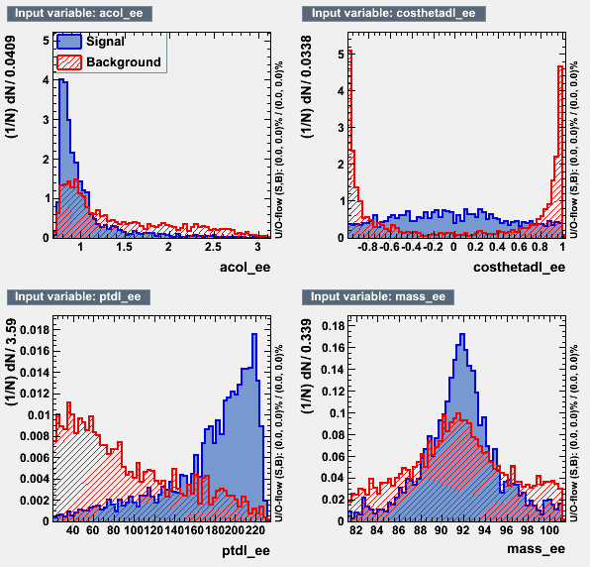
ee: cut table
cut | eeh | mmh | ooh | 2f | 4f | 6f | o
e>=2 | 4582 | 76 | 6241 | 500994 | 1.6e+4 | 94156 | 413309
z mass | 1654 | 2.3 | 559 | 18976 | 151032 | 14827 | 15562
ptdl>20 | 1627 | 2.0 | 459 | 12987 | 115384 | 12983 | 11496
recoil | 1126 | 0.6 | 14 | 478 | 31324 | 443 | 1278
acop | 1118 | 0.6 | 14 | 426 | 30123 | 429 | 1193
ptbal | 1113 | 0.6 | 14 | 388 | 28417 | 417 | 1154
l>0.9 | 757 | 0.6 | 1.4 | 26 | 2763 | 66 | 84

Slide 11
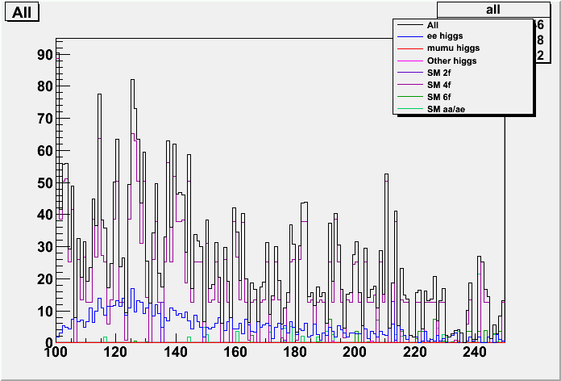
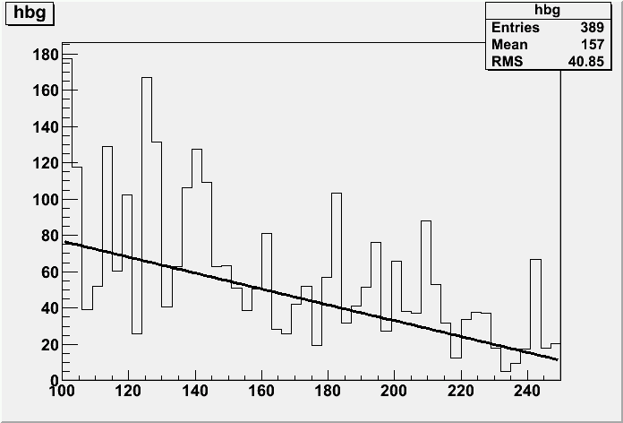
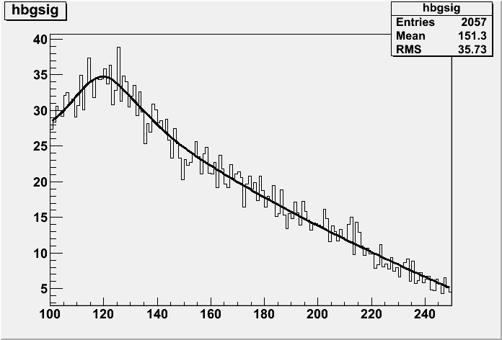
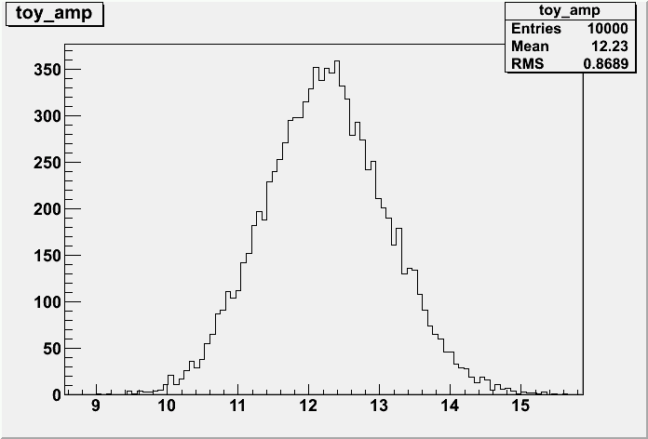
ee: recoil fit
7.10%

Slide 12
Summary
mmh: 6.49%
eeh: 7.10%
combined: 4.8%
Ongoing: with more statistics & bg
  signal (Full: prepared thanks to Akiya)
  2f, 4f (SGV: prepared thanks to Mikael)
  1f_3f (SGV: prepared)
250 GeV: Shun is still working on eeh

