Slide 1


Applications of Stripline and Cavity Beam Position Monitors in Low-Latency, High-Precision, Intra-Train Feedback Systems
Mikey Davis
19 September2013
1/**number**

Slide 2
Introduction
The design for a future linear collider envisage
Mikey Davis
19 September2013
2/**number**

Slide 3
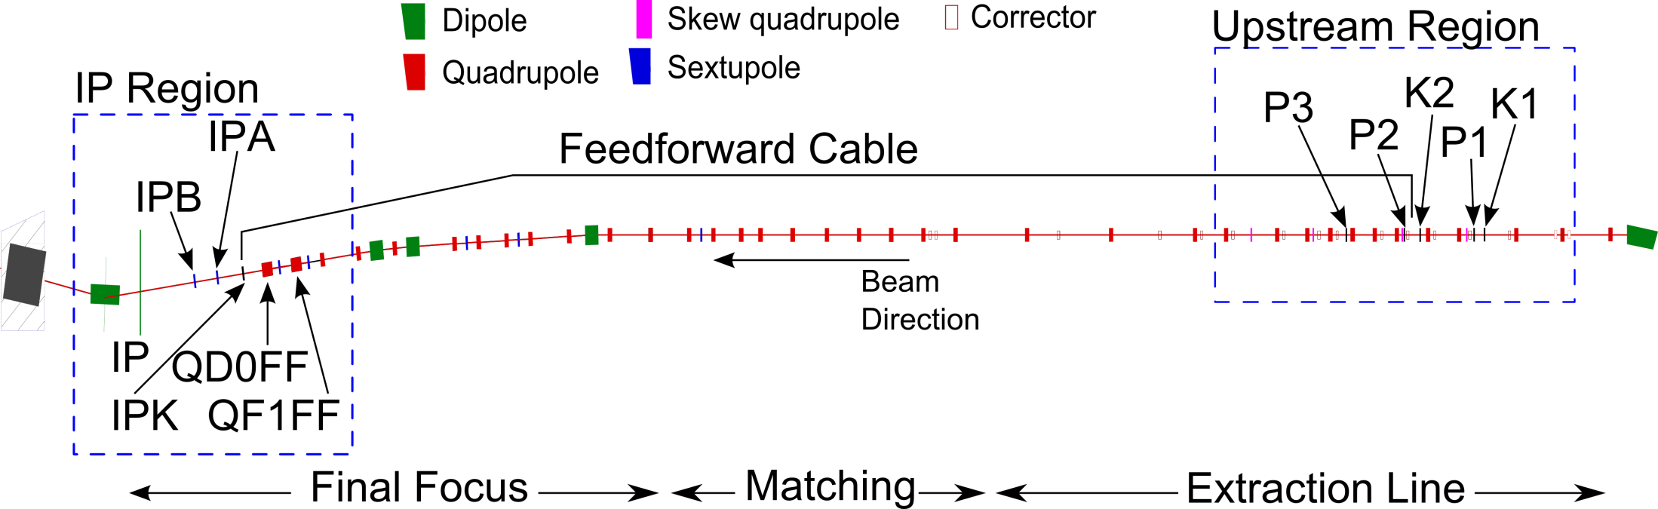
ATF2
Feedback On Nanosecond Timescales (FONT) is in its fifth iteration and is currently based at ATF2
Demonstrated a system which meets ILC targets
Extended targets aim to improve ILC requirements
Ultimately geared at nm level IP stabilisation at ATF
Mikey Davis
19 September2013
3/**number**

Slide 4
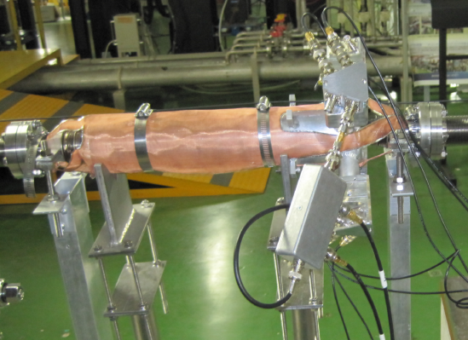
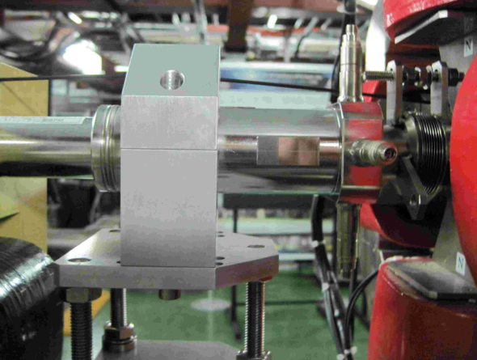
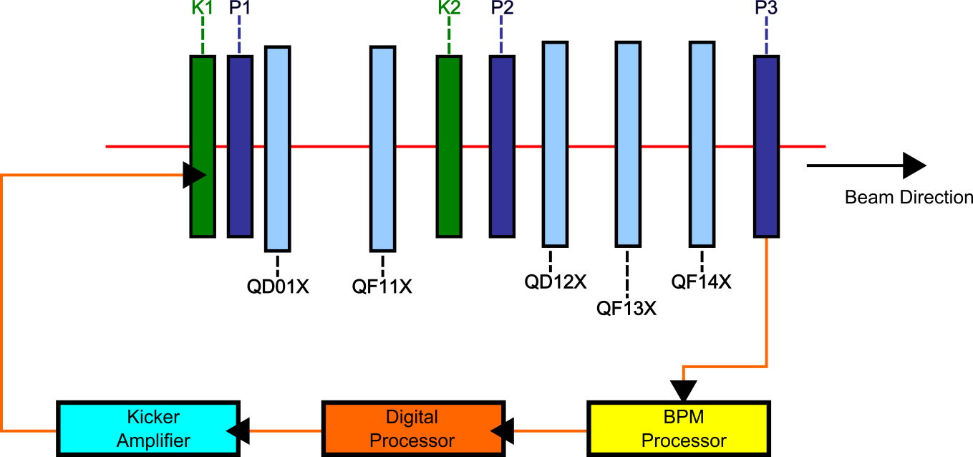
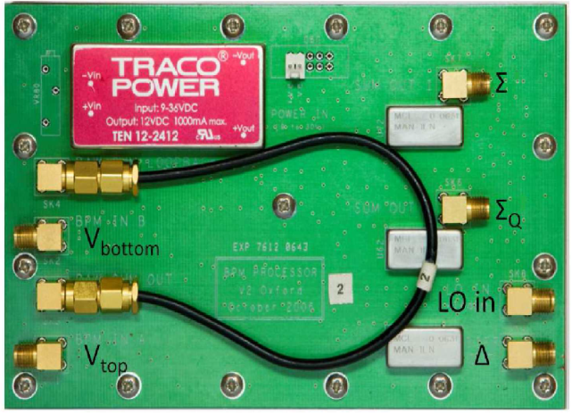
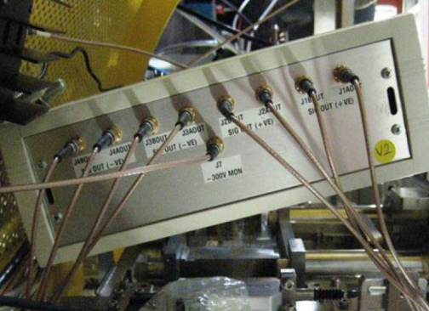
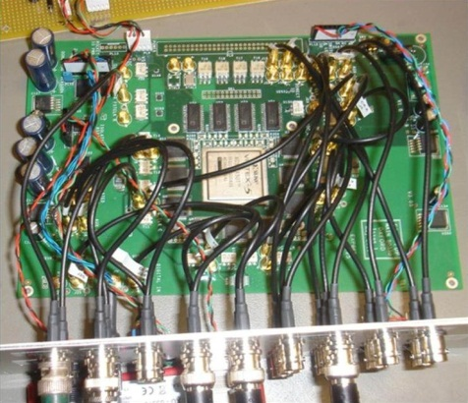
Upstream Feedback System
Mikey Davis
19 September2013
4/**number**

Slide 5
Stripline BPM Processors
Mikey Davis
19 September2013
5/**number**

Slide 6
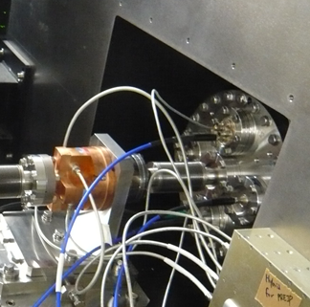
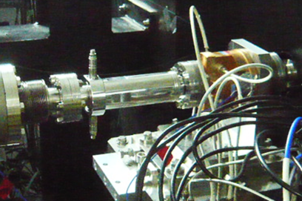
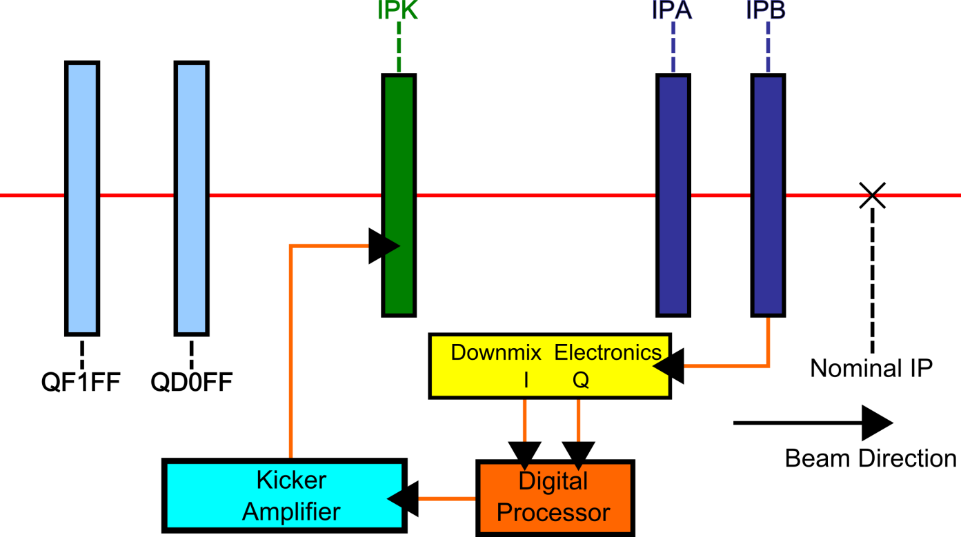
IP Feedback System
Mikey Davis
19 September2013
6/**number**

Slide 7
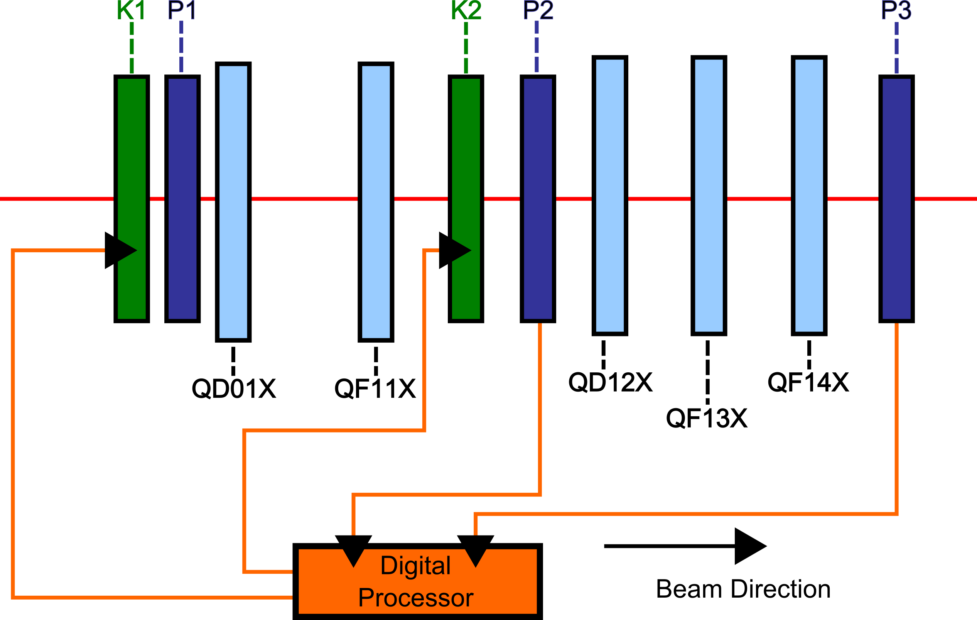
Upstream Feedback
Mikey Davis
19 September2013
7/**number**

Slide 8
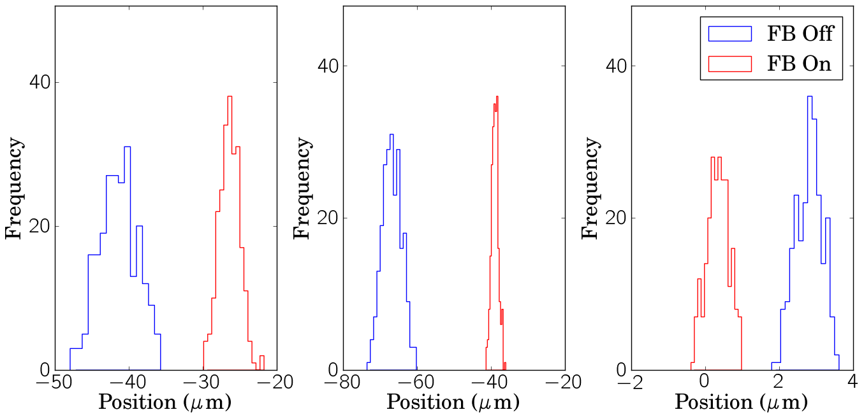
Upstream Feedback Results
FB Off Jitter – 2.5 μm
FB On Jitter – 1.4 μm
FB Off Jitter – 2.5 μm
FB On Jitter – 0.9 μm
FB Off Jitter – 0.36 μm
FB On Jitter – 0.30 μm
Mikey Davis
19 September2013
8/**number**

Slide 9
Upstream Feedback Results
Mikey Davis
19 September2013
9/**number**

Slide 10
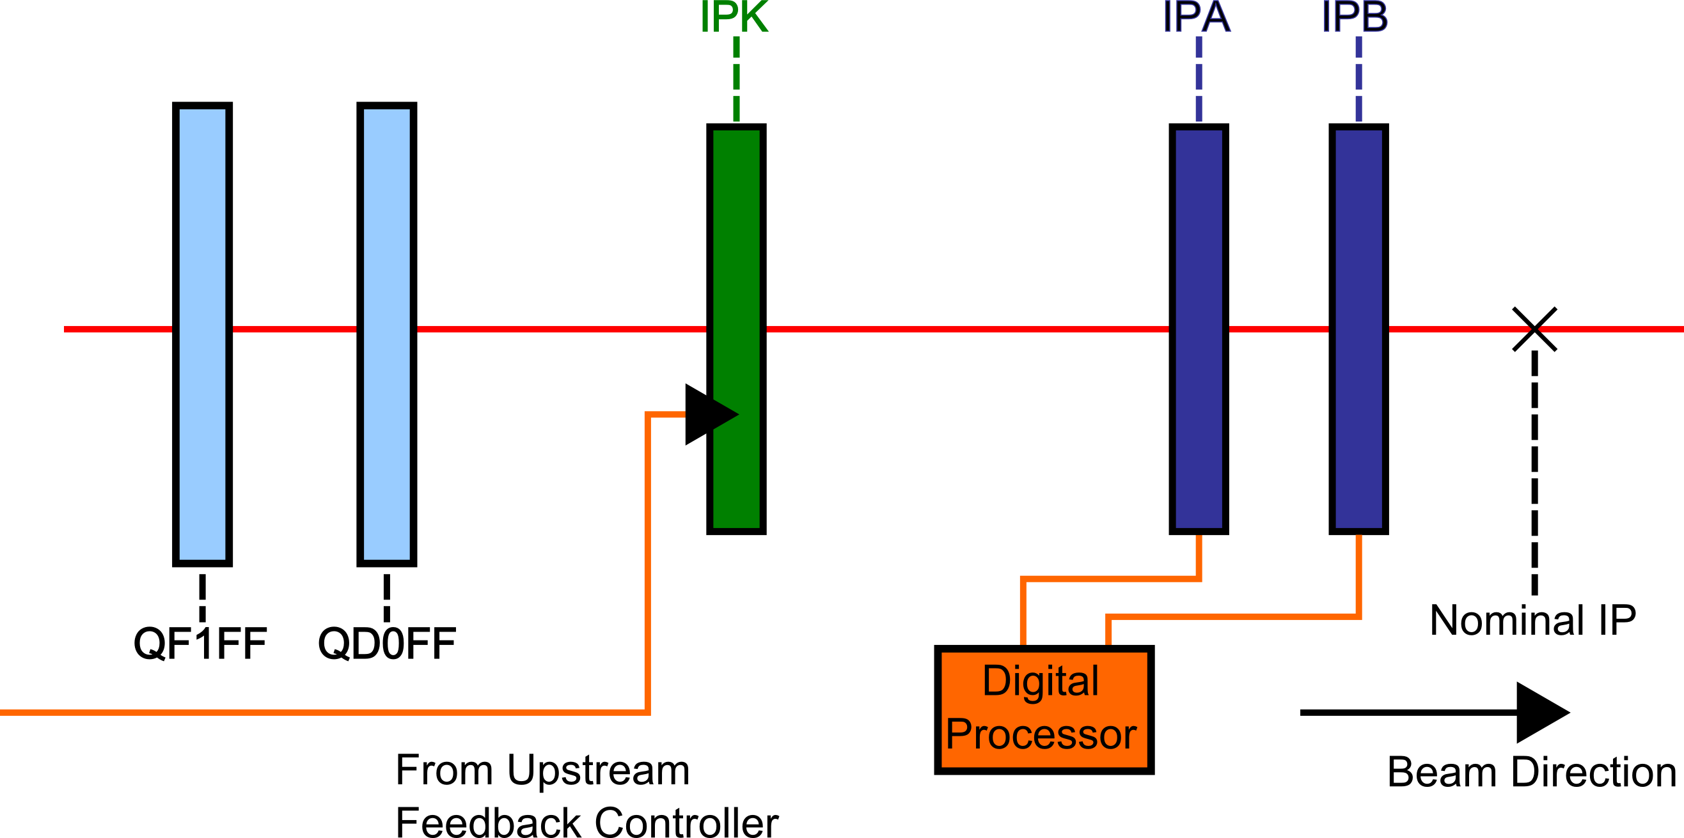
Feedforward
Mikey Davis
19 September2013
10/**number**

Slide 11
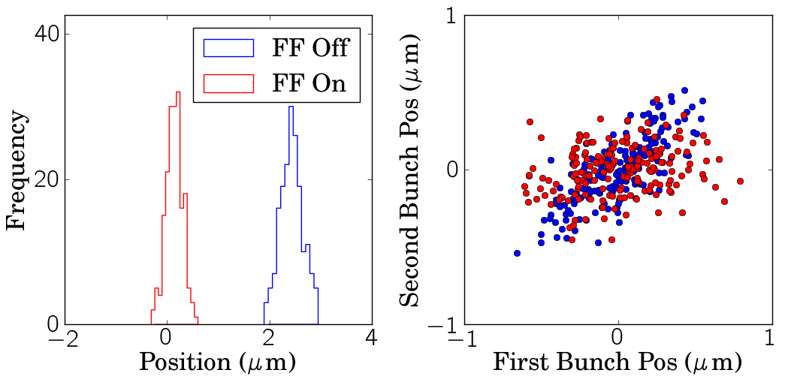
Feedforward Results
Mikey Davis
19 September2013
11/**number**

Slide 12
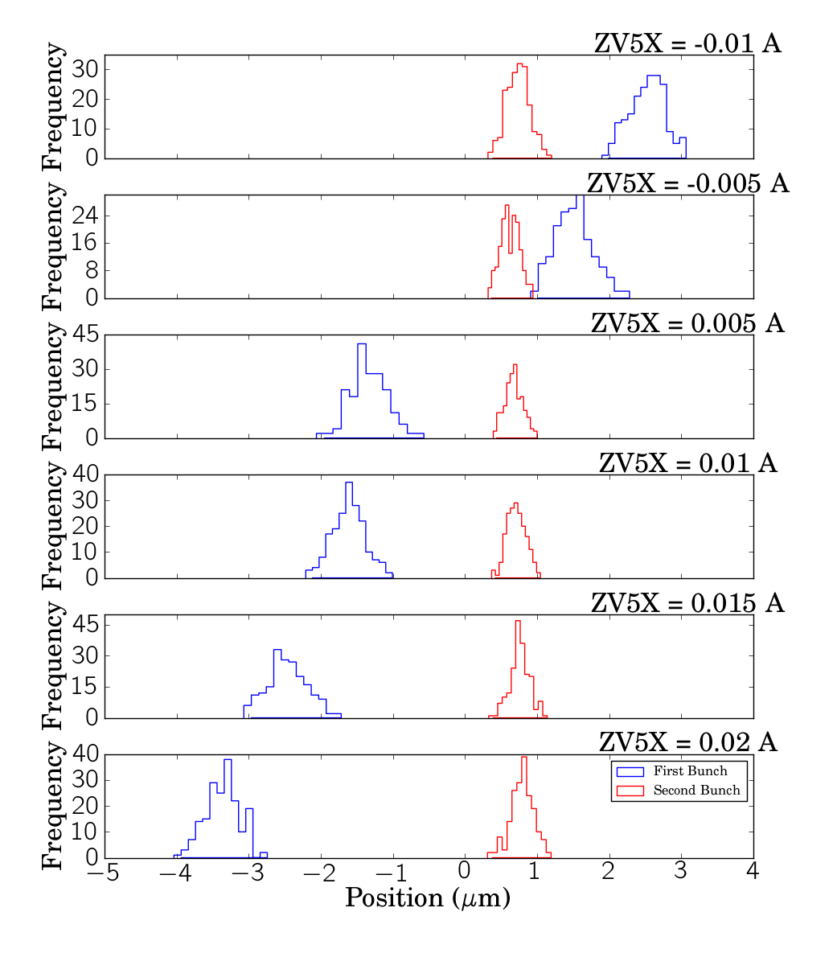
Feedforward Results
Mikey Davis
19 September2013
12/**number**

Slide 13
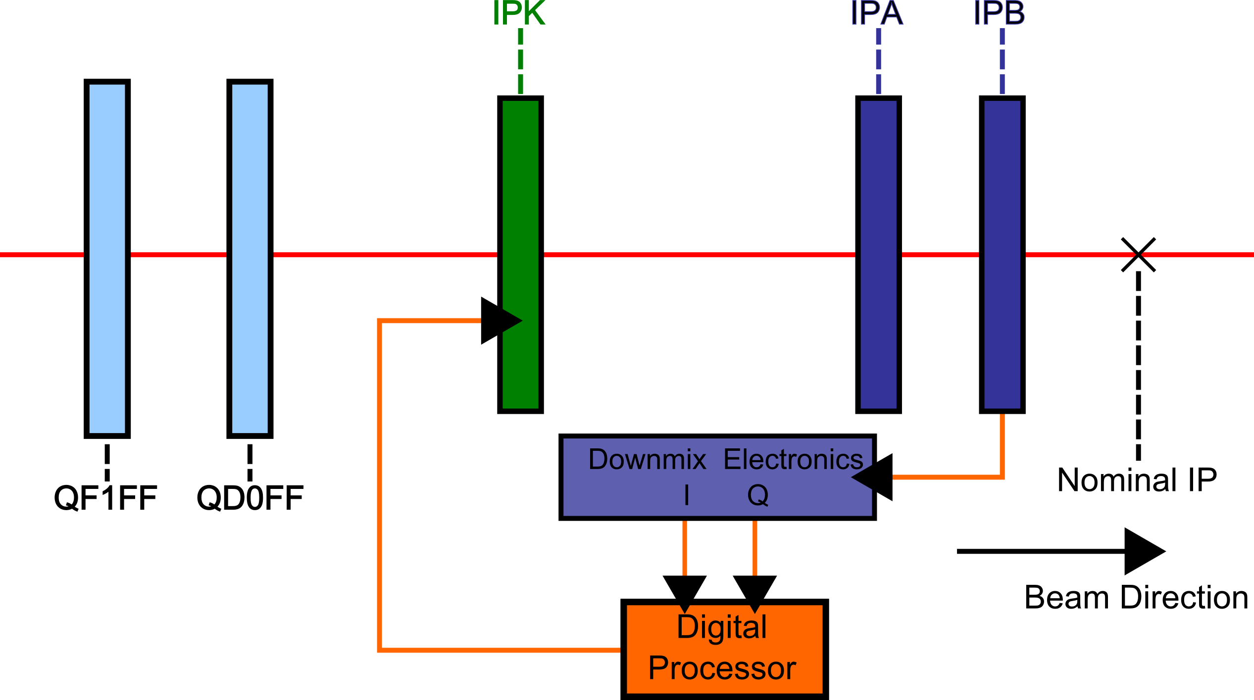
IP Feedback
Mikey Davis
19 September2013
13/**number**

Slide 14
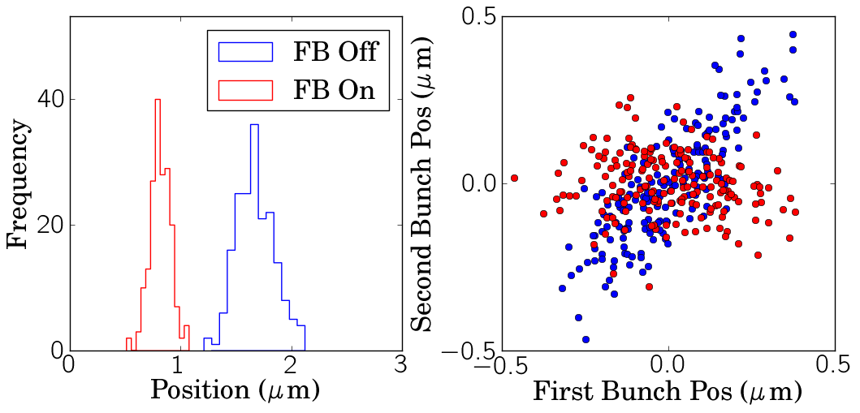
IP Feedback Results
Mikey Davis
19 September2013
14/**number**

Slide 15
IP Feedback Results
Mikey Davis
19 September2013
15/**number**

Slide 16
Conclusions
Mikey Davis
19 September2013
16/**number**

