Slide 1


Applications of Stripline and Cavity Beam Position Monitors in Low-Latency, High-Precision, Intra-Train Feedback Systems
M.R. Davis, D.R. Bett, P.N. Burrows, N. Blaskovic Kraljevic, G.B. Christian, Y.I. Kim, C. Perry
John Adams Institute, Oxford University, UK
Mikey Davis
19 September2013
1/**number**

Slide 2
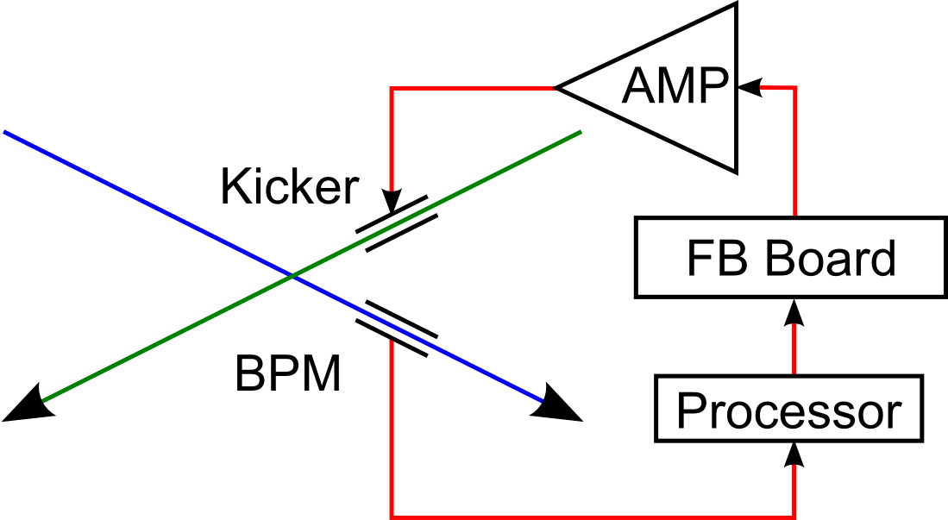
Introduction
Motivation for research is beam stabilisation at ILC
Aim to stabilise nm beams for collision at IP
Misaligned beams at IP cause a beam-beam deflection
Measure one of the outgoing beams
Kick the next bunch of the other incoming beam
Key issue at a collider: latency
Mikey Davis
19 September2013
2/**number**

Slide 3
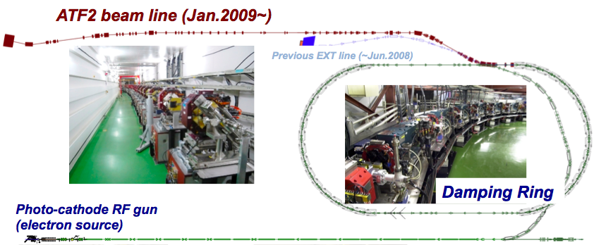
The ATF 2 Project
ATF2 – Scaled down mock up of the ILC FF system
Goals:
Demonstrate 37 nm vertical spot at the focal point (IP)
Demonstrate nanometre level stability
Mikey Davis
19 September2013
3/**number**

Slide 4
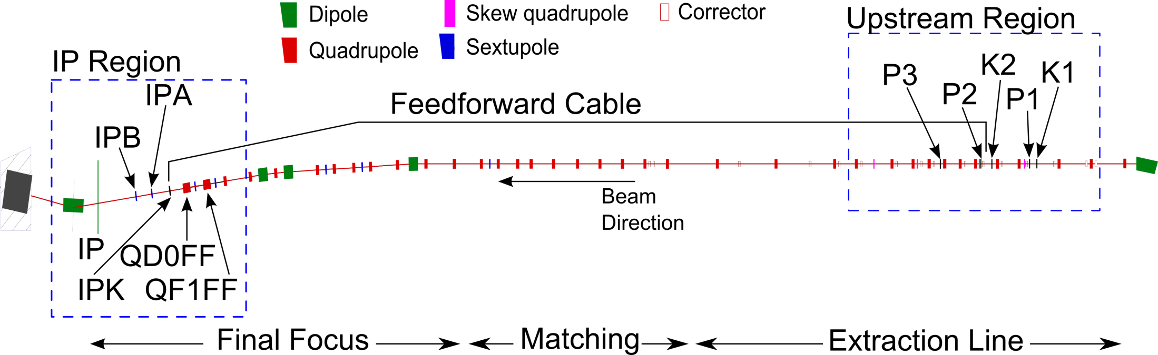
FONT
Feedback On Nanosecond Timescales (FONT)
Previously demonstrated a system meeting ILC latency and jitter specifications
Extended aims to improve on ILC requirements and meet ATF goal 2
Mikey Davis
19 September2013
4/**number**

Slide 5
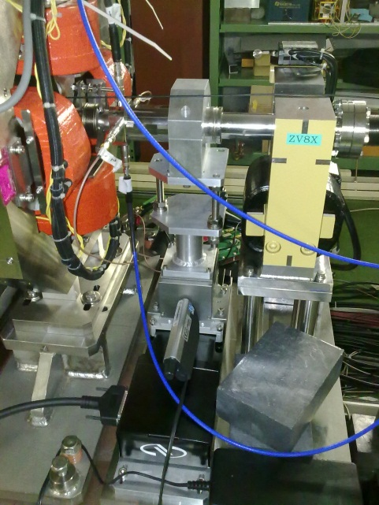
Upstream System
3 Stripline BPMs (P1, P2 and P3)
12 cm long strips
12 mm radius
Mounted on a 2 axis mover system
Strip-line BPM with mover system
Mikey Davis
19 September2013
5/**number**

Slide 6
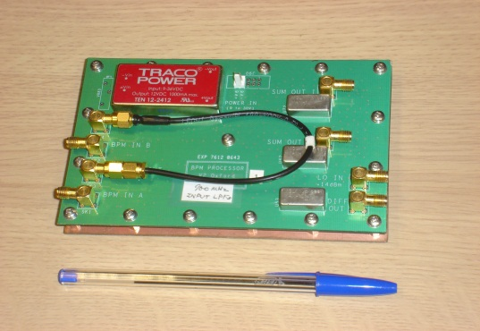
Upstream System
Analogue Front-end
BPM processor
Strip-line BPM with mover system
Mikey Davis
19 September2013
6/**number**

Slide 7
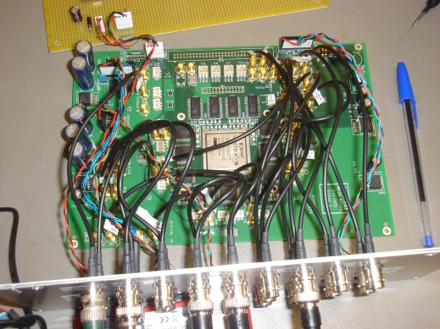
Upstream System
9 analogue input channels
400 MS/s ADCs
2 Analogue output channels
DACs clocked at 210 MHz
Based on a Xilinx Vertex 5 FPGA
Analogue Front-end
BPM processor
FPGA-based digital processor
Strip-line BPM with mover system
Mikey Davis
19 September2013
7/**number**

Slide 8
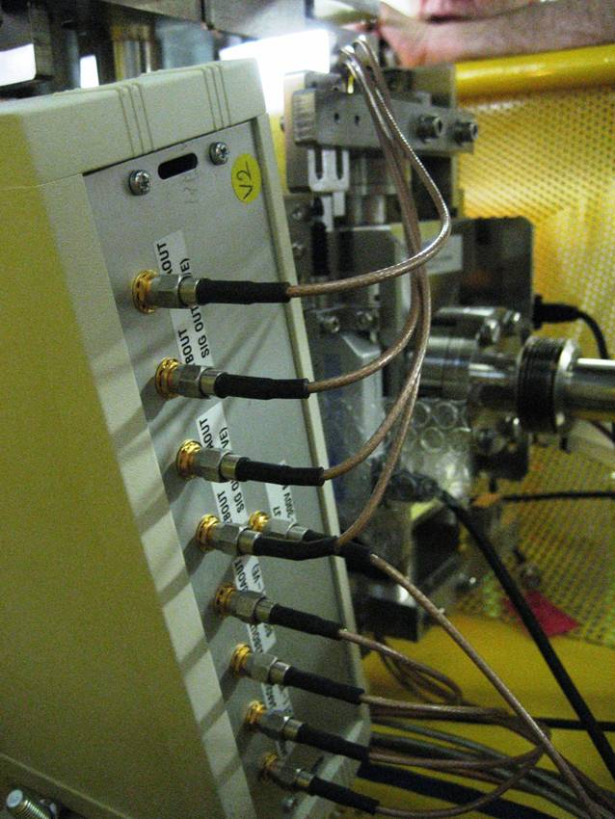
Upstream System
Analogue Front-end
BPM processor
FPGA-based digital processor
Kicker drive amplifier
Manufactured by TMD Technologies
±30 A drive current
35 ns rise time (90% of peak)
Output pulse length up to 10 μs
Strip-line BPM with mover system
Mikey Davis
19 September2013
8/**number**

Slide 9
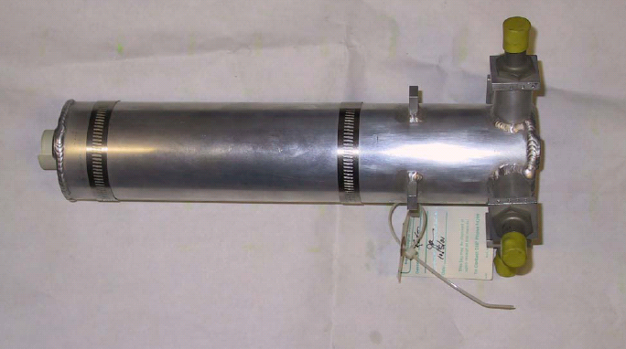
Upstream System
Analogue Front-end
BPM processor
FPGA-based digital processor
Kicker drive amplifier
Strip-line kicker
Strip-line BPM with mover system
Shorted at one end to form a transition line
Mikey Davis
19 September2013
9/**number**

Slide 10
Upstream System
Analogue Front-end
BPM processor
FPGA-based digital processor
System Resolution (BPM processor) | <1μm
System Latency | <150 ns
Amplifier/ Kicker Bandwidth | ~30 MHz
Dynamic range of the BPM system | +/- ~500μm
Kicker drive amplifier
Strip-line kicker
Strip-line BPM with mover system
Mikey Davis
19 September2013
10/**number**

Slide 11
Upstream BPM Processors
High resolution low latency analogue processors
Difference over sum method
Top and bottom signals:
Added using a resistive coupler
Subtracted using a hybrid
Signals then band pass filtered
Down-mixed using DR 714 MHz
Best achieved resolution 350nm
Latency of…
Mikey Davis
19 September2013
11/**number**

Slide 12
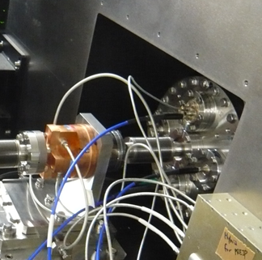
IP System
2 Cavity BPMs (IPA and IPB)
C-band (5.7 GHz)
Low-Q
Inside IP chamber
Cavity BPM
Mikey Davis
19 September2013
12/**number**

Slide 13
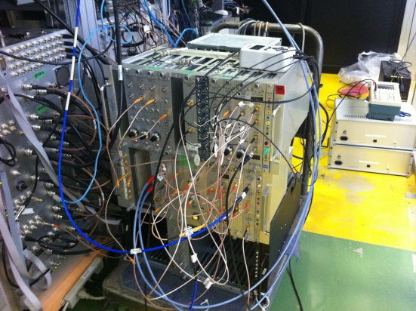
IP System
Analogue Front-end
BPM processor
Strip-line BPM with mover system
Mikey Davis
19 September2013
13/**number**

Slide 14
IP System
Analogue Front-end
BPM processor
FPGA-based digital processor
Kicker drive amplifier
Strip-line BPM with mover system
Mikey Davis
19 September2013
14/**number**

Slide 15
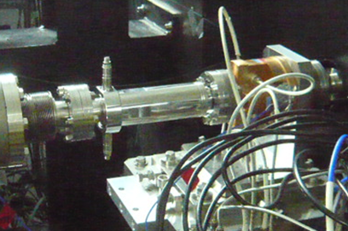
IP System
Analogue Front-end
BPM processor
FPGA-based digital processor
Kicker drive amplifier
Designed in house
Based on the ATF stripline BPMs
Shorter than upstream (less kick)
Strip-line kicker
Strip-line BPM with mover system
Mikey Davis
19 September2013
15/**number**

Slide 16

IP BPM Processors
Two stage homodyne process
1st stage:
Down-mixes 5.7 GHz to 714 MHz
2nd stage:
Down-mixes 714 MHz to 0 MHz
714 MHz generated using upstream reference cavity
We achieve resolutions of order 65 nm
More detail in:
These proceedings – TUPC22
Y. I. Kim, PhD, Kyungpook National University, 2012
Mikey Davis
19 September2013
16/**number**

Slide 17
Experimental Modes
Three experimental modes:
Upstream feedback
Upstream -> IP feedforward
IP feedback
All 3 modes aimed at stabilising the beam at IPB
Mikey Davis
19 September2013
17/**number**

Slide 18
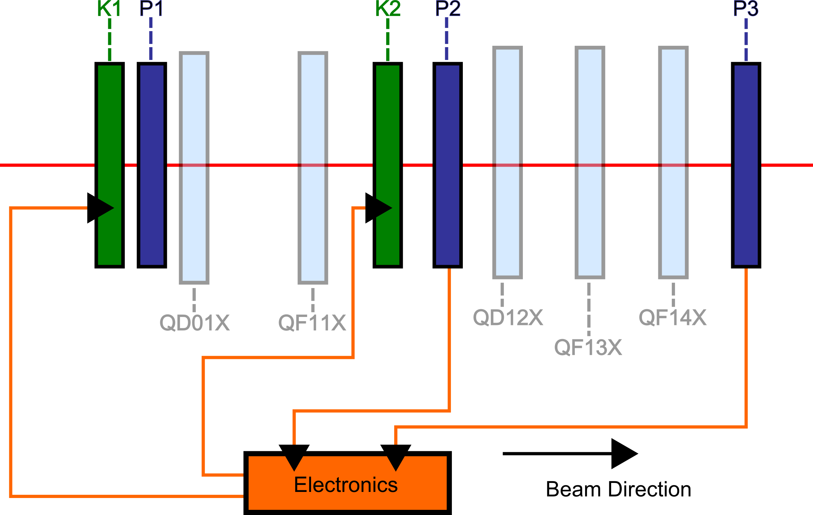
Upstream Feedback
Mikey Davis
19 September2013
18/**number**

Slide 19
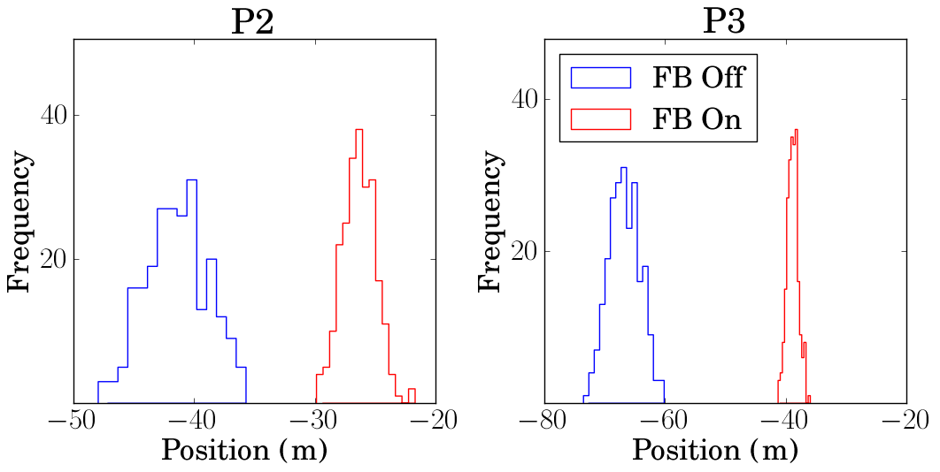
Upstream FB (Upstream)
FB Off Jitter: 2.5 ± 0.1 μm
FB On Jitter: 1.4 ± 0.1 μm
FB Off Jitter: 2.6 ± 0.1 μm
FB On Jitter: 0.9 ± 0.04 μm
Mikey Davis
19 September2013
19/**number**

Slide 20
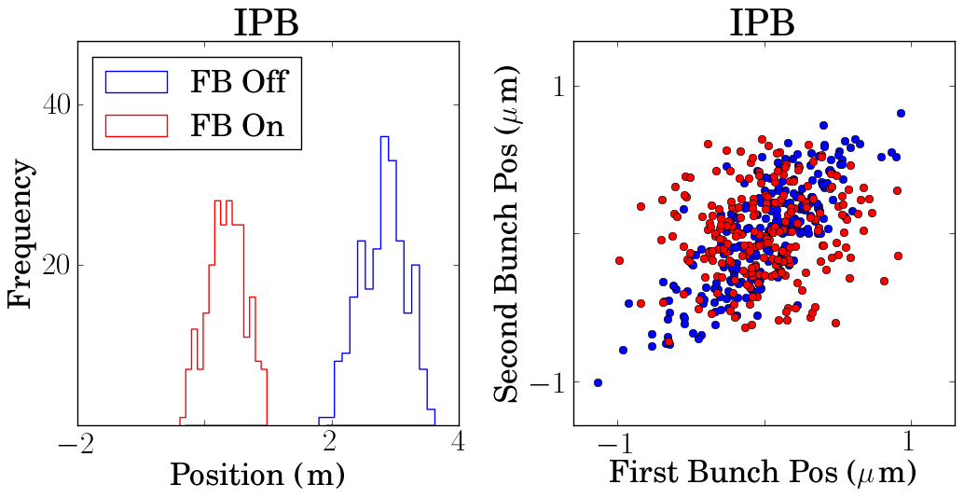
Upstream FB (IPB)
FB Off Jitter: 0.35 ± 0.02 μm
FB On Jitter: 0.3 ± 0.01 μm
FB Off Correlation: 79%
FB On Correlation: 14%
Mikey Davis
19 September2013
20/**number**

Slide 21
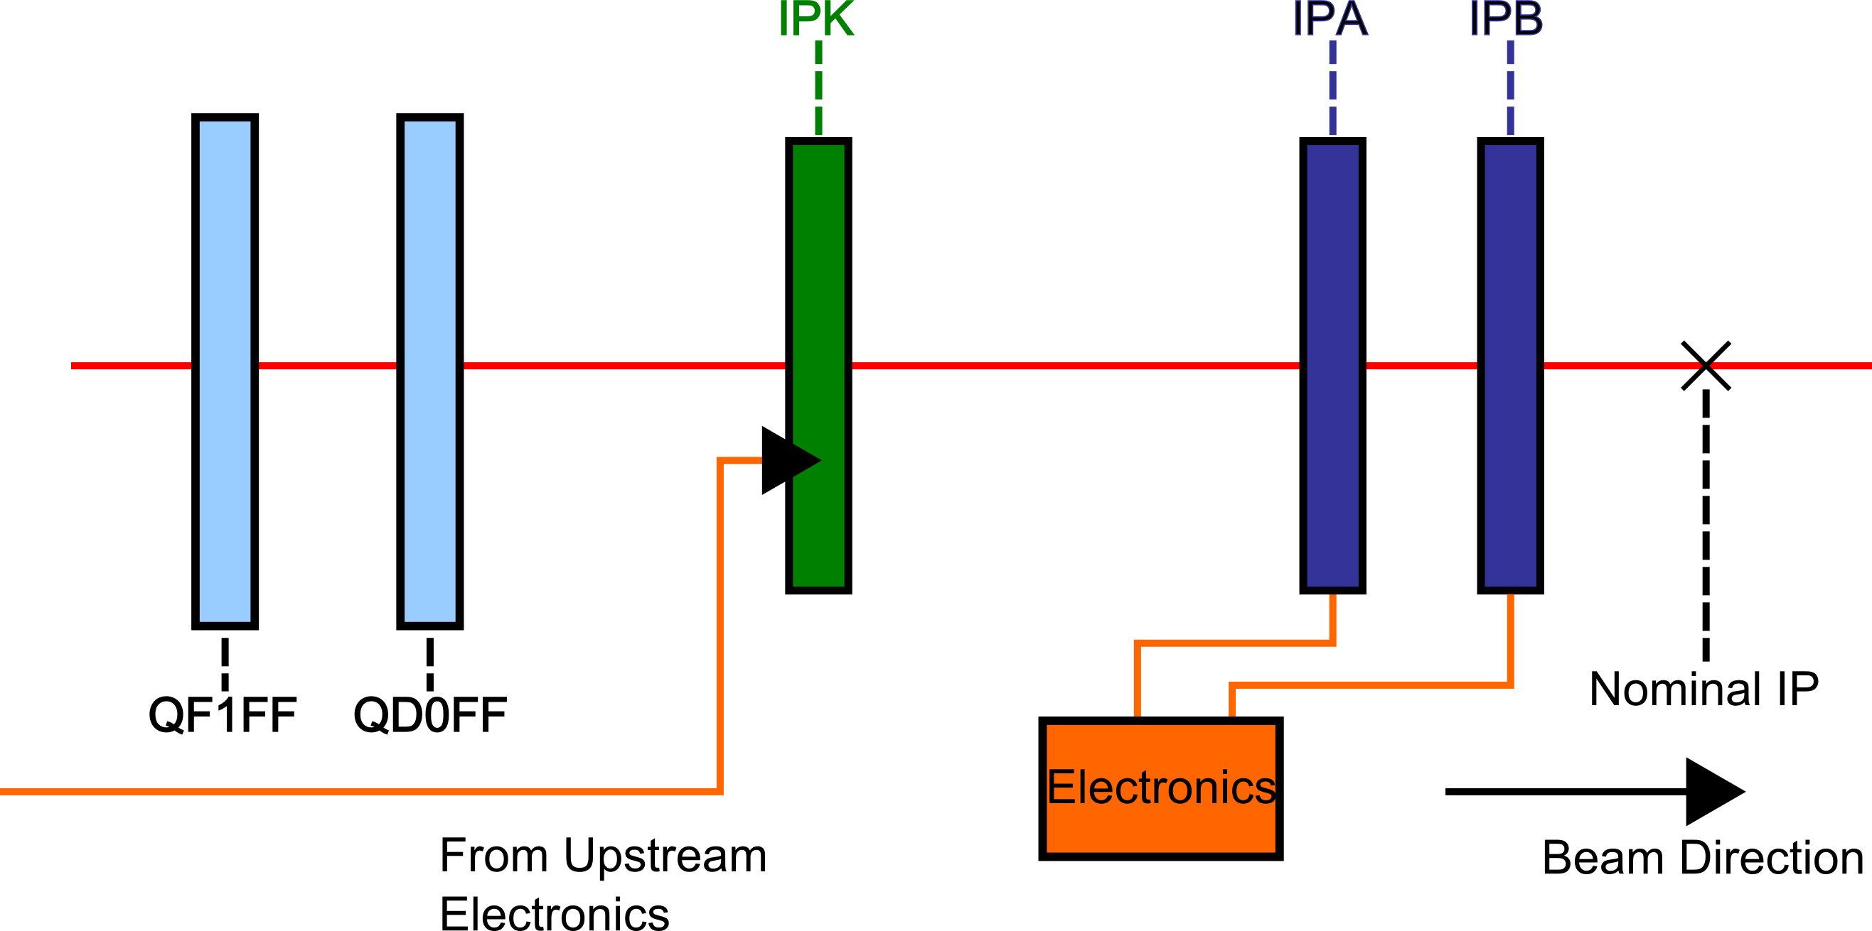
Feedforward
Mikey Davis
19 September2013
21/**number**

Slide 22
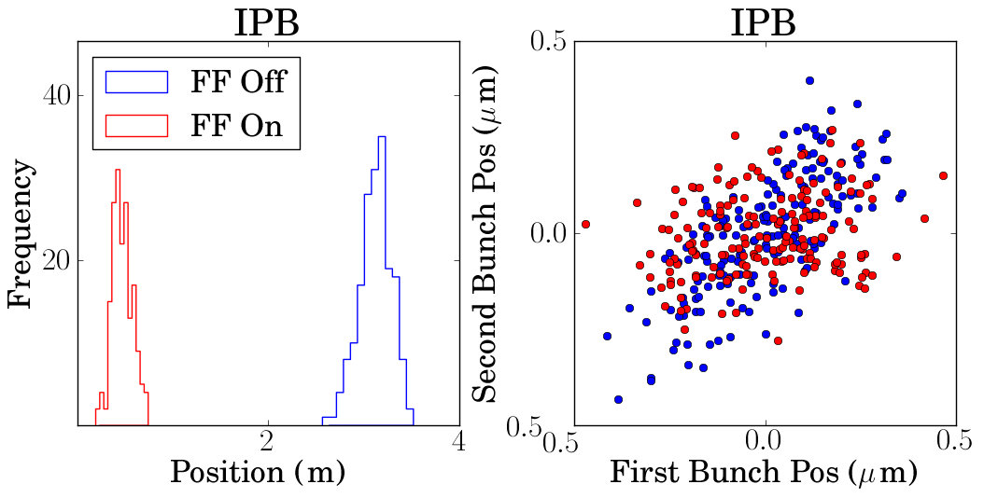
Feedforward Results
FB Off Jitter: 160 ± 10 nm
FB On Jitter: 106 ± 10 nm
FB Off Correlation: 73%
FB On Correlation: 23%
Mikey Davis
19 September2013
22/**number**

Slide 23
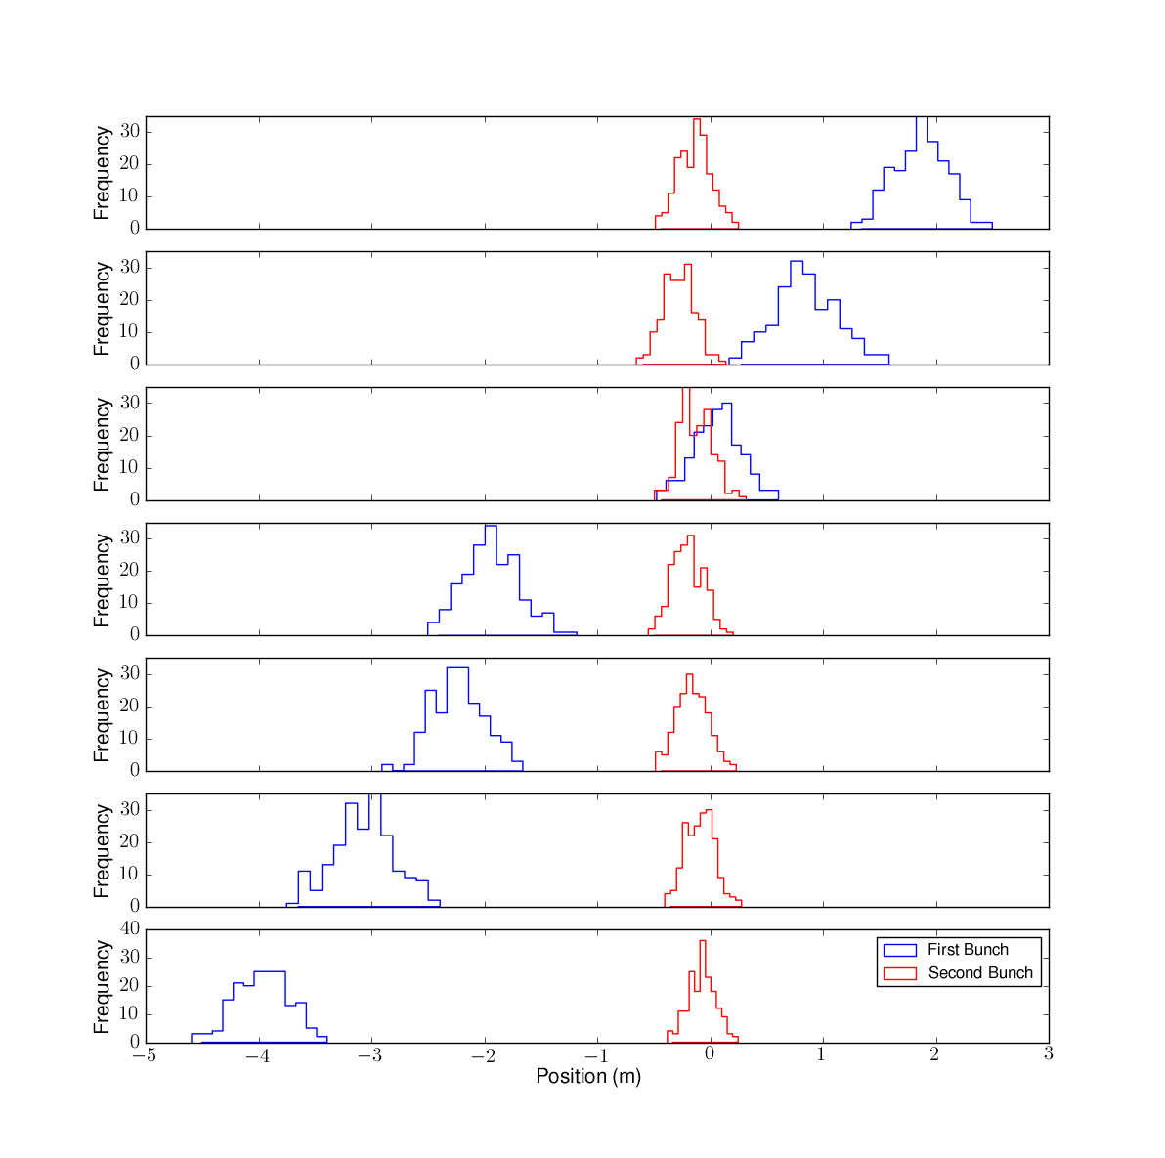
Upstream Corrector Scan
Mikey Davis
19 September2013
23/**number**

Slide 24
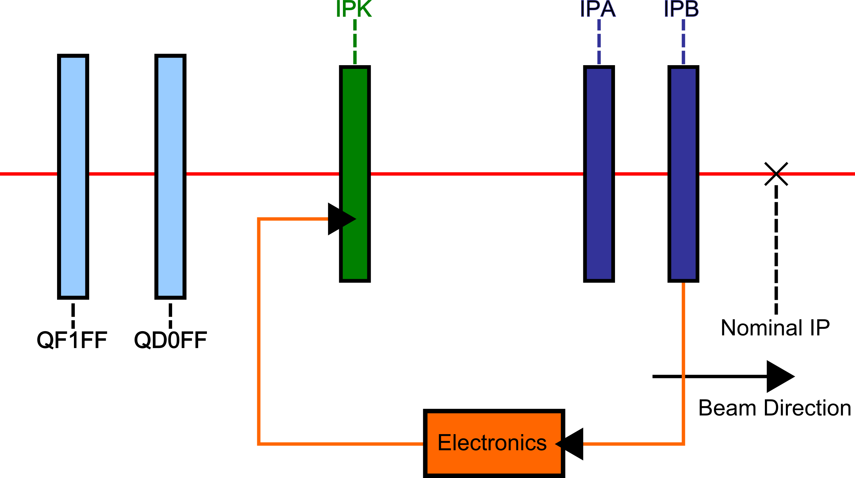
IP Feedback
Mikey Davis
19 September2013
24/**number**

Slide 25
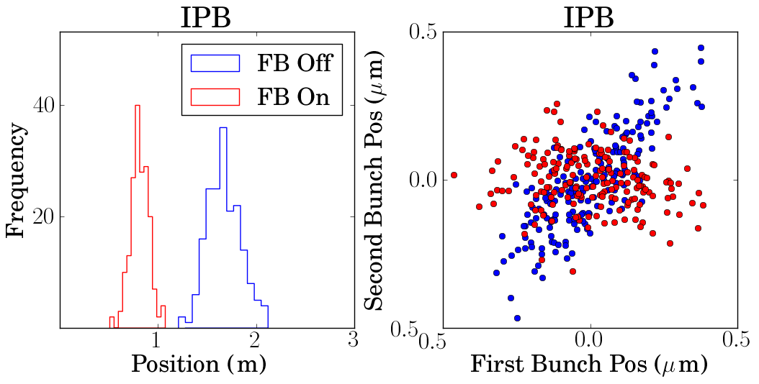
IP Feedback Results
FB Off Jitter: 168 ± 10 nm
FB On Jitter: 93 ± 4 nm
FB Off Correlation: 81%
FB On Correlation: -16%
Mikey Davis
19 September2013
25/**number**

Slide 26
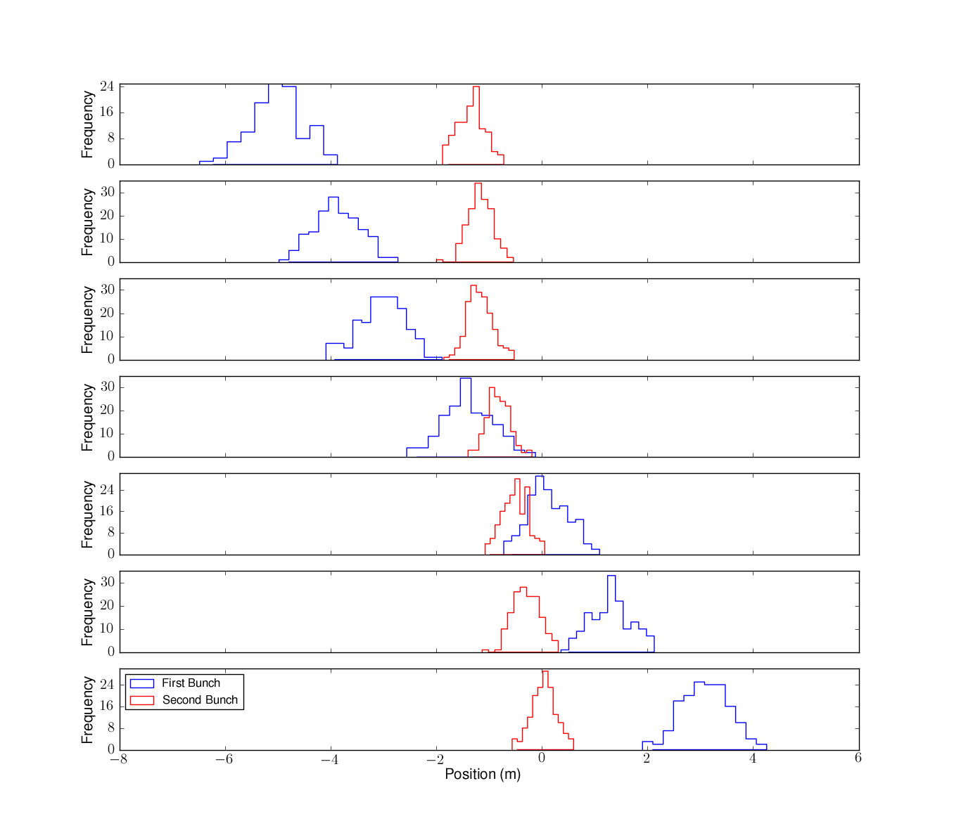
IPFB Corrector Scan
Mikey Davis
19 September2013
26/**number**

Slide 27
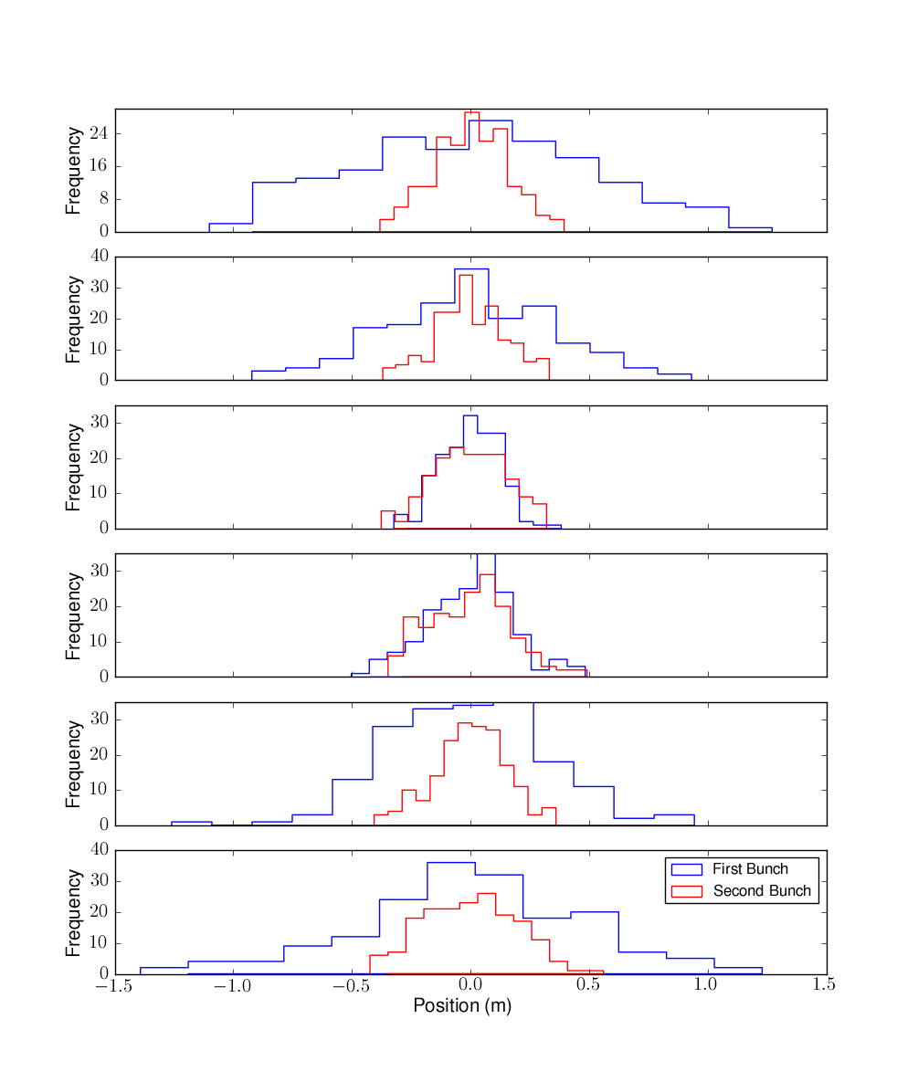
IPFB Waist Scan
Mikey Davis
19 September2013
27/**number**

Slide 28
Conclusions
Demonstrated 3 methods of beam stabilisation
Best vertical beam position stabilisation 100nm
Achieved using feedforward and IP feedback
IP BPMs at ATF have been replaced this summer
Mikey Davis
19 September2013
28/**number**

