Slide 1
Proposed scope for an ILC European Regional Team for the pre-implementation phase
Nick Walker
ILC-TB meeting 01.10.2013

Slide 2
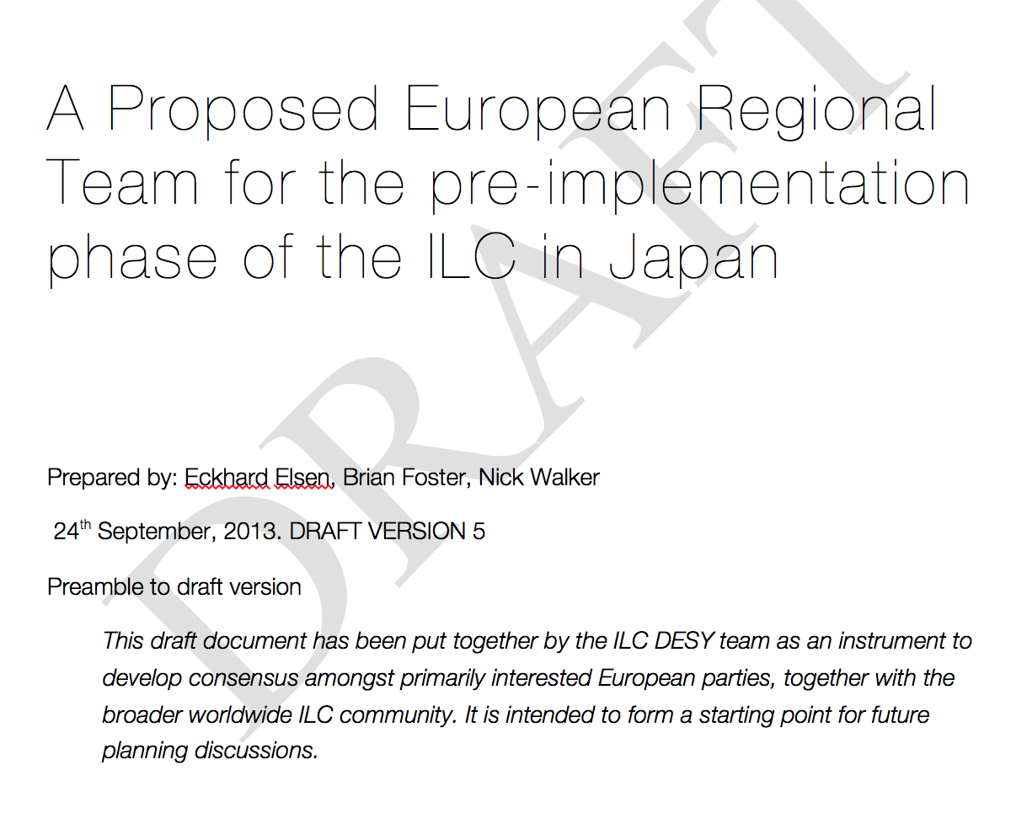
What is this document?
Brainstorming by DESY team
Scope of work for next ~3 years
Form the basis of further discussions within Europe
  CERN, France, Italy, Spain, UK,…
Draft document to give EC a heads-up on the scope of possible requested funding
  currently ~7.5 MEUR over 3 years

Slide 3
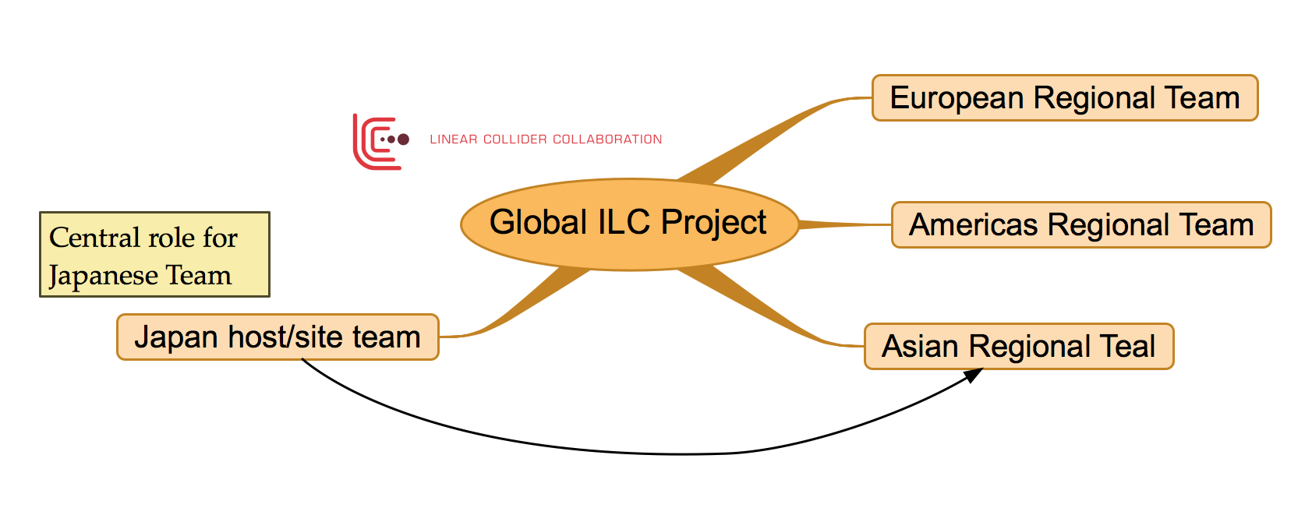

Slide 4
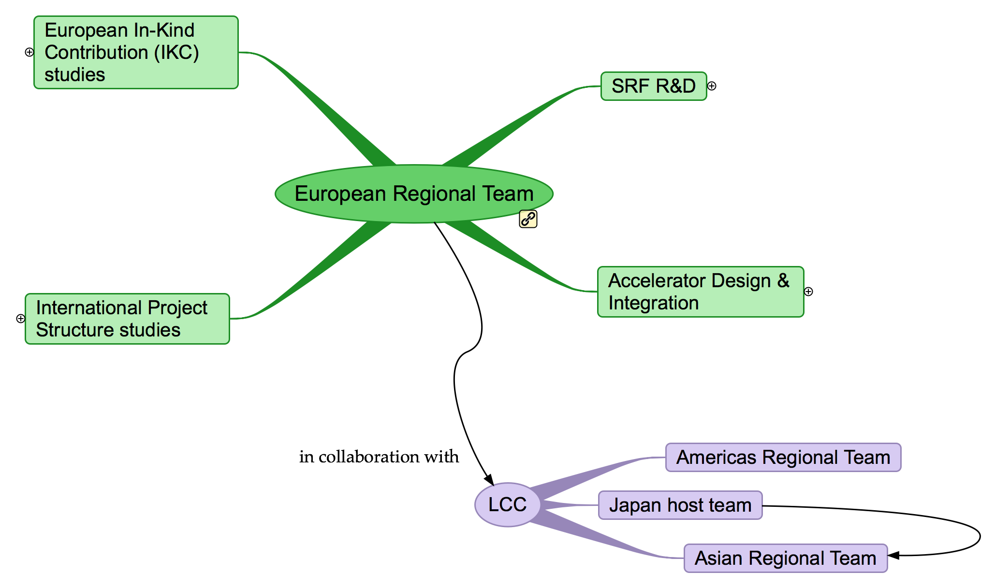
ERT Proposed Themes

Slide 5
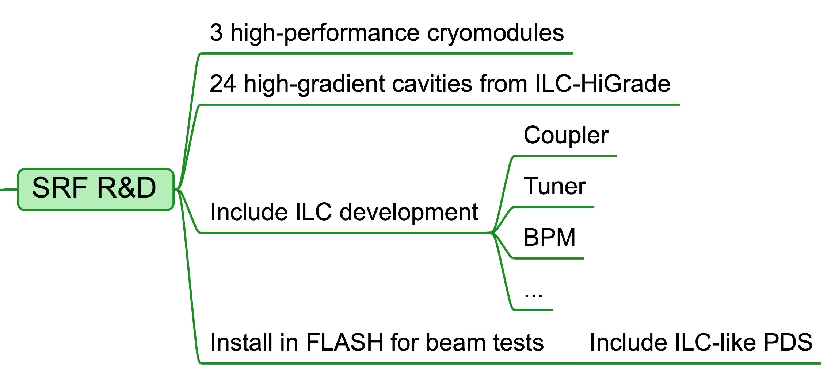

Slide 6
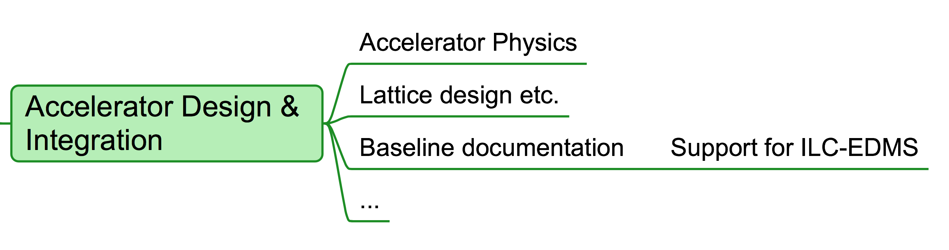

Slide 7
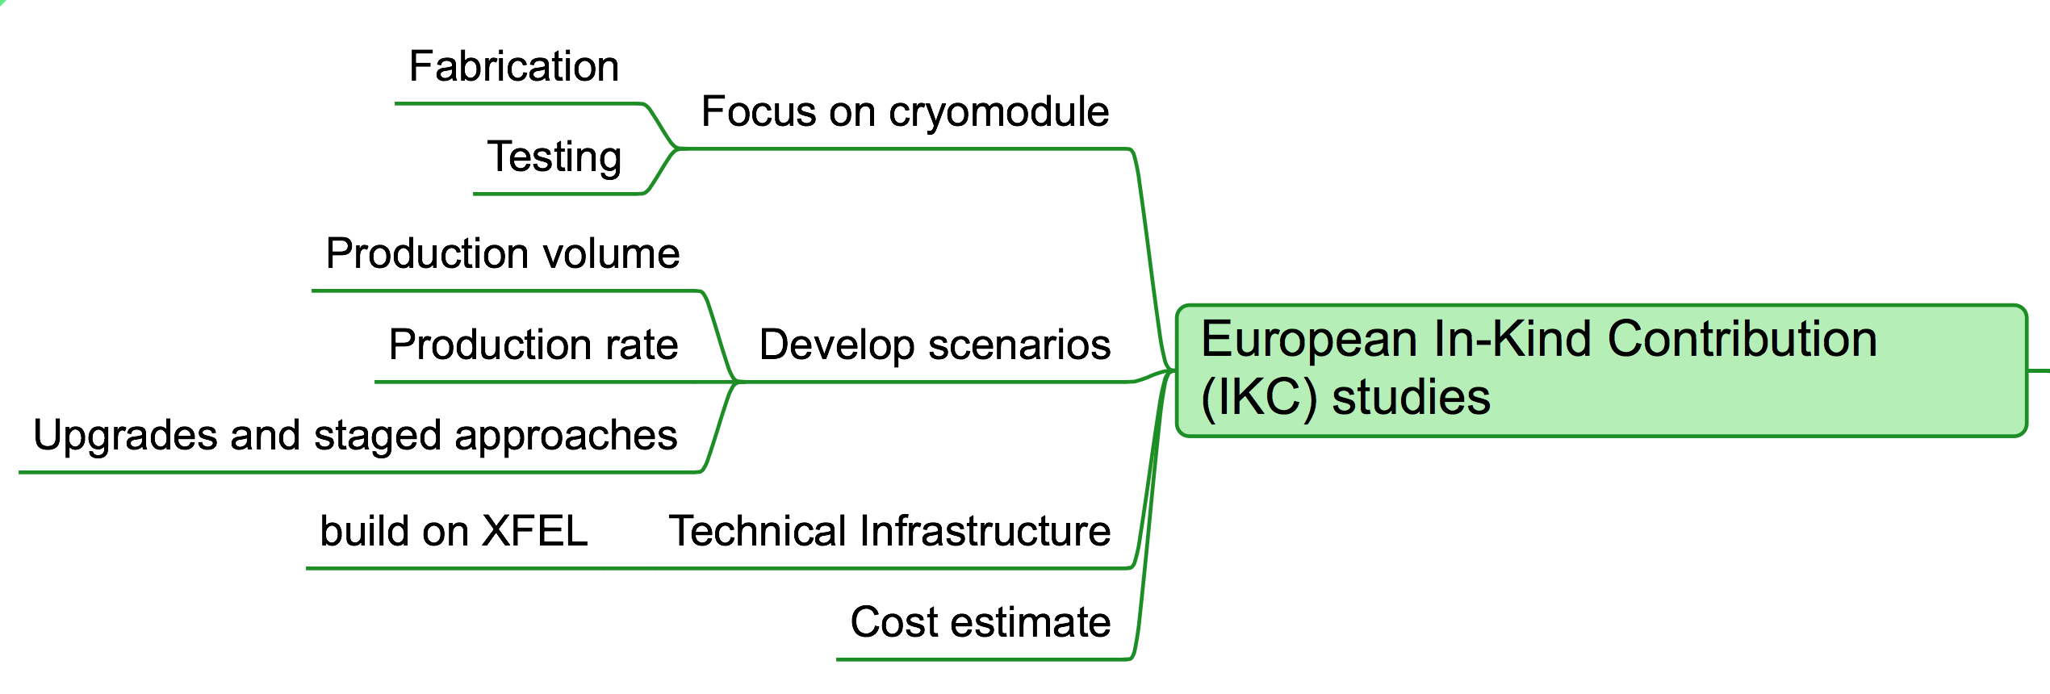

Slide 8
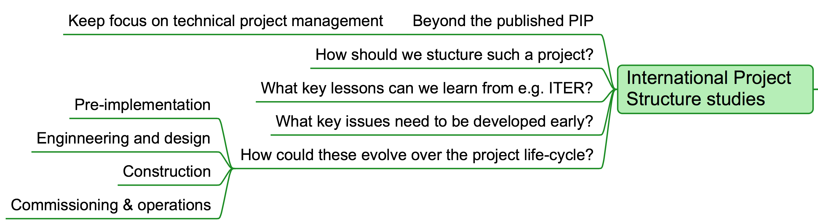

Slide 9
Proposed (Additional) Funding Scope
20 FTE ~4.2 MEUR
SRF 3
AD&I 10
Studies 5
SRF (3×CM) ~3.3 MEUR
Assumes “matching resources”
especially from DESY
not listed in the above

Slide 10
Next Steps
Get feedback from current draft document
  You!
  LCC
  CERN and EC
Begin to discuss within Europe
  Contact key institutes
Prepare next level of detail
  Bid preparation for the EC
Time scale for funding: ~1 year
  end of 2014
Meeting in Paris after LCWS (BF)

