Slide 1
Planning for
ILC-SCRF WG Activities during LCWS2013 in Tokyo, focusing on Power-Input Couplers and
A satellite Meeting during SRF2013
W-D. Moeller, E. Kako, and A. Yamamoto
A satellite Meeting, in SRF-2013,
24 Sept., 2013

Slide 2
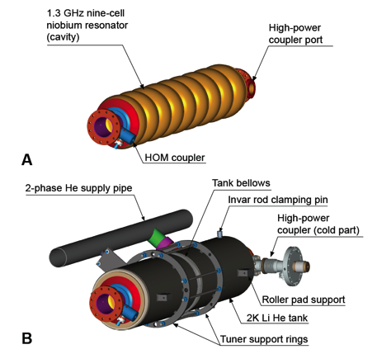
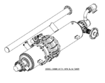
Cavity Integration
9-cell resonator
Input-coupler
  TTF-III coupler
Frequency tuners
  Blade tuner
He tank
Magnetic shield
  Inside He tank

Slide 3
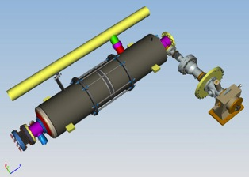
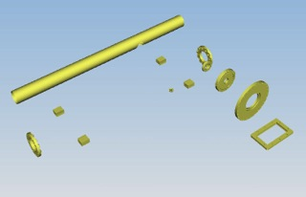
ILC SCRF Cavity Plug-compatible Conditions discussed in the Technical Design Phase
Item | Varieties | Baselines in ILC-TDR
Cavity shape | TESLA / LL | TESLA
Length |  | Fixed
Beam pipe flange |  | Fixed
Suspension pitch |  | Fixed
Tuner | Blade/ Slide-Jack | Blade
Coupler flange (cold end) | 40 or 60 | 40 mm
Coupler pitch |  | Fixed
He –in-line joint |  | Fixed
Plug-compatible interface to be further established

Slide 4
Plan for approaching the LCWS-WG
July:
  1st fuze meeting to discuss and to assign homework
August:
  A meeting at CERN : WD Moeller to visit CERN with RI engineer
  Special discussion on Cu plating with getting CERN’s experts involvment
  2nd fuze meeting
    ILC requirement and comparison of two designs
September:
  An interim meeting during SRF, forcusing on the coupler design to seek for the best for ILC
  Review the progress and to prepare further
October:
  3rd fuze meeting
    To prepare for LCWS
November:
  LCWS and Coupler WG.
    Reach consensus for the ILC coupler design under a plug-compatible interfaces

Slide 5
Candidate Dates: Nov. 12-13, 2013
 | am | pm
11, Monday | Plenary | Plenary
12, Tuesday | SCRF/ML: Coupler WG | SCRF/ML: Coupler WG
13, Wednesday | SCRF/ML: Coupler WG | (SCRF/ML: Coupler WG) become a half-time
14, Thursday | SCR/MLF: Other WG For another half time | SCRF/ML: Other WG
15, Friday | Plenary
A proposal:
Full two-days meeting for Couplers
  Co-conveners: Wolf-Dietrich Moeller and Eiji Kako
- One-day meeting for other WGs to be established -

Slide 6
Power Input Coupler WG
Agenda suggested by Wolf-Dietrich
1. Specification
General specification N. Solyak
Power capacity C. Adolphsen
Thermal balance D. Kostin
Tune-ability &nb sp; H. Hayano,
(maybe the max power and the tune-ability
could be one talk)
2. RF and technical design and cost
EU/AM W.-D. Moeller
JP &nbs p; E. Kako
Assembly TBD
from KEK, DESY
Interfaces/integration/compatibility
H. Hayano
Comparison, pros & cons TBD, discussion
Cost aspects A. Yamamoto
3. Fabrication
Critical fabrication steps (cu-plating, brazing vs welding…) Companies
4. Discussion for the ILC oriented coupler design
------
Some open questions/comments:
Should we talk about cost ?
We would like to have coupler experts not involved in the TTF3 or KEK design, e.g. from CERN or other labs, who?
  Discussed at CERN and the following persons
  advised by L. Evans
  Eric Montesinos (RF Coupler Expert)
  Jose Miguel Jimenez (Vaccum Group L.)
  Leonel Marques Antunes Ferreira (Cu plating)

Slide 7
Focusing Points, today
Understand technical requirements/specification for the ILC SCRF Input-couplers as our common boundary conditions,
Understand technical status of two major designs of TTF-III and KEK-STF couplers
Learn laboratory and industrial experiences and receive advices,
Make clear our home-work to prepare for the LCWS working group to bring our consensus to prepare for the coupler mass-production, with a scale of 16,000 or more, for the ILC, including to seek for better plug-compatibility envelopes.

Slide 8
Agenda for the meeting, 24 Sept.
1. Introduction (by A. Yamamoto for 5 min.):
- Brief summary of the previous meeting discussions, and
- Purpose of the meeting and subjects to be discussed
”Seek for best cost-effective & reliable couplers w/better plug-compatibility for ILC?"
2. Boundary conditions for discussions (by W. Moeller, and E. Kako, 15 min.)
- Confirmation of the ILC-SCRF requirements/specifications
- Technical comparisons, in a summary table, of TTF3 and KEK-STF couplers
- Brief summary of an industrial study made for coupler mass-production,
3. Discussions (~ 30 min.)
- Comments from institutional experiences (LAL, SLAC, CERN and … : ~ 2 or 3 x 5 min.)
- Comments based on industrial experiences (RI, Thales, CPI and Toshiba: ~ 4 x 5 min.)
- General discussion and/comments (by any, 10 min.)
4. Preparation for the LCWS-2013 (led by W.D. Moeller and E. Kako: ~ 15 min.)
- Discussions and individual home-work assignments to prepare for LCWS2013
- Summary of the individual homework.

Slide 9
Notes from the Meeting

Slide 10
Notes from the Meeting drafted by MR, added by AY
Meeting: ILC fundamental power coupler (FPC) meeting,
Time and Date: Tuesday 24.09.2013, 13:10 SRF 2013, Paris
Participants:
From Laboratories:
  W-D. Moeller, DESY, N. Solyak, Fermilab, A. Yamamoto, KEK/CERN, D. Kostin, DESY, E. Kako, KEK, C. Ginsburg, Fermilab, M. Champion, ORNL, C. Adolphsen, SLAC, O. Naoply, CEA, M. Ross, SLAC, E. Montesinos, CERN, Walid Kaabi, LAL, K. Yamamoto, KEK, Y. Iwashita, KU
From companies;
  M. Pekeler, RI, T. Treado, CPI, S. Einarson, CPI, J. Rathke, AES, S. Bethuys, Thales, K. Tetsuka, Toshiba , M. Irikura, Toshiba, K. Kanaoka, MHI

Slide 11
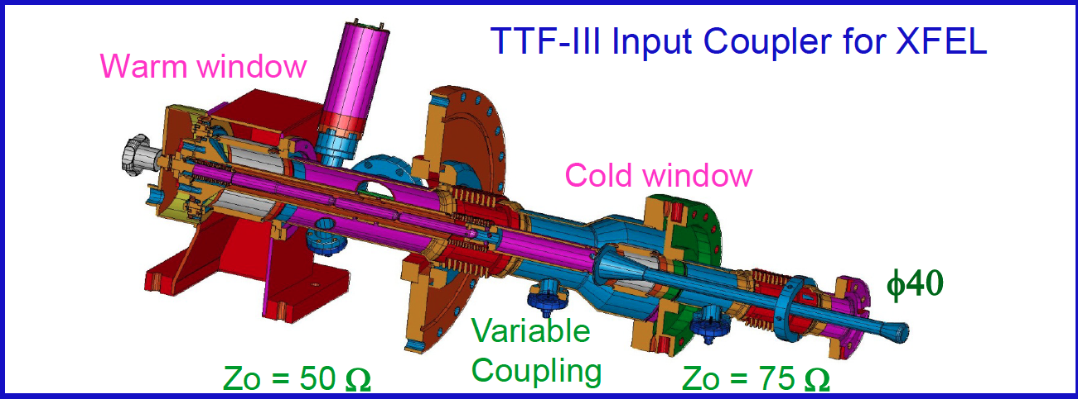
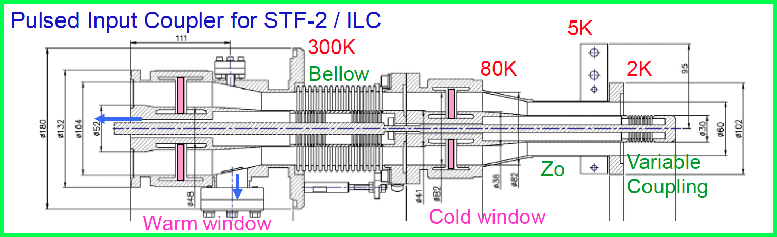
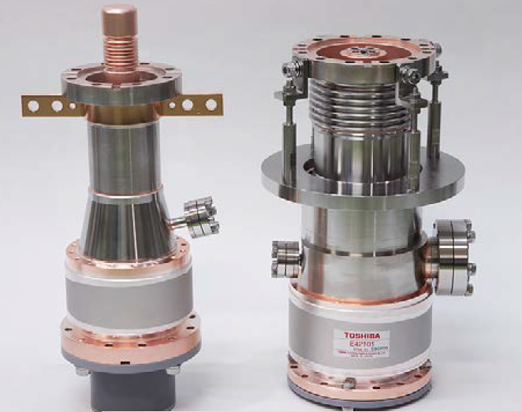
Comparison of Input Couplers
TTF-III
Two bellows
40 mm D.
125 kW
KEK-STF-II/QB
Single bellows
60 mm D
(40 mmD to be tried
350 kW

Slide 12
Our Goals
What is really needed and what can be achieved?
What is most critical and
What are the Cost drivers?
Are the Specifications too strict? Are these specifications cost-drivers?
What relaxed specifications might be proposed?

Slide 13
Description of Issues
W. D. Moeller
The ILC-TDR FPC thermal loss specification is very tight; about a factor 3 tighter than XFEL.
The XFEL FPC production yield to test is now 80%. After conditioning spots appear on the plated surfaces, so the adhesion is not yet sufficient. How should the copper plating issue be solved. (CERN is willing to provide a copper plating recipe for the community).
The power input requirement should also be reviewed.
(There is a print error in V3-II Table 3.7 page 35; ‘mW loss at 2 K’ should be ‘W loss at 2 K’).
The RF choke of the STF2 coupler is difficult to clean.
15 mm lateral movement of the TTF-type is too much.
The XFEL door-knob waveguide contact is not robust and must be handled with care.
Is there a role for a waveguide Stub tuner? Especially one that allows the coupler motion to be reduced.
What is the difference between the multi-pactor performance 40 mm vs 60 mm.
What doorknob modifications are needed to provide bias to the center-conductor of the STF2 coupler?

Slide 14
CPI Comments
When you compare the SNS coupler vs the TTF3 coupler, the SNS coupler is roughly half the cost of the TTF3 coupler. The SNS coupler is a simpler, lower spec design.
There are several design requirements which could be looked at for high volume production, including the requirement for two windows, tunability, lateral mobility. Are these really needed? (<- primary).
Recommendations – there were several in the 2007 report, which will be updated for the November meeting in Tokyo.
While plating is a labor driver with masking done by hand at CPI, CPI has an ‘old style’ plating facility for plating of vacuum electron devices and power couplers. The level of effort for the coupler development should be consistent with that put to development of cavities. (The coupler development is 0.1% of that effort has gone into the cavities.)
While the specifications are difficult to meet for the TTF3 coupler (adhesion, uniformity in particular), CPI has met these specs on over 120 TTF3 power couplers. CPI's power coupler plating process has been in use for 10 years since its original qualification by DESY and CNRS Orsay with over 180 power couplers built and plated during that time.
If the decision is to go to the alternate design – please consider that one cannot easily braze after plating without ruining the RRR. The braze heat drives the plating into the base, ruining the RRR.
RRR vs firing temp. data provided to CNRS Orsay and DESY indicated that heating the high-RRR plating was ok at 400 C but the RRR drops rapidly at 800 C and above. Thicker plating extends the higher temperature limit at which the RRR drops but the thicker plating increases the thermal conduction.
It is hard to braze multiple components at a low enough temperature to prevent reduction of the RRR. CuSil is the lowest temp high vacuum braze material that can be built.
The complete brazing of TTF couplers was tried by CPI for CNRS Orsay. The all-brazed couplers were plated and titanium nitride coated after the couplers were brazed. One of the couplers conditioned well and one did not. This approach was abandoned as a result.
CPI uses an outside vendor to perform the electron beam weld as we do not have an e-beam welder in-house. Yields are very high.
The TTF3 coupler is a very mature coupler design with over 150 successfully built and conditioned by CPI and RI. CPI's plating process is fully qualified and is currently in use on the 3.9 GHz couplers we are building for the XFEL. It took CPI six months to qualify the plating process the first time, approximately 10 years ago. It is CPI's opinion that the root cause of the current problems with the XFEL coupler program are directly attributable to the procurement strategy. Two vendors (CPI and RI) were qualified by DESY and CNRS Orsay with two other vendors (Toshiba and e2v) participating in an industrialization program with two samples built and qualified. A vendor which had not built a qualified coupler and which had very limited experience building power couplers was awarded the production contract.

Slide 15
RI Comments
Have to stretch the bellows more than it is allowed. Plastically deform the bellows 'once'.
The Cu plating is a cost-driver. Can only plate a few times.
Using only one window really saves cost.

Slide 16
Toshiba Comments
Did both types of couplers. (SNS was the old Tristan window). Can do both.
Fabrication man-hours for KEK-STF2 coupler should be smaller for TTF. (what fraction smaller was not indicated).
Rotation of the window is required for coating the cylindrical ceramic cylinder.
Brazing after plate. That causes a drop of RRR. Known problem. Take it into account? Another optimization.
By changing the thickness of the coupler. Now the same as the TTF 3 coupler.

Slide 17
Thales Comments
Problems are due to the fact that they were given (imposed) design with no room for adjustment. They would like to be able to change fabrication parameters such that the overall performance is as-specified.

Slide 18
LAL Comments
Pre-production period important. Qualification phase. Dennis (DESY) added - the prototype process is long.

Slide 19
CEA Comments
Are there installation issues?
  To be answered base on CEA experience for EXFEL

Slide 20
CERN Comments
two windows of >~ 200 coupler single-windows failures after 10 years. Cracks that could be varnished.
The single window for SNS made the cavity volume open during CM assembly.

Slide 21
Homework Assignments
Re-check the ILC FP coupler specifications to be checked from the accelerator integration view points:
  Nick Walker, Chirs Adolphsen, Nikolay Solyak,
  (in cooperation with cryomodule experts to check thermal heat-load)
Design and the design parameters to be further checked/investigated,
  including effort for the most cost-effective design with better plug-compatibility:
  TTF3 type couplers: Denis Kostin
  KEK-STF type couplers: Yasuchika Yamamoto
  General/neutral advices: Eric Montesinos
Industrial studies to be coordinated:
  Akira Yamamoto in cooperation with LCC and contributing laboratories, and
  industrial partners: RI, Thales, CPI, and Toshiba
LCWS working group meeting agenda and coordination (on November 12-14)
Wolf-Dietrich Moeller, and Eiji Kako, and Hitoshi Hayano (and A. Yamamoto, as assistant)
Next meeting through Fuze connection:
in the middle of October (most likely at nominal time, on Oct. 16→ 17, Thursday)

