Slide 1

ILD Status
100th ILC@DESY meeting
Ties Behnke, DESY
18.10.2013

Slide 2
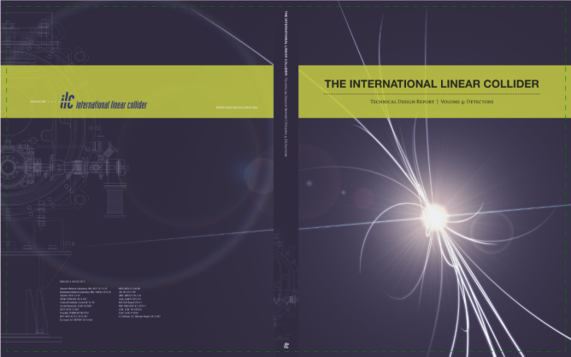
ILD: where are we?
2013: delivery of the ILD DBD as part of the ILC TDR
Fairly sophisticated system design, no complete engineering design
First “complete” estimate of the cost
2013: site decision in Japan, but no overall decision yet on the project
2013: positive statements around the world supporting an ILC in Japan,
European strategy process
Snowmass process in the US
We are in a transition period between pre-project (concept) phase and
project (collaboration) phase
For the near future R&D will remain our main goal, but we need to prepare
to shift gears rapidly once the project is approved.

Slide 3

Concepts at the ILC
SiD is first
proposed at ALCPG
LOI phase
TDR/ DBD phase
2004
2009
2013
1998
2001
2003
2006
2007
2009
TESLA and
GLD detectors
publish first
documents
TESLA
TDR
Detector
concept
reports:
LDC, GLD,
SiD, 4th
LOI
delivered
DBD/ TDR
delivered
SiD, ILD
validated
WWS starts
concept studies
LDC and GLD
merge into
ILD

Slide 4
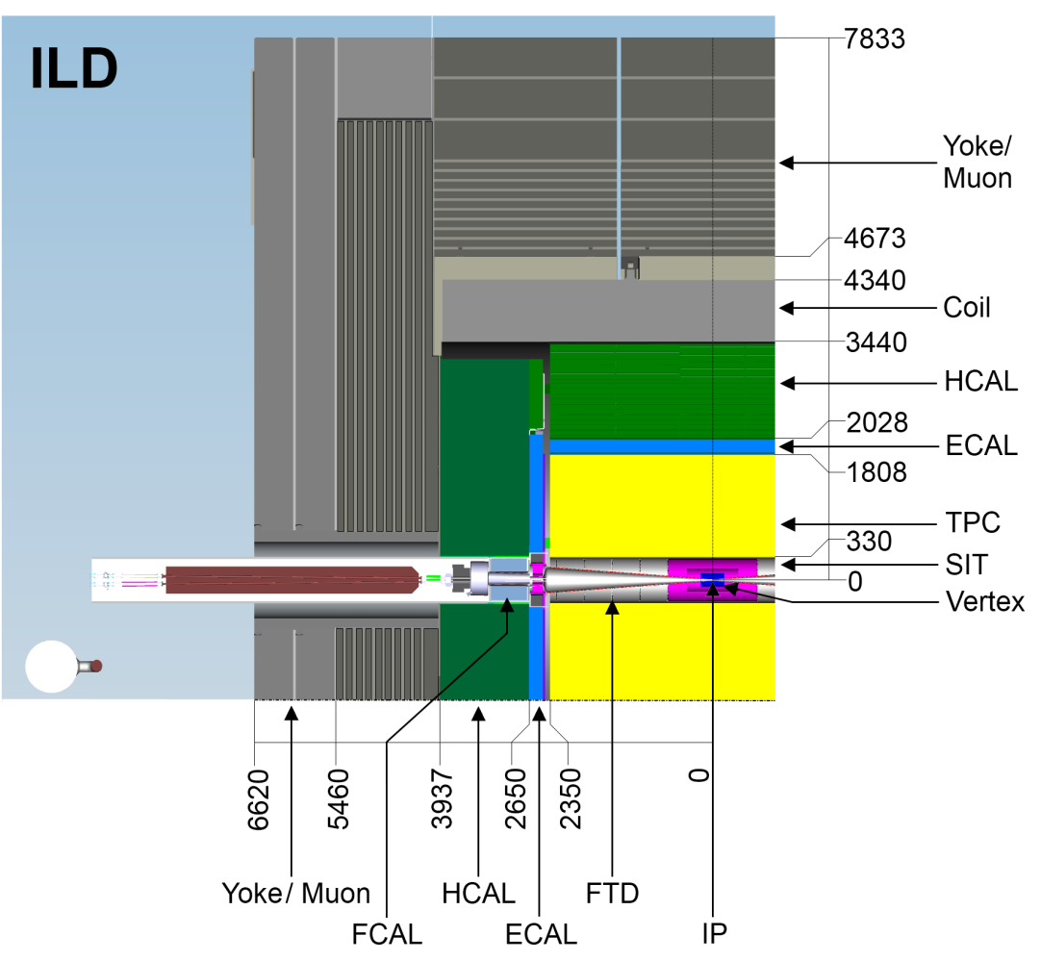
The current ILD concept
Started as a combination of
GLD and LDC in 2007
(LCWS 2007 at DESY)
Some detailed optimization work
done, but main parameter
choices were “ad hoc” (politics)
as much as physics driven
Now is the time to re-open
the box and look at all
choices:
There are no forbidden areas
There are no prejudices

Slide 5
Window of Opportunity
Situation in Japan: see talk by Satoru/ Hitoshi later today.
Window of opportunity NOW
We might have some limited time to
Look carefully into our fundamental design choices
Take costs more fully into account than we have done so far
Question Choices and prejudices
Do fundamental studies on – in particular – the impact on physics
Once ILC is a real project we might not have this chance again!
Lets use it wisely!

Slide 6
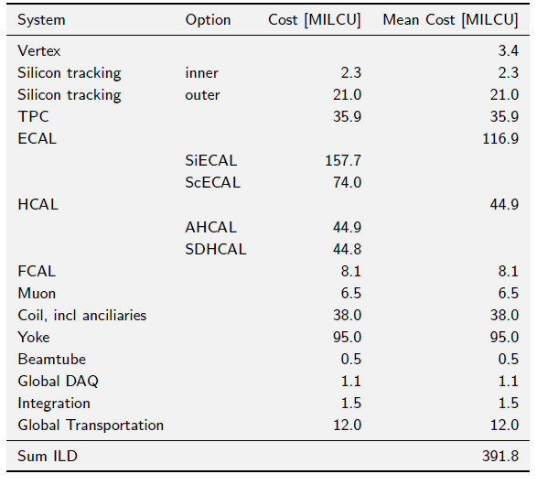
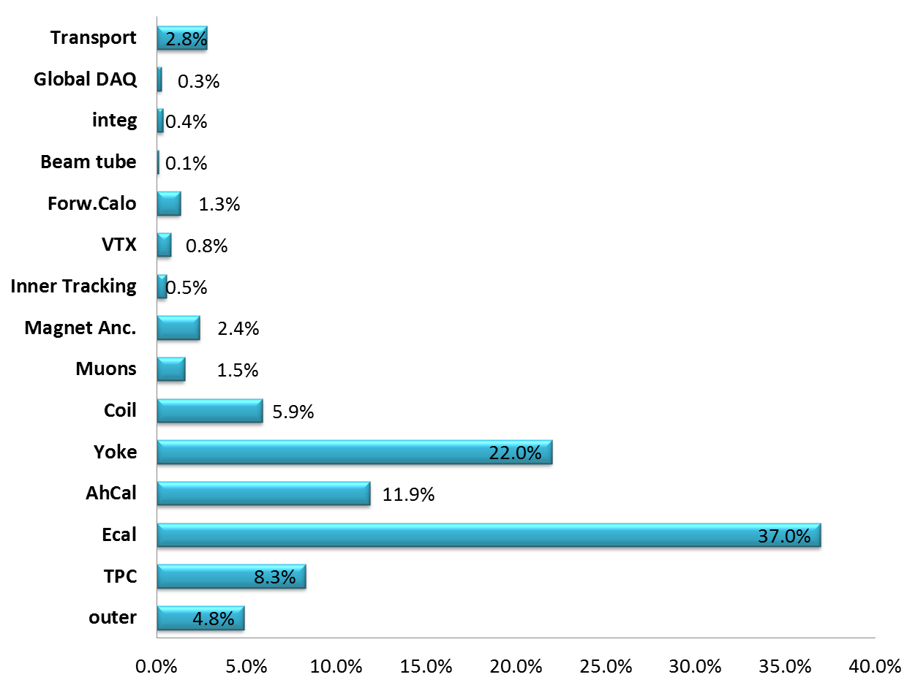
ILD Costs
Costing exercise as part of DBD
Needs significant more work
and checking, but main
messages are clear.
Huge effort by LLR group
for the DBD

Slide 7
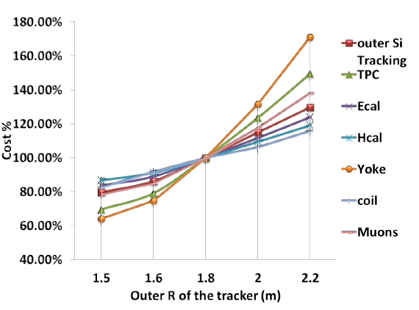
ILD cost scaling
Cost scaling law with
different systems radius
Potentially large impact
on the cost
Careful optimization
of cost –performance
benefit is needed

Slide 8
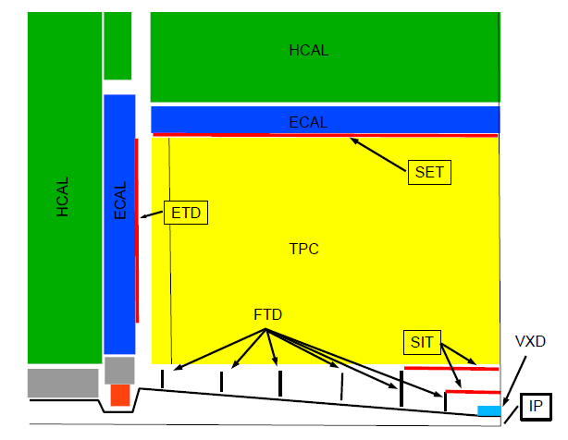
The inner system
Do we understand our performance requirements?
VTX detector
Silicon tracking?
Readout speed might be an important
variable to control background and
complexity:
Are the ambitious enough in ILD in this
respect?
Do we understand / do we have a proper
design of the beamtube etc?
We propose a big Silicon system for ILD:
are we sure of its parameters?
What about the outer Silicon system?
How much of this is baseline?
Design of the VTX detector
Role and merrit of double layer
Alternative geometries?

Slide 9
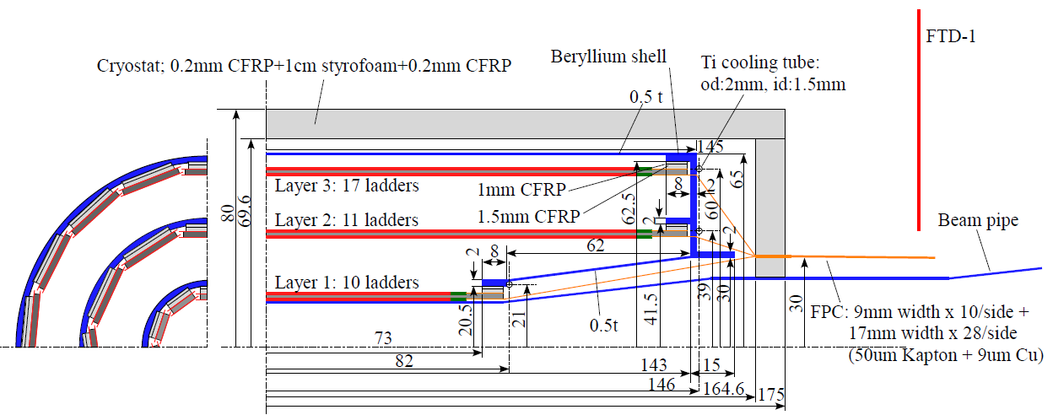
Vertex detector
Excellent impact parameter resolution better than (5⊕10/p sin^{3/2} Θ ) μm is required for efficient flavor tagging
3 layers of double ladders (ca 1 mm apart) (6 pixel layers)
  Effect on pair-background rejection is expected, but not demonstrated yet
Barrel only: |cosΘ|<0.97 for inner layer and |cos Θ |<0.9 for outer layer
Point resolution <3um for innermost layer
Material budget: 0.3%X₀/ladder=0.15%X₀/layer
Sensor options: CMOS, FPCCD, DEPFET, others?

Slide 10
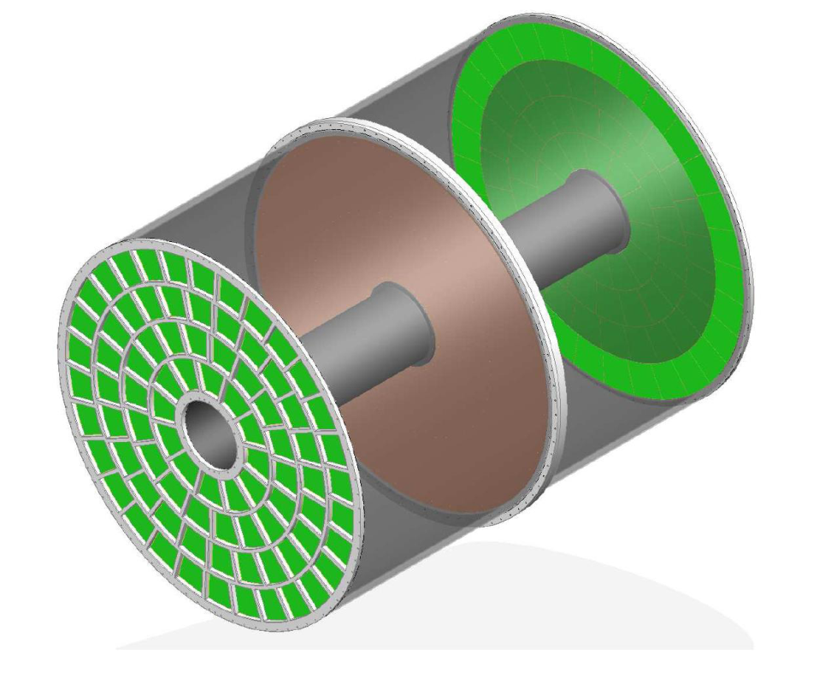
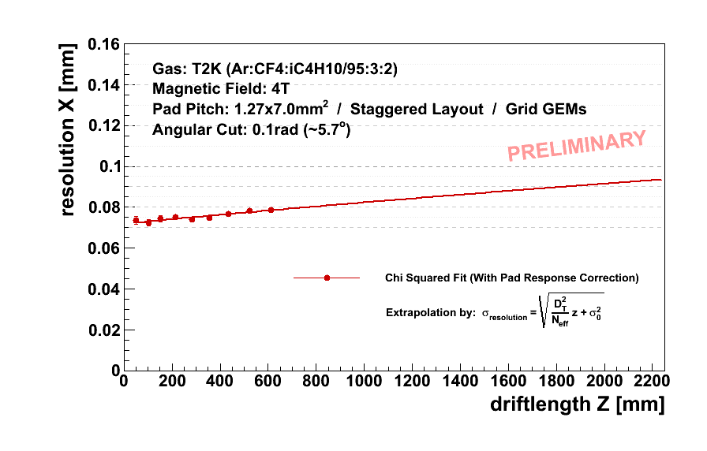
TPC: ILD
Time Projection Chamber: The central tracker of ILD
Tracks can be measured with many (~200/track) 3-dimensional r-f-z space points
s_{rf}<100um is expected for all drift distances
dE/dx information for particle identification
Two main options for gas amplification: GEM or Micromegas
Readout pad size ~ 1x6mm² → 10⁶ pads/side
Pixel readout R&D as a future alternative
Material budget: 5%X₀ in barrel region and <25%X₀ in endplate region
Cooling by 2-phase CO2
Momentum resolution: 2 10^-5

Slide 11
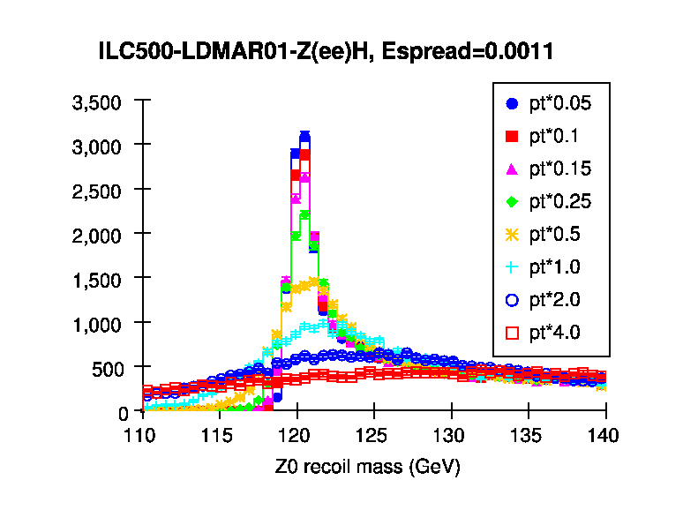
Tracking System
Momentum resolution:
Current parameter is strongly driven by Higgs Mass measurement:
are these arguments still valid?
If we can relax the requirements: what is the impact on TPC/ Silicon?
  Complex interplay of TPC, inner and outer Silicon
Overall system optimization:
Aspect ratio
Outer radius
Role of Silicon
Role of material e.g. in the
TPC system
Forward tracking

Slide 12
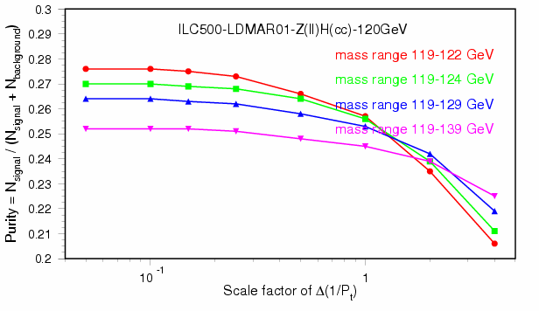
Tracking System
Momentum resolution:
Current parameter is strongly driven by Higgs Mass measurement:
are these arguments still valid?
If we can relax the requirements: what is the impact on TPC/ Silicon?
  Complex interplay of TPC, inner and outer Silicon
Purity of ZH->llcc
Overall system optimization:
Aspect ratio
Outer radius
Role of Silicon
Role of material e.g. in the
TPC system
Forward tracking

Slide 13
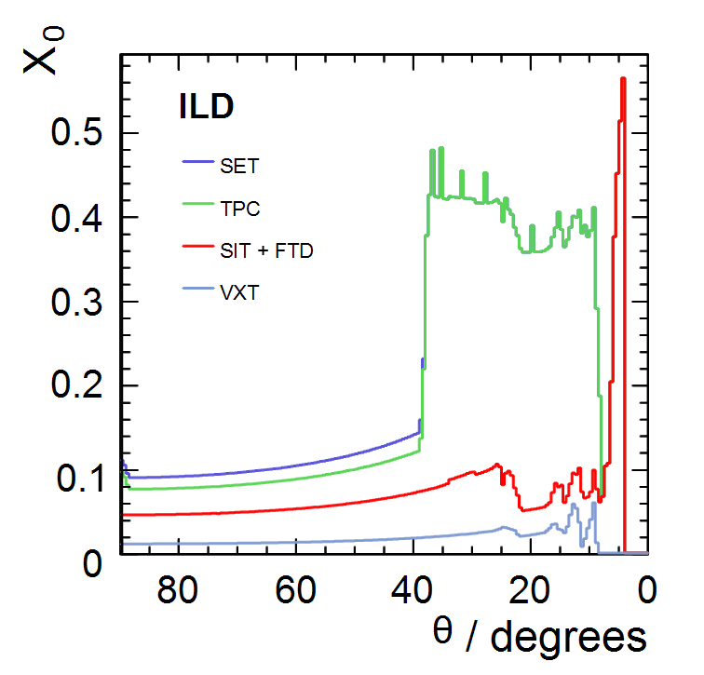
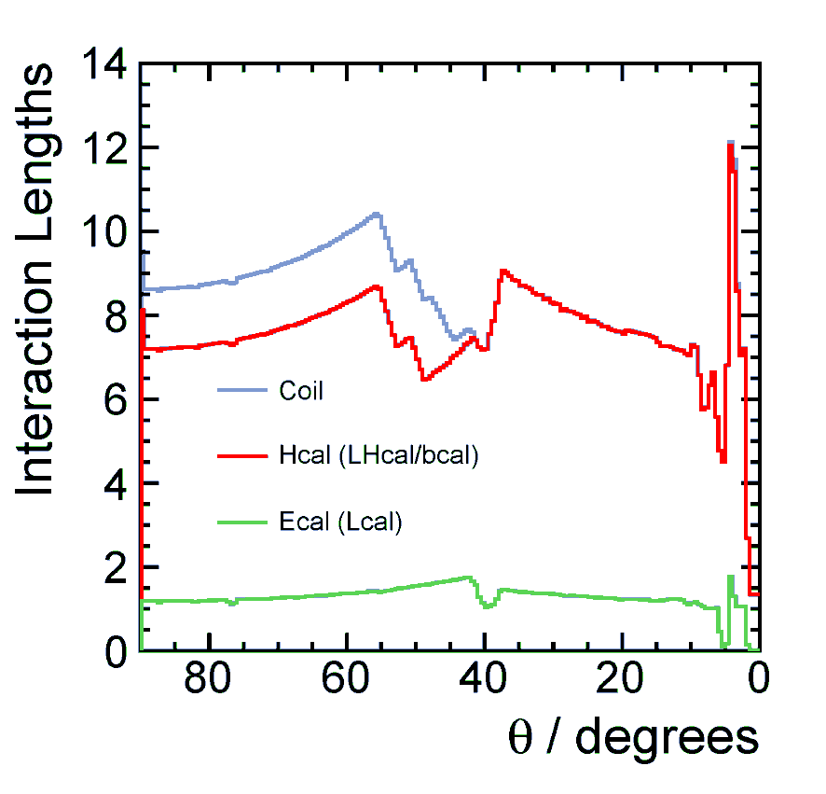
Material
And never forget:
Material issues System thickness
Silicon tracker - ECAL/ HCAL thickness
TPC tracker - choice of material?

Slide 14
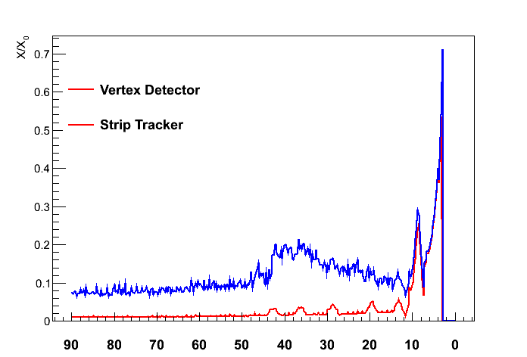
Material
And never forget:
Material issues System thickness
SiD material: this might be
aggressive, but we are not - ECAL/ HCAL thickness
better… - choice of material?

Slide 15
Questions: a possible list
What is the right outer diameter for the VTX?
Are we confident about performance in the forward direction
What is the minimum momentum we need to reconstruct
Does the data size have an impact on design of the VTX?
Where do we need highest momentum resolution
  Higgs mass, invisible higgs, branching ratios?
How important are systematic effects to the final performance
Do we understand possible biases in the momentum estimation
Do we understand the relative roles of TPC and Silicon?
What is the impact of material on the physics performance
  Barrel
  Endcap

Slide 16
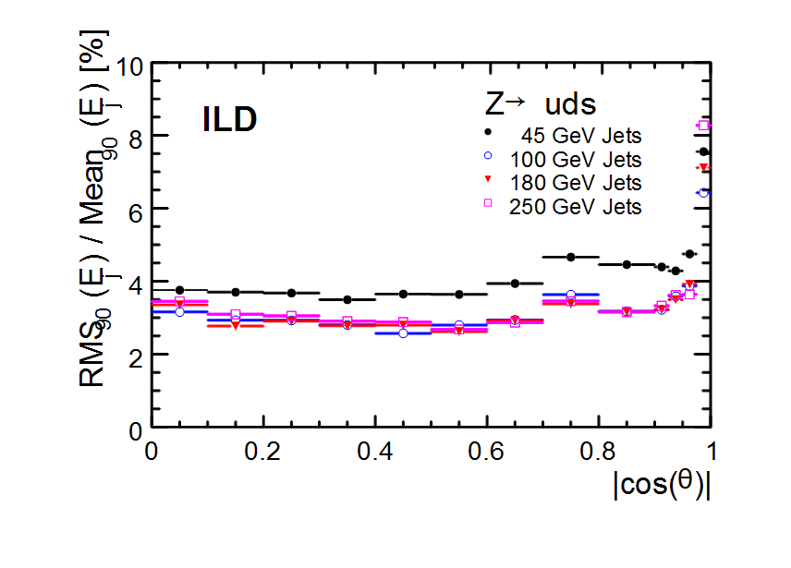
Pflow as a driving force
Pflow has been at the
core of the definition of
ILD
Size
Calorimeter performance
Tracking performance

Slide 17
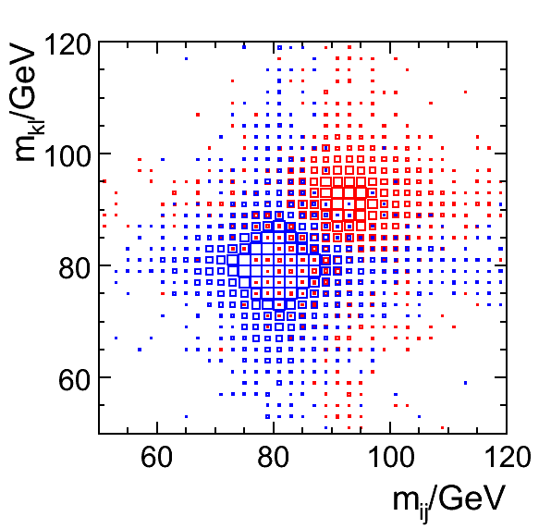
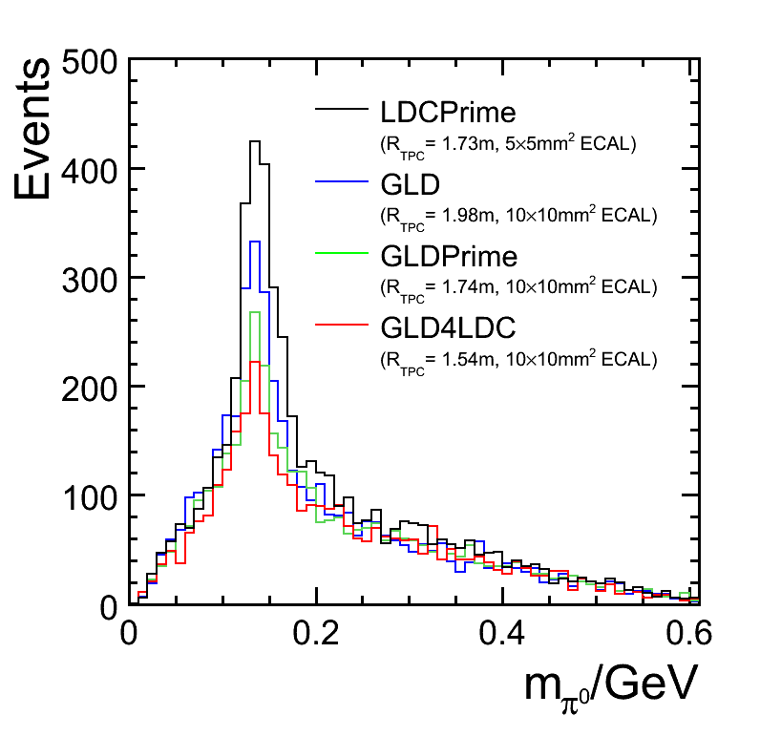
Pflow: Impact
W/Z separation:
Key ingredient to define the requirement
on particle flow performance
Impact on actual physics studies:
typically less clear than thought:
Most studies show little to no sensitivity to
the exact performance
But: how poorly do we do with a significantly
deteriorated particle flow performance?

Slide 18
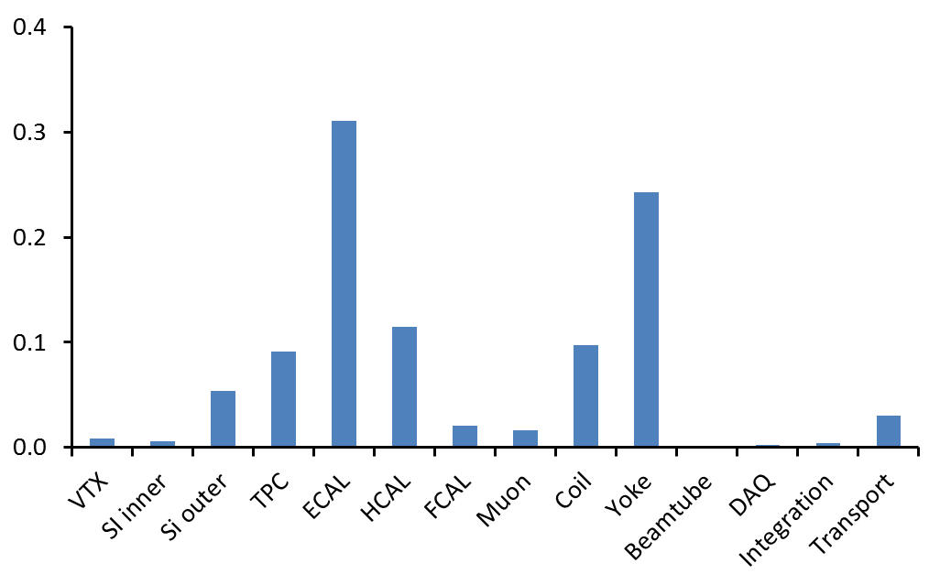
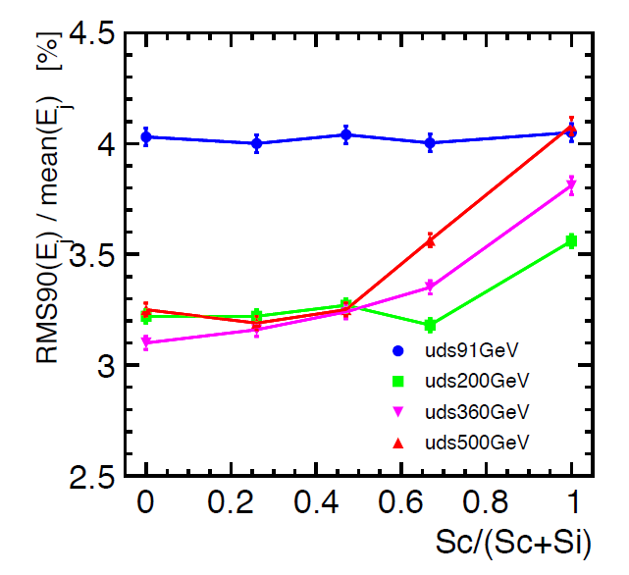
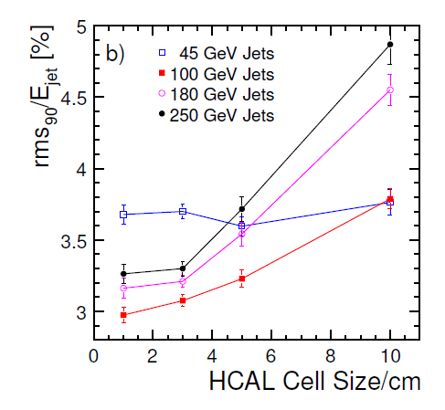
Imaging Calorimeter
Calorimetry is clearly a main part of ILD
Can we make our calorimeter cheaper?
Can we make the step from ECAL to HCAL less severe?
Can we find an intelligent way to stage the system?
Si for the ECAL is a very attractive, but also
very expensive option

Slide 19
Overall Detector size
Other constraints:
Outer radius of Yoke:
Defined from push-pull
condition on field < 50 mG
Is this the correct requirement
Changing this will have a huge impact
on size (and cost)

Slide 20
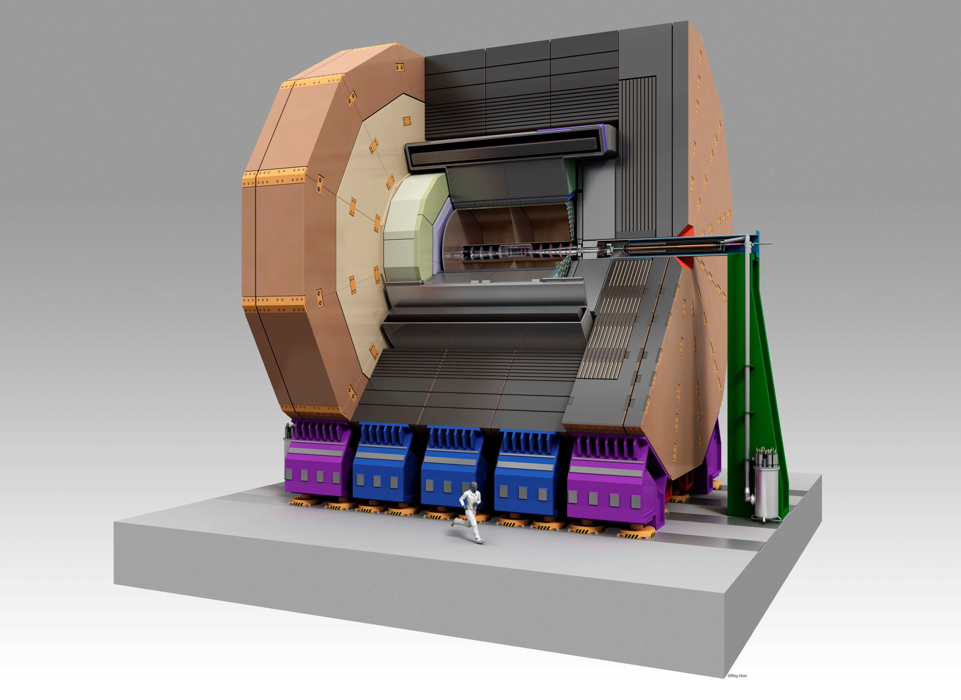

Slide 21
ILD Organisation
The Plan:
At the ECFA meeting May 2013:
Proposed and discussed new structure for ILD
At Cracow: iterate the organisation structure, further disucssions are needed
LCWS 2013: initiate the new ILD structure formally.
Document describing the new structure is on the indico WEB site under
the Thursday meeting
Comments are welcome.

Slide 22
Institute Assembly
Speaker (2)
ILD operations board (>20)
ILD Management group (4)
Physco, detco,
2 free members
Detector Coordinator
Publication office
Physics Coordinator
Central design group
DAQ
Software/ Tools
top
MDI
Higgs
Integration
Documentation
….
…
SI
TPC
VTX
Central groups
FCAL
HCAL
ECAL
muon
Coil/ Yoke
Detector systems groups organize the connection
to the R&D collaborations

Slide 23
ILD
We have a good and clear starting point
The next step will be a re-optimization of the detector
We will need to make sure that we have an adequate and appropriate
structure.

