Slide 1
Modelling the FONT K1–P3 region in MAD
N. Blaskovic

Slide 2
Contents
μ_{y} and β_{y} in FONT K1–P3 region
K1 & K2 kicker sensitivities at P2 & P3 from the transfer matrices, compared to those obtained in kicker scans
N. Blaskovic

Slide 3
Model configurations used
MAD model v5.1 run for:
21st June setfile, with 1.282 GeV and tune T2
nominal saveline ATF2lat_BX10BY1m
doctored saveline ATF2lat_BX10BY1m_DOC (nominal saveline with field strengths between QF9X & P3 replaced by those deduced from 21st June setfile)
N. Blaskovic

Slide 4
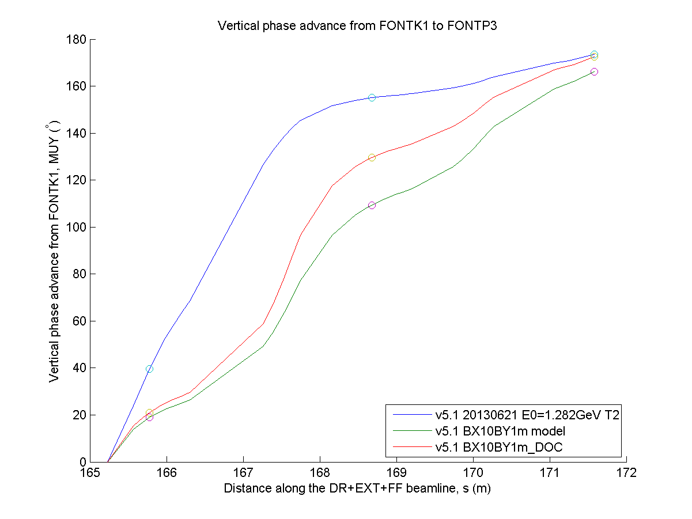
P3
P2
P1
N. Blaskovic

Slide 5
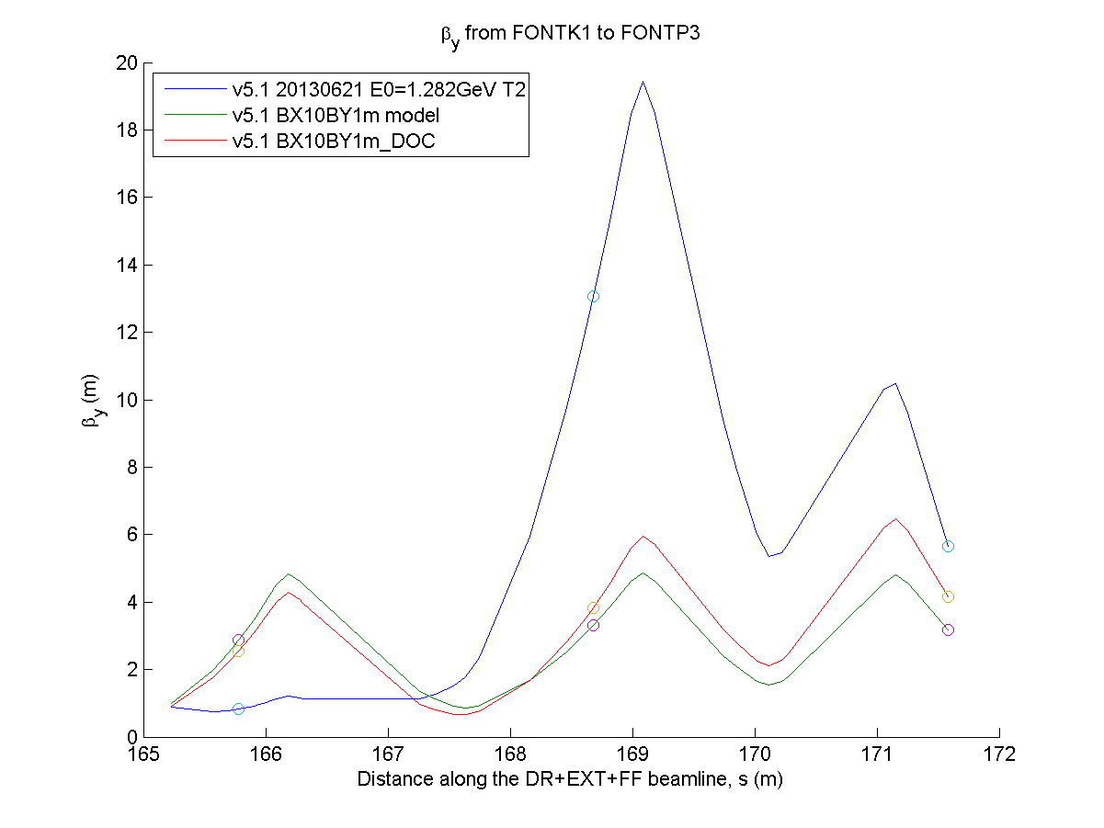
P2
P3
P1
N. Blaskovic

Slide 6
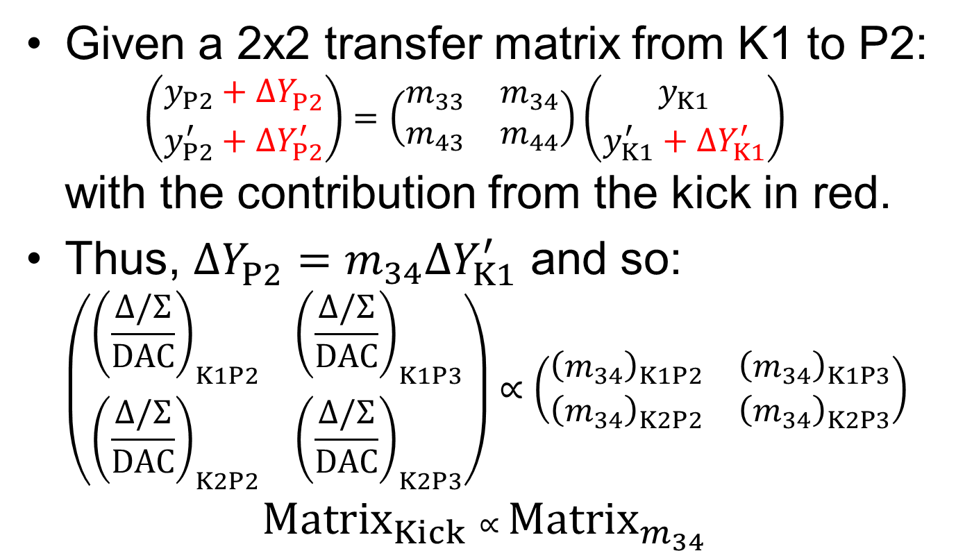
Kicker sensitivity
Given a 2x2 transfer matrix from K1 to P2: $\left({y_{P2}+ΔY_{P2}^{} \atop y_{P2}^{′}+ΔY_{P2}^{′}}\right)=\left(\begin{matrix}m_{33} & m_{34} \\ m_{43} & m_{44}\end{matrix}\right)\left({y_{K1} \atop y_{K1}^{′}+ΔY_{K1}^{′}}\right)$ with the contribution from the kick in red.
Thus, $ΔY_{P2}^{}=m_{34}ΔY_{K1}^{′}$ and so: $\left(\begin{matrix}{\left(\frac{Δ/Σ}{DAC}\right)}_{K1P2} & {\left(\frac{Δ/Σ}{DAC}\right)}_{K1P3} \\ {\left(\frac{Δ/Σ}{DAC}\right)}_{K2P2} & {\left(\frac{Δ/Σ}{DAC}\right)}_{K2P3}\end{matrix}\right)∝\left(\begin{matrix}{\left(m_{34}\right)}_{K1P2} & {\left(m_{34}\right)}_{K1P3} \\ {\left(m_{34}\right)}_{K2P2} & {\left(m_{34}\right)}_{K2P3}\end{matrix}\right)$
$${Matrix}_{Kick}∝{Matrix}_{m_{34}}$$
N. Blaskovic

Slide 7
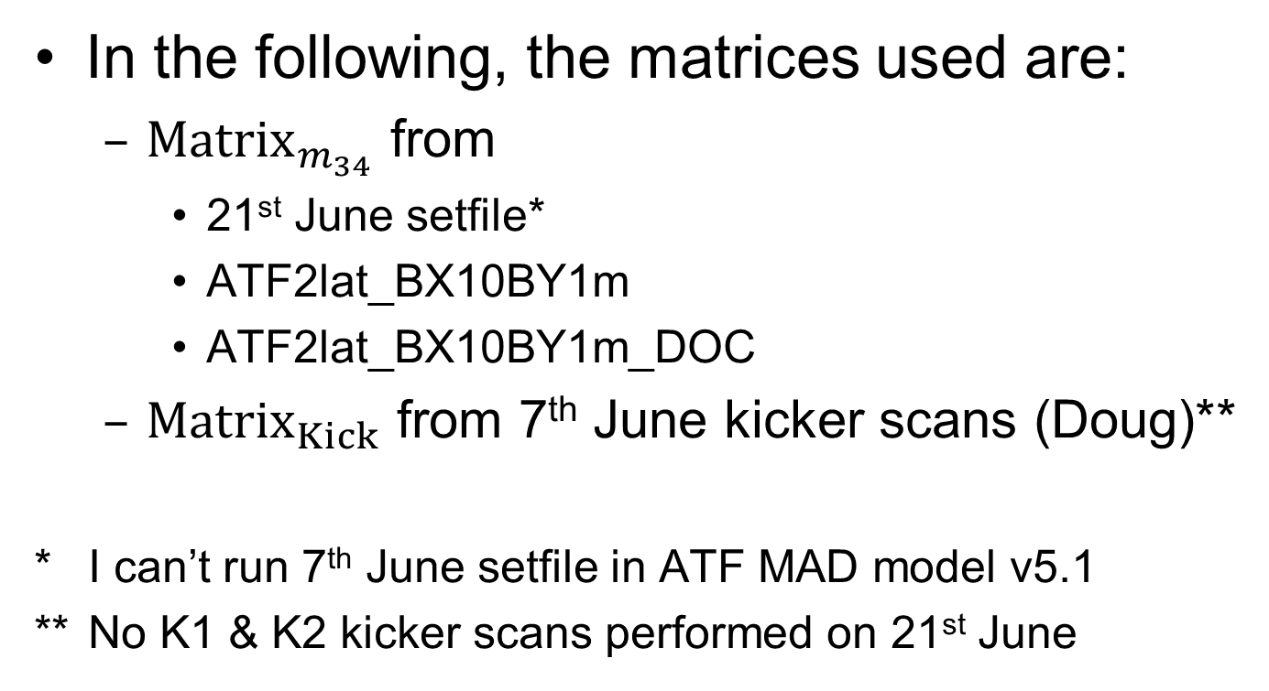
Kicker sensitivity
In the following, the matrices used are:
${Matrix}_{m_{34}}$ from
21st June setfile*
ATF2lat_BX10BY1m
ATF2lat_BX10BY1m_DOC
${Matrix}_{Kick}$ from 7th June kicker scans (Doug)**
* I can’t run 7th June setfile in ATF MAD model v5.1
** No K1 & K2 kicker scans performed on 21st June
N. Blaskovic

Slide 8
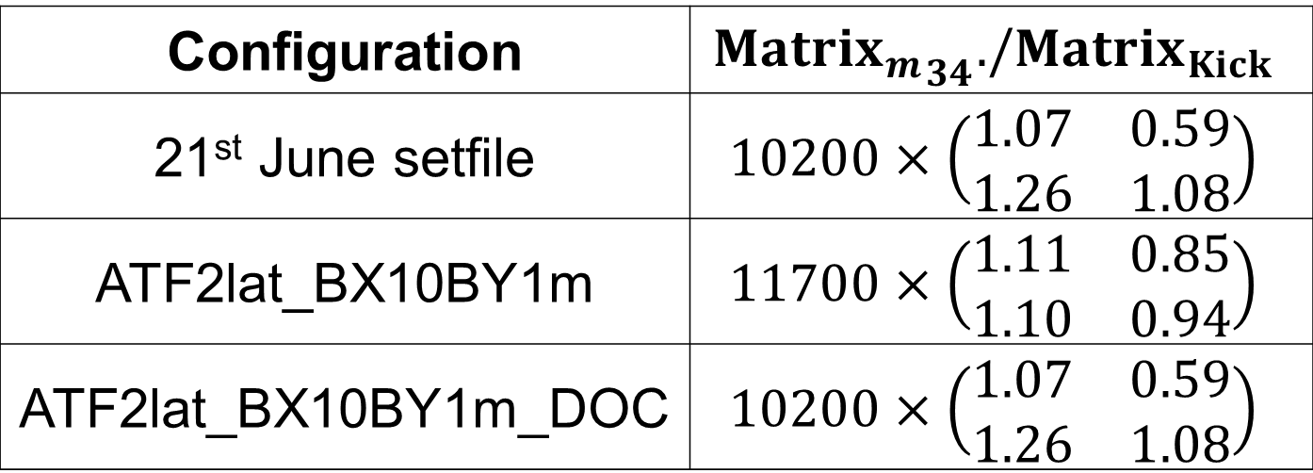
Kicker sensitivity
Preform an element-by-element division of the two matrices, taking a pre-factor out such that the mean of the elements is 1:
Configuration | $${{Matrix}_{m}}_{34}./{Matrix}_{Kick}$$
21st June setfile | $$10200×\left(\begin{matrix}1.07 & 0.59 \\ 1.26 & 1.08\end{matrix}\right)$$
ATF2lat_BX10BY1m | $$11700×\left(\begin{matrix}1.11 & 0.85 \\ 1.10 & 0.94\end{matrix}\right)$$
ATF2lat_BX10BY1m_DOC | $$10200×\left(\begin{matrix}1.07 & 0.59 \\ 1.26 & 1.08\end{matrix}\right)$$
N. Blaskovic

Slide 9
Summary
Both μ_{y} and β_{y} obtained from 21st June setfile are different to those from nominal savelines
Transfer matrices do not depend on optics further upstream (as expected!)
Kicker sensitivities obtained from kicker scans don’t match perfectly those deduced from transfer matrices (regardless of whether setfile or nominal saveline used)
N. Blaskovic

