Slide 1


Simulations and Predictions
Mikey Davis
10 October 2013
1/7

Slide 2
Introduction
I’ve done a bit of work on simulation
Based heavily on Glenn and Neven’s work
Focused on what is happening at the IP
Managed to get some reasonable predictions about feedforward (I think)
Still some questions
I’ll also show a graph on feedforward with predictions for the jitter level from two methods
Mikey Davis
10 October 2013
2/7

Slide 3
Simulation
I basically wanted to try and simulate the gain constants for feedforward (for my thesis)
Also aimed to reproduce and IP waist scan
I haven’t moved anything around, used the lattice from the 21st of June
There are several parameters you can scan
Input beam energy
Input QD0FF setting
Input QF1FF setting
Beam Jitter (I have said 20% of beam size)
Tunes (nominal or measured)
Mikey Davis
10 October 2013
3/7

Slide 4
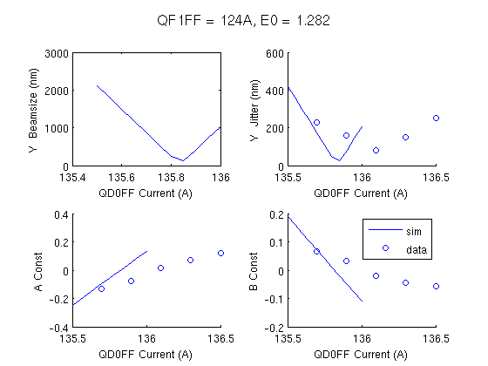
Nominal Lattice
Mikey Davis
10 October 2013
4/7

Slide 5
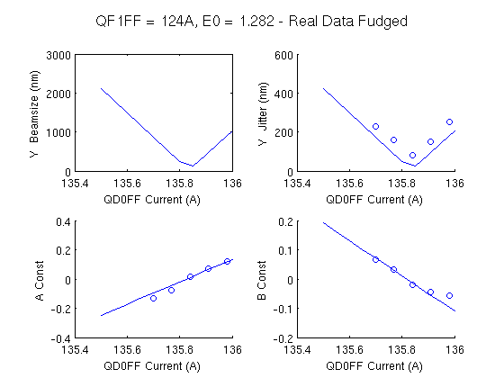
Nominal Lattice – Fudged
Mikey Davis
10 October 2013
5/7

Slide 6
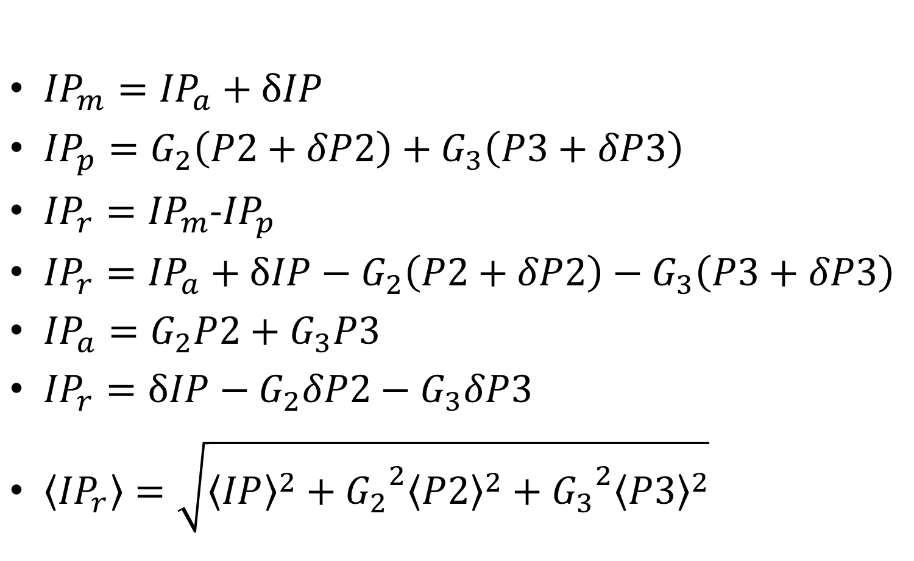
Feedforward Predictions
${IP}_{m}={IP}_{a}+δIP$
${IP}_{p}=G_{2}\left(P2+δP2\right)+G_{3}\left(P3+δP3\right)$
${IP}_{r}={IP}_{m}$-${IP}_{p}$
${IP}_{r}={IP}_{a}+δIP−G_{2}\left(P2+δP2\right)−G_{3}\left(P3+δP3\right)$
${IP}_{a}=G_{2}P2+G_{3}P3$
${IP}_{r}=δIP−G_{2}δP2−G_{3}δP3$
$\left\langle {IP}_{r}\right\rangle =\sqrt{{\left\langle IP\right\rangle }^{2}+{G_{2}}^{2}{\left\langle P2\right\rangle }^{2}+{{G_{3}}^{2}\left\langle P3\right\rangle }^{2}}$
Mikey Davis
10 October 2013
6/7

Slide 7
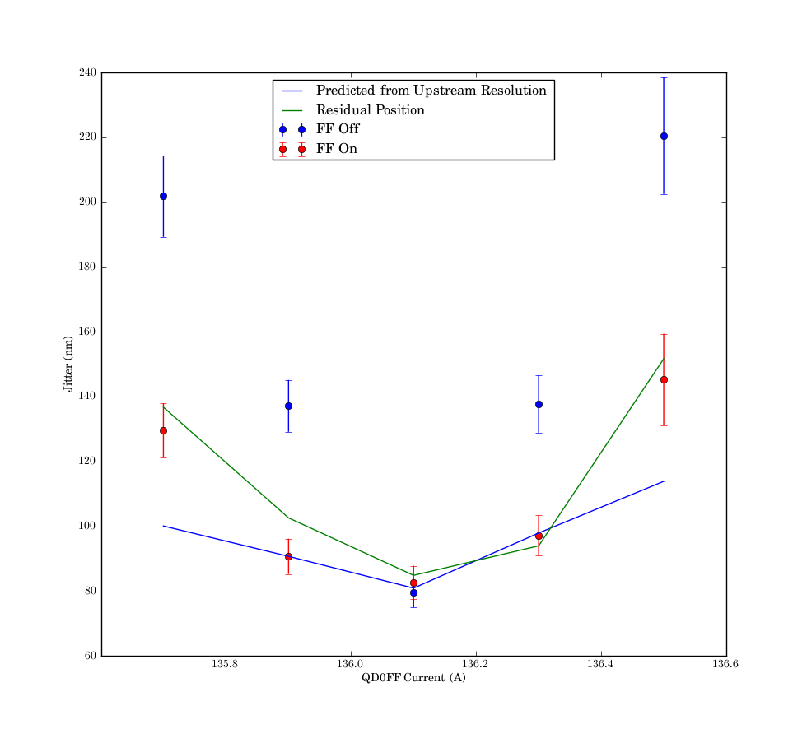
Feedforward Jitter
Mikey Davis
10 October 2013
7/7

